Slide 1
New gene （Y.E. Zhang）Identification of newly evolved genes
Examples: Drosophila
For a D. melanogaster gene A, we deduced its origination time by inferring its ortholog distribution in different species

Slide 2
In other words, we used gene A presence or absence in an outgroup species such as D. simulans. More specifically, we addressed this question by investigating whether gene A exists in the syntenic chain between D. melanogaster and another species
D. melanogaster:subject species
another species:reference species

Slide 3
1.The two lines indicate a syntenic chain between species
2.Boxes marked in the same color indicate orthologous regions.
3.The blue box represents a candidate new gene because it is absent in the reference species.

Slide 4
Young gene classification
DNA-based duplication
Retroposition
de novo gene origination

Slide 5
DNA-based duplication
1.Gene duplication was the first mechanism of gene generation to be suggested , and this process does indeed appear to be the most common way of creating new genes.
2.A duplication may be described as involving an entire genome, large segments of a genome, individual genes, individual exons, or even specific parts of exons

Slide 6
Retroposition
Retroposons are repetitive DNA fragments which are inserted into chromosomes after they had been reverse transcribed from any RNA molecule.

Slide 7
de novo gene origination
1.New genes can additionally originate de novo from noncoding regions of DNA.
2.Several novel genes derived from noncoding DNA have recently been described in Drosophila .
3.Note, however, that the de novo genes described in various species thus far include both protein-coding and noncoding genes.

Slide 8
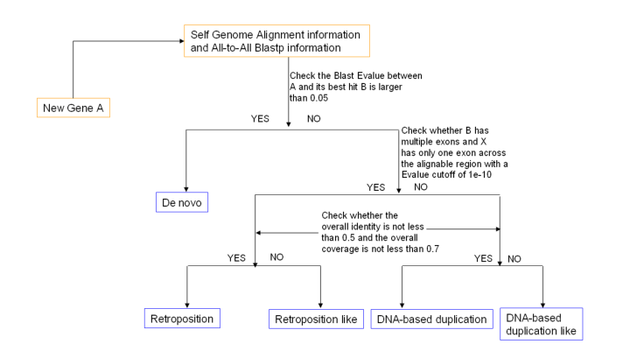
Pipeline

Slide 9
BLAST E-value
BLAST:Basic Local Alignment Search Tool
The BLAST E-value is the number of expected hits of similar quality (score) that could be found just by chance
E-value can be used as a first quality filter for the BLAST search result, to obtain only results equal to or better than the number given by the -evalue option.

Slide 10
The smaller the E-value, the better the match.
E-value | Quality
＜1e⁻⁵⁰ | be considered as very high quality
＜0.01 | be considered as good hit for homology matches.
＜ 10 | can not be considered as good hit for homology matches.
Notes:
The negative fifty power of e
1.Blast hits with an E-value smaller than 1e-50 includes database matches ofquality
2.Blast hits with E-value smaller than 0.01 can still be considered as good hit for homology matches.
3.E-value smaller than 10 will be considered as good hit for homology matches.

Slide 11
Gene Loss(Hecker)
1. Identifying the genomic changes that underlie phenotypic adaptations is a key challenge in evolutionary biology and genomics.
2. Loss of protein-coding genes is one type of genomic change with the potential to affect phenotypic evolution.

Slide 12
Examples: 62 placental mammals &human ↓ detect gene-inactivating mutations

Slide 13
To detect intact genes and lost genes (also called unitary pseudogenes), we made use of a whole-genome alignment between human and placental mammals. These alignments were obtained with parameters that are sufficiently sensitive to align exons among placental mammals
Methods
Strandard genome alignment

Slide 14
Genome alignments are more appropriate for detecting gene loss events than existing gene annotations, since the absence of an annotation for a gene can also be due to incomplete genomic data or other artifacts. Furthermore, gene annotations are not available for many placental mammals

Slide 15
Therefore, we used the gene annotation of a reference species ( the human genome) and investigated the potential loss of these 19,425 genes by searching the genome alignment for gene-inactivating mutations in 62 placental mammals

Slide 16
we did not only search for the complete loss of exons or entire genes, but also searched for the following gene-inactivating mutations:
(i) insertions and deletions that shift the reading frame
(ii) frame-preserving insertions (for example due to a transposon insertion)
that create a premature stop codon
(iii) substitutions that create an inframe stop codon
(iv) mutations that disrupt splice sites
Notes:
Since placental mammals are separated by an evolutionary distance of ~0.5 or fewer substitutions per neutral site,ppt
We considered a disrupted splice site as a deviation from the consensus donor splice site or the consensus acceptor splice site . Since big insertions or deletions are rare in conserved genes, we also considered frame-preserving indels longer than
50 bp as an inactivating mutation.

Slide 17
Interference information
But not all genes in the list are completely missing genes. We need to exclude some non-inactivated genes mixed in
∙mimic real gene-inactivating mutations
∙exon–intron structures of conserved genes have changed

Slide 18
Sequencing errors mimic gene­inactivating mutations
low sequencing quality scores
Notes:
The alignment of the third exon of the human ARL2 gene reveals several frameshifting insertions and deletions in the rabbit. These gene-­inactivating mutations are likely sequencing errors as the corresponding bases in rabbit have very low sequencing quality scores。
Our approach made use of sequence quality scores, where available, to replace all genomic bases of poor quality (Phred score <40) by an “N” character, which were subsequently ignored in the search for inactivating mutations

Slide 19
exclude potential artifacts that can mimic real gene-inactivating mutations
a series of filter
1.we excluded deleted or unaligning exons or genes from the list of inactivating mutations if the respective genomic region overlaps an assembly gap in the query species

Slide 20
Assembly gaps mimic exon or gene deletions
it overlaps an assembly gap
Notes:
Genome assembly gaps indicate regions where parts of the real genome are missing in the given assembly. Missing sequence can comprise exons or even entire genes and, consequently, can mimic larger deletions of exons or genes, which would otherwise be indicative of gene loss。
In this example, the first exon (blue box) of the human CYP11A1 gene aligns to rhesus, mouse, rat and many other mammals ; however, this exon appears to be deleted in the cow 2007 assembly， where it overlaps an assembly gap

Slide 21
2.we only considered genes that occur in a context of conserved gene order in a query species to exclude potential misalignments to processed pseudogenes and paralogs that are typically located in a different context. This also implies that all considered exon or gene deletions occur in an otherwise- conserved context

Slide 22
boxes in an “alignment chain” represent aligning regions, the single horizontal lines show the lack of all introns, which is a hallmark of a processed pseudogene
Notes:
The ortholog of the human RPS15 gene is not present in the genome assembly of the tarsier, however several processed RPS15 pseudogenes align instead . In contrast to orthologs, both paralogs and pseudogenes are often located in a different context, resulting in aligning chains that span only a single gene。
Since processed pseudogenes often evolve neutrally, they can accumulate inactivating mutations

Slide 23
3.Avoiding cases where an inactivating mutation is not observed in an alternative exon alignment, we realigned each coding exon with CESAR
Notes:
CESAR is a Hidden–Markov model-based exon aligner that takes splice site and reading frame information into consideration and finds an intact exon alignment whenever possible

Slide 24
shifted splice acceptor
Notes:
The genome alignment shows that the acceptor of exon of human is mutated in mouse, which inactivates this splice site. However, the mouse acceptor site CAG is shifted by 9 bases into the exon, making the exon three codons shorter. CESAR aligns the shifted mouse acceptor splice site to the human acceptor splice site, and thus recognizes that this exon in mouse has a consensus splice site.

Slide 25
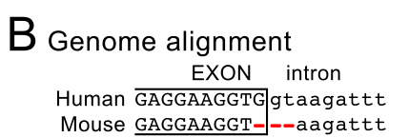
frameshift and splice site deletion
single codon deletion
Notes:
Genome alignment tools are not aware of the protein’s reading frame 。Here, the genome alignment shows a frameshifting 1 bp deletion and the deletion of the donor splice site in mouse at the end of exon 11 of the human ICA1 gene. This is an alignment ambiguity since CESAR reports an alternative alignment where the three bp deletion is shifted such that a single codon is deleted and an intact splice site is present

Slide 26
exclude cases where exon–intron structures of conserved genes have changed in evolution
Additional filter
1. CESAR re-alignment step detects cases where the position of splice sites has shifted. CESAR also explicitly considers the possibility of precise intron deletions, which simply result in a larger composite exon. In case of splice site shifts or intron deletions, we excluded the respective splice site mutations from the list of mutations
Notes:
since we used human gene annotations as a starting point, we employed additional filters to exclude cases where exon–intron structures of conserved genes have changed in evolution.

Slide 27
Precise intron deletions mimic splice site mutations
Notes:
An intron of the PTBP1 gene is deleted in the entire rodent clade (red font), as shown by the single line in the genome alignment visualization
While the deletion of splice sites is indicative of gene loss, the precise deletion of an entire intron, as shown here, should not be taken as evidence for gene loss as it simply results in a larger composite exon in the
query species. we did not consider the splice site deletions as inactivating mutations.

Slide 28
2.since N or C termini of proteins are generally less constrained in evolution, we removed all mutations that are within the first or last 20% of the protein sequence from the list of inactivating mutations

Slide 29
Gene loss events
Standard genome alignment
Low sequencing quality
Assembly gaps
Paralogs/processed pseudogene alignments
loss of intron
Splice site shifts and alignment ambiguities
Mutations in 20% gene boundary
Notes:
In order to explore the event of gene loss, sequence errors are deleted after standard alignment, including assembly gap events, Paralogs / processed pseudogene alignments, and shifted splice acceptor. Structural changes are also deleted, including loss of intron events n and Mutations in 20% gene boundary.

Slide 30
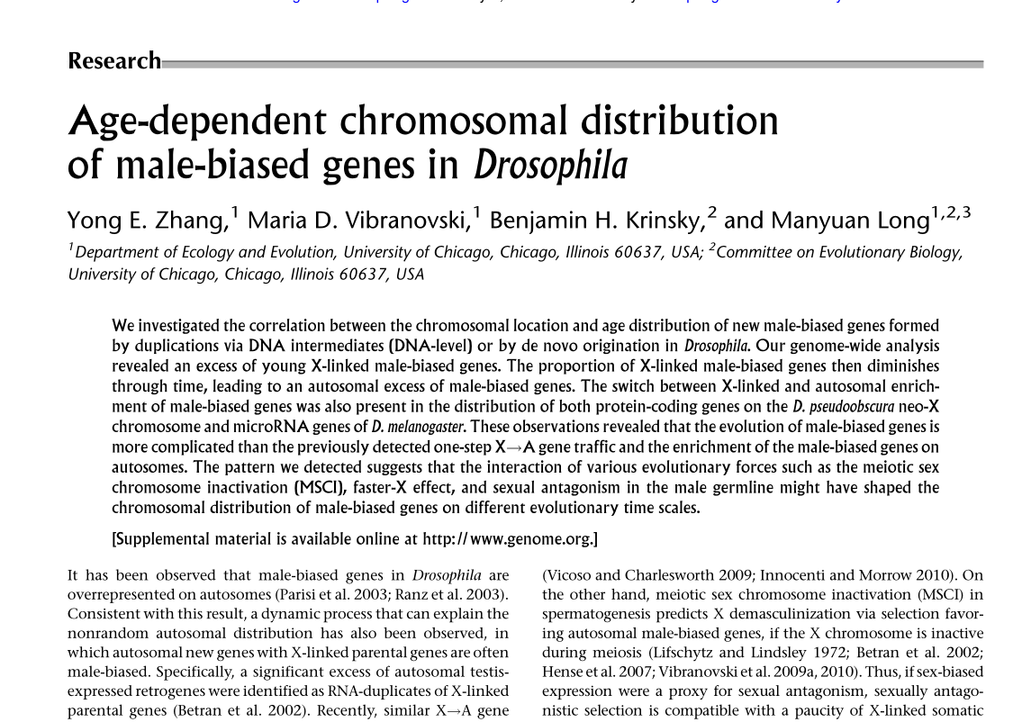
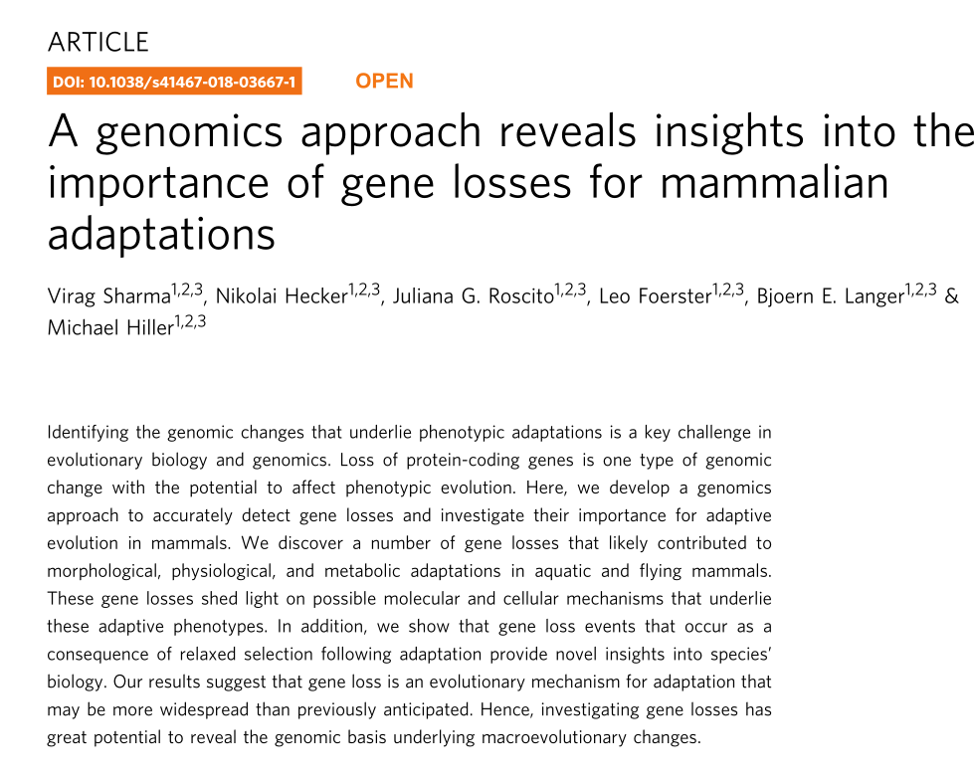
Notes:
Most of the content comes from Zhang Yong and hecker's articles. They spent a lot of time studying new genes and gene loss. I just introduced part of their work. If you are interested, you can read these articles and have some discussion with me.

Slide 31
Thanks for your listening

