Slide 1
Gene tree
HuYun
2020.01.06

Slide 2
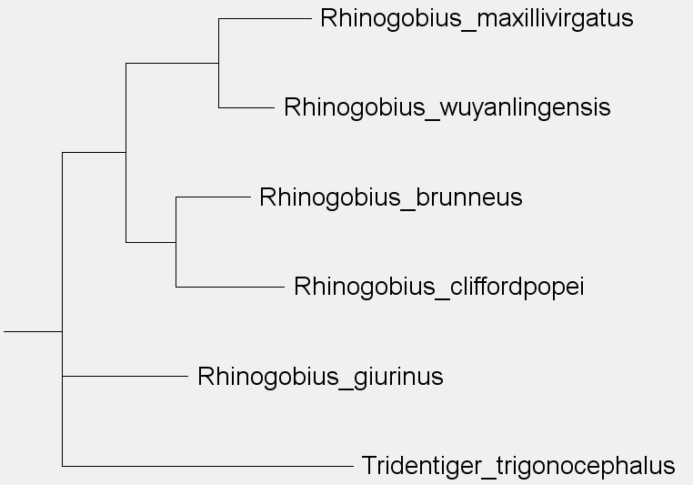
GeneTree is a family history network focused on using DNA to trace ancestry.
Internal nodes
Root
Terminal nodes
Branch

Slide 3
Theory:
（1）data preparation
The data download from GenBank or experiment.
（2）Sequence assembly
Only the correct combine can get the target genome or transcriptome.
（3）Sequence alignment
To determine the similarity between two or more sequences such that they are homologous.
（4）Correction of disputed sites
（5）Model selection
（6）Select method of build tree

Slide 4
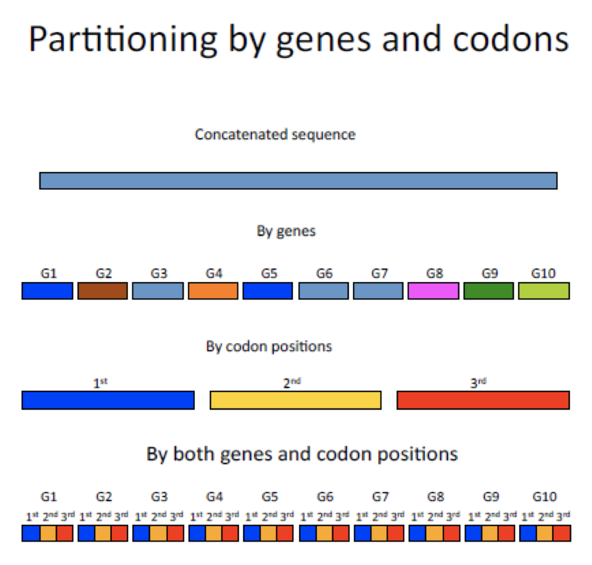
PartitionFinder2
PartitionFinder2 is a program for selecting best-fit partitioning schemes and models of evolution for nucleotide, amino acid, and morphology alignments.

Slide 5
Why partition?
In phylogenetic analyses it is important to account for variation in rates and patterns of evolution among sites.

Slide 6
what can we do?
1. Find the best-fit partitioning scheme nucleotide, amino acid, or morphology datasets
2. Find best-fit models of evolution for each subset in any partitioned dataset
3.The most appropriate partitioning scheme and evolutionary model will improve any downstream analysis of the data, such as estimating phylogenetic trees or molecular dates.
4.Then you can go directly to phylogenetic analysis testing or compare partitioning schemes without any other models.

Slide 7
usage
1. Install Python and dependencies using Anaconda or otherwise 2.Install PartitionFinder2 3.Run PartitionFinder2
In the Terminal, you need to tell the computer where to find Python,PartititionFinder2, and your input files.
eg python “<PartitionFinder.py>” “<InputFoldername>”

Slide 8
Download link：https://github.com/brettc/partitionfinder/releases/tag/v2.1.1
Recommended Literature：
PartitionFinder 2: New Methods for Selecting Partitioned Models of Evolution for Molecular and Morphological Phylogenetic Analyses .

Slide 9
CAT（Category）
Most current models of sequence evolution assume that all sites of a protein evolve under the same substitution process,characterized by a 20 × 20 substitution matrix.
CAT allows the amino-acid replacement pattern at different sites of a protein alignment to be described by distinct substitution processes.
the CAT model is able to adapt to the complexity and it yields an estimate of the substitutional heterogeneity through the posterior mean number of classes.
assumes the existence of distinct processes (or classes) differing by their equilibrium frequencies over the 20 residues.

Slide 10
heterogeneity
eg.
The same rate of evolution
Gene fragment
different rate of evolution
The same rate of evolution

Slide 11
CAT is an infinite mixture model accounting for site-specific amino-acid or nucleotide preferences. It is well suited to phylogenomic studies using large multigene alignments.
Recommened literature:
Phylogenetic models of rate heterogeneity: a high performance computing perspective
A Bayesian Mixture Model for Across-Site Heterogeneities in
the Amino-Acid Replacement Process

Slide 12
The methods of build tree
（1）NJ
（3）ML
（2）MP
（4）BI

Slide 13
（1）NJ
Basic characteristic： When merging classes, not only does the class to be merged be similar, but the class to be merged is far away from other classes.
Applicable situation：A short sequence of distant sequences with little evolutionary distance and few information points.

Slide 14
（2）MP
Basic characteristic: Calculate all possible topologies and calculate the topology with the least number of base substitutions as the best tree
Applicable situation：The number of species sequences is less than or equal to 12.Residues have little difference, have approximate variation rate,

Slide 15
（3）ML
Basic characteristic：Rely on a specific alternative model to analyze a given set of sequence data so that the likelihood of each topology obtained is the maximum, and then select the topology with the highest likelihood as the optimal tree .
Usage：Specific alternative models, ML is the tree that most closely matches evolutionary facts when there are models .

Slide 16
（4）BI
Basic characteristic：The statistical inference method of the genetic evolution model directly reflects the reliability of each branch through the posterior probability, and does not need to be tested by the bootstrap method.
Applicable situation：Large and complex data sets

Slide 17
The Advantages and disadvantages of the four methods
Disadvantage
NJ：All positions on the sequence are treated equally, and the evolutionary distance of the analyzed sequence cannot be too large
MP：Only suitable for sequence number N≤12. The long-varying sequences will attract long branches, which will lead to tree construction errors.
Advantage
NJ：There are few assumptions, the calculation speed is fast, only one tree can be analyzed, and the running speed is better than the maximum parsimony method.
MP：Good at analyzing some special molecular data such as insertions, deletions and other sequences.

Slide 18
The Advantages and disadvantages of the four methods
Advantage
ML:The likelihood method can obtain the minimum variance of the parameter statistics when the sample is large. When the evolution model is determined, the ML method is the best construction algorithm that matches the evolutionary facts.
BI:Evolutionary model with a solid mathematical and statistical foundation that can handle complex and near-real situations
Disadvantage
ML:All possible phylogenetic trees calculate the likelihood function, which is computationally intensive and takes a long time.
BI:Sensitive to evolutionary models, the posterior probability of each amino acid specified in the BI method is established under many assumptions, which may not be true in reality.

Slide 19
Software based on ML
（1）RAxML
（2）ExaML
（3） IQ-tree

Slide 20
RAxML(Randomized Axelerated Maximum Likelihood）
GTR is the only nucleotide substitution model for RAxML
substitution model is constant,we will add different modle of Variation rate .
eg.GTRCAT;GTRGAMMA

Slide 21
RAxML offers different ways to obtain bootstrap support.
It implements the standard non-parametric bootstrap and also the so-called rapid bootstrap
It also offers an option to calculate so-called SH-like support values
RAxML also offers a so-called bootstopping option

Slide 22
bootstrap
It can be used to check the branch reliability of the calculated evolutionary tree
One way to measure the quality of a tree is to look at the bootstrap value

Slide 23
Usage
DNA_selected_aligned.fas
concat_loci.pl--------DNA_selested_aligned.phy
raxmlHPC-PTHREADS –T 12 –p 12345 –m GTRGAMMA –s ***.phy –n raxml -y -f a –x 12345 -# 100 –q partation.txt

Slide 24
-T number of nodes
-p parsimony Random Seed
-m substitution Model
­-s sequence File Name
­-n output File Name
-f a rapid Bootstrap analysis and search for best-scoring ML tree in one program run
–x Specify an integer number (random seed) and turn on rapid bootstrapping
-# Specify the number of alternative runs on distinct starting trees

Slide 25
recommended literature：RAxML version 8: a tool for phylogenetic analysis and post-analysis of large phylogenies
Download link ：https://github.com/stamatak/standard-RAxML
User manual：http://sco.hits.org/exelixis/web/software/raxml/hands_on.html

Slide 26
ExaML（Exascale Maximum Likelihood ） ExaML is sister program RAxML, extremely large analyses on supercomputers。
Advantage:It is up to 4 times faster than its predecessor RAxML-Light and scales to a larger number of processors.

Slide 27
Usage
Note:
­s sequenceFileName
­n outputFileName
­m substitutionModel
[­c]
[­q]
[­h]
­m Type of Data:
For DNA data use: DNA
For AA data use: PROT
For Binary data use: BIN
./parse­examl ­s ../testData/49 ­m DNA ­n 49.unpartitioned
49.unpartitioned.binary
49.partitioned.binary
The usage philosophy is similar to RAxML, albeit it only implements a subset of RAxML features.

Slide 28
Download link:https://cme.hits.org/exelixis/web/software/examl/
recommend literature:
(1)Whole-genome analyses resolve early branches in the tree of life of modern birds
(2)Phylogenomics resolves the timing and pattern of insect evolution
(3)RAxML-Light: a tool for computing terabyte phylogenies
(4)Novel Parallelization Schemes for Large-Scale Likelihood-based PhylogeneticInference

Slide 29
IQ-tree
When we build gene tree,the major challenges is analyze big data, where most phylogenetic software cannot handle.But iqtree can work it.
IQ-TREE can automatically determine the best-fit model for alignment.

Slide 30
Key features
￭Efficient search algorithm
￭Ultrafast bootstrap
￭Ultrafast model selection
￭Big Data Analysis
￭Partition models
￭Polymorphism-aware models

Slide 31
Accuracy:
New Approaches presents a fast and effective stochastic algorithm for finding ML trees. The core idea is to perform an efficient sampling of local optima in the tree space.we combine elements of hill-climbing algorithms, random perturbation of current best trees, and a broad sampling of initial starting trees.Comparative analyses for many large DNA and amino acid (AA) multiple sequence alignments retrieved from TreeBASEshowed that our new search strategy often achieves higher likelihoods compared with RAxML.
The new tree search strategy helps to escape local optima and, thus, leads to trees with high likelihood and the phylogenetic likelihood library reduces the time for the likelihood computation.
references:(IQ-TREE: A Fast and Effective Stochastic Algorithm for Estimating Maximum-Likelihood Phylogenies)

Slide 32
Flexibility
ModelFinder： a model-selection method that combines substitu-tion models used in other popular model-selection methods（WAG + I +Γ5）with a flexible rate heterogeneity across sites (RHAS) model and show that its use often leads to substantial improvements in the fit between tree, model and data
three models of RHAS:
(i) all sites evolved at the same rate,
(ii) some sites evolved at the same rate whilst the others were invariable
(iii) RHAS follows a probability distribution like the popular discrete Γ distribution.
references:(modelfinder: fast model selection for accurate phylogenetic estimates)

Slide 33
Speed
An ultrafast bootstrap approximation approach (UFBoot)
bootstrap used to test Branch credibility，it must be count 1000 times .
UFBoot provides approximately unbiased branch support values and runs 100X faster than nonparametric bootstrap and 10 to 40 times faster than RAxML rapid bootstrap
References:(Ultrafast Approximation for Phylogenetic Bootstrap)

Slide 34
Polymorphism-aware models:(Accounting for incomplete lineage sorting to infer species tree from genome-wide population data )
Iqtree present a reversible Polymorphism-Aware Phylogenetic Model (revPoMo) for species tree estimation from genome-wide data.revPoMo enables the reconstruction of large scale species trees for many within-species samples. It expands the alphabet of DNA substitution models to include polymorphic states, thereby, naturally accounting for incomplete lineage sorting.

Slide 35
Usage
Since IQ-TREE is a command-line program, clicking on iqtree.exe will not work. You have to open a Command Prompt for all analyses:
1. Click on “Start” menu .
2. Type in “cmd” and press “Enter”.
3. Go into IQ-TREE folder you just extracted by entering .
4. Now you can try an example run by entering.
5. You have finished the first IQ-TREE analysis.

Slide 36
Download link：
http://www.iqtree.org/
Recommended Literature：
Dominik's paper accepted at Journal of Theoretical Biology

