Slide 1
Genome alignment
&
Synteny
Lu Liang
LMSE
Shanghai Ocean University
Jan 9 2020

Slide 3
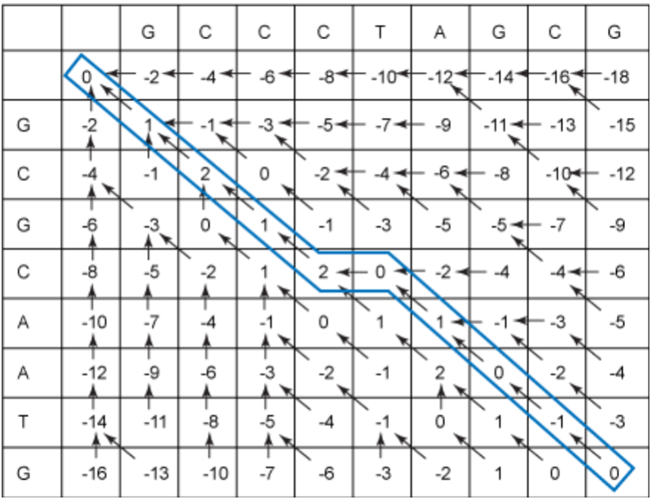
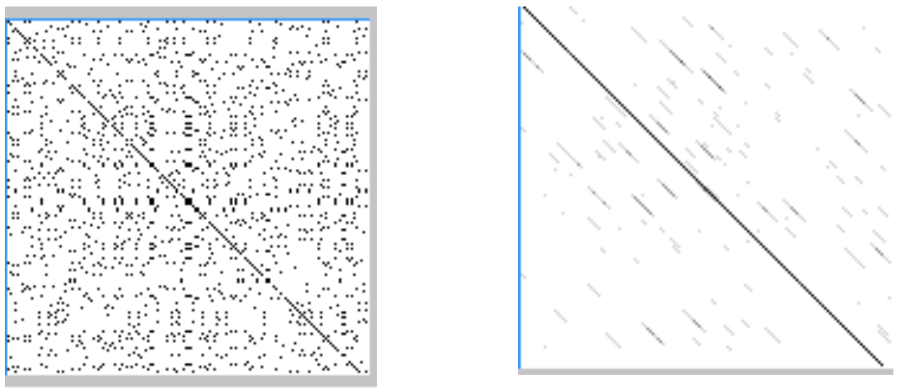
Difference between short sequence alignment and genomic alignment
Basic alignment algorithm
Short sequence alignment
10^6
numbers
≈ 1MB
1000bp
1000bp

Slide 4
Long sequence alignment OR short sequence alignment to long sequence
1000 bp
10^7 bp
10^7 bp
10^7 bp
10^10
numbers
≈ 10 GB
10^14
numbers
≈ 100 TB
Unacceptable time consumption
Unacceptable memory consumption
Need a more efficient algorithm !

Slide 5
BLAST / LASTZ basic algorithm
....
Genome
......
Format database with k-mer
（Usually k = 12）
Enter k-mer as a seed
search database
Aligning sequences
Basic alignment using
sequences near the seeds
Output it
Y
N
Are the alignment results good?
No acceptable match

Slide 6
Special design for genome alignment in LASTZ
Genome
Format database with seed
Usually k = 12
Large step sizes step = 100
Enter k-mer as a seed
search database
Every seed search needs to be
compared to find slightly different seeds
Aligning genome sequences
Basic alignment using
sequences near the seeds
Gap-free Extension
Y
N
Are the alignment results good?
No acceptable match

Slide 7
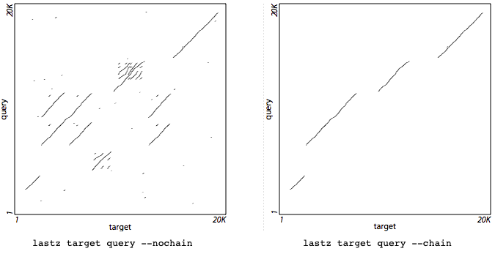
Use dynamic programming algorithm to connect results to generate HSP Chaining
（High scoring segment pairs)
The chaining stage aims to find a series of HSPs that forms a high-scoring path through the DP matrix, aligning as much as possible while avoiding backtracking in either sequence.

Slide 8
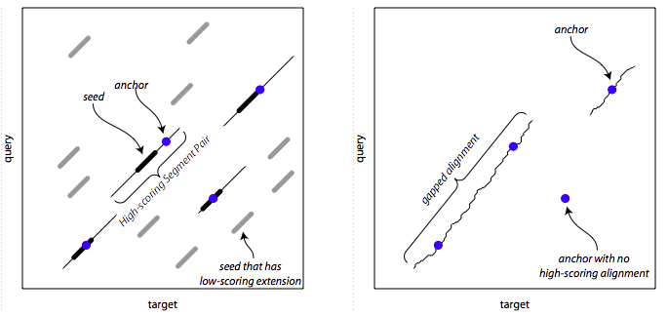
Gapped Extension
Before the HSPs are extended further by allowing gaps, each HSP is first reduced to a single anchor point; this allows for the possibility that the optimal alignment may include gaps within the region occupied by the HSP.

Slide 9
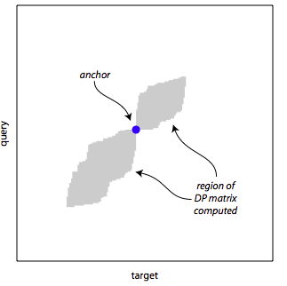
Region of DP matrix computed
wherever the alignment score drops below the peak score seen so far by more than the threshold specified in the option, the DP matrix is truncated and no further cells are computed along that row or column.

Slide 10
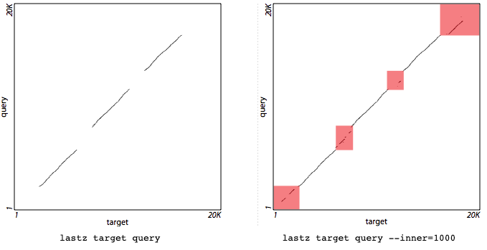
Interpolation
Once the above stages have been performed, it is not uncommon to have regions left over in which no alignment has been found. In the interpolation stage we repeat the seeding through gapped extension stages in these leftover regions, at a presumably higher sensitivity. Using such high sensitivity from the outset would be computationally prohibitive (due to the excessive number of false, low-scoring matches), but is feasible on the smaller, leftover regions.

Slide 11
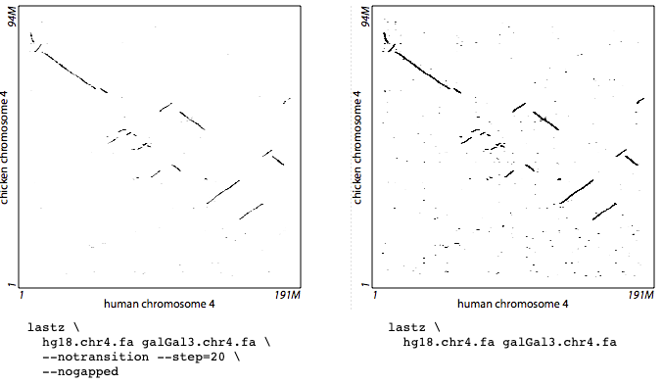
LASTZ usage
Installation
$ git clone https://github.com/lastz/lastz.git
$ cd /path/to/lastz-distrib-X.XX.XX/src
$ make
$ make install
Running
Comparing a Human Chromosome and a Chicken Chromosome
$ lastz hg18.chr4.fa galGal3.chr4.fa \
--notransition --step=20 --nogapped \
--format=maf > hg18_4_vs_galGal3_4.maf

Slide 12
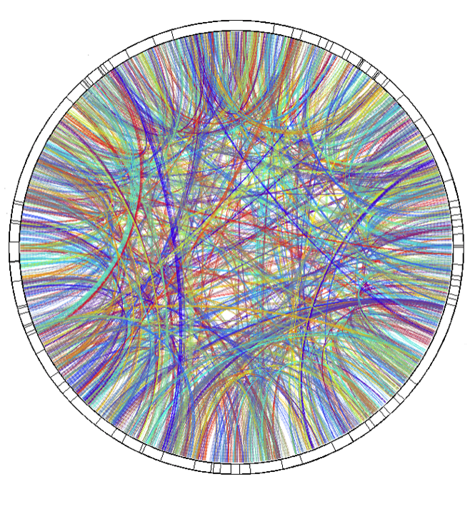
Genome Synteny

Slide 13
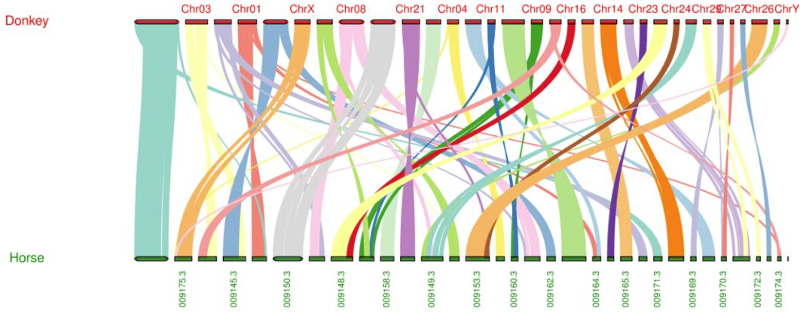
What is genomic synteny
Order of genes on different sequence

Slide 14
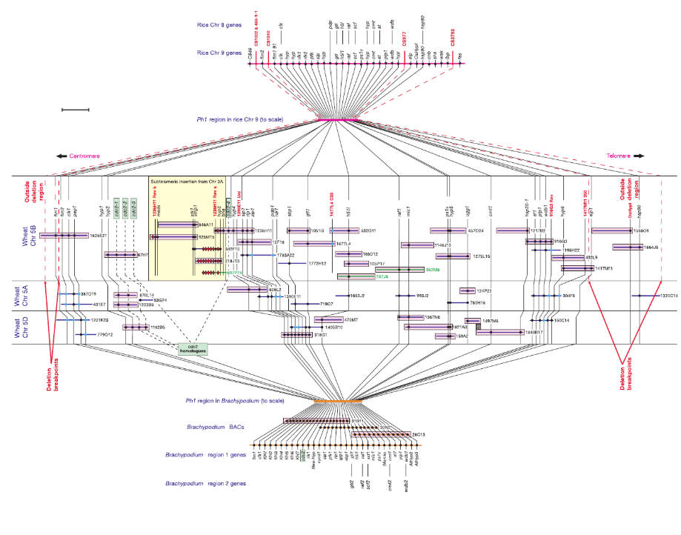
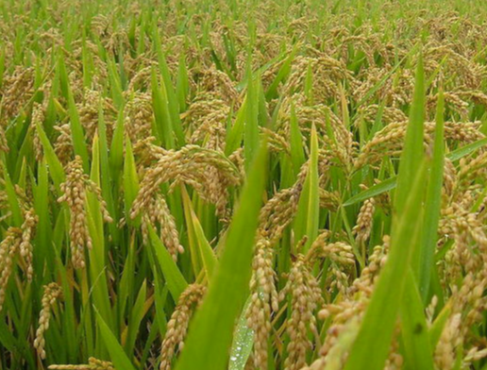
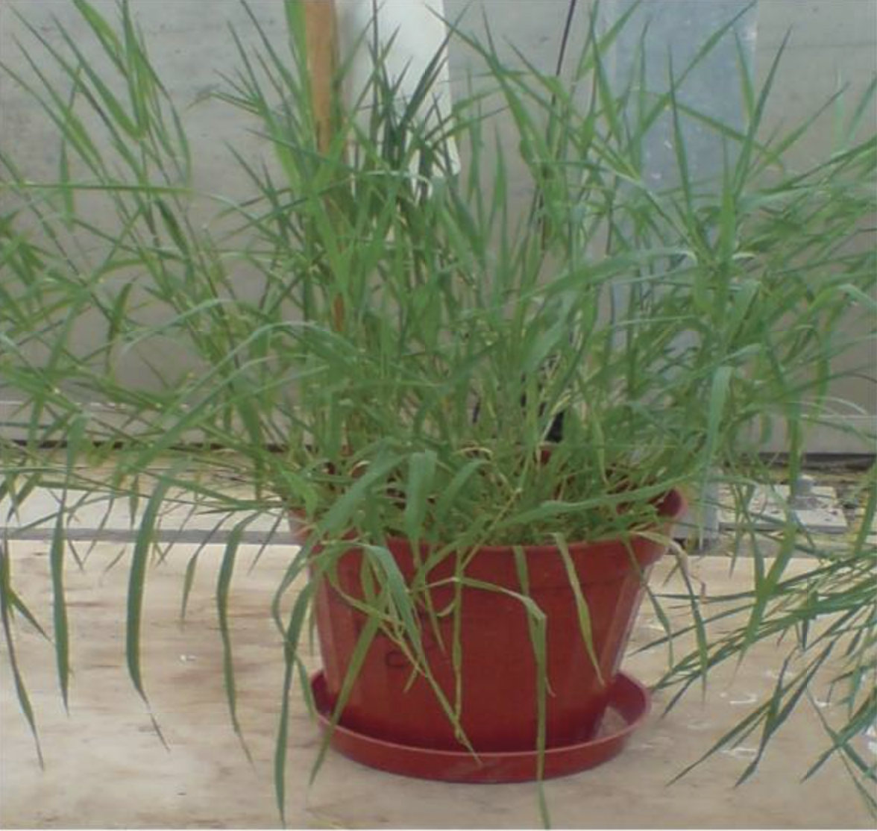
Synteny between rice and Brachypodium reveals important functions of the PH1 locus
Ph1 locus involved in genome stability and fertility

Slide 15
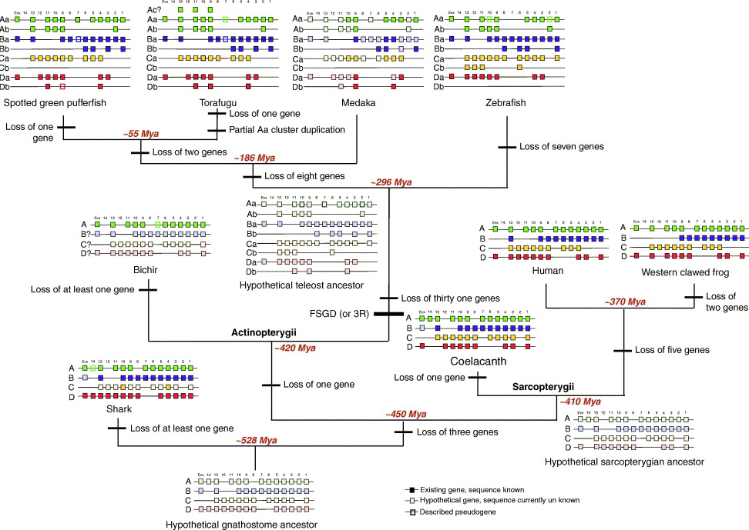
Synteny of Hox cluster
The order of genes in the "Hox cluster", which are key determinants of the animal body plan and which interact with each other in critical ways, is essentially preserved throughout the animal kingdom.

Slide 16
Analyzing genomic synteny with MCScanX
http://chibba.pgml.uga.edu/mcscan2/#tm

Slide 17
MCScanX Usage
Installation
$ wget http://chibba.pgml.uga.edu/mcscan2/MCScanX.zip
$ unzip MCScanX.zip
$ cd MCScanX
$ make
Step 1: BLAST alignment
Use multiple genome-annotated proteins as a database
at.fa, vv.fa from MCScanX webpage
at means Arabidopsis thaliana, vv means grape(Vitis vinifera L.)
$ cat at.fa vv.fa >>all.fasta
$ makeblastdb -in all.fa -dbtype prot -parse_seqids -out all
$ blastp -query all.fa -db all -out at_vv.blast -evalue 1e-10 -num_threads 16
-outfmt 6 -num_alignments 5

Slide 18
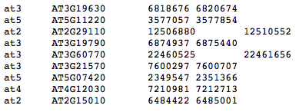
Step 2: MCScanX input file preparation
at_vv.blast
BLAST result
2. at_vv.gff
A shortened version of the gff file, example:
Species name
chromosome name
gene name
gene starting point
name, point same as .blast file
Write script to generate .gff from annotation result
gene End position

Slide 19
Step 3: Running MCScanX
$ MCScanX at_vv
Note: at_vv.gff, at_vv.blast and at_vv must be named the same and in the same folder

Slide 20
Step 4: Plot, Need a control (.ctl) file
1. dot_plotter
$ java dot_plotter -g at_vv.gff -s at_vv.collinearity -c dot.ctl -o dot.PNG
dot.ctl
2.dual_synteny_plotter
$ java dual_synteny_plotter -g at_vv.gff -s at_vv.collinearity -c dual_synteny.ctl -o dual_synteny.PNG
dual_synteny.ctl
3.circle_plotter
$ java circle_plotter -g at_vv.gff -s at_vv.collinearity -c circle.ctl -o circle.PNG
circle.ctl
4.bar_plotter
$ java bar_plotter -g at_vv.gff -s at_vv.collinearity -c bar.ctl -o bar.PNG
bar.ctl

Slide 21
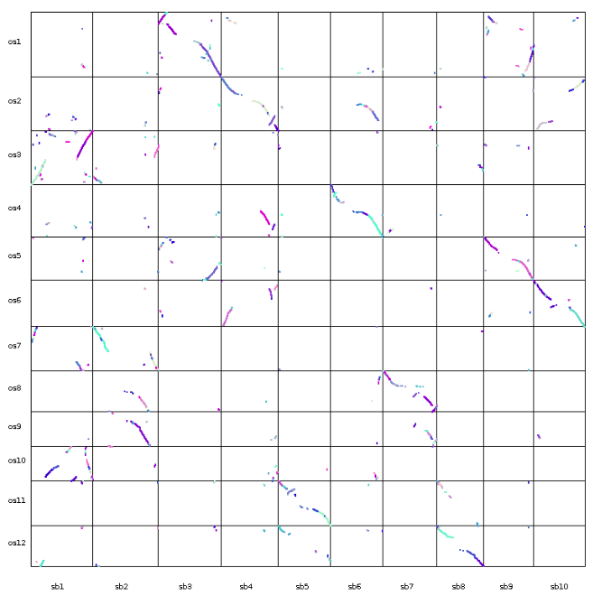
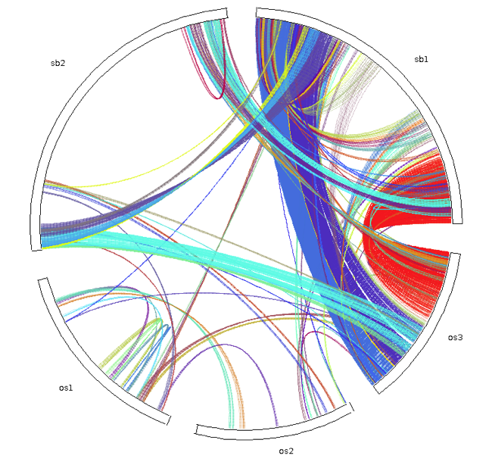
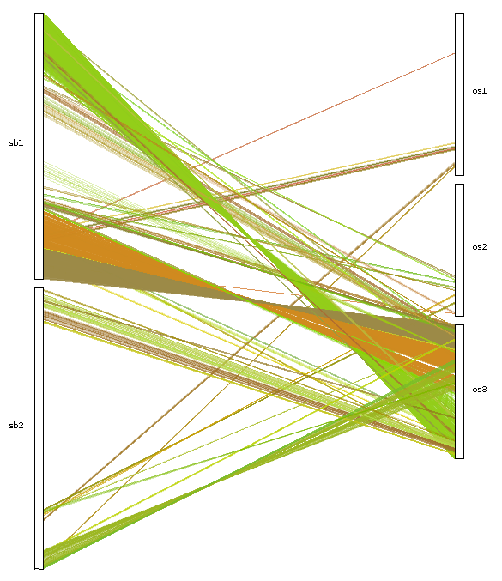
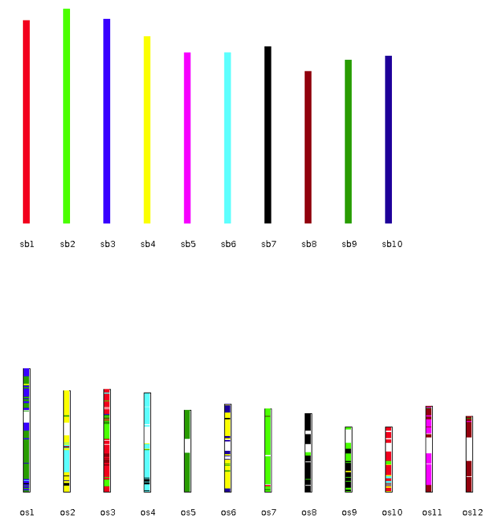
1
3
2
4

Slide 22
Hope you have fun in the genome

