Slide 1
Genome evaluation
&
Annotation
Lu Liang
LMSE
Shanghai Ocean University
Jan 9 2020
Notes:
Good genome quality, good data, and good results
For a new genome, you need to know where the function is generated.

Slide 2
How to evaluate the quality of genome after genome assembly is complete？
1. Length
N50
2. Gene structure
BUSCO(Benchmark Universal Single-Copy Ortholog)
Notes:
There are two ways to evaluate genomic quality
A longer length means better quality,
N50 is a score of evaluation length
After evaluating the genome length, we need to evaluate the gene structure

Slide 3
N50—A method to evaluate Genome assemble quality by length
1.Sort genomic sequences by length, from long to short
2.Start with the longest one and add the sequence lengths in order
3.When the sum of the lengths increases to 50% of the genome length, the length of the last sequence added is N50

Slide 4
Real Genome (size = 100bp)
Assemble result
Sort by length
Sum
Percent
20bp
20bp
20%
18bp
38bp
38%
15bp
53bp
53%
14bp
67bp
67%
13bp
80bp
80%
10bp
90bp
90%
10bp
100bp
100%
Because
Sum / Genome size >= 50%
Therefore
N50 = 15bp
Notes:
confused
the length of the last sequence added is N50

Slide 5
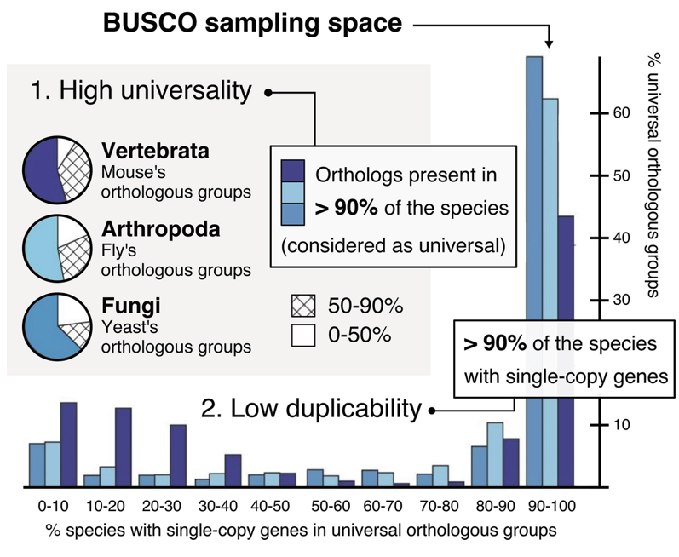
Benchmark Universal Single-Copy Ortholog
Based on evolutionarily-informed expectations of gene content of near-universal single-copy orthologs, BUSCO metric is complementary to technical metrics like N50.
Notes:
If all single-copy orthologous genes are successfully assembled, then other genes in this new genome have a great probability of being successfully assembled.

Slide 6
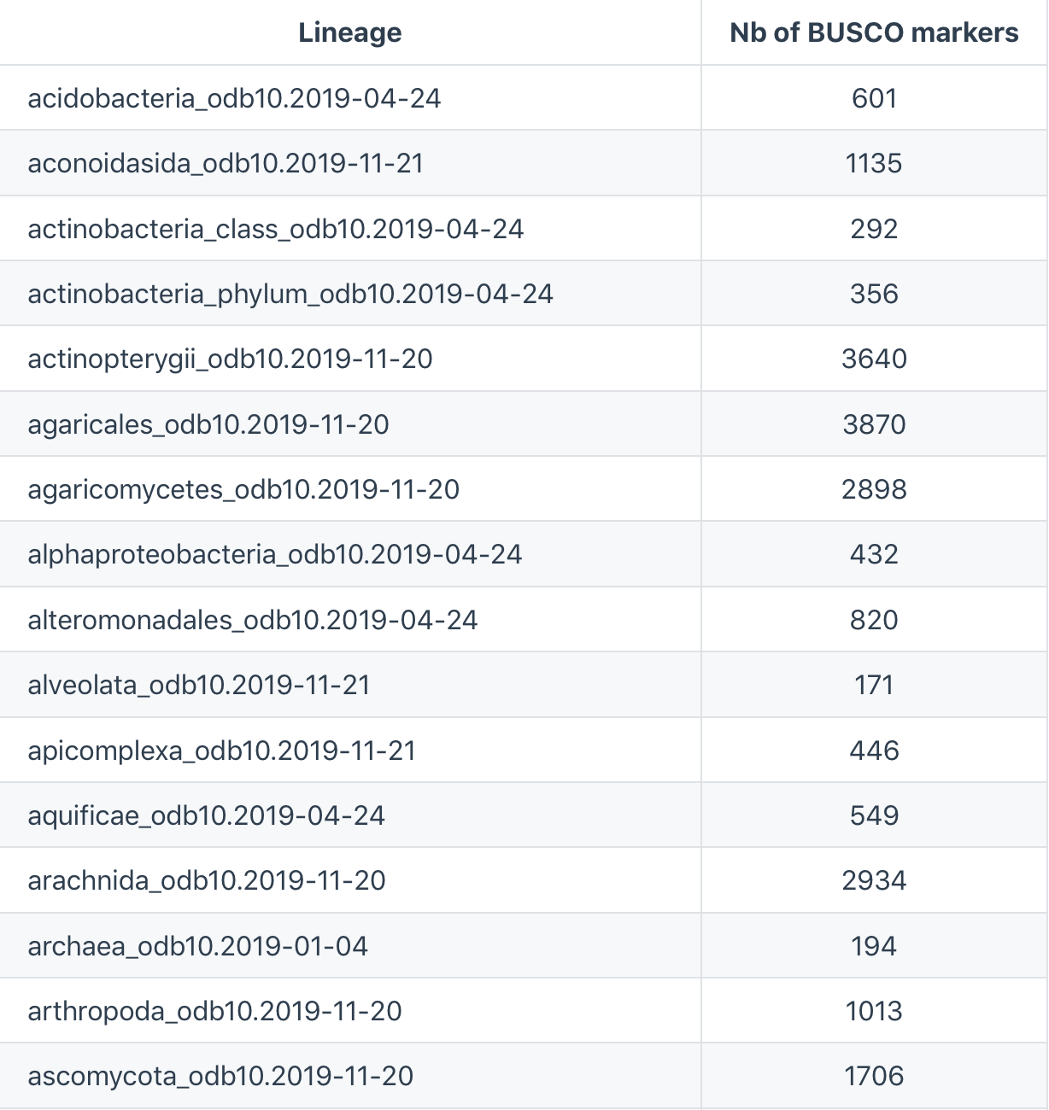
.
.
.
166 databases
Notes:
界kingdom 门phylum 纲class 目order 科family 属genus 种species

Slide 7
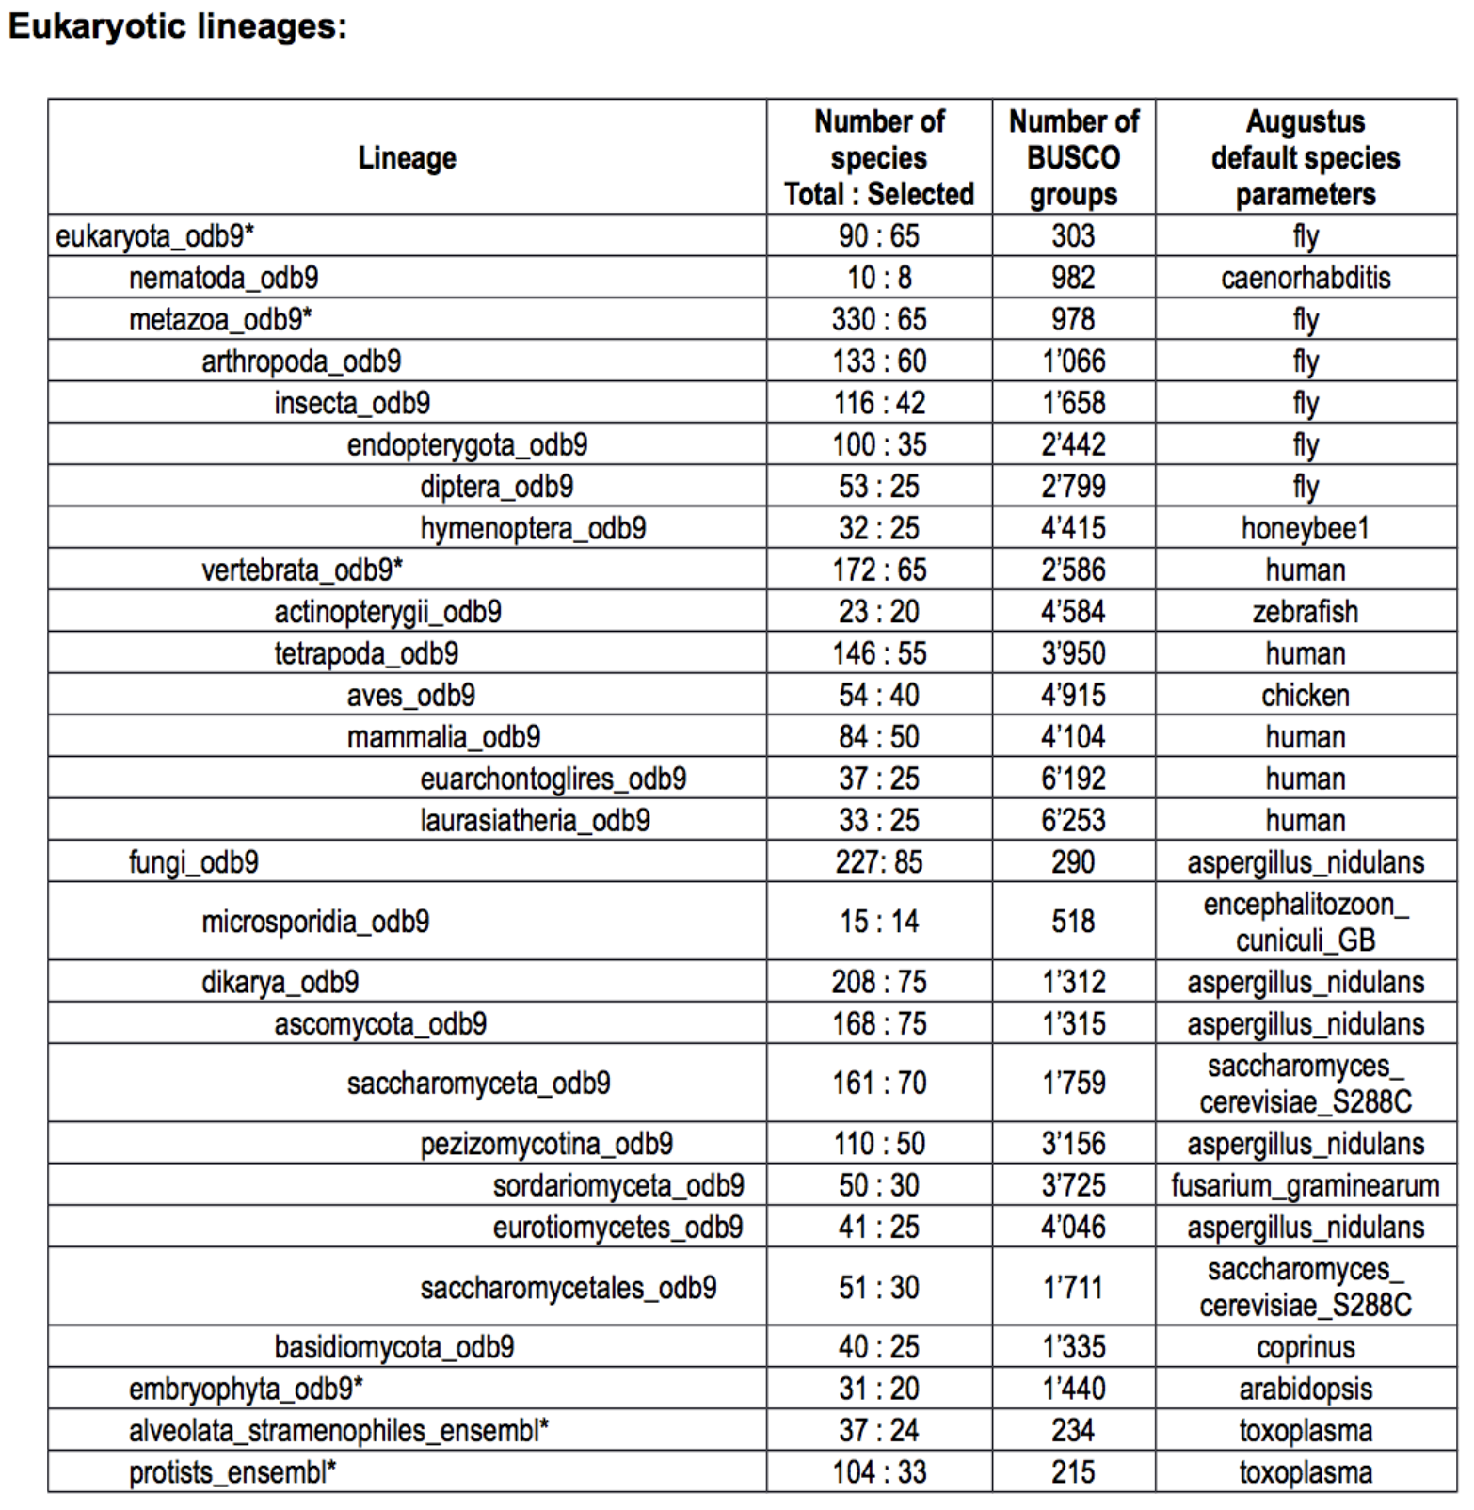
Notes:
Eukaryotic. lineages. actinopterygii vertebrate
U care rui ao tic | lin nie G s |. ac tin no (p) tai ruo G |. ver t bu rui t
界kingdom 门phylum 纲class 目order 科family 属genus 种species

Slide 8
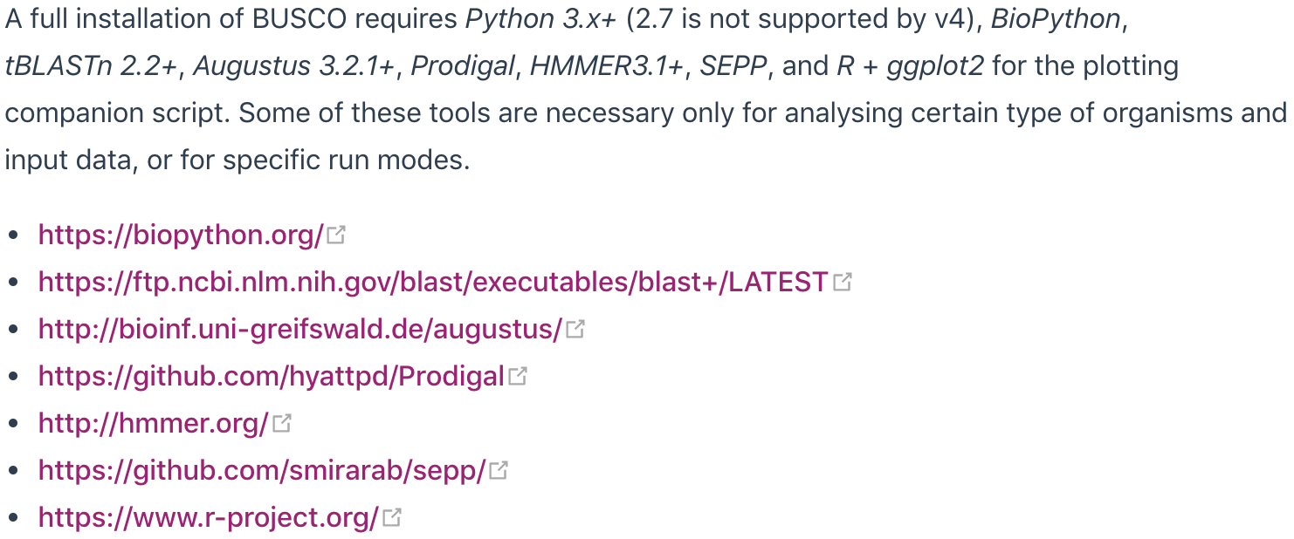
BUSCO usage
Installation (Linux)
Method 1
Method 2
$ yum install conda
or
$ apt-get install condo
$ conda install busco
Method 3
MAC & windows
Run BUSCO v3 using our Ubuntu virtual machine, with all dependencies included:
$ wget https://busco-archive.ezlab.org/v3/files/BUSCO_3_Ubuntu_Gnome_16.04.ova
Use VirtualBox to run this virtual system.

Slide 9
Download Database
https://busco.ezlab.org/busco_v4_data.html
Running BUSCO
$ python script/run_busco.py \
-i /path/to/fish_genome.fasta \
-o BUSCO_fish_genome1 \
-l /path/to/database/actinopterygii_odb10/ \
-m genome \
-c 10 \
-sp zebrafish
Plot
$ python scripts/generate_plot.py –wd BUSCO_fish_genome1
Notes:
principle 原理

Slide 10
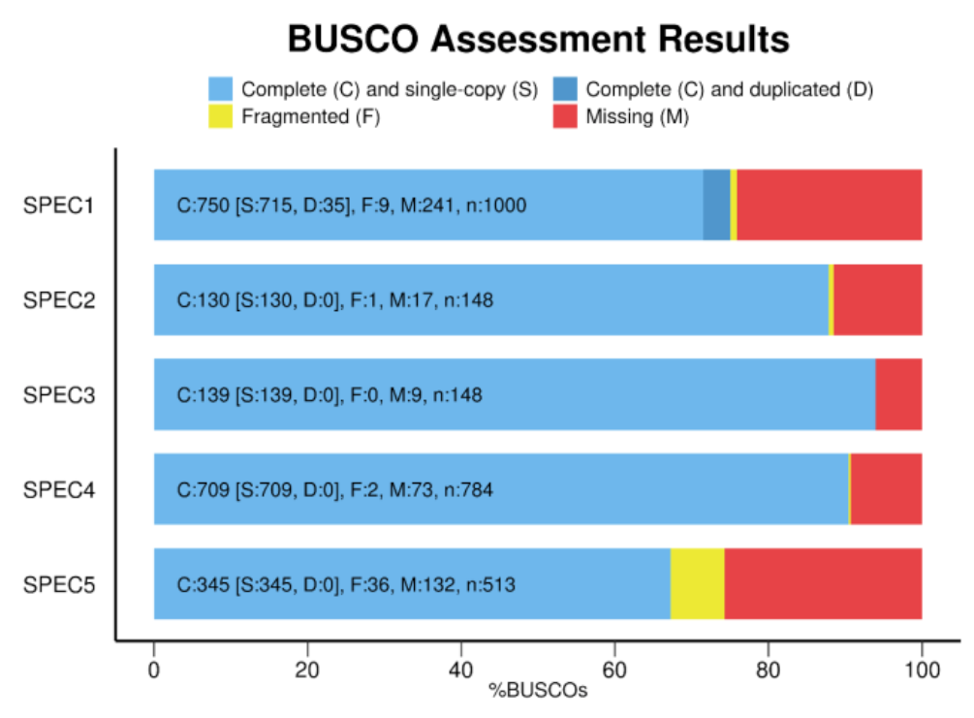
Notes:
the worst
Assembled most single copy genes
Assembled minimal single copy genes

Slide 11
Prediction & Annotation
Notes:
snails 蜗牛
evidence 证据
shock 震惊

Slide 12
New Genome
Where are the genes, each gene structure
Non-coding region
Coding region
Non-coding region
Enhancer
Promoter
Exon
Intron
Terminator
Enhancer
Transcription initiation site
Transcription termination site
5‘cap
3‘PolyA tail
（splicing or modifications）
Translation initiation site
Translation termination site
Polypeptide chain
Gene function
Notes:
polypeptide. chain. protein
pao lei paipu taide | chi ing |. pu ru ting
Adjacent species 临近物种

Slide 13
A new Genome
(After mask the repeat sequence)
Ab initio prediction
2. homology-based prediction
3. transcriptome-based prediction
Prediction
for
Where are the genes each gene structure
Multiple annotations
are often required to
improve accuracy
（retraining de novo
prediction model)
Filter results
Annotation
for
Gene function
Alignment with multiple databases
Structure and function of multiple genes in the genome
Nr; Nt; Interproscan; GO; Pfam; KEGG...
Notes:
process 流程. Adjacent species 临近物种。 Introduction 介绍
flow chart 流程图 Combine them 组合他们。 Key Information
ab initio
ˌab əˈniSHēˌō

Slide 14
Ab initio prediction
Based on
Hidden Markov Model
——Probability of the next element in the sequence
Notes:
Quarter 四分之一。 generate。生成。 dice 骰子 one-sixth 六分之一
Regular tetrahedron 正四面体
tai chuo hei zhun

Slide 15
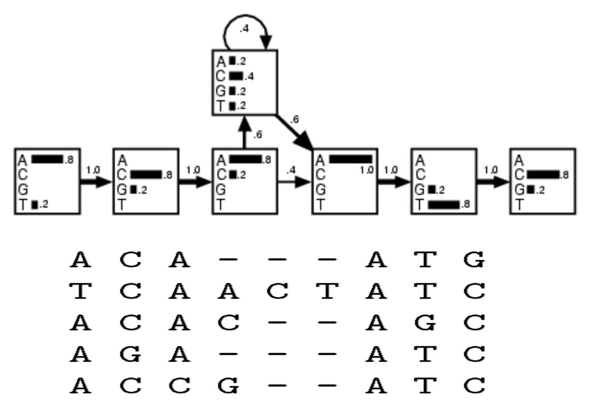
Hidden Markov Model of DNA Sequence

Slide 16
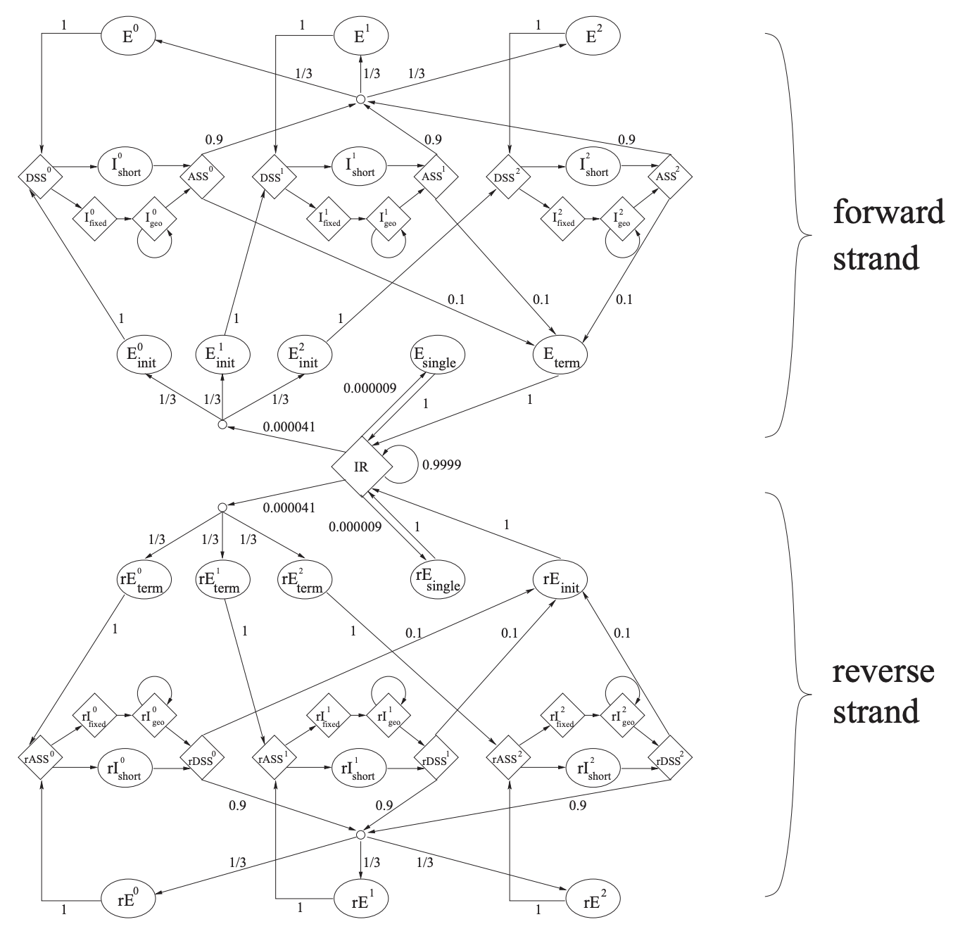
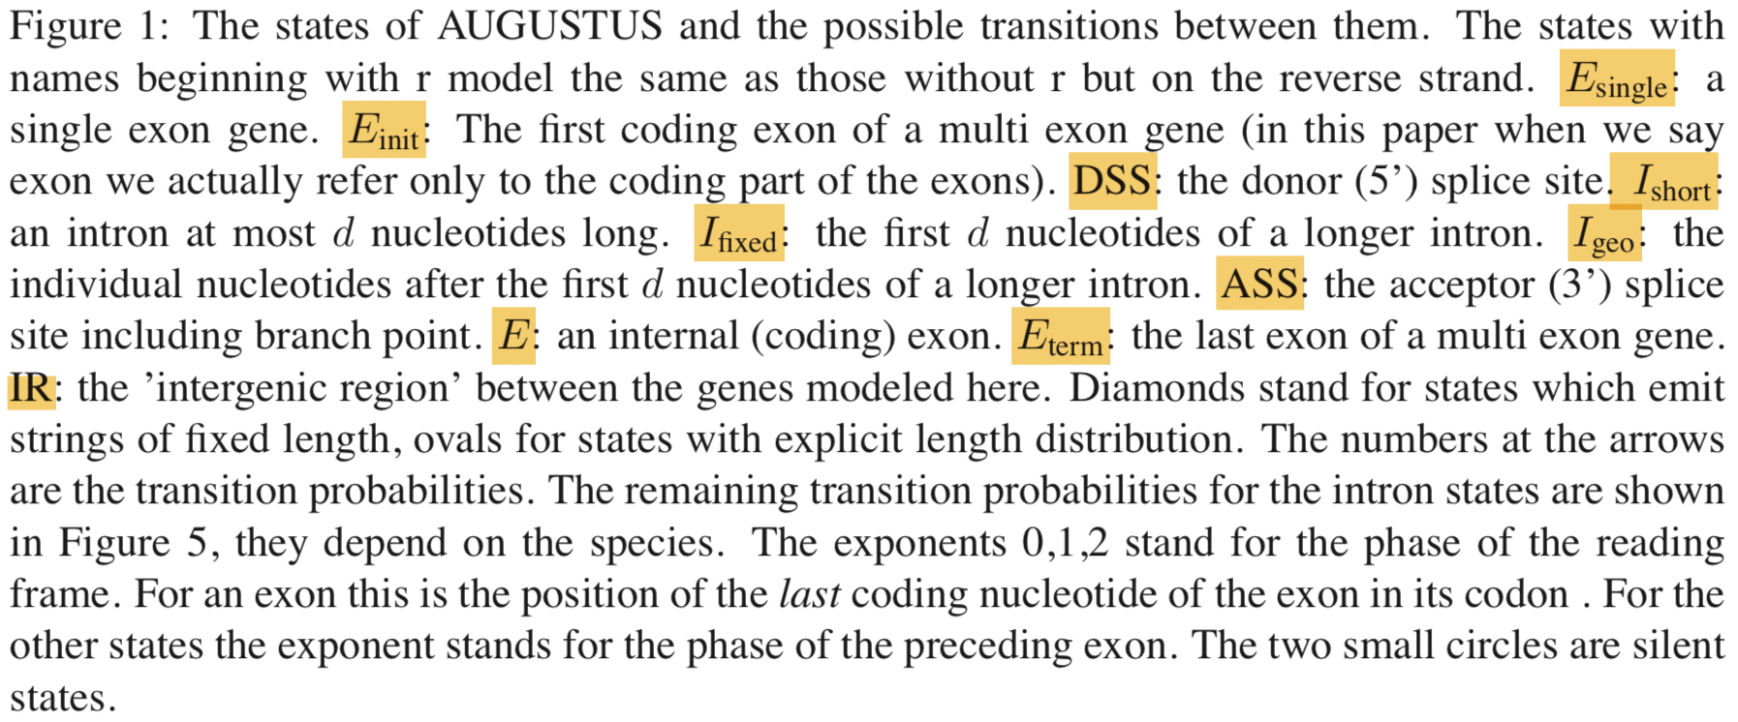
Hidden Markov Model of Gene Structure
Training Database
Homology genes
Gene from Transcriptome
Results of the last run
Notes:
Symmetrical 对称的

Slide 17
Homology-based prediction
&
Transcriptome-based prediction
Homology genes
Transcriptome
Alignment
（BLAST）
New Genome
These results can be used
to retrain the genetic model

Slide 18
Filter Result
Polishing, Synthesize, Selecting and Revising
Polishing: Use Exonerate to correct inaccurate BLAST alignments
Synthesize: Integrate all evidence to retaining model, then produce
even better gene predictions.
Selecting&Revising: Updates features such as 5' and 3' UTRs based on EST
evidence, tries to determine alternative splice forms where EST
data permits.

Slide 19
Gene function
Nr Nt
Most comprehensive
The protein sequence is experimentally verified
Metabolic pathway annotations
Classification of protein domains
Gene ontology database
Prediction Result
Alignment
Annotation Result
Gene+Function
Notes:
Highest accuracy 最高准确率

Slide 20
Software for Prediction&Annotation
DNA/Protein Alignment | NCBI BLAST 2.2.X; Exonerate 1.4
Ab initio prediction | AUGUSTUS 2.0 ; SNAP 2009-02-03
Mask repeat sequence | RepeatModeler; RepeatMasker 3.1.6
Genome annotation pipeline script | MAKER 2.31.8

Slide 21
How to use
on Linux
http://gmod.org/wiki/MAKER_Tutorial#Ab_Initio_Gene_Prediction

Slide 22
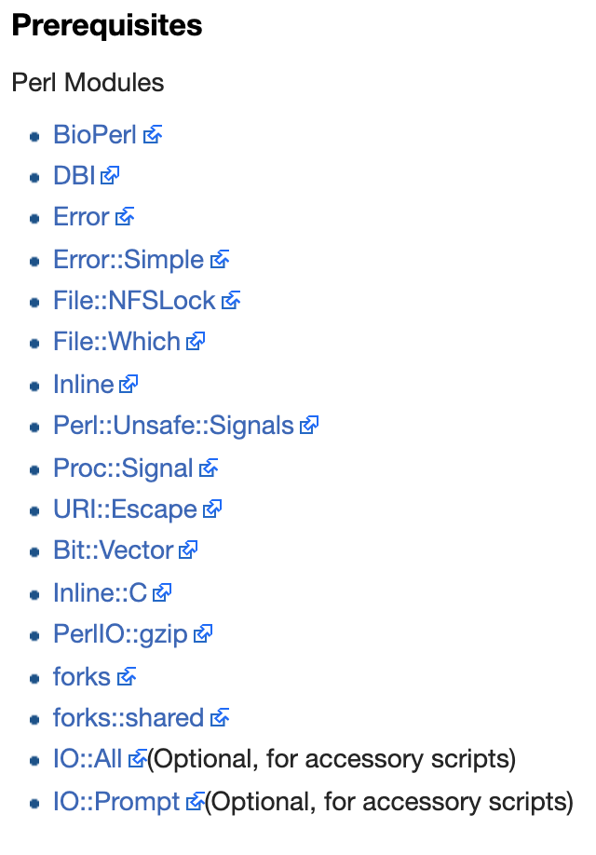
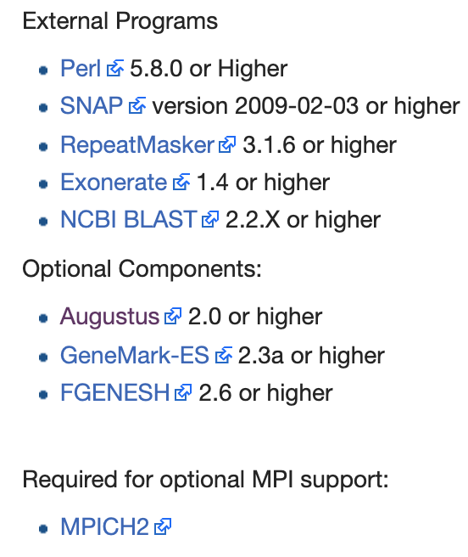
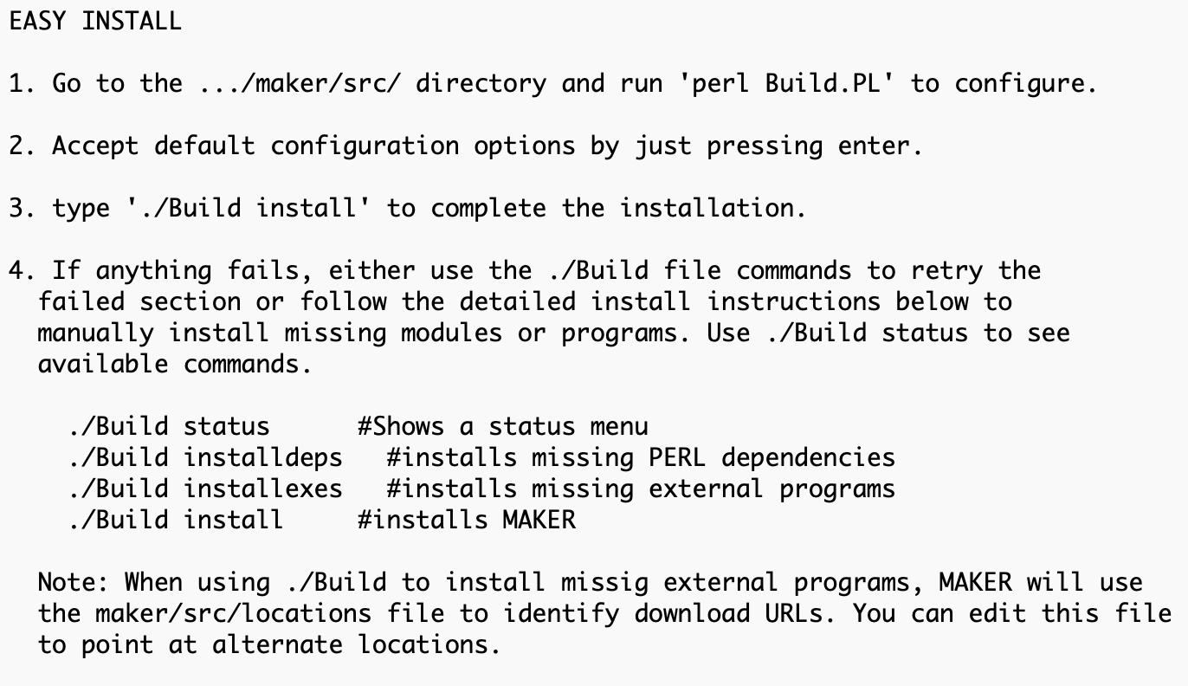
Installation (Linux)
Method 1
Method 2
$ conda install maker
Notes:
Convenience 方便

Slide 23
Data preparation
genome.fasta | The genome you want to annotation
transcriptome.fasta | Transcriptome sequence, the same species as the genome
Protein.fasta | Protein sequences of neighboring species can be downloaded from NCBI's Taxonomy database
consensi.fa.classified | Repeated sequence database, built using RepeatModeler
Notes:
preparation
p rai per rui tion

Slide 24
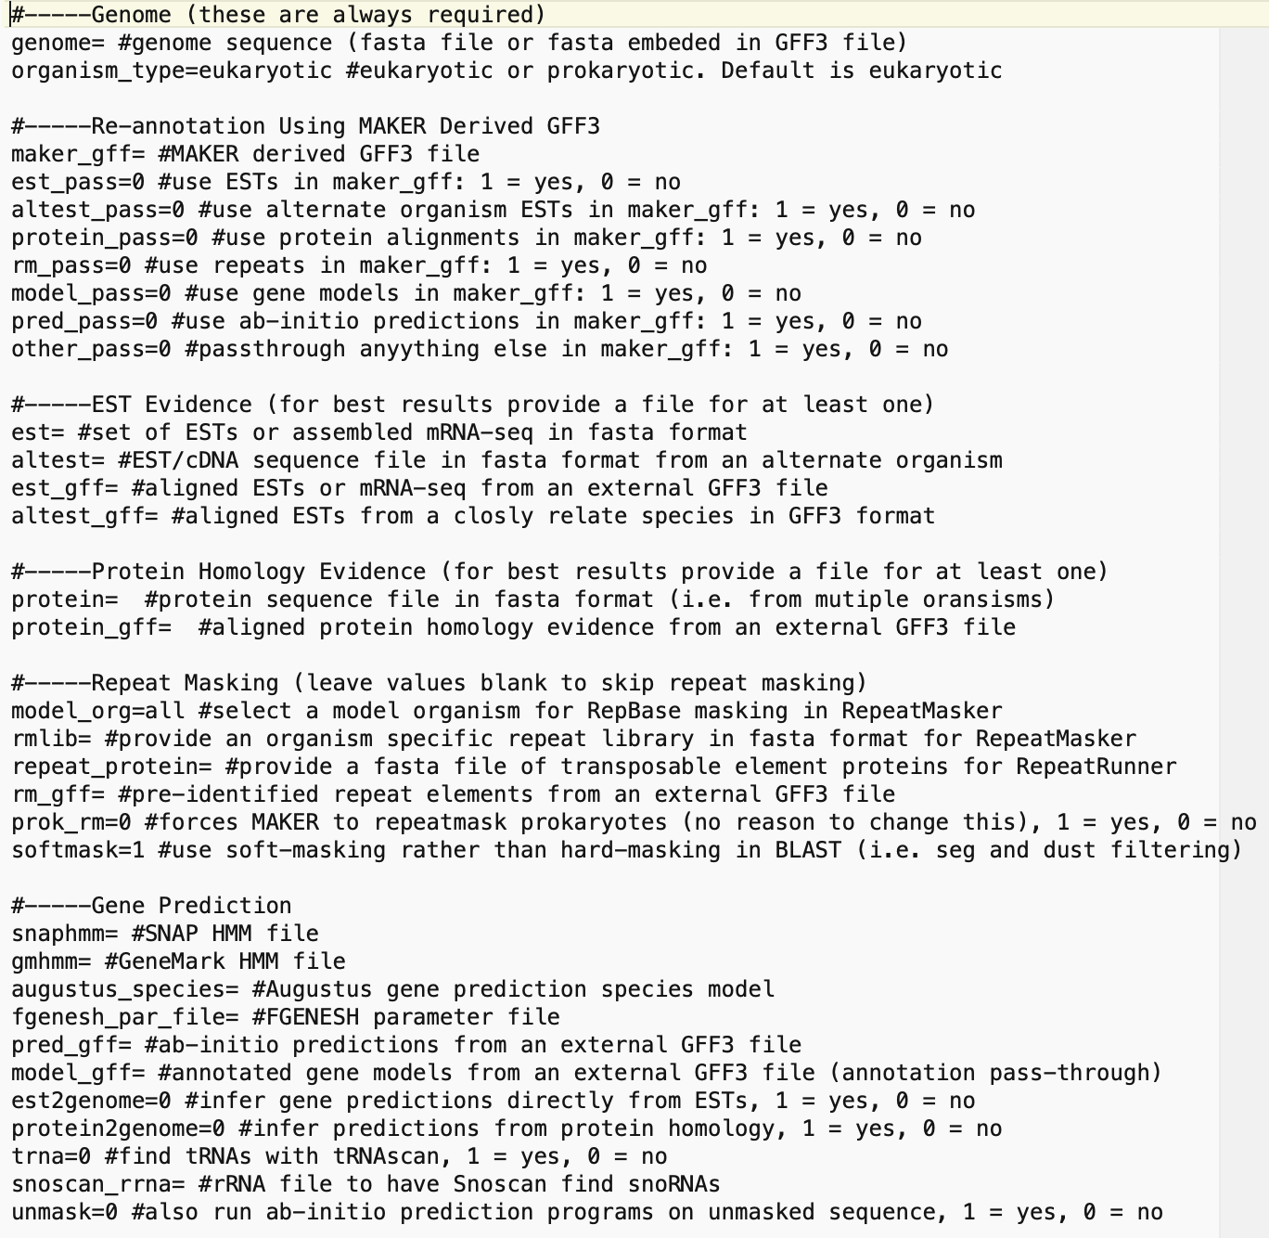
Run MAKER
1st Run
other Run
1. Configuration
$ maker -CTL
Get three files：
maker_bopts.ctl
maker_exe.ctl
maker_opts.ctl
genome.fasta
transcriptome.fasta
Protein.fasta
consensi.fa.classified

Slide 25
2. Running
Use singe core
$ maker
Use Multiple cores
$ mpiexec -n 40 maker

Slide 26
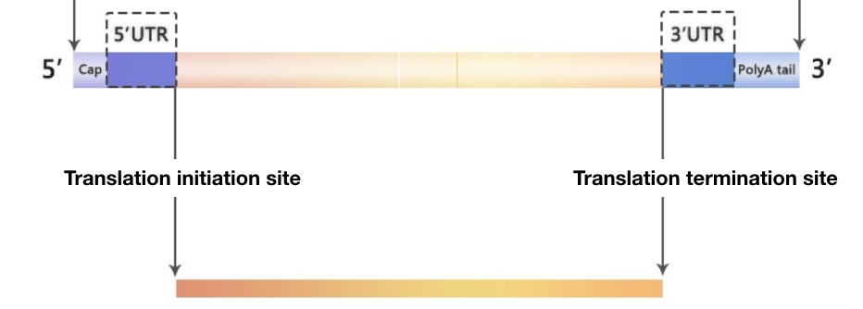
Get Result
$ fasta_merge -d <datastore_index> -o <outfile>
$ gff3_merge -d <datastore_index> -o <outfile>
mRNA and Protein Sequences
Gene structure

Slide 27
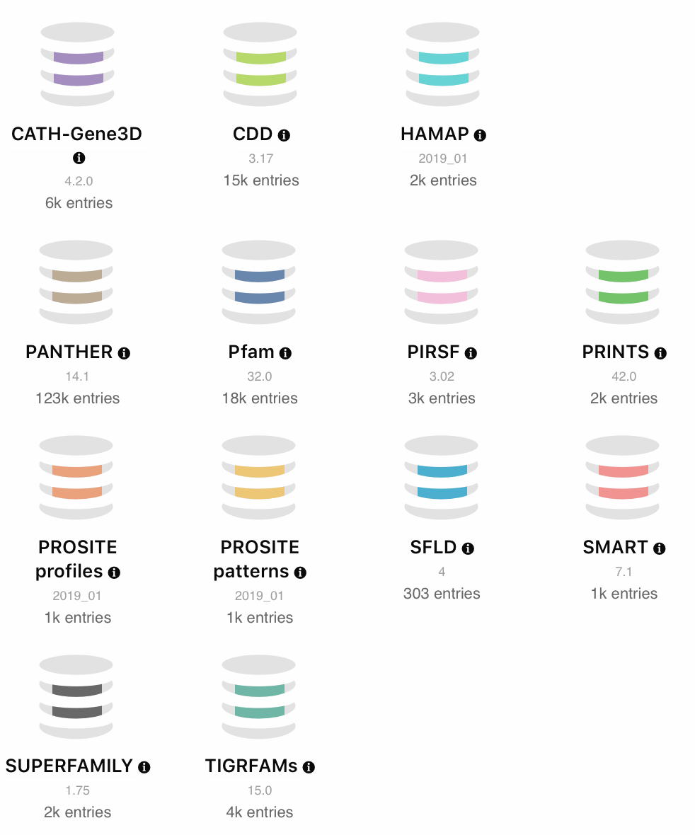
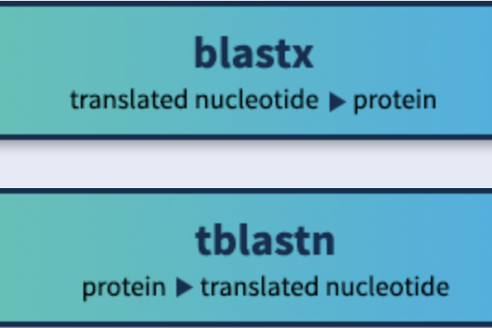
Gene Function Annotation
InterProScan
http://www.ebi.ac.uk/interpro/download/
ftp://ftp.ncbi.nlm.nih.gov/blast/executables/blast+/LATEST
ftp://ftp.ncbi.nlm.nih.gov/blast/db/FASTA/

Slide 28
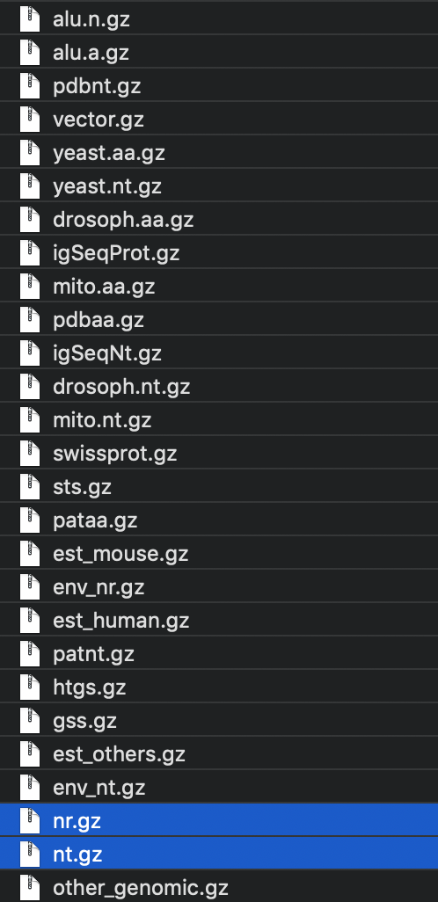
Software Usage
InterProScan
$ interproscan.sh \
-i /path/to/sequences.fasta \
-o /path/to/output/ \
-goterms \
-iprlookup \
--cpu 40
BLAST
$ makeblastdb \
-in nr0x.fasta \
-prase_seqids \
-hash_index \
-dbtype nucl
nucl for DNA, prot for Protein
$blastx \
-db db_name \
-query seq.fasta \
-out seq.blast \
-outfmt 6 \
-evalue 1e-5 \
-num_threads 20
here is nr0x, from makeblastdb
from annotation
ftp://ftp.ncbi.nlm.nih.gov/blast/db/FASTA/
Notes:
unzip 解压

Slide 29
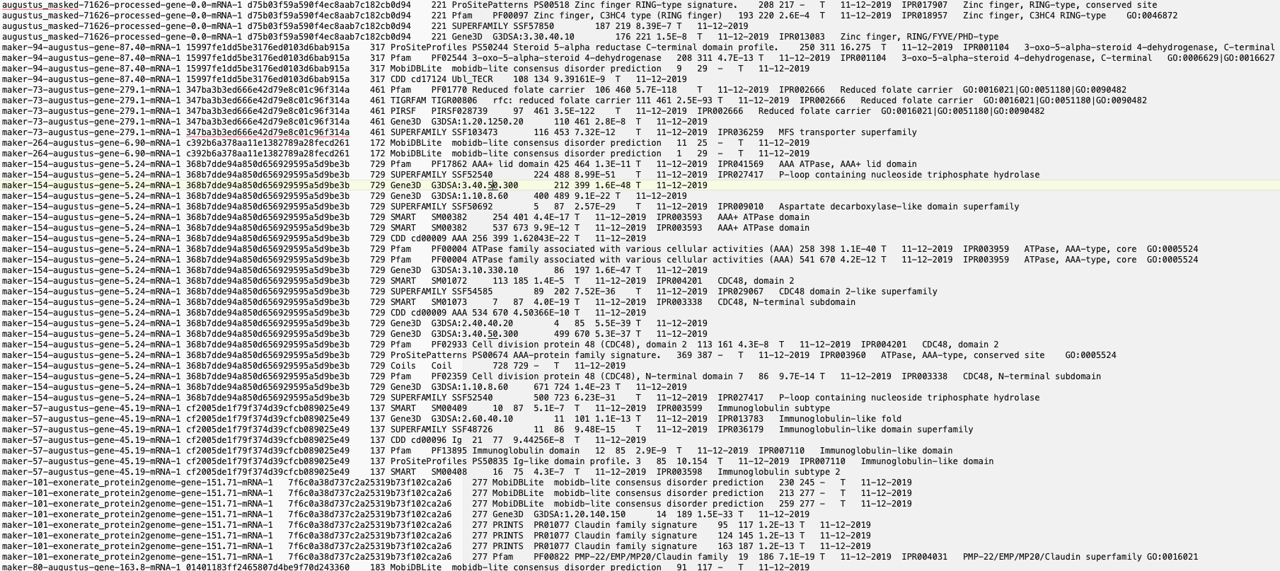
.
.
.

Slide 30
Hope you have fun in the genome

