Slide 1
Identify phenotype associated genes
Lu Liang
LMSE
Shanghai Ocean University
Jan 9 2020

Slide 2
How sequences control different phenotype?
genome
New gene
Gene mutation
Selected site
Gene lose
SNP
.
.
.
Notes:
fin 鱼鳍

Slide 3
The basic idea
Interesting questions of the species itself
The most important steps
How to narrow the
scope of gene searches
Genes of interest
All genes
Different genes

Slide 5
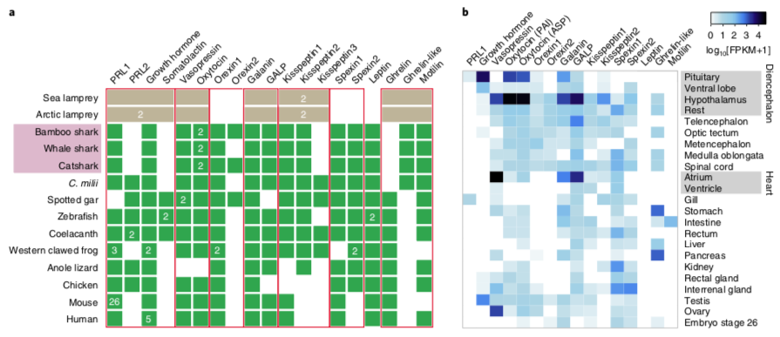
Just alignment and dN / dS, compare all the more detailed data from previous studies, and look for differences and selected sites
Hox genes and clusters, FoxG gene....
Verify results using transcriptome and
chromatin immunoprecipitation
(ChIP)
Notes:
染色质免疫沉淀 Chromatin immunoprecipitation
a)暴力比对，把之前研究比较详细的数据全部拿来比对，寻找不同
i.人类保守非编码元件（CNE）比对
ii.人类长非编码RNA（lncRNA）比对
B) 多物种比对得到直系同源基因，计算每个基因的dN / dS

Slide 6
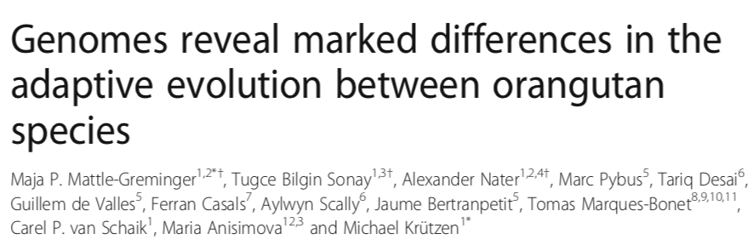
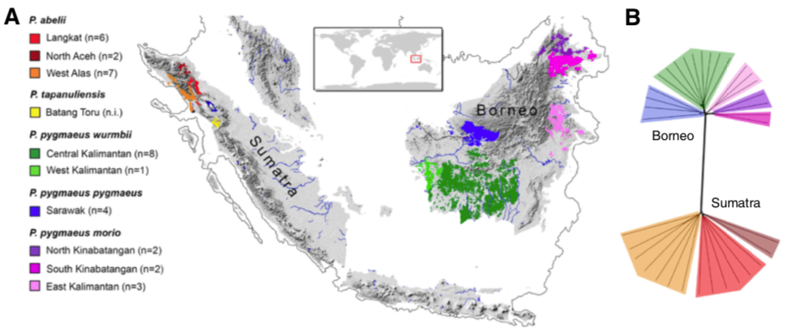

Slide 7
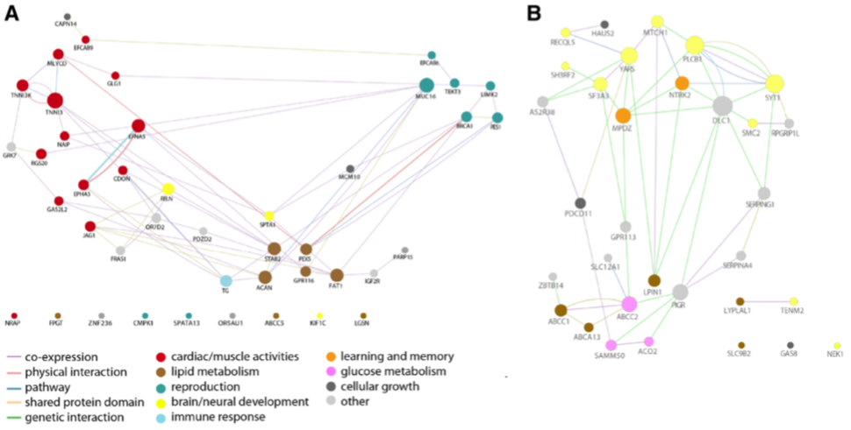
Compare human, rhesus, chimpanzee and orangutan genomes.
Got 34379 aligned genes
Calculate positive selection genes with synonymous mutations and heterosense mutations (MCM test)
Northeast Bornear : 46
North Sumatran: 33
GO enrichment analysis identified GO terms
Bornean
Sumatran
fatty acid metabolism and muscle activities
brain-derived neurotrophic factor binding
Notes:
比对人，恒河猴，黑猩猩和红毛猩猩基因组，有34379个基因可以对齐，使用这些基因进行MCM test。结果显示婆罗洲东北部的群体有46个正向选择的基因，苏门答腊北部的群体有33个正向选择的基因。
2)使用GO富集分析两组正向选择的基因，找功能
东北婆罗洲——肌肉，心脏，生殖，脂质代谢
北苏门答腊——神经系统发育，能量代谢，大脑皮层发育

Slide 8
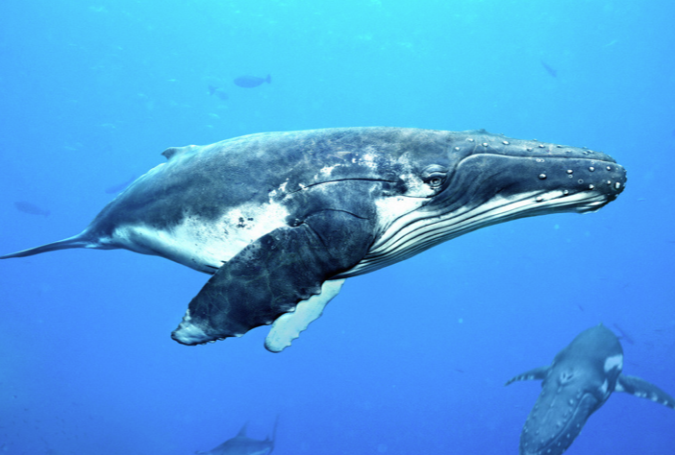
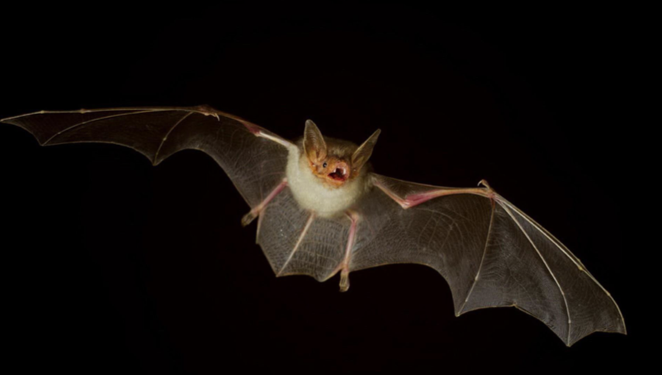
Notes:
bat
whale
Ultrasound

Slide 9
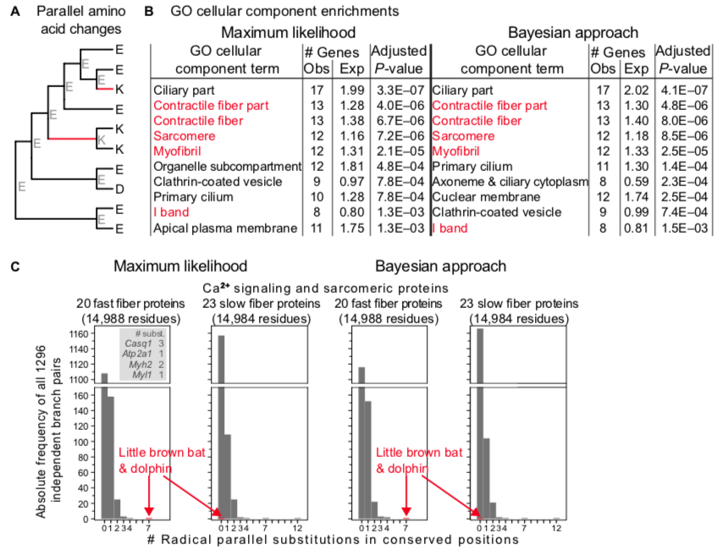
Compare the orthologous protein data of 30 different placental mammals with each other, and find 14,406 high-quality orthologous alignments.
Infer the most probable ancestral protein sequence of each internal node in the phylogenetic tree using maximum likelihood and Bayesian methods
Extract all proteins with one or more amino acid mutations and perform GO enrichment analysis
Find muscle-related genes，for sound-producing “superfast” muscles, which consist of specialized fast-twitch fibers
Verify results using transcriptome
Notes:
a)使用30种不同的胎盘哺乳动物的直系同源蛋白数据互相比对，找到14406个高质量的直系同源比对。然后用最大似然法建立系统发育树。
b)使用最大似然法和贝叶斯方法推断系统发育树中每个内部节点最可能的祖先蛋白序列
c)提取所有发生一个或多个氨基酸取代的那些蛋白，进行GO富集功能分析
d)结果发现最大似然发估计和贝叶斯估计都取得了与肌纤维成分，听力相关的基因
e)测试这些肌纤维蛋白是否在其他哺乳动物中发生氨基酸替代，发现只有microbat和海豚之间有。快肌纤维蝙蝠海豚有更多取代，慢肌纤维这两种都没有取代
f)使用转录组验证基因表达

Slide 10
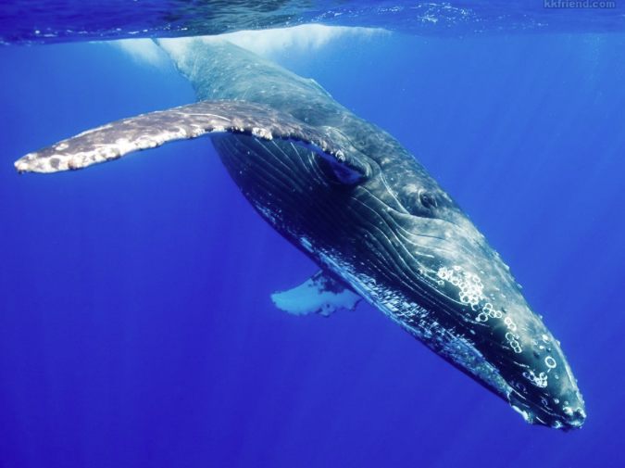

Slide 11
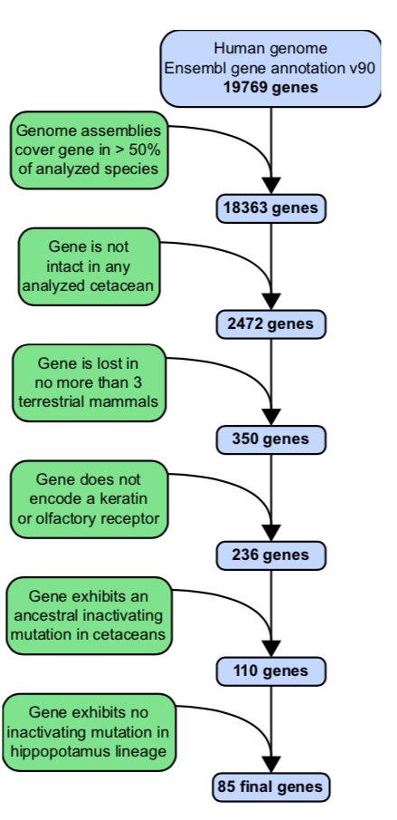
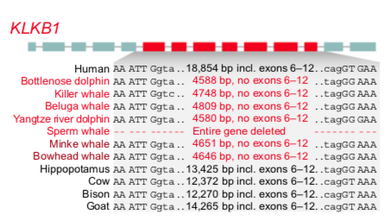
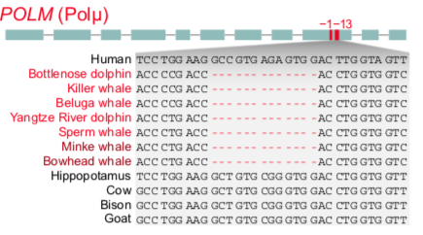
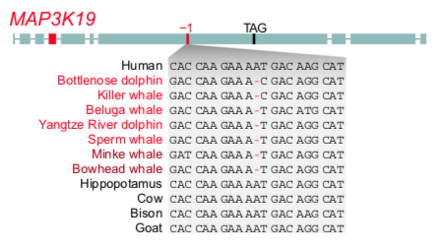
Mapping to the human genome using 62 placental mammals
Verify results using transcriptome and raw reads
Validated in other aquatic or semi-aquatic mammals
Notes:
a)使用人类基因组19769个基因作为参考基因组，使用62个胎盘😔哺乳动物比对到人类基因组上，找到18363个至少在一半基因组中存在的基因。
b)在其中找到在4个鲸类物种中不完整的基因，共有2472个
c)排除在超过5%（55个中的3个）陆生哺乳动物中丢失的基因，产生350个基因
d)之前研究过一部分，所以研究剩下的236个基因。
e)分为部分缺失和完全缺失两组。然后在部分缺失基因中找到鲸类断点相同的基因（至少在一条齿鲸和一条须鲸中共有），完全缺失+断点相同=110
f)人与鲸全基因组比对排除失活的基因，获得85个基因
g)转录组+原始reads验证
h)在其他水生或半水生哺乳动物中验证，发现这些基因有逐渐丢失的现象

Slide 13
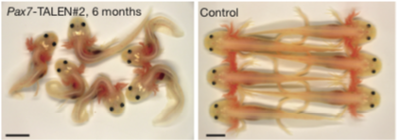
Hox, Pax gene family alignment finds key developmental Pax3 gene deletions.
Other studies have shown that Pax3 and Pax7 have some of the same functions, but the absence of Pax3 and Pax7 in mice can cause different phenotypes
Editing Pax7 gene validation function with CRISPR
Using Transcriptomes to Find Highly Expressed Genes in Regenerative Tissues
Find unusual expressed microRNA and non-coding RNAs
Notes:
a)Hox，Pax基因家族比对找到有关键的发育相关Pax3基因缺失
b)其他研究说明Pax3和Pax7具有某些相同功能，但是小鼠中Pax3和Pax7缺失会造成不同表型
c)使用CRISPR编辑蝾螈Pax7基因验证功能

Slide 14
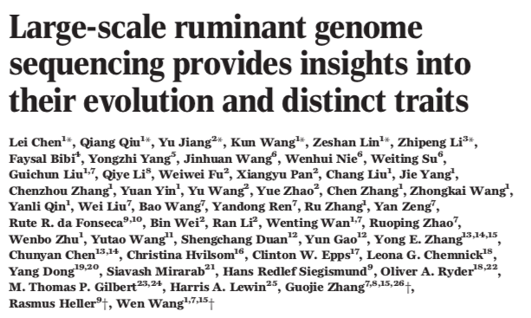
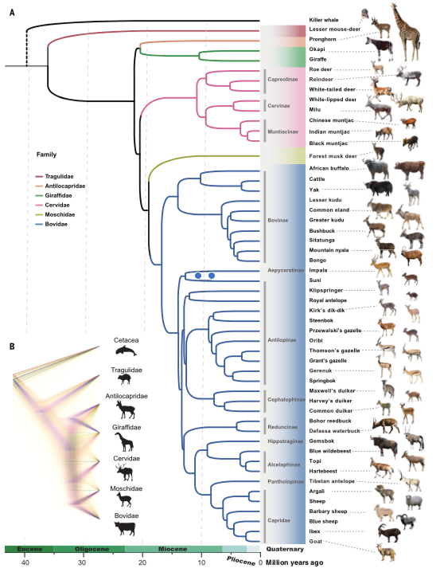

Slide 15
Basic Step
Positive selection: PAML estimates dN / dS
New genes: goats, black clogs, pronghorns, giraffes, musk deer, killer whales, pigs, horses, mice, human genomes are compared with each other to find new genes for ruminants
Rapidly evolving genes: PAML estimates dN / dS, with high selection values
Notes:
a)正向选择：PAML估计dN / dS
b)新基因：山羊，黑木樨，叉角羚，长颈鹿，麝香鹿，虎鲸，猪，马，小鼠，人类基因组互相比对，找到反刍动物的新基因
c)快速进化基因：PAML估计dN / dS，选择值高的

Slide 16
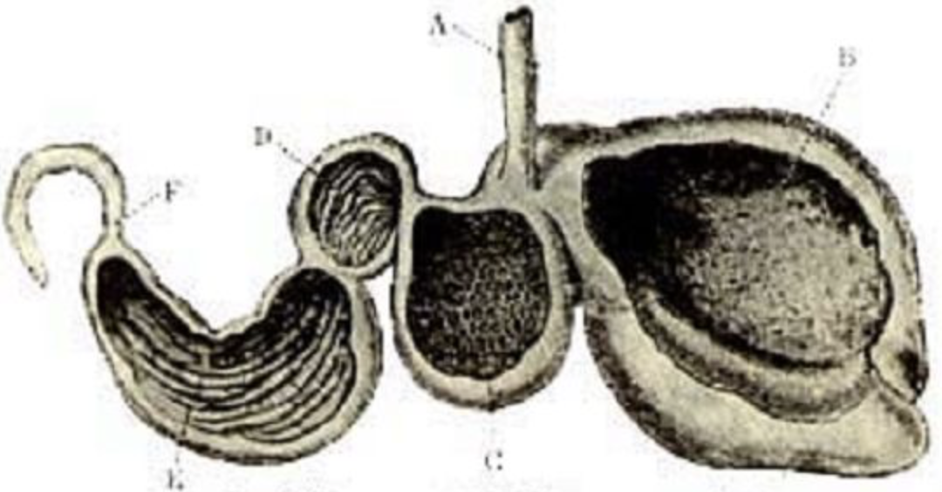
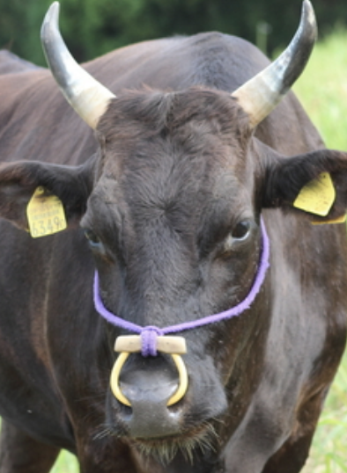
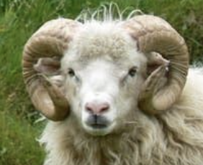
7 genes in the rumen transcriptome of the sheep are among the newly generated genes, which can represent the genes produced by the rumen
There are 201 highly expressed genes in horns, 36 genes were found, nine of which are related to bone development
Seven highly expressed keratin genes were obtained using the transcriptome of sheep and goat horn buds. Using 12 mammals to compare with ruminants, 106 homologous proteins were found to contain at least two common amino acid changes in two ruminant families, of which there was a horn-specifically expressed gene and one of the amino acid sites was in keratin In the head domain, this protein is important for bovine keratin sheath formation
Notes:
d)羊瘤胃转录组中有7个基因在新产生的基因中，可以代表瘤胃产生的基因
e)牛角中有201个高表达基因，找到36个identified 36 of these genes harboring pecoran-specific CNEs，其中九个与骨骼发育相关
f)使用绵羊和山羊角芽的转录组得到七个高表达角蛋白基因。使用12种哺乳动物与反刍动物比对，找到106个同源蛋白质在两个反刍动物家族中至少含有两个共同的氨基酸变化，其中有一个角特异表达的基因，其中一个氨基酸位点在角蛋白头部结构域中，说明该蛋白对牛科角蛋白鞘形成很重要

Slide 17
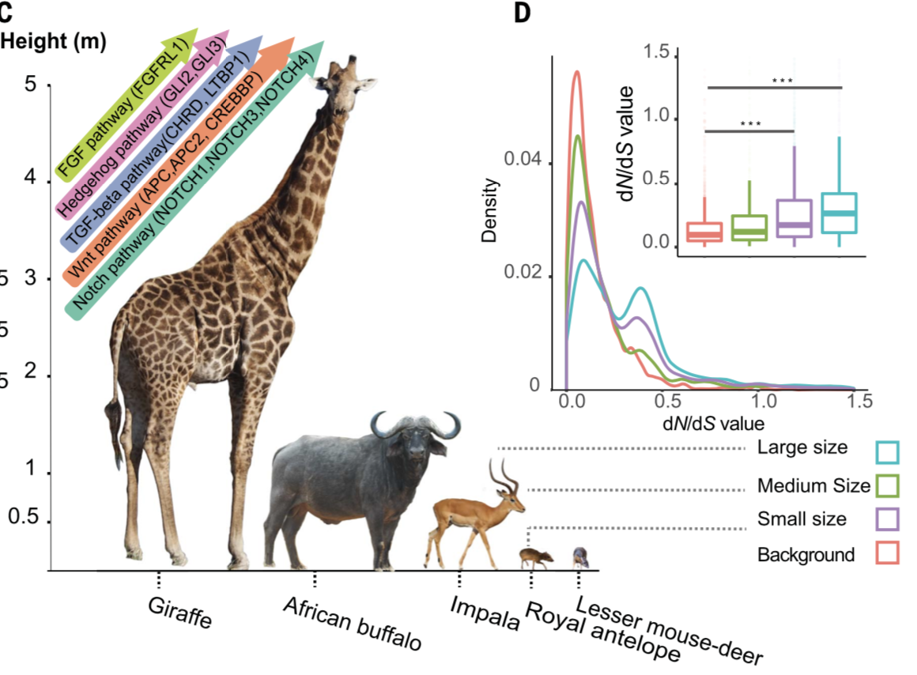
Retrieved 642 individual-type development-related genes and estimated the dN / dS ratios of these genes. It was found that six genes significantly increased dN / dS with weight gain, two of which were dN / dS> 1, and were strongly selected. Mineralizing osteoblasts affects osteogenesis. Disruption of this gene can affect muscle mass. In the small part of the body, five genes, dN / dS, increased significantly, and the SBDS value was greater than 1, which is a human disease-causing gene that causes bone abnormalities and dwarfing.
Notes:
d)羊瘤胃转录组中有7个基因在新产生的基因中，可以代表瘤胃产生的基因
e)牛角中有201个高表达基因，找到36个identified 36 of these genes harboring pecoran-specific CNEs，其中九个与骨骼发育相关
f)使用绵羊和山羊角芽的转录组得到七个高表达角蛋白基因。使用12种哺乳动物与反刍动物比对，找到106个同源蛋白质在两个反刍动物家族中至少含有两个共同的氨基酸变化，其中有一个角特异表达的基因，其中一个氨基酸位点在角蛋白头部结构域中，说明该蛋白对牛科角蛋白鞘形成很重要

Slide 18
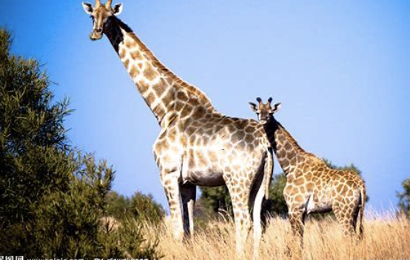
Annotate the giraffe with KEGG and find 366 skeletal development-related genes. Compared with other animals, 115 of them have giraffe-specific mutations and 11 genes have more than 4 non-synonymous mutations, which may be extreme to the giraffe's body structure. Elongation related
Notes:
d)羊瘤胃转录组中有7个基因在新产生的基因中，可以代表瘤胃产生的基因
e)牛角中有201个高表达基因，找到36个identified 36 of these genes harboring pecoran-specific CNEs，其中九个与骨骼发育相关
f)使用绵羊和山羊角芽的转录组得到七个高表达角蛋白基因。使用12种哺乳动物与反刍动物比对，找到106个同源蛋白质在两个反刍动物家族中至少含有两个共同的氨基酸变化，其中有一个角特异表达的基因，其中一个氨基酸位点在角蛋白头部结构域中，说明该蛋白对牛科角蛋白鞘形成很重要

Slide 19
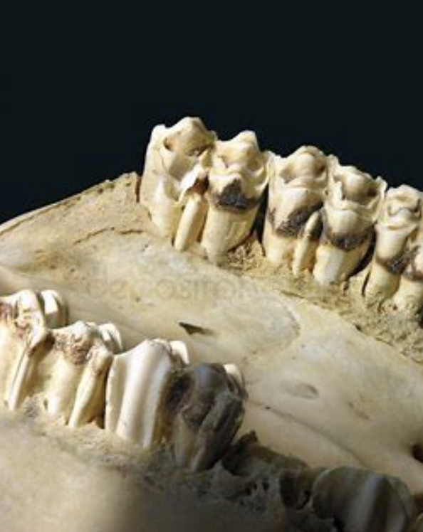
ruminant-specific conserved nonexonic elements (RSCNE)
In ruminants, there are 11 genes downstream of 10 kb or RSCNE in introns. Among them, there are seven RSCNEs in the ENAM gene, two amino acid insertions, and several ruminant-specific mutations, which are important factors for adapting teeth to specific diets.
Notes:
j)ruminant-specific conserved nonexonic elements（RSCNE）反刍动物特定保守的非外显子元素
在反刍动物中有11个基因下游10kb或上游内含子中有RSCNE，其中ENAM基因中有七个RSCNE，两个氨基酸插入，几个反刍动物特有突变，是使牙齿适应特定饮食的重要因素。

Slide 20
Summary
Interesting Questions
dN / dS
Multigenomic alignment
GO enrichment analysis / KEGG
Transcriptome
Amino acid substitution
Feature screening
Non-coding element
CRISPR / ChIP / ...

Slide 21
Software
dN / dS
PAML; Hyphy
GO / KEGG database & BLAST
LASTZ; MULTIZ
Trinity; BLAST
RAxML
Custom script
LASTZ; MULTIZ
GO enrichment analysis / KEGG
Multigenomic alignment
Transcriptome
Amino acid substitution
Feature screening
Non-coding element

Slide 22
Hope you have fun in the genome

