Slide 1
Workshop in Molecular Evolution
Jan 6 - 10, 2020
Shanghai

Slide 3
Two faces of one process: phylogenetics vs. population genetics

Slide 4
Phylogenetics – model of speciation
Tine et al., 2014

Slide 5
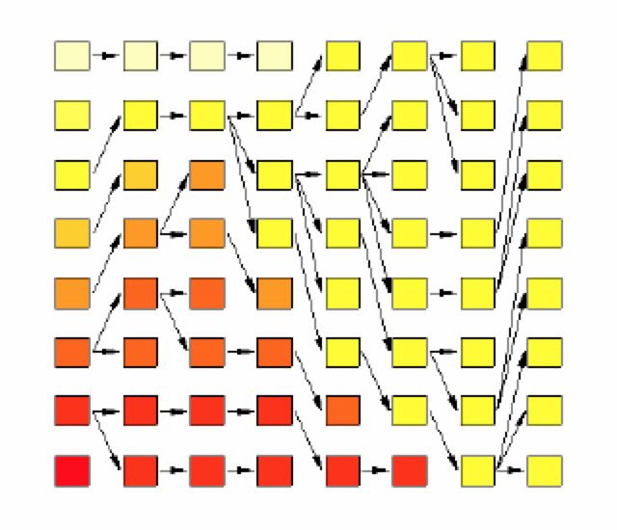
Population genetics – model of coalescence

Slide 6
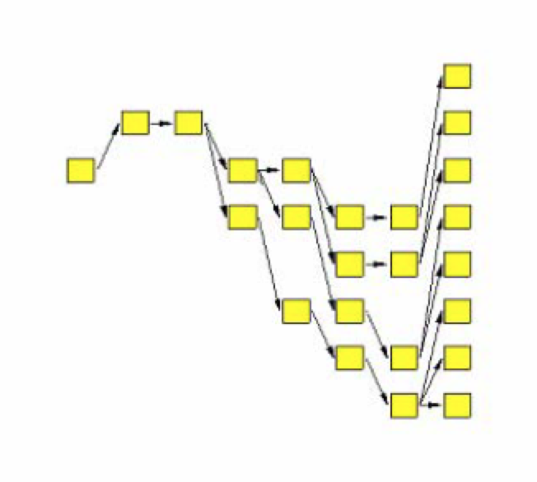
Population genetics

Slide 7
Null model of phylogenetics
Topology and branch length
Substitution matrix
r_{TC} (= r_{CT}), r_{TA} (= r_{AT}), r_{TG} (= r_{GT})
r_{CA} (= r_{AC}), r_{CG} (= r_{GC})
r_{AG} (= r_{GA})
Stationary base frequencies
f_{T}, f_{C}, f_{A}, f_{G},
Taxa 1
Taxa 2
Taxa 3
Taxa 4
Taxa 5

Slide 13
i.i.d. assumption
Each site evolves independently and according to the identical process, so called “i.i.d.” process.

Slide 14
Assumptions in basic models
Stationarity and time reversibility. Stationarity and time reversibility assure the expected frequencies of the nucleotides or amino acids are constant along the evolutionary pathway.
The conditional probabilities of nucl. subst. are the same for all sites and do not change over time or among lineages.
Q...... Are these assumptions reasonable?

Slide 15
INDEPENDENCE?
We assume that change at one site has no effect on other sites. Frequently violated. eg. Ribosomal RNA
A substitution in a stem region can result in a pair of nucleotides that cannot “Watson-Crick pair” correctly, reducing stability of the structure.
Often we find that single changes are accompanied by compensatory changes.
Clearly violates the independence assumption.
Weight differently for stem and loop sites

Slide 16
Variation in rates of substitution among sites?
All of the methods presented assume that each site in a sequence is equally likely to undergo substitution.
If rates of substitution vary, can have considerable influence on sequence divergence (i.e. how much change we estimate to have occurred)
Consider the case where some sites are free to vary while others are constrained to be invariant

Slide 17
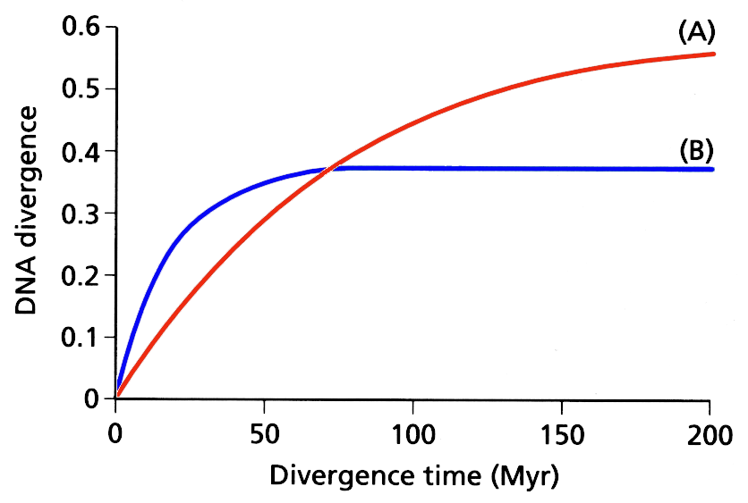
If a large proportion of sites are not free to vary then paradoxically, sequences that evolve at a fast rate can appear to show less sequence divergence than more slowly evolving sequences that have fewer constraints.
(A)
rate of subst. 0.5%/Myr: 80% of sites free to vary
(B)
rate of subst. 2%/Myr: 50% of sites free to vary

Slide 18
In reality sites show a range of probabilities of distribution of rates
Challenge is to develop a tractable model of the rate variation
Most widely used approach uses the “gamma distribution”
Gamma distrib has a shape parameter α that specifies range of rate variation among sites
small values of α result in L-shaped distrib. larger values smaller range of rates.
when α > 1 distribution is “bell shaped”

Slide 19
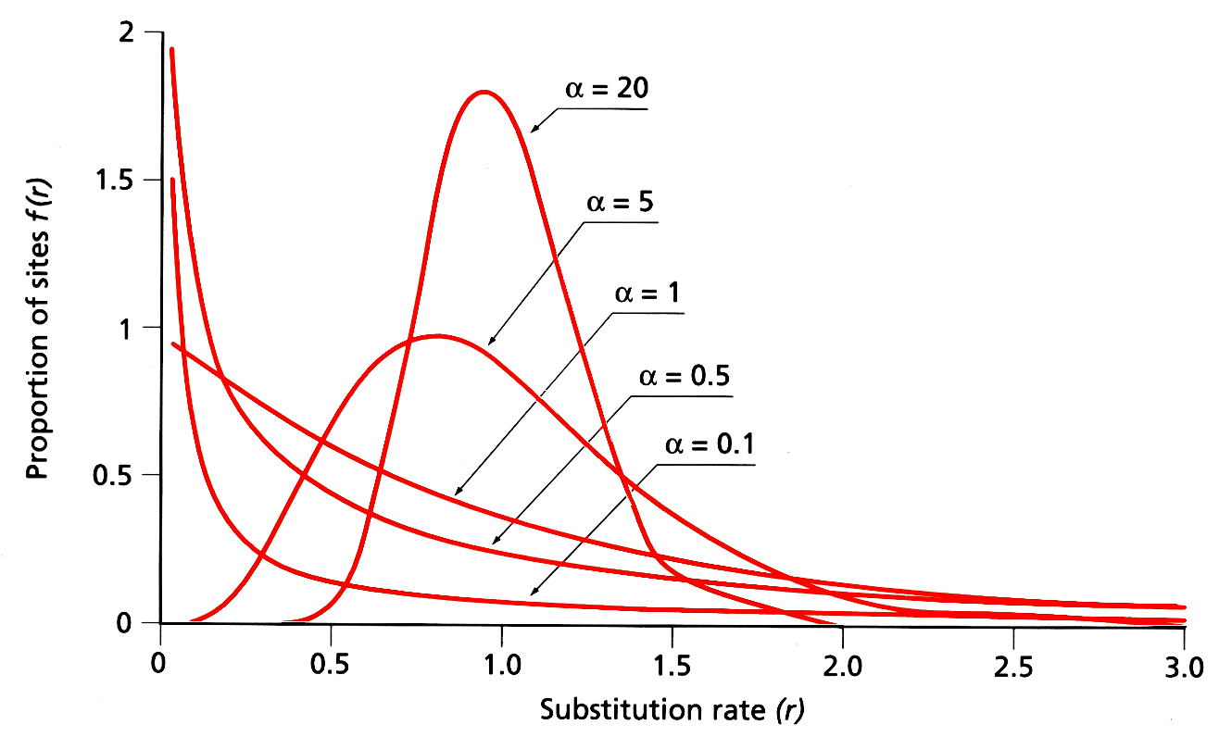
Estimates of alpha vary from nuclear and mitochondrial genes vary between 0.16 (12sRNA) - 1.37 (prolactin)
note. Values of α from first & 2nd codon positions tend to be smaller than
those from 3rd codon positions

Slide 20
Can modify models of evolutionary change to include the gamma distribution - typically represented by the symbol Γ
HKY + Γ

Slide 21
Base Composition Equilibrium?
Assumes that base composition is roughly the same over the collection of sequences.
Deviations from this assumption occur commonly and often lead to misleading inferences.
When constructing trees there is a tendency to cluster sequences together that have similar base compositional profiles.
Explicitly modeling the non-stationary process

Slide 22
Compositional bias (non-stationary)
“Compositional bias can result in the artefactual grouping of species with similar nucleotide composition, because most methods assume the homogeneity of the substitution process and the constancy of sequence composition (stationarity) through time ” (Delsuc et al. 2005).
A
50%
B
70%
C
70%
D
50%
A
50%
B
70%
C
70%
D
50%
50%

Slide 23
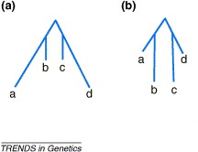
Heterotachy
Heterotachy is the variation of evolutionary rate of a given position of a molecule through time.
The diagram on the right is a simple scenario used by Kolaczkowski and Thornton (2004).
From Steel, 2005

Slide 24
Long branch attraction
A
C
A
C
“Intuitively, with long branches leading to speices A and C, the probability of parallel changes that arrive at the same state becomes greater than the probability of an informative single change in the interior branch of the tree” (Felsenstein, 2004).
B
D
B
D

Slide 25
Phylogenomics
Prediction of gene function (Eisen, 1998)
Establishment of evolutionary relationships using genome or genome-scale data

Slide 26
One gene or more genes?
Single gene or a few genes often result low resolution.
Single gene or a few genes may even reach to the wrong phylogeny.

Slide 27
Systematic error
+
+
+ …
Phylogenetic signal
Gene A
Gene B
Gene C

Slide 28
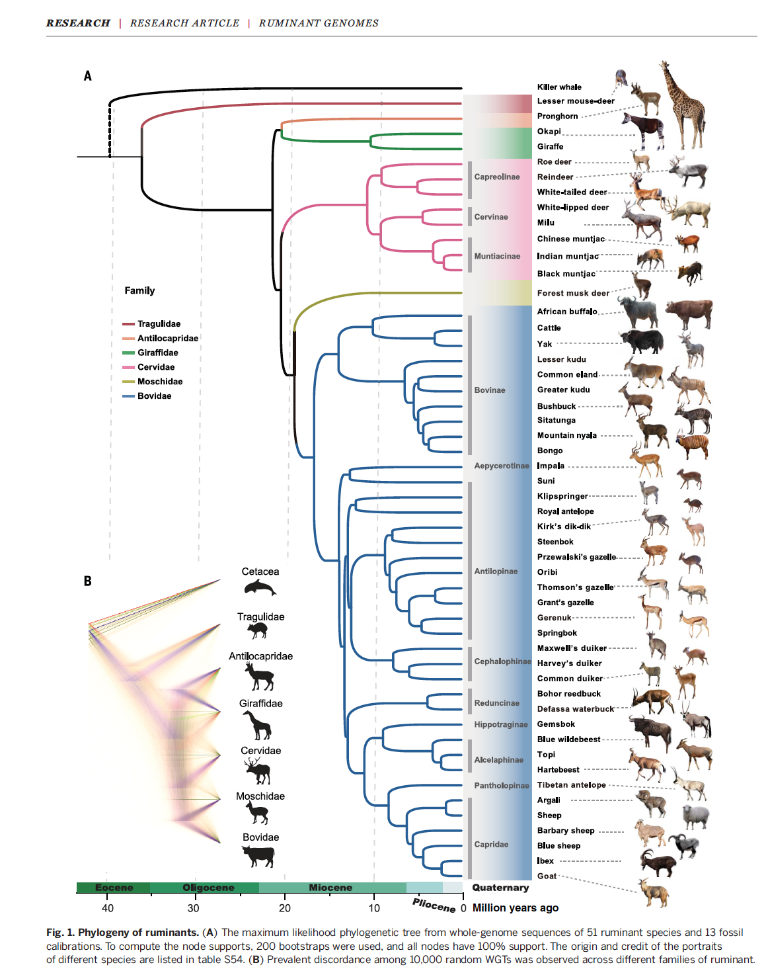

Slide 29
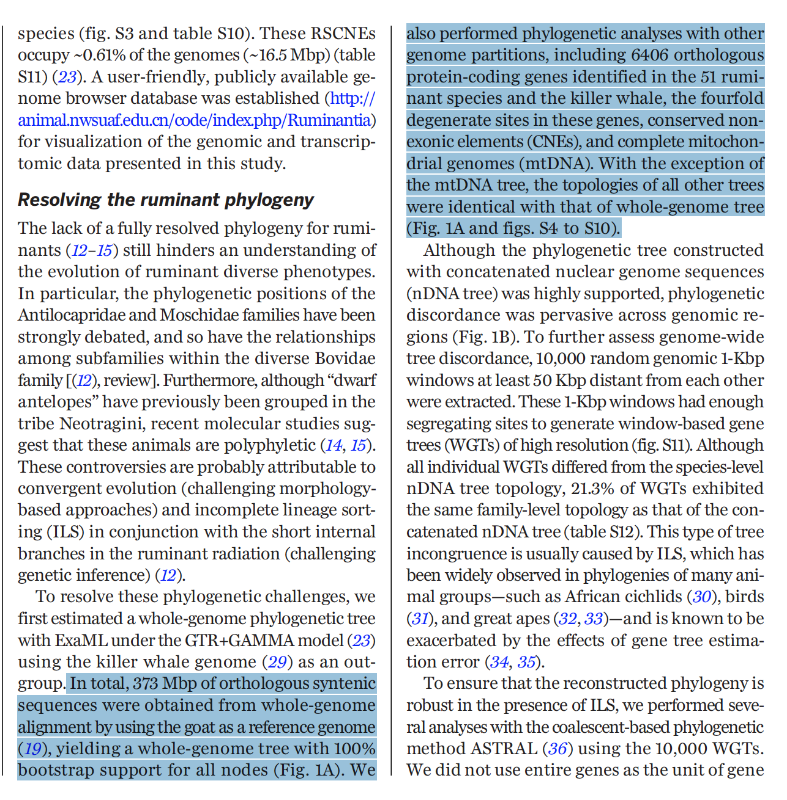

Slide 30
DNA Barcoding Species delimitation / identification
Calculate distance
PCR amplificationCOI
Barcoding
DNA Extraction
Build tree

Slide 31
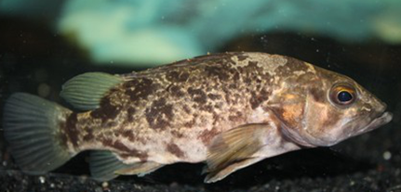
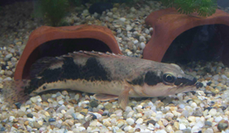
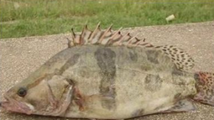
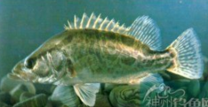
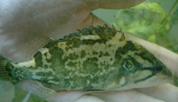
COI barcoding

Slide 32
Problems with current barcoding method
Solution：DNA barcoding using multiple loci

Slide 33
Results of multilocus barcoding

Slide 34
Results of multilocus barcoding

Slide 35
Results from simulations
Success rate of species identification under different simulated scenarios
a）no gene flow 700000 gen（red lines），100000 gen（black plus signs），10000 gen（blue triangles），1000 gen（green circles）；
b) 10000 generations，gene flow 0（red lines），0.000001（black plus signs），0.00001（blue triangles），0.0001（green circle）；
C）100000 generations，gene flow 0（red lines），0.000001（black plus signs），0.00001（blue triangles），0.0001（green circle）；
D）700000 generations，gene flow 0（red lines），0.000001（black plus signs），0.00001（blue triangles），0.0001（green circle）；

Slide 36
Continuous/ independent sequences
Use one continuous locus（red circles）and multiple independent loci（blue circles）for species identification。The length of single continuous locus and total length of multiple loci are equal.

Slide 37
Species delimitation
Is species an objective item?
No!!!
Two criteria to be a meaningful species – Chenhong Li
It is independently evolving
There are unique and meaningful phenotypic traits

Slide 38
Statistics and concepts
Likelihood function
Distribution
Bayesian approach
MCMC
Model selection
Testing hypothesis

Slide 39
Likelihood function

Slide 40
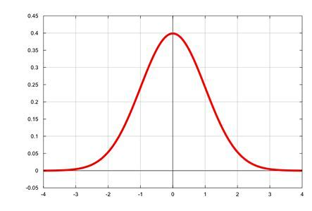
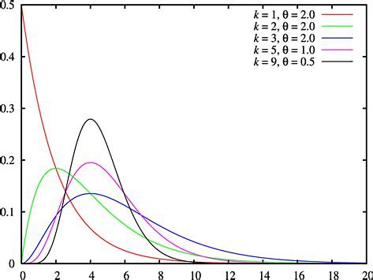
Distribution

Slide 41
The Dirichlet Process the Chinese Restaurant Process

Slide 42
Markov chain
A Markov chain is a model in which changes in states
follow transition probabilities.
It is a stochastic system, i.e. random process
The probability of the next state depends on the current state,
but can also have a chain with memory
The probability of moving to another state follows a
probability distribution
But it can stay in the same locality, where locality may be in
space or time

Slide 43
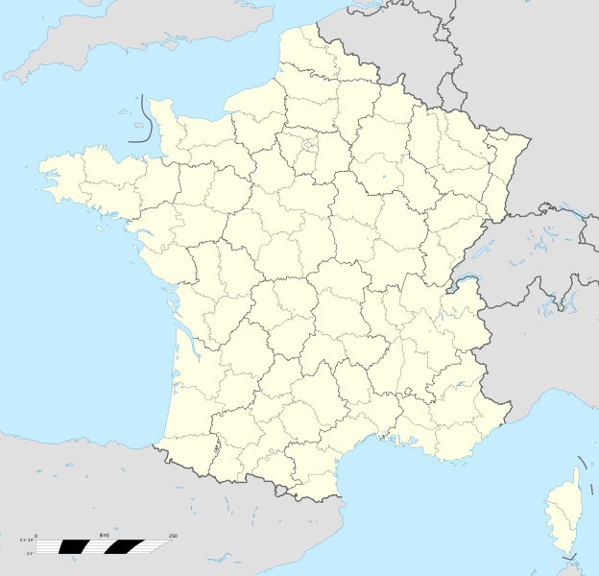
Markov chain Monte Carlo
Monte Carlo: town in Monaco famous for its casino (including the European Poker Tour and World Backgammon Championship)
Relevance ?
both operate on random processes

Slide 44
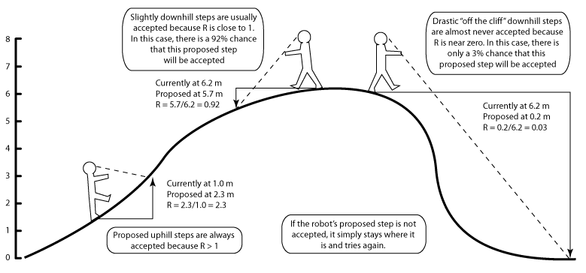
MCMC Robot
http://marple.eeb.uconn.edu/mcmcrobot/?page_id=24

Slide 45
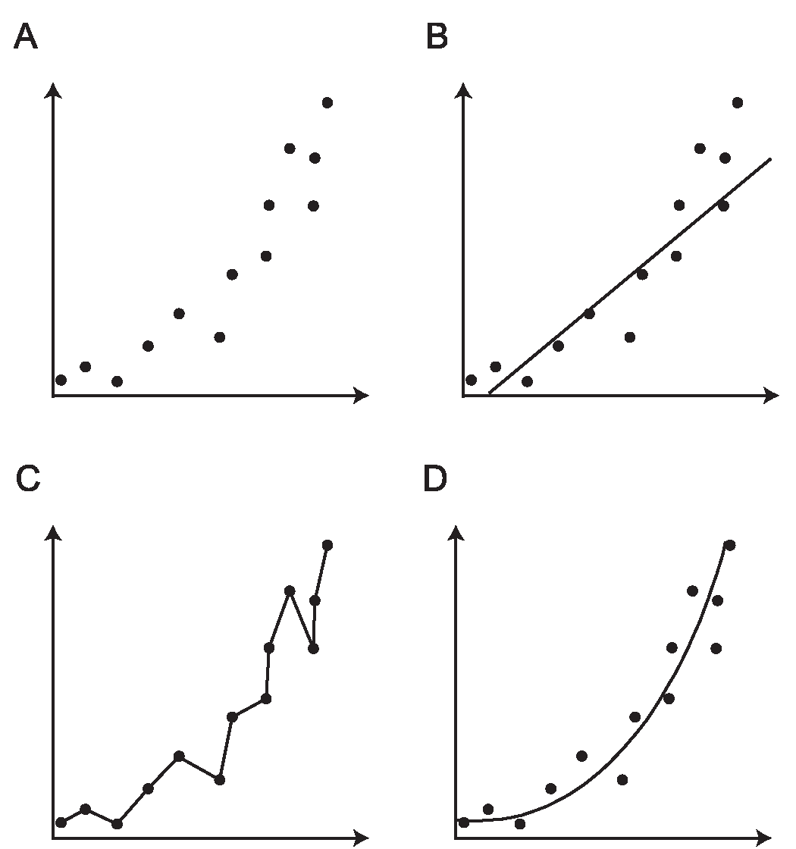
Model selection

Slide 46
Likelihood ratio test

Slide 52
Thank you!

