Slide 1
Workshop in Molecular Evolution
Jan 6 - 10, 2020
Shanghai

Slide 2
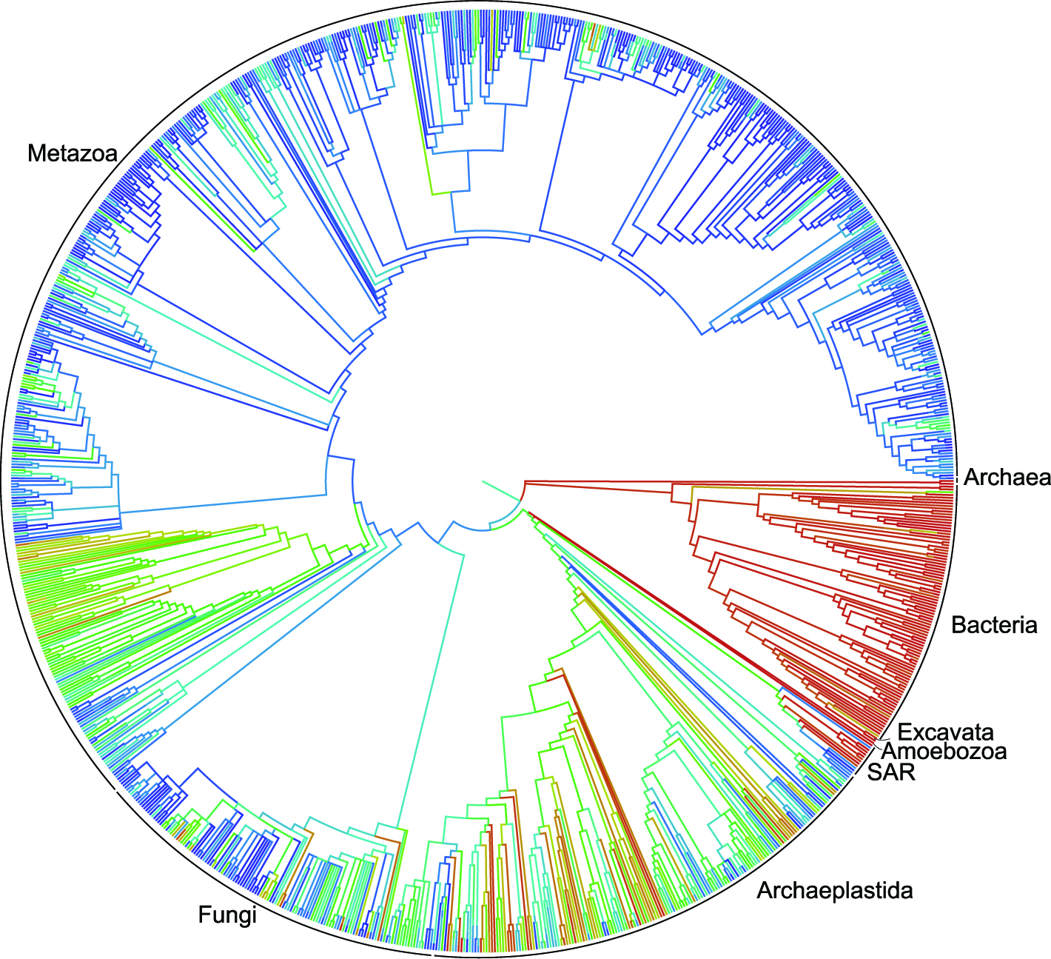
Two faces of one process: phylogenetics vs. population genetics

Slide 3
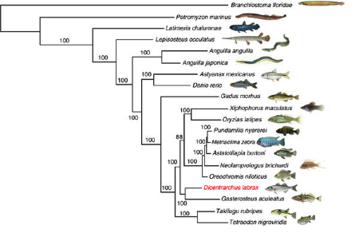
Phylogenetics – model of speciation
Tine et al., 2014

Slide 4
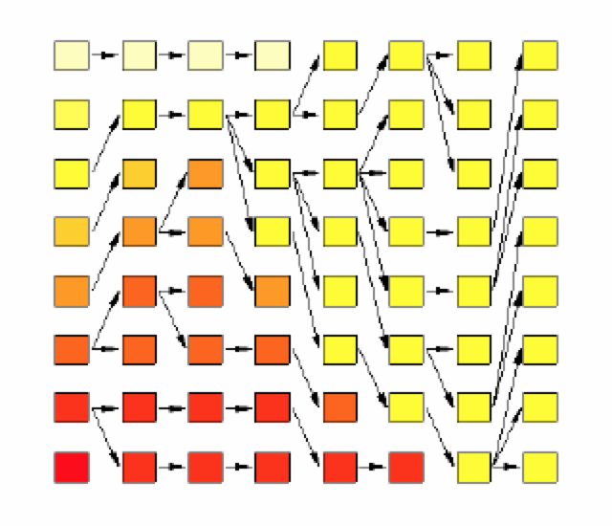
Population genetics – model of coalescence

Slide 5
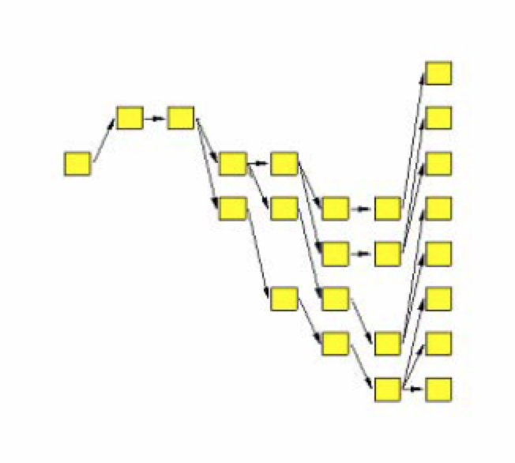
Population genetics

Slide 6
Idealised population
(Fisher-Wright population)
Random mating
  each copy of the gene found in the new generation is drawn independently at random from all copies of the gene in the old generation
No selection
No migration
No mutation
Large population size, no drifting

Slide 7
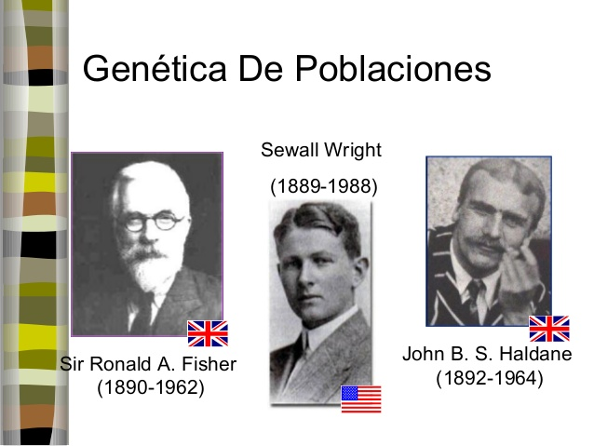

Slide 8

British biologist and statistician
Ronald Fisher
In a series of papers starting in 1918 and culminating in his 1930 book The Genetical Theory of Natural Selection
Fisher showed that the continuous variation measured by the biometricians could be produced by the combined action of many discrete genes, and that natural selection could change allele frequencies in a population, resulting in evolution.

Slide 9
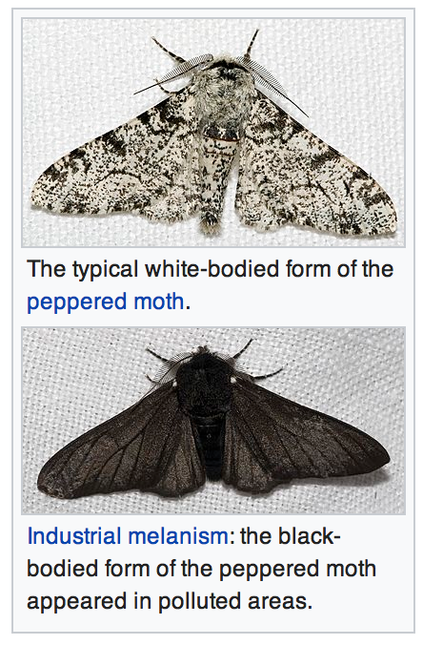
British geneticist
J.B.S. Haldane
worked out the mathematics of allele frequency change at a single gene locus under a broad range of conditions.
Haldane also applied statistical analysis to real-world examples of natural selection, such as peppered moth evolution and industrial melanism

Slide 10
The American biologist
Sewall Wright
animal breeding experiments, focused on combinations of interacting genes, and the effects of inbreeding on small, relatively isolated populations that exhibited genetic drift.
In 1932 Wright introduced the concept of an adaptive landscape and argued that genetic drift and inbreeding could drive a small, isolated sub-population away from an adaptive peak, allowing natural selection to drive it towards different adaptive peaks.

Slide 11
Idealised population
(Fisher-Wright population)
Random mating
  each copy of the gene found in the new generation is drawn independently at random from all copies of the gene in the old generation
No selection
No migration
No mutation
Large population size, no drifting

Slide 12
Idealised population
(Fisher-Wright population)
Hardy-Weinberg equilibrium
  allele frequencies stay constant over time, genotype frequencies are related to allele frequencies
Linkage equilibrium

Slide 13
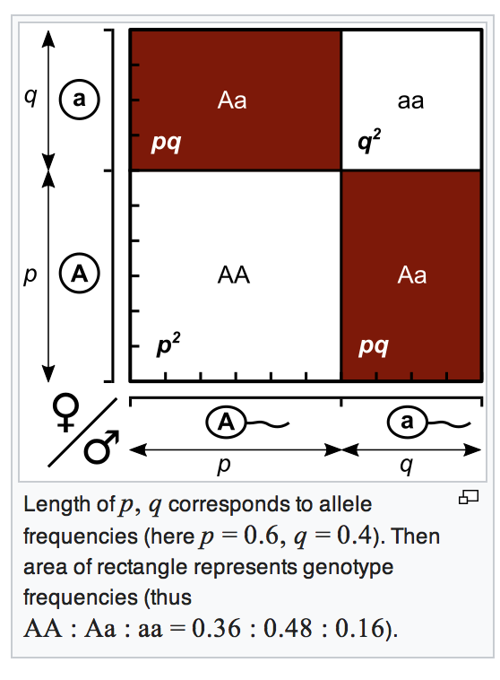
Hardy-Weinberg equilibrium
One locus with 2 alleles at HWE: p² + 2pq + q² = 1

Slide 14
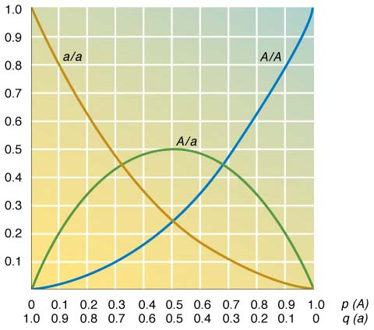
Implications of HWE (two-allele locus)
Rare alleles mostly in heterozygotes
Common ones mostly in homozygotes
Maximum He is 0.5 at 2 allele locus, rising to 1.0 with more alleles

Slide 15
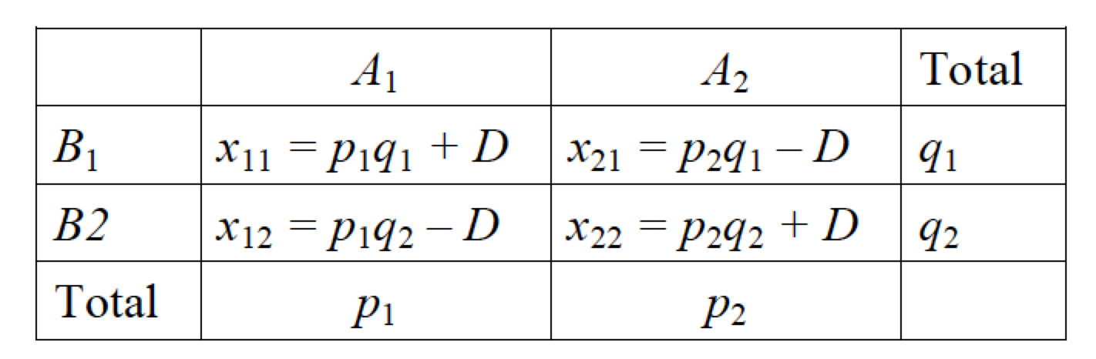
Linkage equilibrium
Alleles at separate loci are expected to segregate independently during meiosis. They show linkage equilibrium.
Example:
2 loci with alleles A₁ and A₂; B₁ and B₂ their frequencies will be p₁ and p₂ and q₁ and q₂.
Possible gametes A₁B₁; A₁B₂; A₂B₁; A₂B₂
Genotype frequencies will be the product of constituent allele frequencies

Slide 16
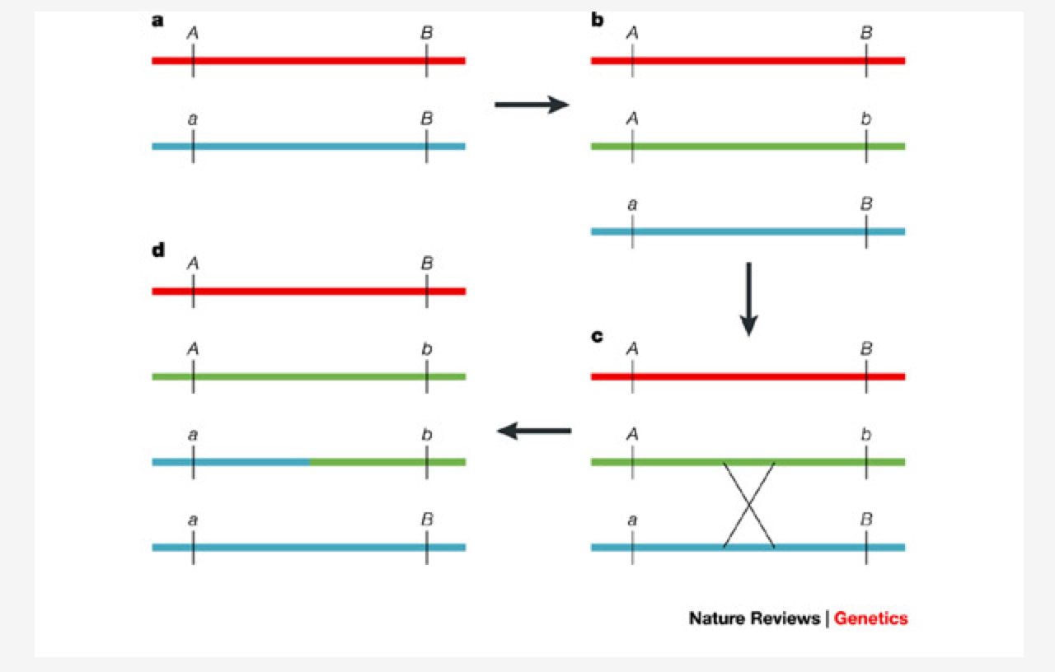
Linkage disequilibrium

Slide 17
Linkage disequilibrium
Linkage disequilibrium = a deviation from random associations of alleles at different loci
Linkage disequilibrium can be caused by :
- chance events
- population bottlenecks
- recent mixing of different populations
- selection
Linkage disequilibrium is important because:
  It is common in threatened species with small populations
  evolutionary processes are altered
  functionally important genes may exhibit linkage disequilibrium
  can be a signal of recent admixture of populations

Slide 18
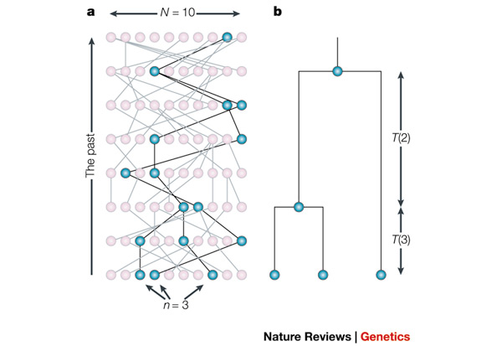
Coalescent theory

Slide 19
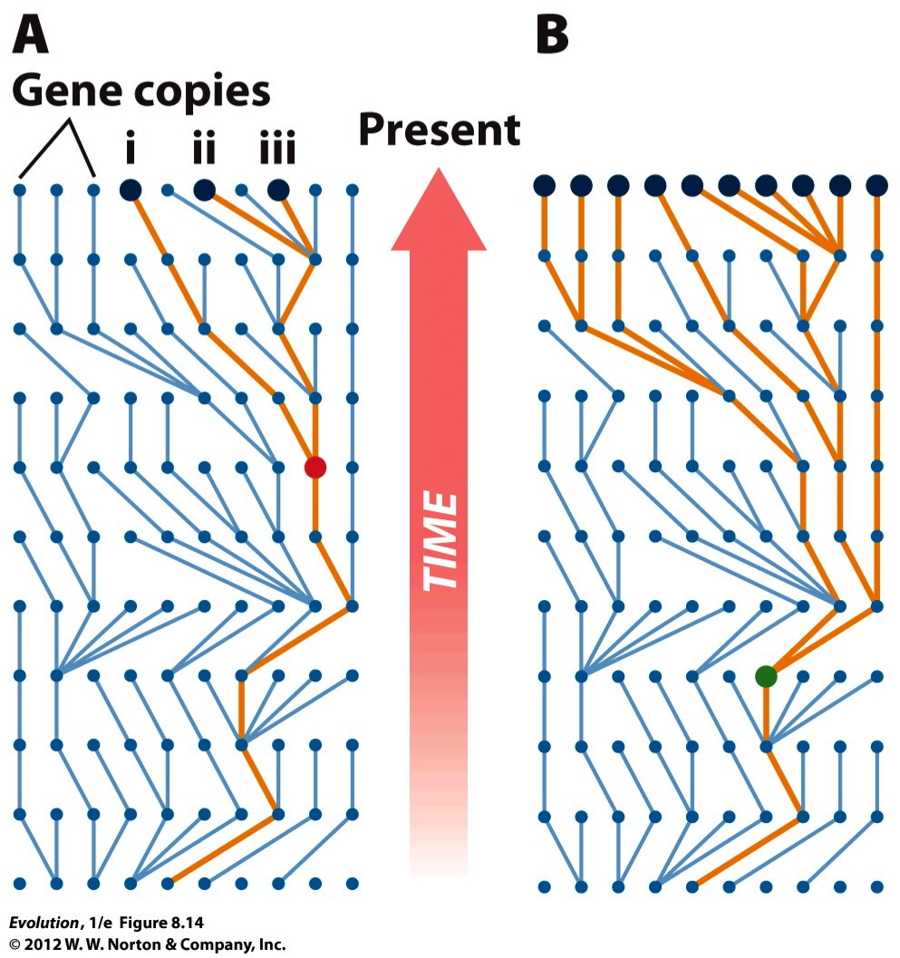
Sampling for coalescent analysis

Slide 20
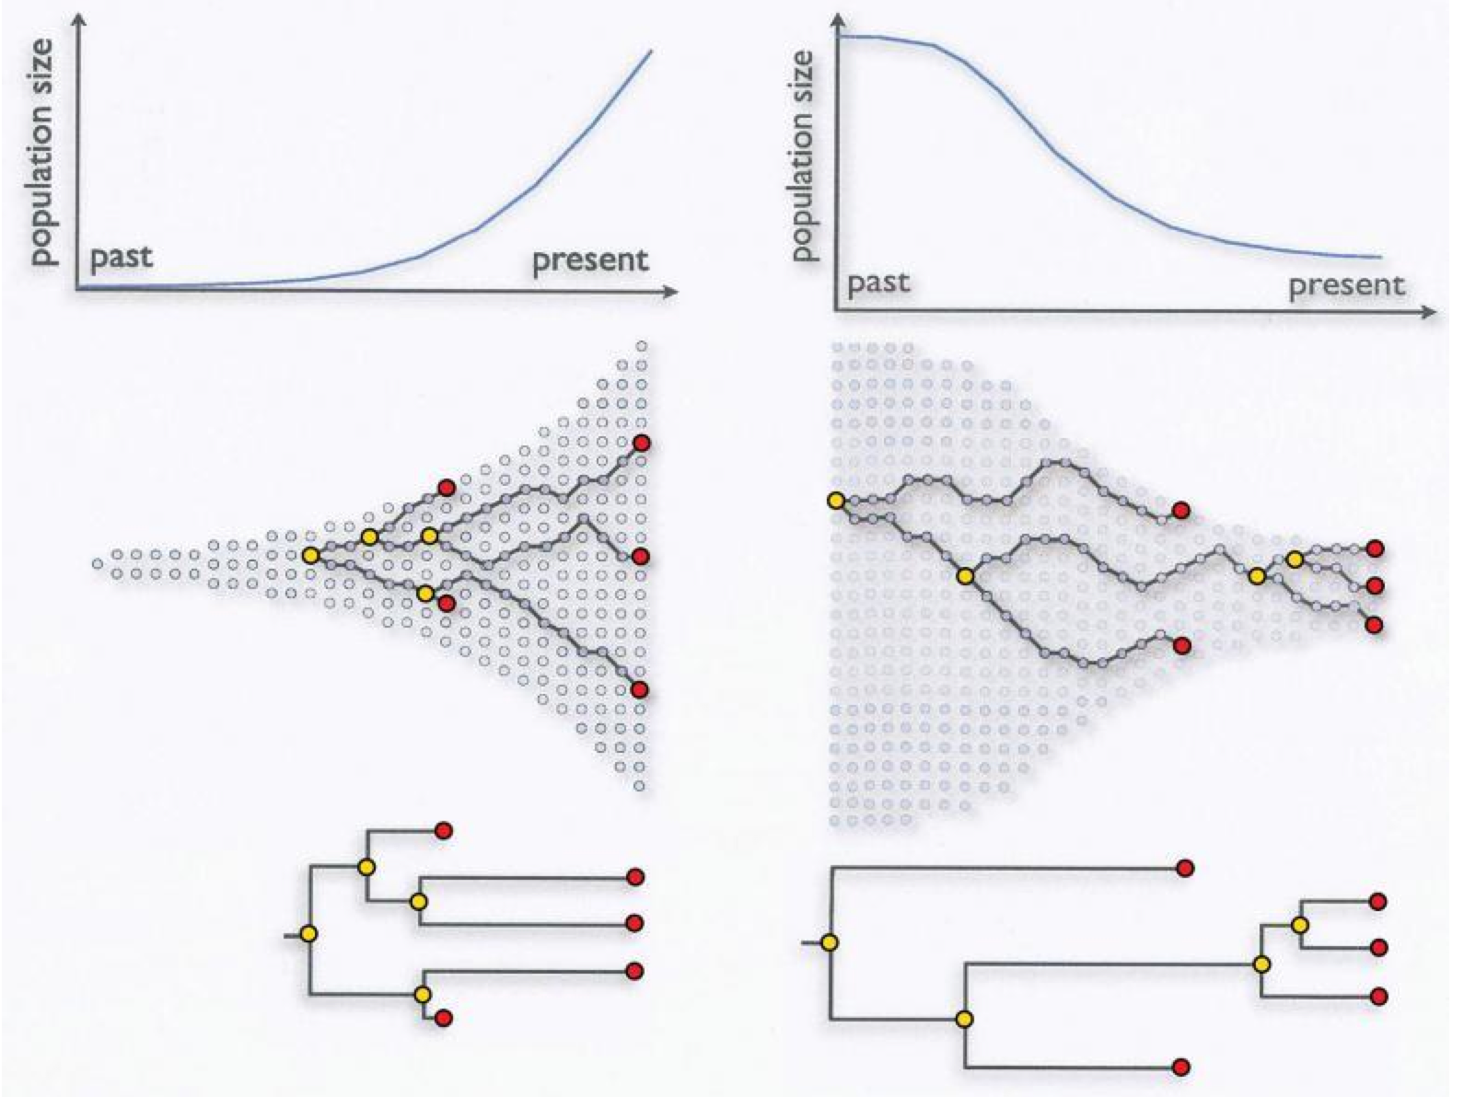
Population growth

Slide 21
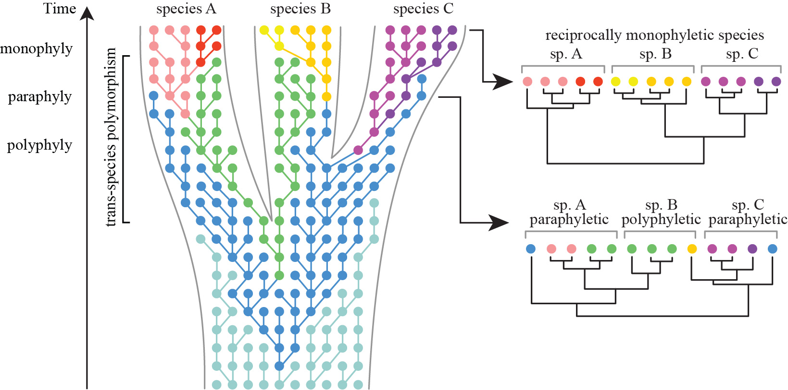
Species delimitation

Slide 22
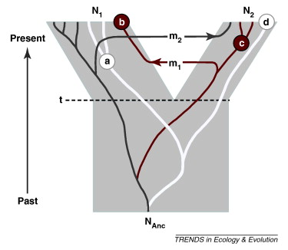
Migration

Slide 23

Thank you!

