Slide 1
Population structure
jianglei

Slide 2
A population may have a lot of subpopulation – differences in genetic variation among its constituent parts.
low gene flow, genetic drift, selection, and mutation lead to genetic variation in subpopulation
Notes:
什么导致了亚群的产生呢？What caused the subpopulation.
由于不断的进化，变异和 环境共同作用的结果。It is due to the evolution.mutation and the environm
How can we know How many subpopulation among the population?
I will explain it later

Slide 3
Characteristic
The frequencies of different genetic variants (alleles) in each subpopulation.
The degree of genetic isolation of the sub populations.
Notes:
种群有什么特点呢？ What is the characteristic of the population?

Slide 4
Population structure
Stracture
PCA
Notes:
我会和你的这两种软件谈谈i will talk with yours this 2 kind of software

Slide 5
Notes:
我们可以得出他们之间的关系，但是我们不知道有多少亚群？个体是否是Heterozygote(杂合子），纯合子（Homozygote）

Slide 6
stracture
The program structure implements a model-based clustering method for inferring population structure using genotype data consisting of unlinked markers.
Population structure, assigning individuals to populations, identifying migrants and admixed individuals
Notes:
是基于模型聚类的方法，推断种群结构
If you want to study population stracture this individual Is belongto which subpopulation.

Slide 7
Structure is a calculation method based on the Bayesian model. For each K value simulation result, the maximum likelihood value (likelihood) is generated correspondingly.
Is to find a simulation result with the largest likelihood (larger and more reliable) and the smallest K value, which is close to the real situation

Slide 8
Data Format: microsatellites, SNPs and RFLPs
Rules to follow:
1,Hardy-Weinberg equilibrium: The frequency of each allele is stable in heredity, that is, the genetic balance is maintained.
① The population is large enough; ② Random mating between individuals in the population; ③ No mutation; ④ No selection; ⑤ No migration; ⑥ No genetic drift.
2, Each site is independent（We select a part of independent sites for analysis from all snp data.）
Notes:
RFLP标记是发展最早的DNA标记技术。RFLP是指基因型之间限制性片段长度的差异，这种差异是由限制性酶切位点上碱基的插入、缺失、重排或点突变所引起的。

Slide 9
What can we learn from it
1. The group should be divided into several subgroups;
2. The degree of gene communication between groups;
3. The degree of mixed blood of an individual.

Slide 10
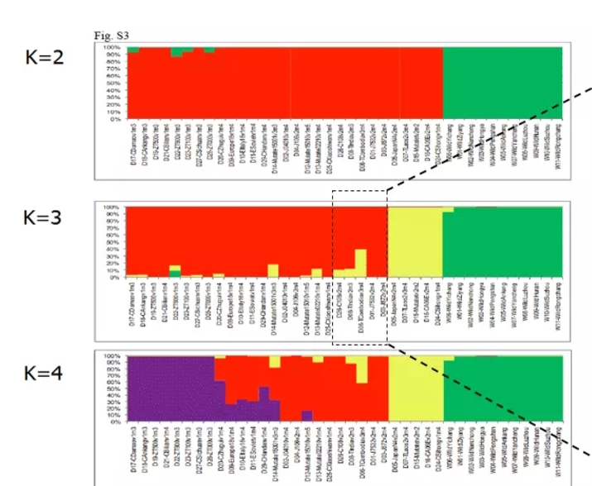
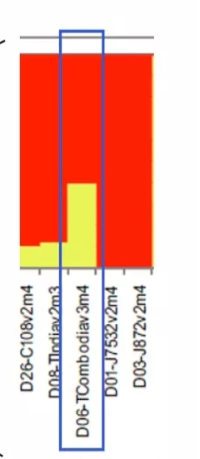
Notes:
The k is 2 means that there 2kind of subpopulation ,if the color of the individual is total red the individual is Homozygote
For example, the sample D06 in the enlarged image is taken as an example. The corresponding histogram pillar is composed of two colors, which are about 40% yellow and 60% red. This indicates that this individual is likely to cross from two ancestral subgroups, and the two ancestor subgroups accounted for 40% and 60% of the lineage, respectively.

Slide 11
How to find the best classification
It is the use of the computer‘s operating ability. At first, the computer just randomly divided the sample into two (k = 2), and then performed the Harwin equilibrium test in each subgroup. After calculating n times, the computer finds the best classification from results. The number of calculations involves a parameter Number of MCMC Reps（10000—100000）.
Before the calculation, a pre-experiment needs to be performed. The calculation is based on the optimal classification of the pre-experiment. The number of pre-experiments is another parameter of length of burn-in period（10000—100000）

Slide 12
burn-in period
Notes:
Pre experiment

Slide 13
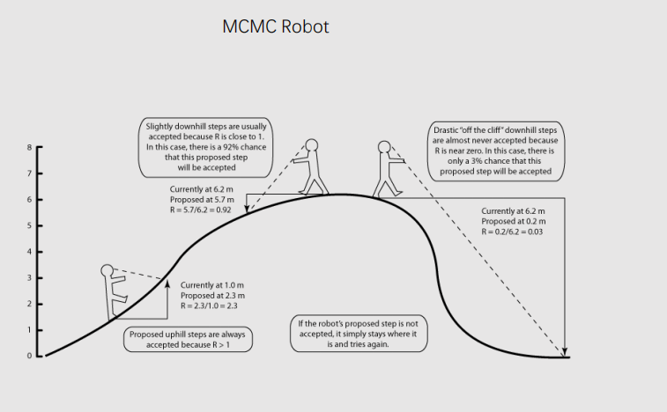
Number of MCMC Reps
Notes:
Next I will explain how the mcmc work .
We assume that k is the highest position， The robot will keep walking when he find the direction is right. We can get the k value through it.

Slide 14
steps
File -> new project -> name the project + select directory + choose data file -> number of individual (13) + ploidy of data (2) + number of loci (2444) + missing data value (-9) -> skip -> choose individual ID for each individual -> ProceedParameter set -> new -> length of burnin period (50000) + number of mcmc reps after burnin (500000) -> name parameterProject -> start a job -> set k from m to n (i.e. 2-4) + number of Iterations (3 or 5) -> startCompress the result and upload to Structure Harvester.File -> load structure results -> Browse (choose your result with the best value of K)-> Bar Plot -> show -> sort by Q -> save

Slide 15
download link: http://web.stanford.edu/group/pritchardlab/structure_software/release_versions/v2.3.4/html/structure.html.

Slide 16
PCA
PCA is a statistical procedure that uses an orthogonal transformation to convert a set of observations of possibly correlated variables into a set of values of linearly uncorrelated variables called principal components(from wikipedia)

Slide 17
the main purpose
There are many variables in the description of things. PCA is to delete duplicate variables and remove redundant variables, and integrate as few new variables as possible. These new variables are not related to each other. These new variables keep the original information as much as possible when reflecting things
Notes:
For example in, our daily life when we talk with other people , there is always noise. We need ignore it so that we can listen to some clear

Slide 18
Relationship between principal and new components
The number of principal components is less than the number of original variables
The principal components are not connected to each other
Each principal component is a linear combination of the original variables
Notes:
When we reduce the data from the k dimension to the n dimension, it is obvious that n is less than the k, if not ,it is useless
Only in this way ,can we reduce more redundant data.

Slide 19
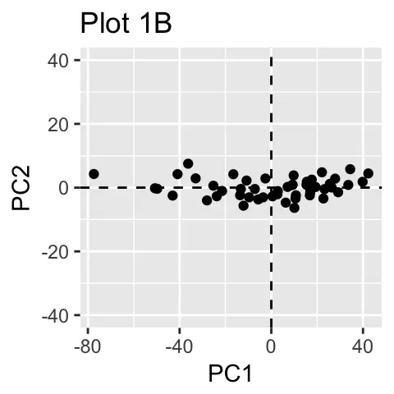
Reduce dimension
Notes:
这是一个例子，有一些点（dot）散乱的分布（distributed）在在坐标轴（Axis）中，然后我们假设PC1,PC2为新的坐标轴.
然后我们就得到了后面的这幅图。

Slide 20
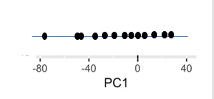
Notes:
这里我们怎么确定所谓的PC1这个坐标轴呢？Where should we put the pc1 axis,
这时候就需要通过计算了，计算机会不断的进行模拟找到一个值，这个值代表的就是当所有的点投射到PC1后，信息保留最佳的时候。We can get a value through computing.and This value represents when all dots are projected to PC1 and the information retention is the best. 然后把所有的点投射到PC1上 then we project all the dots to PC1 axis.and we get the pc1.

Slide 21
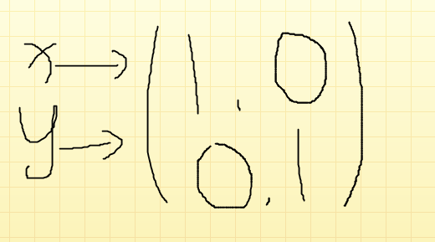
Vector (3,2) represent a vector which maped
in X vector is 3, in Y vector is 2.
Vector (3,2) is seen as
(3.2)=3*x+2*y
Notes:
X.Y is the base vector

Slide 22
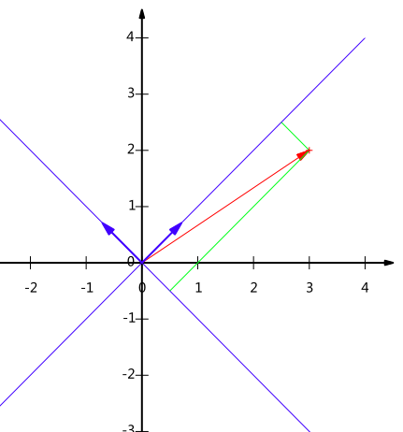
If we transfer （3，2）to a new
coordinate axis, we can use
Notes:
然后我们给这个点一个新的坐标We set a new coordinate for this number.然后我们就需要一个新的基向量we need a new base vector .现在尽管两个数不同，但是代表同一个点，though the number is different but they represent the same dot.

Slide 23
If we have three vector (1,1), (2,2),(3,3),
transfer them to the new coordinate axis
Notes:
我们通过找一个合适的基向量就可以把这个二维的数据转变成一维的。We can transfer the 3 dimensional axis into 2 dimensional axis through the base vector.

Slide 24
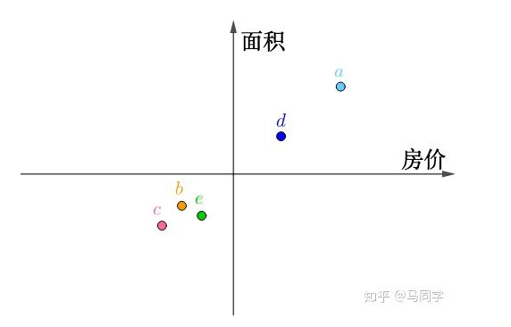
Notes:
Now ,I will introduce a realistic Example. All the numbers subtract the average.然后我们在坐标轴上画出来，then we draw these dots in the axis.

Slide 25
Notes:
我们以其中的一个数字为例。 we use a as our example
We can see that the distance from point a to the origin is constant. When more is allocated to the x-axis, the y-axis must be less, when the a overlap with the x axis ，the information will not be lost after reducing the dimension.

Slide 26
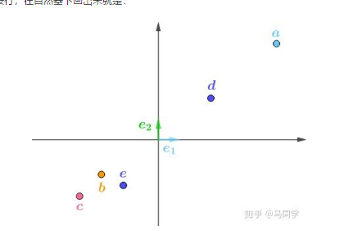
Notes:
When the data increases, we find that in extreme cases, it will inevitably lead to the loss of information, so we need to find an optimal solution that contains all the samples at the same time.

Slide 27
According to the above we can get the new coordinate axis, and the basis vector。
Notes:
Then calculate the basis vector based on the new coordinate axis（然后根据新的坐标轴算出基向量）

Slide 28
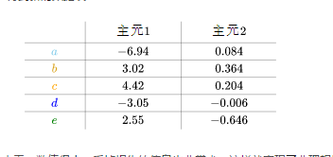
Notes:
From the new axes and basis vectors, we can get the coordinates of each point（根据新的坐标轴和基向量，我们可以得出每个点的坐标）Principal element 2 as a whole has a very small value and very little information is lost, thus achieving non-ideal dimensionality reduction（主元2整体来看，数值很小，丢掉损失的信息也非常少，这样就实现了非理想情况下的降维。）. A lot of linear algebra knowledge is used in PCA analysis. If you are interested, you can learn more（PCA分析中用了很多的线性代数知识，如果感兴趣，大家可以深入学习）。

Slide 29
Self-study site
https://www.bilibili.com/video/av54437544/
https://v.qq.com/x/page/h0515f9g8dk.html

