Slide 1
Skyline plot

Slide 2
Skyline plot
A method-of-moments estimate of a piecewise model
effective population size through time

Slide 3
The classic skyline plot
The generalized skyline plot

Slide 4
The classic skyline plot
the coalescent event time

Slide 5
The classic skyline plot
The waiting times between coalsecent events

Slide 6
The classic skyline plot

Slide 7
The classic skyline plot
The number of lineages
K= { }

Slide 8
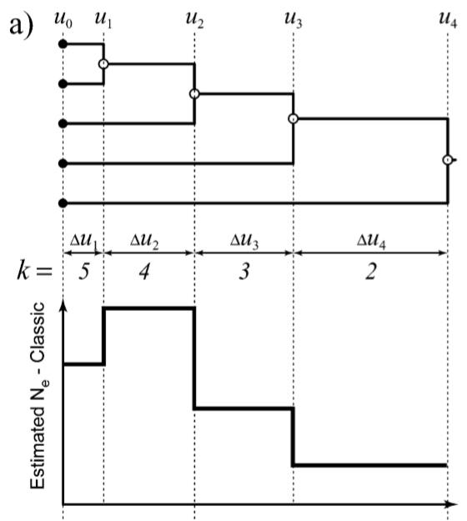

Slide 9
heterochronous genealogies have two types of intervals
Coalescent intervals
Sample intervals

Slide 10
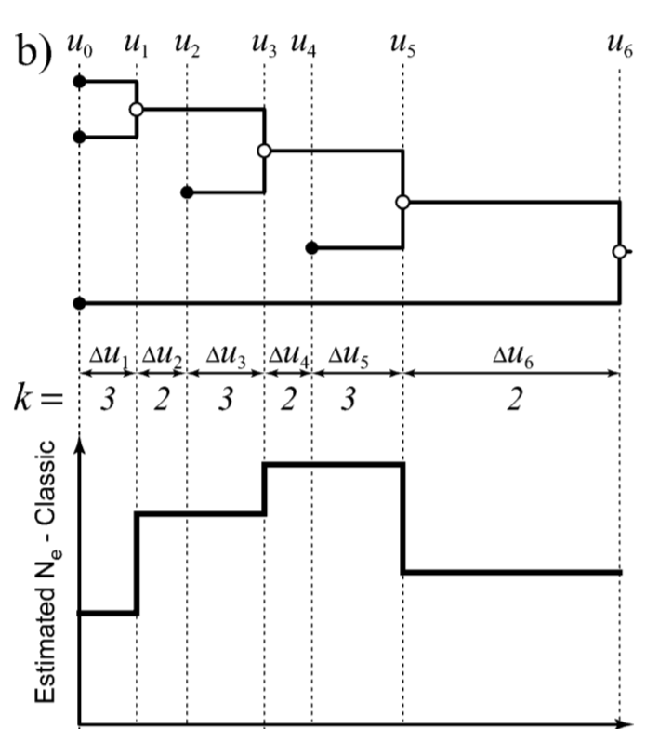

Slide 11
The generalized skyline plot
ordered subset of group sizes
the group times w

Slide 12
The generalized skyline plot

Slide 13
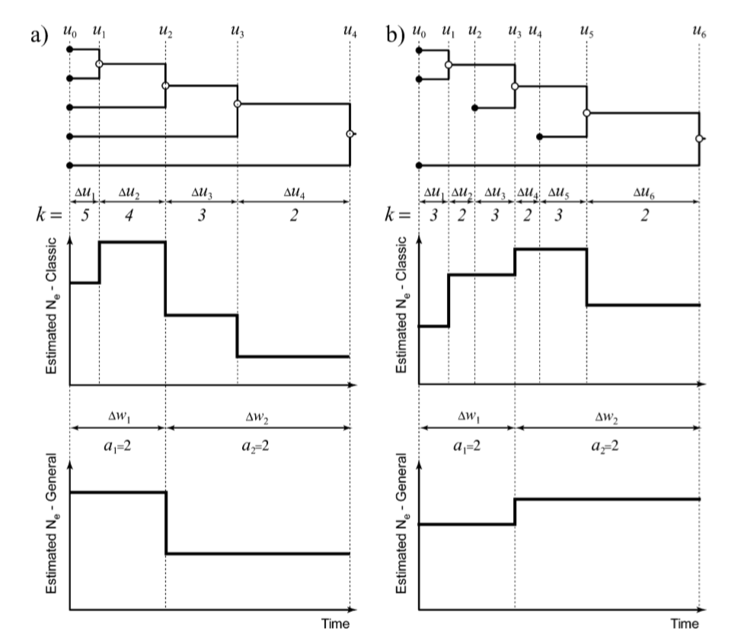

Slide 14
The skyline plot typically produces ‘‘noisy’’ plots that display the stochastic variability inherent in the coalescent process.
To reduce this noise, the ‘‘generalized skyline plot’’ was developed.

Slide 15
https://taming-the-beast.org/tutorials/Skyline-plots/Skyline-plots.pdf

Slide 16
Thanks

