Slide 1
Quantifying Natural Selection using Hyphy
Reporter : Chen Wenjun from LMSE,
Shanghai Ocean University, Shanghai, China

Slide 2
Natural Selection
Mutation, recombination and other processes introduce variation into genomes of organisms.
The fitness of an organism describes how well it can survive or grow in a given environment, or how well it can pass on its genetic material to future generations.
Any mutation can be
Neutral: no or little change in fitness
Deleterious: reduced fitness
Adaptive: increased fitness.
The same mutation can have different fitness costs in different environments (fitness landscape), and different genetic backgrounds (epistasis).
Notes:
Concepts which are related to natural selection. PPT . Base on these， what can be the unit of evolution?

Slide 3
Evolution of Coding Sequences
Proper unit of evolution is a triplet of nucleotides — a codon
Mutation happens at the DNA level
Selection happens at the protein level
Synonymous (protein sequence unchanged) and non-synonymous (protein sequence changed) substitutions are fundamentally different
Notes:
Codons have degeneracy

Slide 4
Measles, rinderpest, and peste-de-petite ruminant viruses' nucleoprotein

Slide 5
An antigenic site in H3N2 IAV hemagglutinin
Notes:
What can we learn from these substitutions?
Or in other words, how can they reflect to the natural selection during their evolution?

Slide 6
Molecular signatures of selection
Because synonymous substitutions do not alter the protein, we often posit that they are neutral.
The rate of accumulation of synonymous substitutions (dS) gives the neutral background.
We can compare the rate of accumulation of non-synonymous substitutions (dN), which alter the protein sequence, to classify the nature of the evolutionary process.
Notes:
efficiency

Slide 7
Evolutionary Modes

Slide 8
Consider two aligned homologous sequences
Can we claim that dN/dS = 1, because there is one synonymous and one non-synonymous substitution?
Notes:
I:Isoleucine T:threonine N:Asparagine

Slide 9
Universal genetic code
Substitution types | Synonymous |  |  | Non-synonymous |  |  | Stop codon
 | Transitions | Transversions | Total | Transitions | Transversions | Total | Total
1st position | 8 | 0 | 8 | 140 | 26 | 166 | 9
2nd position | 0 | 0 | 0 | 148 | 28 | 176 | 7
3rd position | 58 | 68 | 126 | 2 | 48 | 50 | 7
Total | 66 | 68 | 134 | 290 | 102 | 392 | 23
Approximately 3:1(392 N/ 134 S) ratio when mutations are generated and fixed at random
Non-random distribution over codon positions
All second position mutations are non-synonymous
Most synonymous mutations are confined to the third position

Slide 10
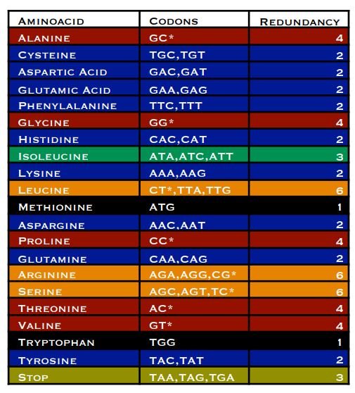
Computing synonymous and non-synonymous sites for GAA (Glutamic Acid)
8/3 non-synonymous sites(including 1/3 to a stop codon)
1/3 synonymous sites
Notes:
Such method was used in this model.

Slide 11
Nei-Gojobori dN/dS estimate (NG86)
For each codon C we define ES(C) and EN(C) - the numbers of synonymous and non-synonymous sites of a codon
e.g., ES(GAA) = 1/3, EN(GAA) = 8/3.
May also define them as fractions of substitutions that do not lead to stop codons,
e.g., ES(GAA) = 1/3, EN(GAA) = 7/3.
The sum of ES and EN over all codons in a sequence gives an estimate of expected synonymous and non-synonymous sites in a sequence.
For two sequences (the target of the original method), we average ES(C) and EN(C) at each site.
EN/ES is thus the expected ratio of non-synonymous to synonymous substitutions counts under neutral evolution.
Notes:
This is the first codon model that calculate the dN/dS ratio to reflect the natural selection.

Slide 12
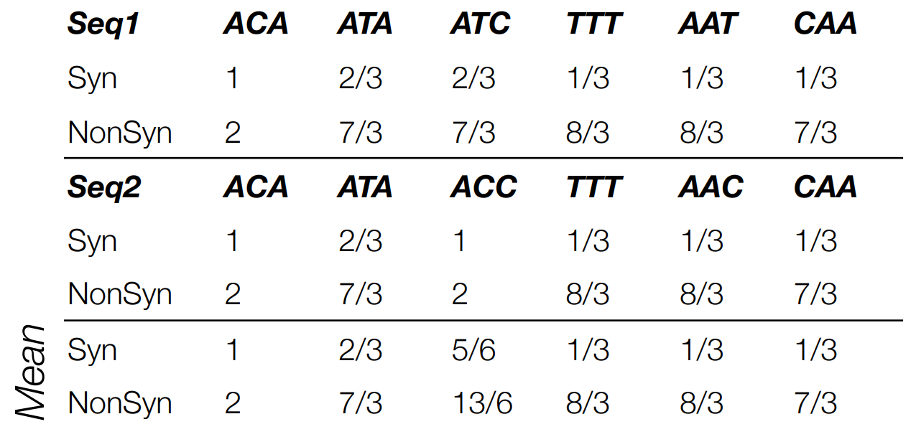
NG86 example
ES = 3½, EN = 14⅙: under neutrality, would expect the ratio of non-synonymous to synonymous substitutions of EN/ES ~ 4

Slide 13
NG86 example
The observed N/S ratio (1.0) is lower than the expected EN/ES ratio (4.05).
The ratio of the ratios (N:S)/(EN:ES) yields dN/dS=1/4.05~0.25.
This ratio quantifies the excess or paucity of non-synonymous substitutions and is near one for neutrally evolving sequences/sites.
Because there are fewer non-synonymous substitutions than expected, we conclude that most non-synonymous mutations are removed by natural selection, i.e., the sequences are under negative selection.

Slide 14
NG86 limitations: multiple substitutions
How many synonymous and how many non-synonymous substitutions does it take to replace CCA with CAG?
Assume the shortest path (minimum of 2 substitutions)
Option 1: CCA (Proline)⟹ CAA (Histidine) ⟹ CAG (Glutamine)
Option 2: CCA (Proline)⟹ CCG (Proline) ⟹ CAG (Glutamine).
Average over the paths: 0.5 synonymous and 1.5 non-synonymous substitutions.
Intuitively, paths should not be equiprobable, e.g., because it should be more expensive to route evolution through (presumably) suboptimal intermediate amino acids.

Slide 15
NG86 limitations: underestimation of substitution counts for higher divergence levels
Analogous to how p-distance underestimates true divergence due to multiple hits.
Simulated 100 replicates of 1000 nucleotide long sequences for various divergence levels (substitutions/site).
Plotted ‘true’ divergence vs that estimated by p-distance.
Even for divergence of 0.25 (1/4 sites have mutation on average), p-distance already significantly underestimates the true level: 0.2125 (0.19-0.241 95% range).
Underestimation becomes progressively worse for larger divergence levels.

Slide 16
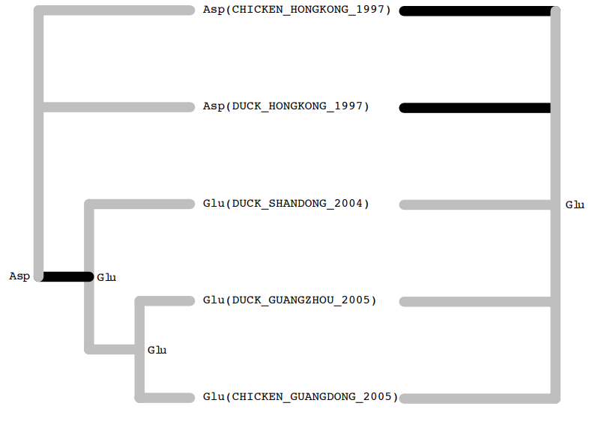
NG86 limitations: ignoring phylogenies
Effect of phylogeny on estimating synonymous and nonsynonymous substitution counts in a dataset of Influenza A/H5N1 haemagglutinin sequences. Using the maximum likelihood tree on the left, the observed variation can be parsimoniously explained with one nonsynonymous substitution along the darker branch, whereas the star tree on the right involves at least two.
Notes:
Glu: glutamic acid Asp: aspartic acid

Slide 17
NG86 limitations: averaging across all sites in a gene
Different sites in a gene will be subject to different selective forces
A gene-wide measure of selection is going to average these effects
Most sites in most genes will be maintained by purifying selection
Positively selected sites are of great biological interest, because they point to how a particular gene can respond to selective pressures
Negatively selected sites are also of interest, because they point to functional constraint, and could be used to guide drug or vaccine design
Must develop methods that are able to disentangle the contributions of individual sites
Notes:
Structure function. Weaken these differences

Slide 18
Codon-substitution models
In 1994, first tractable mechanistic evolutionary models for codon sequences were proposed by Muse and Gaut (MG94), and, independently, by Goldman and Yang (GY94) [in the same issue of MBE, back to back]
Markov models of codon substitution provide a powerful framework for estimating substitution rates from coding sequence data, as they
encode our mechanistic understanding of the evolutionary process,
enable one to compute phylogenetic likelihood,
permit Hypothesis testing or Bayesian inference,
systematically account for confounding processes (unequal base frequencies, nucleotide substitution biases, etc.),
afford many opportunities for extension and refinement (still happening today).

Slide 19
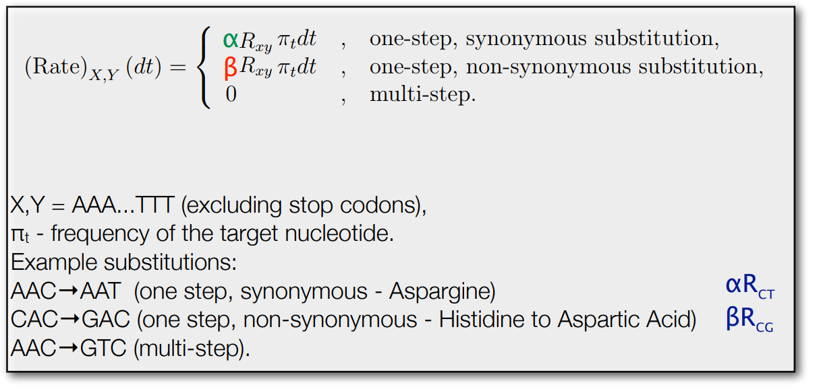
Rate matrix for an MG-style codon model
α (syn. rate) and β (non-syn. rate)
are the key quantities for all selection analyses

Slide 20
Computing the transition probabilities
In order to recover transition probabilities T(t) from the rate matrix Q, one computes the matrix exponential T(t) = exp (Qt, same as with standard nucleotide models, e.g. HKY85 or GTR)
Because the computational complexity of matrix exponentiation scales as the cube of the matrix dimension, codon based models require roughly (61/4)³ ≈ 3500 more operations than nucleotide models
This explains why codon probabilistic models were not introduced until the 1990s, even though they are straightforward extensions of 4x4 nucleotide models

Slide 21
Multiple substitutions
The model assumes that point mutations alter one nucleotide at a time, hence most of the instantaneous rates (3134/3761 or 84.2% in the case of the universal genetic code) are 0.
This restriction, however, does not mean that the model disallows any substitutions that involve multiple nucleotides (e.g., ACT⟹AGG).
Such substitutions must simply be realized via several single nucleotide steps, e.g. ACT⟹AGT⟹AGG
In fact the (i,j) element of T(t) = exp(Qt) sums the probabilities of all such possible pathways of duration t, including reversions

Slide 22
Alignment-wide estimates
Using standard Maximum Likelihood Estimate(MLE) approaches it is straightforward to obtain point estimates of dN/dS := β/α
Can also easily test whether or not dN/dS > 1, or < 1 using the likelihood ratio test (LRT)
Codon models also support the concepts of synonymous and nonsynonymous distances between sequences using standard properties of Markov processes (exponentially distributed waiting times)

Slide 23
PAML
(http://abacus.gene.ucl.ac.uk/software/paml.html)

Slide 24
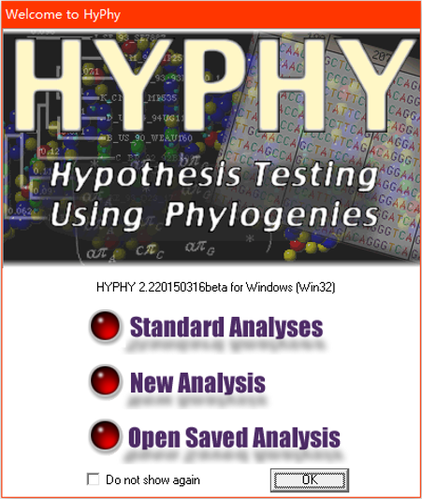
The Hyphy
The HyPhy system, available for download from www.hyphy.org, was designed to provide a unified platform for carrying out likelihood-based analyses on molecular evolutionary data sets, the emphasis of analyses being the molecular evolutionary process, that is, studies of rates and patterns of the evolution of molecular sequences.

Slide 25
Getting Started with HyPhy

Slide 26
Example1: MG94xHKY85 applied to HIV-1 Integrase gene
This data file contains the integrase gene of 6 Ugandan subtype D, 3 Kenyan subtype A and 2 subtype B (Bolivia and Argentina) HIV-1 sequences

Slide 27
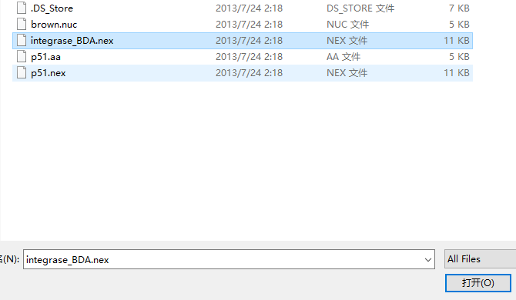
Example1: MG94xHKY85 applied to HIV-1 Integrase gene
Choose the file and open it.

Slide 28
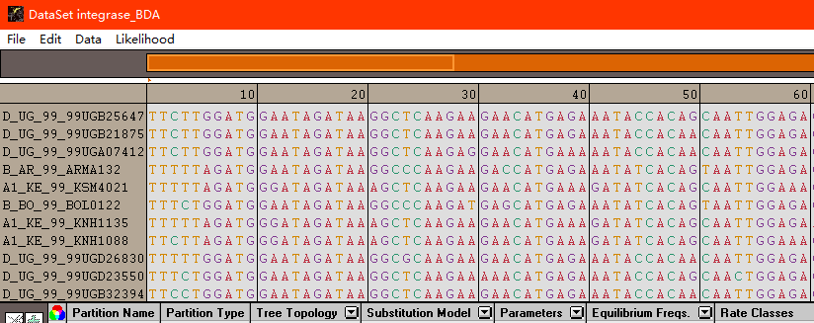
Example1: MG94xHKY85 applied to HIV-1 Integrase gene
HyPhy data panel(Windows)

Slide 29
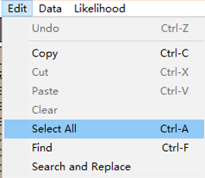
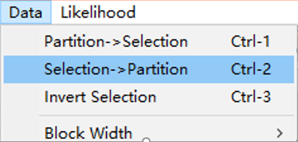
Example1: MG94xHKY85 applied to HIV-1 Integrase gene
Define a data filter
Select all sites in the alignment by using the Edit: Select All menu command.
Create a new partition by choosing Data: Selection → Partition

Slide 30
Example1: MG94xHKY85 applied to HIV-1 Integrase gene
The program creates a data filter with all the sites selected in the sequence viewer, assigns a default name and color to the partition, updates the navigation bar and selects the newly created partition.

Slide 31
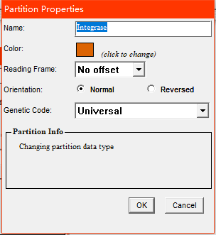
Example1: MG94xHKY85 applied to HIV-1 Integrase gene
Analysis Setup
Notes:
For the model, let us choose substitution matrix HKY85, with Global parameters (in this case meaning that there is a single transition transversion ratio κ for every branch in the tree) and equilibrium frequencies gathered from the partition, so that entries of the frequency vector π are simply the frequencies of characters observed in the data.

Slide 32
Example1: MG94xHKY85 applied to HIV-1 Integrase gene
Once all the necessary analysis components have been successfully assigned to at least one data partition, the status light in the bottom left corner of the window will change from red to yellow, indicating that we are now ready to create a likelihood function

Slide 33
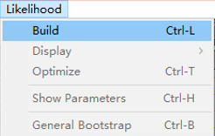
Example1: MG94xHKY85 applied to HIV-1 Integrase gene
Build the Likelihood Function.

Slide 34
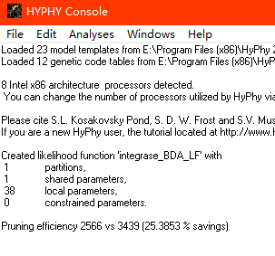
Example1: MG94xHKY85 applied to HIV-1 Integrase gene
Note that 38 local parameters (α and β for each of the 19 branches) and 1 global parameter (transversion/transition ratio) have been created.

Slide 35
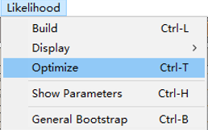
Example1: MG94xHKY85 applied to HIV-1 Integrase gene
Optimize the likelihood function

Slide 36
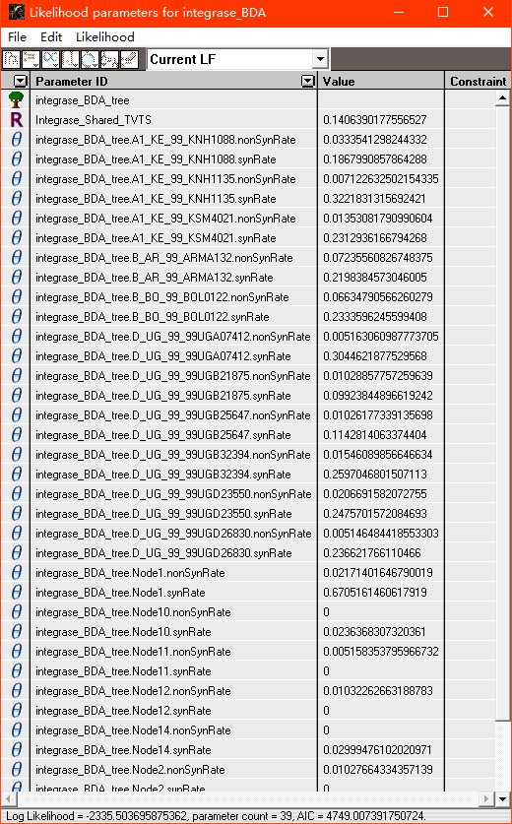
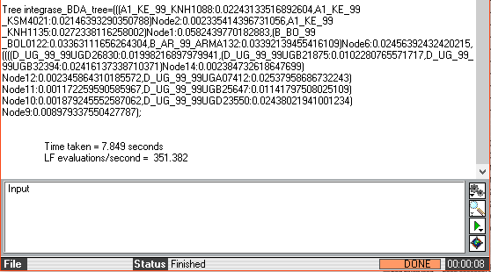
Example1: MG94xHKY85 applied to HIV-1 Integrase gene

Slide 37
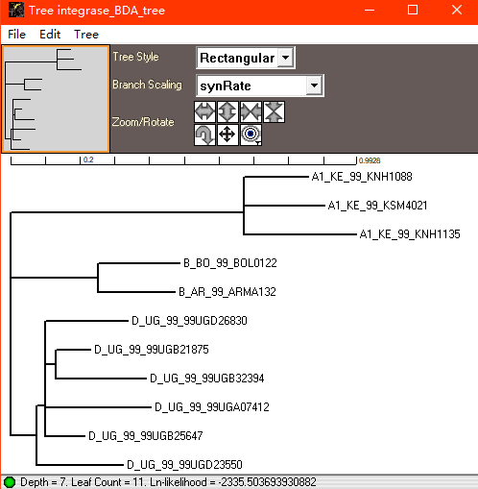
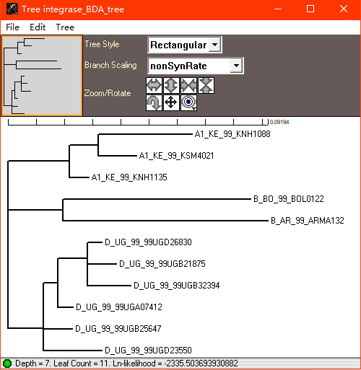
Example1: MG94xHKY85 applied to HIV-1 Integrase gene
Open two tree displays, and scale one on synonymous rates and the other on nonsynonymous rates. Notice the radical differences between the trees, both in lengths and shapes.

Slide 38
Example2: Spatial Rate Heterogeneity: Selective Pressure and Functional Constraints
In this example we allow both synonymous and nonsynonymous rates to be variable across sites, leading to the possibility, for instance, that a particular site might have a fast non-synonymous rate but a slow synonymous rate. We will consider the case of MG94xHKY85 applied to a codon data set with αs and βs sampled independently from two separate distributions. Because only products of evolutionary rates and times can be estimated, we let the mean of the distribution of αs to be one. Widely used models of Nielsen and Yang (1998) assume that αs = 1 for every site s, thus our approach is a natural extension.

Slide 39
Example2: Spatial Rate Heterogeneity: Selective Pressure and Functional Constraints
1. Open the data file p51.nex.
2. Select all data, create a single partition, change its data type to codon and name to RT Gene.
3. Assign the tree, the model “MG94xHKY85x3 4x2 Rates” with “Rate Het.” model parameters and 4 (per parameter) rate categories. The model we selected implements the extension to the MGx94xHKY85 model.
4. Build the likelihood function and optimize it.

Slide 40
Example2: Spatial Rate Heterogeneity: Selective Pressure and Functional Constraints

Slide 41
Prepackaged analyses

Slide 42
Choose best practices

Slide 43
Visit Datamonkey
http://test.datamonkey.org/

Slide 44
Thanks！

