Slide 1
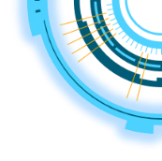
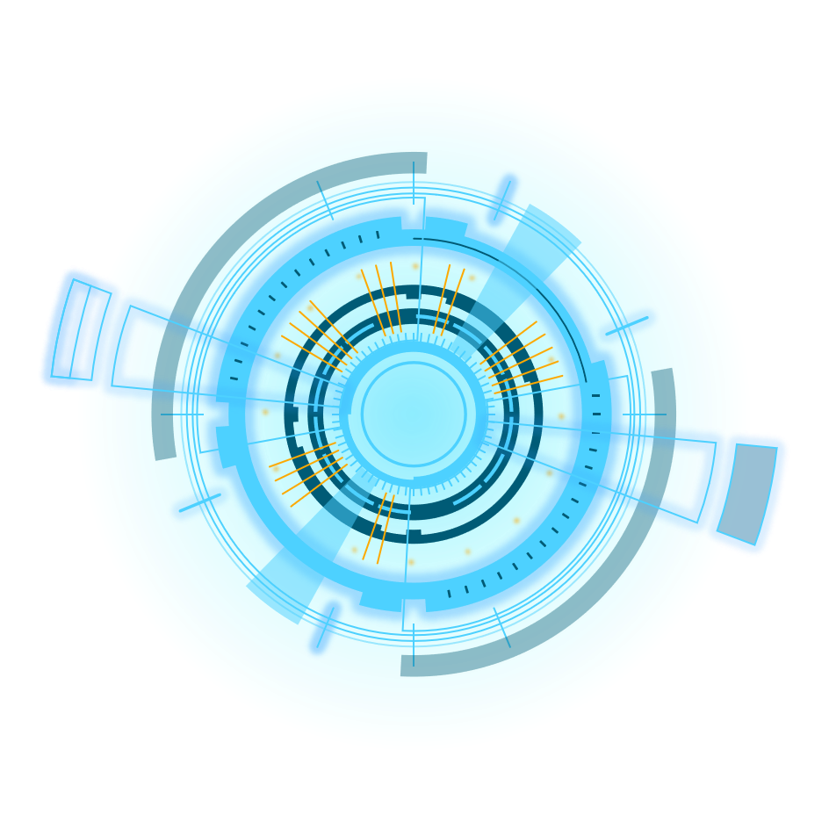
Repeat Elements
RepeatModeler & RepeatMasker
LTR_FINDER
2020 workshop
Presenter:Yingyi Yang

Slide 2
Content
Repeat Element
Repeatmodeler
Repeatmasker
LTR-FINDER

Slide 3
Repeat Elements
01
What? Types? Diferences? Why

Slide 4
Repeat Elements
tandem repeats 串联重复
Minisatellite
Satellite DNA
卫星DNA
Microsatellite
interspersed repeats散布重复
class-II：Transposons转座子
Transposable
elements（TEs）
转座元件
class-I：Retrotransposons反转座子

Slide 5
Repeat Elements
Minisatellite小卫星——10-60bp
单一型(pure)
ATATATATATATATATATAT
Microsatellite
微卫星
——2-10bp
复合型(compound)
ATATATCACACACACAC
间断型(interrupted)
ATATATCAATATATCAAT
Simple Sequence Repeat(SSR)简单重复序列Short tandem repeat（STR）简单串联序列

Slide 6
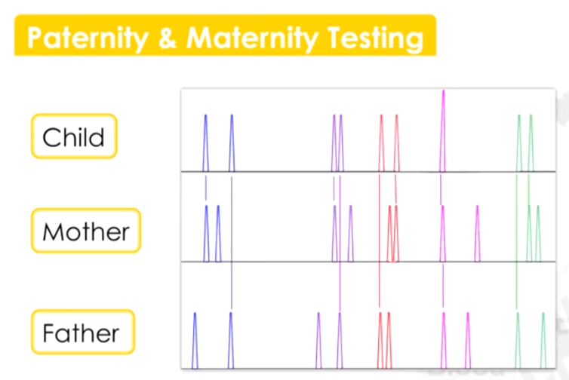
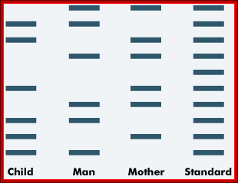
PCR primer/Breeding/paternity testing/individual identification
restriction enzyme
gel electrophoresis

Slide 7
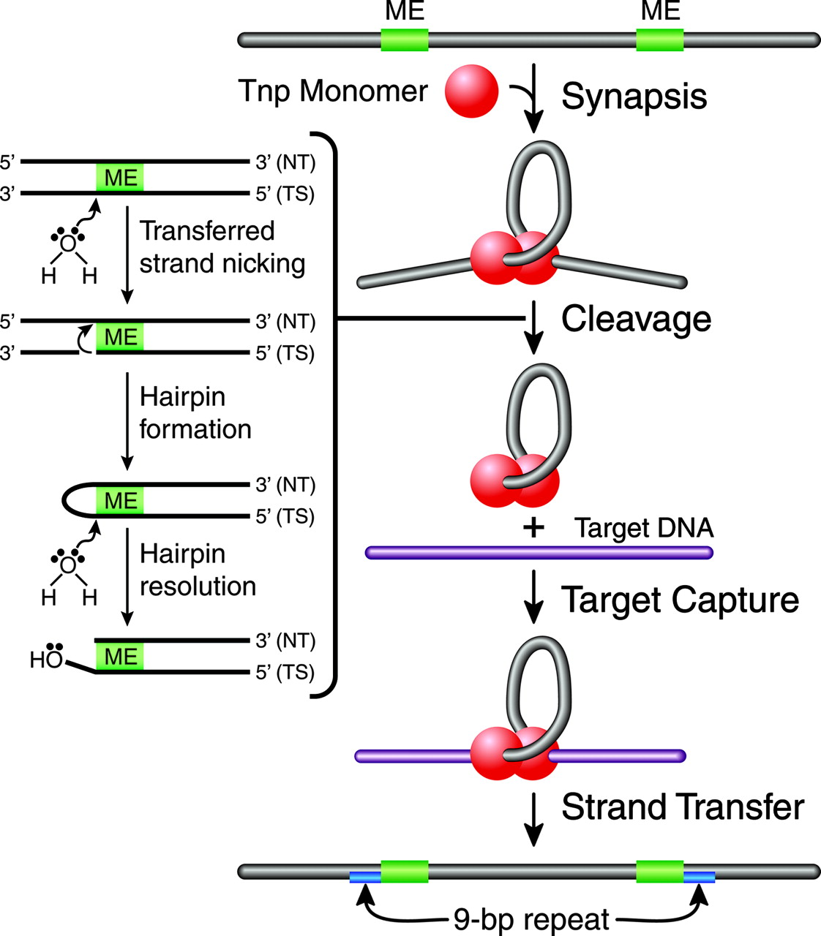
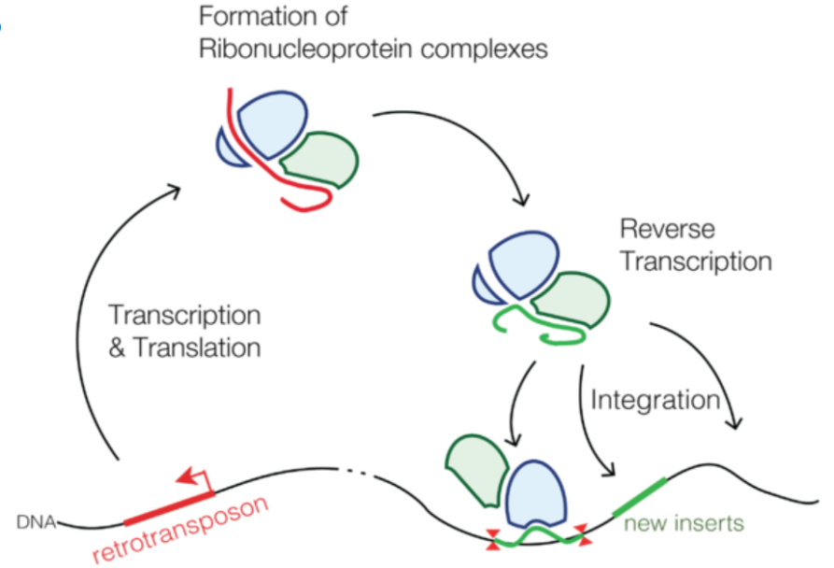
Transposable elements
Transposons
encode the protein transposase
——cut and paste
RNA
transposase
LTR retrotransposons
Retrotransposon
cDNA
Non-LTR retrotransposons
function via reverse transcription
——copy and paste similar to retroviruses, such as HIV

Slide 8
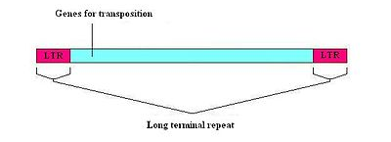
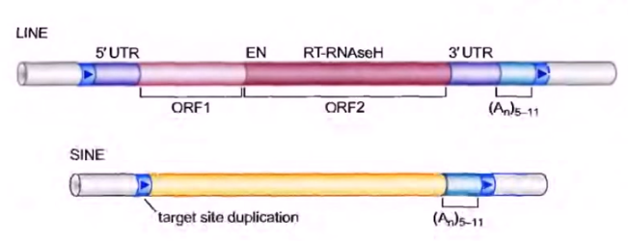
Retrotransposon
LTR —— Long terminal repeats
LTR retrotransposons
LINE
——Long INterspersed Elements
Non-LTR
SINE
——Short INterspersed Elements

Slide 9
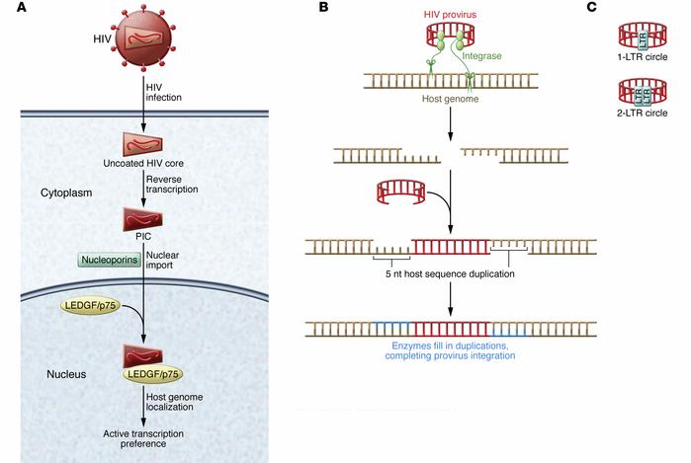
5,3-LTR，不编码蛋白质，但含有启动子，增强子等调控元件，病毒基因组内的LTR可转移到细胞原癌基因protooncogene邻近处，使这些原癌基因在LTR强启动子和增强子的作用下被激活，将正常细胞转化为癌细胞。
originated from virus?
parasitism
寄生
promoter
polyadenylation聚核苷酸化

Slide 10
Comparison
 | widespread | structure | function
LINE | eukaryotes | longer 2 * ORF 2 * UTR | autonomous retroelements， enlarge the genome | lack LTR, most are inactive, "junk DNA"
SINE | eukaryotes | shorter | non-autonomous retrotransposons.
untranslated region (UTR) that includes an RNA polymerase II promoter
5' UTR contains the promoter sequence,
3' UTR contains a polyadenylation signal (AATAAA) and a poly-A tail
ORF - open reading frame
RNA binding protein
endonuclease/reverse transcriptase
ORF——open reading frame

Slide 11
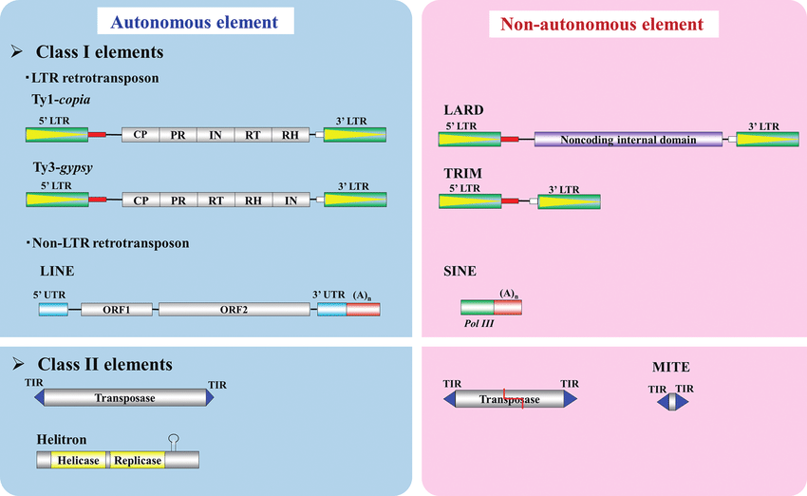
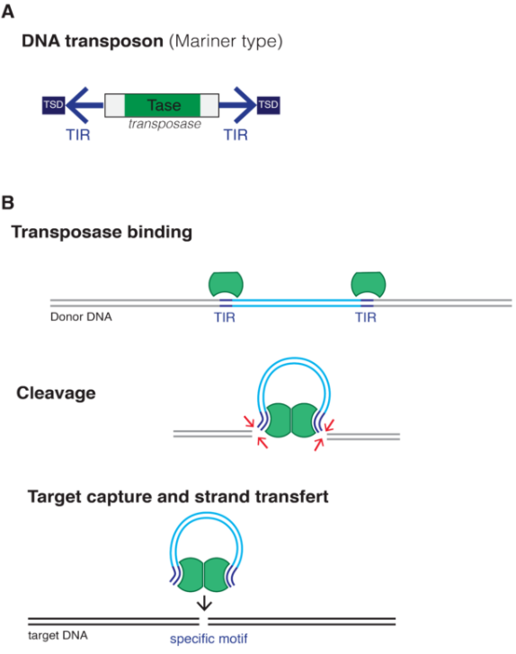
is the mainly responsible for
genome enlargement
TIR: terminal inverted repeat.
反向重复序列
Because of accumulated mutations, most retrotransposons are no longer able to retrotranspose

Slide 12
Repeat Elements
Minisatellite
Satellite
DNA
pure
Microsatellite（SSR、STR）
compound
interrupted
Transposons
HERV
Transposable
elements（TEs）
LTR
MER4
LINE1
Retrotransposon
retroposon
LINE
Non-LTR
LINE2
Alu
SINE
MIR

Slide 13
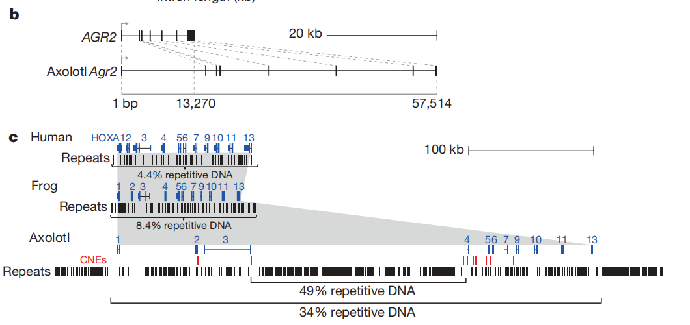
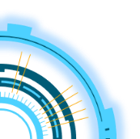
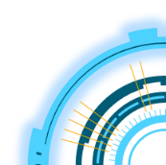
Why we analysis Repeat Elements ?
Transposable elements
abundant
induce mutations— functionalization
related to desease
Satellite DNA
reduce repeat frequency
Appendages regeneration
Human genome：
42% —— retrotransposons
2–3% —— transposons
镰刀型贫血
sickle cell anemia

Slide 14
Software
02

Slide 15
Software
RepeatModeler可用来从头对基因组的重复序列家族进行建模注释，它的核心组件是RECON和RepatScout。
RepeatModeler
ReapeatMasker
Algorithm:
nhmmer、cross_match、ABBlast/WUBlast、RMBlast 、Decypher
Library-based:
通过相似性比对来识别重复序列，可以屏蔽序列中转座子重复序列和低复杂度序列（默认将其替换成N）

Slide 16
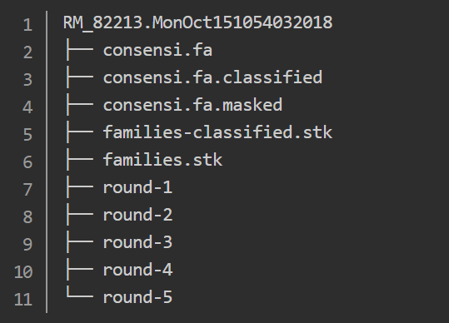
Usage
Install
Input
1
2
fasta
System:Cent OS https://www.centos.org
install:conda yum install conda
https://docs.conda.io/en/latest/miniconda.html
install:RepeatMasker,RepeatModeler
http://www.repeatmasker.org/RepeatModeler/
http://repeatmasker.org/
3
Process
RepeatModeler
Output
4
5
Input
6
Process
Result
fasta
n → 1 file
RepeatMasker

Slide 17
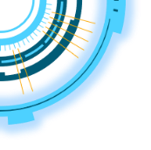

Slide 18
Software
LTR_FINDER
Select possible LTR pairs
trace through it upstream and downstreams as long as there‘re high similarity
find signals in near LTR region
gather informations

Slide 19
2020
Thanks
Repeat Elements

