Slide 1
SNP calling using GATK
Jiahui
Zheng

Slide 2

Content
1
GATK introduction
2
Preparation
3
Data Pre-processing
4
Joint calling

Slide 3
【 GATK introduction】

Slide 4

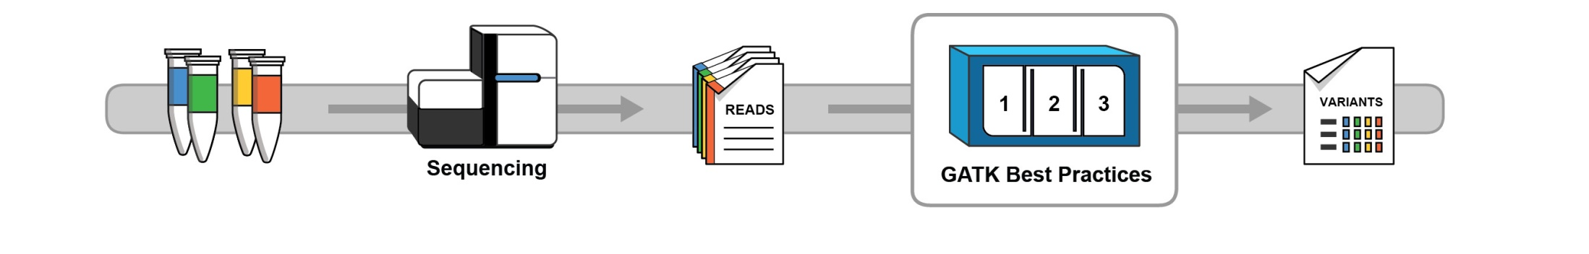
GATK:Genome Analysis ToolKit
Function:Analyze variation information of High-throughput sequencing data.
One of the most mainstream
SNP calling software.

Slide 5
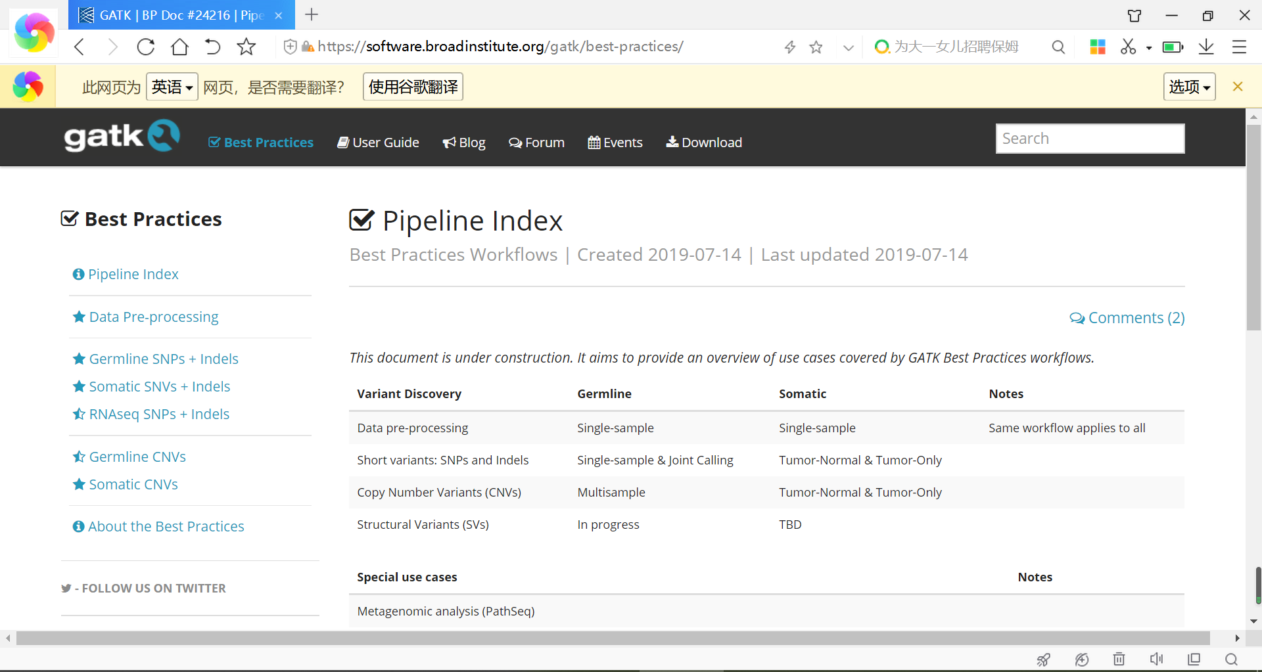

Slide 6
Germline SNPs + Indels
Germ cell mutation
Germline CNVs
For DNA sequence
Somatic SNVs + Indels
Somatic cell mutation
Somatic CNVs
For RNA sequence
RNAseq SNPs + Indels

Slide 7
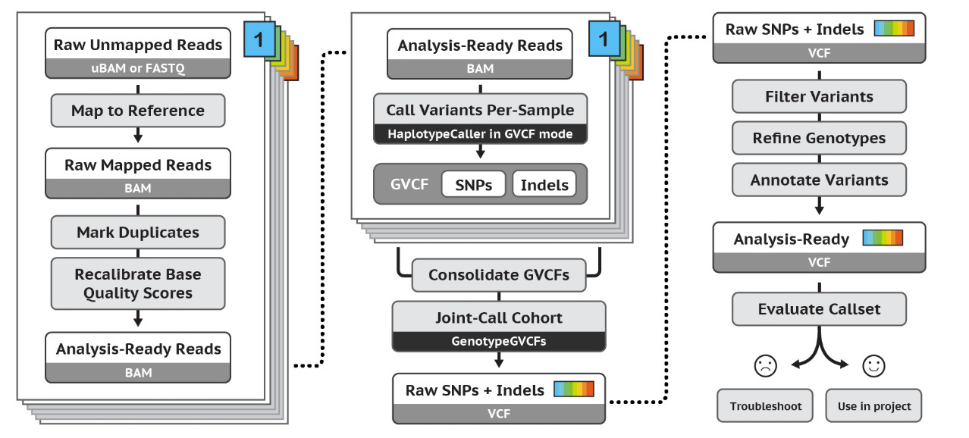
Best Practices for Germline SNPs + Indels

Slide 8
【 Preparation 】

Slide 9
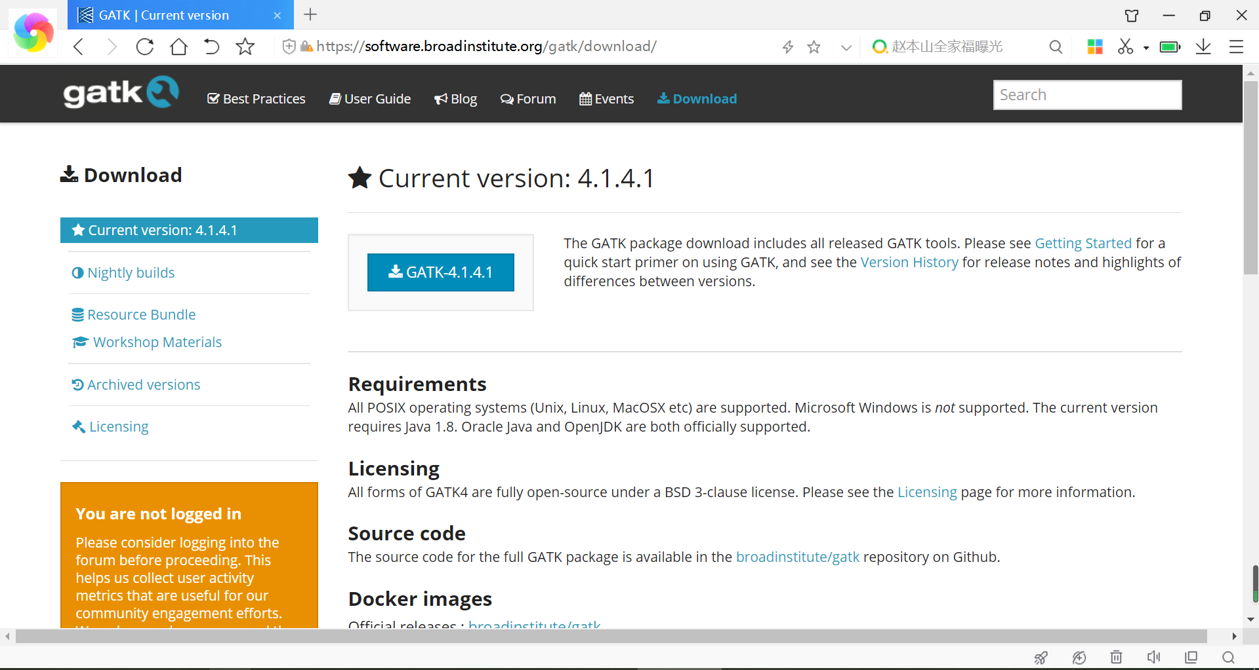
Download and Install:
https://software.broadinstitute.org/gatk/download/

Slide 10
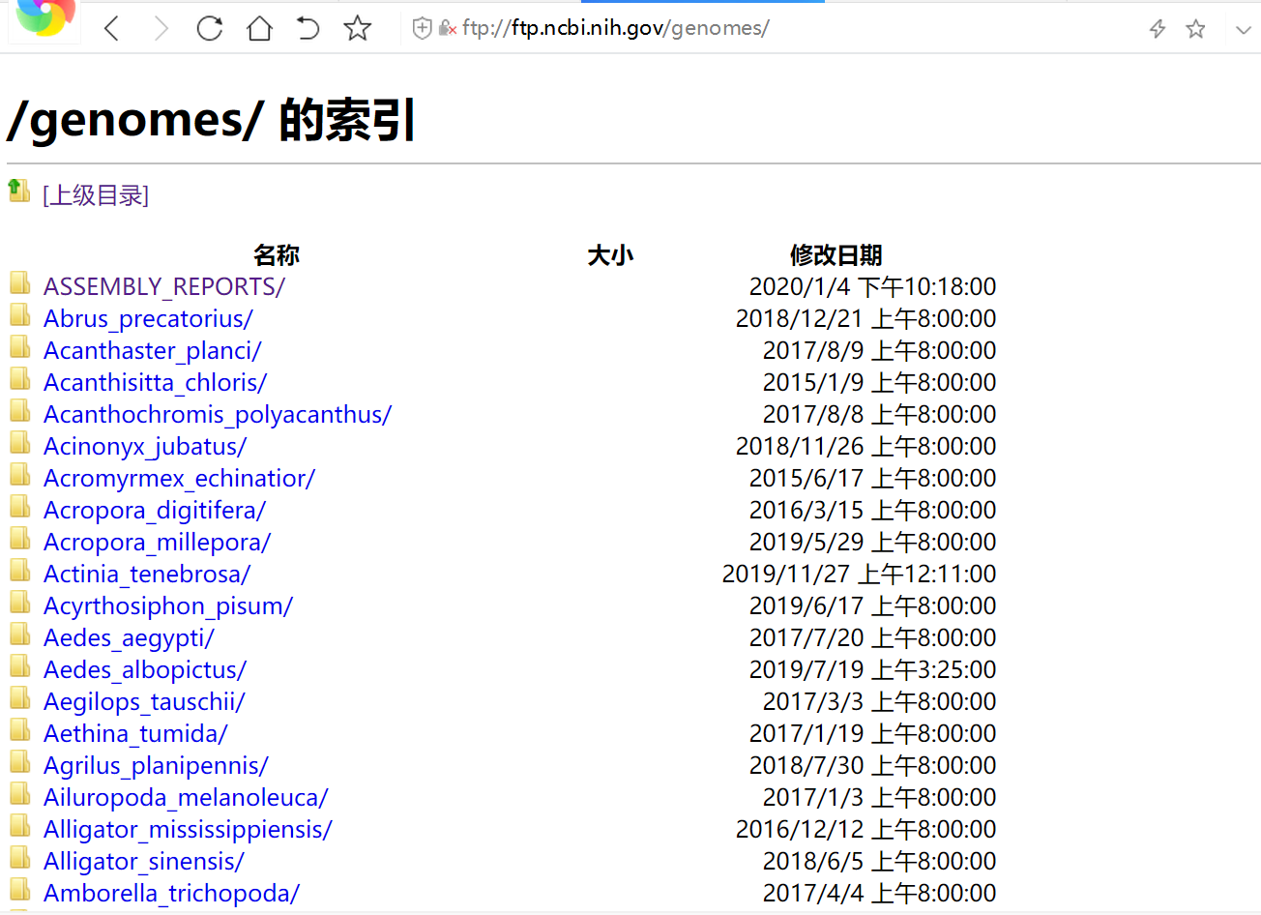
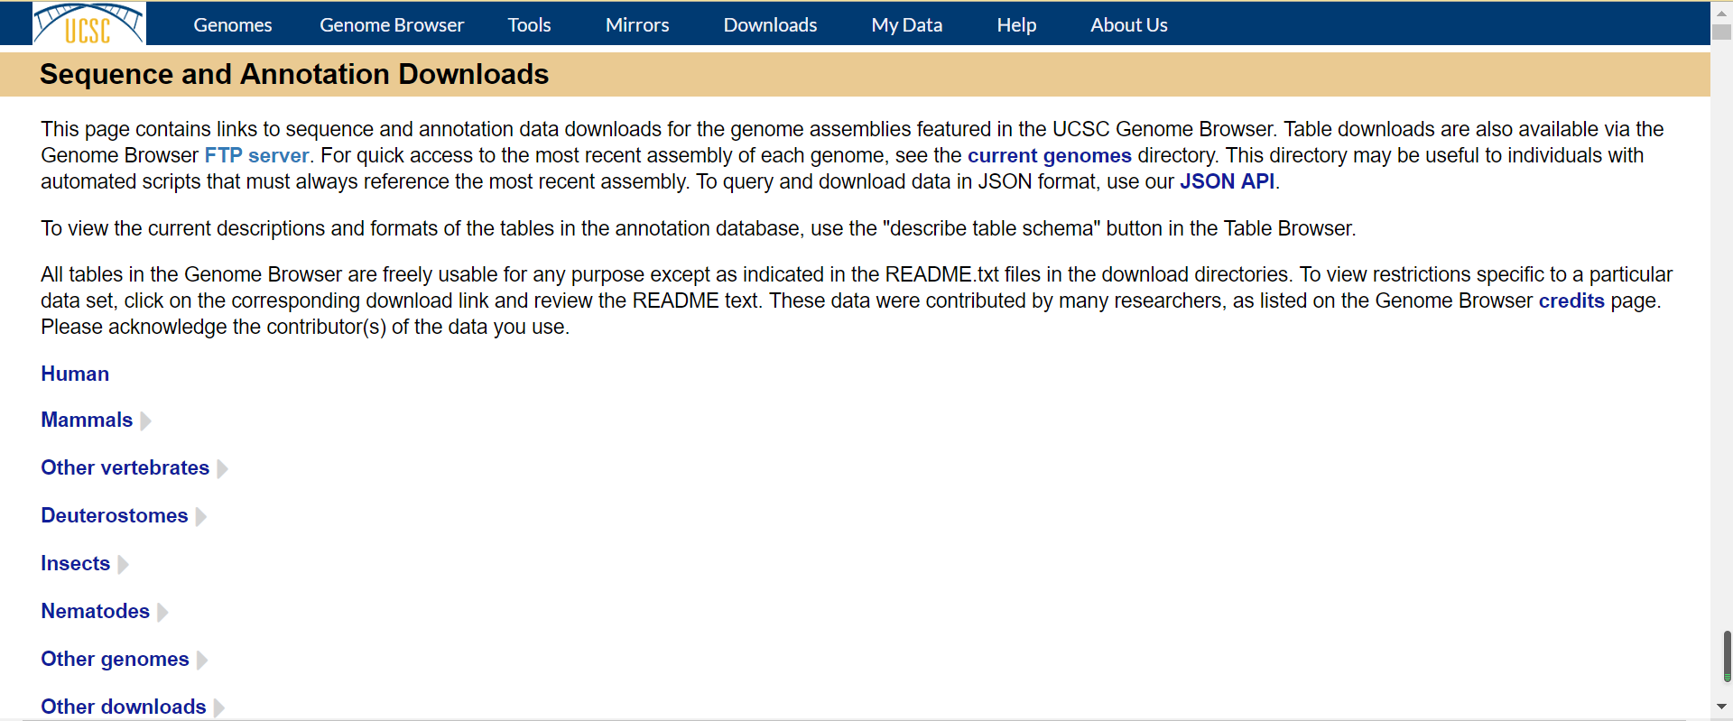
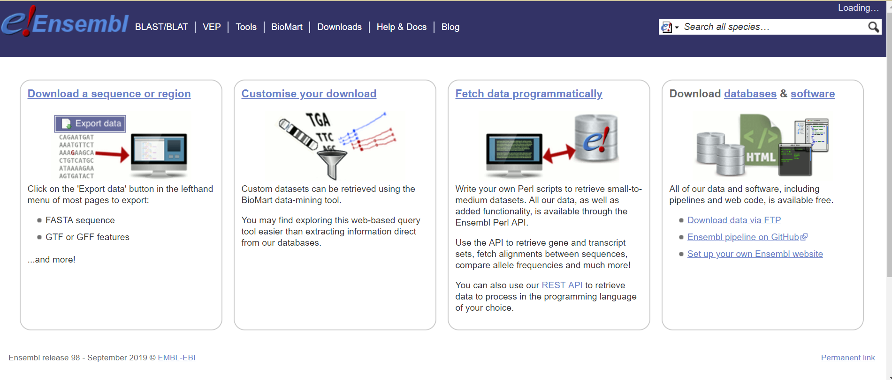
Access to Reference Genome:NCBI/ensembl/UCSC……

Slide 11
【 Data Pre-processing】

Slide 12
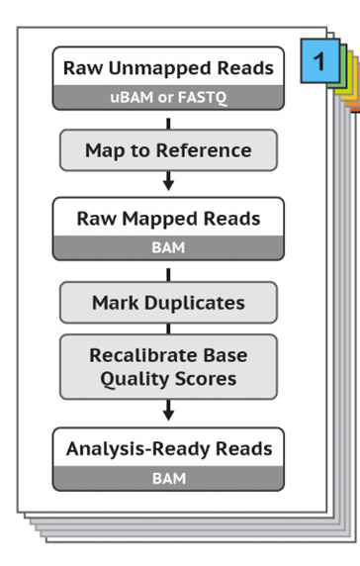
01 Map to reference
Purpose:
Pre-processing the raw sequence data (provided in FASTQ or uBAM format) to analysis-ready BAM files.
Make the data suitable for varient calling analysis.

Slide 13
01 Map to reference
1、Indexing reference:
$ bwa index -a bwtsw reference.fa
*Parameter-a：
①bwtsw ：>10M
②is ：<2G
Whether or not to specify the -a parameter is optional, and the bwa index automatically selects the appropriate indexing method based on the genome size
2、Generate the.dict file
$ gatk CreateSequenceDictionary-R reference.fa -O reference.dict

Slide 14
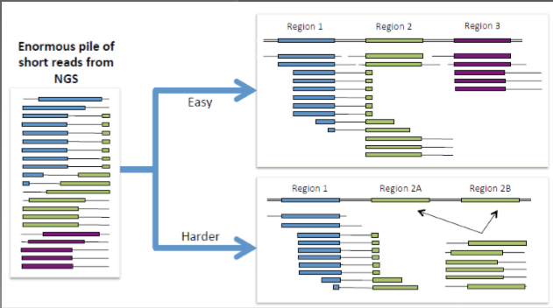
02 Mapping with BWA
Generate SAM file containing aligned reads
3、Sequence alignment:
$ bwa mem ref.fa sample_1.fq sample_2.fq -R '@RG\tID:sample\tLB:sample\tSM:sample\tPL:ILLUMINA' \
2>sample_map.log | samtools sort -@ 20 -O bam -o sample.sorted.bam 1>sample_sort.log 2>&1
is a generic nucleotide alignment format that sequencing reads to a reference sequence.

Slide 15


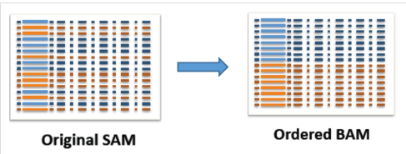
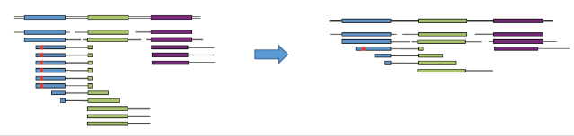
03 Mark duplicates
1
2
SortSam
Use Picard SortSam
Markduplicates
During the sequencing process, the same DNA molecules can be sequenced several times. The resulting duplicate reads are not informative.
The markduplicates identify these reads so that the GATK tools know they should ignore them.

Slide 16
03 Mark duplicates
Picard:
①SortSam:
$ gatk SortSam -I mapping/T.chr17.sam -O preprocess/T.chr17.sort.bam -R database/chr17.fa -SO coordinate --CREATE_INDEX
$ java -jar picard.jar SortSam \
I=input.bam \
O=sorted.bam \
SORT_ORDER=coordinate
②Markduplicates：
gatk MarkDuplicates -I preprocess/T.chr17.sort.bam -O preprocess/T.chr17.markdup.bam -M preprocess/T.chr17.metrics --CREATE_INDEX

Slide 17
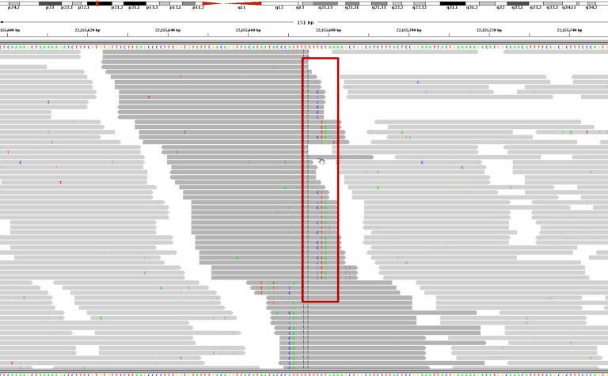
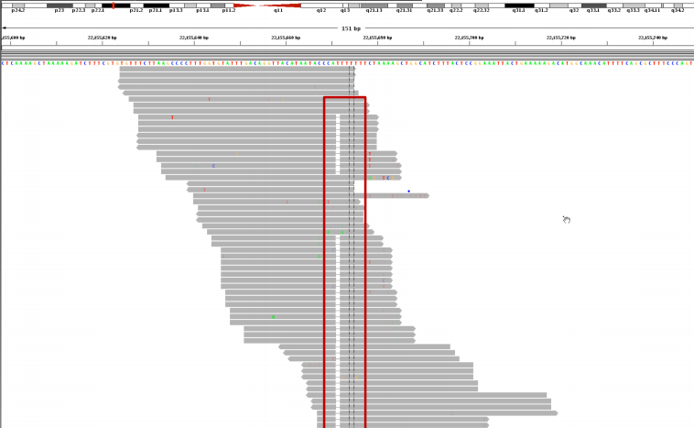
04 Local Realignment

Slide 18
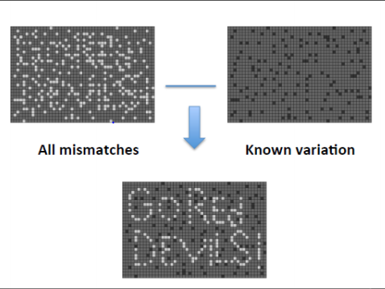
05 Base (Quality Score) Recalibration
2
1
Establish a model
Use existing SNP database to establish correlation model and generate recalibration table.
Quality Score Recalibration
Adjusting the original base group of the non-known SNP region based on this model.

Slide 19
【 Joint calling】

Slide 20



SNP calling policy selection
When you have multiple samples and then call SNP, you should separate all samples and merge them together after the call. Or do you just input all samples as and then call the SNP?
Question
Single sample calling
Batch calling
Joint calling
SNP calling Policy
Why?

Slide 21
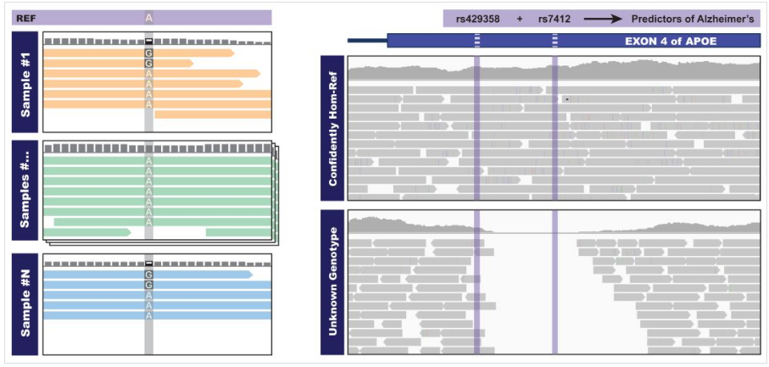

Slide 22
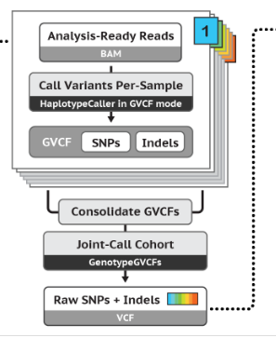
Joint calling
1、Call variants per-sample：
Separately generate the intermediate file -- gVCF file -- required for subsequent analysis for each sample
2、Consolidate GVCFs：
Merge multiple GVCF files to get GenomicsDB for joint genotyping
3、 Joint-Call Cohort

Slide 23

Thank you for your attention！
Notes:
In this slide there is a background placeholder. Click to the small icon on the center of the slide and choose an image from computer. When add an image, you must sent it to back with Right Click on Image -> Send to Back -> Send to Back.

