Slide 1
MEworkshop2020
Sequences vs SNPs
Reported by Kai Tan
Jan 7, 2020

Slide 2
Introduction to sequences
Introduction to SNPs
Contents
Differences between SNPs and Mutation
Analysis&Significance of SNPs

Slide 3
PART 01
Introduction to sequences

Slide 4
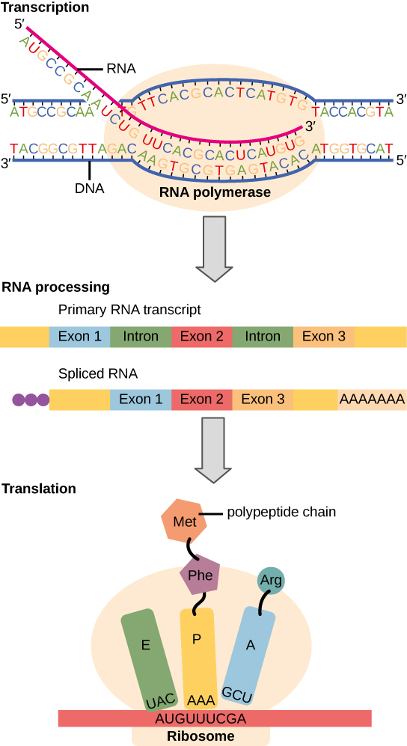
Introduction to sequences

Slide 5
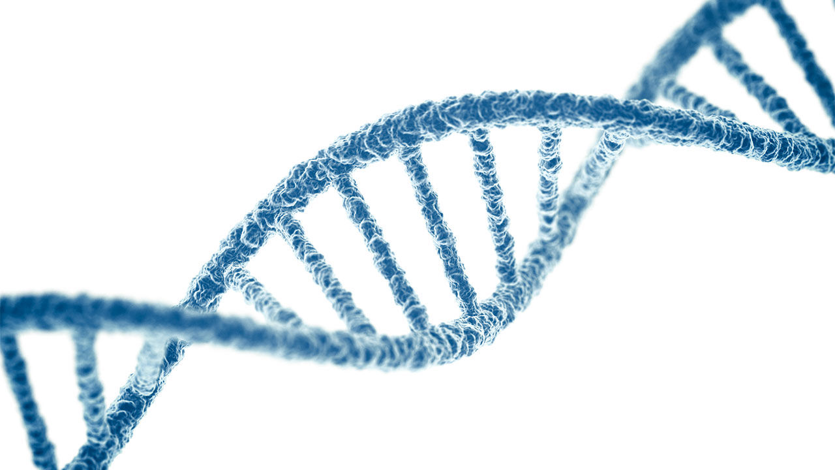
Introduction to sequences
DNA sequence
↓
Transcription
RNA sequence
↓
Translation
base
sequence
amino acid sequence

Slide 6
Introduction to sequences
cap
poly-A tail
Intrinsic features
of the sequence

Slide 7
PART 02
Introduction to SNPs

Slide 8
Introduction to SNPs
What is SNPs?
Oh, that's...
most common type of genetic variation
biological markers

Slide 9
Introduction to SNPs
S
Single
Nucleotide
N
P
Polymorphism

Slide 10
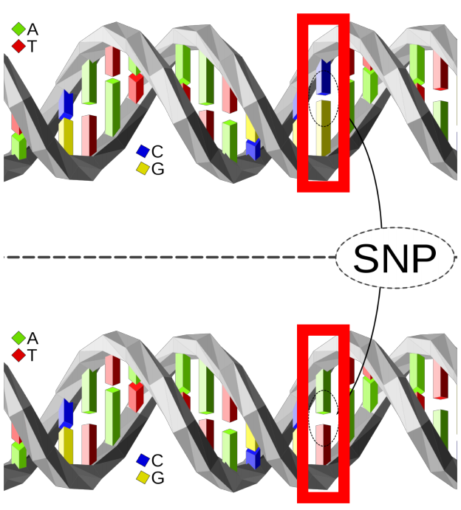
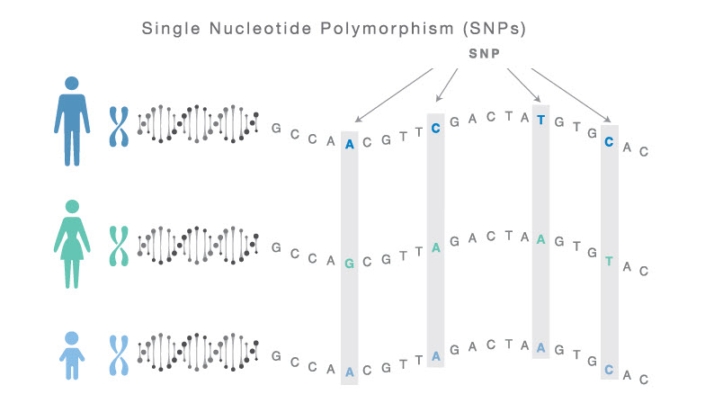
Introduction to SNPs
point mutation
dimorphism
the most common type of genetic variation among people
represent a difference in a single DNA building block
nucleotide cytosine (C) → nucleotide thymine (T)
a person’s DNA
frequency
unique / many individuals
100 million SNPs
found in the DNA between genes
biological markers

Slide 11
Introduction to SNPs
Types of SNPs
Non-coding region
Coding region
Intergenic region
Synonymous
Non-Synonymous
Missense
Nonsense

Slide 12
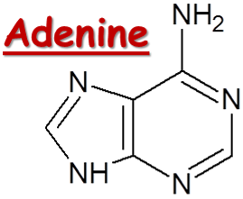
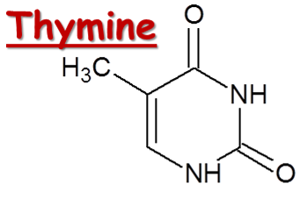
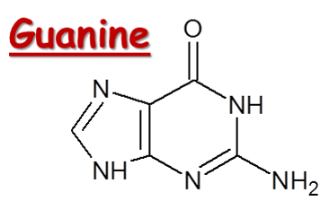
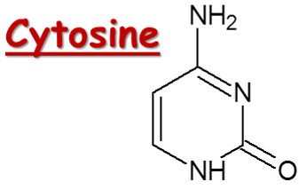
Introduction to SNPs
Four DNA bases
purine
pyrimidine
T——
C——
A——
G——

Slide 13
Introduction to SNPs
1.substitution
A
T
C
G
A
C
G
Transition：
pyrimidine(C/T) to pyrimidine(C/T)
or purine(A/G) to purine(A/G)
A
T
C
G
A
T
G

Slide 14
Introduction to SNPs
1.substitution
A
T
C
G
A
C
G
Transversion：
pyrimidine(C/T) to purine(A/G)
or purine(A/G) to pyrimidine(C/T)
A
T
C
G
A
A
G

Slide 15
Introduction to SNPs
2.deletion
A
T
C
G
A
C
G
a part of a sequence
of DNA is left out
A
T
C
G
A
G

Slide 16
Introduction to SNPs
3.insertion
A
T
C
G
A
C
G
the addition of one or more nucleotide base pairs into a DNA sequence
A
T
C
G
A
C
T
G

Slide 17
PART 03
Differences between SNPs and Mutation

Slide 18
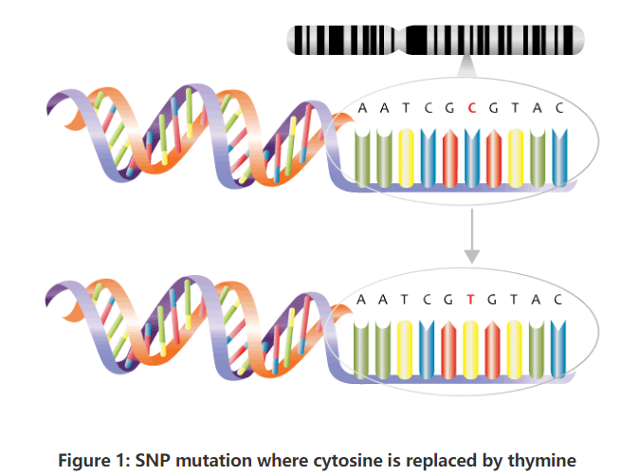
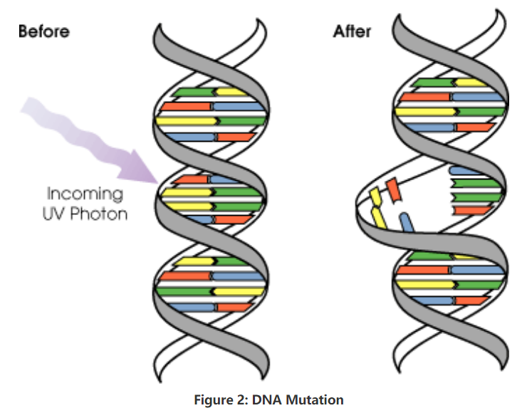
Diferences between SNPs and Mutation

Slide 19
Diferences between SNPs and Mutation

Slide 20
PART 04
Analysis&Significance of SNPs

Slide 21
Analysis of SNPs
SNPs Data
Genetic research
Function research
Genetic structure
Outlier locus detection
Power analysis
GWAS

Slide 22
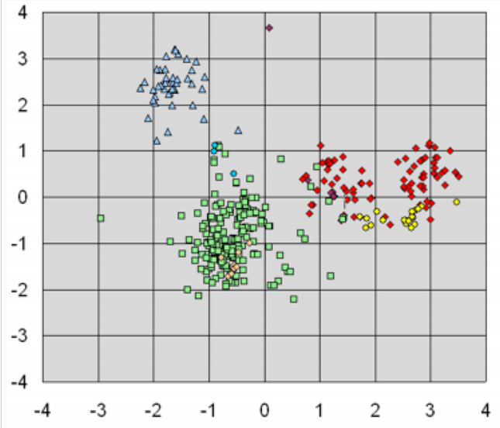
Analysis of SNPs: Genetic structure
Structure
PCA

Slide 23
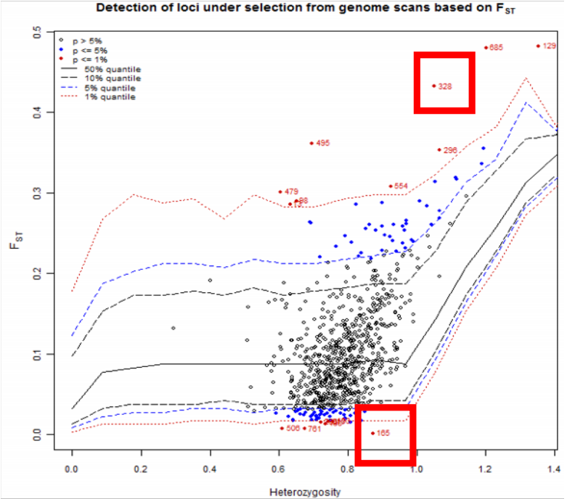
Analysis of SNPs: Outlier locus detection
FST | the genetic differentiation among populations
0～0.05 | very small
0.05～0.15 | moderate
0.15～0.25 | large
>0.25 | very large

Slide 24
Analysis of SNPs: Power analysis

Slide 25
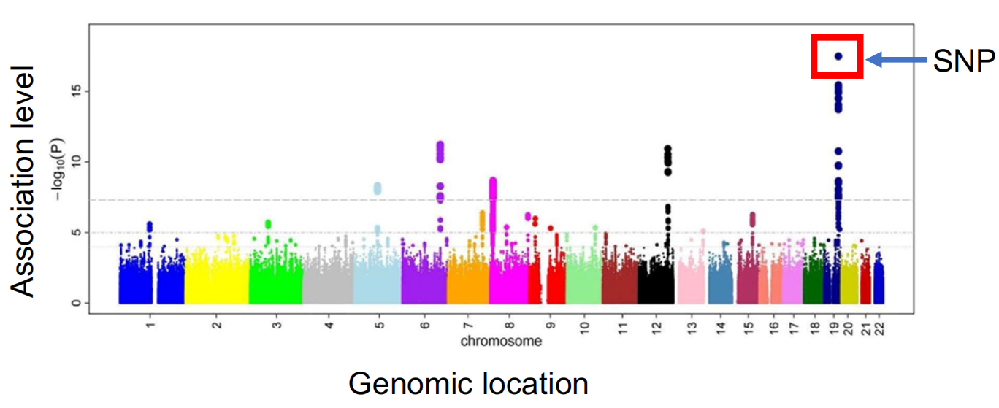
Analysis of SNPs: GWAS

Slide 26
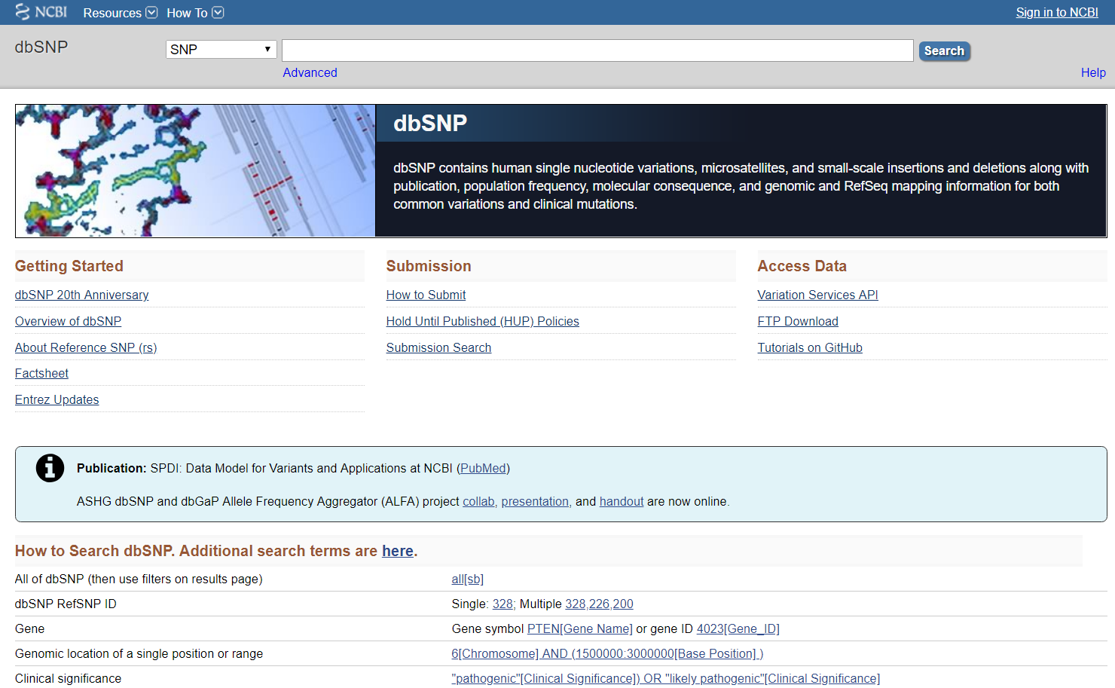
Analysis of SNPs

Slide 27
Significance of SNPs:
susceptibility to disease
personalized medicine
disease prevention
Human Genome Project
genetic relationship
forensic medical study

Slide 28
MEworkshop2020
Thank you for listening！
Reported by Kai Tan
Jan 7, 2020

