Slide 1
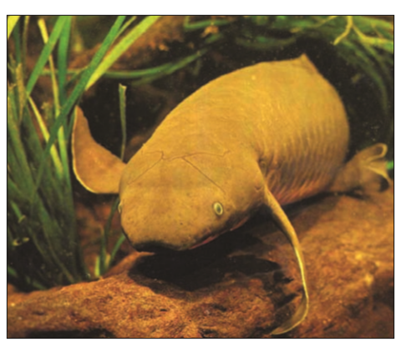
TIME CALIBRATION
Sang Longlong ＆ Liu Suhan

Slide 2
Restoring the history
Lungfishes number only six species in three families, but are an important group of vertebrates because of their relationship to tetrapods.
Phylogenetic analyses of morphology and molecular data agree that African lungfishes and South American Lungfish are closest relatives
And both families diverged from a common ancestor with Australian lungfish
Can we trace the branch time?

Slide 3
Study revealed that divergence of these families from Australian lungfish occurred 277 million years ago, the divergence of South American and African lungfishes was in the early Cretaceous,120 Ma, and was probably
Related to the breakup of Gondwanaland

Slide 4
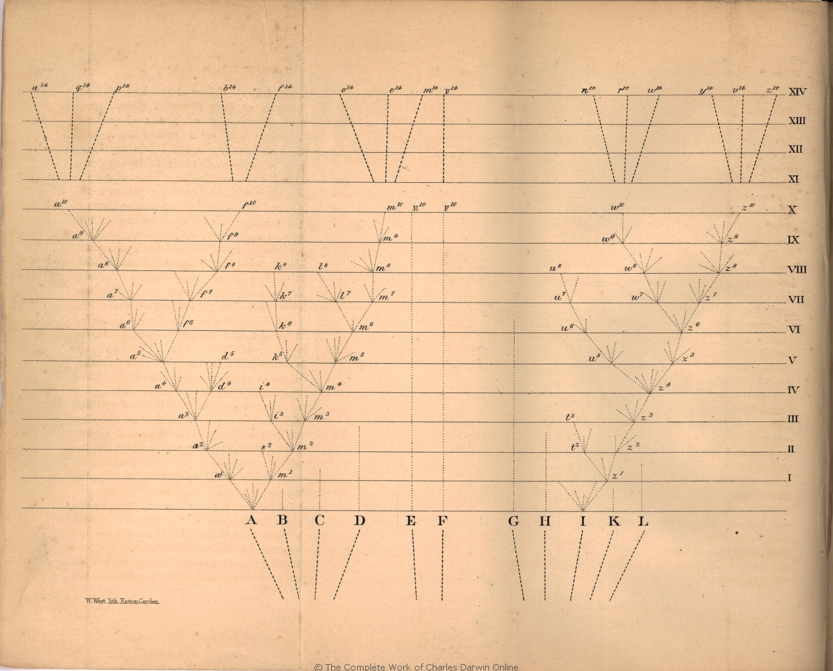
Timetree
a phylogenetic tree scaled to time
TIMETREEs were not invented with molecular data.
In fact, Darwin’s only figure in the Origin of Species is essentially a timetree, a hypothetical one, scaled to generations rather than years

Slide 5
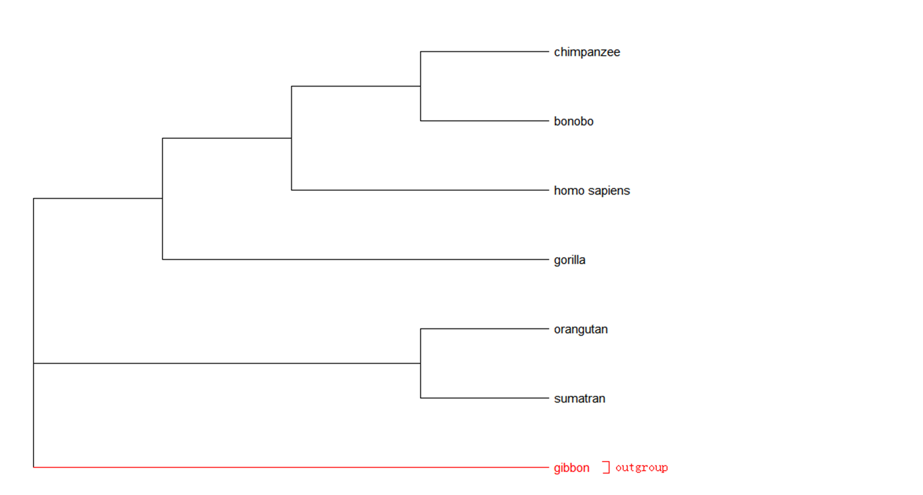
Timetree based on phlylogenetic tree
Branch length roughly represents nucleotide substitutions
On the other hand, the branch length indicates the time scale of evolution.
To calibrate the time, we need a ruler

Slide 6
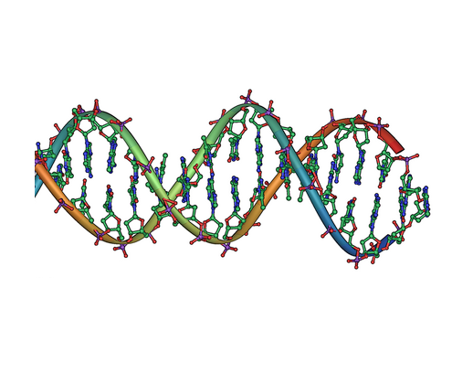
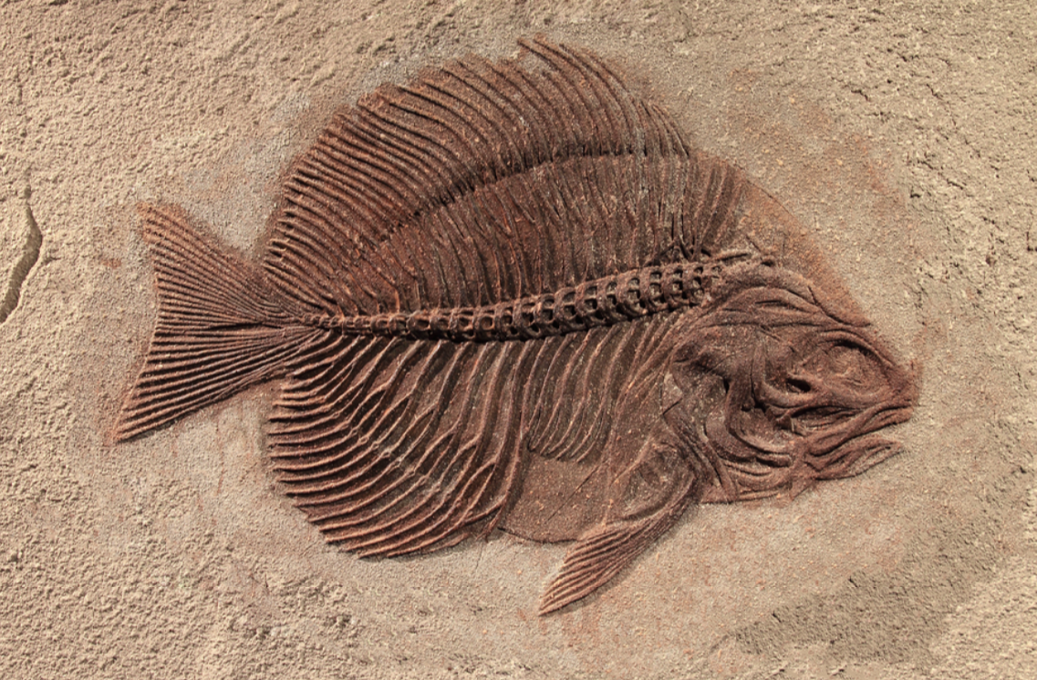
Ruler, Where to find
Molecular clock and fossil

Slide 7
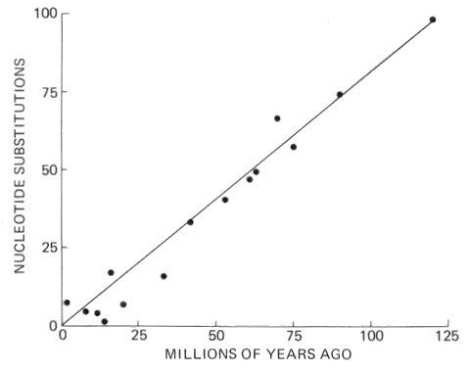
Molecular clock
The basic principle of molecular clocks is that there is a strong enough correlation between molecular changes and geologic time, such that rate can be used to measure time in parts of tree lacking a calibration time

Slide 8
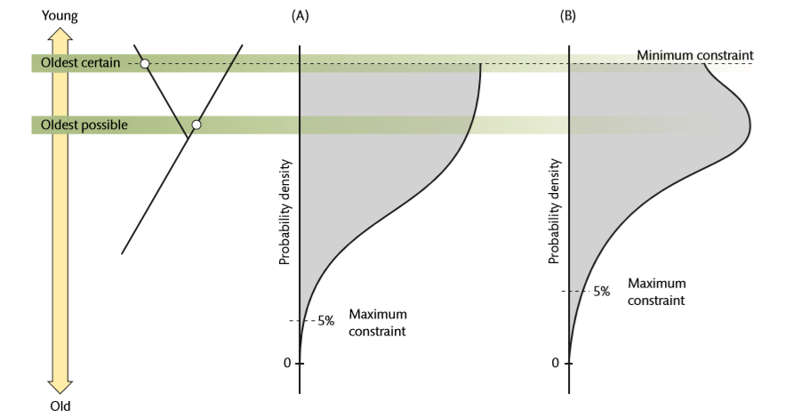
Fossil calibration
fossils under each layer of soil enabled us to clarify the certain time between their generation and extinction, and reveal a picture of evolution history

Slide 9
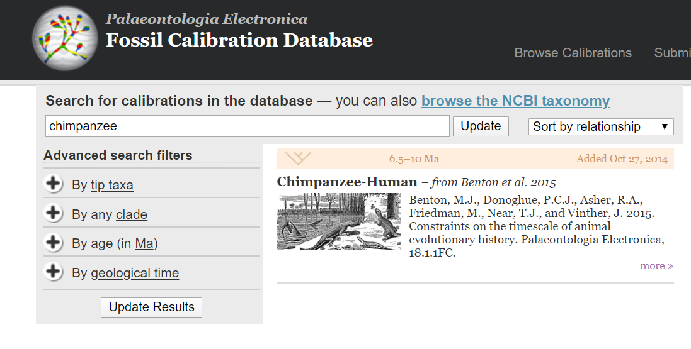
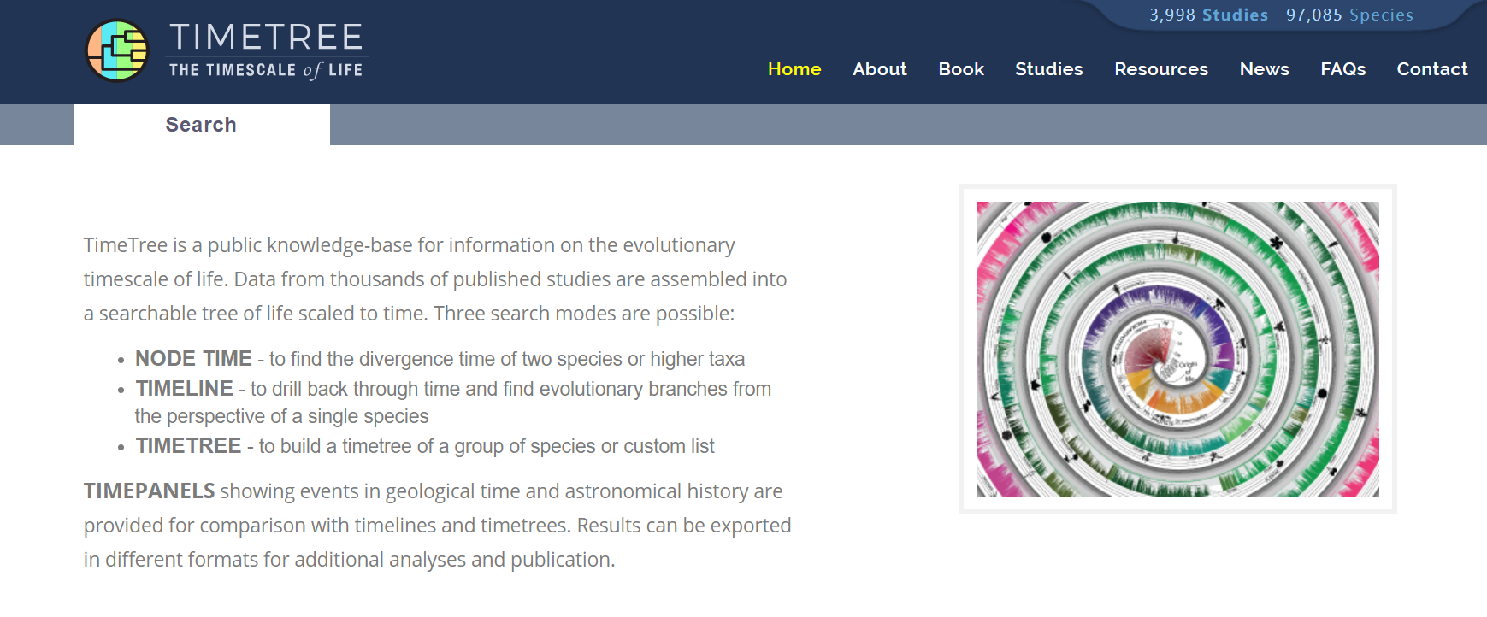
Where to find related fossil
-Morphological analyze process,
-*(Ancient DNA sequence)
Search related fossil in Database :
fossilcalibrations.org/
http://timetree.org/

Slide 10
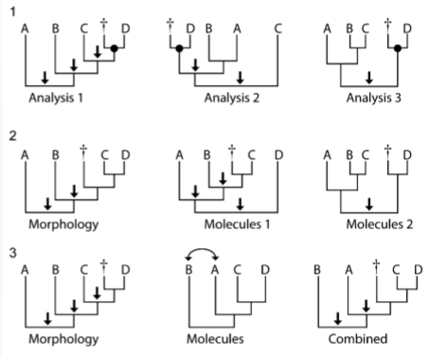
Discussion
Is Calibration Absolutely right?
Incorrect calibrations, those based upon fossils that are phylogenetically misplaced or assigned incorrect ages, clearly introduce error into an analysis, Consequently, thorough and explicit justification of both phylogenetic and chronologic age assessments is necessary for all fossils used for calibration.

Slide 11
How to use Mega running analysis for construction of time tree
LM
SE

Slide 12
GUI Version
Preparation
1.Sequence file(Mega received format)
2.Tree file(Newick format)
3.Pin out your outgroup
4.Constrain the minimum and maximum time on several node

Slide 13
RelTime-ML, demonstrating how to use it
Interface of mega

Slide 14
Pin out your outgroup and set your constrain age
Max:5.0, min=1.2
Max:13

Slide 15
A tree was constructed
Age information

Slide 16
Command line Version
How to generate control file
Already existed file:
Sequence file
Tree file
What do we need to build
Outgroup information file
File include max and min age information file
RelTime control file

Slide 17
Outgroup information
Format in a text file:
chimpanzee=UNGROUPED
bonobo=UNGROUPED
homo_sapiens=UNGROUPED
gorilla=UNGROUPED
orangutan=UNGROUPED
sumatran=UNGROUPED
gibbon=OUTGROUP
How to mark it if you have a lot of species in a tree?
Use the Mega GUI version to help yourself.

Slide 18
File include max and min age information, calibration information
Format in text file:
!MRCA=‘Node1' TaxonA=chimpanzee TaxonB=bonobo minTime=1.2 maxTime=5.0
!MRCA= 'Node2' TaxonA=orangutan TaxonB=sumatran maxTime=13.0
#text what your want to name the node in “Node1”and “Node2”

Slide 19
RelTime control file
Choose PROTOTYPE pattern
to prepare for the control file
making.
Export a control file with a suffix of
.mao
ANALYZE
PROTOTYPE

Slide 20
Command line for running
Command line:
megacc -a x.mao -d x.meg -t x.treefile -c time.txt -g group.txt –o xx
-a RelTime control file
-d data, your sequence file
-t tree, your newick format tree file
-c calibration information, max and min age for nodes
-g group information
-o prefix of your output file

Slide 21
More help
Mega web
Type: megacc -help

Slide 22
Thanks

