Slide 1
Transcriptome analysis
Tao Zhou
LMSE
2020.1.10

Slide 2
What is transcriptome
The transcriptome is the set of all RNA molecules( mRNA, tRNA, rRNA , non-coding RNA ) in one cell or a population of cells.
It is sometimes used to refer to all RNAs, or just mRNA, depending on the particular experiment.

Slide 3
Why we need transcriptome
Bulk RNA-seq
A population of cells
RNA-seq
Single cell RNA-seq

Slide 4
A generic roadmap for RNA-seq analysis

Slide 5
Experiment design
I. drug-treated vs controls
II. diseased vs healthy individuals
III. different tissues
IV. different stages of development
V. etc.

Slide 6
Bulk RNA-seq

Slide 7
Major RNA-seq Platforms and Their General Properties

Slide 8
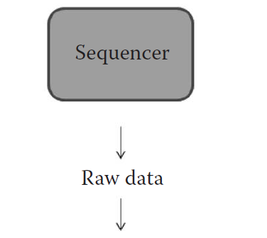
Possible paths in RNA-seq data analysis
within a reference genome
without a reference genome
Notes:
Within a reference genome ; without a reference genome

Slide 9
Quality control and Preprocessing
1.FastQC ——a standalone Java program with a graphical user interface ,and is also easy to use on command line.
$ fastqc xx.fastq
Ouput: xx_fastqc.html (fastqc reports) & xx_fastqc.zip (txt ,html)

Slide 10
Quality control and Preprocessing
2.Trimmomatic —— a versatile Java-based tool for preprocessing reads.(remove adapters and trim reads in different ways based on quality)
$ java –jar trimmomatic-0.32.jar PE SampleT12.R1.fastq SampleT12.R2.fastq T12paired1.fastq T12unpaired1.fastq T12paired2.fastq T12unpaired2.fastq ILLUMINACLIP:TruSeq3-PE.fa:2:30:10 CROP:107 HEADCROP:2 SLIDINGWINDOW:4:20 MINLEN:50
Output: T12paired1.fastq, T12unpaired1.fastq (R1)
T12paired2.fastq, T12unpaired2.fastq (R2)
ILLUMINACLIP: Cut adapter and other illumina-specific sequences from the read.
SLIDINGWINDOW: Perform a sliding window trimming, cutting once the average quality within the window falls below a threshold.
LEADING: Cut bases off the start of a read, if below a threshold quality
TRAILING: Cut bases off the end of a read, if below a threshold qualityInput
CROP: Cut the read to a specified length
HEADCROP: Cut the specified number of bases from the start of the read
MINLEN: Drop the read if it is below a specified length

Slide 11
Aligning Reads to a Reference
1.Downloading a existing Reference Index
Ensembl database (http://asia.ensembl.org/index.html)
a. download genome FASTA files
$ wget ftp://ftp.ensembl.org/pub/release93/fasta/oreochromis_niloticus/
dna/Oreochromis_niloticus.Orenil1.0.dna.toplevel.fa.gz
b. download GTF files (annotations)
$ wget ftp://ftp.ensembl.org/pub/release-93/gtf/
oreochromis_niloticus/Oreochromis_niloticus.Orenil1.0.93.gtf.gz

Slide 12
Aligning Reads to a Reference Genome
2. Build reference index--hisat2
$ hisat2-build genome.fa genome
$python3 extract_exons.py Oreochromis_niloticus.Orenil1.0.93.gtf > genome.exon
$ python3 extract_splice_sites.py Oreochromis_niloticus.Orenil1.0.93.gtf > genome.ss
$ python3 extract_snps.py snp142Common.txt > genome.snp (optional)
$ hisat2-build genome.fa --snp genome.snp --ss genome.ss --exon genome.exon genome_snp_tran

Slide 13
III. Aligning reads to reference
$ hisat2 --dta -x ./grch38_tran/genome_snp_tran -1 T12paired1.fastq -2 T12paired2.fastq –S SRR534293.sam
$ hisat2 --dta-cufflinks -x ./grch38_tran/genome_snp_tran -1 T12paired1.fastq -2 T12paired2.fastq –S SRR534293.sam (tailored for cufflinks )

Slide 14
De novo assembly(transcpritome)
Software: Trinity
Trinity consists of three separate programs:
(a) Inchworm, which constructs initial contigs(kmer),
(b) Chrysalis, which clusters the contigs produced by Inchworm and creates a de Bruijn graph for each locus
(c)Butterfly, which extracts the isoforms within each de Bruijn graph.
Then you can annotate the unigenes by blasting against NCBI database etc.

Slide 16
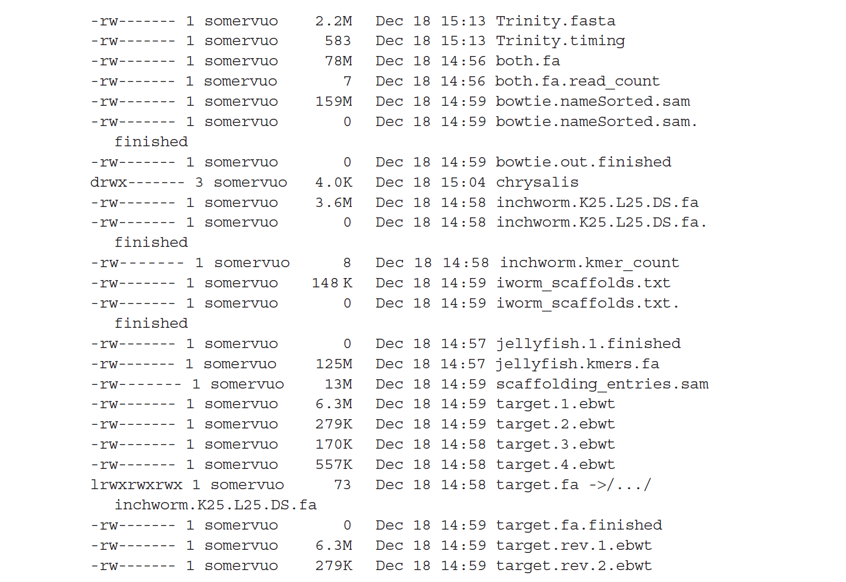
Trinity usage
$ Trinity.pl --seqType fq --JM 10G --left chr18_1.fq --right chr18_2.fq --CPU 4
Trinity.fasta was used to blast against the database for annotation (diamond blast)
Notes:
Trinity.fasta was used to blast against the database for annotation

Slide 17
Align Sequences to a reference (Genome/transcriptome)
Gene A
Gene ID | Sample1
A | 3
B | 3
C | 0
D | 2
TTAGCA ACCGAC
ATGGCA
Gene B
Gene C
GeneD
TTGTCA
CGCATG GTCACT
AACGTT
CTAACG
For a given gene, the number of reads aligned to the gene measures its expression level.

Slide 18
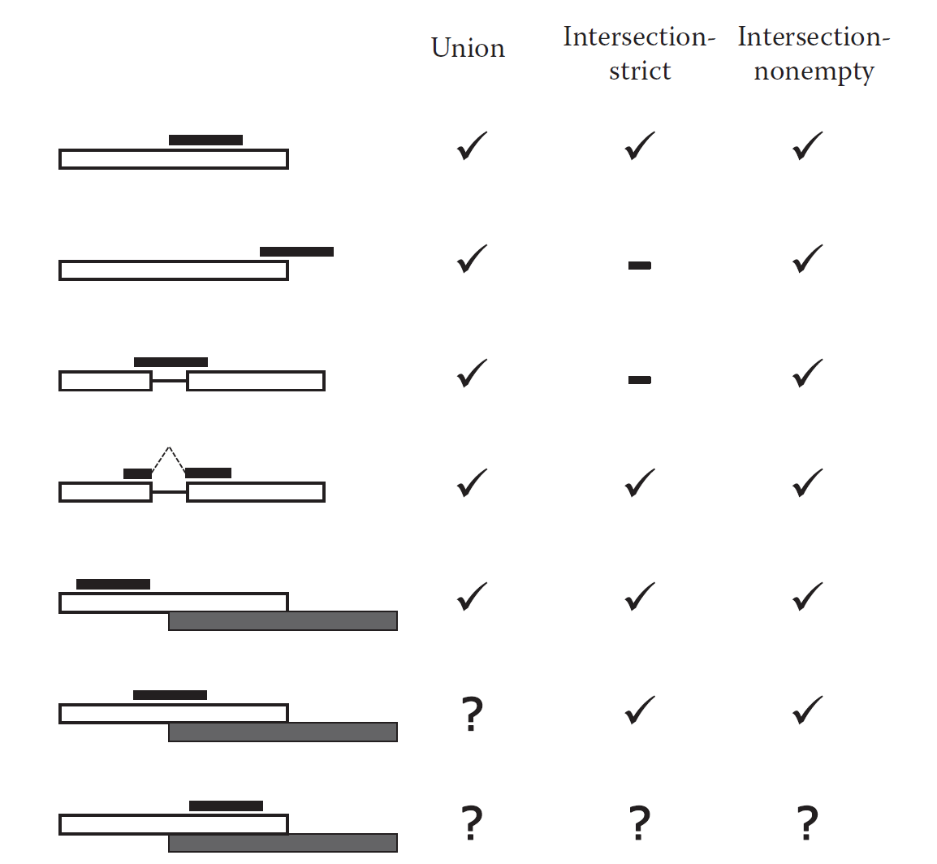
Quantitation of gene expression(count, rpkm/fpkm)
1.Counting reads per genes
HTSeq-count - - a part of the HTseq package of Python scripts for NGS data analysis, by default it expects paired-end data to be sorted by read names so that paired reads follow each other in the file
Black bar indicates a read,
white box indicates a gene that the read maps to,
grey box indicates another gene which partially overlaps with the white one.

Slide 19
Counting reads per genes
I. Convert SAM to BAM
$ samtools view –bS -o alignments.bam input.sam
II. Sort alignments in BAM by read names (-n)
$ samtools sort –n alignments.bam –o alignments.namesorted
III. htseq-count ounting reads per Genes
$ htseq-count –f bam --stranded=no alignments.namesorted Oreochromis_niloticus.Orenil1.0.93.gtf > counts.txt
-f bam indicates input format is BAM
--stranded=no so that a read is counted also when it maps to the opposite strand

Slide 20
Example Dataset after Aligning Reads
Gene
Treatment 1
(3 replicates)
Treatment 2
(3 replicates)
1 14 18 10 47 13 24
2 10 3 15 1 11 5
3 1 0 10 80 21 34
4 0 0 0 0 2 0
5 4 3 3 5 33 29
. . . . . . .
. . . . . . .
. . . . . . .
53256 47 29 11 71 278 339
Total 22910173 30701031 18897029 20546299 28491272 27082148
Notes:
(3 replicates)

Slide 21
Quantitation of gene expression
RPKM／FPKM
RPKM, Reads per kilobase of exon per million reads mapped (single-end)
RPKM= counts of mapped reads of a gene/length of a gene
Per Kilobase means length of gene
Per Million is the depth of sequencing
FPKM, Fragments per kilobase of exon per million reads mapped (pair-end)
FPKM= counts of mapped reads of a gene/length of a gene
When sequencing is single-end, RPKM =FPKM ；
When it is pair-end, we using FPKM. Therefore, FPKM is commonly used.

Slide 22
Counting reads per transcripts
$ cufflinks –G Homo_sapiens.GRCh37.74.gtf -b GRCh37.74.
fa -u -p 8 accepted_hits.bam -o outputFolder
outputFolder: 1.genes.fpkm_tracking
2.isoforms.fpkm_tracking
3.skipped.gtf
4.transcripts.gtf

Slide 23
Counting Reads per Exons
Differential expression can be studied at exon level using the Bioconductor package DEXSeq
Transcript isoforms tend to have some exons in common, so an exon can appear several times in a GTF file.
Exons can also overlap with each other if their start/end coordinates differ.
For counting purposes, we need to construct a set of nonoverlapping exonic regions. The DEXSeq package contains a Python script dexseq_prepare_annotation.py for this task. It “flattens” a GTF file to a list of exon counting bins, which correspond to one exon or a part of an exon (in the case of overlap).

Slide 24
DEXseq usage
1. “flatten” a GTF file to a list of exon counting bins
$python dexseq_prepare_annotation.py Homo_sapiens.GRCh37.74.gtf GRCh37.74_DEX.gtf
2. Count reads per Exons
$python dexseq_count.py –p yes –s no –r name GRCh37.74_DEX.gtf hits_namesorted.sam exon_counts.txt

Slide 25
Differential Expression Analysis
Work in R (edgeR,limma,….)
Software: Rstudio
Unix-like system: Cuffdiff

Slide 26
Differential Expression Analysis
1.Differential expression(DE) analysis refers to the identification of genes(or other genomic features, such as, transcripts or exons) that expressed in significantly different quantities in distinct groups of samples, be it biological conditions :
I. drug-treated vs controls
II. diseased vs healthy individuals
III. different tissues
IV. different stages of development
V. etc.

Slide 27
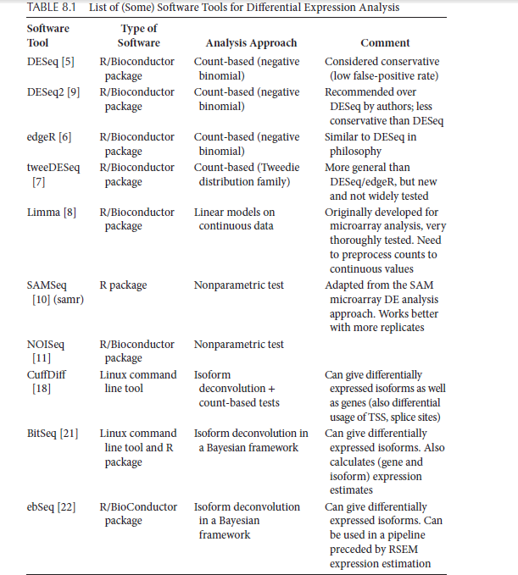
3. Choice of software
The DESeq(2), edgeR, and limma packages are all based on the concept of
(generalized) linear models

Slide 28
For instance, if you have an experiment involving different patients, treatments, and time points, the linear model for each gene could be thought of as
y = a + b ⋅ treatment + c ⋅ time + d ⋅ patient + e
y is the gene expression measured in some unit,
e an error term,
a, b, c, d are parameters to be estimated from the data. a is called the intercept and represents the average expression level of the gene when all the other factors (treatment, time, and patient) are in their reference state.

Slide 30
Here we choose two different packages(commonly used) for different expression analysis
1. edgeR package (count-based)
2. Cuffdiff –part of cufflinks package (Isoform deconvolution + count-based tests)

Slide 31
edgeR (count-based) http://www.360doc.com/content/18/0815/22/57890290_778579575.shtml
Article: A scaling normalization method for differential expression analysis of RNA-seq data
CPM：Counts per million
CPM=C/N*1000000
C is mapped reads of gene A (read count)，
N is the number of mapped reads of total genes
CPM normalized read counts by the length of gene.
RPKM=CPM/length of gene

Slide 32
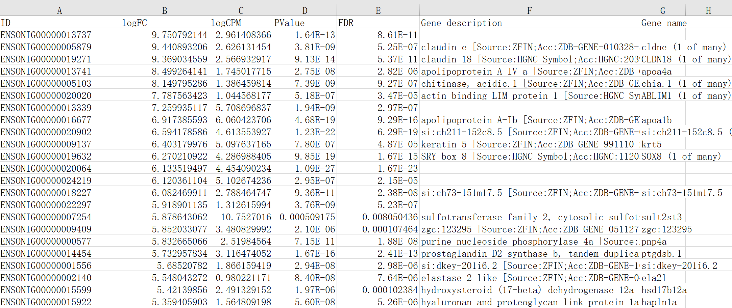
DEGs results caculated by edgeR

Slide 33
Differently expressed genes(DEGs)
Foldchange(FC)=(FB-FA)/FA
FA: a gene expression under condition A
FB: the same gene expression under condition B
FDR: false discovery rate
Which are DEGs:
expression of a gene |log2FC|>1 & FDR<0.05

Slide 34
Visualization
1.Volcano plot-DEGs

Slide 35
2. Heatmap plot-DEGs

Slide 36
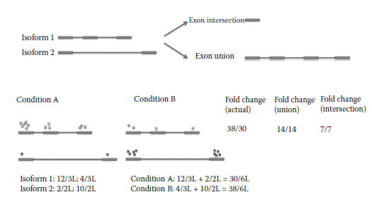
Cuffdiff (Isoform deconvolution + count-based tests)

Slide 37
Alternative splicing
Isoforms(transcripts)
Notes:
This graph shows five categories of alternative splice

Slide 38
Cuffdiff usage
$cuffdiff -o chr18_hESC_vs_GM12892 -p 4 –L hESC,GM12892 --FDR 0.05 -u Homo_sapiens.GRCh37.59.chr-added.gtf hESC1_chr18.bam,hESC2_chr18.bam,hESC3_chr18.bam,hESC4_chr18.bam Gm12892_1_chr18.bam,Gm12892_2_chr18.bam,Gm12892_3_chr18.bam
Options:
-o output folder name
--FDR gives the false discovery rate cutoff for the DE analysis
−u specifies that we want to use something called “multi-read correction” which is generally recommended

Slide 39
Functional annotation-Gene Ontology
1. About GO
Gene ontology http://www.geneontology.org/
The Gene Ontology (GO) project is a major bioinformatics initiative to develop a computational representation of our evolving knowledge of how genes encode biological functions at the molecular, cellular and tissue system levels. Biological systems are so complex that we need to rely on computers to represent this knowledge.
The project has developed formal ontologies that represent over 40,000 biological concepts, and are constantly being revised to reflect new discoveries. To date, these concepts have been used to "annotate" gene functions based on experiments reported in over 140,000 peer-reviewed scientific papers.

Slide 40
The Gene Ontology defines the universe of concepts relating to gene functions (‘GO terms’), and how these functions are related to each other (‘relations’). It is constantly revised and expanded as biological knowledge accumulates.
GO describes function with respect to three aspects:
molecular function (molecular-level activities performed by gene products),
cellular component (the locations relative to cellular structures in which a gene product performs a function),
biological process (the larger processes, or ‘biological programs’ accomplished by multiple molecular activities).

Slide 41
2.GO annotation
I.Ensembl database –biomart (http://www.ensembl.org/biomart/)
II. (a)blast against protein database(Swiss-port databse)
UniProt2GO_annotate.py
https://www.cnblogs.com/xiaojikuaipao/p/7190779.html
(b)Blast2GO(https://www.blast2go.com/blast2go-pro/download-b2g)

Slide 42
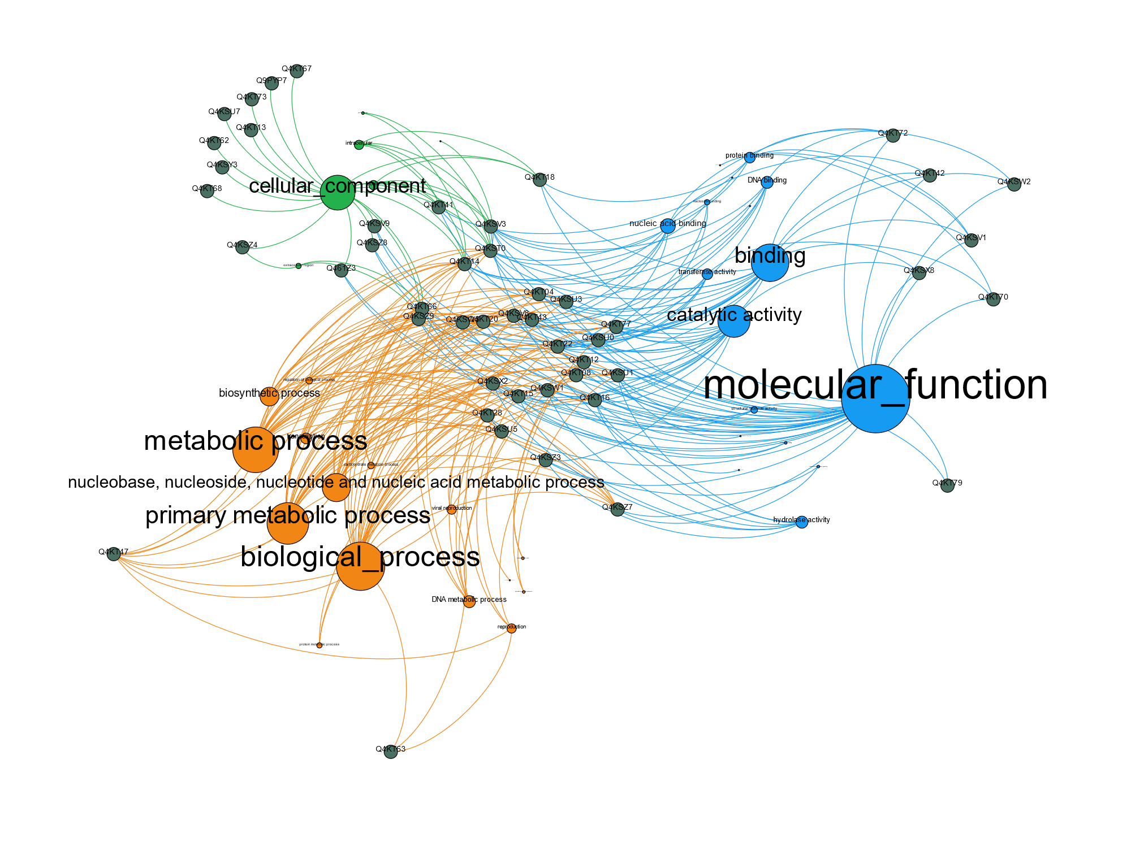
Example of GO function(network)

Slide 43
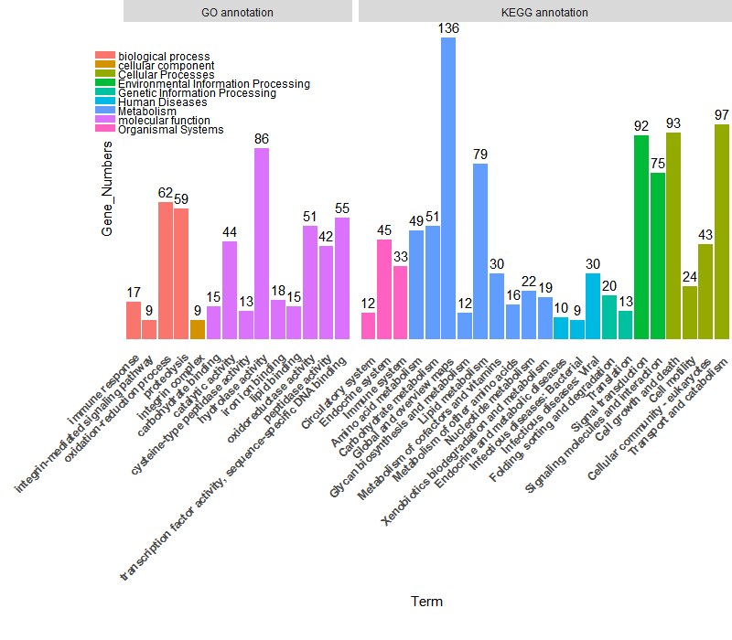
3. Barplot - GO, KEGG annotation

Slide 44
Function enrichment(GO/KEGG)
1. An enrichment analysis is performed via a hypergeometric test.
The P value was calculated using the following formula:
N is the total number of genes annotated to GO term/KEGG pathway,
n is the total number of differently expressed genes annotated to GO/KEGG pathway,
M is the number of genes annotated to a certain GO term/KEGG pathway,
i is the number of differently expressed genes annotated to a certain GO term/KEGG pathway.
GO terms/KEGG pathway with P value below 0.05 were considered enriched(overrepresented).
All statistical calculations were performed in R.

Slide 45
2. Use R package to perform enrichment analysis
Typical example: clusterprofiler package
Dependencies: datasets of differently expressed genes (DEGs)

Slide 46
Gene ontology enrichment
example

Slide 47
Functional annotation-KEGG
1.About KEGG
Kyoto Encyclopedia of Genes and Genomes(KEGG) https://www.kegg.jp/
KEGG is a database resource for understanding high-level functions and utilities of the biological system, such as the cell, the organism and the ecosystem, from molecular-level information, especially large-scale molecular datasets generated by genome sequencing and other high-throughput experimental technologies.

Slide 48
2. KEGG annotation
KAAS - KEGG Automatic Annotation Server
https://www.genome.jp/tools/kaas/
Then mapped to kegg
pathway

Slide 49
4. Bubble plot-KEGG enrichment

Slide 50
Fusion gene(transcript)

Slide 51
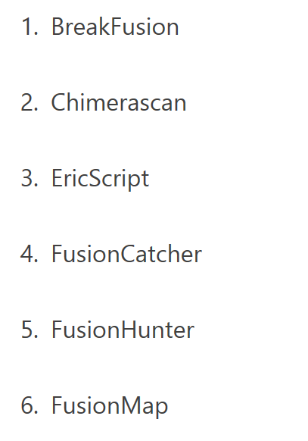
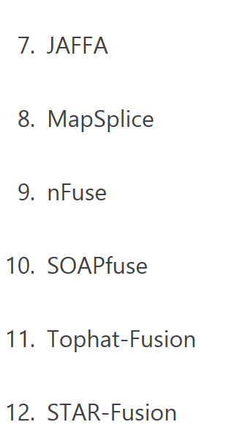
softwares
Notes:
softwares

Slide 52
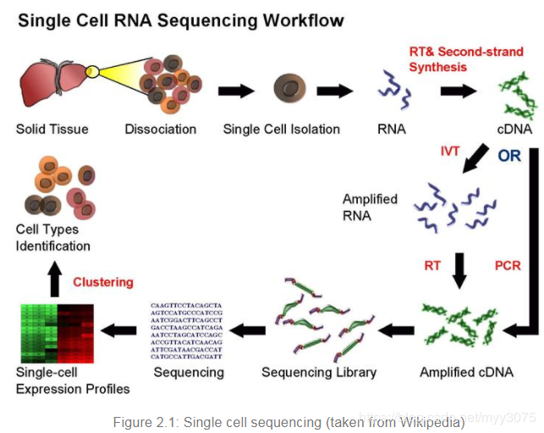
Single cell RNA-seq(scRNA-seq)

Slide 53
Notes:
Fluorescence activated Cell sorting

Slide 57
THANK YOU

