Slide 1
Conserved element
Phylofit & PhastCons
Presenter：Yang Yingyi
2020 Workshop

Slide 2
Content
01
Conserved element
02
Phylofit
03
PhastCons

Slide 3
Conserved element
01

Slide 4
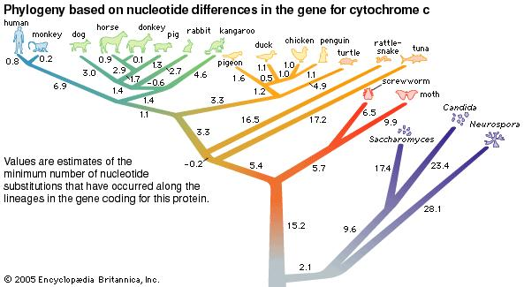
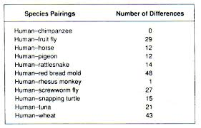
Cytochrome c

Slide 5
Conserved element
Coding sequence
Non-coding sequence
Housekeeping
genes
管家基因
Non-housekeeping genes
非管家基因

Slide 6
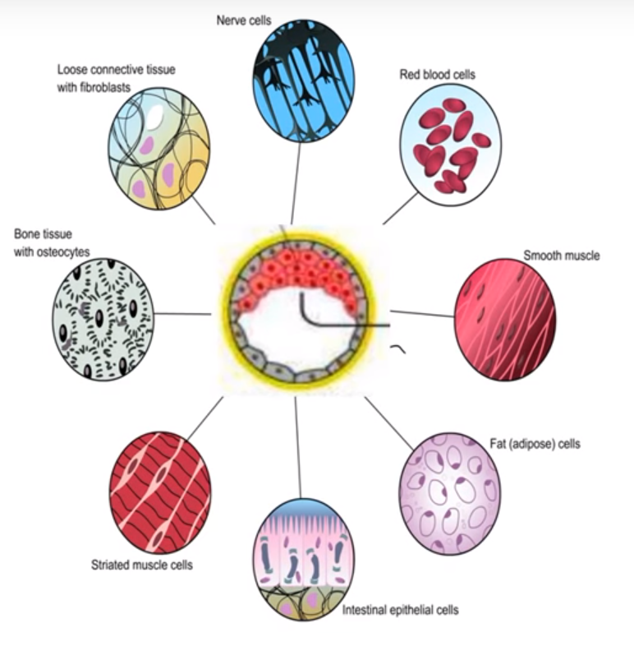
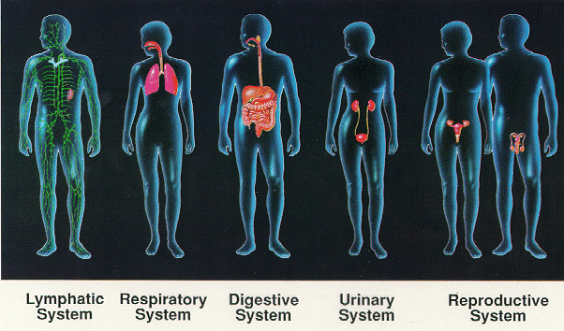
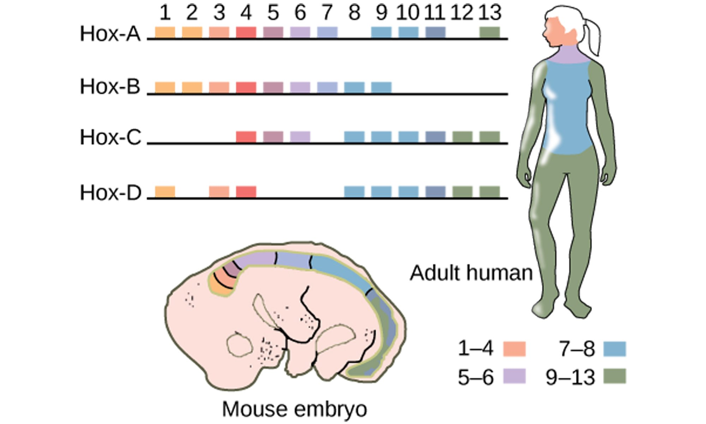
单击此处添加大标题
Housekeeping
genes
Non-housekeeping genes
Gene expression:
Transcription factors
Repressors
RNA splicing
Translation factors
tRNA synthesis
RNA binding protein
DNA replication
......
Metabolism:
Carbohydrate metabolism
Citric Acid Cycle
Lipid metabolism
ATPase
tubulin
Ribosomal Protein
......
Development
Structural:
Cytoskeletal
Organelle synthesis
Mitochondrion
......
Surface:
Cell adhesion
Channels and transporters
Receptors
......
Miscellaneous:混杂的
Open_reading_frame
Sperm/Testis
......
Regulatory of basic life activity
Unknown gene

Slide 7
Conserved element
Coding sequence
Non-coding sequence
Housekeeping
genes
管家基因
Non-housekeeping genes
非管家基因

Slide 8
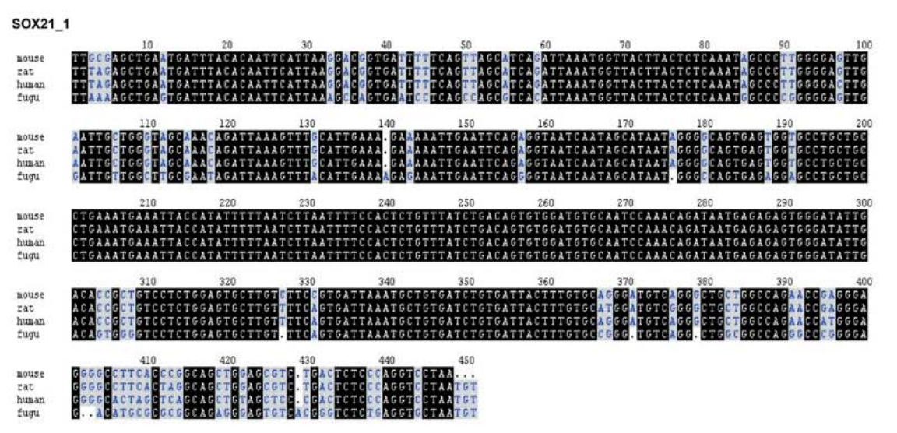
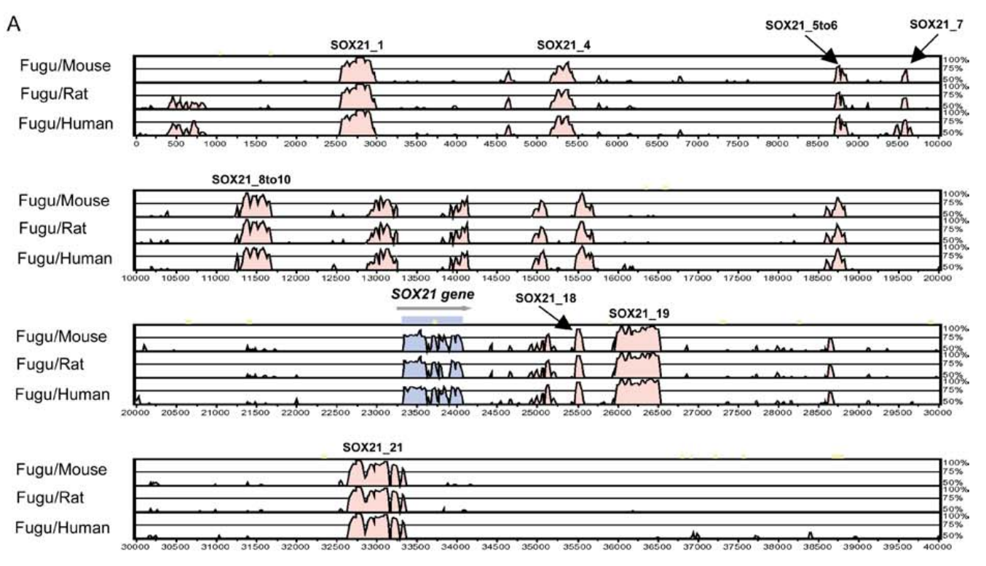
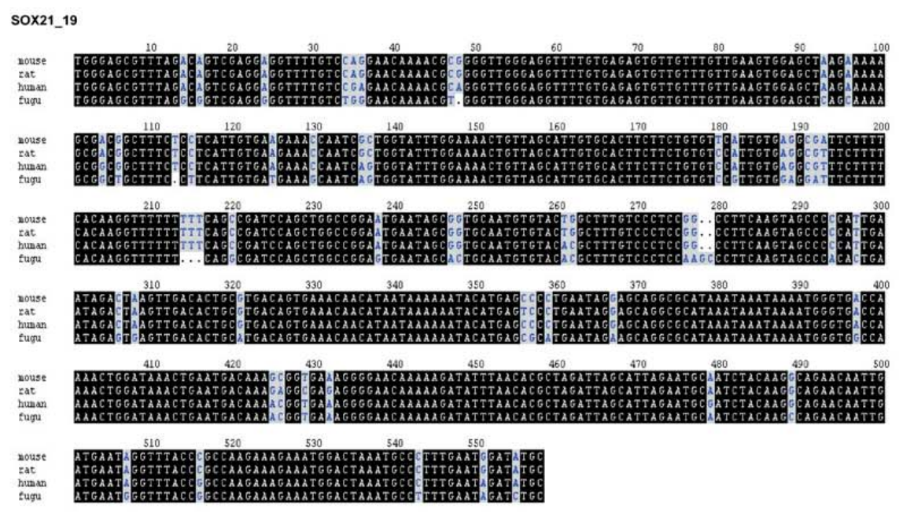
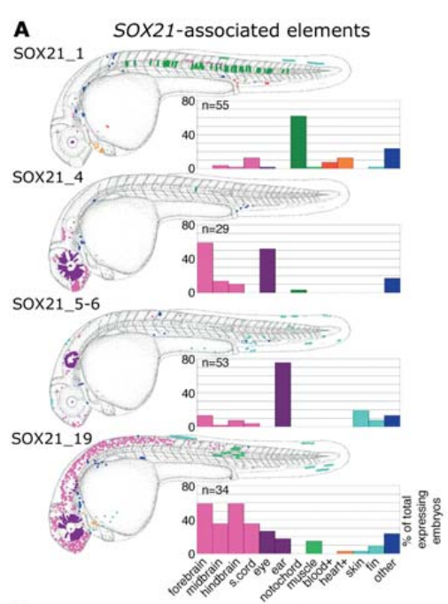
Non-coding genes
100
10

Slide 9
单击此处添加大标题
phyloFit
hidden Markov model
multiple alignment
estimates the probability that each nucleotide belongs to a conserved element
individual alignment column & flanking columns
same parameters for each species set
maximum likelihood
tree topology and substitution model
fit one or more tree models to a multiple alignment of DNA sequences
PhastCons
Genome Conservation Scores
phyloFit

Slide 10
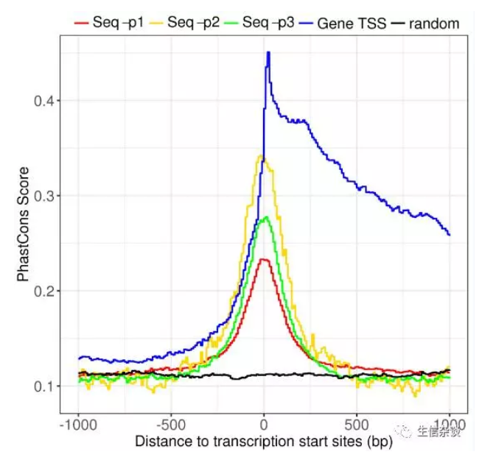
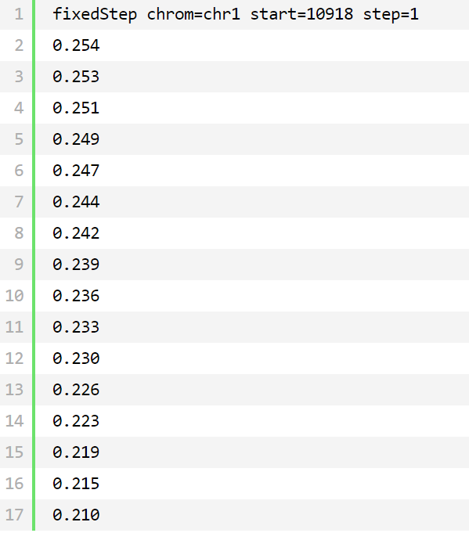
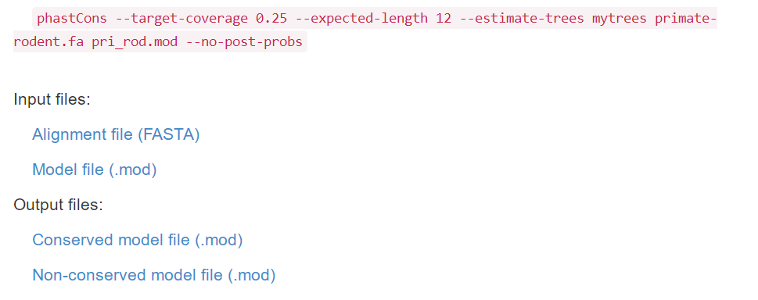
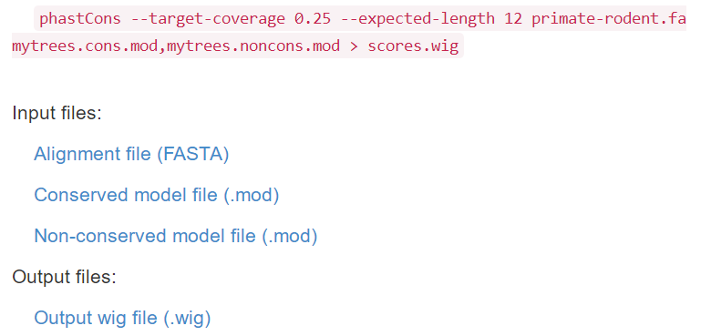
PHAST
phyloFit
phyloFit
R
Install
Input
Output
Input
result
graph
ing
Install PHAST
FASTA
.mod
Models available - JC69, F81, HKY85, HKY85+Gap, REV, SSREV, UNREST, R2, R2S, U2, U2S, R3, R3S, U3, U3S

Slide 11
Thanks

