Slide 1
pairwise sequentially Markovian coalescent (PSMC) model
Notes:
1. good afternoon everyone, today I am going to show you some model to describe the population size by using the genome data. Firstly,we are gonna talk about the PSMC. model .

Slide 2
PSMC
a method to infer the history of effective population size from genome-wide diploid sequence data.
Notes:
2. PSMC is call that pairwise sequentially Markovian coalescent (PSMC) model and it a method to infer the history of effective population size from genome-wide diploid sequence data. It based on Hidden Markov model.

Slide 3
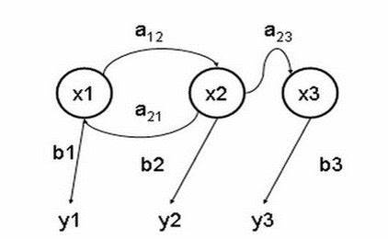
hidden Markov model
Notes:
3. So what is hidden Markov model? Lu Laing has told some about it yesterday.This is a picture to show but maybe it is hard to understand it .So I will show you a single example.

Slide 4
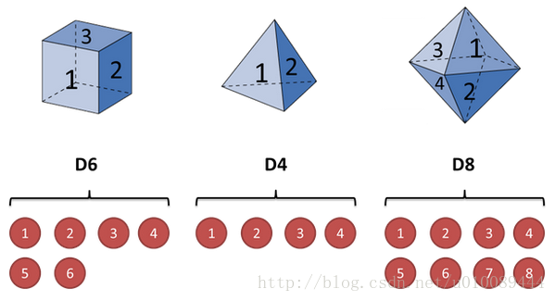
hidden Markov model
Notes:
4. Just imagine that we now have 3 kinds of dices. The first one has 6 surfaces,the second one has 4 surfaces and the third one has 8 surfaces. We just call them D6,D4 and D8.If we throw the dices, D6 we can 1 to 6, D4 we can see 1 to 4 ,D8 we can see 1 to 8.

Slide 5
hidden Markov model
CHOOSE 1 DICE TO THROW
10 times
1、6、3、5、2、7、3、5、2、4
Notes:
5. Now we just choose 1 dice to throw and put it back. We repeat this step 10 times.we now have 10 number.

Slide 6
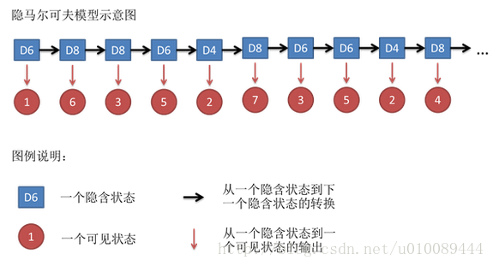
hidden Markov model
Notes:
6. The number we have seen can be observed,so we can say it is a observation. Which dice we have chosen is a hidden situation ,so we can call it the hidden states. There is a probability between dice we have chosen this time and the dice we will choose next time and we call it transitions. The probability of which number the dice will show us is called emissions. So there is a hidden chain in this situation, and this is a simple hidden Markov model.

Slide 7
psmc
The PSMC infers the local time to the most recent common ancestor (TMRCA) on the basis of the local density of heterozygotes, using a hidden Markov model in which the observation is a diploid sequence, the hidden states are discretized TMRCA and the transitions represent ancestral recombination events.
Notes:
7. Let’s Back to the PSMC model.The PSMC infers the local time to the most recent common ancestor (TMRCA) on the basis of the local density of heterozygotes, using a hidden Markov model in which the observation is a diploid sequence, the hidden states are discretized TMRCA and the transitions represent ancestral recombination events.

Slide 8
PSMC
X – discretized TMRCA
A – ancestral recombination events
y –a diploid sequence
b – genetic change probability
Notes:
8. Put them on the picture of hidden Markvo model, x is discretized TMRCA, a is ancestral recombination events, y is a diploid sequence and g isgenetic change probability.

Slide 9
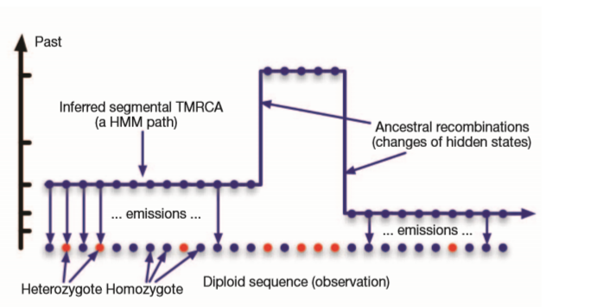
PSMC
Notes:
9. This is x1 . this is x2. This is x3 .if at the x time,the number of heterozygotes more ,the population at x time will be bigger .why ?because at x time , the population bigger ,there will be more gene diversity.

Slide 10
psmc
a consensus genome sequence (fastq)
ﬁltered
account for coverage and sequencing errors
single individuals for SNP calling
samtools
PSMC
Notes:
10. How to do the PSMc? Firstly,you should put in a consensus genome sequence (fastq) and filtered to account for coverage and sequencing errors. Using Sam tools to sort the snap calling and then do the PSMC.

Slide 11
Data provided
Individual resequencing data ------------mainly based on individual heterozygous sites for analysis.
Species mutation rate
The average generation interval
Notes:
11. The data we need to provide areIndividual resequencing data ------------mainly based on individual heterozygous sites for analysis.,Species mutation rate and The average generation interval

Slide 12
PSMC data quality
The average depth is not less than 18X;
The deletion rate of genomic genotype data is not higher than 25%;
Filter sites whose sequencing depth is lower than 10 reads.
Notes:
12. Before you do the PSMC analyze,you should make sure that The average depth is not less than 18X;The deletion rate of genomic genotype data is not higher than 25% and Filter sites whose sequencing depth is lower than 10 reads.

Slide 13
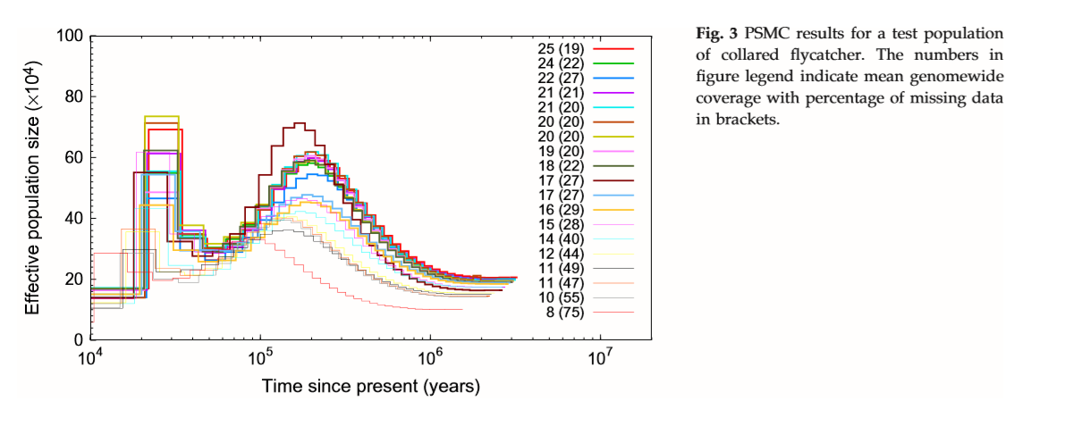
PSMC
Notes:
13. Now we can see the PSMc picture. The x axis is the time , the more right the time will older. The y axis is effective population size. We can find out when the time is close to now ,the effective population size will be not so current. That is because when the time is close to now, the number of heterozygote will be small, so it can’t estimated the population size.

Slide 14
MSMC
The multiple sequentially Markovian coalescent (MSMC) analyzes the observed pattern of mutations in multiple individuals, focusing on the first coalescence between any two individuals.
Notes:
14. So now clever scientists have give out a more efficient model, MSMC model .The multiple sequentially Markovian coalescent (MSMC) analyzes the observed pattern of mutations in multiple individuals, focusing on the first coalescence between any two individuals.

Slide 15
MSMC
MSMC requires, in principle, fully phased haplotypes as input, although we could partially allow for unphased data at a subset of sites
MSMC extends PSMC by an order of magnitude to more recent times and also allows us to explicitly model the history of genetic separations between populations.
Notes:
15. MSMC requires, in principle, fully phased haplotypes as input, although we could partially allow for unphased data at a subset of sites .MSMC extends PSMC by an order of magnitude to more recent times and also allows us to explicitly model the history of genetic separations between populations. MSMC is very similar to PSMC , however MSMCcan allowed 8 haplotype at most and it makes the effective population size close to now more current.

Slide 16
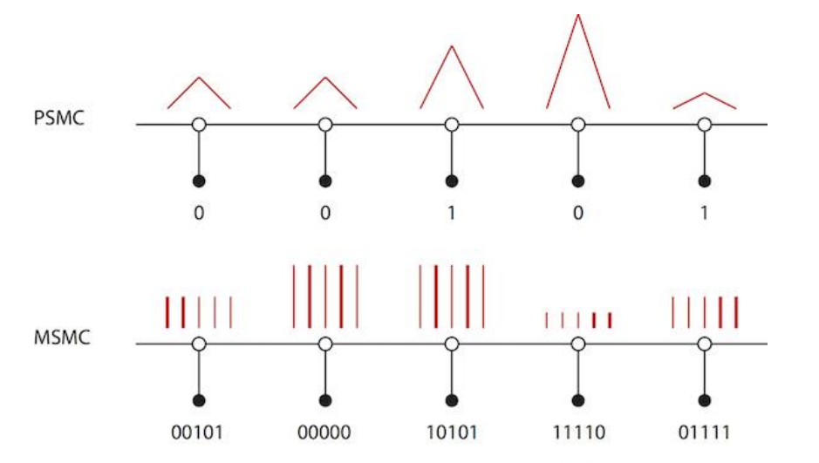
Msmc
Notes:
16. Just like the picture show, we see the PSMC first,the white point means the 100bp bias, the two red line means TMRCA. So if PSMC find there is a heterozygote,it will output a binary signal 1, if not ,it will output 0. Now we can check on the MSMC. It is the same that the white point is 100bp and the red line is the TMRCA .what is different is that there are 5 haplotypes so there are 5 red line and the thick two line means they are the first one to find the most recent common ancestor. So that is why MSMC more efficient than PSMC.

Slide 17
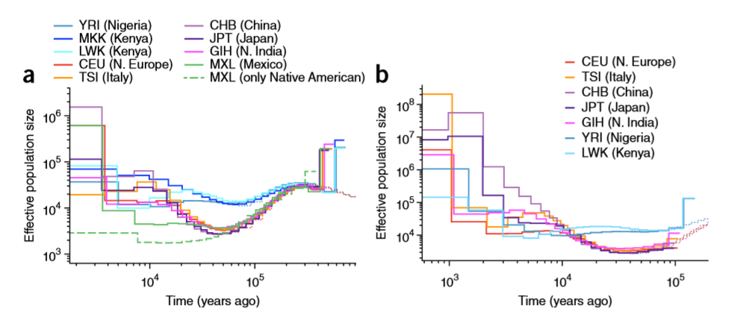
MSMC
Notes:
17. And this is the MSMC picture. The left one used 4 haplotype and the right one used 8 haplotype. We can see that if we choose more haplotype,the population size close to now will be more current.but don’t use more than 8 haplotype,because it will be too many calculations. So in these pictures,we can see that MSMC will be more current.

Slide 18
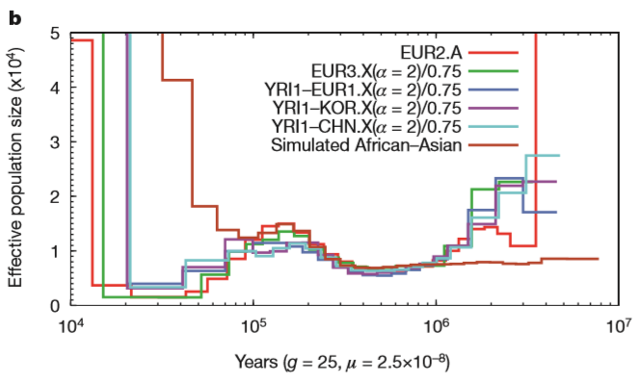
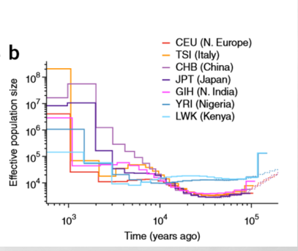
PSMC vs MSMC
Notes:
So in these pictures,we can see that MSMC will be more current.

Slide 19
How to use them
Psmc
https://github.com/lh3/psmc
Msmc
https://github.com/stschiff/msmc-tools/blob/master/msmc-tutorial/guide.md
Notes:
19. If you want to use it,they are on the github.com.every command is on the web site.

