Slide 1
Workshop on Molecular Systematics and Evolution -- Phylogenomics
Jan 6 - 10, 2025
Lingang, Shanghai

Slide 3
What is systematics?
Taxonomy – the orderly classification of organisms and other objects
Systematics – scientific study of the diversity of organisms
Classification – arrangement into groups
Nomenclature – scientific names
Phylogenetics – evolutionary history

Slide 4
What is molecular systematics?
Using molecular data to
delimitate species
reconstruct phylogenies
propose classification

Slide 5
Why high-throughput molecular systematics?
Papers based on few taxa and single molecular markers (for example, including only mitochondrial or chloroplast genes or genomes) will not be considered for publication. Papers based on a few molecular markers obtained by legacy PCR-Sanger methods, although acceptable in principle, will receive low priority or will be considered only in exceptional cases. Well into the genomics-era, MPE aspires to publish papers based on genome-wide datasets obtained by next-gen approaches. Multi-locus datasets which attempt to provide signal from across the genome are a minimum requirement.

Slide 6
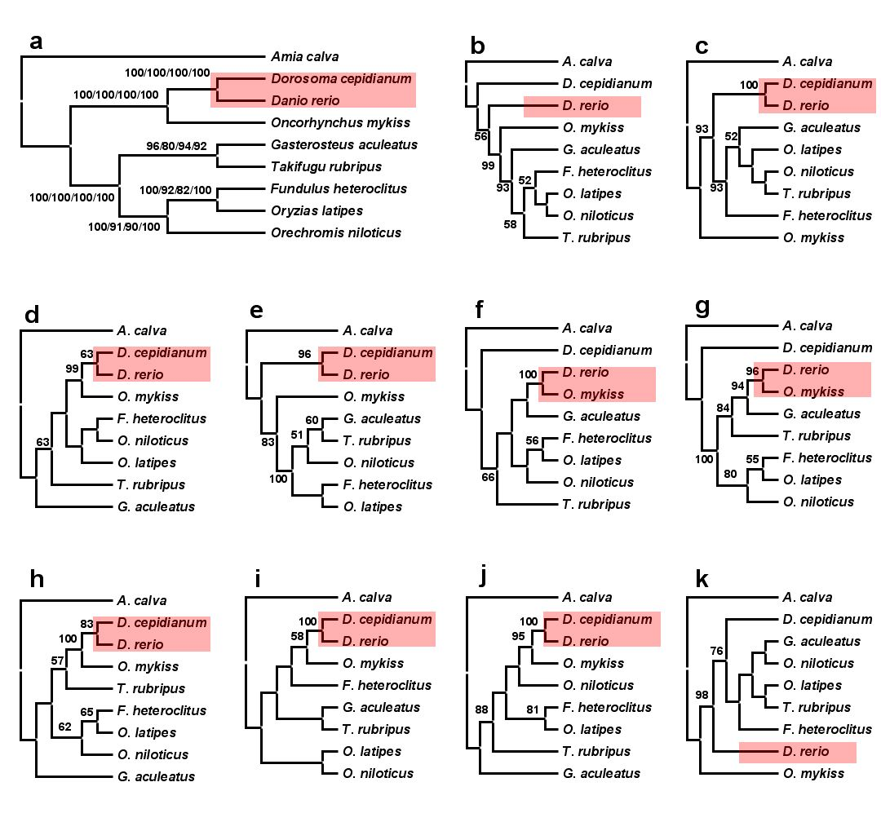
Why high-throughput molecular systematics?
ML phylogenies of teleosts based on nuclear genes, zic1, myh6,
RYR3, Ptc, tbr1, ENC1, Gylt, SH3PX3, plagl2, and sreb2.

Slide 7
Reasons for inconsistent results
Sampling error (characters and taxa)
Systematic error (model misspecification)
Long branch attraction
Base compositional bias
Heterotachy (variation in rate of change)
Gene tree vs. species tree
Incomplete lineage sorting
Paralogy

Slide 8
Null model of phylogenetics
Topology and branch length
Substitution matrix
r_{TC} (= r_{CT}), r_{TA} (= r_{AT}), r_{TG} (= r_{GT})
r_{CA} (= r_{AC}), r_{CG} (= r_{GC})
r_{AG} (= r_{GA})
Stationary base frequencies
f_{T}, f_{C}, f_{A}, f_{G},
Taxa 1
Taxa 2
Taxa 3
Taxa 4
Taxa 5

Slide 9
i.i.d. assumption
Each site evolves independently and according to the identical process, so called “i.i.d.” process.

Slide 10
Compositional bias (non-stationary)
A
50%
B
70%
C
70%
D
50%
“Compositional bias can result in the artefactual grouping of species with similar nucleotide composition, because most methods assume the homogeneity of the substitution process and the constancy of sequence composition (stationarity) through time ” (Delsuc et al. 2005).
A
50%
B
70%
C
70%
D
50%
50%

Slide 11
Long branch attraction
A
C
A
C
“Intuitively, with long branches leading to speices A and C, the probability of parallel changes that arrive at the same state becomes greater than the probability of an informative single change in the interior branch of the tree” (Felsenstein, 2004).
B
D
B
D

Slide 12
Phylogenomics
Prediction of gene function (Eisen, 1998)
Establishment of evolutionary relationships using genome or genome-scale data

Slide 13
One gene or more genes?
Single gene or a few genes often result low resolution.
Single gene or a few genes may even reach to the wrong phylogeny.

Slide 14
Systematic error
+ …
+
+
Phylogenetic signal
Gene A
Gene B
Gene C

Slide 16
Choose the right data

Slide 17
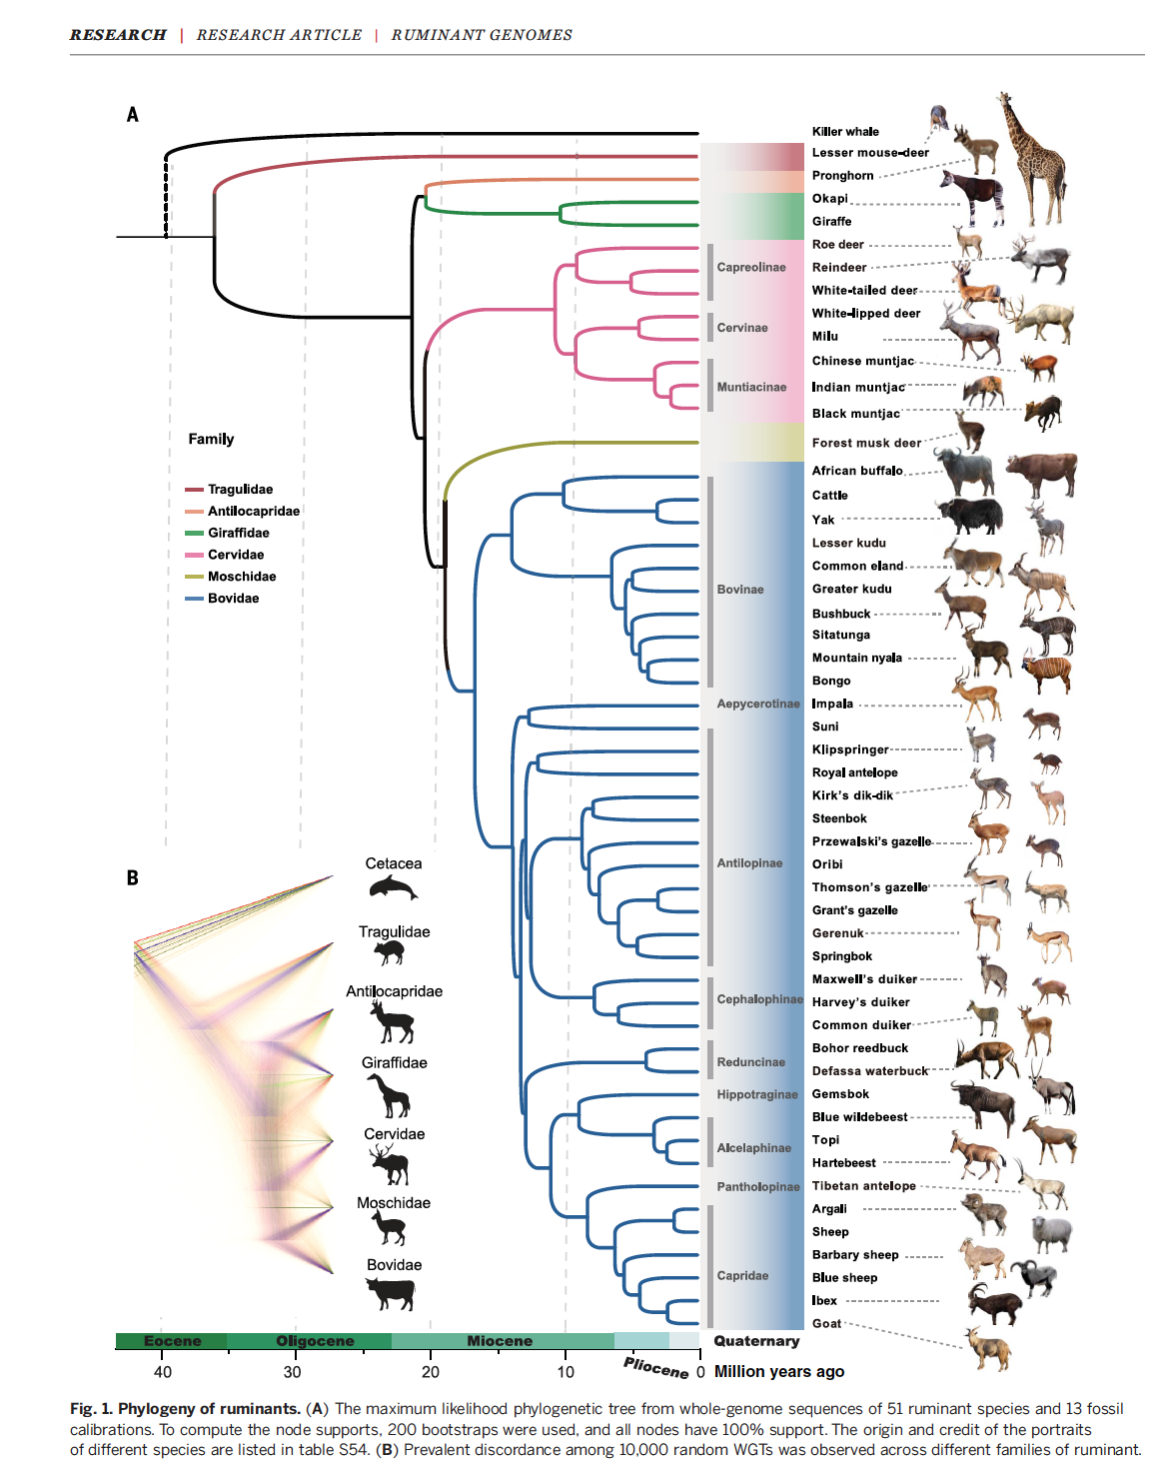

Slide 18
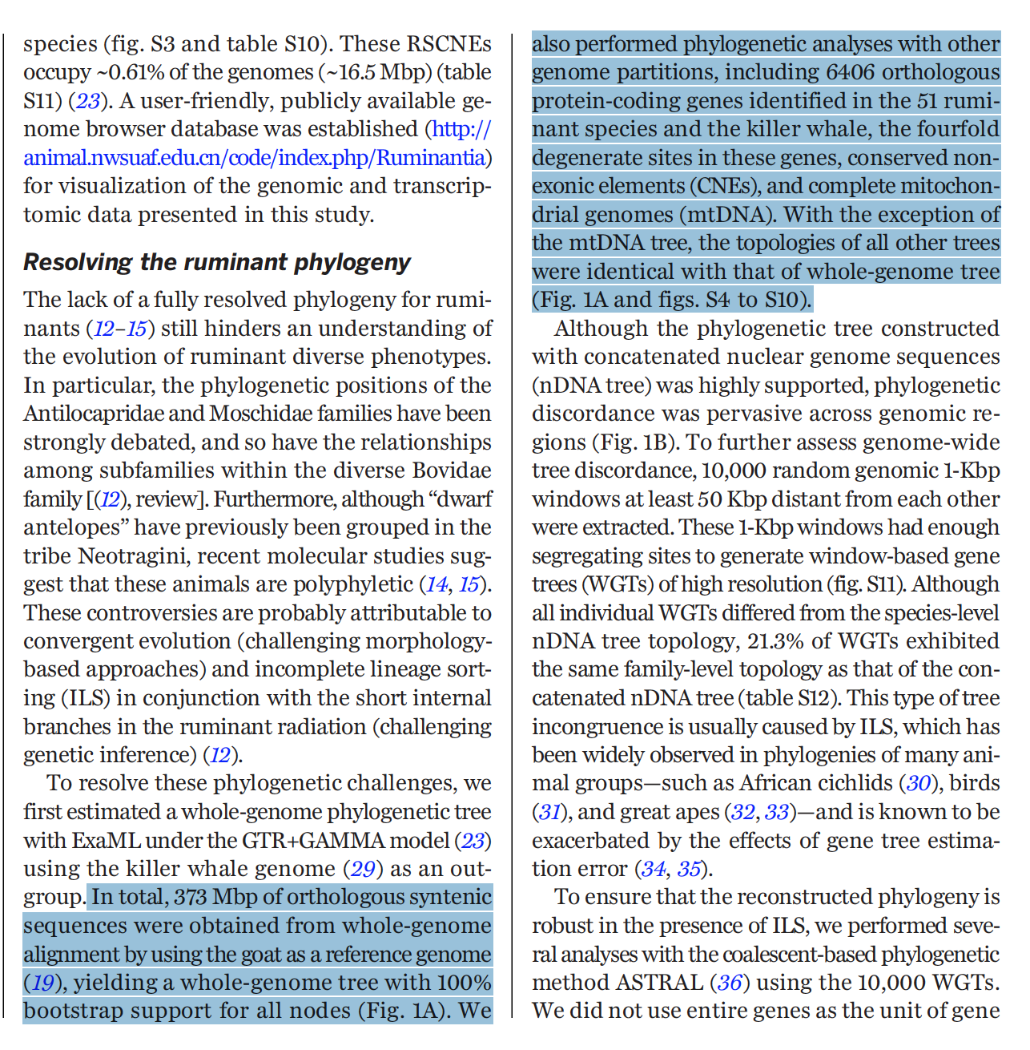

Slide 19
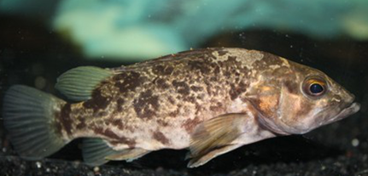
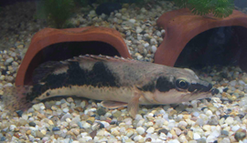
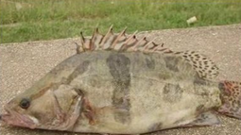
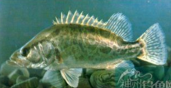
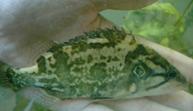
How about species delimitation?
COI barcoding

Slide 20
Problems with current barcoding method
Solution：DNA barcoding using multiple loci

Slide 21
Results of multilocus barcoding

Slide 22
Continuous/ independent sequences
Use one continuous locus（red circles）and multiple independent loci（blue circles）for species identification。The length of single continuous locus and total length of multiple loci are equal.

Slide 23
Species delimitation
Is species an objective item?
No!!!
Two criteria to be a meaningful species – Chenhong Li
It is independently evolving
There are unique and meaningful phenotypic traits

Slide 24
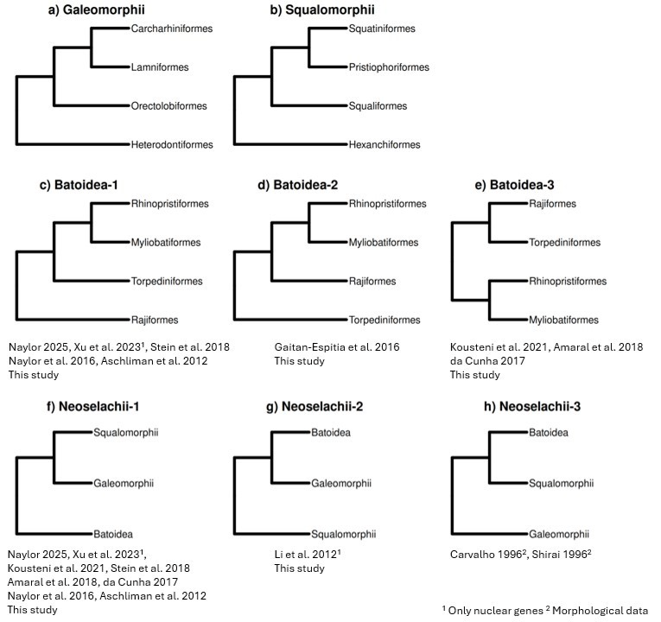
The hypothesized relationships among major elasmobranch orders

Slide 25
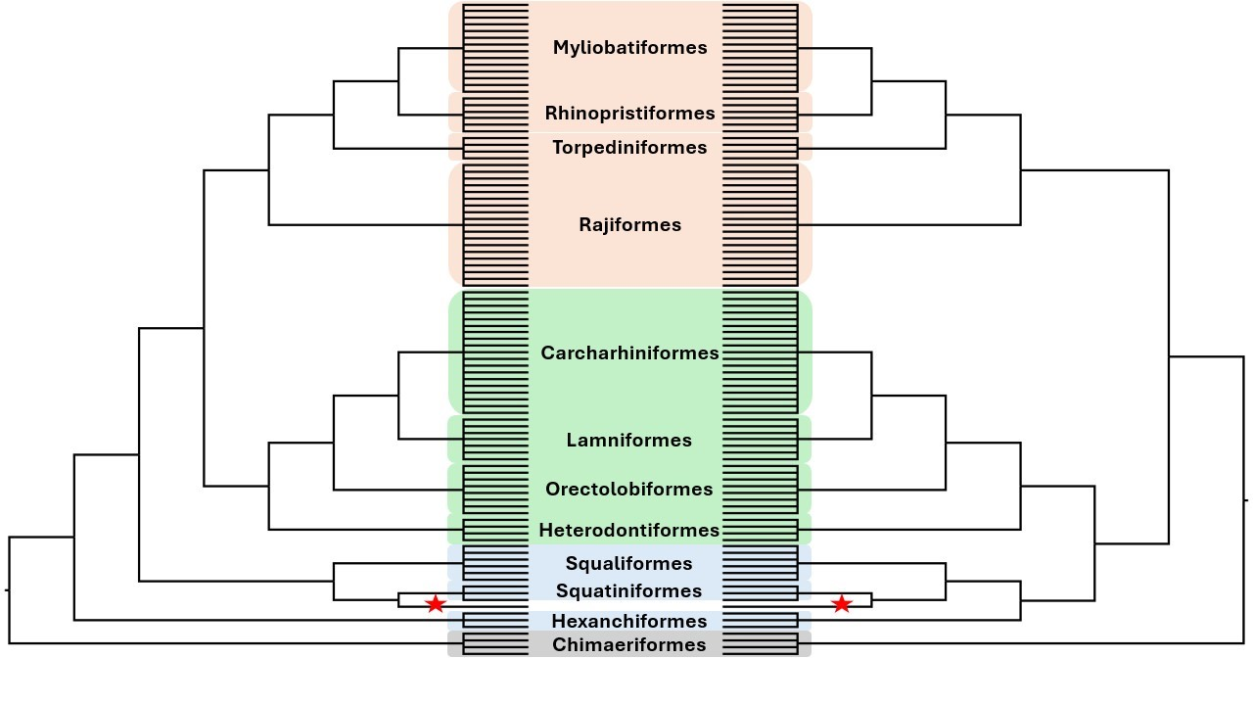
Phylogenomic Incongruence
Method of tree inference
Taxon or locus selection
Incongruent gene or species trees
Orthlogy inference, alignment and site trimming, selection of substitution model
Steenwyk et al. 2023, Incongruence in the phylogenomics era

Slide 26
Approaches for phylogenomic subsampling
Phylogenetic signal measurement
Parsimony informative sites
Relative composition frequency variability (RCFV)
Degree of violation of molecular clocklikeness
Evolutionary rate
Hypothetical testing
Gene Genealogy interrogation (GGI)
Gene-wise log-likelihood score (GLS), Site-wise log-likelihood score (SLS)
KH, SH, AU test
SOWH test

Slide 27
Phylogenetic signal measurement
Traditional (all taxon)
Novel (taxon- or group-specific)
$$GC= \frac{1}{n}\sum_{i=1}^{n}{\frac{Gi+Ci}{Gi+Ci+Ai+Ti}}$$
$$absDiffGC= \left|\left|GCOut−GCIng1\right| − \left|GCOut −GCIng2\right|\right|$$
$$absRatioLen= \left|\frac{EvolRateIng1 − EvolRateIng2}{EvolRateIng1+EvolRateIng2}\right|$$
$$EvolRate= \frac{1}{n}\sum_{i=1}^{n}{Xi}$$
$$DVMC= \sqrt{\frac{1}{n−1}\sum_{i=1}^{n}{\left(Xi − \overline{X}\right)}}$$
$Xi$: Distance between root and taxon $i$
$n$: Taxon
$μAi$: Base frequency of A for the $i$th taxon
$$RCVF= \sum_{i=1}^{n}{\frac{\left|μAi − \overline{μA}\right|+\left|μCi − \overline{μC}\right|+\left|μGi − \overline{μG}\right|+\left|μTi − \overline{μT}\right|}{n}}$$

Slide 28
OUTGROUP
INGROUP1
INGROUP2

Slide 29
Naylor 2025, Xu et al. 2023¹, Stein et al. 2018, Naylor et al. 2016, Aschliman et al. 2012
This study (19):
nt_wop, nt_wpc, nt12_wpc, aa_wop, aa_wpg, nt_outgroup_wpc, nt_300absDiffGC_wpc, nt_coal, nt_300dvmc_coal, nt_300evorate_coal, nt_300nrcfv_coal, nt_rmHex_wpc, nt_300absRatioLen_wpc, nt_outgroup_coal, nt_rmHex_coal, nt_300absRatioLen_coal, aa_coal, nt_300absDiffGC_coal
Gaitan-Espitia et al. 2016
This study (2):
nt_300eovrate_wpc,
nt_300nrcfv_wpc
Kousteni et al. 2021, Amaral et al. 2018
da Cunha 2017
This study (1):
nt_300dvmc_wpc
Naylor 2025, Xu et al. 2023¹,
Kousteni et al. 2021, Stein et al. 2018
Amaral et al. 2018, da Cunha 2017
Naylor et al. 2016, Aschliman et al. 2012
This study (8):
nt_rmHex_wpc, nt_300absRatioLen_wpc, nt_outgroup_coal, nt_rmHex_coal, nt_300absDiffGC_coal, nt12_coal, aa_coal, nt_300absRatioLen_coal
Li et al. 2012¹
This study (14):
nt_wop, nt_wpc, nt12_wpc, aa_wop, aa_wpg, nt_outgroup_wpc, nt_300absDiffGC_wpc, nt_coal, nt_300dvmc_coal, nt_300evorate_coal, nt_300nrcfv_coal, nt_300evorate_wpc, nt_300nrcfv_wpc, nt_300dvmc_wpc
Carvalho 1996², Shirai 1996²
¹ Only nuclear genes ² Morphological data

Slide 30
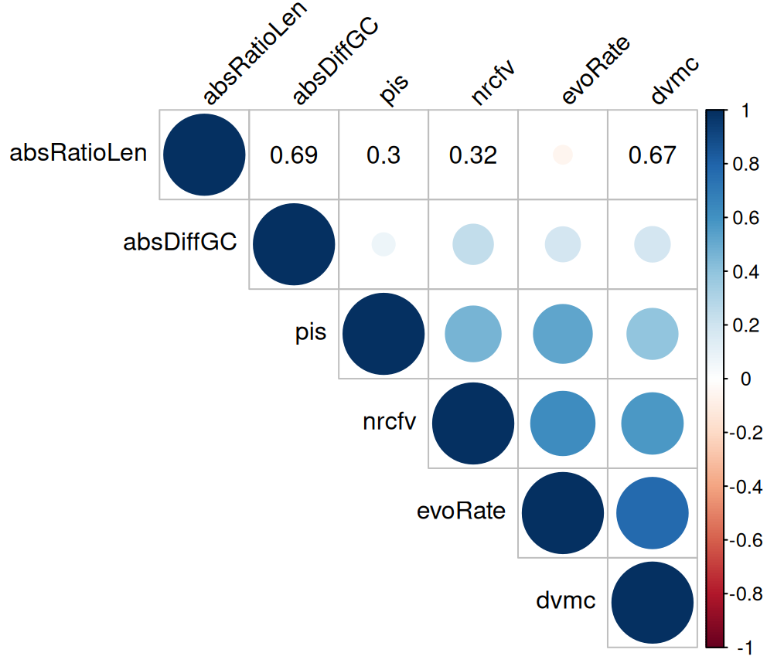
Distribution for each phylogenetic signals
Correlations among phylogenetic signals

Slide 31
Thank you!

Slide 32
Time for a tea break!

