Slide 1
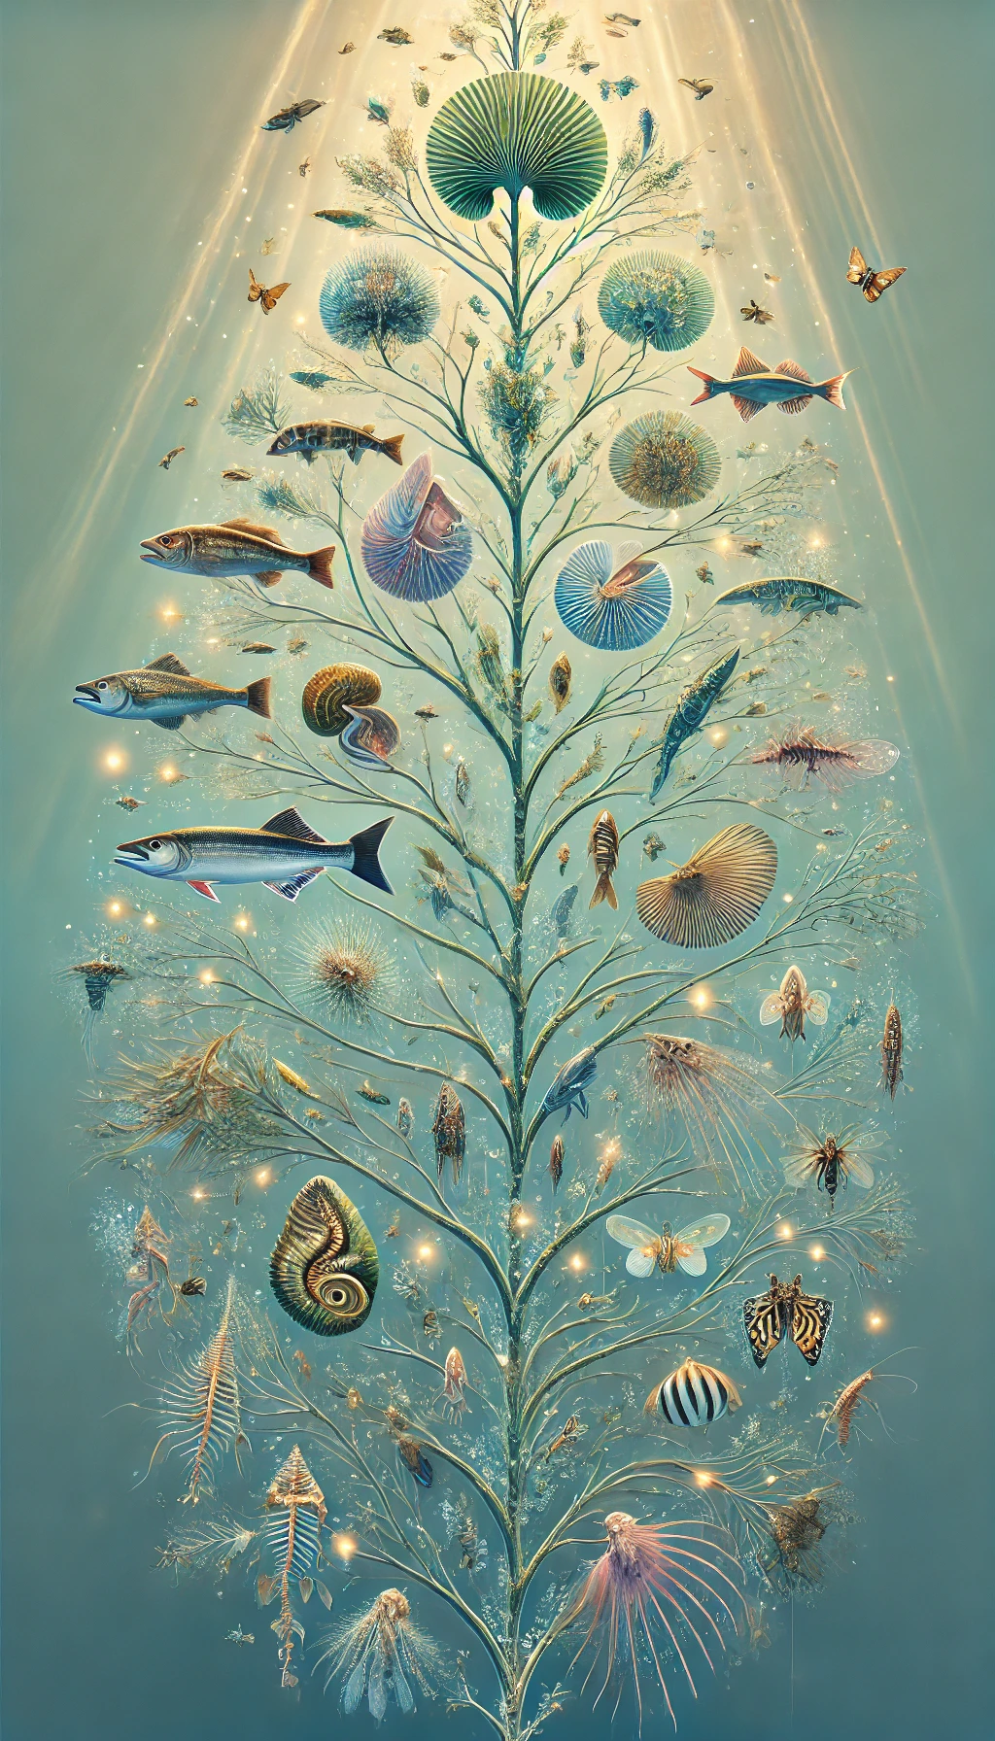
Workshop Phylogenetic Tree Beautification
Yao Yuan
2025.1.7

Slide 2
Outlines
Step-by-step beautification process of phylogenetic trees
iTOL website (https://itol.embl.de/) introduction

Slide 3
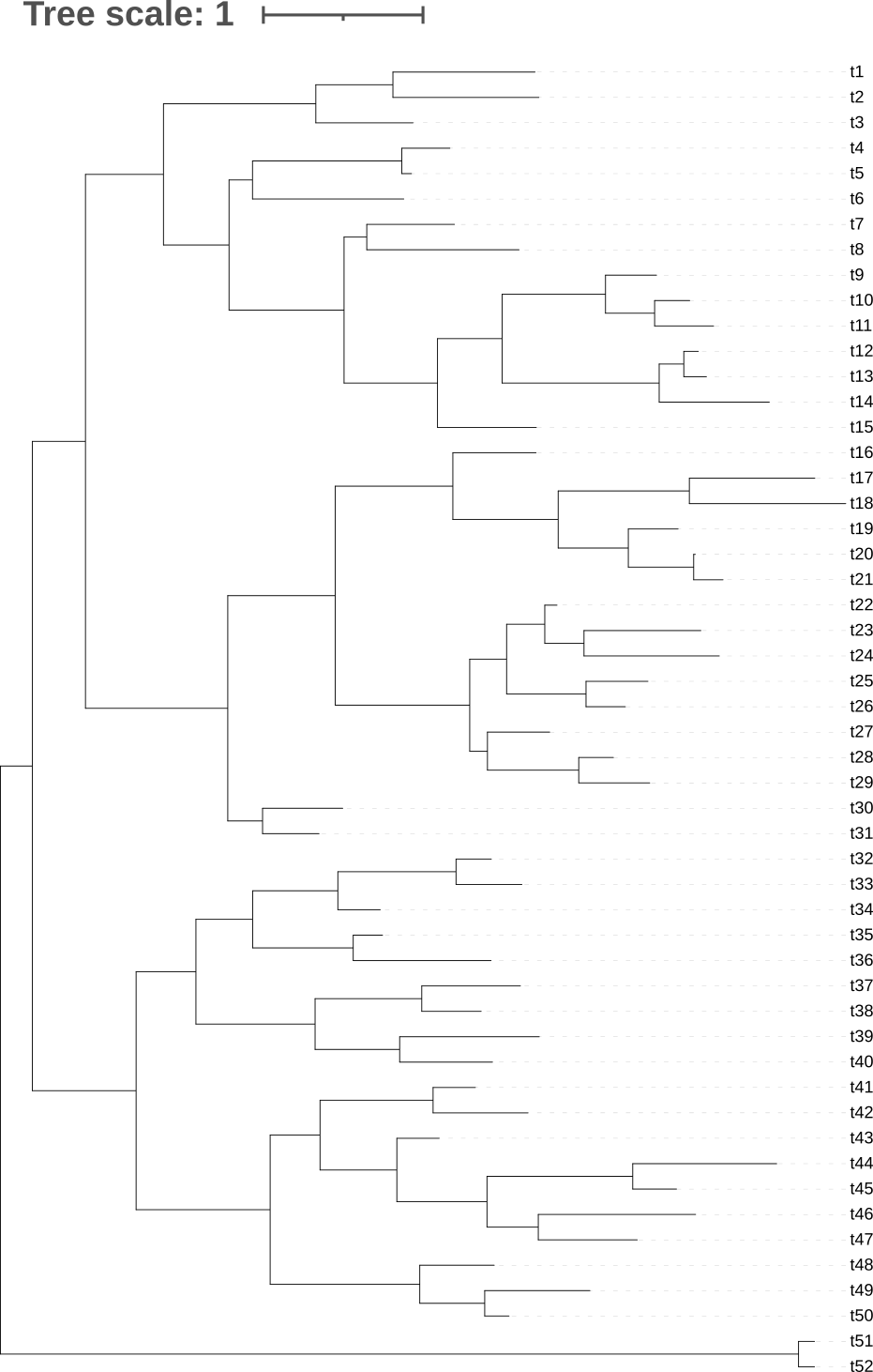
Introduction and Assumptions
Tip labels: t1-t52
Outgroup: t51, t52
Group1: t1-t15
Group2: t16-t31
Group3: t32-t40
Group4: t41-t50

Slide 4
Introduction and Assumptions
Tip labels: t1-t52
Outgroup: t51, t52
Group1: t1-t15
Group2: t16-t31
Group3: t32-t40
Group4: t41-t50

Slide 5
2
1

Slide 6
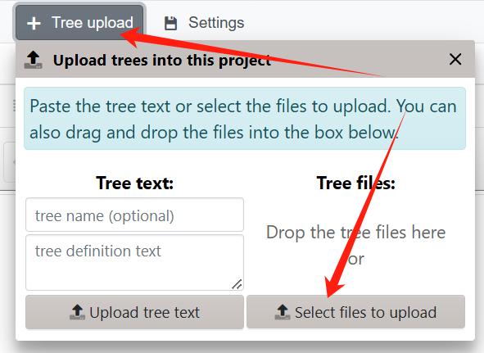
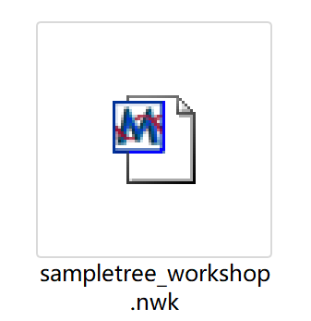
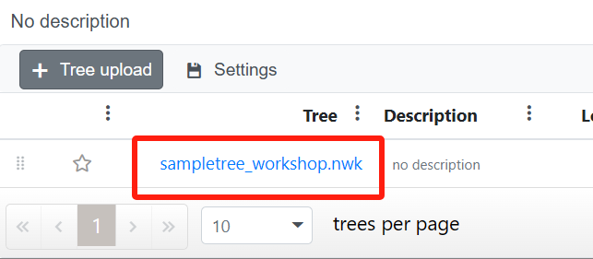
Upload Successfully

Slide 7
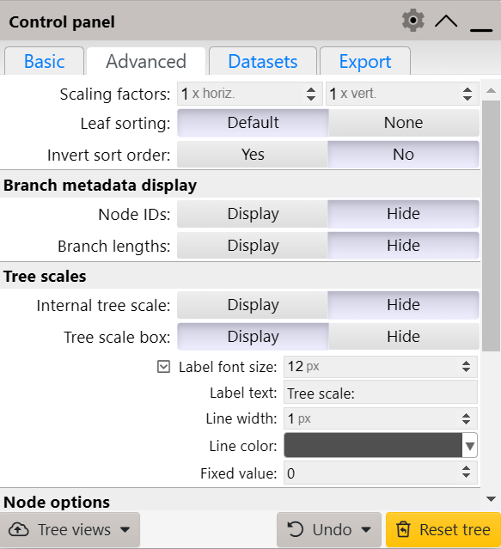
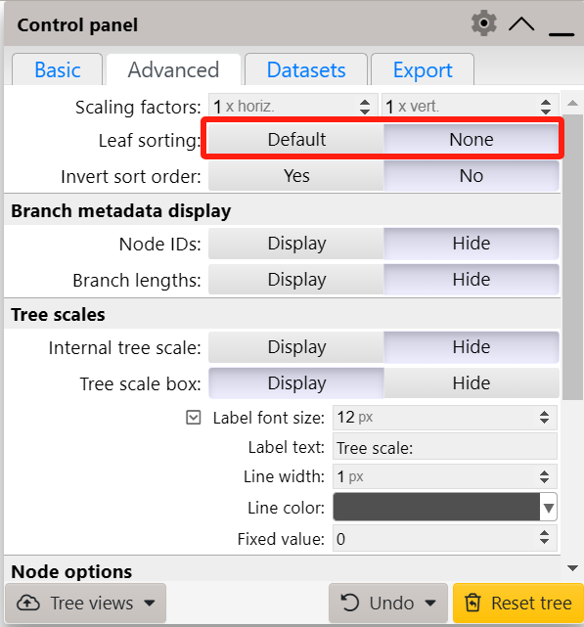

Slide 9
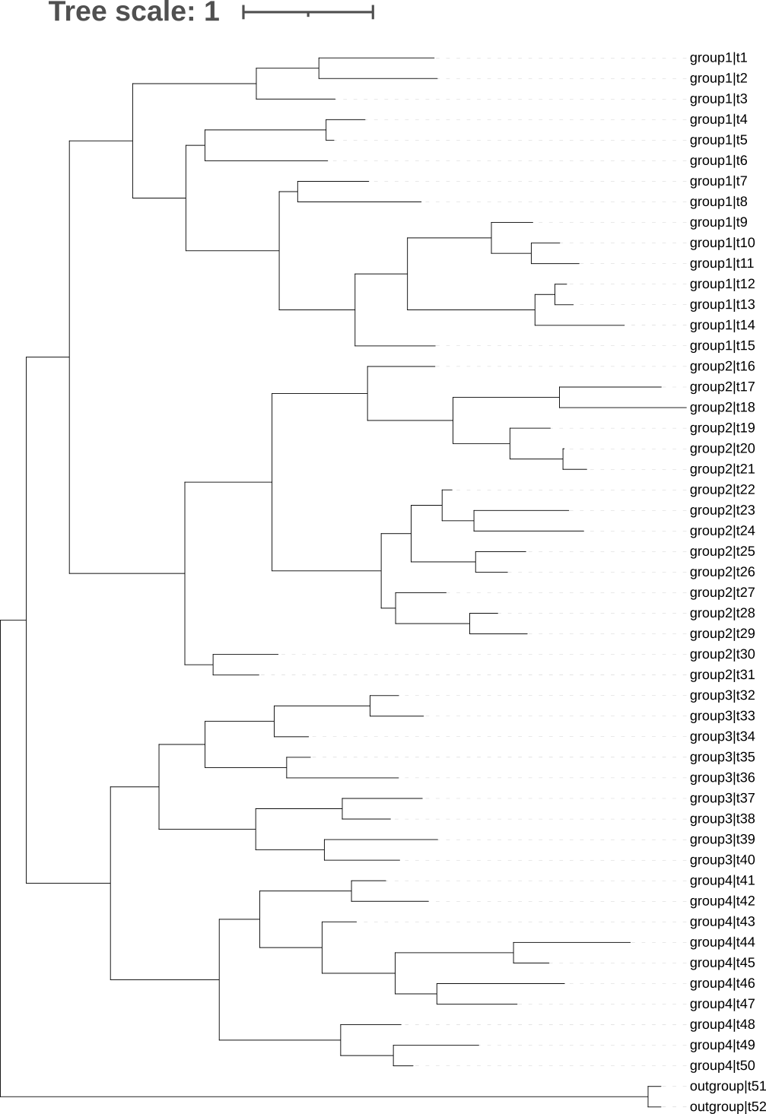
Changing leaf labels
t1→group1|t1
labels_template.txt
Original, Modified
t1, group1|t1

Slide 10
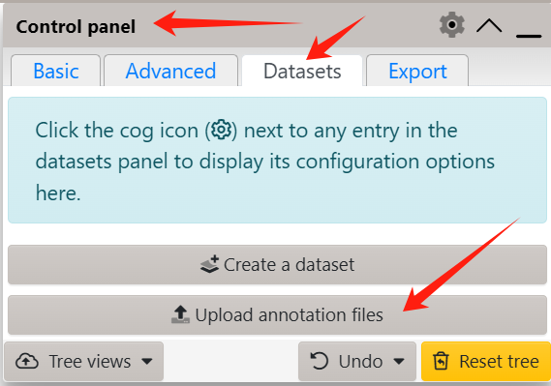
Changing leaf labels
labels_template.txt
Original, Modified
t1→group1|t1↓
t1,group1|t1

Slide 11
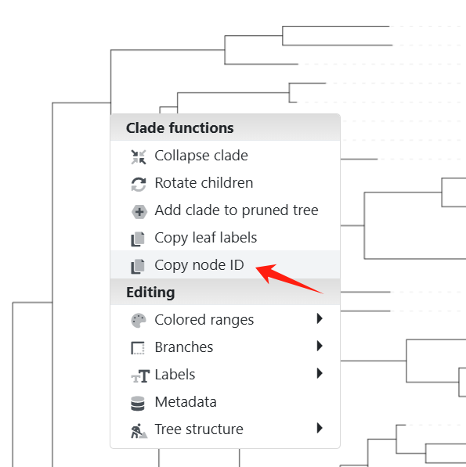
Color by group
dataset_ranges_template.txt
5 clades with different colors
Finding internal node code
How to choose color?
http://lcpmgh.com/colors/
I3,I3,#ffffff,#237B9F
separator:,
Most Recent Common Ancestor (MRCA) is the most recent individual or population from which two or more descendants share a direct lineage. It represents the last shared node in an evolutionary tree.
START_NODE_ID | END_NODE_ID | FILL_COLOR | GRADIENT_COLOR
I3 | I3 | #ffffff | http://lcpmgh.com/colors/

Slide 12
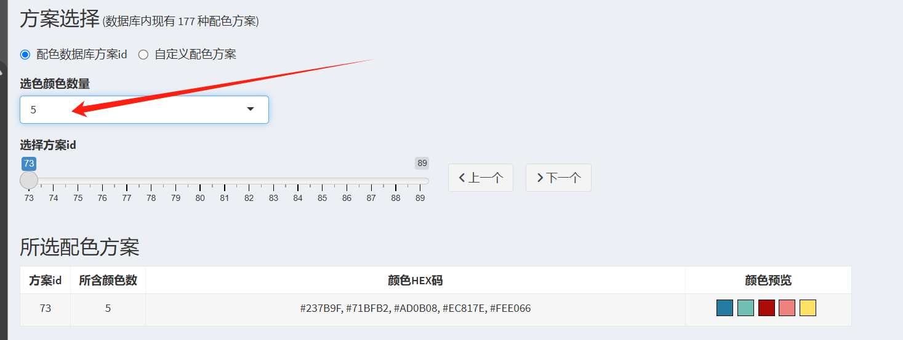
http://lcpmgh.com/colors/

Slide 13
Color by group
dataset_ranges_template.txt
5 clades with different colors
Finding internal node code
How to choose color?
http://lcpmgh.com/colors/
I3,I3,#ffffff,#237B9F
separator:,
START_NODE_ID | END_NODE_ID | FILL_COLOR | GRADIENT_COLOR
I3 | I3 | #ffffff | http://lcpmgh.com/colors/

Slide 14
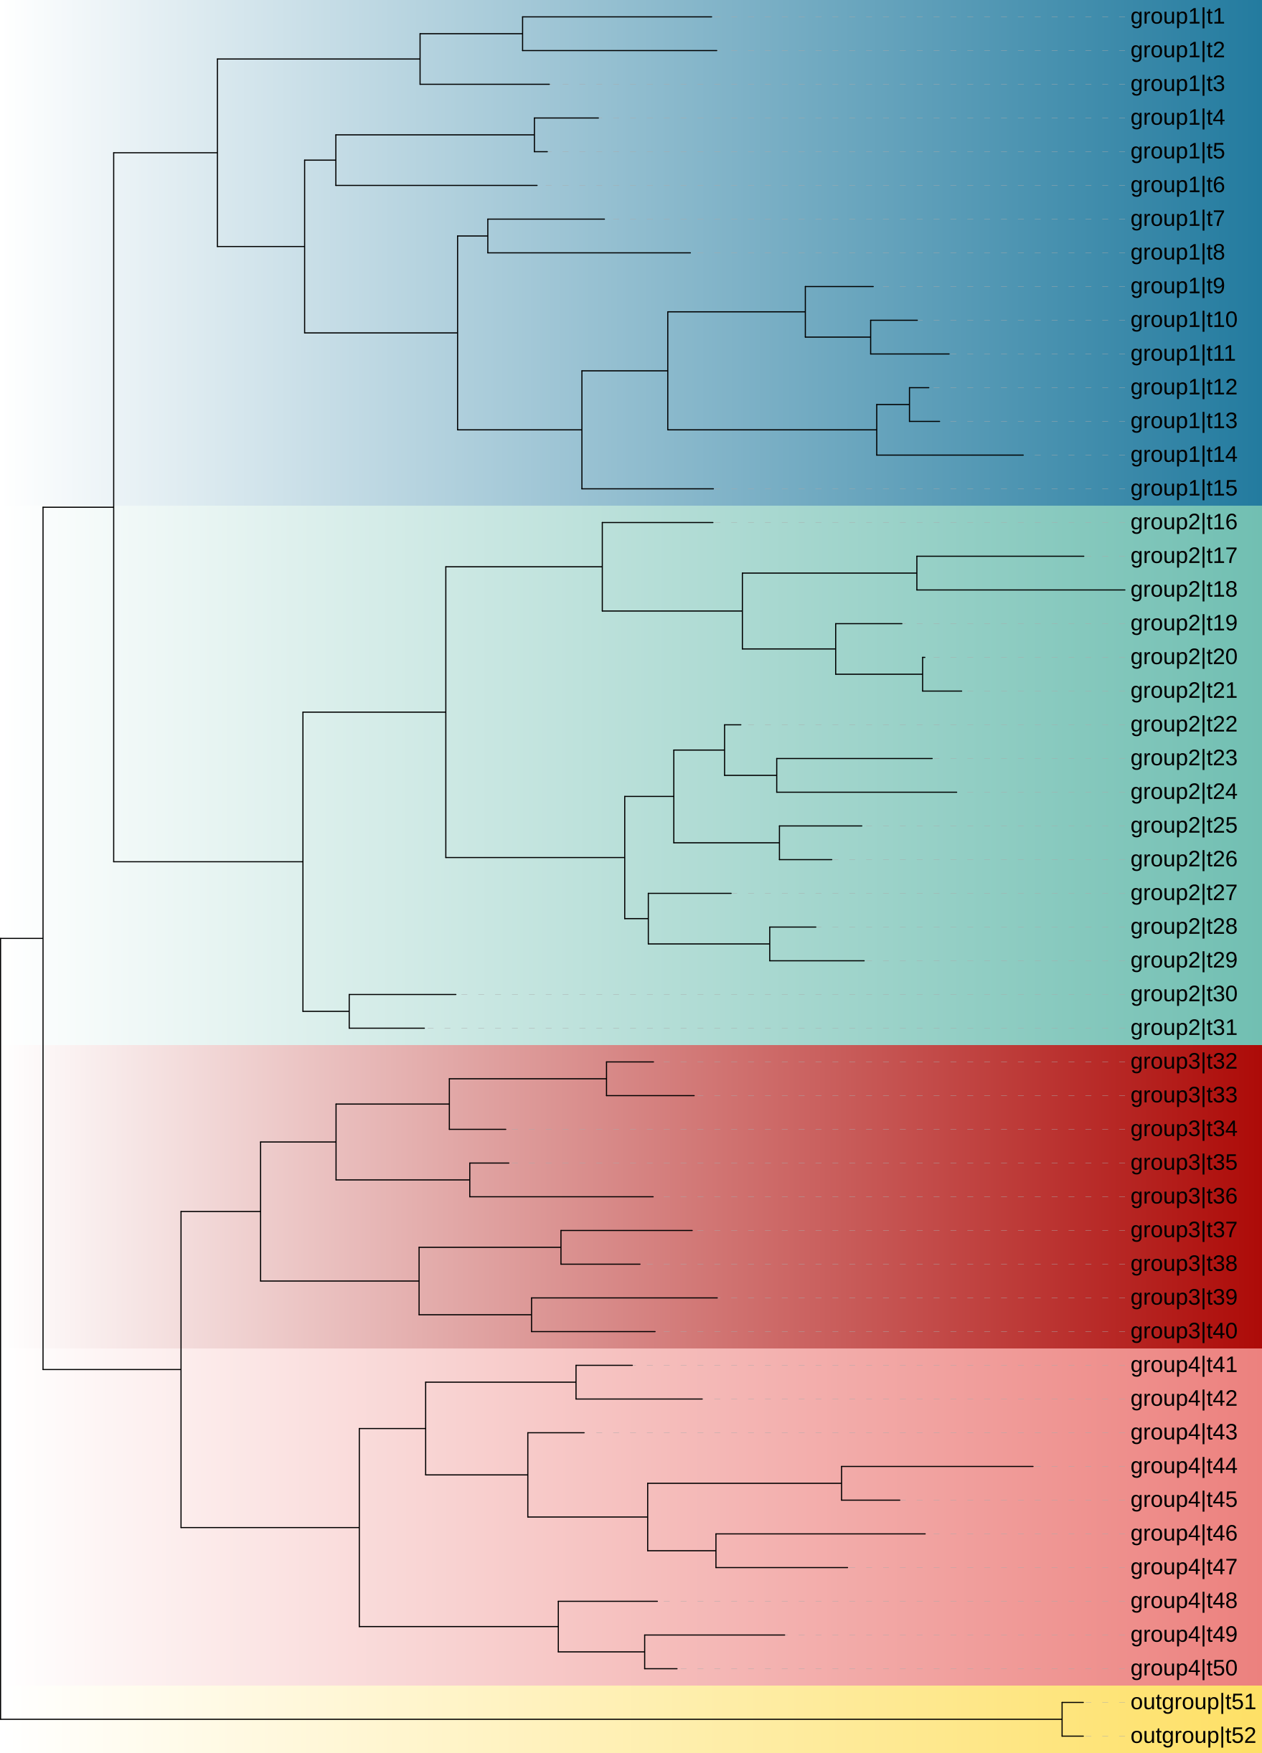
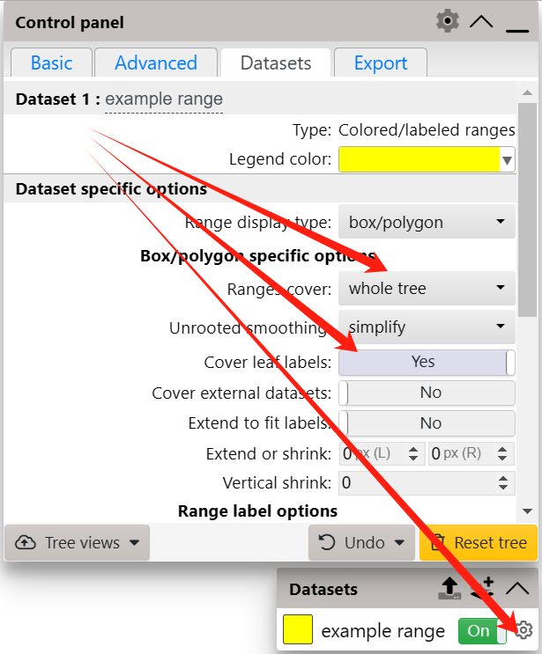
Color by group

Slide 15
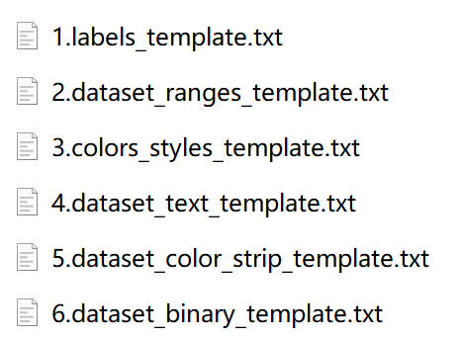
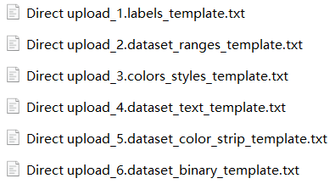

Slide 16
Color by group
colors_styles_template.txt
Different colors for branches and tip labels of the five clades
I3 clade #237B9F normal
t1 label #237B9F normal
separator:space
nodes ID ≠ nodes labels
node | type | color | branch style
I3 | clade | http://lcpmgh.com/colors/ | normal
t1 | label | http://lcpmgh.com/colors/ | normal
group1|t1

Slide 17
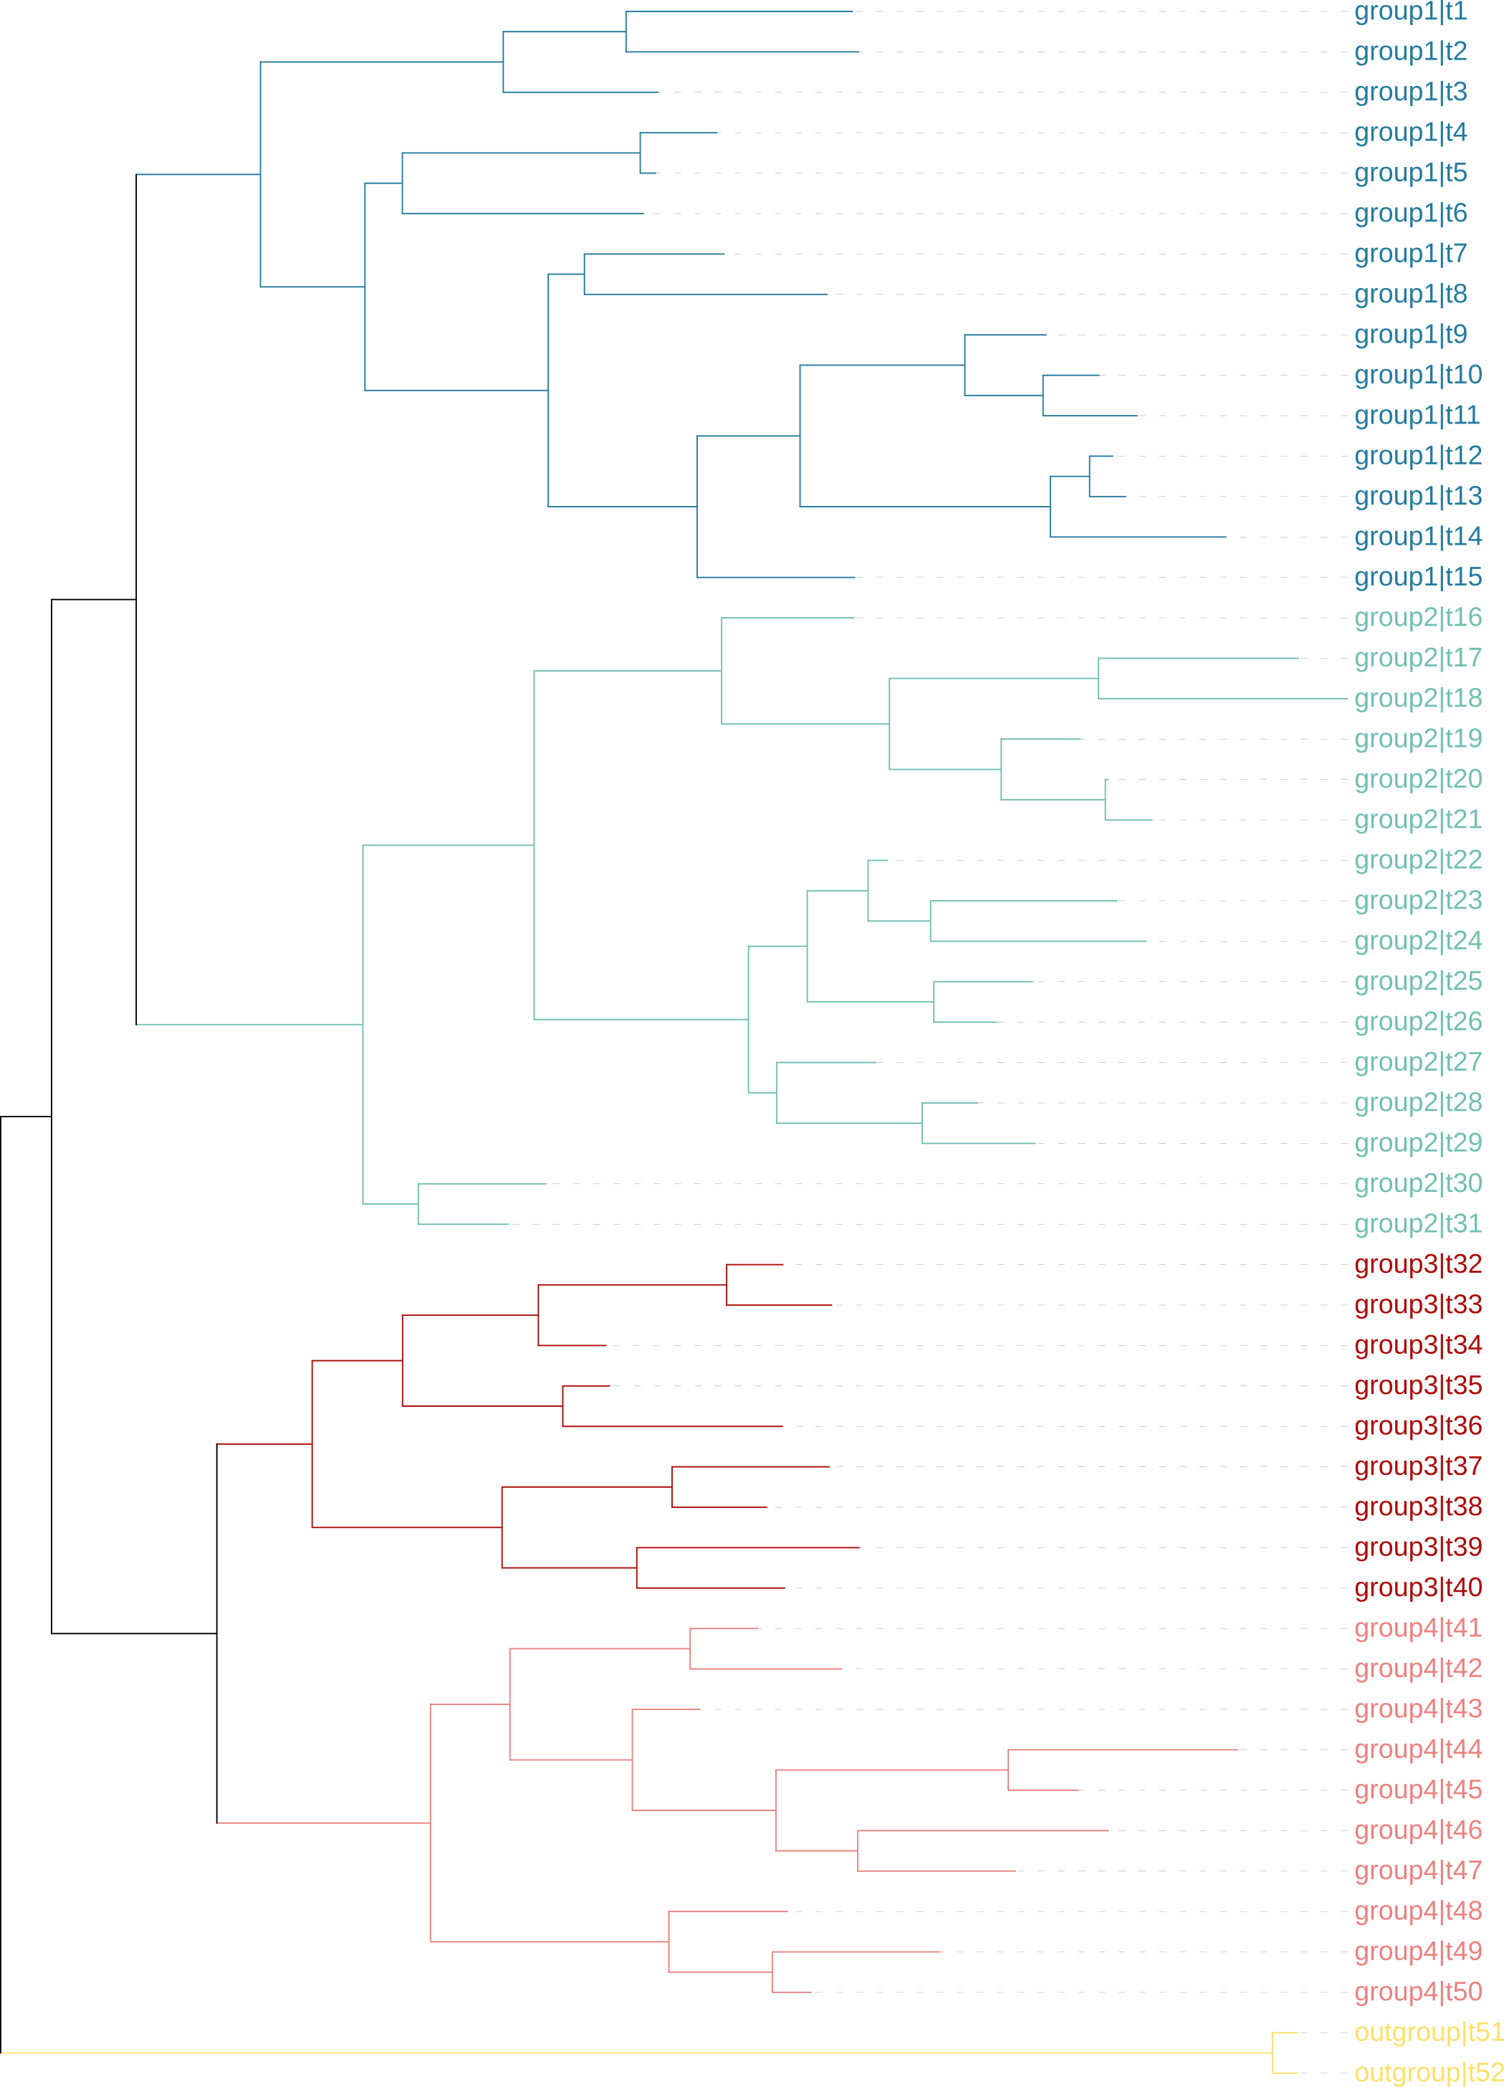
Color by group
colors_styles_template.txt
Different colors for branches and tip labels of the five clades
I3 clade #237B9F normal
group1|t1 label #237B9F normal
separator:space
Vision is limited to color selection

Slide 18
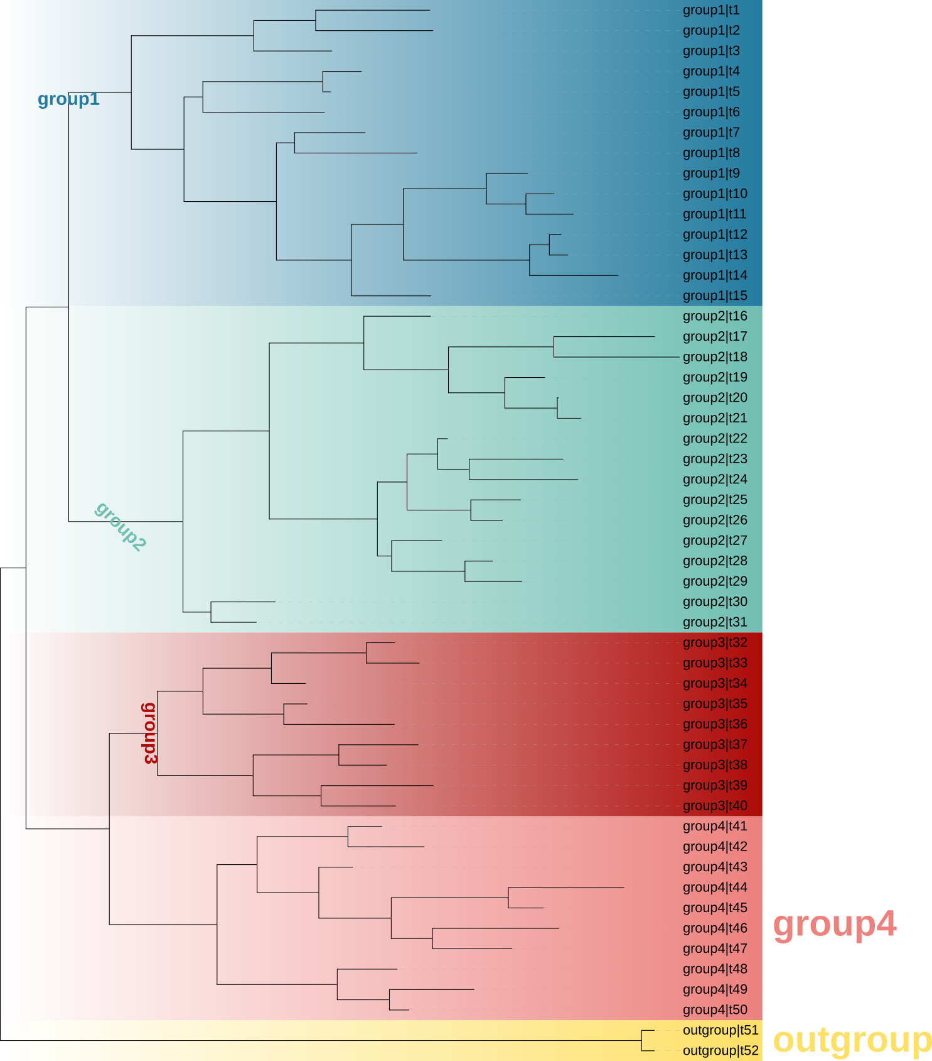
Adding external text labels
dataset_text_template.txt
separator:,
I3,group1,-1,#237B9F,bold,2,90
ID | label | position | color | style | size_factor | rotation
I3 | group1 | 0 | #237B9F | bold | 2 | 0
I32 | group2 | 0.5 | #71BFB2 | bold | 2 | 45
I64 | group3 | 1 | #AD0B08 | bold | 2 | 90
I81 | group4 | -1 | #EC817E | bold | 2 | 0
I100 | outgroup | -1 | #FEE066 | bold | 2 | 0

Slide 19
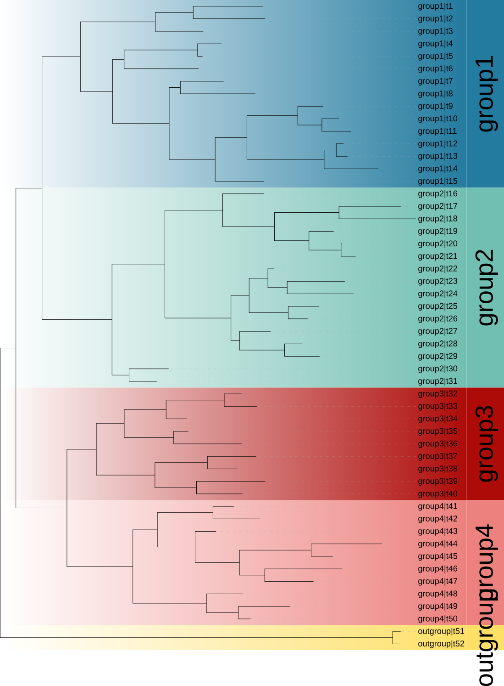
Adding colour strips
dataset_color_strip_template.txt
separator:space
I3 #237B9F group1
Limited by clades with small sample size
ID | color | label
I3 | #237B9F | group1
I32 | #71BFB2 | group2
I64 | #AD0B08 | group3
I81 | #EC817E | group4
I100 | #FEE066 | outgroup

Slide 20
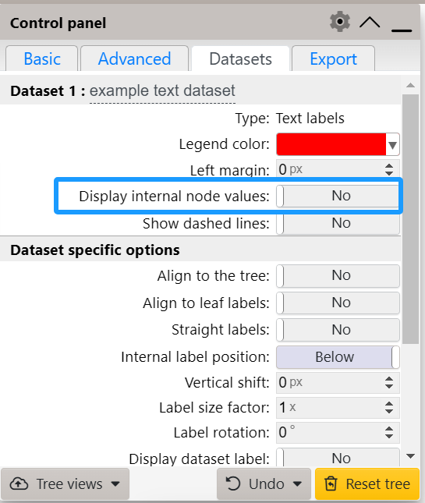
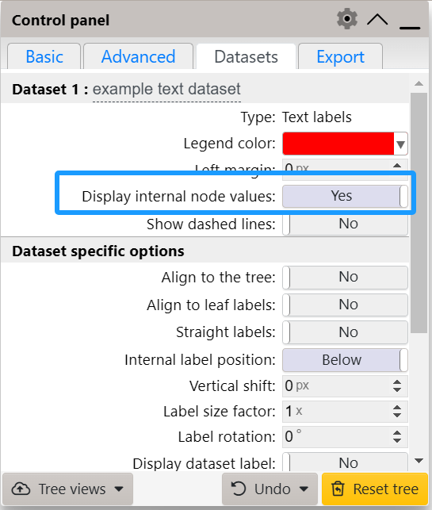

Slide 21
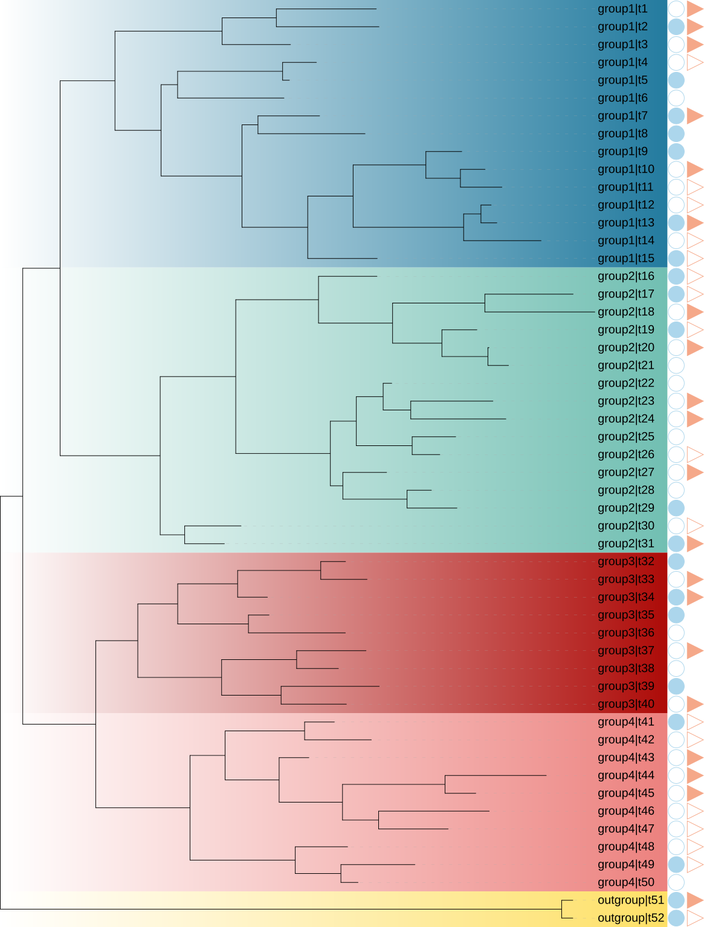
Binary data
dataset_binary_template.txt
highlight data that can be divided into 2-3 categories (0,1 / 0,1,-1)
FIELD_SHAPES,2,4
FIELD_COLORS,#ACD6EC,#F5A889
t1,0,1
Target shapes | circle | right pointing triangle
FIELD_SHAPES | 2 | 4
FIELD_COLORS | #ACD6EC | #F5A889
Custom Classification | 1: male | 1: freshwater
 | 0: female | 0: saltwater
 |  | -1: both
ID | ↑↓ | ↑↓
t1 | 0 | 1

Slide 22
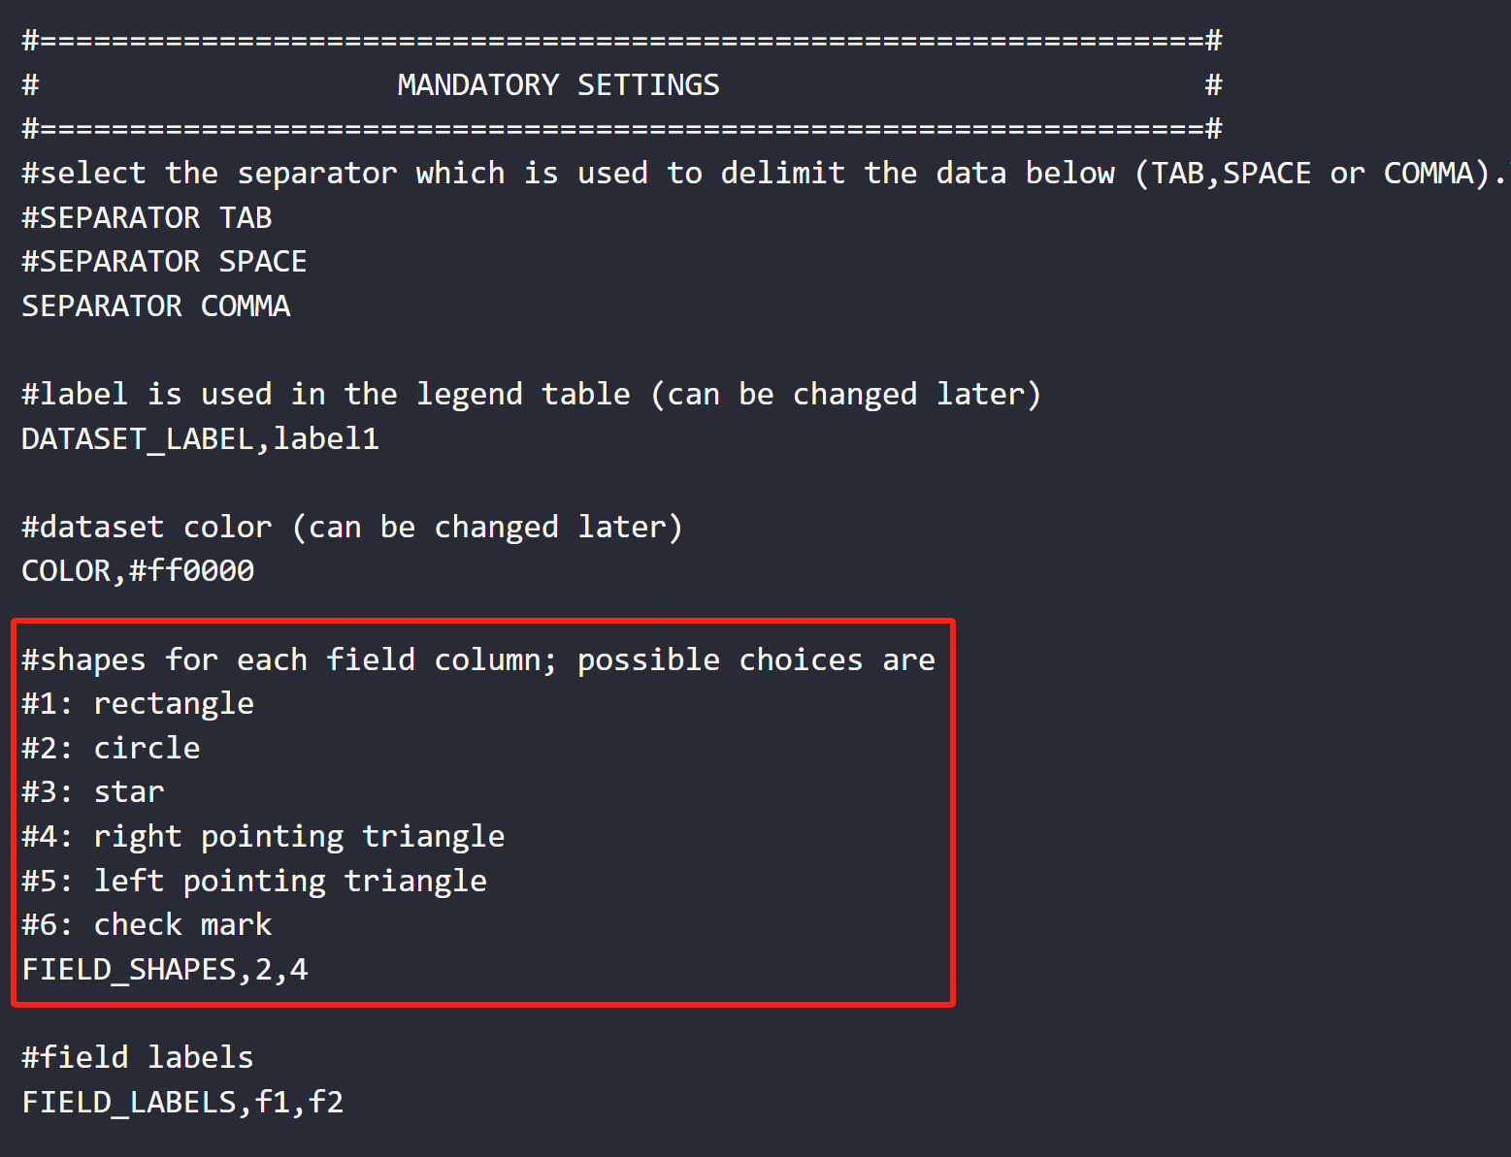
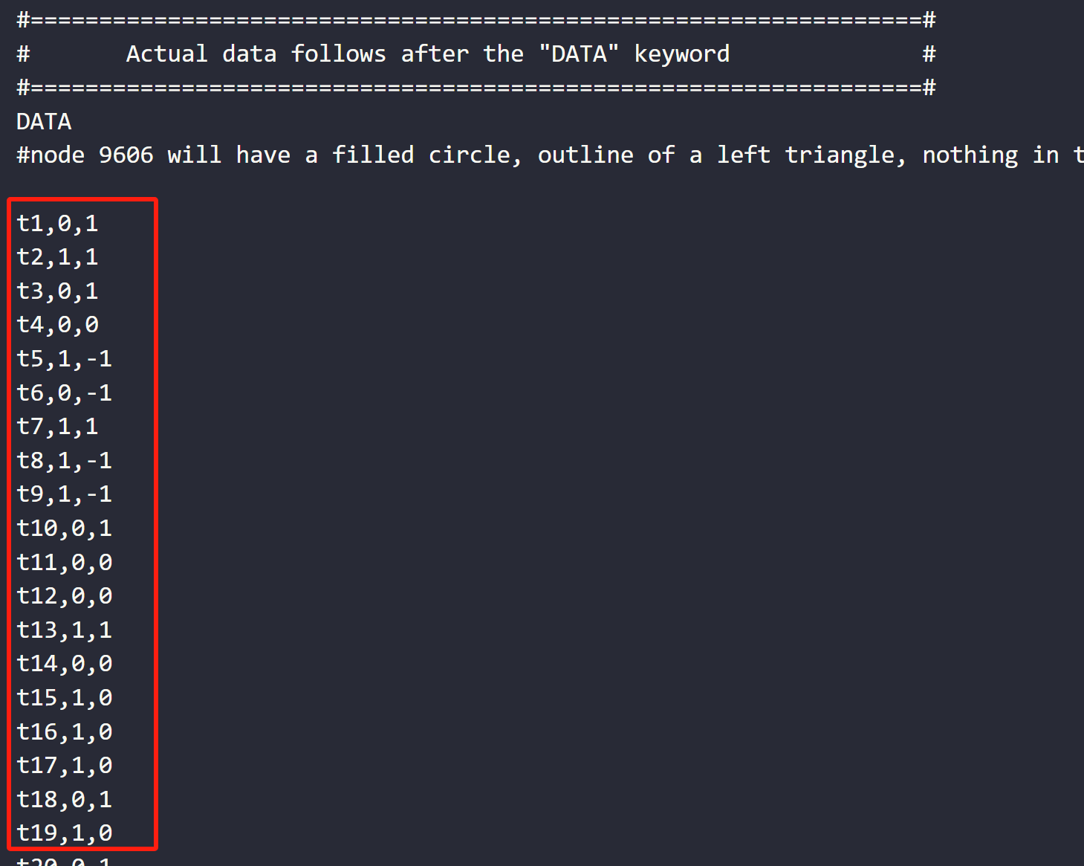
2
1
3

Slide 23
Binary data
dataset_binary_template.txt
highlight data that can be divided into 2-3 categories (0,1 / 0,1,-1)
FIELD_SHAPES,2,4
FIELD_COLORS,#ACD6EC,#F5A889
t1,0,1
Target shapes | circle | right pointing triangle
FIELD_SHAPES | 2 | 4
FIELD_COLORS | #ACD6EC | #F5A889
Custom Classification | 1: male | 1: freshwater
 | 0: female | 0: saltwater
 |  | -1: both
ID | ↑↓ | ↑↓
t1 | 0 | 1

Slide 24
Summary
Changing leaf labels
Add Legend information
dataset_ranges_template.txt
Color by group
colors_styles_template.txt
Adding external text labels
Add classification information
Adding colour strips
Binary data

Slide 25
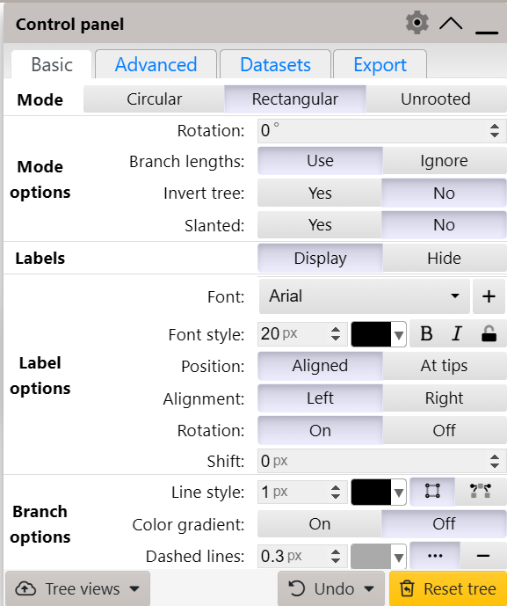
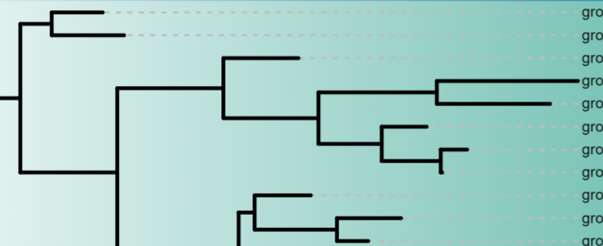

Slide 26
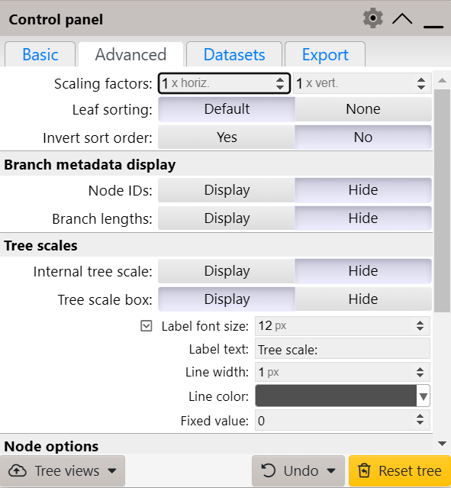
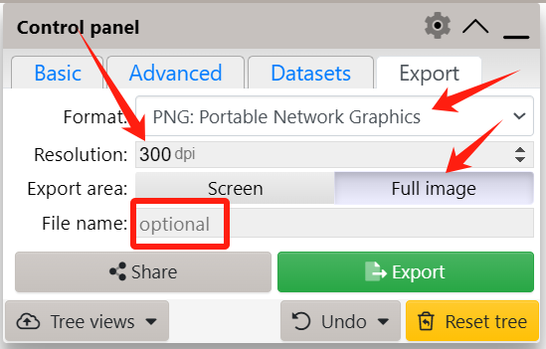

Slide 27
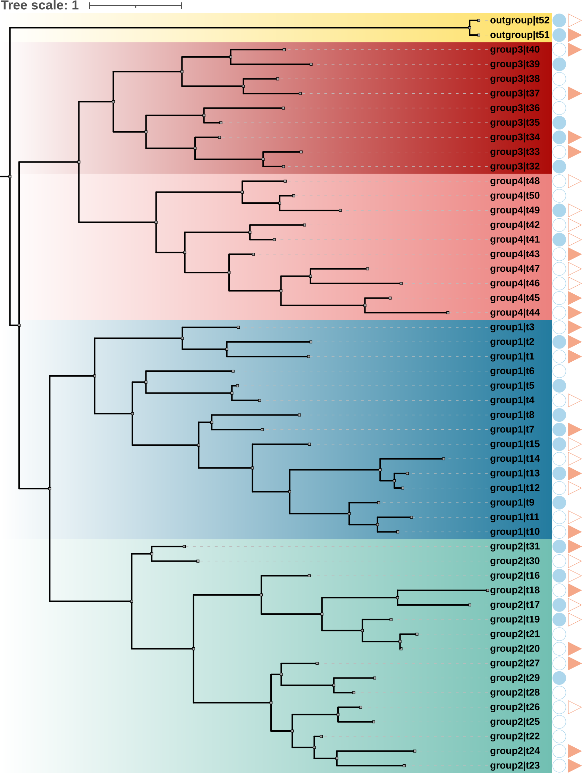
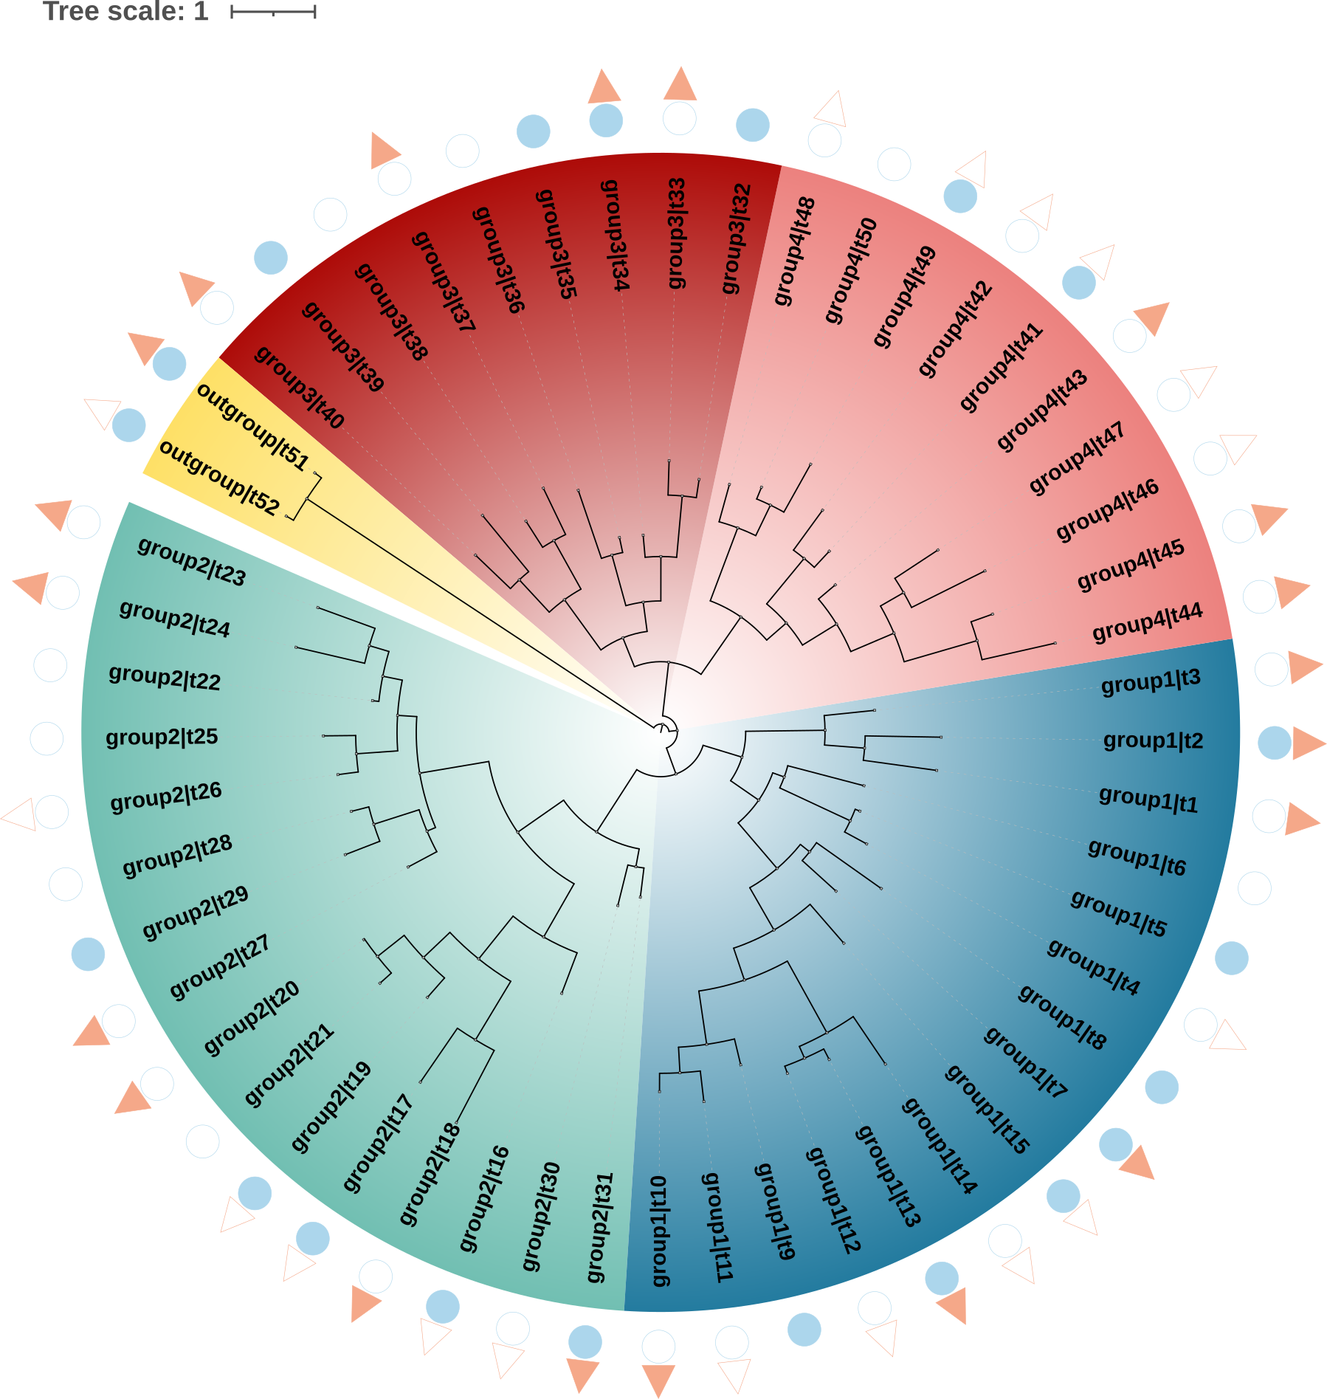
Original View
After beautification
After beautification

Slide 28
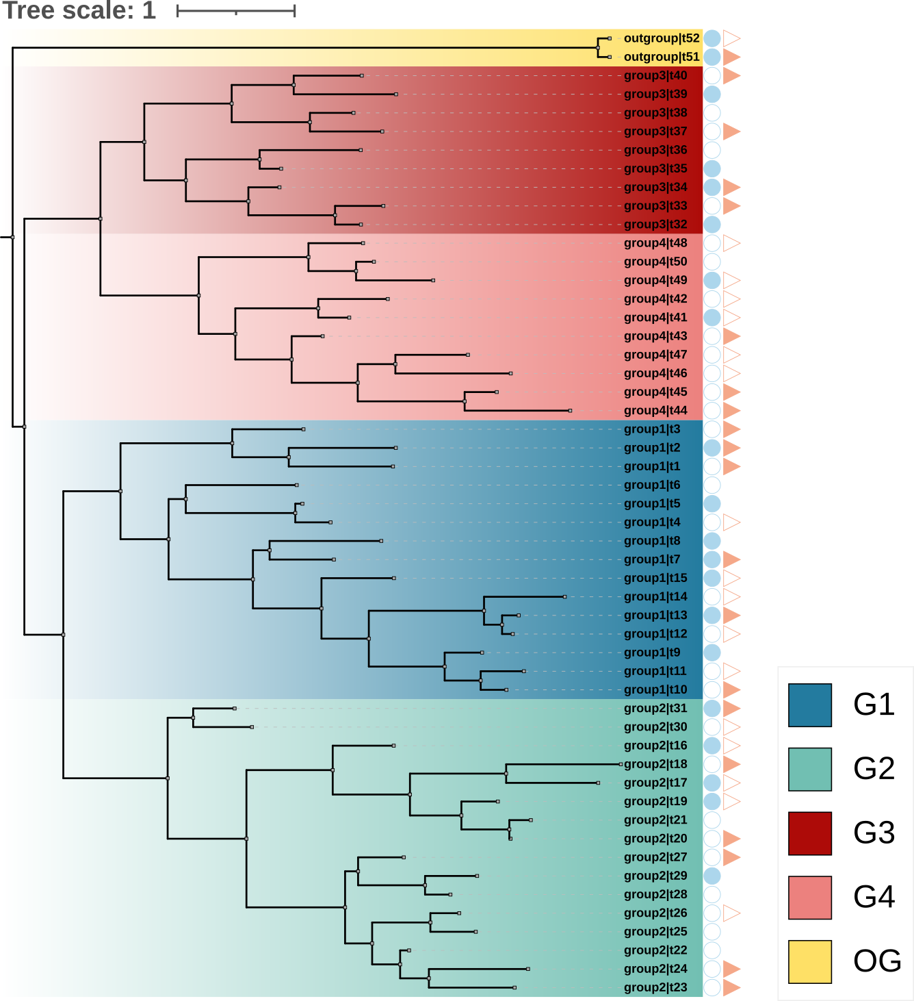
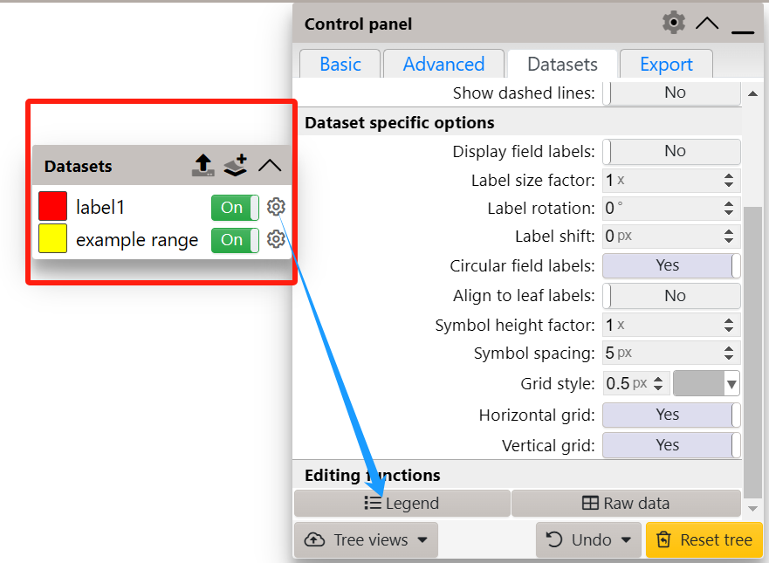
https://doi.org/10.1093/nar/gkae268

Slide 29
Thanks !

Slide 30
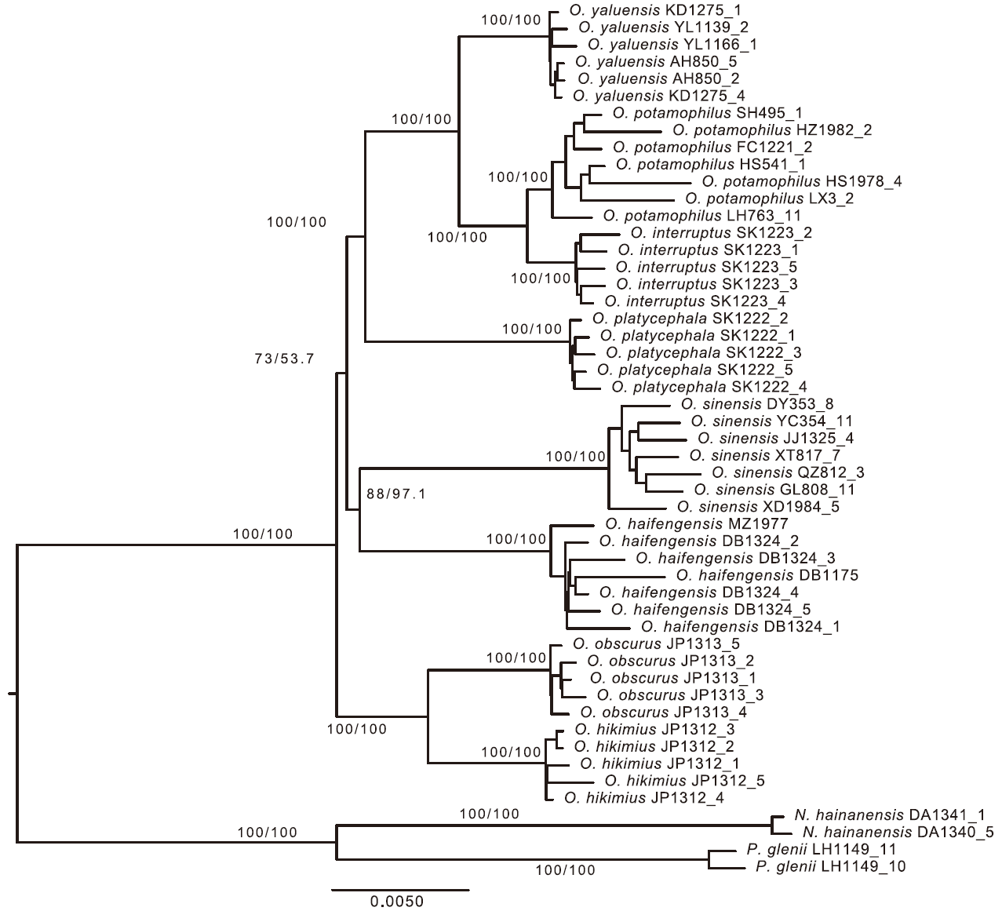
Overview of a Gene Tree
Branch Length
Terminal Node
Root: Represents the most recent common ancestor of all organisms, marking the starting point of the gene tree.
Branch: Represents evolutionary lineages, connecting different nodes on the tree.
Branch Length: Reflects the amount of evolutionary change or the time elapsed.
Internal Node: A junction point of branches, representing a hypothetical common ancestor.
Terminal Node: The endpoint of a branch, representing specific species or groups.
Monophyletic Group: A group that includes an ancestor and all its descendants.
Scale Bar: Used to measure the evolutionary time or degree of change represented by branch lengths.
Branch
Internal Node
Root
Monophyletic Group
Scale Bar

