Slide 1

Assemble gene capture & resequencing data
(Assexon pipeline)
2025.01.06
FAM YI QING 范扆溱

Slide 2
Assexon Pipeline – Reads Assembly
Parse reads to homologous targeted loci
Remove PCR duplication
Parse reads to homologous targeted loci
De novo assembly
Trimmed Reads
Remove PCR duplication
Further assembly & extract exons
Done!
Filter
alignment
Align sequences
Remove potential paralogs - UBLAST

Slide 3
01
Receiving Raw Data
Perform the Assexon Pipeline from Raw Data
02
Data Decompression
03
Data Demultiplexing
04
Data Trimming
05
Data Assembly

Slide 4
01
Receiving Raw Data

Slide 5
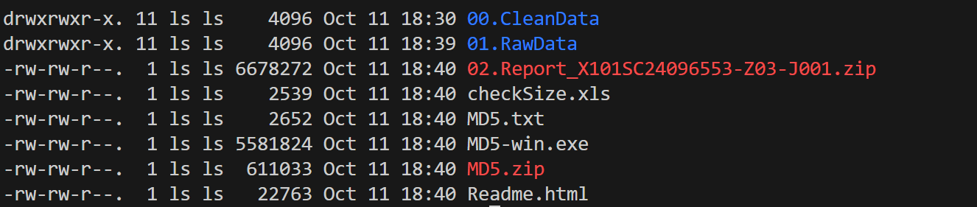
Receive Raw Data
After sequencing data is returned, it is usually in a folder corresponding to the name provided during sequencing submission. The folder contains a series of subfolders and files as shown in the figure below:
JAN 6th

Slide 6
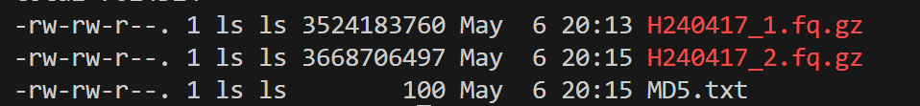
Receive Raw Data
请输入您的标题
The RawData folder consists of different subfolders based on different P5 and P7 adaptor.
Each subfolder contains paired compressed files in .gz format.
.gz format compressed files
Forward sequencing
Reverse Sequencing

Slide 7
Receive Raw Data
Copy the raw data folder from the local server (or wherever server the folder is in) to our targeted remote server and to the exact working directory
请输入您的标题
Note:
scp = Secure Copy Protocol = Used for securely copying files between a local host and a remote host or between two remote hosts
-r = Recursive
Command for local-to-remote Copy
scp -r [space] #CompleteLocalDataPath# [space] #RemoteServerUsername#@#RemoteServerIPAddress#:#CompleteDestinationPathOnRemoteServer#
Ex：scp –r /data/data_backup/2024data/FYQ/01. RawData/ Gate@10.21.2.2008:/home/phylogenetic/User/FYQ/Fish

Slide 8
Receive Raw Data
Copy the raw data folder from the local server (or wherever server the folder is in) to our targeted remote server and to the exact working directory
请输入您的标题
Command for remote-to-local Copy
Note: Do not delete the raw data in the local server
scp -r [space] #RemoteServerUsername#@#RemoteServerIPAddress#:#CompleteDestinationPathOnRemoteServer# [space] #CompleteLocalDataPath#
Ex：scp –r Gate@10.21.2.2008:/home/phylogenetic/User/FYQ/Fish/01. RawData /data/data_backup/2024data/FYQ/

Slide 9
02
Data Decompression

Slide 10
Data Decompression
After transferring to your desired server, run the decompression command in the directory where the data files is located.
请输入您的标题
Command
nohup gunzip -d *.gz > gunzip.log &
Note:
nohup = no hang up = Allows tasks to continue running in the background even if the terminal is closed.
gunzip –d = Command to decompress files in gzip (.gz) format
*.gz = Matches all files in the current directory that end with .gz
& = Runs the task in the background

Slide 11
Data Decompression
请输入您的标题
Data after decompression
Rename
Data before decompression
FILE_NAME
├── FILE_NAME_1.fq
└── FILE_NAME_2.fq
FILE_NAME
├── FILE_NAME_R1.fq
└── FILE_NAME_R2.fq
Command
rename 's/old/new/' *old
Note:
rename = Batch Rename
s = substitute
* = wildcard = matches all files or directory names that meet the specified conditions
Ex:
rename 's/_2.fq/_R2.fq/' *_2.fq
JAN 6th

Slide 12
03
Data Demultiplexing

Slide 13
Data Demultiplexing
Switch Environment
Command: conda activate #name of the environment#
Ex: conda activate phylogenetic_analysis

Slide 14
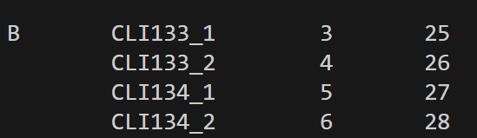
Data Demultiplexing
Inlineindex.txt
Note:
inlineindex.txt contains all sequence information for the inline index. Please store it properly and do not modify it casually
Make sure you have this inlineindex.txt under your environment variables
Command = vim indexpair.txt
Raw Data
File name [Tab] Sample_code [Tab] IS1 [Tab] IS2
Create indexpair.txt
Create indexpair.txt under your working directory and enter the corresponding data information.
The formatting is a 4-column table separated by [Tab]

Slide 15
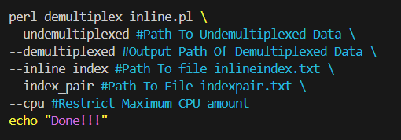
Data Demultiplexing
Edit script demultiplex.sh to invoke the demultiplex_inline.pl
请输入您的标题
Make sure demultiplex.sh under your working directory
Note:
After data demultiplexing is complete, you may clean up unnecessary data and free up disk space.
rm -rf [space] #PathToUndemultiplexedData#
Run demultiplex.sh
Under the directory containing the file demultiplex.sh, enter the command:
nohup sh ./demultiplex.sh > demultiplex.log &

Slide 16
04
Data Trimming

Slide 17
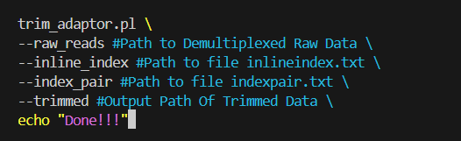
Data Trimming
Trimming sequencing adapters and low-quality sequences
请输入您的标题
Make sure trim.sh under your working directory
Note:
1. After data trimming is complete, you may clean up unnecessary data and free up disk space.
rm -rf [space] #PathToUntrimmedData#
2. Do not delete the trimmed data as it is important for further work
Run trim.sh
Under the directory containing the file trim.sh, enter the command:
nohup sh ./trim.sh > trim.log &

Slide 18
05
Data Assembly

Slide 19
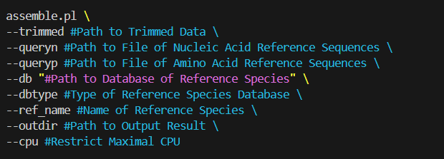
Data Assembly
Edit script assemble.sh
请输入您的标题
Make sure assemble.sh under your working directory
Note:
After data assembly is complete, you may clean up unnecessary data and free up disk space.
rm -rf ./run_dir
Run assemble.sh
Under the directory containing the file assemble.sh, enter the command:
nohup sh ./assemble.sh > assemble.log &

Slide 20
06
Practice

Slide 21
Data Demultiplexing
Switch Environment
Command: conda activate #name of the environment#
Ex: conda activate phylogenetic_analysis

Slide 22
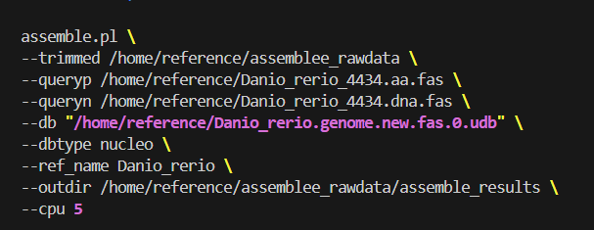
Data Assembly
Edit assemble.sh
请输入您的标题
Make sure assemble.sh under your working directory
Ex: cp [space] /home/reference/phylogenetic_pipeline/script_and_others/assemble.sh [space] /mnt/phylogenetic_practical
Under your working directory，command vim assemble.sh
trimmed /home/reference/assemblee_rawdata \
queryp /home/reference/Danio_reference/Danio_rerio_4434.aa.fas \
queryn /home/reference/Danio_reference/Danio_rerio_4434.dna.fas \
db “/home/reference/Danio_reference /Danio_rerio.genome.new.fas.0.udb” \
dbtype nucleo \
ref name Danio_rerio \
outdir /mnt/phylogenetic_practical/assembly results \
cpu 5

Slide 23
07
Result

Slide 24
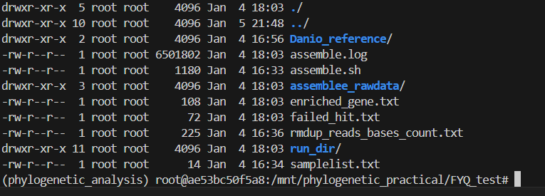
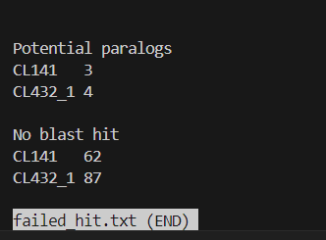
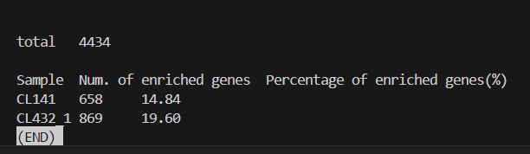
1
2
3
2
1
3

Slide 25
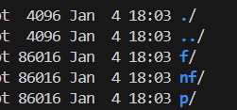
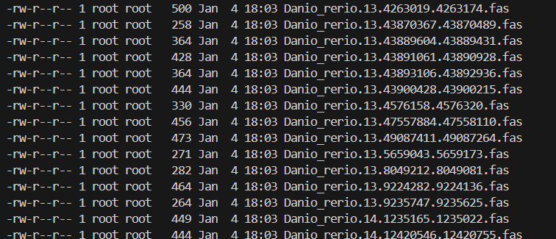
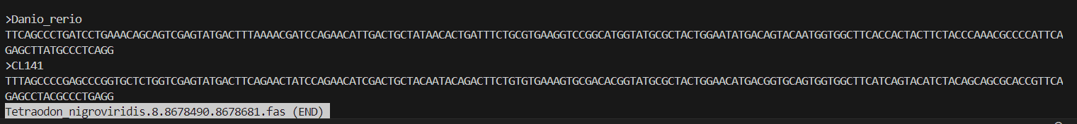

Slide 26
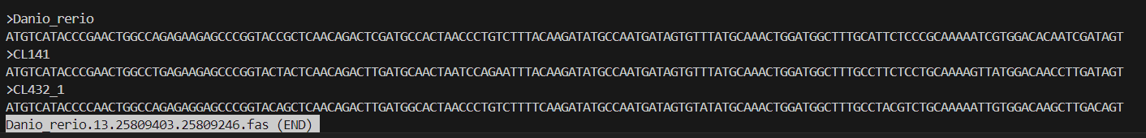

Slide 27
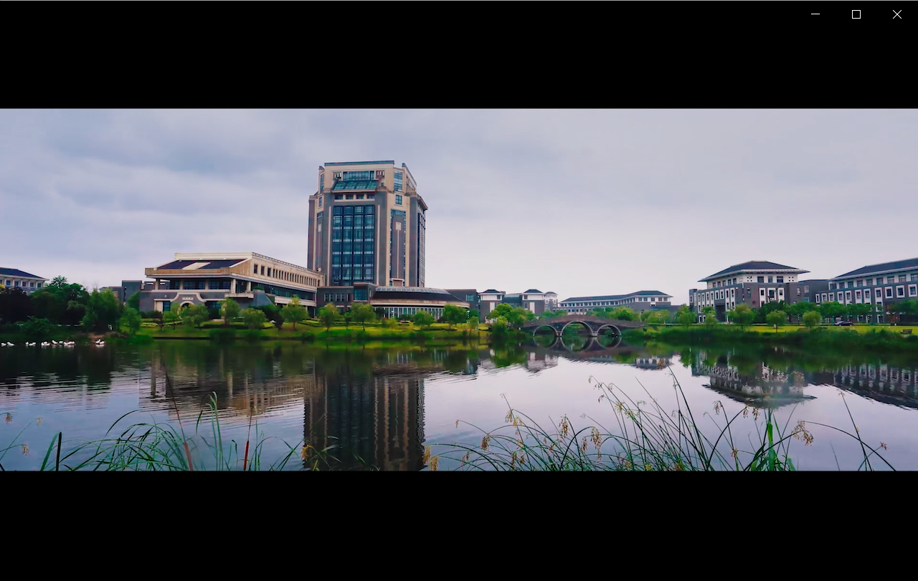
Thank You
2025.01.06
FAM YI QING 范扆溱

