Slide 1
Black Usage
JunLong Jiang
LMSE
Shanghai Ocean University
Jan 6 2025

Slide 2



Softwares used in SSH login
Visual Studio Code
Download: https://code.visualstudio.com/
Xshell
Download: https://www.netsarang.com/en/xshell/
Windows powershell
Download: https://github.com/PowerShell/PowerShell/releases/tag/v7.3.2

Slide 3
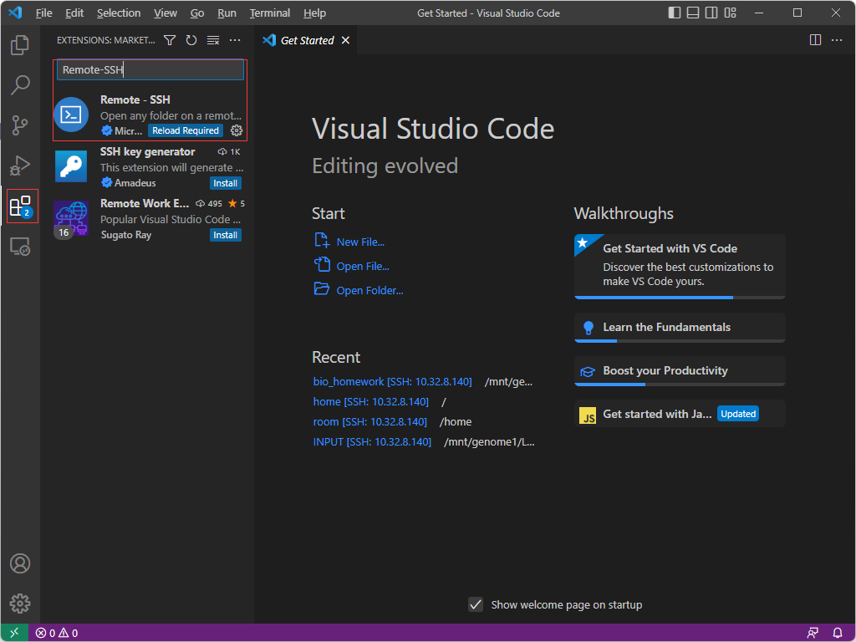
Visual Code Studio
1. Install Remote-SSH
Notes:
For Visual Code Studio, a plug-in named Remote-SSH need to be installed.

Slide 4
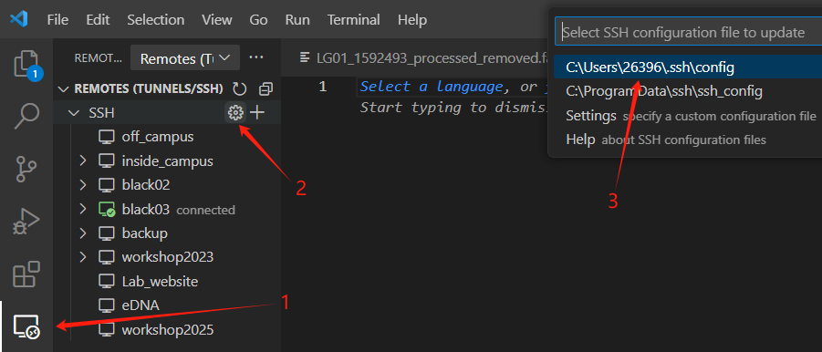

2. Edit Config file

Slide 5
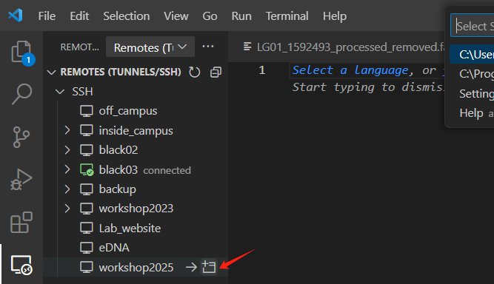
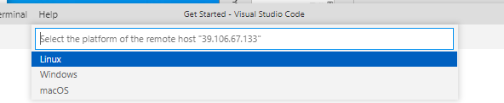

3.Login workshop account and Open terminal

Slide 6
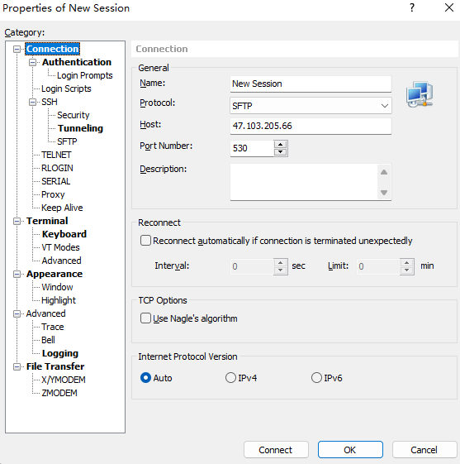
Xshell
1. Edit session
Notes:
For Xshell, the first step is to edit a new session. Import Host IP, Port Number and change Protocol to SFTP

Slide 7
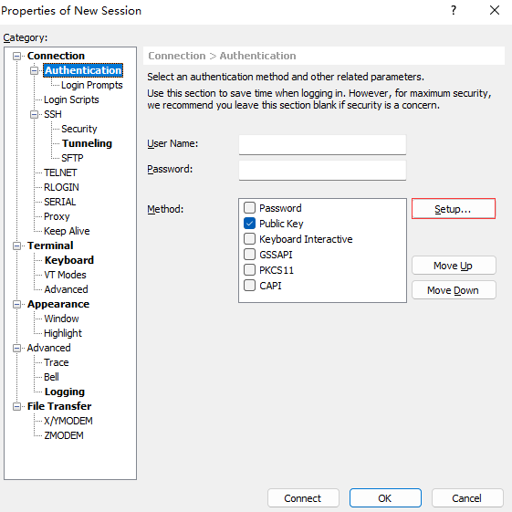
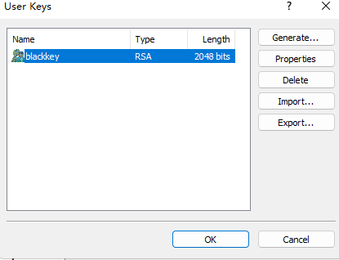
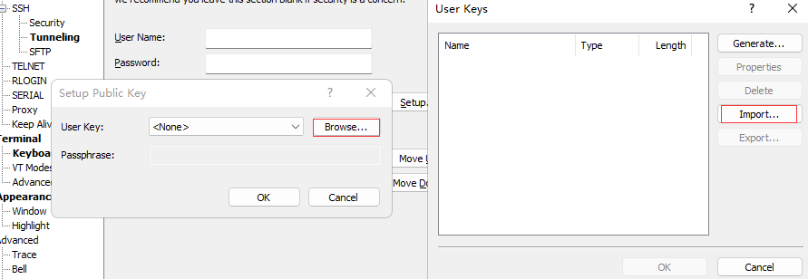
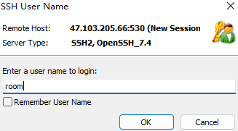

2. Impart Private Key and enter the username
Notes:
The next step is to enter the username and password. If we choose the public key to login, we need impart private key. Finally, we can login our terminal.

Slide 8
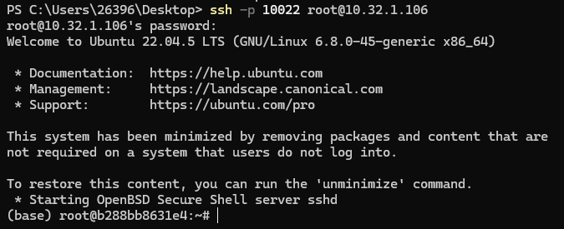
Windows powershell

Slide 9


Softwares used in file transfer
Cyberduck
Download: https://cyberduck.io/
Filezilla
Download: https://filezilla-project.org/

Slide 10
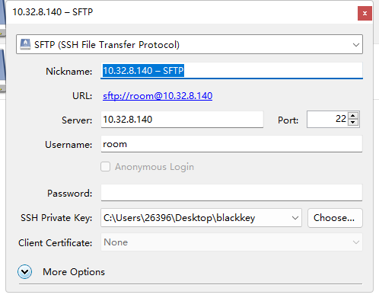
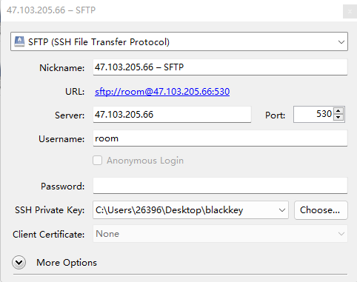
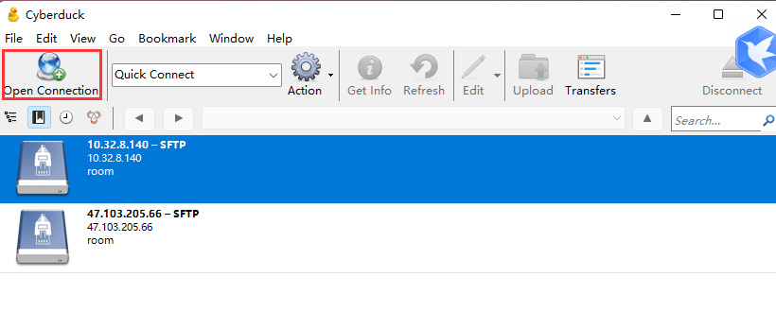
Cyberduck

Slide 11
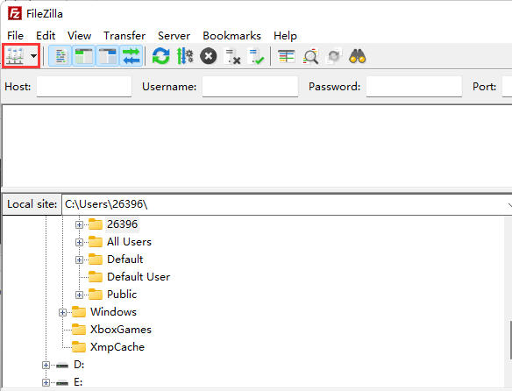
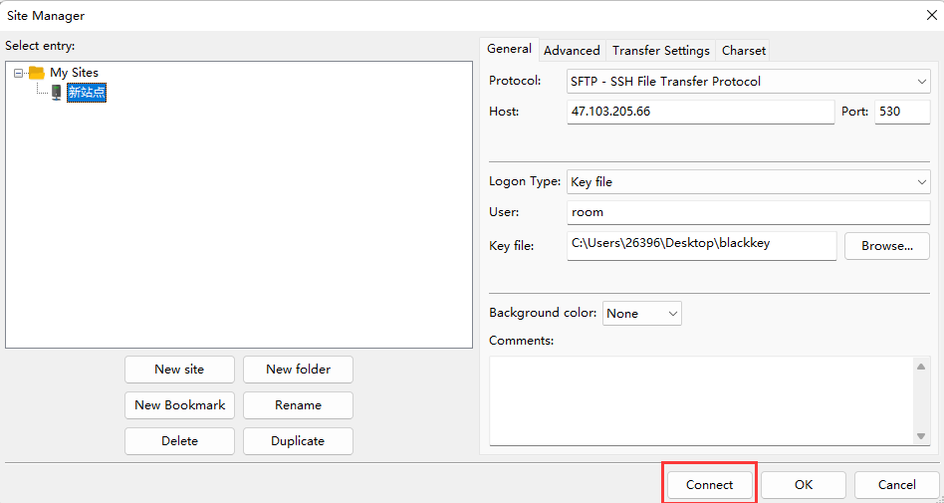
Filezilla
1. Edit new site

Slide 12
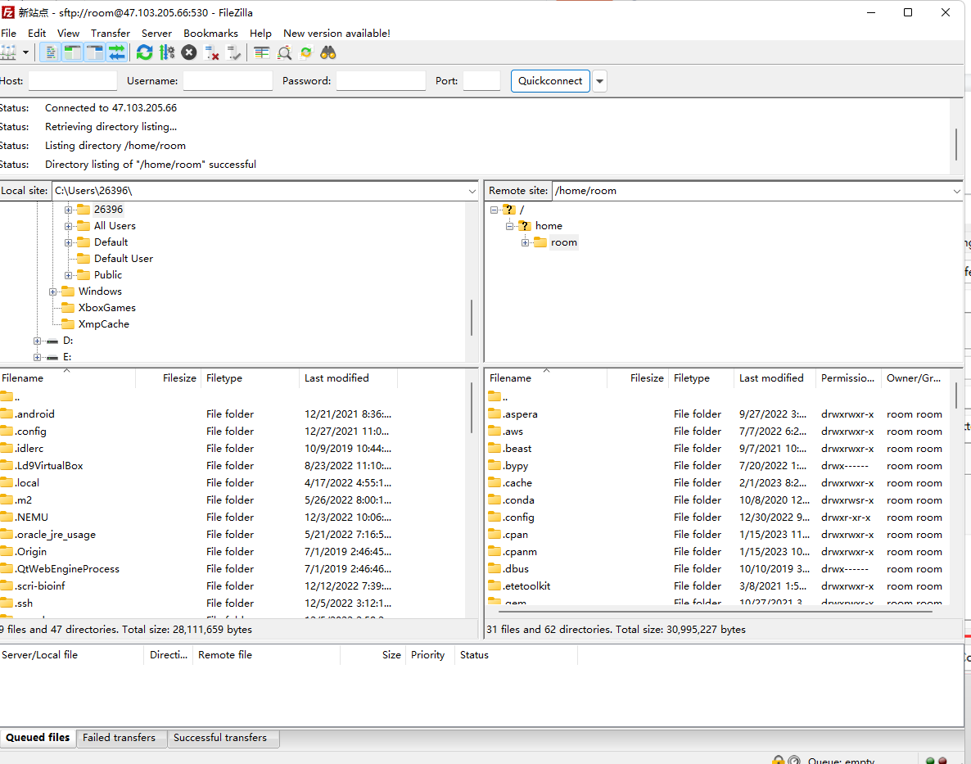

Slide 13
Black Using Regulation
1. Check system usage before running your commands!
2. For beginners, do not install any softwares or perform updates on your own!
3. Monitor your disk volume after each step!
4. Pay attention to your configuration file settings!
5. Run commands under your directory!
6. Feel free to ask administrators when you are not ensure about your commands!

Slide 14
LMSE服务器使用守则
1. 运行你的程序前，请先检查系统占用，保证系统不负载；
2. 对于初学者而言，涉及到系统配置，软件安装等步骤时，请先联系服务器管理员；
3. 及时删除中间文件以保证磁盘空间（尤其是比对生成的.bam,.sam文件）；
4. 运行某些软件会用到配置文件，注意检查配置文件中的各种设置；
5. 请在自己的路径下运行指令；
6. 当你对某项指令不太明确时，请及时上网查阅相关信息或询问服务器管理员

Slide 15
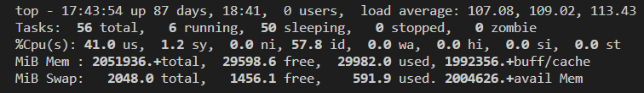
How to check system occupies?
top command
Load average -- better not to exceed maximum thread number
Thread number:
  Black01: 112; Black02: 144 ; Black03: 256

Slide 16
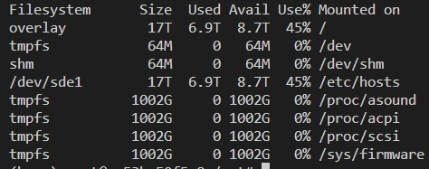
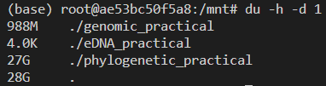
How to check disk space?
df -h # give a summery for the current disk usage
du -h -d 1 # display the size of directory under current path

Slide 17
Useful methods for saving the disk space
Delete the intermediate files after each step;
Compress files, especially the large one;
Centralize database, avoid downloading repetitive database or reference genome;
Replace duplicate file with symbolic link;
Archive old files and upload to our backup server

Slide 18
Thanks!

