Slide 1
Gene Family Analysis
Presented by Kishor Kumar Sarker Lab of Molecular Systematics and Ecology Shanghai Ocean University 2025.01.09

Slide 2
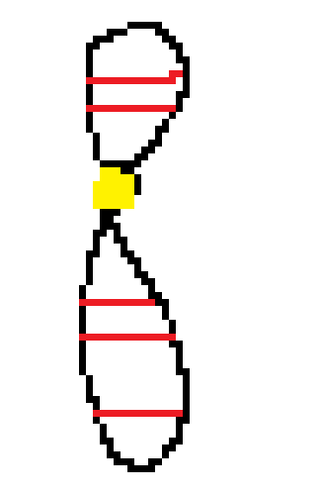
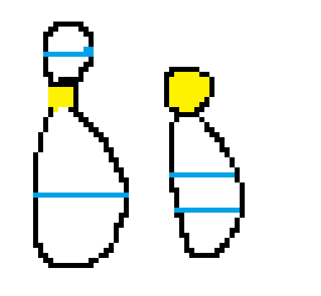
What is gene family
If -several similar genes, either in same chromosome or different chromosome
A₁
A₂
B₁
A₃
B₃
A₄
B₂
B₁
A₅

Slide 3
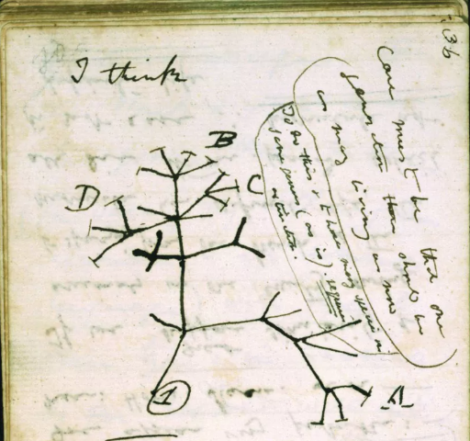
-inherited from common ancestor
May be X,Y,Z or anything else!!!

Slide 4
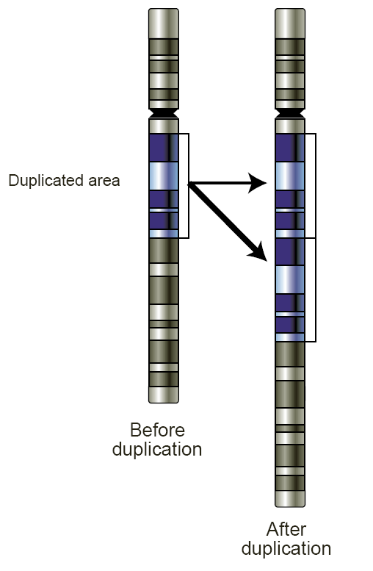
-originates for the result of gene duplication

Slide 5

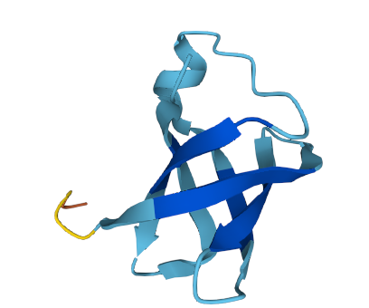
and finally having the similar function by those group of genes can be considered as a ‘gene family’.
Alfa Interferon

Slide 6
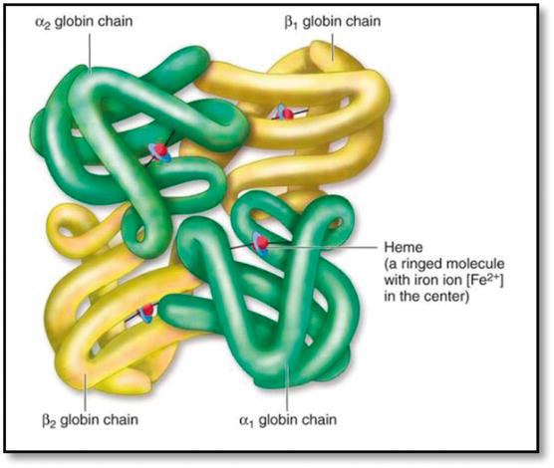
The tale of ‘Globin’ !
Globin, 500 My
Haemoglobin
Myoglobin, 22th chr
Alfa Haemoglobin, 11th chr
Beta Haemoglobin, 16th chr
HBZ
HBM
HBA2
HBA1
HBQ
HBE
HBG2
HBG1
HBD
HBB

Slide 7
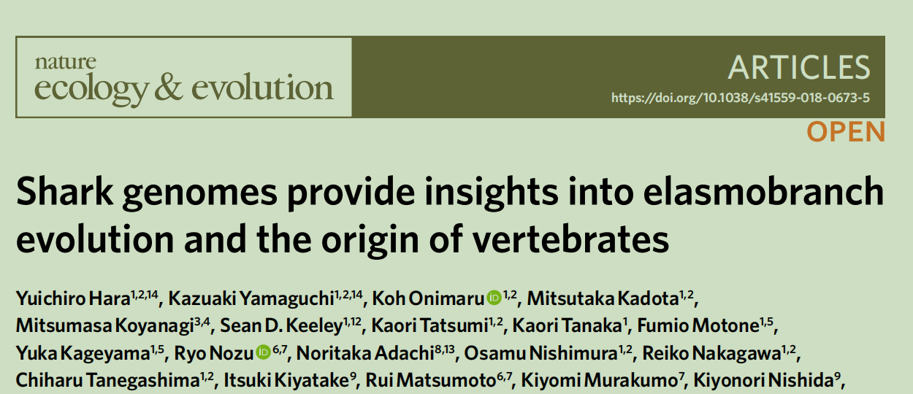
Gene family analysis in comparative genomics
Gene loss and Gain

Slide 8
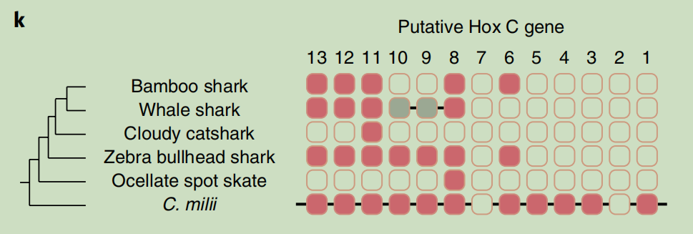
Evolutionary Necessity of Hox C in Sharks!

Slide 9
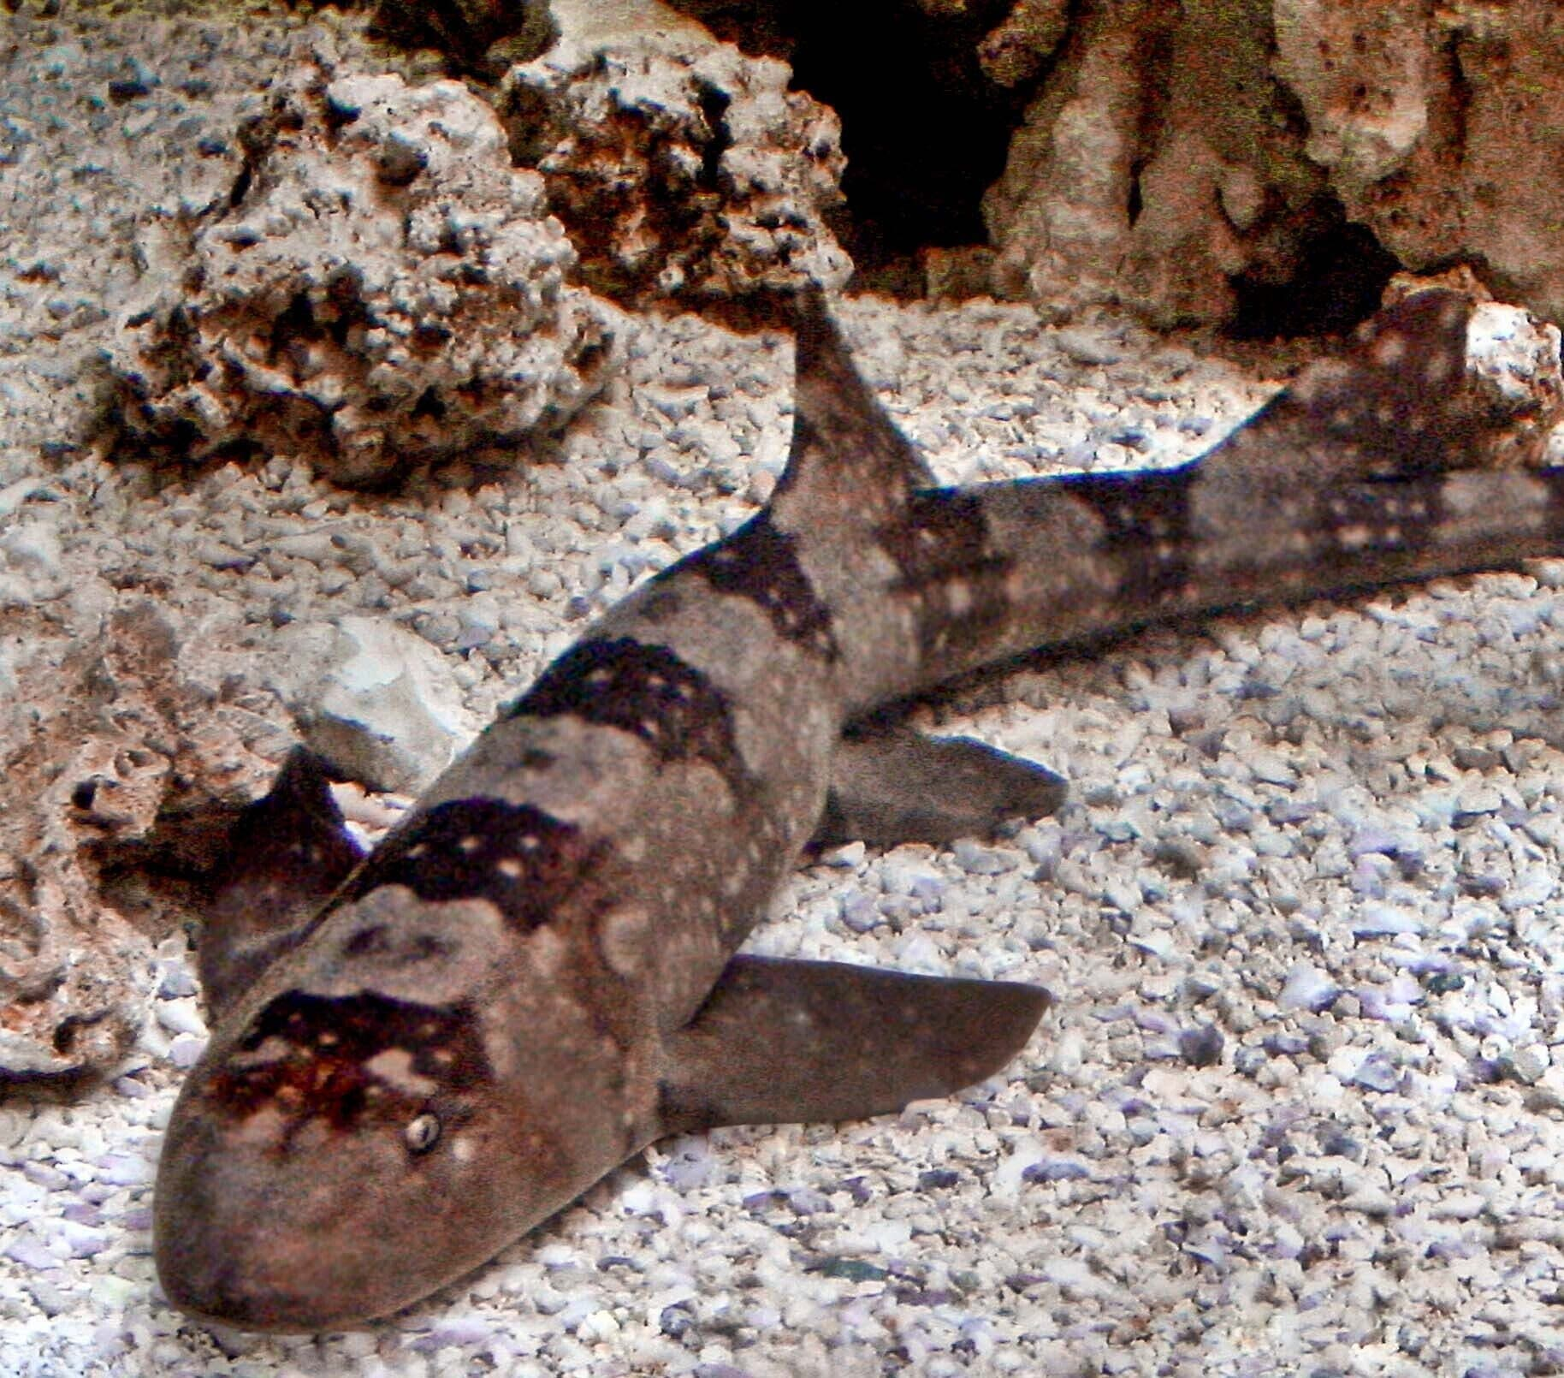
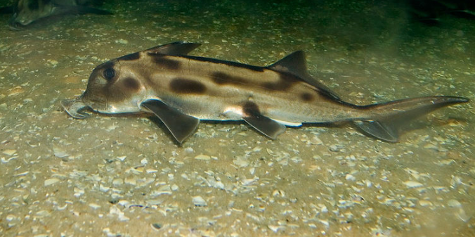
85m
200m
Avearge living depth

Slide 10
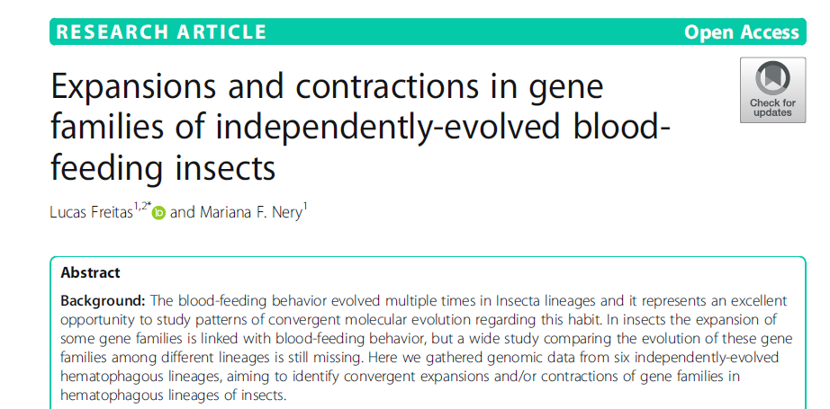
Rapid expansion and contraction

Slide 11
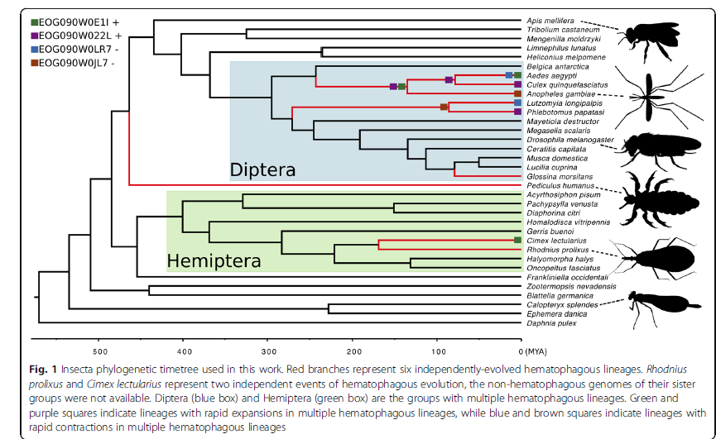

Slide 12
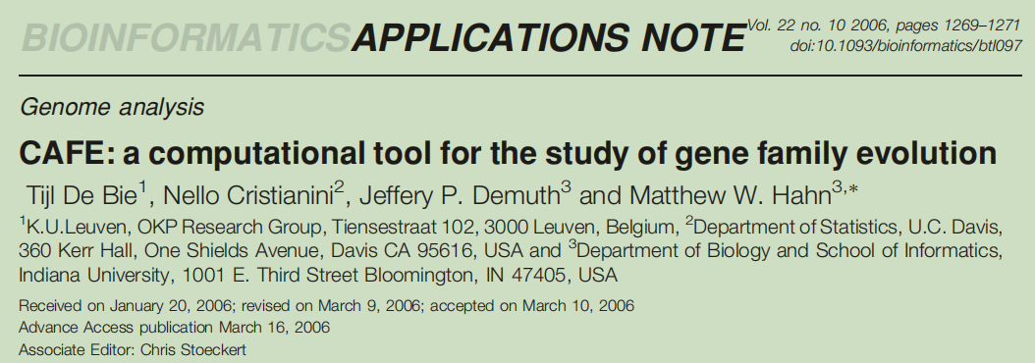
Lets meet with CAFE!

Slide 13
How CAFE works
CAFE (Computational Analysis of gene Family Evolution) inferences both the direction and size of evolutionarily significant changes in gene family size in a phylogenetic context.
The probabilistic model adopted in CAFE was introduced by Hahn et al. (2005)
It uses a random birth and death process to model gene gain and loss along each lineage of a phylogenetic tree.
t
A-1
A
A+1

Slide 14
Contd..
CAFE’s main inputs are a Newick description of a rooted and bifurcating phylogenetic tree (including branch lengths in units of time)
A data file containing the gene family sizes for the extant taxa
A third input is lamda(ɤ), which is the probability of both gene gain and loss per gene per unit time in the phylogeny

Slide 15
Running CAFE
1. Prepare Database
Prerequisite
- Select closely related 10 species or more
- Extract proteins using the genome and gff file using gffread software
gffread genomic.gff -g genome.fa -x cds.fa -y pep.fa

Slide 16
Contd..
-Pick the longest isoform from each species python /home/tools/genome/annotools/pick_longest_isoform_for_gff.py -gff species.gff -fa species.pep -o species.pep.longest.fa
-Convert all the file name according to the species name
-Concatenate all the *.pep file into a single file for blast.

Slide 17
Contd..
What will happen you don’t pick longest isoforms?
ISO1
√
ISO2
×
ISO3
×

Slide 18
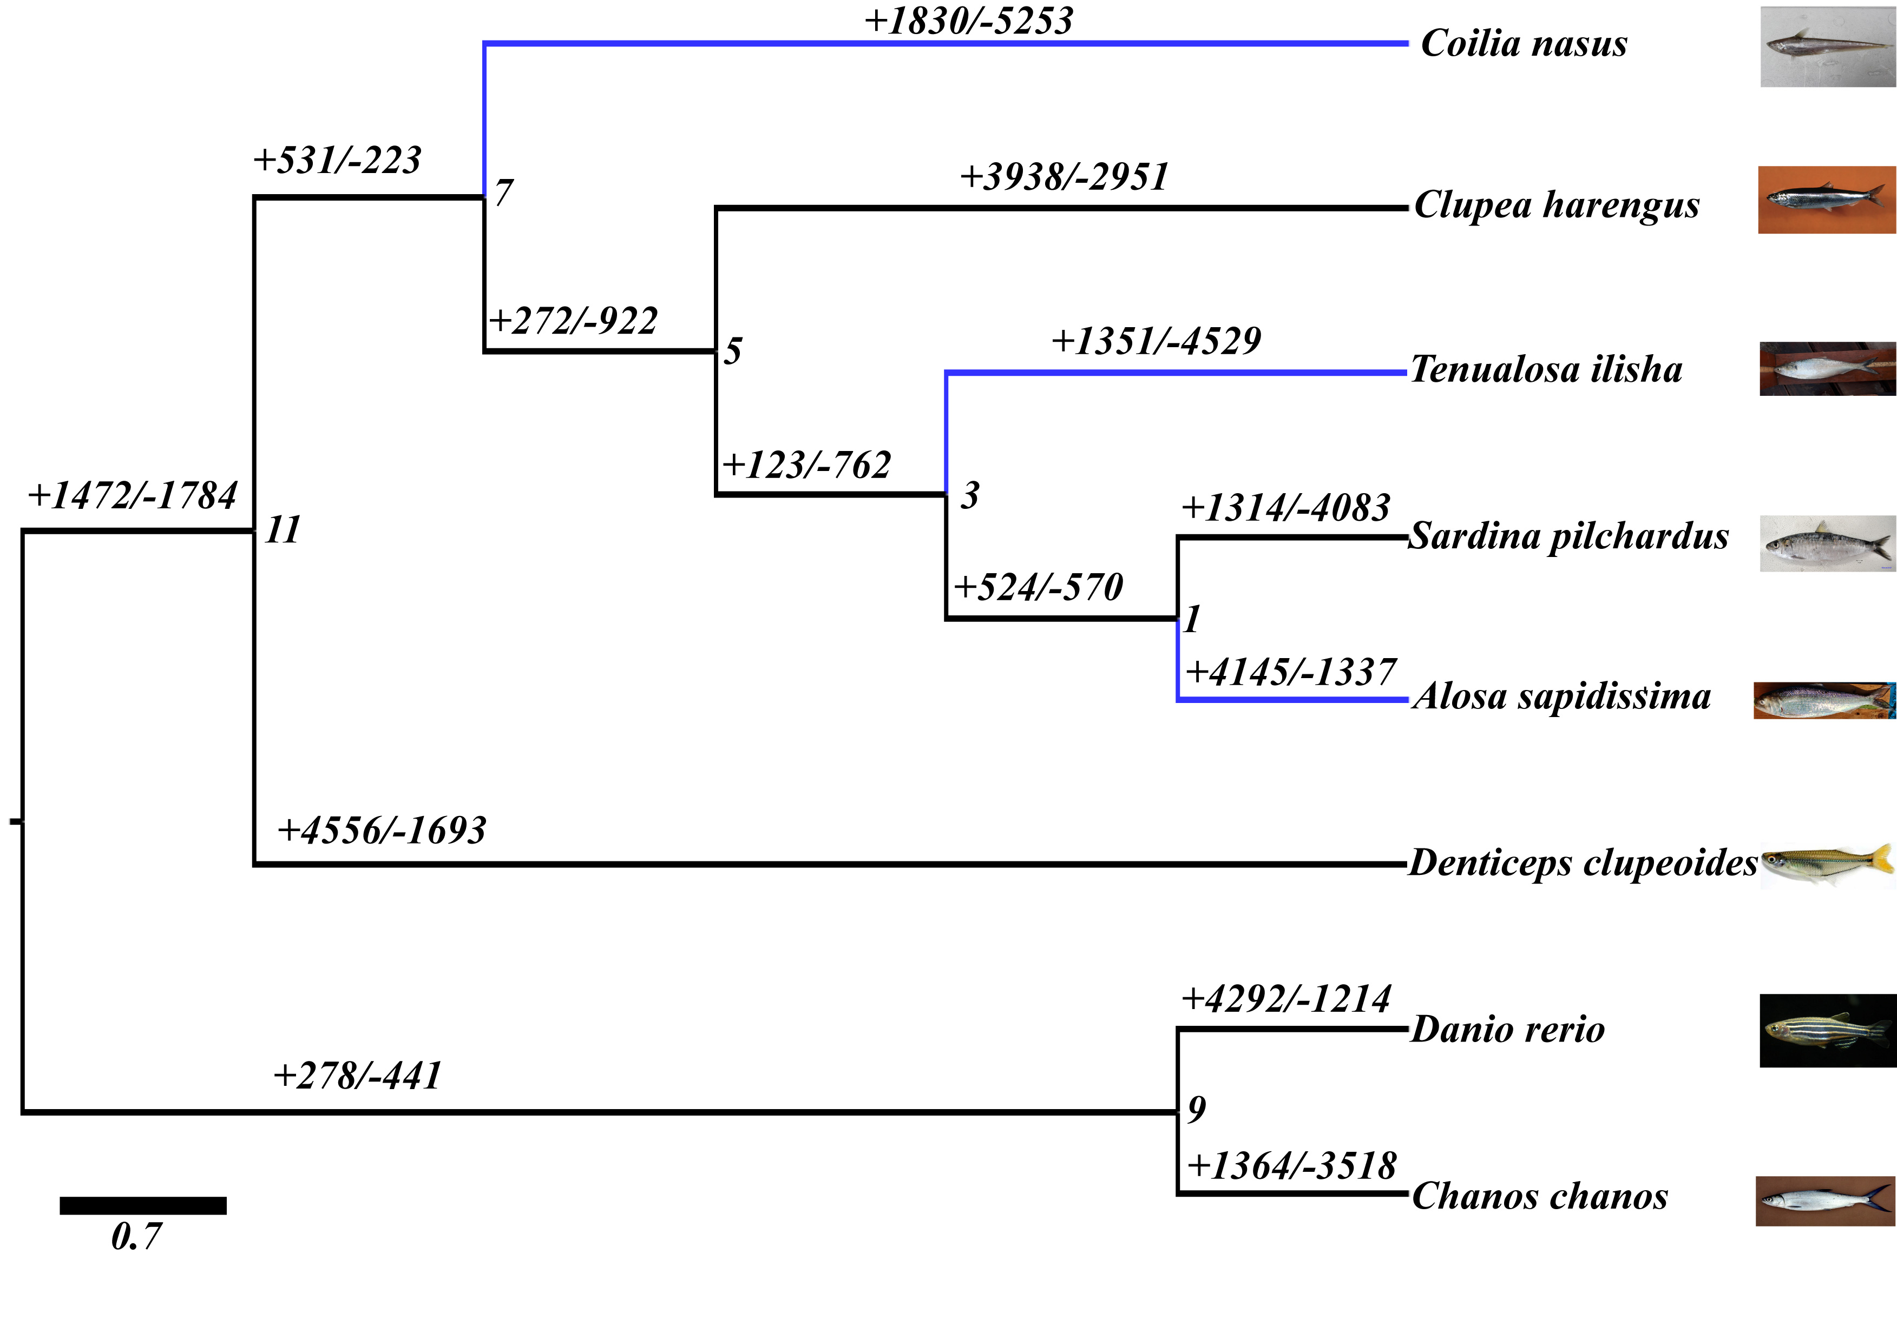
Contd..
Looks like a great result!!!! But Sorry!!!!

Slide 19
Contd..
2. All by all blast
2.1. Preparing the database
makeblastdb -in makeblastdb_input.fa -dbtype prot -out blastdb
2.2 Now blast it!
blastp -num_threads 20 -db blastdb -query makeblastdb_input.fa -outfmt 7 -seg yes > blast_output.txt &

Slide 20
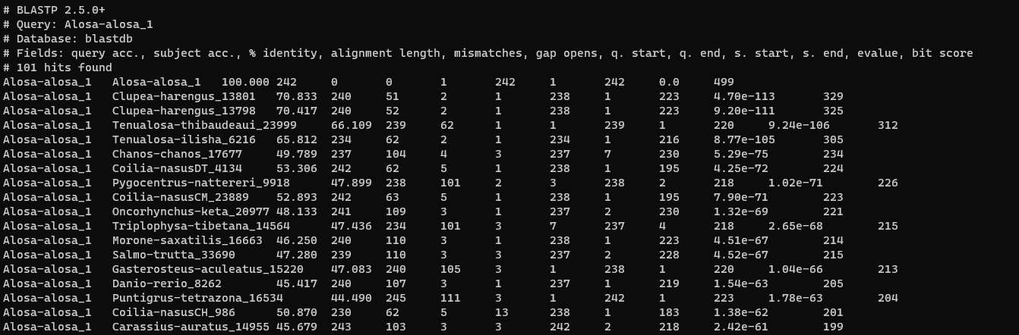
Contd...
Blast Output..
A1
B1
C1

Slide 21
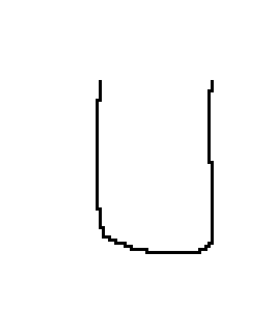
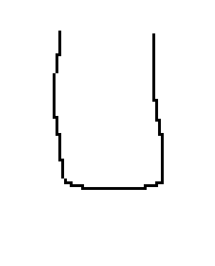
Contd..
B3
3. mcl clustering: a graph clustering algorithm that groups the items
A1,B1,B2,C1,C3
Cluster 1
A1
A2
A3
C4
C3
B2
C2
A4
A5
B1
C1
A3,A4,A5,B3,A5,C4
Cluster 2

Slide 22
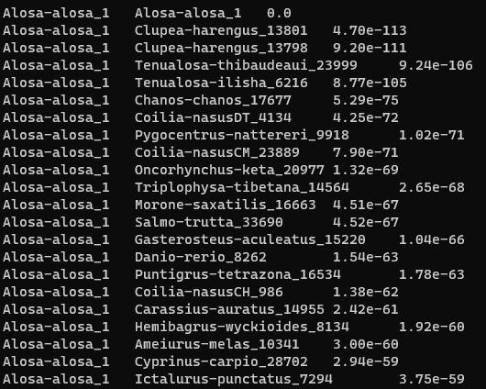
Contd..
3.1. Prepare the format for ‘mcl’
grep -v "#" blast_output.txt | cut -f 1,2,11 > blast_output.abc

Slide 23
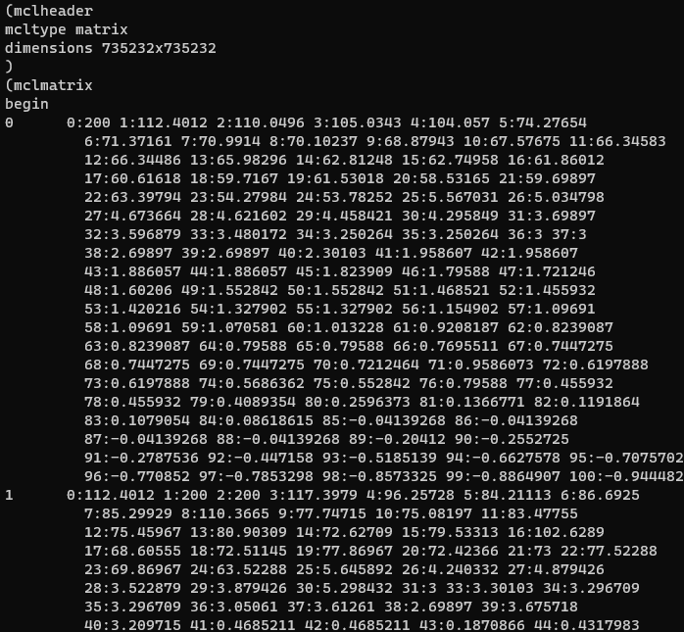
Contd..
3.2 Create network file in *.mci and dictionary file in *.tab format
mcxload -abc blast_output.abc --stream-mirror --stream-neg-log10 -stream-tf 'ceil(200)' -o blast_output.mci -write-tab blast_output.tab &

Slide 24
Contd..
3.3 Cluster and deduplicate
mcl blast_output.mci -I 3
mcxdump -icl out.blast_output.mci.I30 -tabr blast_output.tab -o dump.blast_output.mci.I30

Slide 25
Contd..
3.4. Organize mcl results into a compatible format to cafe
python /mnt/genome1/Lab_Users/LL/tools/genome/cafe_script/python_scripts/cafetutorial_mcl2rawcafe.py -i dump.blast_output.mci.I30 -o unfiltered_cafe_input.txt -sp "ENSG00 ENSPTR ENSPPY ENSPAN ENSNLE ENSMMU ENSCJA ENSRNO ENSMUS ENSFCA ENSECA ENSBTA"

Slide 26
Contd..
3.5. Eliminate the category with particularly large copy variation
python /mnt/genome1/Lab_Users/LL/tools/genome/cafe_script/python_scripts/cafetutorial_clade_and_size_filter.py -i unfiltered_cafe_input.txt -o filtered_cafe_input.txt -s

Slide 27
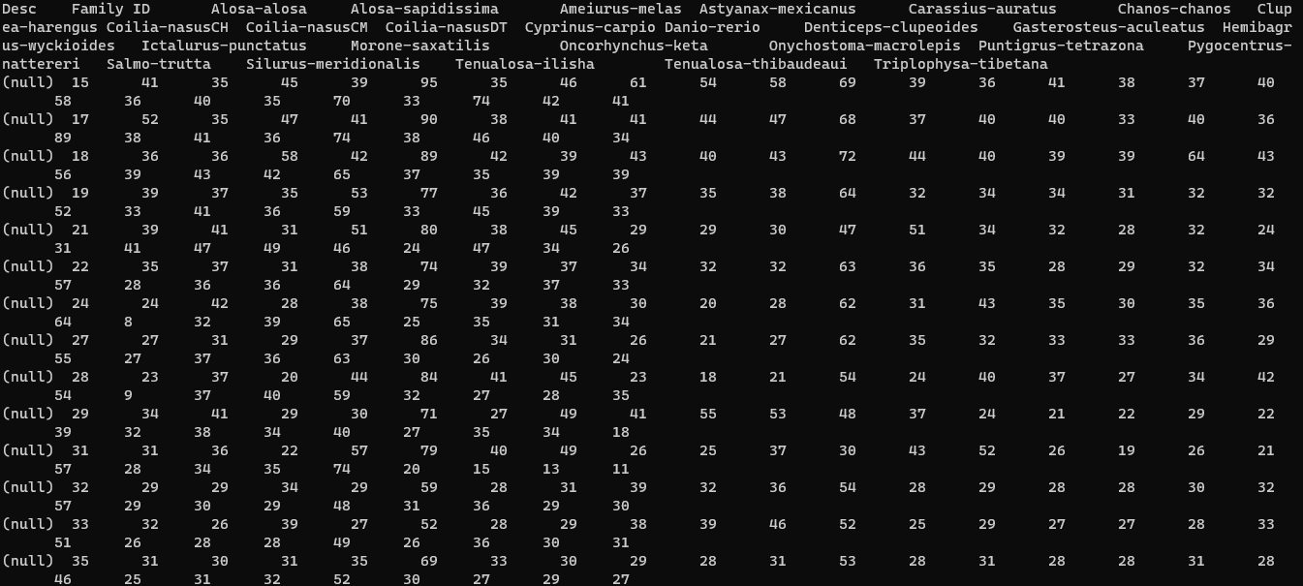
Gene family size for CAFE input

Slide 28
Contd..
4. Species tree and time tree inference
4.1. Infer species tree using OrthoFinder
orthofinder -f /protein/in/path/ -S diamond -t 50 -a 50 -T iqtree -M msa
4.2. Use seqkit find out the total alignment length
seqkit stat SpeciesTreeAlignment.fa

Slide 29
Contd..
4.3. Building Time Tree (Ultrametric Trees)
4.3.1. Prepering the *.ctl file for r8s
python2 cafetutorial_prep_r8s.py -i SpeciesTree_rooted.txt -o r8s_ctl_file.txt -s 31629122 -p 'B.ceiba,G.raimondii' -c '33'
The following two parameters are from timetree.org, use the two species in the tree, find the divergence time in the website
‘-p’ denotes for Species names, separated by commas, the same as the names in the tree
‘-c’ denotes for the differentiation time provided by timetree, only numbers

Slide 30
Contd..
4.3.2. Running r8s
r8s -b -f r8s_ctl_file.txt > r8s_tmp.txt
tail -n 1 r8s_tmp.txt | cut -c 16- > time_tree.txt

Slide 31
Contd..
From, ((Micropterus-dolomieu:0.624284,Micropterus-salmoides:0.624284)0.882346:4.440236);
To, ((Micropterus-dolomieu:0.624284,Micropterus-salmoides:0.624284):4.440236)

Slide 32
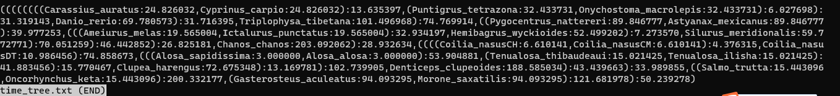
Tree file as Input

Slide 33
Contd..
5. Run CAFE
5.1. Create the control file (cafe_run_ctl.sh)
python3 cafe_run_sh_edit.py -i filtered_cafe_input.txt -o /path/to/report -tree "(sp1,(sp2,sp3))"
5.2. Running the program cafe cafe_run_ctl.sh

Slide 34
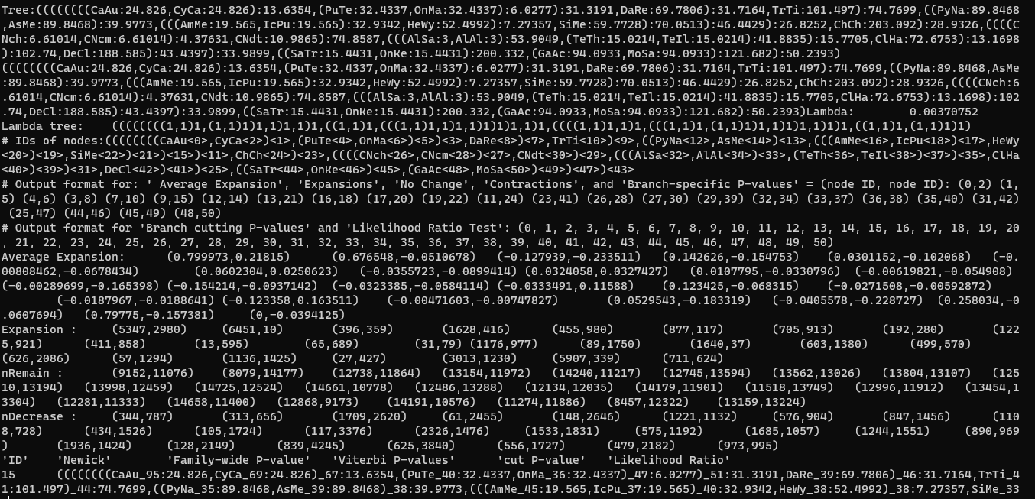
Raw output...

Slide 35
Contd..
5.3. Statistics
python cafetutorial_report_analysis.py -i reports/report_run1.cafe -o reports/summary_run1

Slide 36
Final tree output..
Now you dont need to feel sorry!

Slide 37
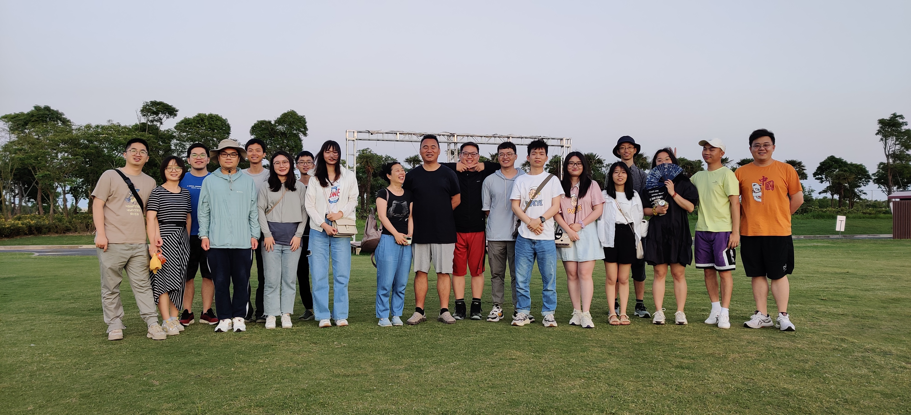
Thanks to all.....

