Slide 1

PAML
By
Kishor kumar sarker
Lab of Molecular Systematics & Ecology
Shanghai Ocean University, China
Date: 08.01.25

Slide 2
PAML
PAML (for Phylogenetic Analysis by Maximum Likelihood) is a package of programs for phylogenetic analyses of DNA and protein sequences using maximum likelihood that has been developed by Joseph P. Bielawski and Ziheng Yang

Slide 3
Program’s Included...
The PAML package currently includes the following programs: baseml, basemlg, codeml, evolver, infinitesites, pamp, yn00, mcmctree and chi2

Slide 4
What PAML can DO?
• Comparison and tests of phylogenetic trees (baseml and codeml)
• Estimation of parameters in sophisticated substitution models (baseml and codeml)
• Likelihood ratio tests of hypotheses through comparison of implemented models (baseml, codeml, chi2)
• Estimation of divergence times (baseml and codeml);
• Ancestral state reconstruction (baseml and codeml);

Slide 5
ConTD...
• Generation of datasets of nucleotide, codon, and amino acid sequence by Monte Carlo simulation (evolver);
• Estimation of synonymous and nonsynonymous substitution rates and detection of positive selection in protein-coding DNA sequences (yn00 and codeml).
• Bayesian estimation of species divergence times incorporating uncertainties in fossil calibrations (mcmctree).

Slide 6
So, what we gonna do??
Branch-site model for Positive selection

Slide 7


What is POsitive Selection
Any Advantageous swap over any trait

Slide 8
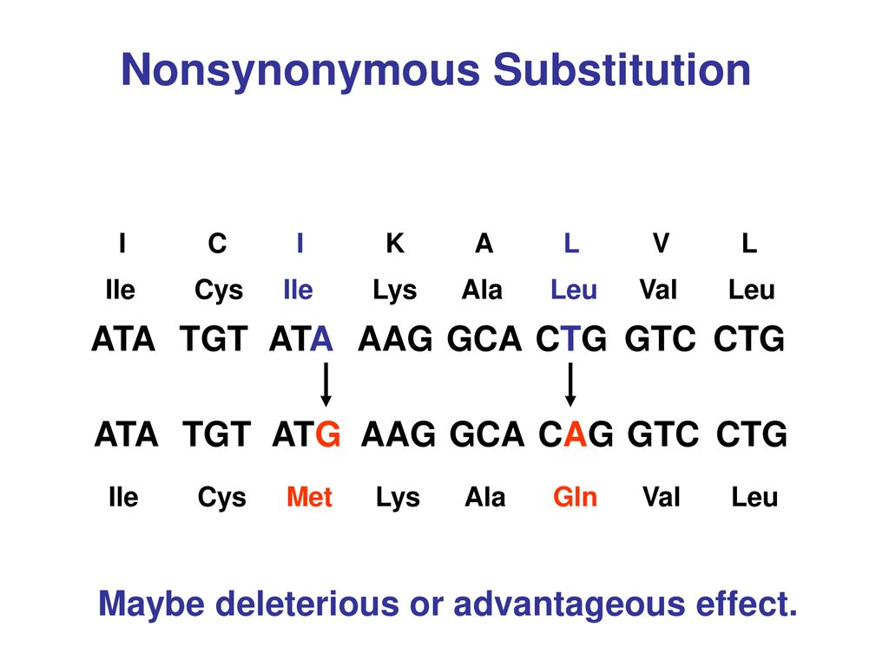
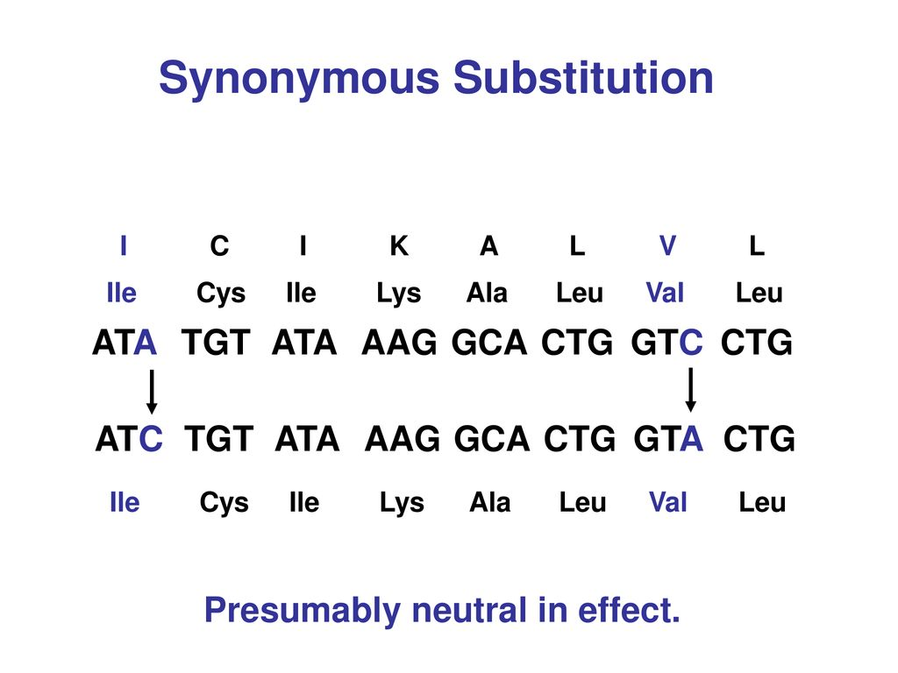
CONTD..
branch-site model, which estimates different dN/dS values among branches and among sites with in a tree of a life

Slide 9
COntD..
A branch of interest is selected and called "foreground branch".
All other branches in the tree are the "background" branches.
The background branches share the same distribution of ω = dN/dS value among sites, whereas different values can apply to the foreground branch.
Two models are computed: a null model (H0), in which the foreground branch may have different proportions of sites under neutral selection than the background (i.e. relaxed purifying selection);
And an alternative model (H1), in which the foreground branch may have a proportion of sites under positive selection.
As the alternative model is the general case, it is easier to present it first.

Slide 10
Contd..
Alternative model (H1): three classes of sites on the foreground branch
1. ω0: dN/dS < 1
2. ω1: dN/dS = 1
3. ω2: dN/dS ≥ 1
K0: Proportion of sites that are under purifying selection (ω0 < 1) on both foreground and background branches.
K1: Proportion of sites that are under neutral evolution (ω1 = 1) on both foreground and background branches.

Slide 11
COntd..
K2a: Proportion of sites that are under positive selection (ω2 ≥ 1) on the foreground branch and under purifying selection (ω0 < 1) on background branches.
K2b: Proportion of sites that are under positive selection (ω2 ≥ 1) on the foreground branch and under neutral evolution (ω1 = 1) on background branches.
For each category, we get the proportion of sites and the associated dN/dS values.

Slide 12
CONTD..
Null model (H0) (ω2 fixed to 1):
K0: Sites that are under purifying selection (ω0 < 1) on both foreground and background branches.
K1: Sites that are under neutral evolution (ω1 = 1) on both foreground and background branches.
K2a: Sites that are under neutral evolution (ω2 = 1) on the foreground branch and under purifying selection (ω0 < 1) on background branches.
K2b: Sites that are under neutral evolution (ω2 = 1) on the foreground branch and under neutral evolution (ω1 = 1) on background branches.

Slide 13
COntd..
For each model, we get the log likelihood value (lnL1 for the alternative and lnL0 for the null models), from which we compute the Likelihood Ratio Test (LRT).
The 2×(lnL1-lnL0) follows a χ² curve with a degree of freedom of 1, so we can get a p-value for this LRT

Slide 14
Files Required
1. Protein Sequence
2. Correspondoing Nucleotide sequence
3. Phylogenetic tree

Slide 15
How to Retrieve protein and Nucleotide sequence
1. From Genome: By structural Annotation using annotation tools like MAKER3
2. From Transcriptome: By prediction using Trasdecoder

Slide 16
Find One To ONE ortholgous Genes
. Several Softwares can be used, like: OMA, OrthoMCL, Swift-Ortho, Orthofinder.
. Orthofinder is faster then any other as it uses Diamond to Blast
. cmdline to run orthofinder:
orthofinder -f pep_folder #pep_folder→proteins of all species

Slide 17
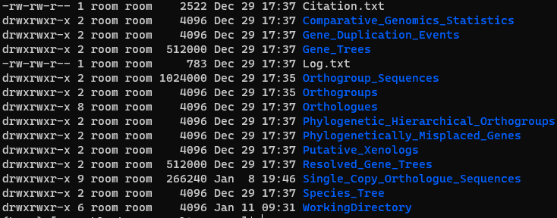
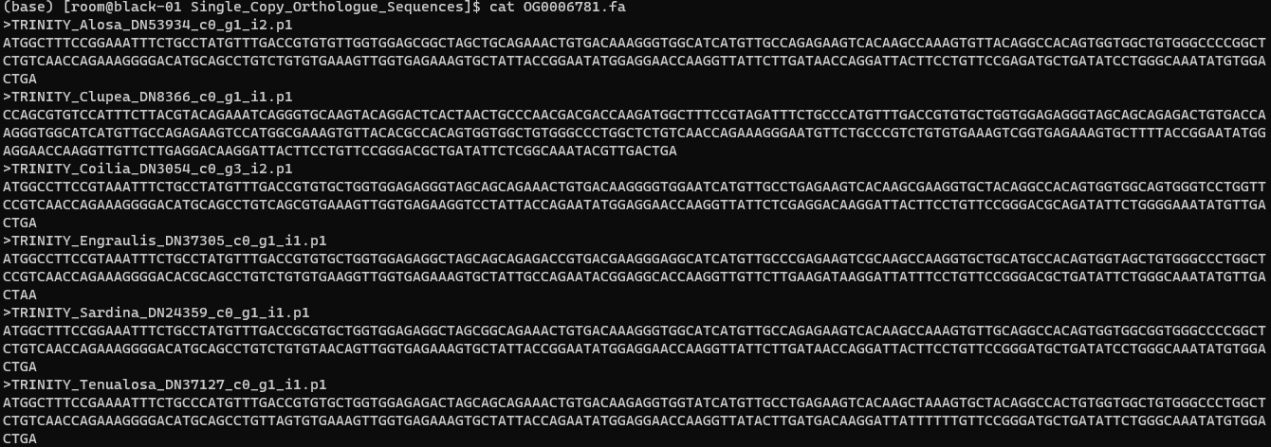
Orthofinder Output

Slide 18
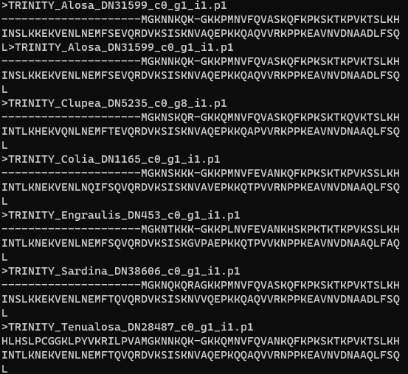
Protein ALignment
As a aligning tool mafft will be a good option
For better accuracy use ‘mafft-linsi’
Cmd line:
mafft-linsi OG000826.fa > $OG000826.fa.aln.out

Slide 19
Contd..
For a bunch of file, write a simple bash script:
#!/bin/bash
for file in *.fa
do
mafft-linsi ${file} > $file.aln.out ;

Slide 20
REspective CDS retrieval
Take out all the CDS in a single file
cat sp1.fa sp2.fa sp3.fa sp4.fa sp5.fa sp6.fa > all_cds.fa
Use a python script to seperate according to orthogroup id
python get_same_name_seq_from_fasta.py -name pep.fa -seq all_cds.fa -o output_prefix

Slide 21
Contd..
For a bunch of a file write a loop in bash, like:
#!/bin/bash
for file in *.out; #here, the peptide alignment was used
do
python get_same_name_seq_from_fasta.py -name ${file} -seq all.cds.fa -o ${file}.cds
done

Slide 22
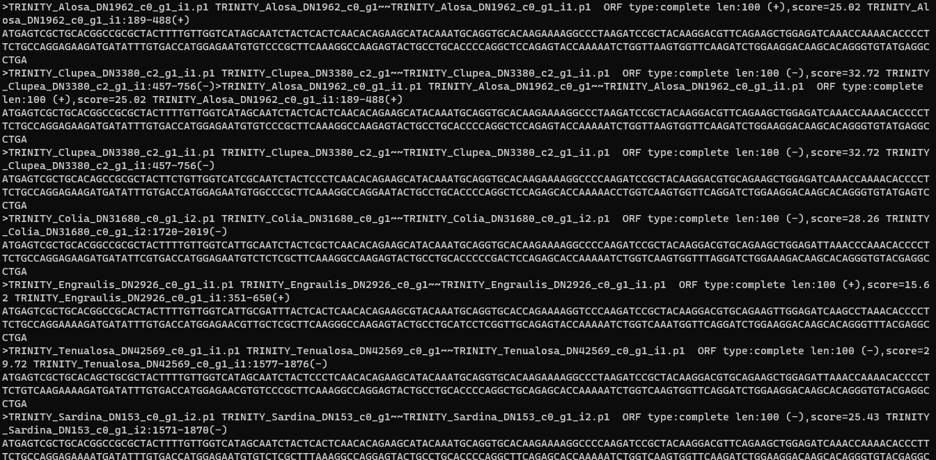
contd..
CDS file (*_accept.fa)

Slide 23
Contd..
Remove the stop codons (TGA, TAG, TAA)
Use a perl script “ReplaceStopWithGap.pl” to remove the stop codon.
Cmd line:
perl ../Scripts/ReplaceStopWithGaps.pl -pep OG000826.fa -nuc OG000826.fa.aln.out_accept.cds -output OG000826.fa.codon
For a bunch of a file write loop to do that
Keep both the input file in same directory

Slide 24
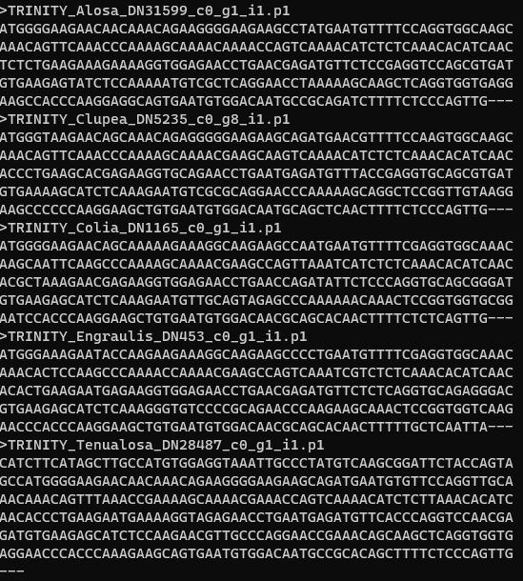
Contd..

Slide 25
UFFFFFFFF, Still few works to do..
Gap signs (---) need to be removed
Take all the ‘*.codon’ file in a single folder and use a simple ‘sed’ cmd to remove gap signs, like:
sed -i 's/---//g' *.codon

Slide 26
CHANGE All the ID’s According to Speceies Name
>TRINITY_Alosa_DN1962_c0_g1_i1.p1 ------ >Alosa
>TRINITY_Colia_DN31680_c0_g1_i2.p1 ------- >Coilia
>TRINITY_Clupea_DN3380_c2_g1_i1.p1 ------ >Clupea
>TRINITY_Engraulis_DN2926_c0_g1_i1.p1 ------ >Engraulis
>T>TRINITY_Sardina_DN153_c0_g1_i2.p1 ------ >Sardina
>TRINITY_Tenualosa_DN42569_c0_g1_i1.p1 ------ >Tenualosa
Use any of the following script:
‘changeID.pl’ or ‘edit_codon_seqName.py’

Slide 27
Backtransletion of alignment
Use Trimal to backtraslate the alignment into codon
Cmdline:
/mnt/genome3/Lab_Users/Kishor/DISK_2/softwares/trimal-1.4.1/source/trimal -in OG000826.fa.aln.out -out OG000826.fa.aln.out.trim -automated1 -backtrans OG000826.fa.codon
##For a bunch of file write a loop

Slide 28
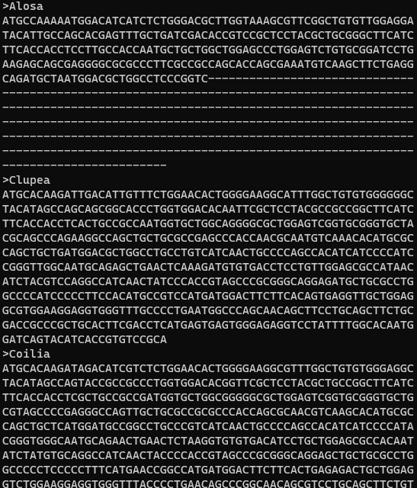
COntd..

Slide 29
Contd..
Remove the gaps from the coding regeion again using Trimal.
cmdline:
/mnt/genome3/Lab_Users/Kishor/DISK_2/softwares/trimal-1.4.1/source/trimal -in OG0008206.fa.aln.out.trim -out OG0008206.fa.aln.out.trim.codon -nogaps -phylip_paml

Slide 30
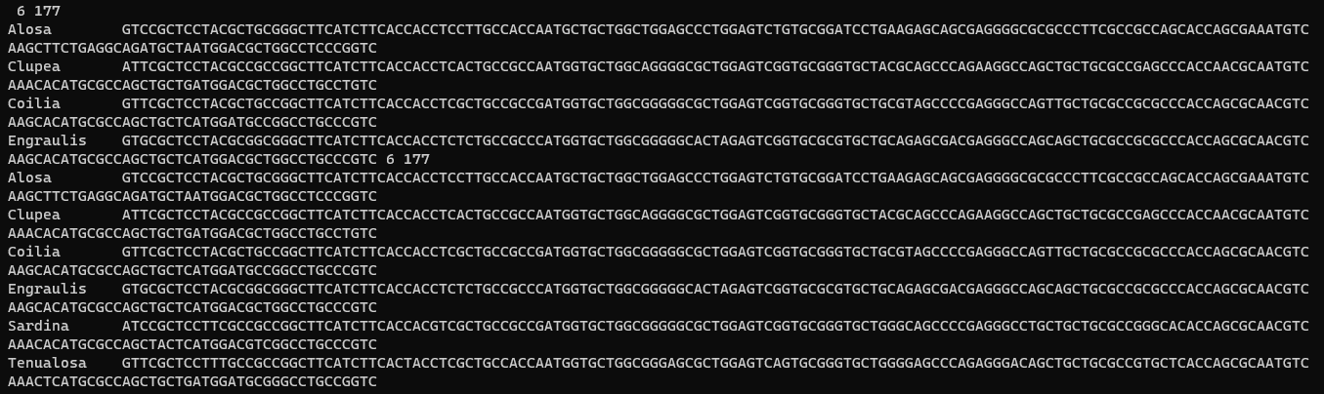
Contd..

Slide 31
Prepare the tree
A species tree from Orthofinder can be used
((coilia:0.101849,engraulis:0.148352)0.469925:0.0318736,(clupea:0.115353,(tenualosa:0.128968,(alosa:0.0792854,sardina:0.121469)0.414901:0.0507301)0.271702:0.0461246)0.469925:0.0318736);
The tree format need to be compatible with PAML
Use a ‘vim’ command to edit the tree
Put the number inside the tree carefullly

Slide 32
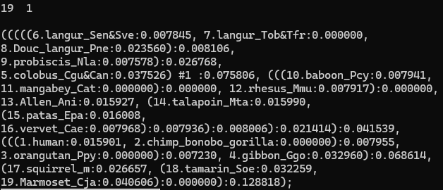
Contd..
#Represents foreground lineage

Slide 33
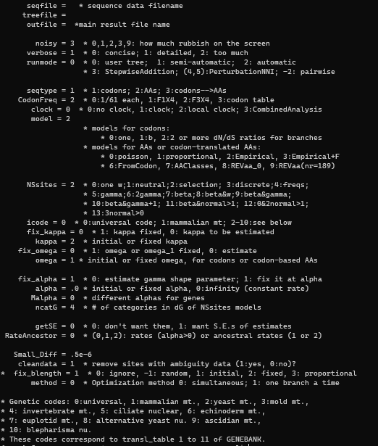
Prepare the Control File

Slide 34
Running PAML
/mnt/genome3/Lab_Users/Kishor/DISK_2/softwares/paml4.9j/src/codeml codeml.ctl

Slide 35
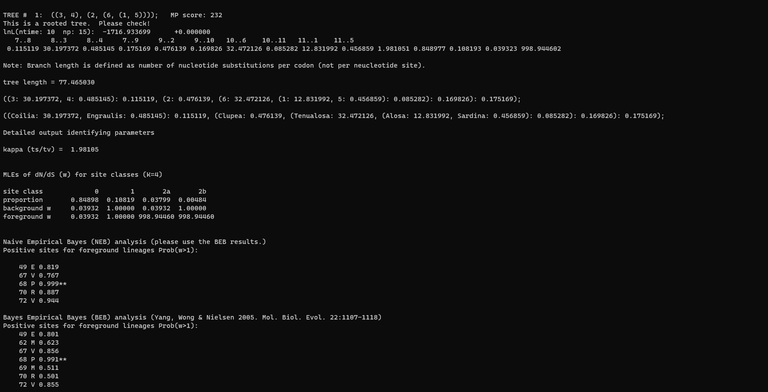
Interpretting Output

Slide 36
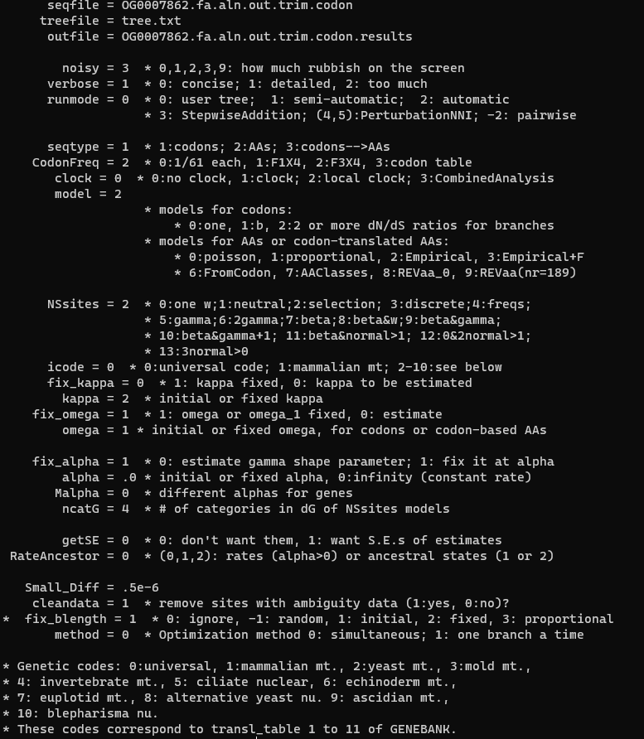
Now, Run NULL Hypothesis..

Slide 37
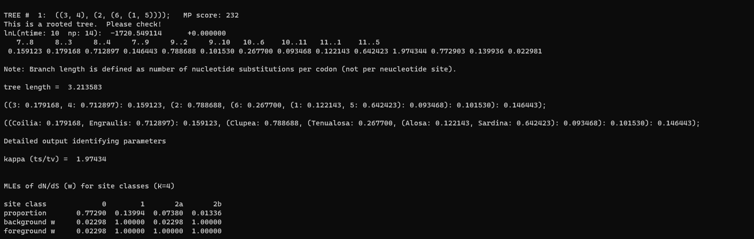
Null MOdel REsult

Slide 38
Likelihood Ratio Test(LRT)
Calculate the LRT, like:
2×(lnL1-lnL0)
=2*｛-1716.933699 - (-1720.549114)｝
=7.231 ##chi score
Degree of Freedom (d^{f})
npª - np^{n} = 15 - 14 = 1
Do a online chi square at https://www.socscistatistics.com/pvalues/chidistribution.aspx

Slide 39
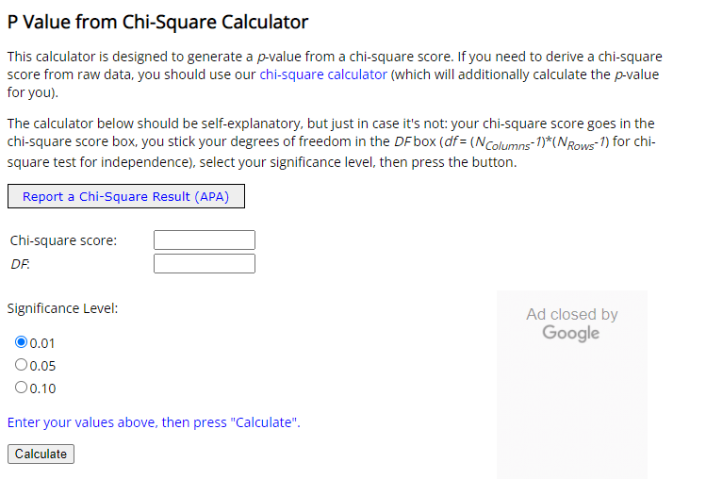
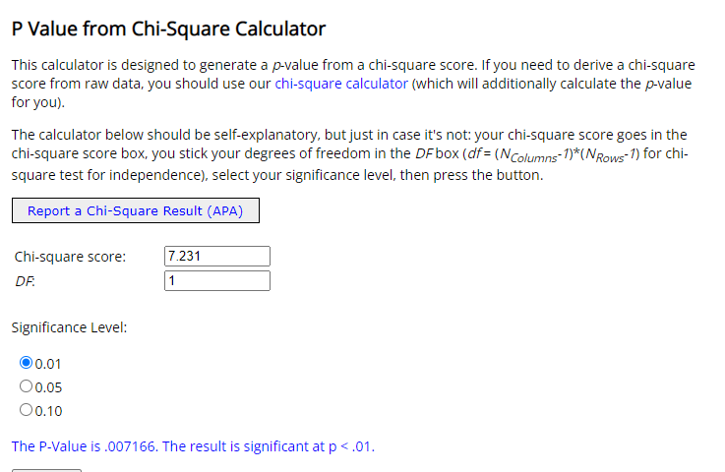
Contd..

Slide 40
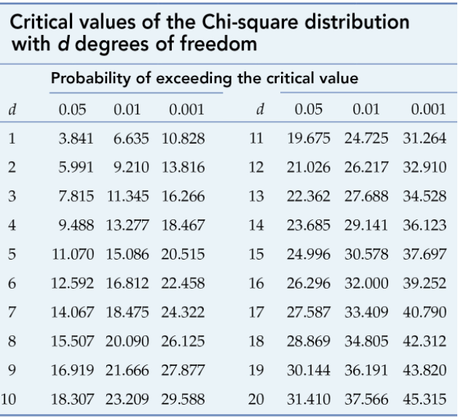
Manual Checking

