Slide 1
Phylogenetic Networks (Gene flow across species) Phylonetworks Intro & Practice
BY: Jiantao Hu

Slide 2
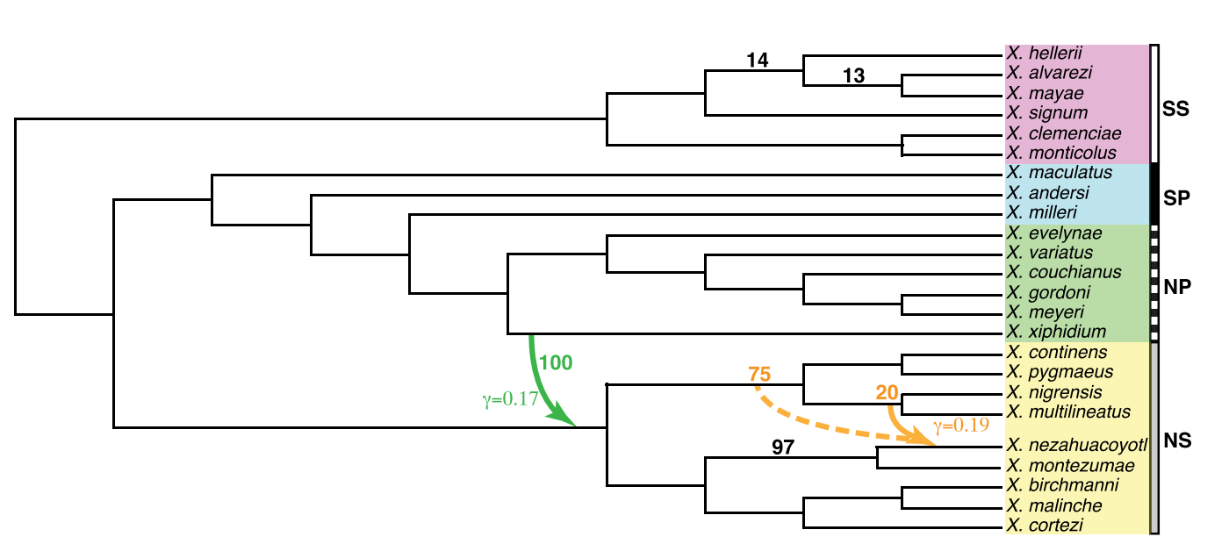
What is Phylogenetic networks?
A phylogenetic tree with added hybrid edges
hybrid edges
Incorporate organisms to the “tree of life” in parts that are more net-like than tree-like

Slide 3
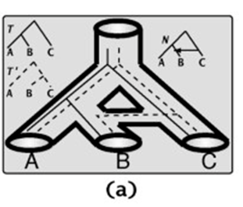
Why there are Phylogenetic networks
Cases 1:
Horizontal introgression:
Network cases
Observed gene trees
Species trees

Slide 4
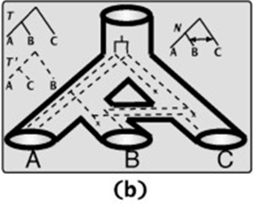
Cases 2:
Interspecific recombination:

Slide 5
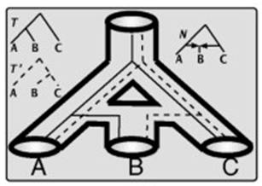
Cases 3:
Hybridization:

Slide 6
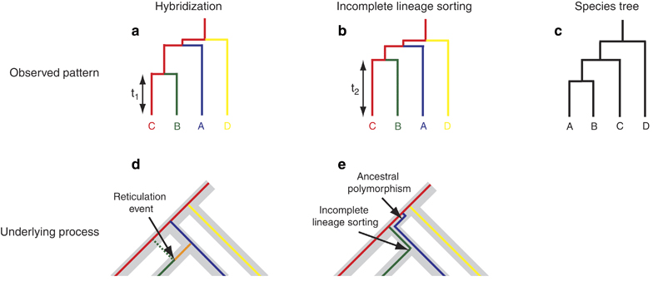
Phylogenetic networks or ILS?
Either Reticulation or ILS account for the gene tree discordance
How to distinguish them?
ABBA-BABA D-statistics analysis: allele-base (SNPs data)
Species Networks applying Quartets (SNaQs) method: maximum pseudolikelihood-base (gene trees or quartet CF value)

Slide 7
ABBA-BABA D-statistics analysis:
based on the frequencies of discordant SNP genealogies in a four-taxon tree: O+[C+(B+A)]
*D: a way to test the correctness of a hypothetical genetic relationship between the four groups
*ABBA: SNPs where A retains the outgroup (O) allele and B and C share the derived allele
*BABA :SNPs where A and C share the derived allele and B retains the outgroup(O) allele
According to the IUA model:
If there is no gene flow, ABBA=BABA, D = 0
D>0, gene flow between B and C
D<0, gene flow between A and C

Slide 8
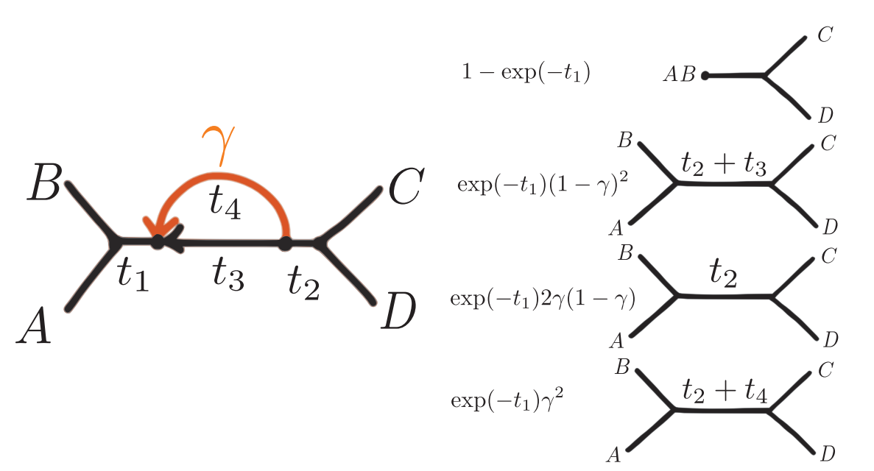
SNaQs method
Parameters：N （topology）, t (branch length), γ (inheritance values)
pseudolikelihood model would be identifiable if two different combinations quartet CFs of parameters (N ; t; γ)

Slide 9
Practice
1. Install PhyloNetworks & PhyloPlots (Under Julia)
$ using Pkg
$ Pkg.add("PhyloNetworks")
$ Pkg.add("PhyloPlots")
2. Read Gene trees
$ using PhyloNetworks $ raxmltrees=joinpath("raxmltrees.tre")
$ genetrees = readMultiTopology(raxmltrees)

Slide 10
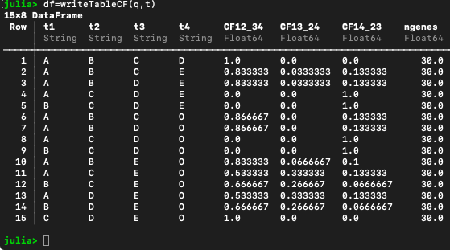
3. Generate Table CF
$ q,t = countquartetsintrees(genetrees) $ df = writeTableCF(q,t) $ using CSV $ CSV.write("tableCF.csv", df) $ raxmlCF = readTableCF("new_tableCF.csv")
Check Headers!!!

Slide 11
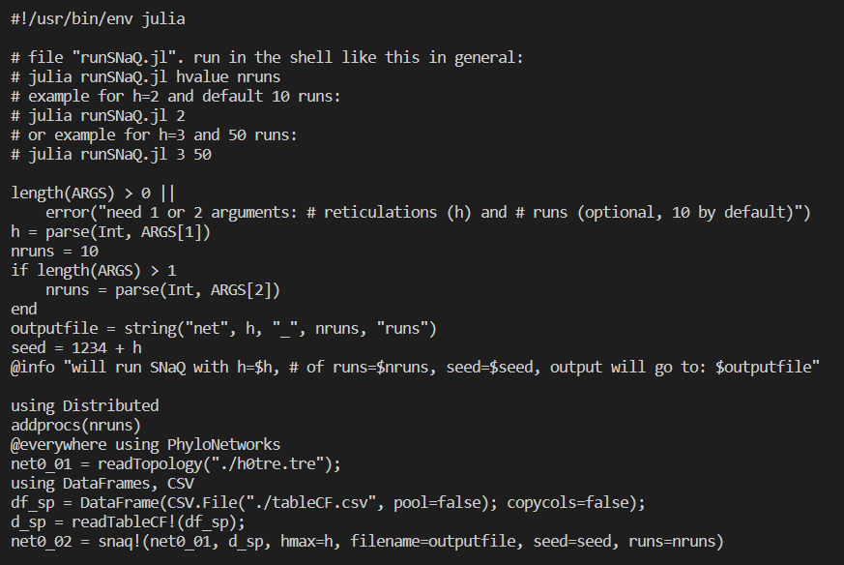
3. Run SNaQ with scripts
$ nohup julia runSNaQ.jl {$m} {$i} > h1.log &
{$m} numbers of hybrid edges
{$i} numbers of replicates

Slide 13
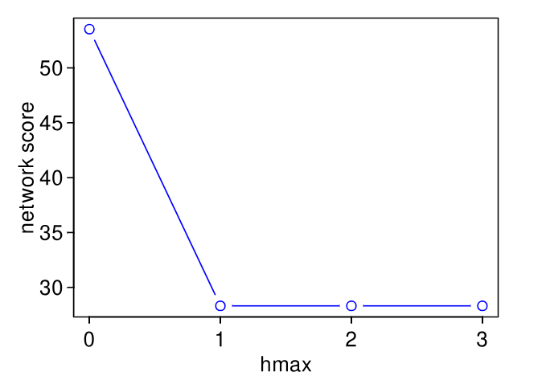
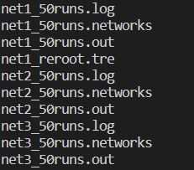
4. Finding the best h (reticulation events number) and plotting
$ scores = [net0.loglik, net1.loglik, net2.loglik, net3.loglik] $ hmax = collect(0:3) $ R"plot"(hmax, scores, type="b", ylab="network score", xlab="hmax", col="blue");

Slide 14
5. Output the best tree and reroot
$ using PhyloNetworks $ net = readTopology("net1_5runs.out")
$ writeTopology(net,"bestnet_h1.tre") $ net1 = readTopology("bestnet_h1.tre")
$ rootatnode!(net1,"C") $ net1_reroot = rootatnode!(net1,"C") $ writeTopology(net1_reroot) $ writeTopology(net1_reroot, "net1_reroot.tre")
6. Result network visualization
$ using PhyloPlots
$ using RCall
$ imagefilename = "../assets/figures/snaqplot_net1_2.svg"
$ R"svg"(imagefilename, width=4, height=3)
$ R"par"(mar=[0,0,0,0])
$ plot(net1_reroot, showgamma=true, showedgenumber=true);
$ R"dev.off()"; # wrap up and save image file

Slide 15
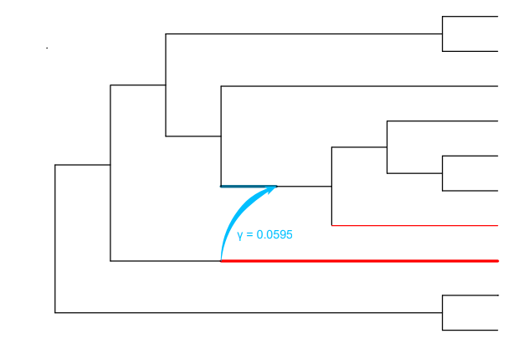
More on:
https://crsl4.github.io/PhyloNetworks.jl/latest/man/snaq_plot/

Slide 16
Gene flow within population Treemix Intro & Practice

Slide 17
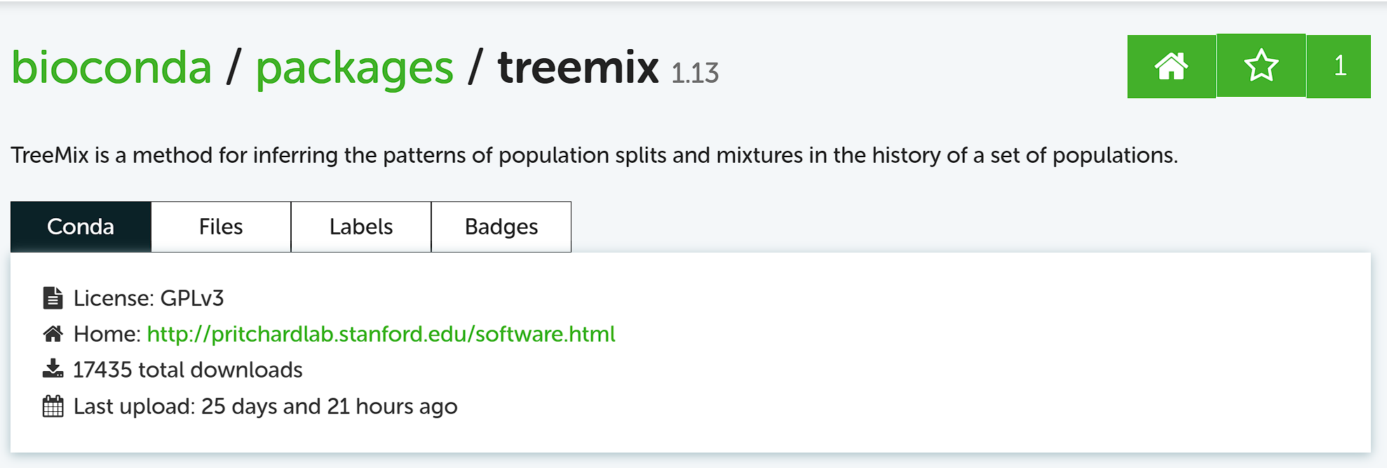

Slide 18
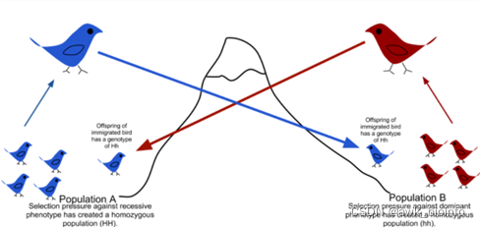
How gene flow works:

Slide 19
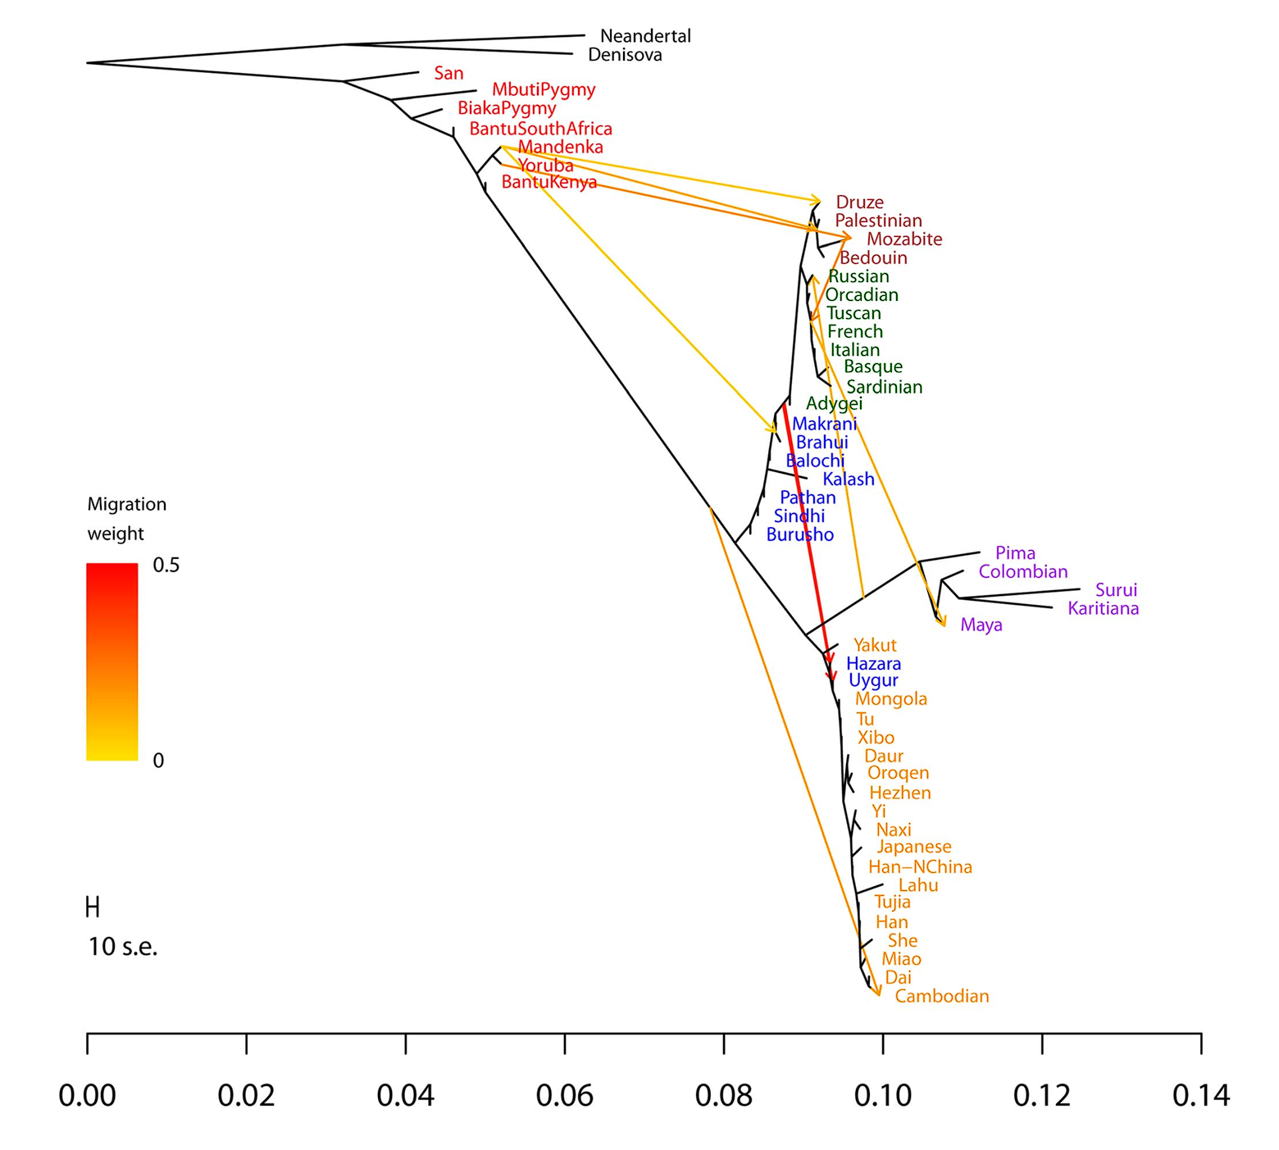
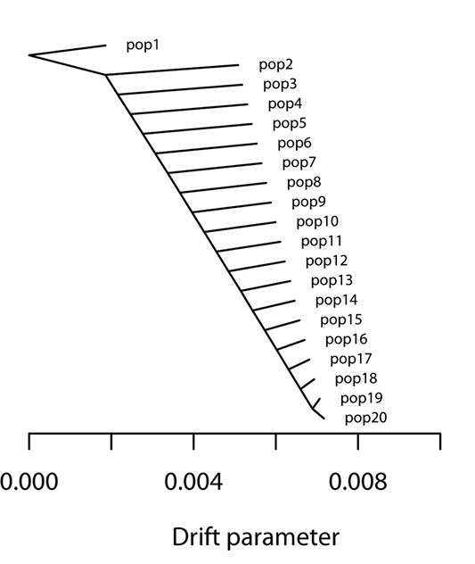
How Treemix works:
SNP data
allele frequency
Real value
ML tree
If R.V < Est.V
Gene flow exist
Tree topology
Estimate value

Slide 20
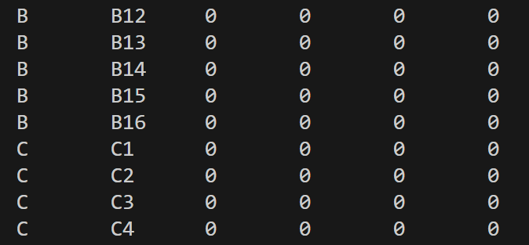
Let's practice!
Step 1:
Vcf data to tped/tfam
Family ID
Idv. ID
Father Info.
Mother Info.
Sex Info.
Phenotype Info.

Slide 21
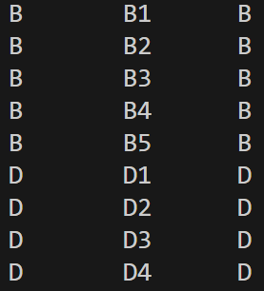
Step 2: Edit pop.cov

Slide 22
Step 3: Calculate allele frequency
Important for non-human sample
gzip

Slide 23
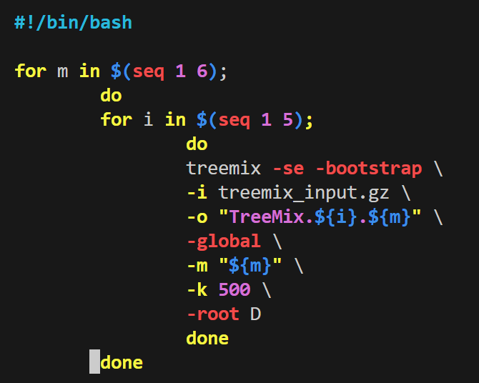
Step 4: generate input file for Treemix
Step 5: run Treemix

Slide 24
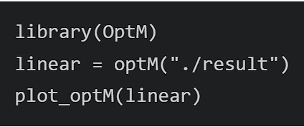
Step 6: find the best m & visualize

