Slide 1
Calling SNPs & filtering (GATK) Fst, Fdist, Genome-wide statistics scan (Stack)
Md Rashedur Rahman
LMSE Workshop 2025
SHOU

Slide 2
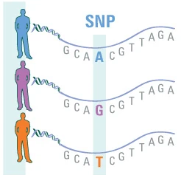
We are nearly very similar 99.5%
The Difference
0.5%

Slide 3
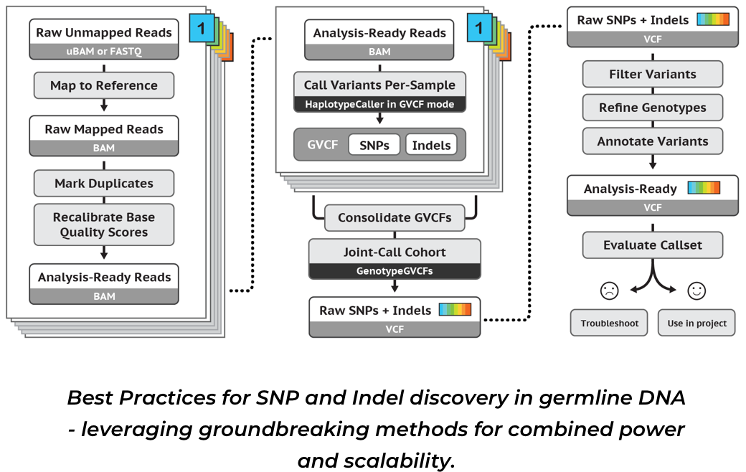
SNP calling
Raw data
Gunzip
Demultiplexed
Trimming
Assemble
1. Pre-processing
2. SNP calling
3. Filtering

Slide 4
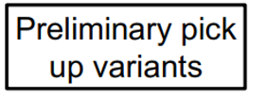
SNP calling

Slide 5
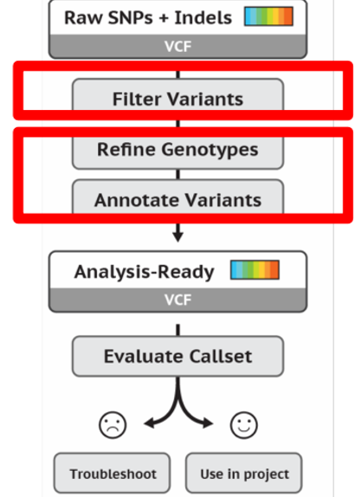
Filtering
Identify potential false positives
2. Remove those false variants
3. Variant quality score recalibration
4. Hard filtering on quality criteria

Slide 6
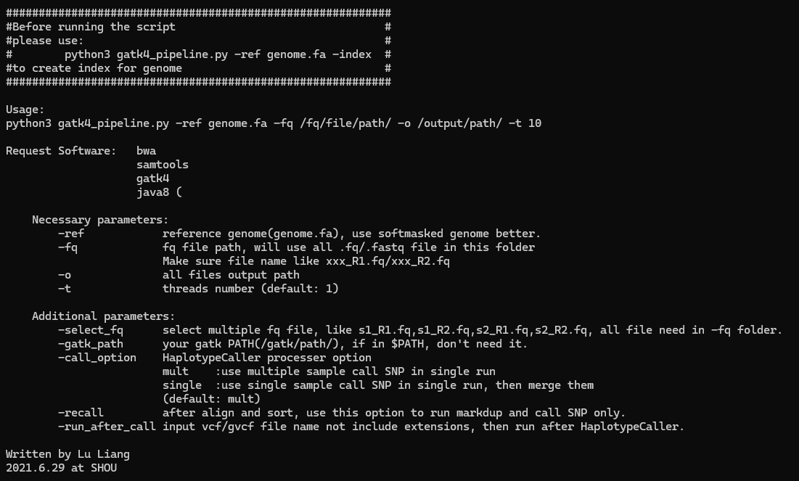

Slide 7
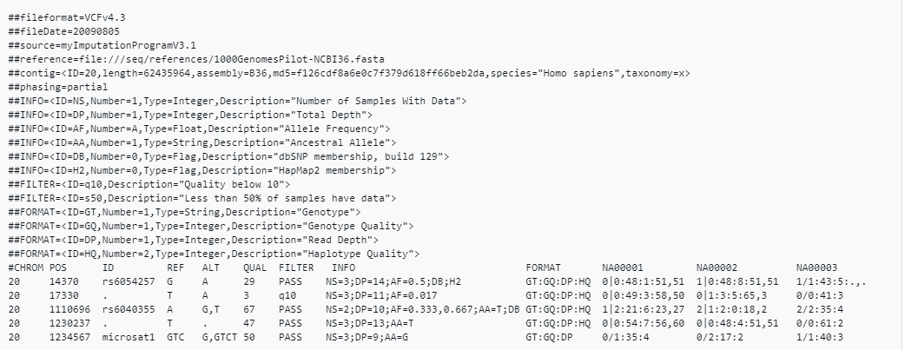

Slide 9
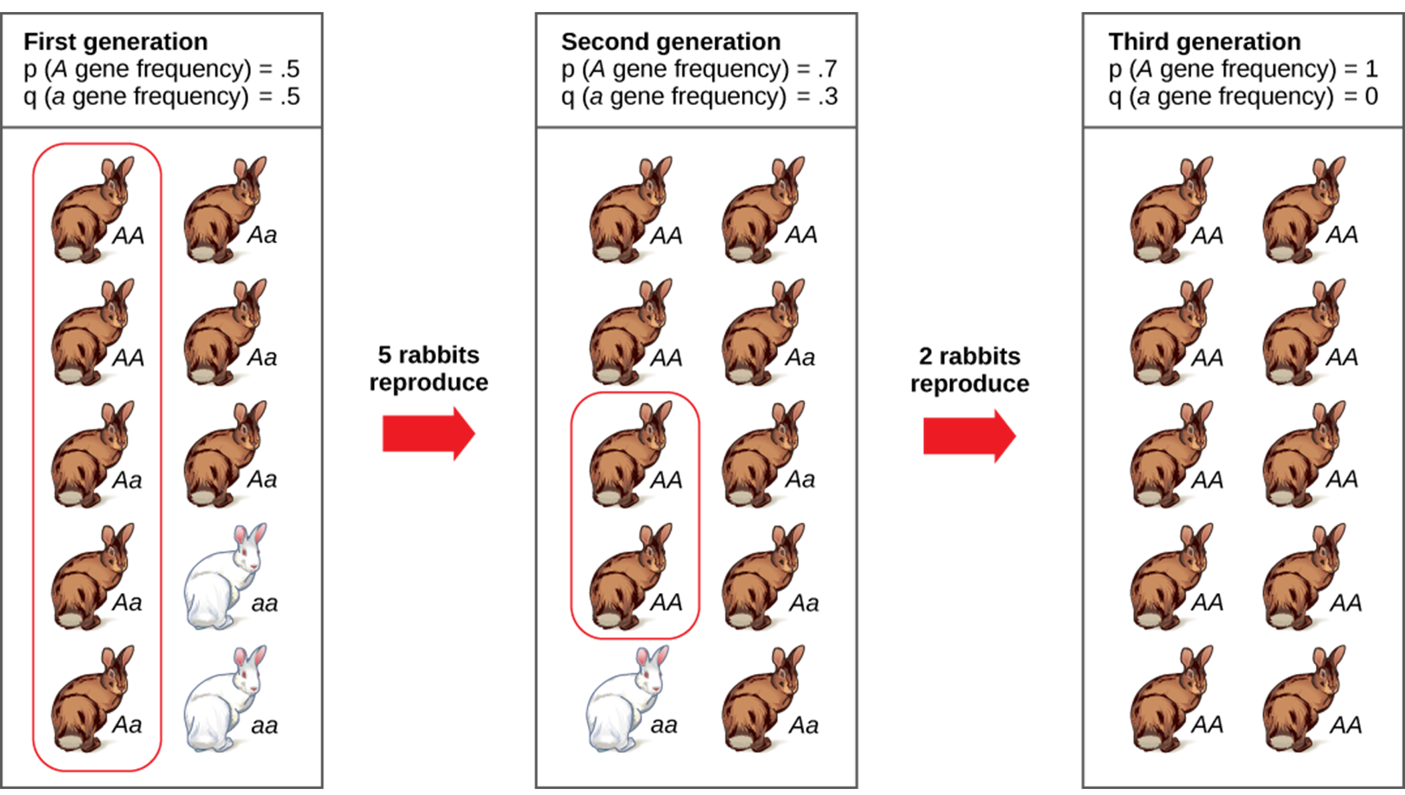
FST
Wright’s Fixation Index
Measure of Genetic Variance
Detect: Genetic drift and breeding structure

Slide 11
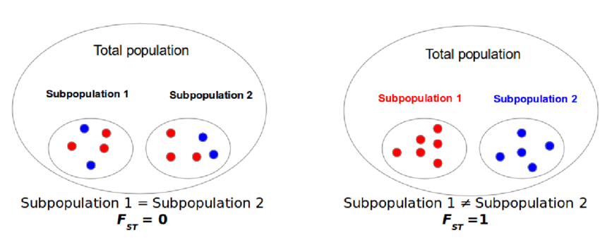

Slide 12
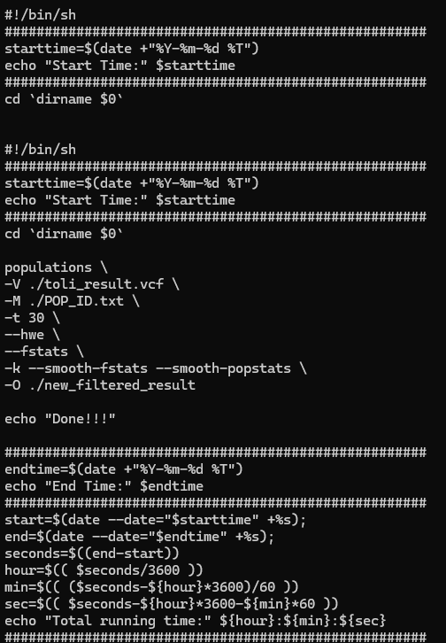
population.sh
POP_ID.txt
Use “tab” for spacing

Slide 13
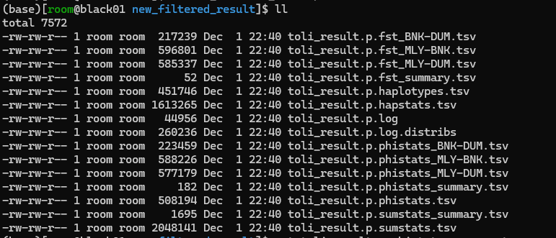

Slide 15
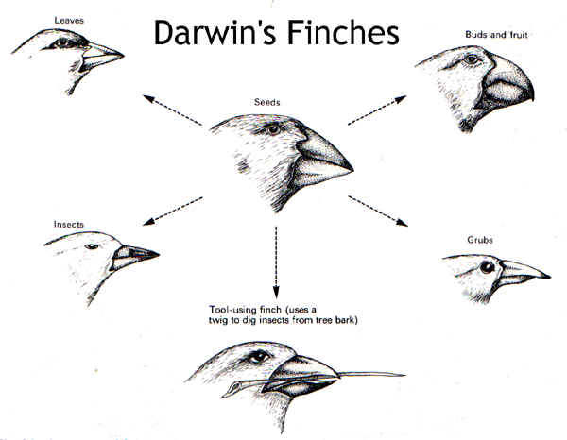
FDIST
FDIST is a statistical tool that uses the relationship between heterozygosity (H) and FST​ to detect outlier loci
Detect: Natural selection

Slide 16
Nucleotide diversity (π) quantifies the average number of nucleotide differences between all pairs of individuals in a sample
Genome-wide statistics scan
Linkage Disequilibrium (LD) reflects how alleles at different genetic loci are inherited together more or less frequently than expected by chance
Tajima's D uses pairwise comparisons of nucleotides which identifies genes that do not evolve neutrally

Slide 17
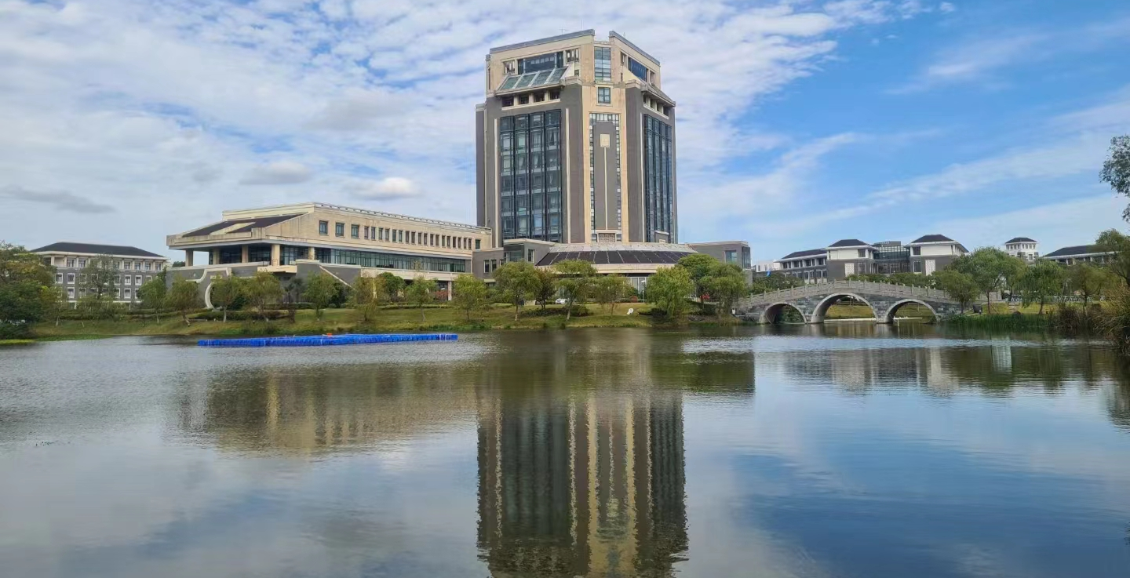
Thank you for your attention!!

