Slide 1
SweeD analysis
Likelihood-based Selective Sweep Detection
LMSE
Workshop2025
Lu liang
2025.1.10

Slide 2
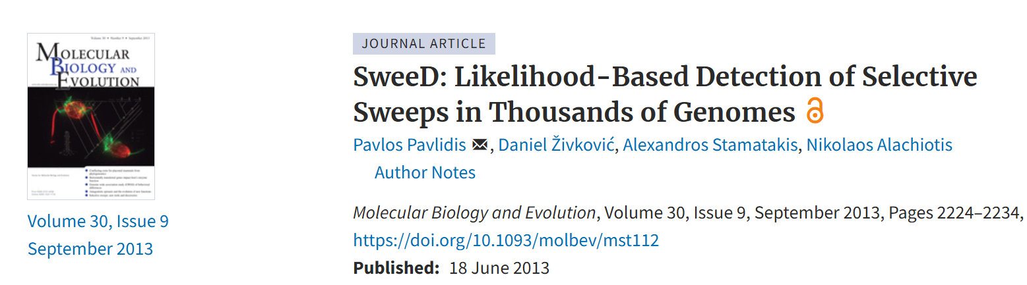
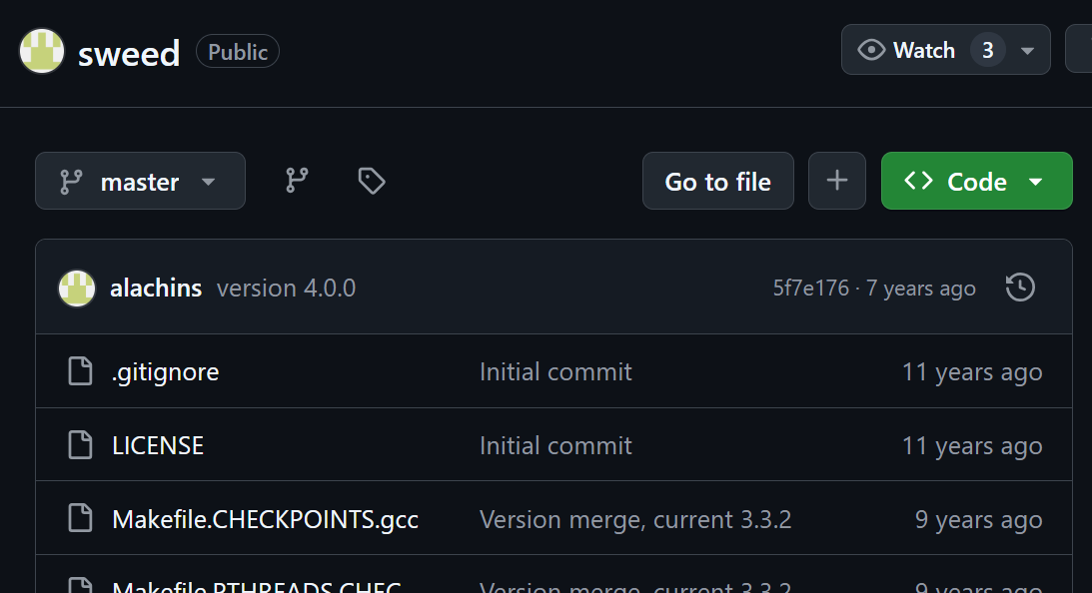

Slide 3
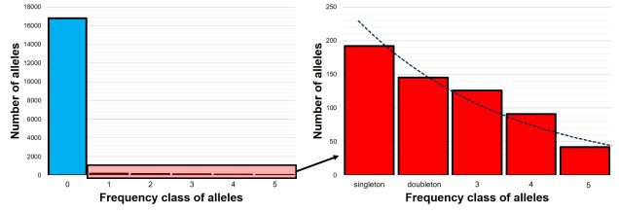
CLR base on SFS(Site/Allel Frequency Spectrum)

Slide 4
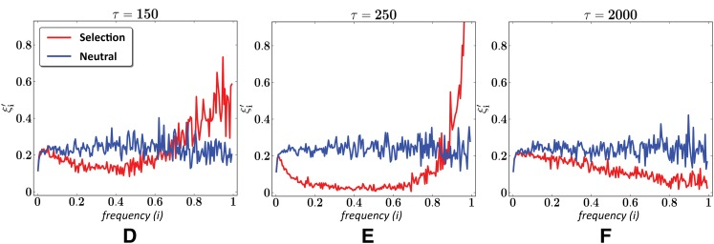
SFS and Generations(τ)
Not surprisingly, selective sweeps have a dramatic effect on the scaled SFS. Near the point of fixation, the scaled SFS is characterized by an abundance of very high-frequency alleles and a near absence of intermediate frequency alleles (Figure E). Importantly, the scaled SFS of regions evolving under selective sweeps differs even in the prefixation and postfixation regimes from that of regions evolving neutrally (Figure D and F). (Roy Ronen et. al. 2013)

Slide 5
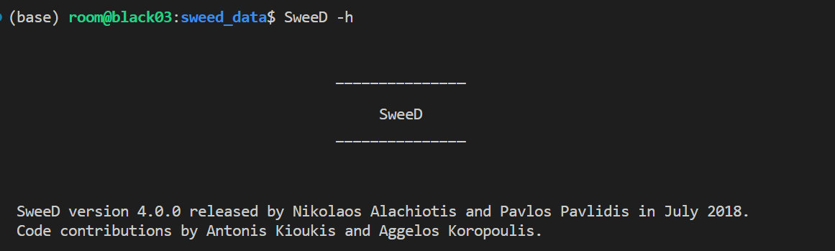
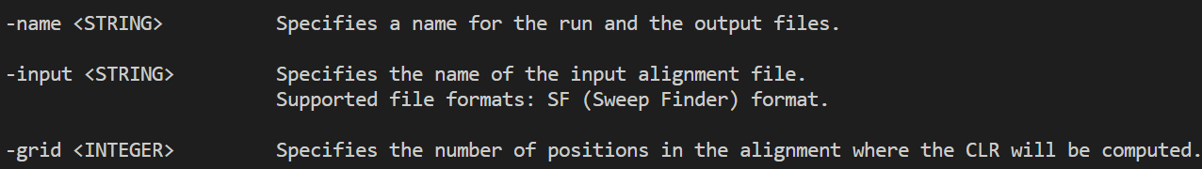
Usage

Slide 6
Usage
Input data -> .vcf file
Extract single chromosome vcf file
$ vcftools --vcf test.vcf --recode --recode-INFO-all --stdout --chr chr1 > chr1.vcf
Calculate SweeD windows (10kb)
$ grep chr1 chr1.vcf
##contig=<ID=chr1,length=31077448>
-grid = 31077448 / 10000 = 3107

Slide 7
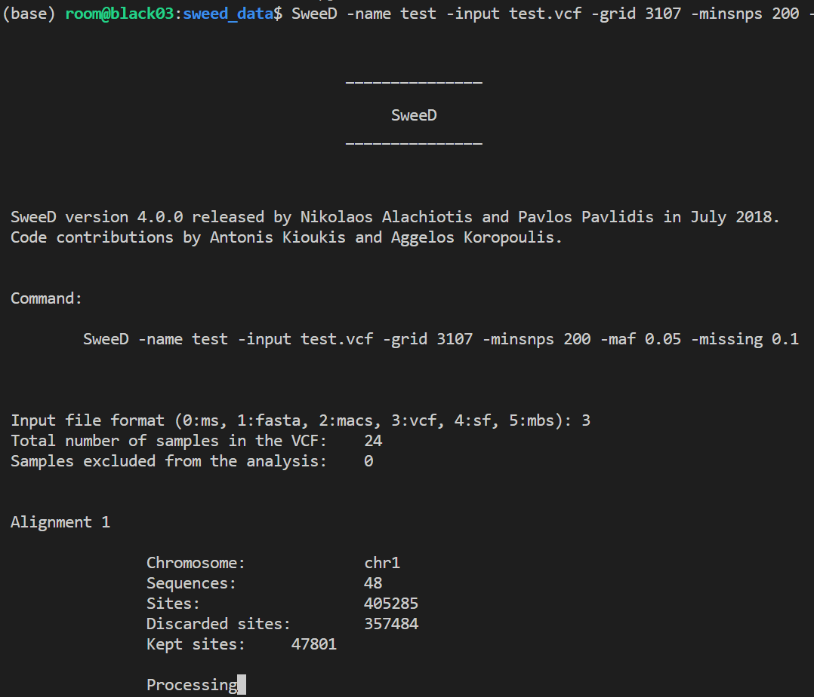
Usage
Run SweeD
$ SweeD -name pop1.chr1.10kb \
-input test_old.vcf \
-grid 3107 \
-minsnps 200 \
-maf 0.05 \
-missing 0.1

Slide 8
Practice

Slide 9
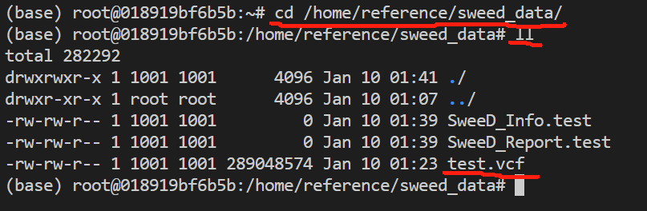
-grid = 31077448 / 10000 = 3107

Slide 10
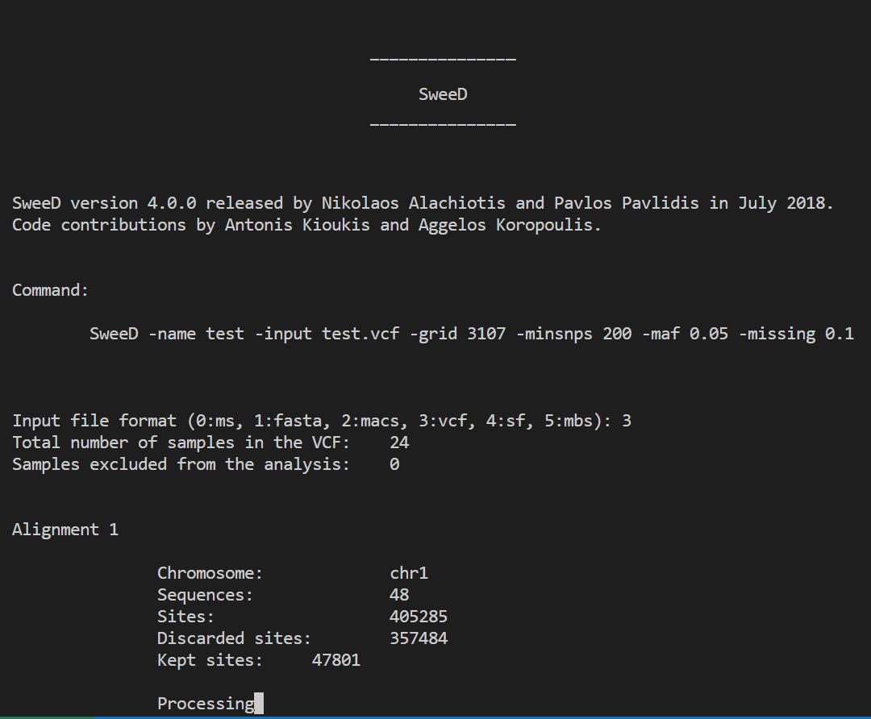

Slide 11
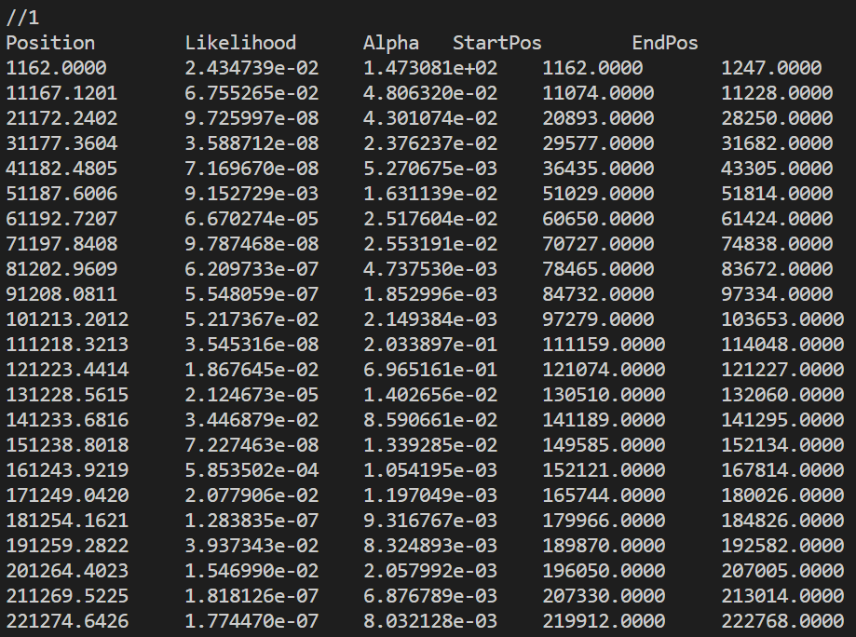
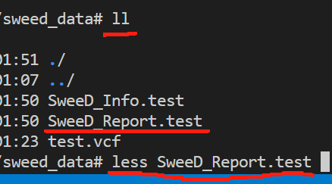

Slide 12
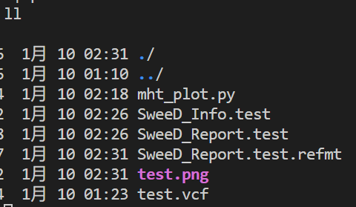

Slide 13
