Slide 1
Plink PCA Admixture

Slide 2
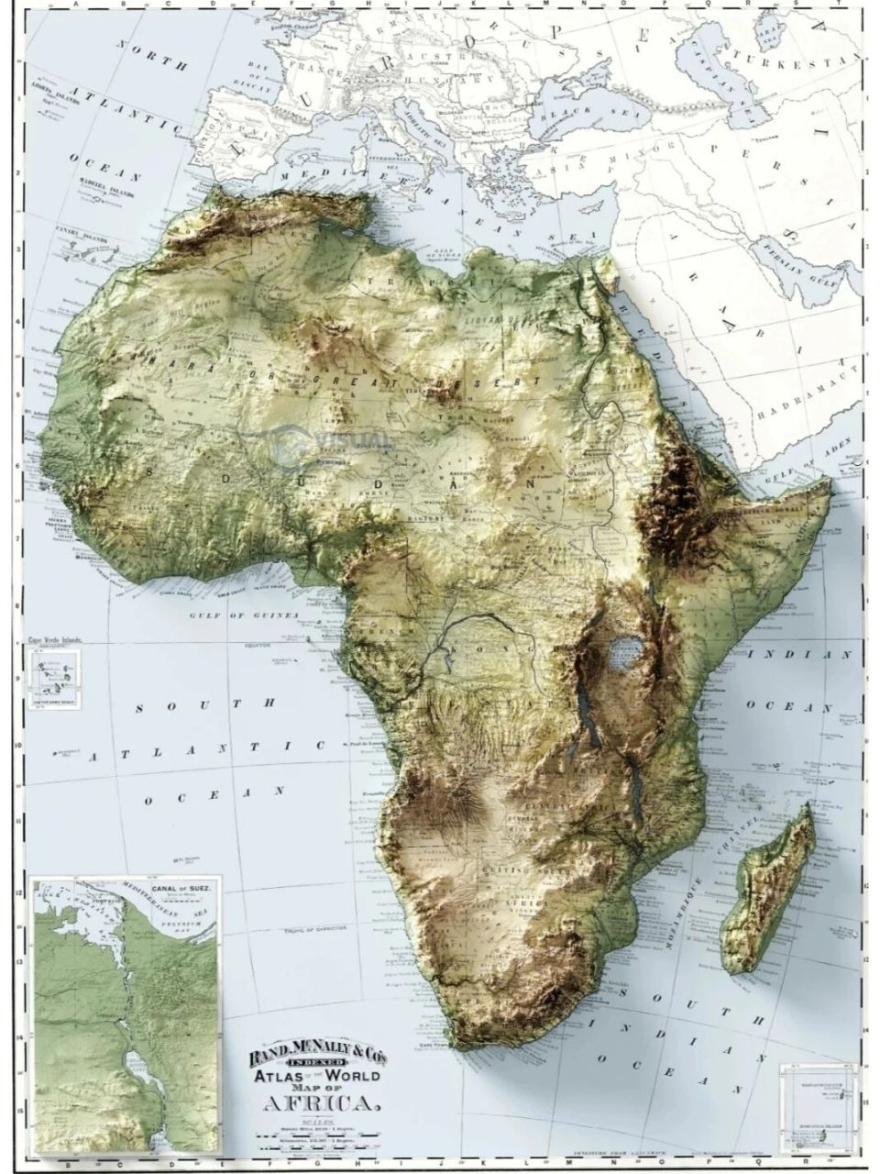
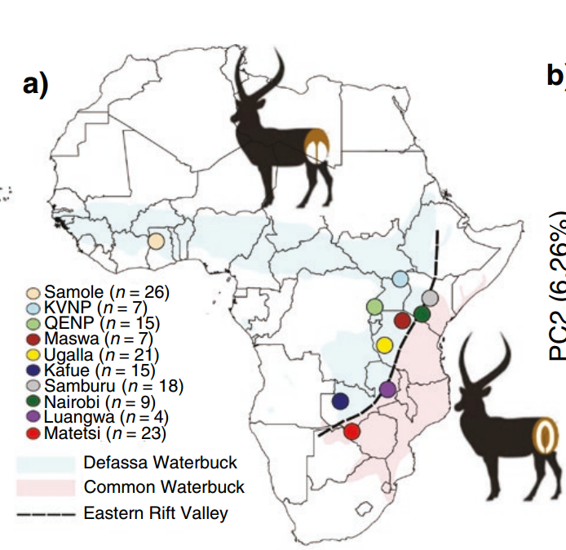
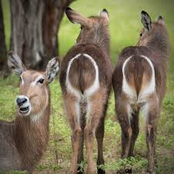
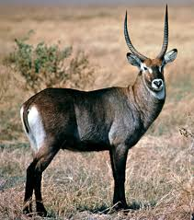
From: Persistent Gene Flow Suggests an Absence of Reproductive Isolation in an African Antelope Speciation Model

Slide 3
What is plink, PCA, Admixture?
PLINK, primarily dedicated to SNP data statistics, filtering, and GWAS analysis, facilitates the conversion of vcf files into .bim, .bed, and .fam formats, compatible with inputs required by software like NJ tree, PCA, and Admixture.
PCA, a statistical approach for dimensionality reduction and feature extraction, analyzes genetic variation data to distill high-dimensional genetic information into a few principal components, elucidating genetic structures and relationships among populations through scatter plots that depict individuals as points positioned by their PCA scores.
Admixture, a software for estimating individual genetic compositions, utilizes statistical models to deduce the proportions of diverse ancestral components within an individual's genome based on genetic variation data, presenting results as bar charts where each bar signifies an individual's genetic makeup, segmented by color to represent distinct ancestral contributions.

Slide 4
PCA is the most commonly used method for dimensionality reduction.
Mapping high-dimensional data to a low-dimensional space.

Slide 5
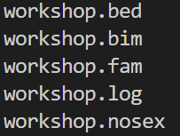
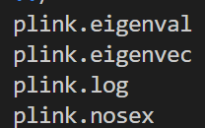
Plink do PCA
mkdir /mnt/pca && cd /mnt/pca && cp /home/reference/Tianqin_data/workshop.vcf .
plink --vcf workshop.vcf --const-fid --allow-extra-chr --make-bed --out workshop
# Turn the vcf file to the Plink format
plink -bfile workshop –pca
# Do the pca. Download these 2 files to your Desktop
plink.eigenval .
plink.eigenvec .
cd C:\Users\**\Desktop
scp -P 100** root@10.32.1.106:/mnt/pca/plink.eigenval ./

Slide 6
Rstudio
install.packages("ggplot2")
library(ggplot2)
pca <- read.csv('C:\\Users\\wutianqin\\Desktop\\ppt\\plink.eigenvec.csv',header = T)
gxz <- read.csv('C:\\Users\\wutianqin\\Desktop\\ppt\\plink.eigenval.csv',header = T)
xlab <- paste0("PC1(", round(gxz[1,2] * 100, 2), "%)")
ylab <- paste0("PC1(", round(gxz[2,2] * 100, 2), "%)")
ggplot(pca, aes(x= PC1, y= PC2, color=group))+
geom_point(size=2)+
theme_bw()+
theme(panel.grid = element_blank())+
labs(x=xlab,y=ylab)+
stat_ellipse(level=0.95, linetype = 2)+
scale_color_manual(values = c("#FF9900","#68cc99","#EF566B","#3E91D2"))

Slide 7
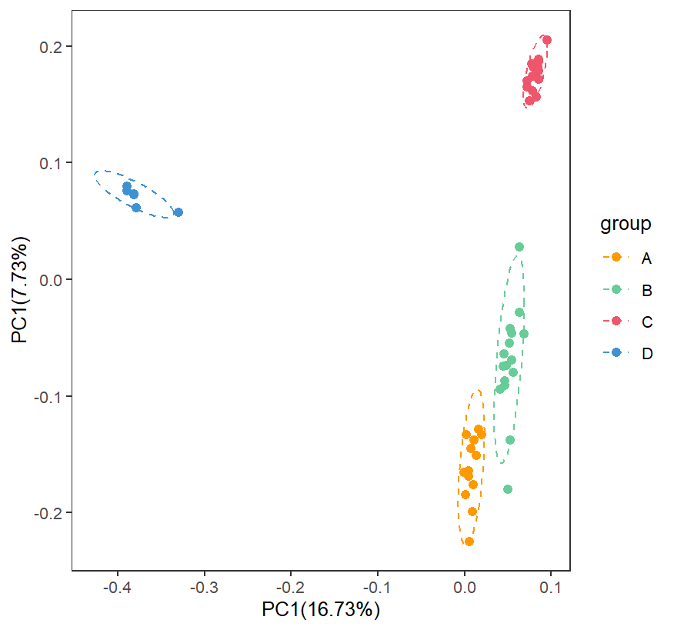

Slide 8
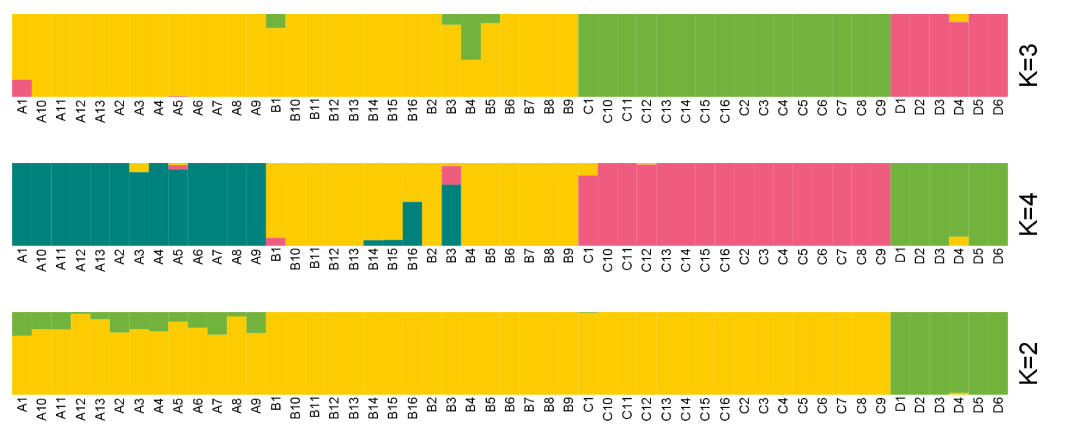
ADMIXTURE用于基于模型的估计无亲缘关系个体的祖先。
ADMIXTURE is used for model-based estimation of ancestry in unrelated individuals.

Slide 9
Admixture
for K in `seq 1 4`; do admixture --cv workshop.bed $K -j5 |tee log${K}.out; done
# Download these 4 files to your Desktop
workshop.2.Q .
workshop.3.Q .
workshop.4.Q .
workshop.fam .

Slide 10
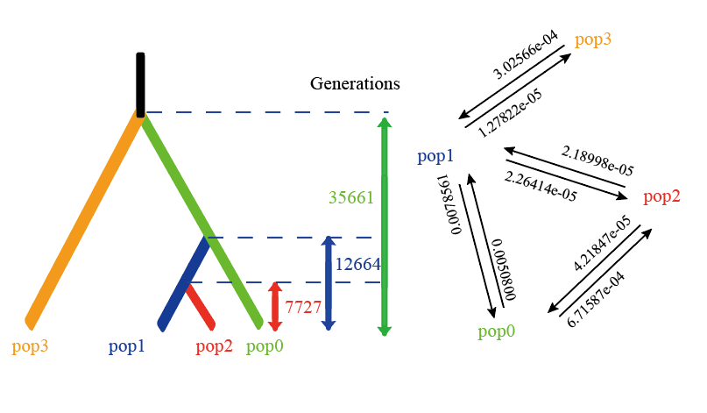
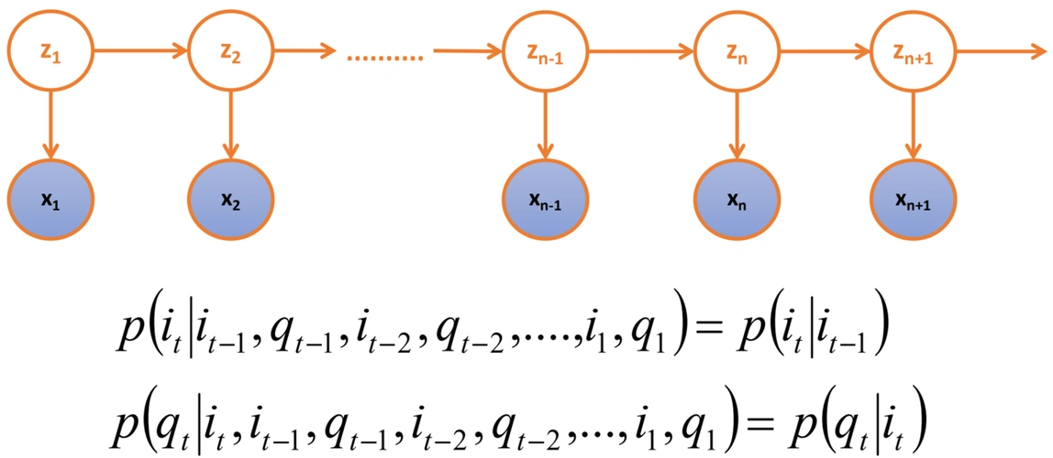
Fastsimcoal
基因流和种群历史动态可视化解读
Visualization interpretation of gene flow and population historical dynamics
reads with adapter trimmed: 163738

Slide 11
Fastsimcoal v2.8
fastsimcoal2是由伯尔尼大学的Laurent Excoffier小组2016年开发的一种非常灵活的人口统计(Demography)建模软件。 它通过执行合并模拟，使用位点频谱（SFS），推断最适合所观察数据的模型参数。
fastsimcoal2最关键的步骤就是完成自己的配置文件，接下来将会介绍配置文件中需要有哪些信息。
Fastsimcoal2 is a highly flexible Demography modeling software developed by Laurent Excofier's team at the University of Bern in 2016. It infers the most suitable model parameters for the observed data by performing merge simulations and using Site Frequency Spectrum (SFS).The most crucial step of fastsimcoal2 is to complete its own configuration file. The following will introduce what information is required in the configuration file.

Slide 12
使用Fastsimcoal2.7利用SFS模拟种群动态历史，需要三个输入文件，这三个文件的前缀必须相同：
.tpl 模版文件（参数文件）：用来指定历史事件、migration、样本大小、突变率重组率等等。注意，这里的突变率重组率都为【per generation】
.est 参数评估文件（prior文件）：在这里对参数施加prior，指定参数之间关系等等。
.obs SFS观测文件：可以用easySFS生成
To simulate population dynamic history using SFS with Fastsimcoal2.7, three input files are required, and the prefixes of these three files must be the same:
.tpl template file (parameter file): used to specify historical events migration、 Sample size, mutation rate, recombination rate, etc. Note that the mutation rate and recombination rate here are all [per generation]
. est parameter evaluation file (priority file): Here, apply priority to parameters, specify relationships between parameters, and so on.
. obs SFS observation file: can be generated using easySFS

Slide 13
Copy data
mkdir /mnt/fastsimcoal && cd /home/reference/Tianqin_data/fastsimcoal && cp workshop.vcf name.txt run/model_4.* run_fsc_4D.py selectbestrun.sh /mnt/fastsimcoal && cd /mnt/fastsimcoal

Slide 14
*.est file
1. #isInt? 是否为整数 1是，0否 #dist 是原始数据还是log10处理后结果。#min#max设定的最小/大值的范围。
2.NPOP* 群体*的有效群体大小。
3.TSP(1,2)最晚（倒数第二晚的，倒数第三晚的）群体分离事件。距离现在的该物种的“代”数。
4.TBO1/TBOEND 群体三的瓶颈事件的开始/结束时间
5.M01：现在pop1到pop0的基因流大小。ME01最晚的群体分离时间之前的pop1到pop0的基因流大小。

Slide 15
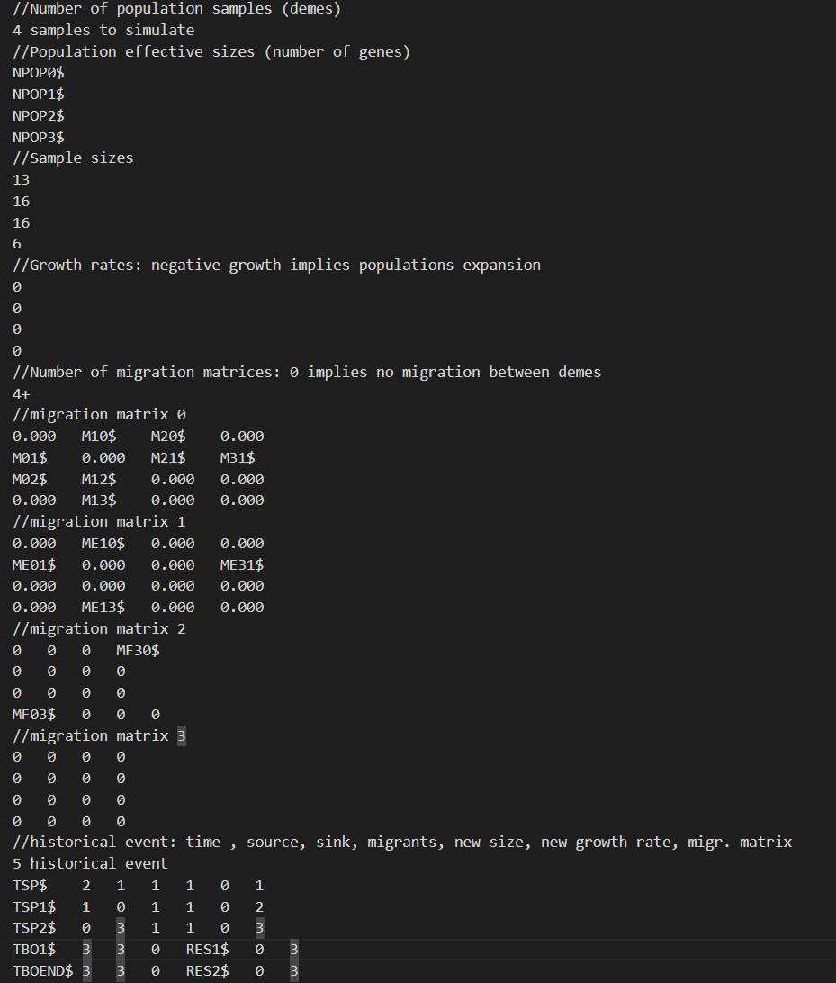

Slide 16
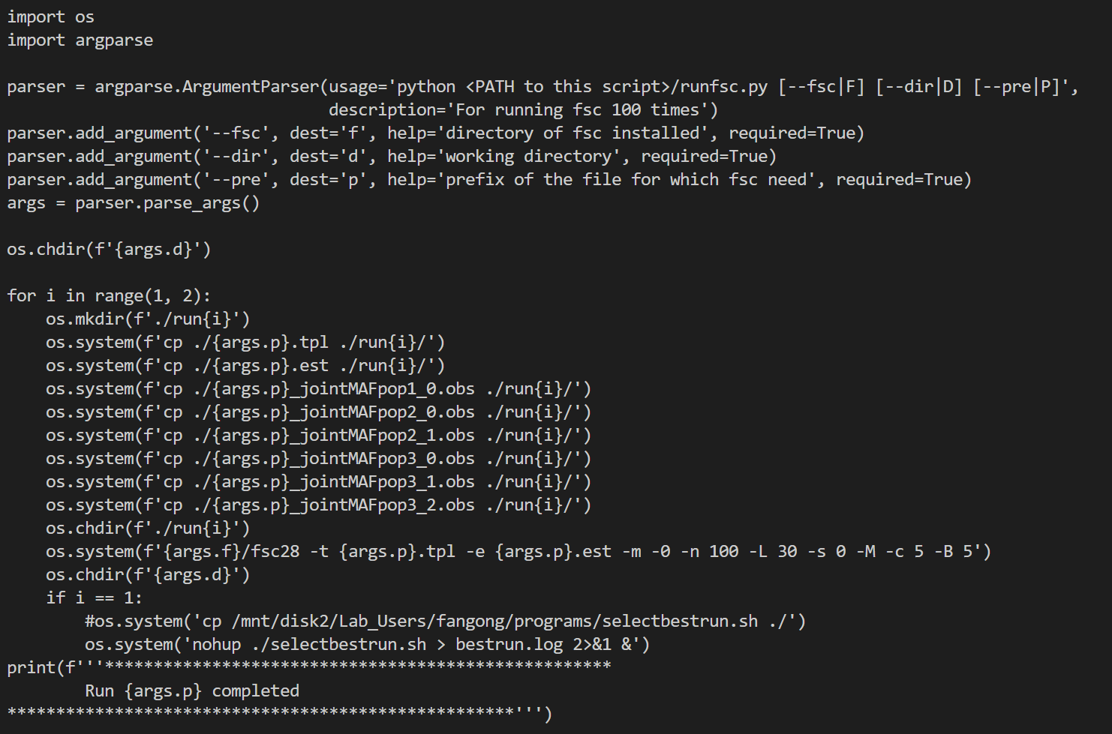

Slide 17
Fastsimcoal
#Fastsimcoal needs SFS format input data.
#We must transform *.vcf file to SFS data.
python3 /home/reference/Tianqin_data/fastsimcoal/easySFS.py -i ./workshop.vcf -p ./name.txt --preview
python3 /home/reference/Tianqin_data/fastsimcoal/easySFS.py -i ./workshop.vcf -p ./name.txt --proj 21,29,29,11

Slide 18
cd output/fastsimcoal2
# use for loop to change name
for file in workshop_jointMAFpop{1,2,3}_{0,1,2}.obs; do mv "$file" "model_4_${file#workshop_}";done
# move the model_4* files to the run folder
mkdir /mnt/fastsimcoal/run && cp model_4* /mnt/fastsimcoal/run && cd /mnt/fastsimcoal && cp model_4.* run/

Slide 19
python run_fsc_4D.py --fsc /home/software/fsc/fsc28_linux64 --dir /mnt/fastsimcoal/run/ --pre model_4
#compare the MaxEstLhood & MaxObsLhood…
less mnt/fastsimcoal/run/run1/model_4/model_4.bestlhoods

Slide 21
