Slide 1
Workshop on Molecular Systematics and Evolution
Jan 12 - 16, 2026
Lingang, Shanghai

Slide 2
Why we do this?
understand and document biodiversity

Slide 3

Why we do this?

Slide 4
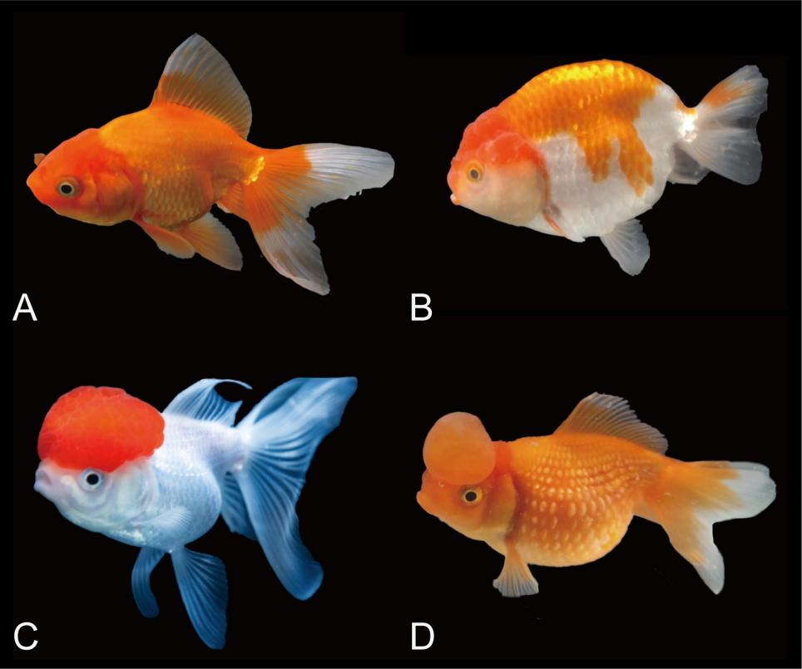
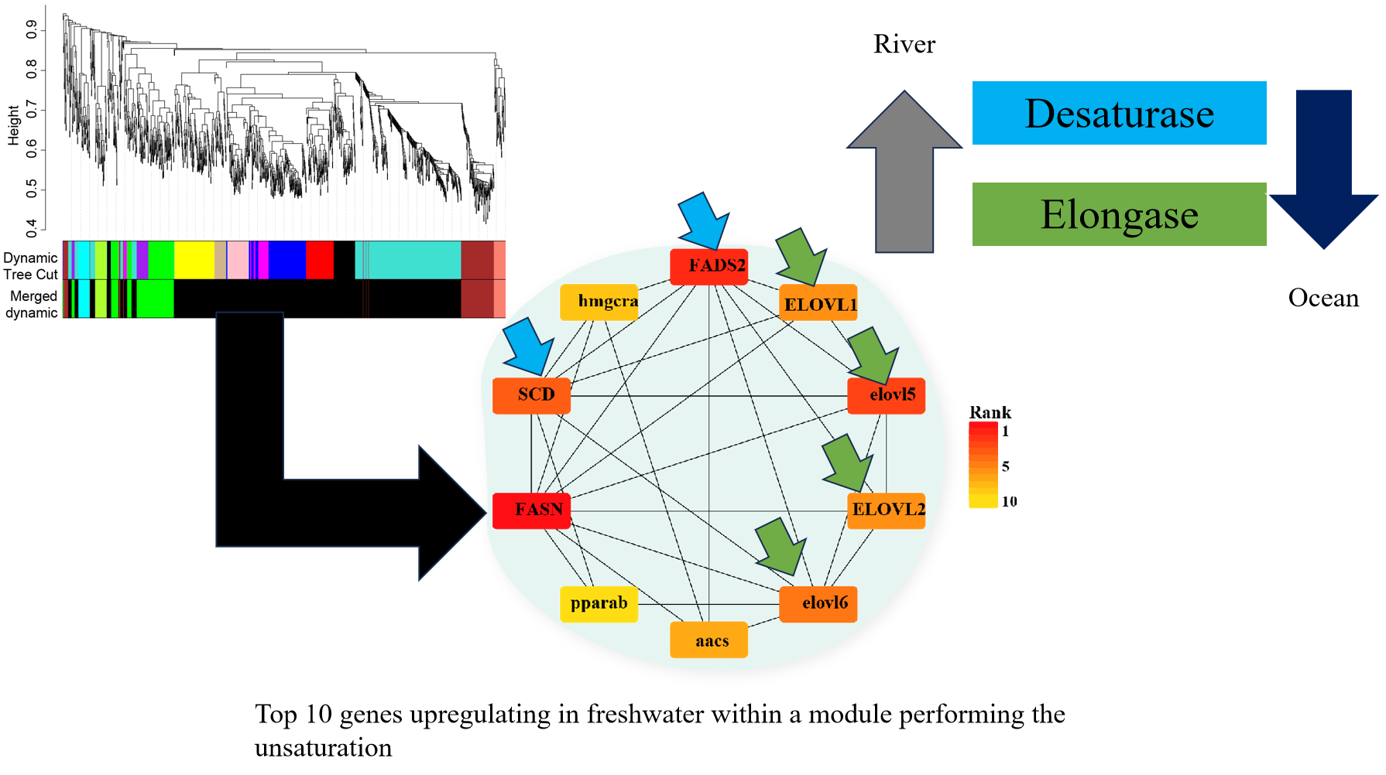
Why we do this?
learn from the nature!!!

Slide 5
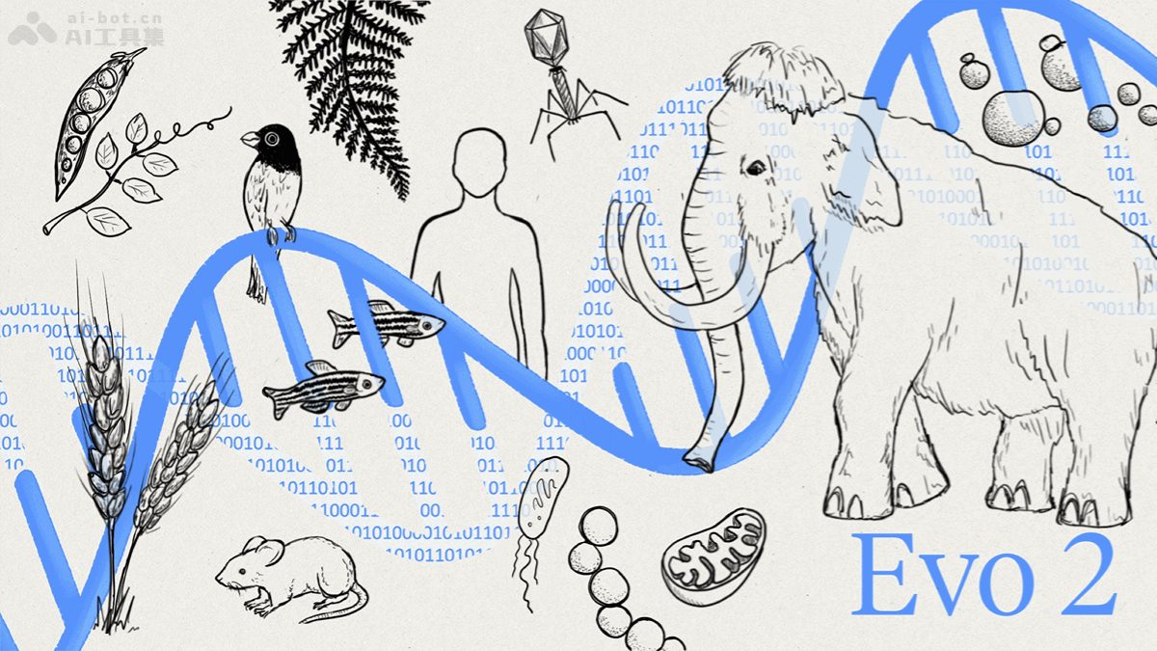

Slide 6
What is systematics?
Taxonomy – the orderly classification of organisms and other objects
Systematics – scientific study of the diversity of organisms
Classification – arrangement into groups
Nomenclature – scientific names
Phylogenetics – evolutionary history

Slide 7
What is molecular systematics?
Using molecular data to
delimitate species
reconstruct phylogenies
propose classification

Slide 8
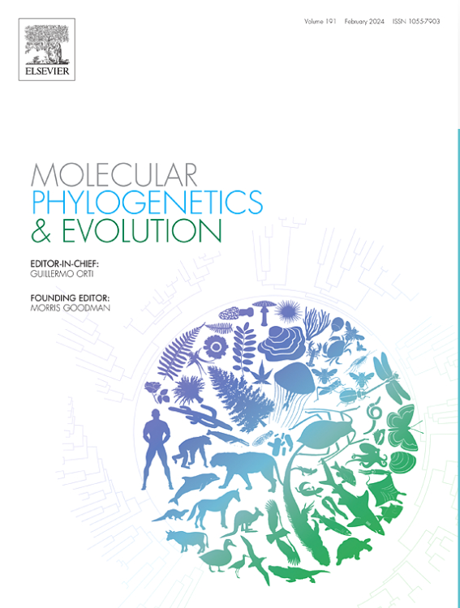
Why high-throughput molecular systematics?
Papers based on few taxa and single molecular markers (for example, including only mitochondrial or chloroplast genes or genomes) will not be considered for publication. Papers based on a few molecular markers obtained by legacy PCR-Sanger methods, although acceptable in principle, will receive low priority or will be considered only in exceptional cases. Well into the genomics-era, MPE aspires to publish papers based on genome-wide datasets obtained by next-gen approaches. Multi-locus datasets which attempt to provide signal from across the genome are a minimum requirement.

Slide 9
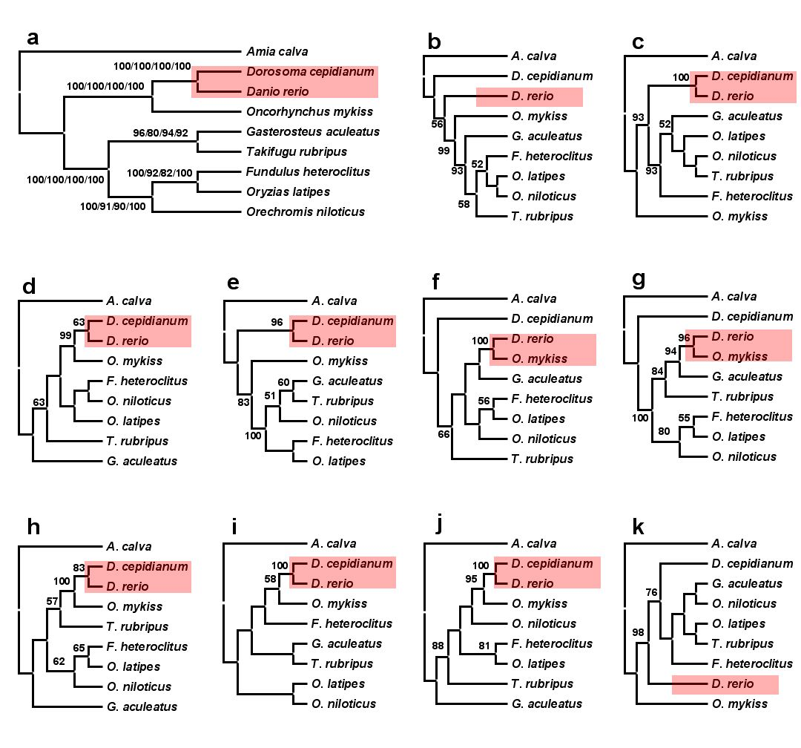
Why high-throughput molecular systematics?
ML phylogenies of teleosts based on nuclear genes, zic1, myh6,
RYR3, Ptc, tbr1, ENC1, Gylt, SH3PX3, plagl2, and sreb2.

Slide 10
Reasons for inconsistent results
Sampling error (characters and taxa)
Systematic error (model misspecification)
Long branch attraction
Base compositional bias
Heterotachy (variation in rate of change)
Gene tree vs. species tree
Incomplete lineage sorting
Paralogy

Slide 11

Null model of phylogenetics
Topology and branch length
Substitution matrix
r_{TC} (= r_{CT}), r_{TA} (= r_{AT}), r_{TG} (= r_{GT})
r_{CA} (= r_{AC}), r_{CG} (= r_{GC})
r_{AG} (= r_{GA})
Stationary base frequencies
f_{T}, f_{C}, f_{A}, f_{G},
Taxa 1
Taxa 2
Taxa 3
Taxa 4
Taxa 5

Slide 12
i.i.d. assumption
Each site evolves independently and according to the identical process, so called “i.i.d.” process.

Slide 13
Compositional bias (non-stationary)
A
50%
B
70%
C
70%
D
50%
“Compositional bias can result in the artefactual grouping of species with similar nucleotide composition, because most methods assume the homogeneity of the substitution process and the constancy of sequence composition (stationarity) through time ” (Delsuc et al. 2005).
A
50%
B
70%
C
70%
D
50%
50%

Slide 14
Long branch attraction
A
C
A
C
“Intuitively, with long branches leading to speices A and C, the probability of parallel changes that arrive at the same state becomes greater than the probability of an informative single change in the interior branch of the tree” (Felsenstein, 2004).
B
D
B
D

Slide 15
Phylogenomics
Prediction of gene function (Eisen, 1998)
Establishment of evolutionary relationships using genome or genome-scale data

Slide 16
One gene or more genes?
Single gene or a few genes often result low resolution.
Single gene or a few genes may even reach to the wrong phylogeny.

Slide 17

Systematic error
+ …
+
+
Phylogenetic signal
Gene A
Gene B
Gene C

Slide 18
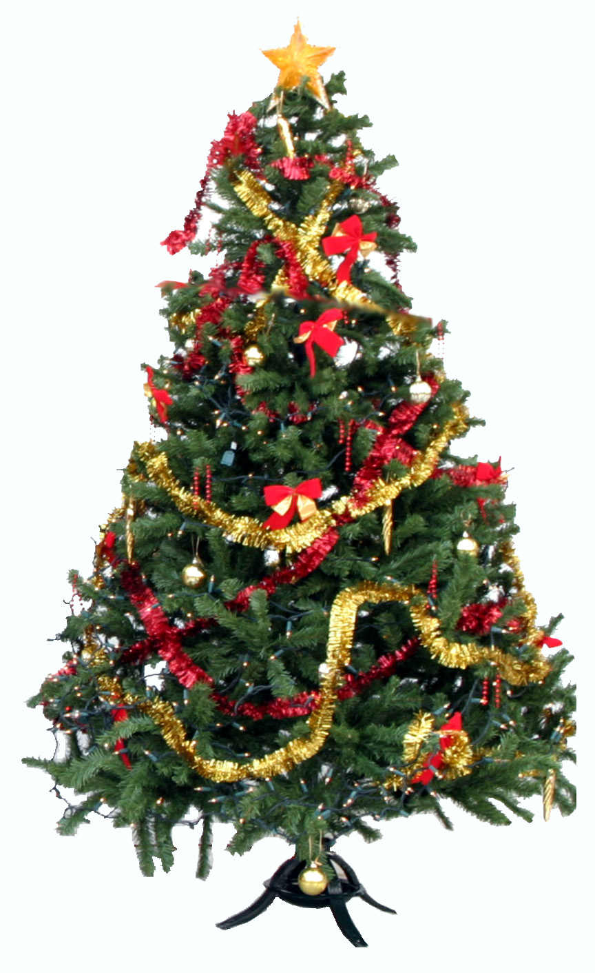

Slide 19
Choose the right data

Slide 20
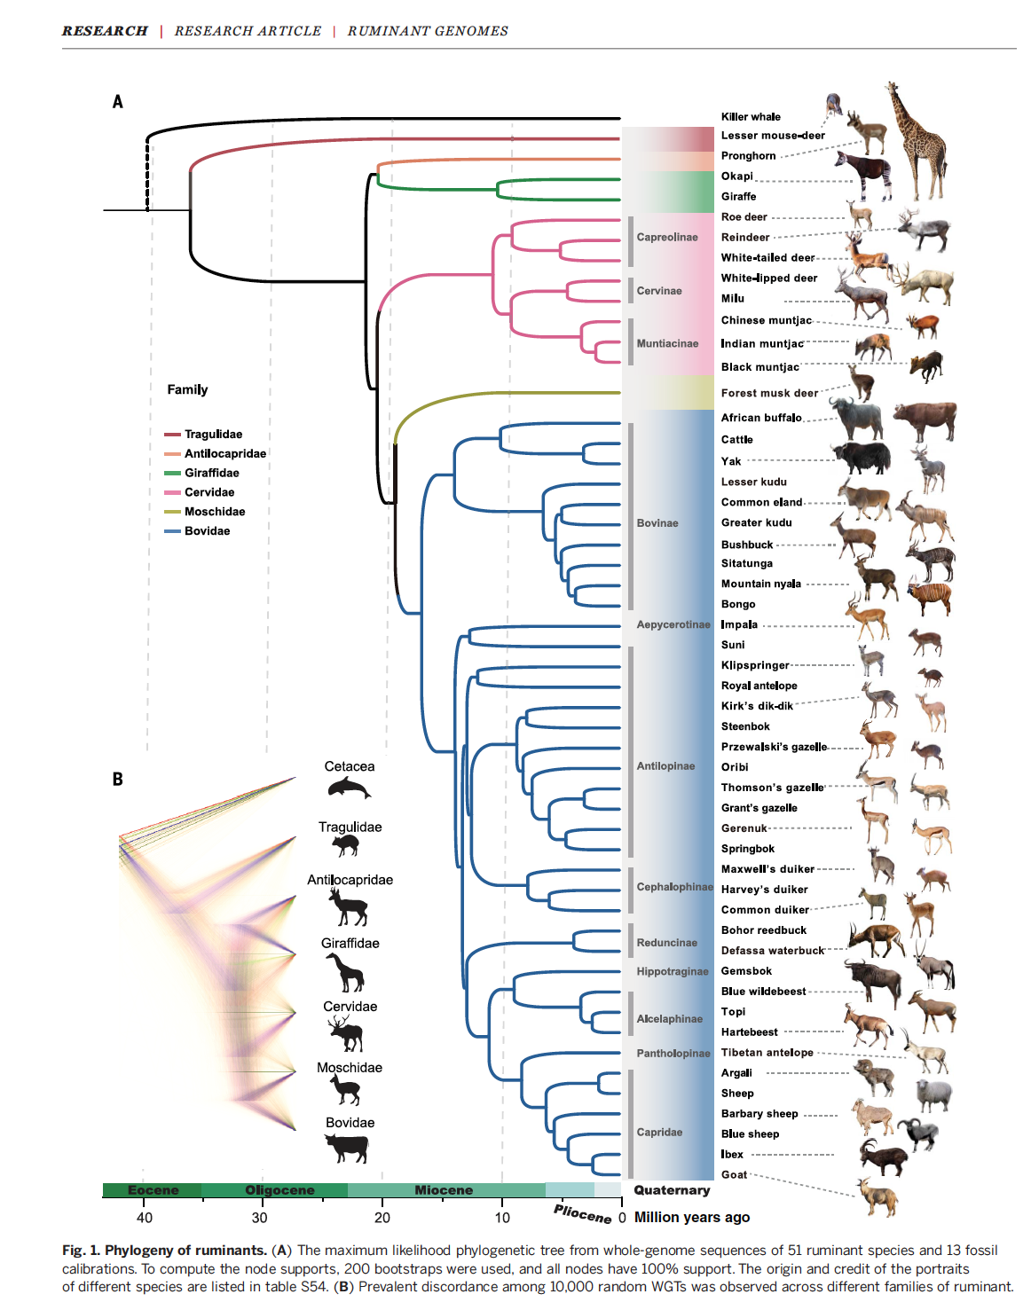

Slide 21
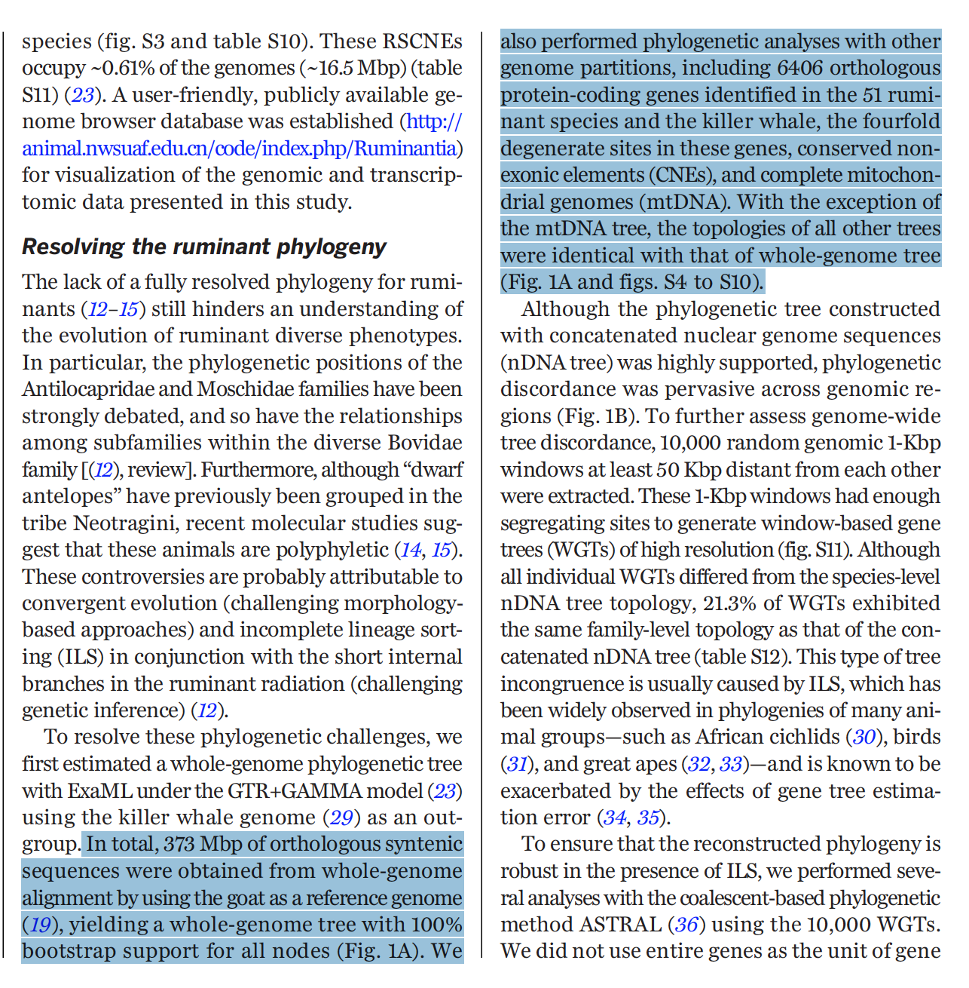

Slide 22
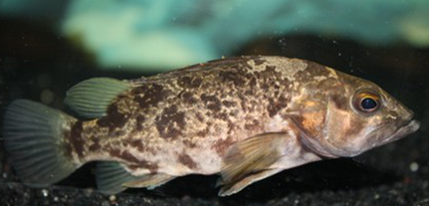
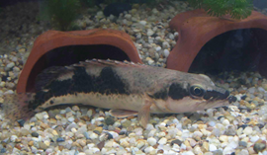
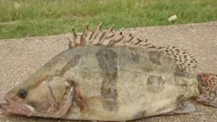
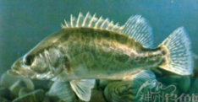
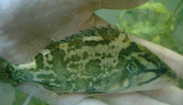
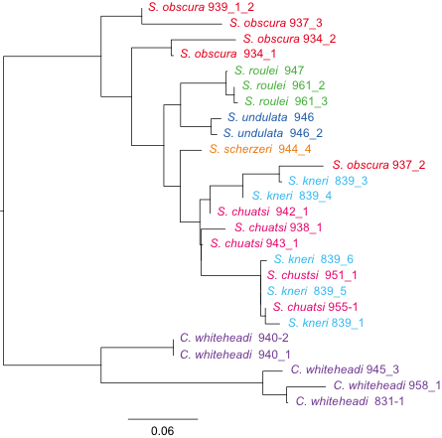
How about species delimitation?
COI barcoding

Slide 23
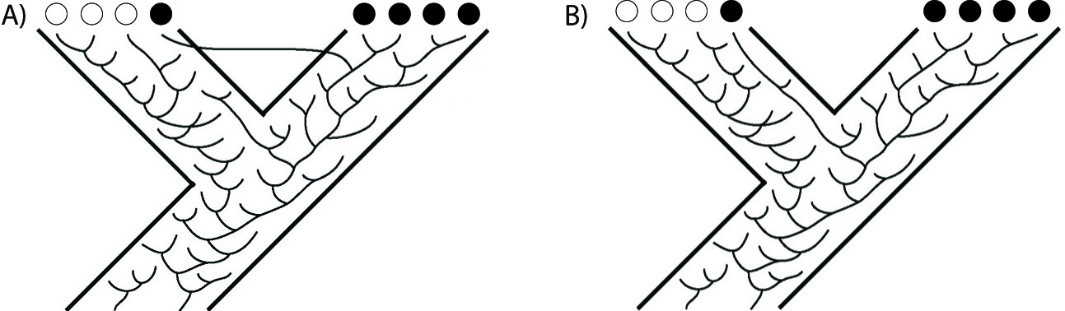
Problems with current barcoding method
Solution：DNA barcoding using multiple loci

Slide 24
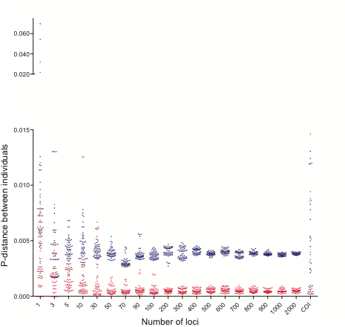
Results of multilocus barcoding

Slide 25
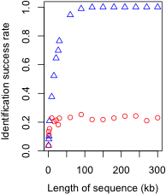
Continuous/ independent sequences
Use one continuous locus（red circles）and multiple independent loci（blue circles）for species identification。The length of single continuous locus and total length of multiple loci are equal.

Slide 26
Species delimitation
Is species an objective item?
No!!!
Two criteria to be a meaningful species – Chenhong Li
It is independently evolving
There are unique and meaningful phenotypic traits

Slide 27
How to obtain genome-scale data
RAD-seq?
Gene capture
Resequencing

Slide 28
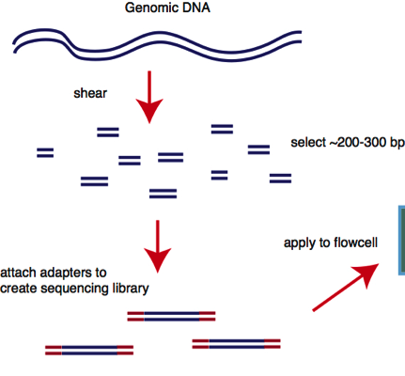

Library preparation
Why it is called library prep?

Slide 29
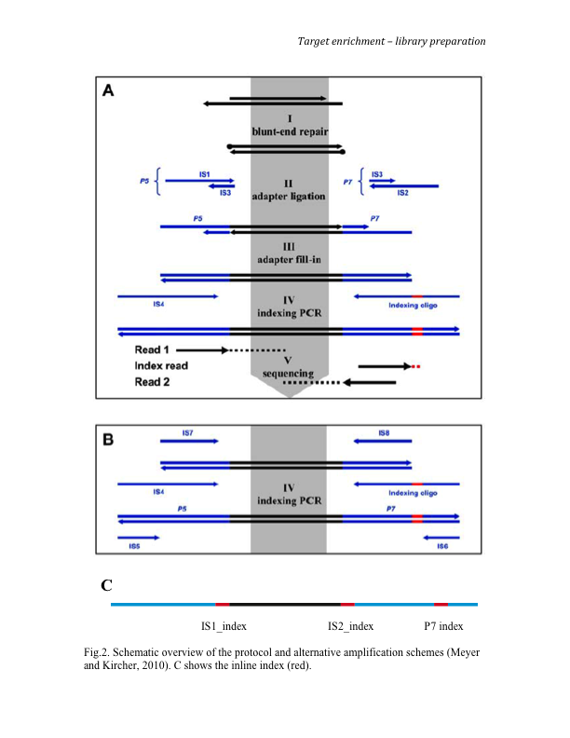
Library preparation

Slide 30
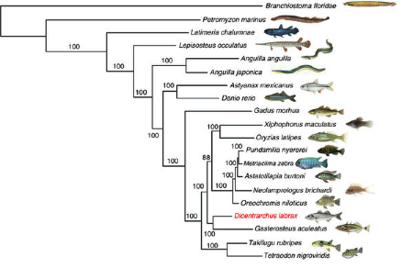
Phylogenetics – model of speciation
Tine et al., 2014

Slide 31
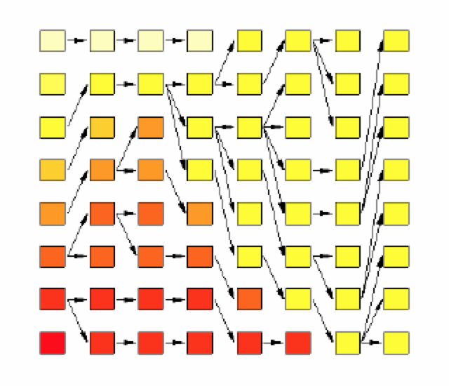
Population genetics – model of coalescence

Slide 32
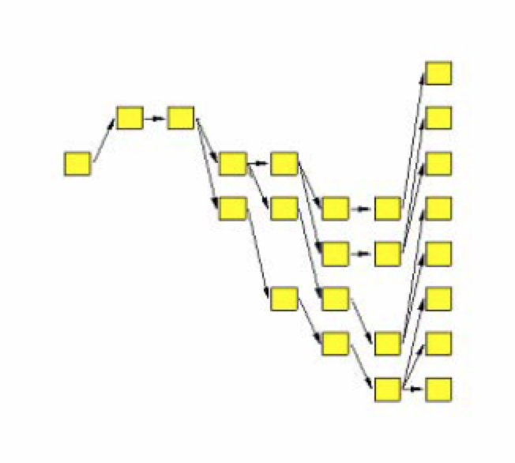
Population genetics

Slide 33
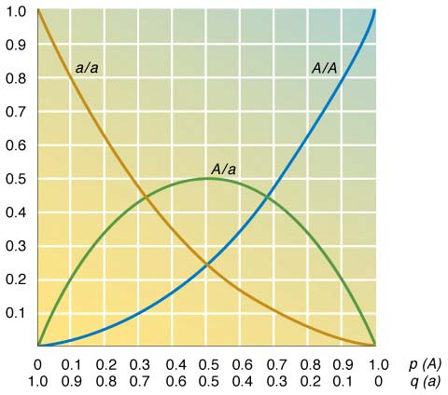
Implications of HWE (two-allele locus)
Rare alleles mostly in heterozygotes
Common ones mostly in homozygotes
Maximum He is 0.5 at 2 allele locus, rising to 1.0 with more alleles

Slide 34
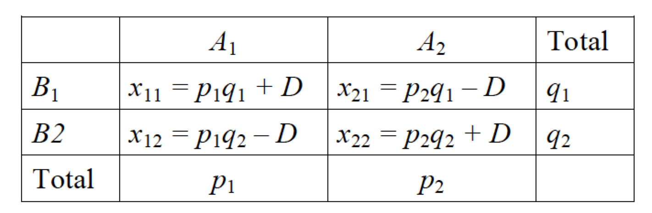
Linkage equilibrium
Alleles at separate loci are expected to segregate independently during meiosis. They show linkage equilibrium.
Example:
2 loci with alleles A₁ and A₂; B₁ and B₂ their frequencies will be p₁ and p₂ and q₁ and q₂.
Possible gametes A₁B₁; A₁B₂; A₂B₁; A₂B₂
Genotype frequencies will be the product of constituent allele frequencies

Slide 35
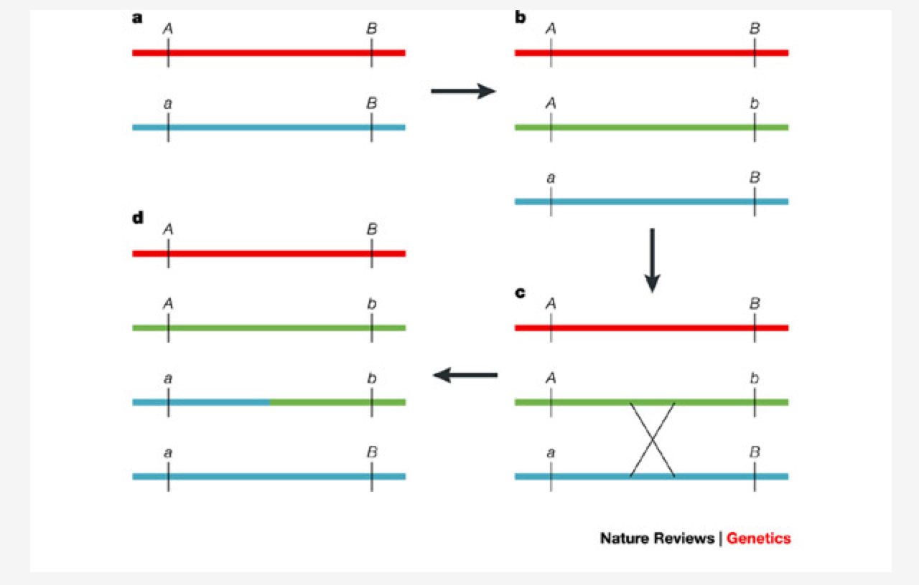
Linkage disequilibrium

Slide 36
Linkage disequilibrium
Linkage disequilibrium = a deviation from random associations of alleles at different loci
Linkage disequilibrium can be caused by :
- chance events
- population bottlenecks
- recent mixing of different populations
- selection
Linkage disequilibrium is important because:
It is common in threatened species with small populations
evolutionary processes are altered
functionally important genes may exhibit linkage disequilibrium
can be a signal of recent admixture of populations

Slide 37
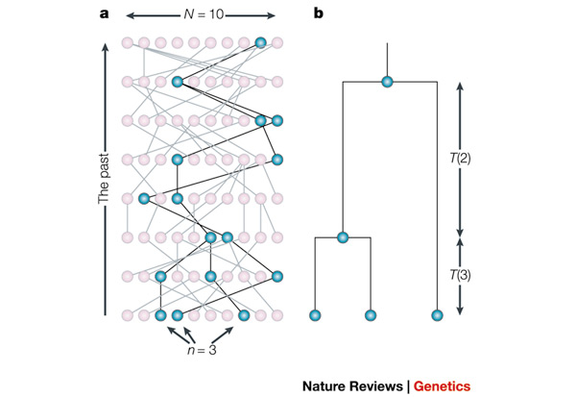
Coalescent theory

Slide 38
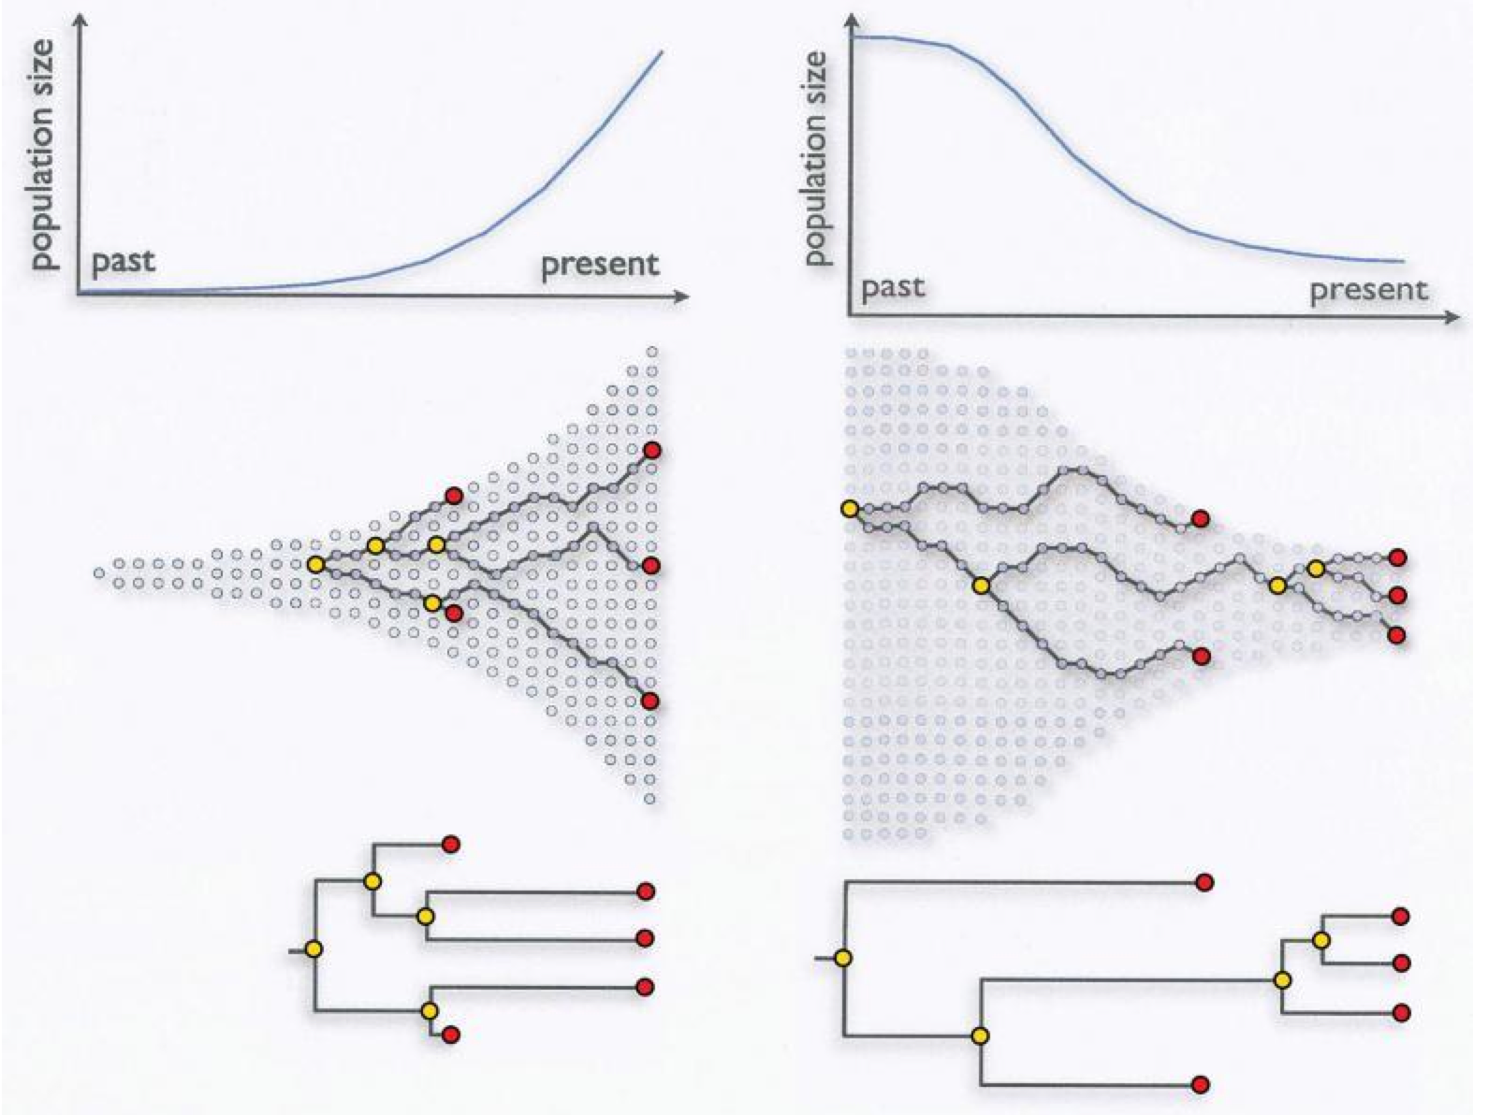
Population growth

Slide 39
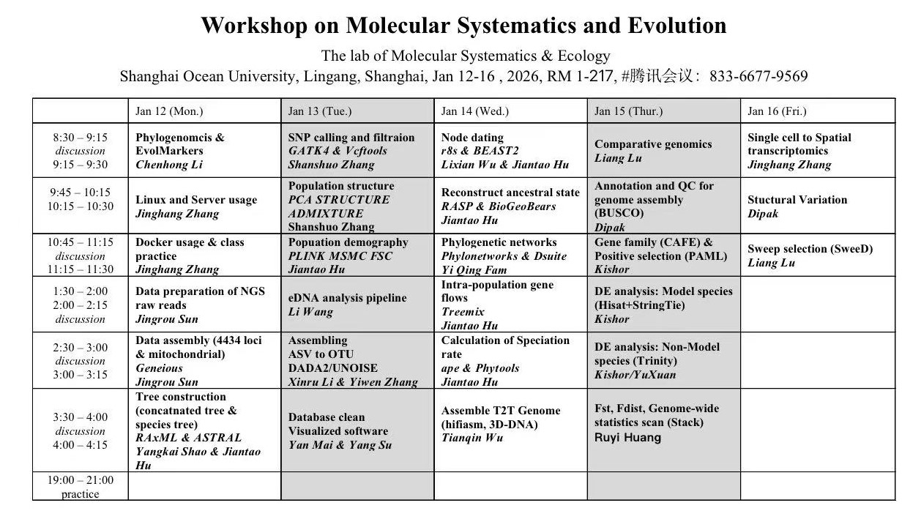

Slide 40

Time for a tea break!

