Slide 1
Data assembly (4434 loci & mitochondrial)

Slide 2
4434 loci: assemble + og stat
mitochondrial: NOVOPlasty

Slide 3
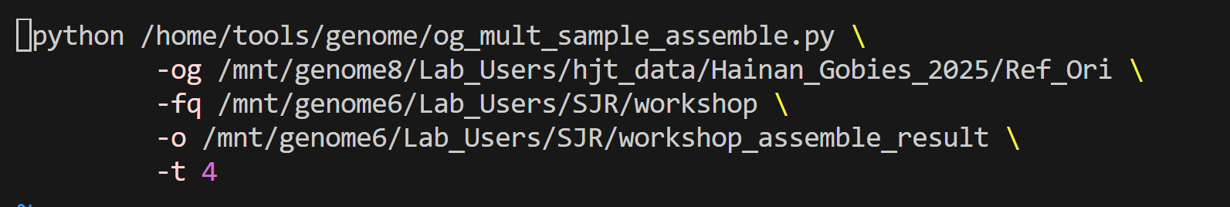
Assemble
new_assemble.sh
trim_adaptor.pl \
--og #reference path# \
--fq #demultiplex result path# \
--o #output file path# \
--t #maximent cpu# \
Command: nohup sh new_assemble.sh > Assemble.log &

Slide 4
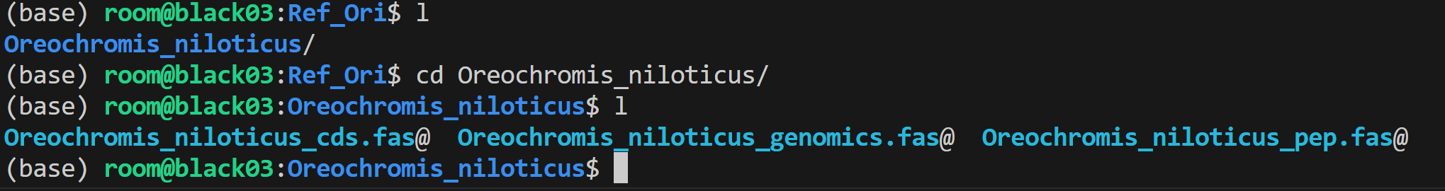
Ref data form
If the species you are analyzing is not a teleost fish, please name the reference sequence according to the following format and place it under a path where the folder name is the name of the reference species.

Slide 5
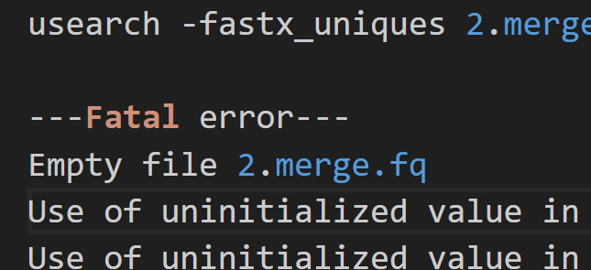
Fix fq name
If a Fatal error appears in your assembly log, it may be due to a delimiter issue. Please use fix_fq_name.py to modify the delimiter
Command: python fix_fq_name.py -t #maximent cpu# -in #trimmed path# -raw_chara "/" -new_chara " " &

Slide 6
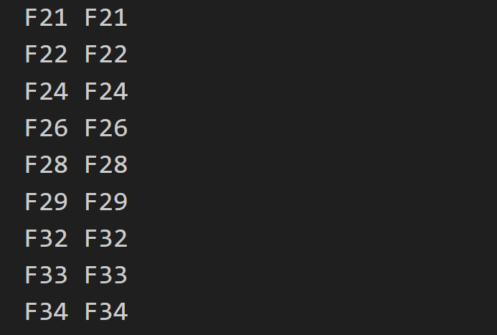
Sample list
vim samplelist.txt
#sample name# [Tab] #new name#

Slide 7
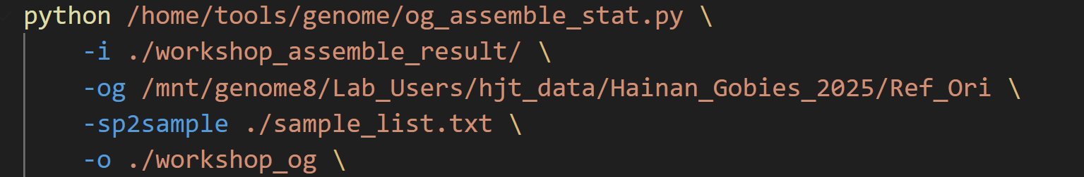
Stat
vim og_stat.sh
-i #assemble result path# \
-og #reference path# \
-sp2sample ./sample_list.txt \
-o #output file path# \
Command: nohup python og_stat.sh > Og.log &

Slide 8
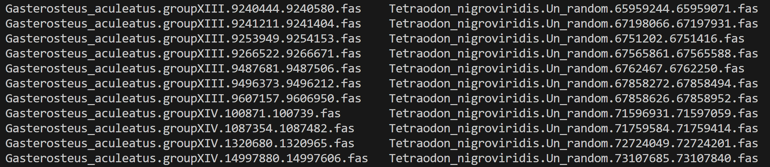
Result
Path

Slide 9
4434 loci: assemble + og stat
mitochondrial: NOVOPlasty

Slide 10
Prepare trimmed result & reference mitochondrial sequence
Make batch
Finish config.txt
Run NOVOplasty
blastn
Cut region

Slide 11
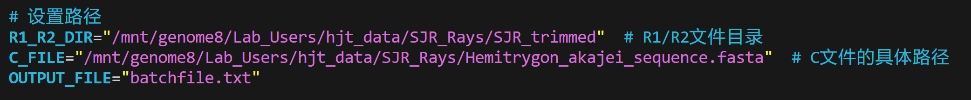
Batchfile
Vim makebatch.sh
R1_R2_DIR=“#R1/R2 folder path#”
C_FILE=“#Reference file path#”
OUTPUT_FILE=“#output file path# ”
Commend: nohup sh makebatch.sh > Makebatch.log &

Slide 12
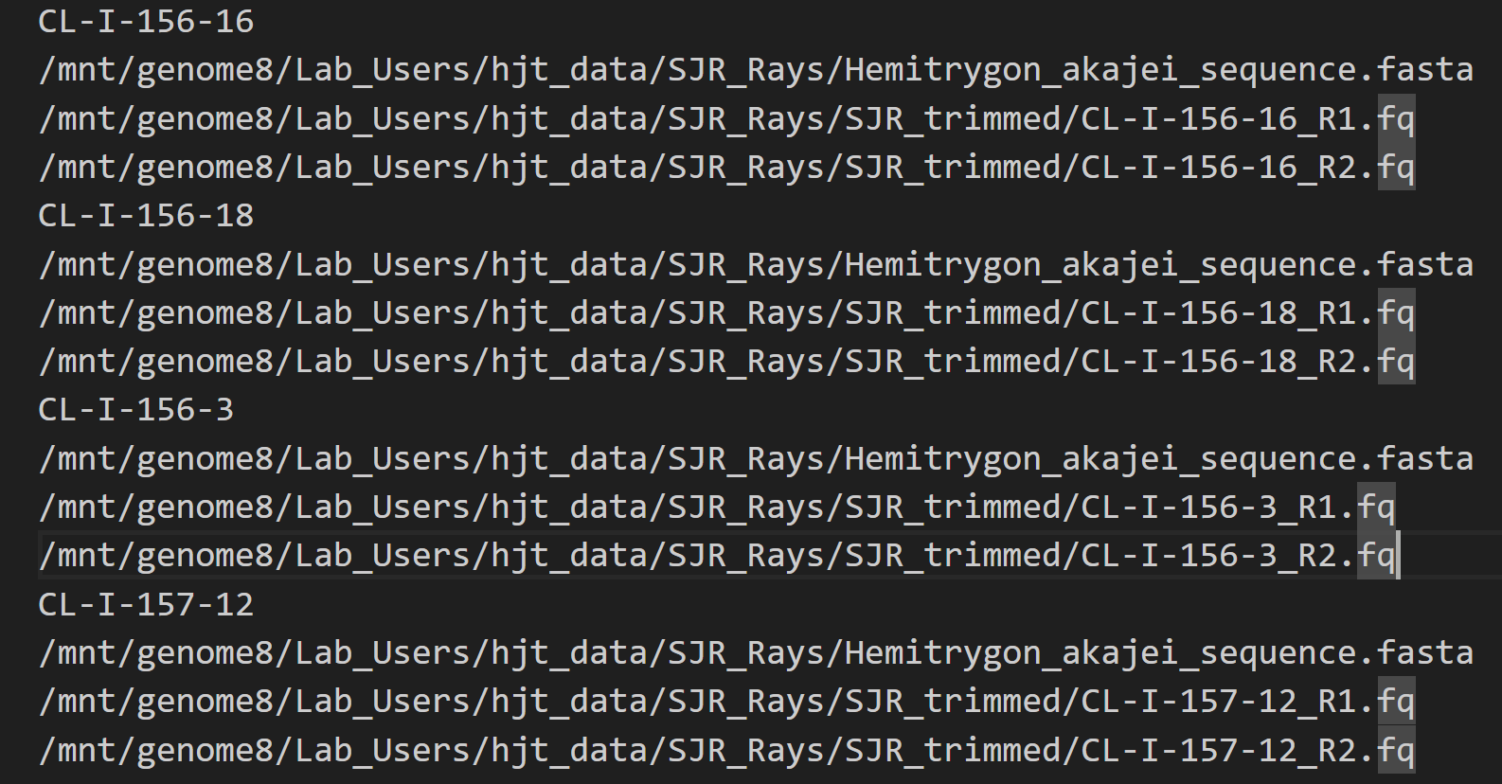
Batchfile

Slide 13
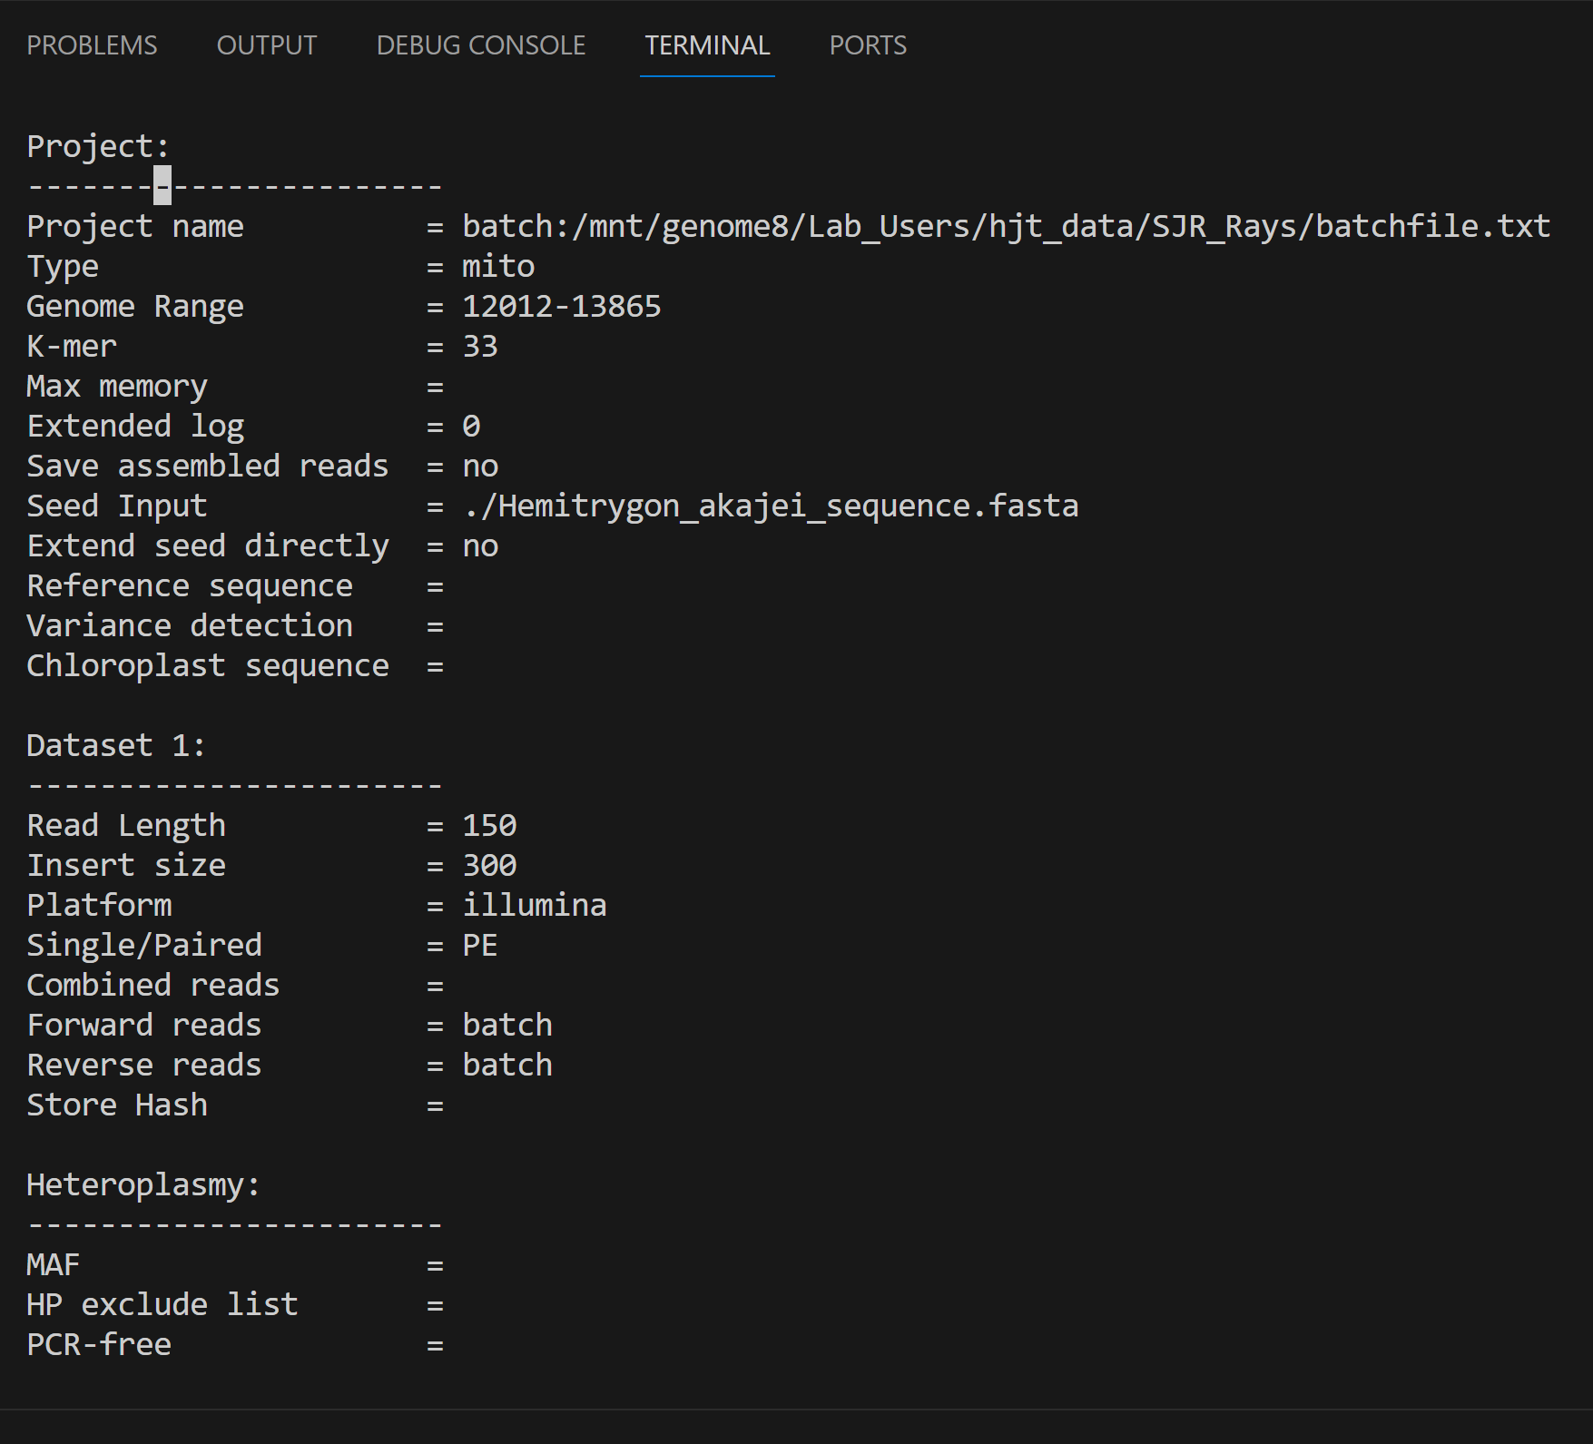
Config

Slide 14
Config
Batch: #batchfile.txt (makebatch result) path #
Mini range
Reference sequence file path

Slide 15
Config

Slide 16
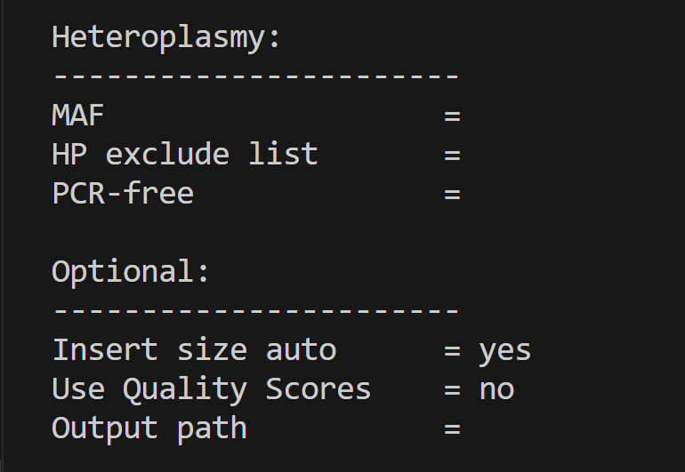
Config
You need to creat the output folder before running
Output path
Command: nohup perl NOVOPlasty4.3.1.pl -c config.txt &

Slide 17
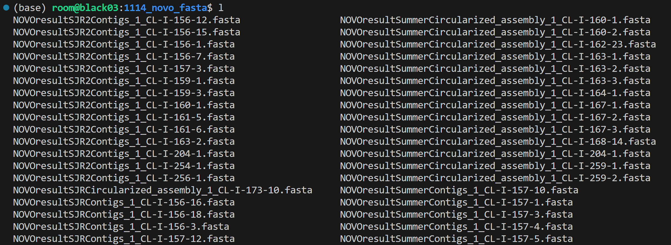
NOVOPlasty result

Slide 18
Prepare
Concatenate all the .fas file in novo result
Command: cat #NOVOplasty result file#/*.fas > full.fas
Prepare a reference mitochondrial sequence

Slide 19
Blastn
Command: blastn[space]-query [space] #full.fas# [space] –db [space] #reference path# [space] –evalue [space] 1e-6 [space] –outfmt [space] 6 [space] –num_threads [space] 5 [space] –out [space] #out put file name#
Ex:
scp -r blastn -query full.fas -db ./Dichotomyctere_nigroviridis_ND5_Ref/ –evalue 1e-4 –outfmt 6 –num_threads 5 – out workshop_blastn.txt

Slide 20
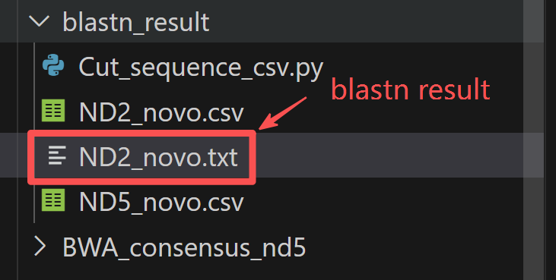
Blastn result

Slide 21
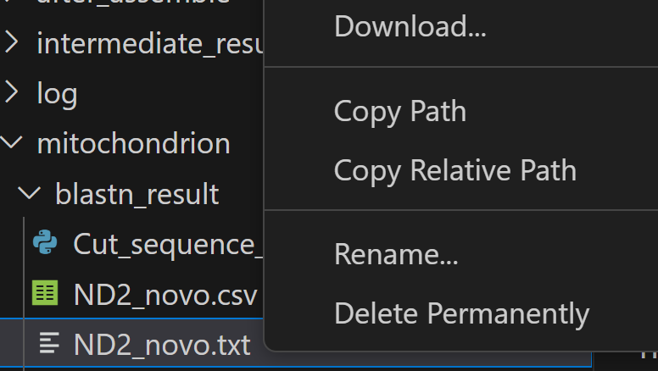
Blastn
Download the blastn result

Slide 22
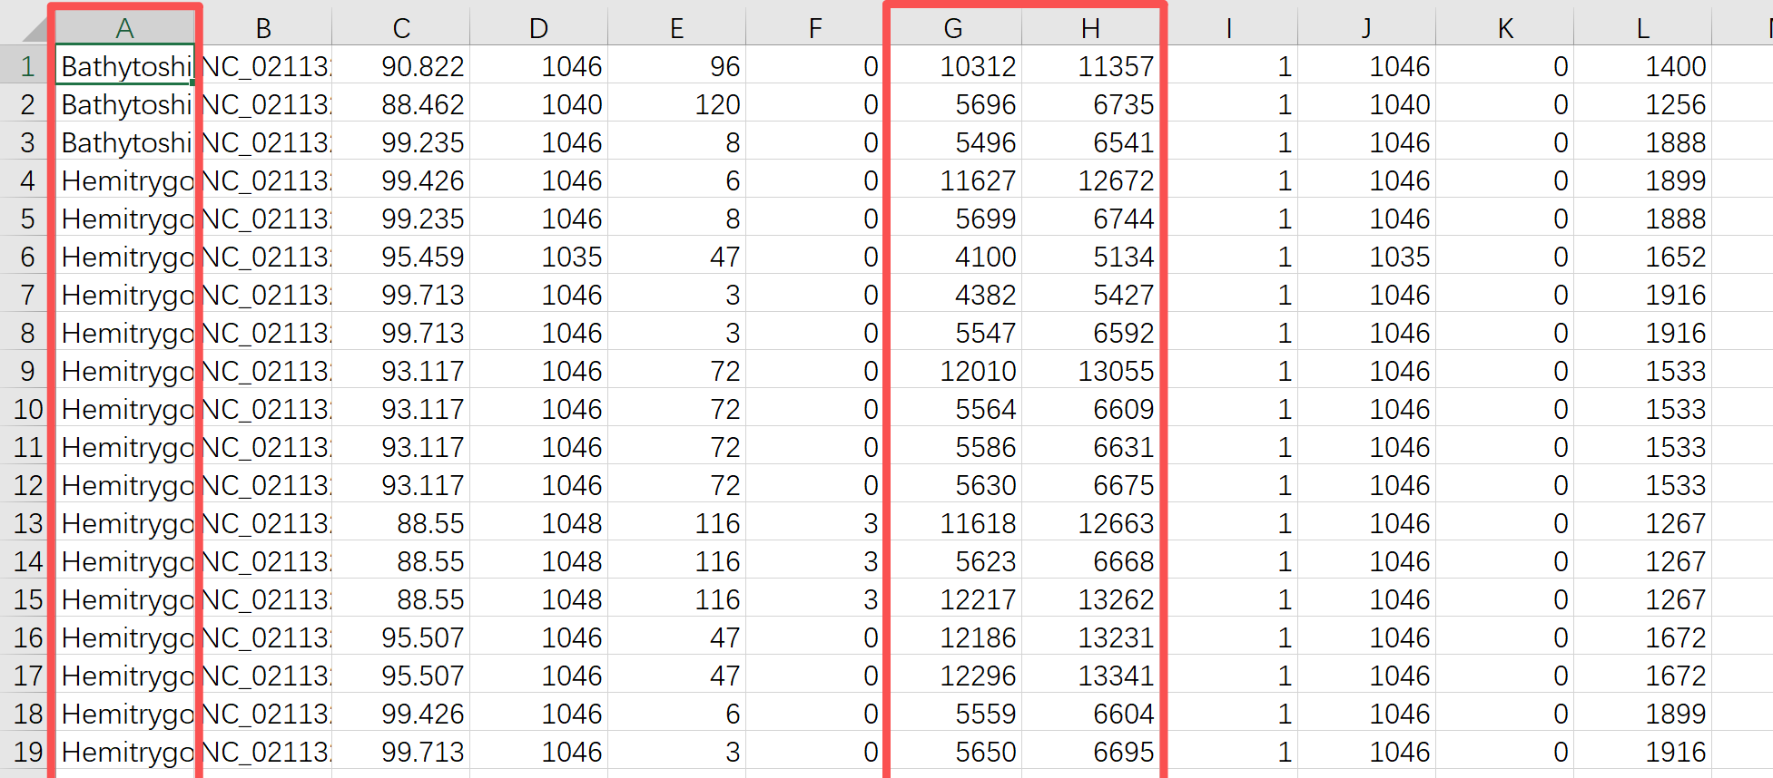
Blastn
Excel

Slide 23
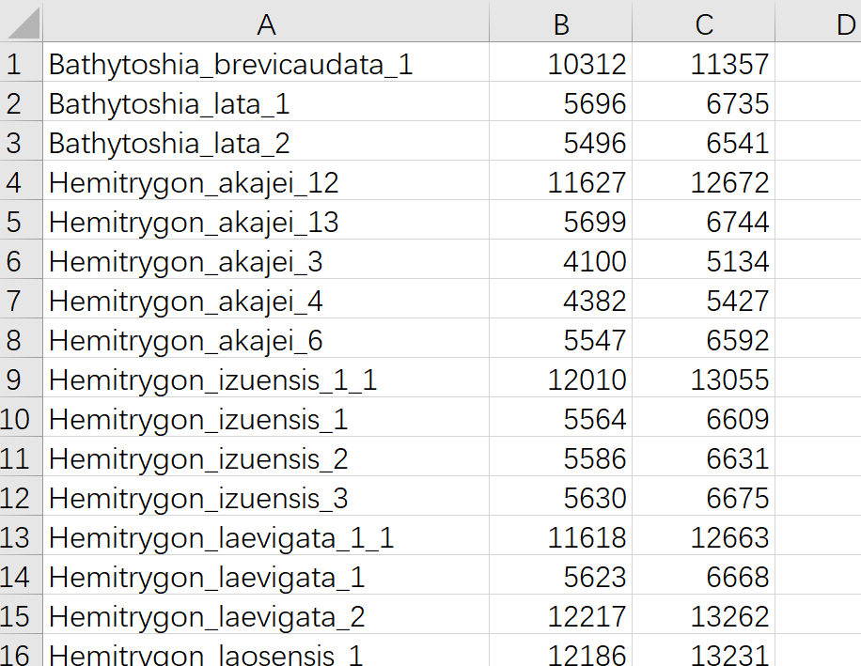
Blastn
Line A G H
Save as csv file

Slide 24
Open in terminal
Commend: scp -r [space]#.csv file path# room@10.64.5.75:#work path#

Slide 25
Cut target region
Cut_sequence_csv.py
Command: python Cut_sequence_csv.py -f #novoplasty result# -c #csv file path# -o #output path#

Slide 26
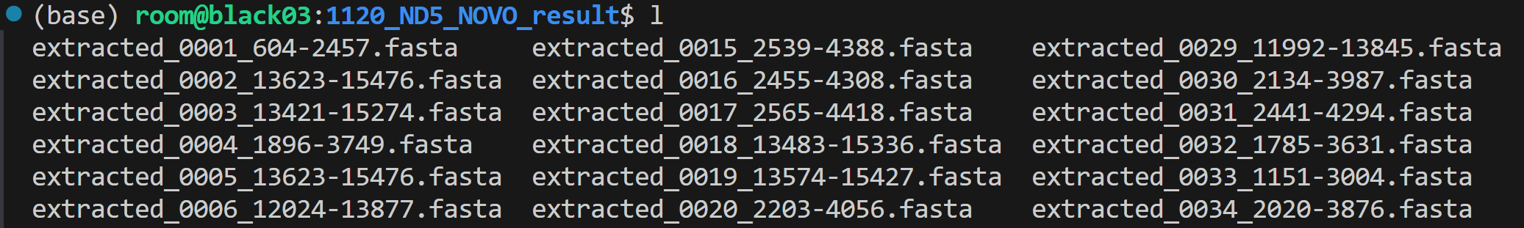
Result

Slide 27
Thanks for watching

