Slide 1
Data preparation of NGS raw reads

Slide 2
Prepare raw data
Decompression
Demultiplex
Trim

Slide 3
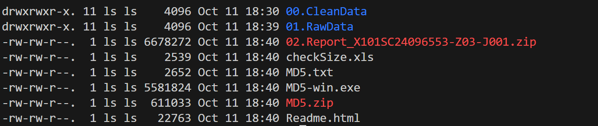
Prepare raw data
The sequencing data in the path: /data/data_backup/2025data/#foldername#
name you gave to the sequencing company

Slide 4
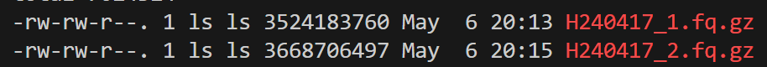
01.RawData
filename_1.fq.gz (forward sequencing)
filename_2.fq.gz (reverse sequencing)

Slide 5
Copy the raw data from backup to your work path
Command : scp [space] -r [space] #Complete local data path# [space] #Remote server username#@#Remote server IP address#:#Complete destination path on remote server#
Ex:
scp -r /data/data_backup/2025data room@10.32.5.75:/mnt/genome6/LabUsers/SJR/
R:Recursive
Scp: Secure Copy
!!! Do not delete the raw data in the local server !!!

Slide 6
Decompression
Command: nohup gunzip -d *.gz > Gunzip.log &
nohup : no hang up = no interrupt
gunzip : decompress
*.gz : all file of gz format
log : run log
& : run in back ground
See progressing:
Command: jobs

Slide 7
Rename
FILE_NAME
├── FILE_NAME_1.fq
└── FILE_NAME_2.fq
FILE_NAME
├── FILE_NAME_R1.fq
└── FILE_NAME_R2.fq
>
Command: mv [space] oldname [space] newname
Ex: mv filename_1.fq filename_R1.fq

Slide 8
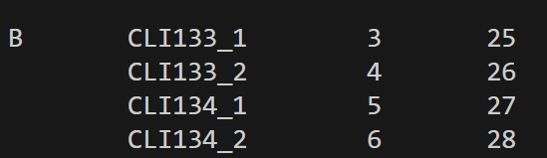
Indexpair
Make file indexpair.txt
vim indexpair.txt
File_name[Tab]Sample_code[Tab]IS1 [Tab]IS2

Slide 9
Change environment
Command : conda activate #name of the environment#

Slide 10
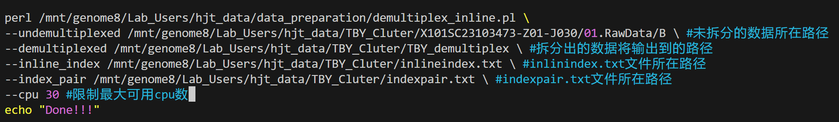
Demultiplex
vim demultiplex.sh
Perl /mnt/genome8/Lab_Users/hjt_data/data_preparation/demultiplex_inline.pl \
--index_pair #file indexpair.txt path# \
--undemultiplexed #file rawdata path# \
--demultiplexed #output file path# \
--inline_index /mnt/genome8/Lab Users/hjt_data/TBY_Cluter/inlineindex.txt \
--cpu #maximent cpu#
Command: nohup sh demultiplex.sh > Demultiplex.log &

Slide 11
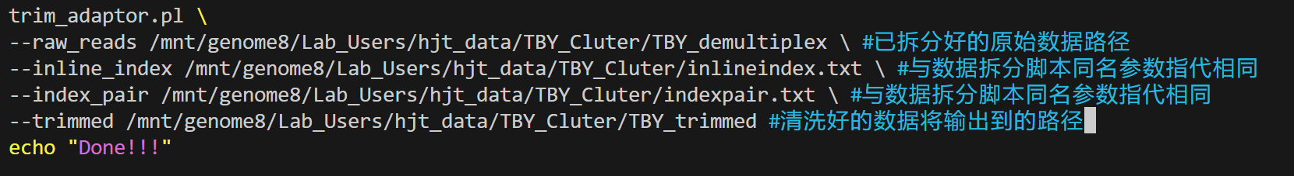
Trim
vim trim.sh
trim_adaptor.pl \
--raw_reads #demultiplex result path# \
--inline_index /mnt/genome8/Lab Users/hjt_data/TBY_Cluter/inlineindex.txt \
--index_pair #file indexpair.txt path# \
--trimmed #output file path# \
Command: nohup sh trim.sh > Trim.log &

Slide 12
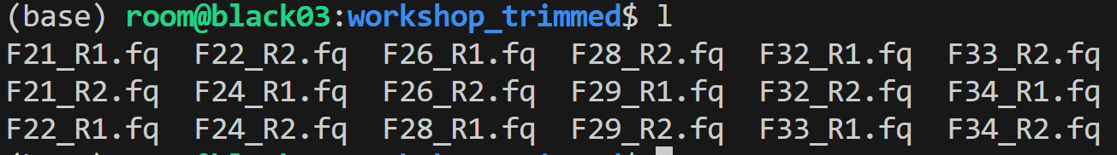
Result
After trimming is completed, delete all intermediate results (such as demultiplexed files) to free up storage space.
!!! Do not delete the raw data in the local server !!!
!!! Do not delete the raw data in the local server !!!
!!! Do not delete the raw data in the local server !!!

