Slide 1


Linux Tutorial
Zhang Jinghang
Shanghai Ocean University
Jan 11 2026

Slide 2
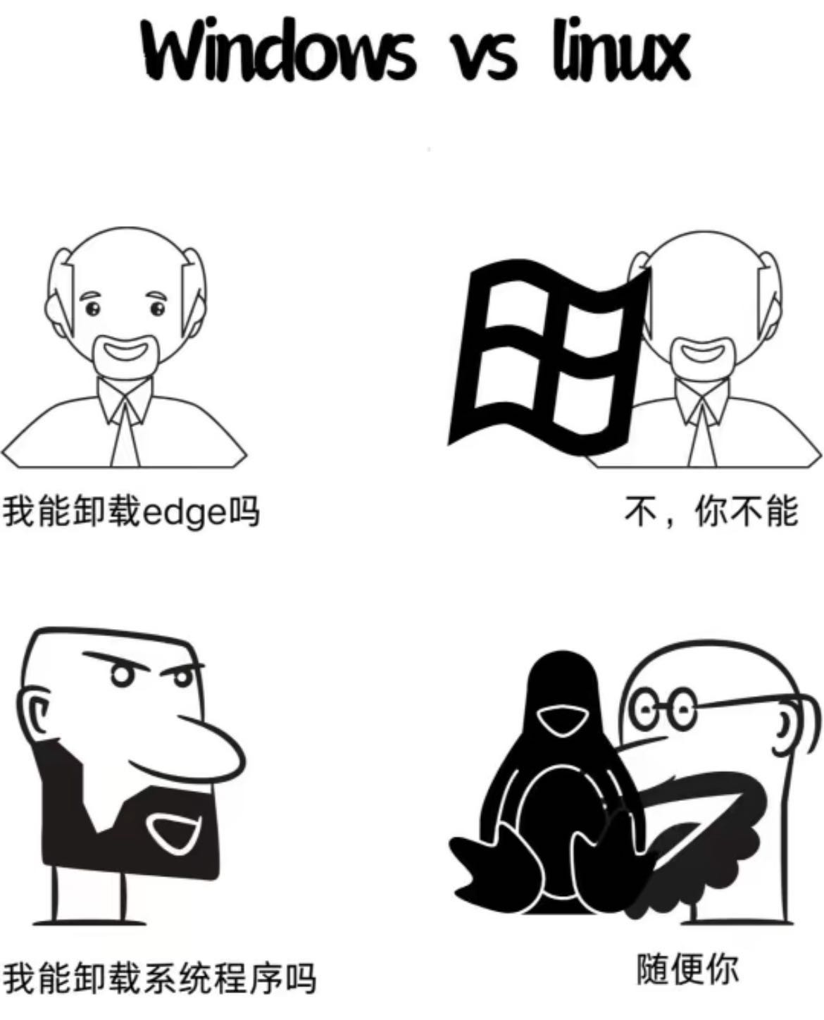
Why we need login server and learn linux?
Open source
High productivity and stability for mass-data computing
Efficiency and Speed
Automatic operation
High compatibility for most bioinformatic software
Notes:
Most softwares in linux are open source. According to build-in software “shell”, we can write codes and realize automatic operation

Slide 3
Basic usage of linux
The common format for a linux command:
command -options target
Commands related to pathway
Commands related to file
Commands related to software/script
Commands related to system
Notes:
Most softwares in linux are open source. According to build-in software “shell”, we can write codes and realize automatic operation

Slide 4
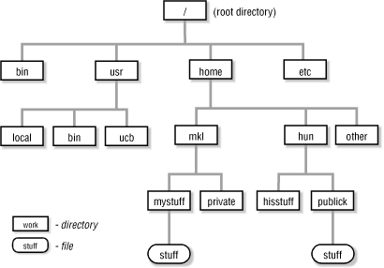
Tree directory and paths
full paths/absolute path: start from root directory
e.g. /usr/ucb
relative path
./ start from current directory
../ start from parent directory
Notes:
dolt slash

Slide 5



pwd, cd
/
pwd - Where I am
/mnt/genome/user1
cd - Change Directory
cd /mnt/eDNA
cd ../../eDNA
bin
home
mnt
usr
ls
pwd
cp
cat
software
eDNA
bin
lib
genome
user1
user2
Notes:
Most softwares in linux are open source. According to build-in software “shell”, we can write codes and realize automatic operation

Slide 6




Navigation
Tip: Tab can complete your pathname
pwd - Print Working Directory
#pwd can show your current path
$pwd
cd - Change Directory
#return to previous directory
$cd ../
#change directory through full path or absolute path
$cd /mnt/genome1/Lab_Users/jjl
$cd ./jjl
Notes:
Most softwares in linux are open source. According to build-in software “shell”, we can write codes and realize automatic operation

Slide 7

Directory structure
Absoulte path
/
/mnt/genome/user1
/usr/bin
bin
home
mnt
usr
Relative path
ls
pwd
cp
cat
software
You are here! /mnt/eDNA
How we get to?
genome
eDNA
bin
lib
../genome/user1
user2
. refers to our current location
.. refers to the location above us
user1
../../usr/bin
Notes:
Most softwares in linux are open source. According to build-in software “shell”, we can write codes and realize automatic operation

Slide 8


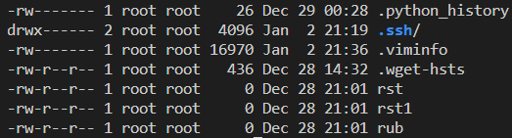
ls (list)
ls
# ls can show a summery of your current directory
ls -l
# ls -l can give you a list view with each item on its own line
ls -la / ll
# ls -la or ll can show a detailed information including hidden files
Owner and group of the file
Modified data
Permission State
r: read permission; w: write permission; x: execute permission
① rwx means user permission; ② rwx means group permission;
③ rwx means others’ permission
Notes:
Most softwares in linux are open source. According to build-in software “shell”, we can write codes and realize automatic operation

Slide 9
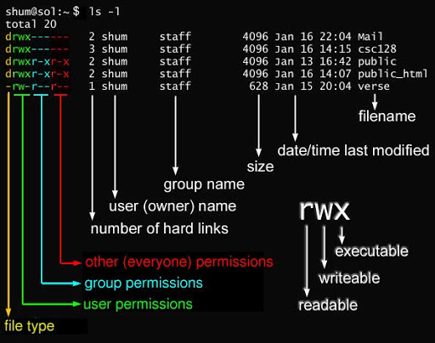
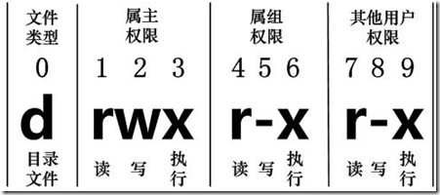
File information
chmod #change file permission
chmod 755 ./xxx

Slide 10



Creating and editing directories and files
mkdir - make directory
# generate a fold named “workshop”
$mkdir workshop
nano/touch
# create a null file named “workshop”
$touch workshop.txt
$nano workshop.txt
rm - remove
#delete fold “workshop”
$rm -r workshop
Tip: -r is needed if your object is fold instead of file
Notes:
Most softwares in linux are open source. According to build-in software “shell”, we can write codes and realize automatic operation

Slide 11
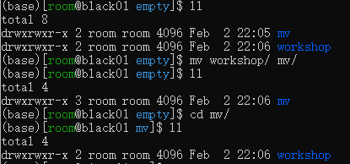
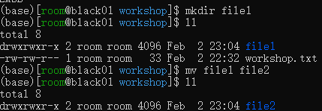




Creating and editing directories and files
mv - move
# move * to directory “mv”
$mv * mv/
#rename file1 to file2
$mv file1 file2
cp - copy
# copy * to current path
$cp * ./
cat - concatenate
# integrate the content of “file1” into “file2”
$cat file1 >> file2
Cat Command
Tip: Symbol “>” means overwrite
Notes:
Most softwares in linux are open source. According to build-in software “shell”, we can write codes and realize automatic operation

Slide 12
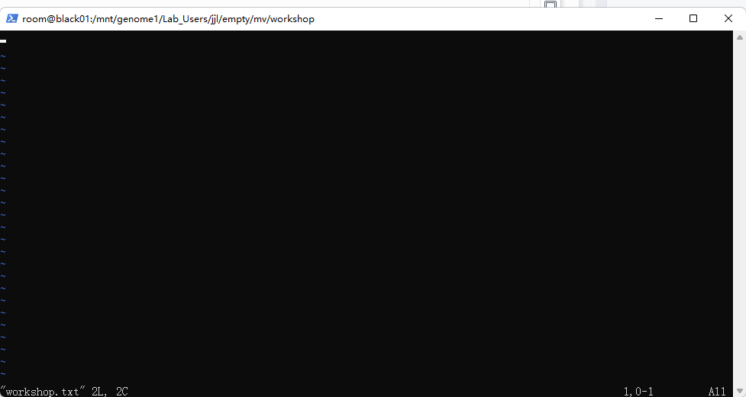
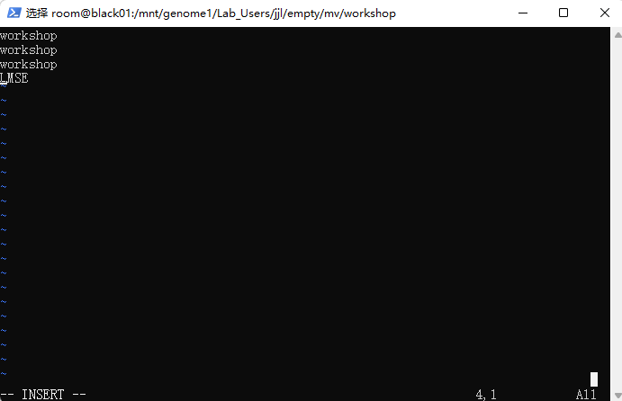
Explore file content - vim, sed
vim
#enter visual mode in “workshop.txt”
$vim workshop.txt
sed
# replace all “species” in files into “sp”
$sed ‘s/species/sp/g’ tax.txt > newTax.txt
Press “i”
enter insert mode
and
input “workshop”
Press “esc” to exit insert mode and input “:wq” to save the content
Notes:
Most softwares in linux are open source. According to build-in software “shell”, we can write codes and realize automatic operation

Slide 13




Explore file content
less
# display file1’s contents
$less file1
wc - word count
# print the line numbers, word number, byte number and name of “workshop.txt”
$wc workshop.txt
head
# show the first two lines content of file “workshop.txt”
$head -n 2 workshop.txt
tail
# show the last two lines content of file “workshop.txt”
$tail -n 2 workshop.txt
Notes:
Most softwares in linux are open source. According to build-in software “shell”, we can write codes and realize automatic operation

Slide 14


Symbolic links
Why we need create hard/soft link?
Save space!
ln - link
# create a hard link for file “LMSE_Workshop.txt” from previous path and name “workshop”
$ln ../LMSE_Workshop.txt workshop
#create a soft link for file “LMSE_Workshop.txt”
$ln -s ../LMSE_Workshop.txt workshop1
Notes:
Most softwares in linux are open source. According to build-in software “shell”, we can write codes and realize automatic operation

Slide 15
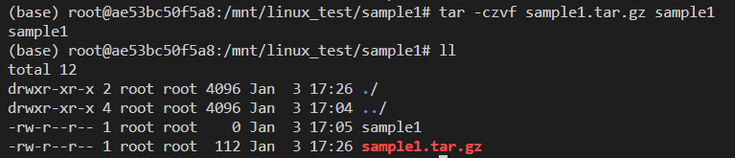
Compress and Uncompress
gunzip
$gunzip -c file1.gz #uncompress file1
$gzip file1 file1.gz #compress file1 into .gz format
tar
$ln ../LMSE_Workshop.txt workshop
$tar -zxvf file1.tar.gz #uncompress .tar.gz format
$tar -xvf file1.tar #uncompress .tar format
$tar -cxvf file1.tar.gz file1 #compress file1 into file1.tar.gz
unrar
$unrar -e *.rar #uncompress .rar format package
unzip
$unzip *.zip #uncompress .zip format package
Notes:
Most softwares in linux are open source. According to build-in software “shell”, we can write codes and realize automatic operation

Slide 16
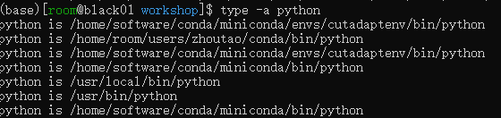
Locating softwares/scripts
whereis
#looking for python in system
$whereis python
type
#type command line also can be used to locate software or command find
$type -a python
Notes:
Most softwares in linux are open source. According to build-in software “shell”, we can write codes and realize automatic operation

Slide 17
Running and monitoring your commands in the background
nohup
#invoke abyss1.3.7 and assemble the genome background
$nohup /home/software/abyss-1.3.7/ABYSS/ABYSS -o consensus.fa -k 64 reads1.fq\ reads2.fq &
#A file named “nohup.out” will be generated, which record the process of software running.
jobs
#jobs can show your submit nohup programs
kill
#kill can shut down your submit nohup programs
Notes:
Most softwares in linux are open source. According to build-in software “shell”, we can write codes and realize automatic operation

Slide 18
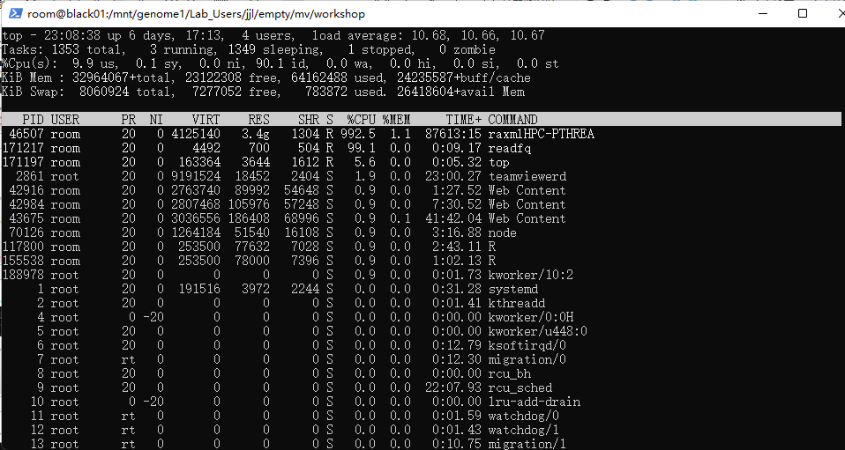
Monitoring system dynamics
top - show the current running progress
$top
Notes:
Most softwares in linux are open source. According to build-in software “shell”, we can write codes and realize automatic operation

Slide 19
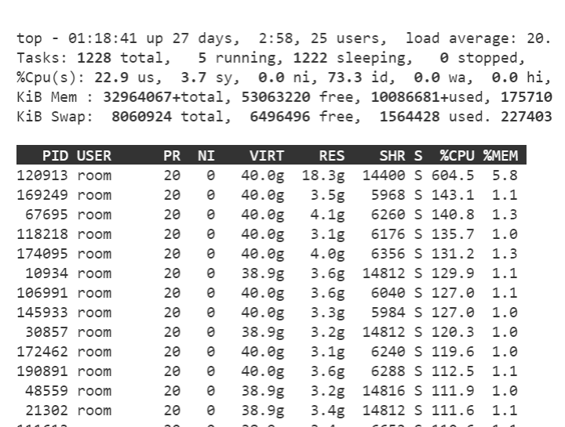
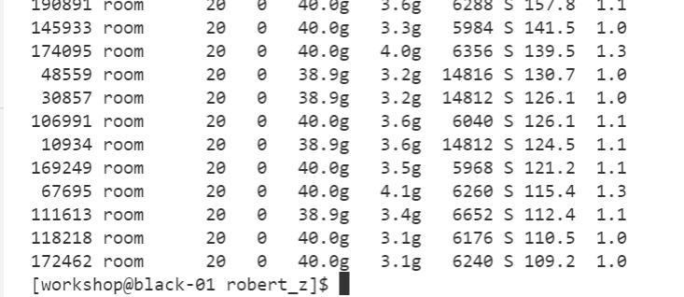
Ctrl+C(break down current running software) top (display Linux processes)
Ctrl+C
Quit the top program

Slide 20
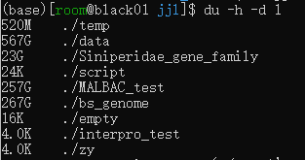
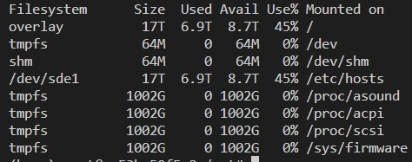
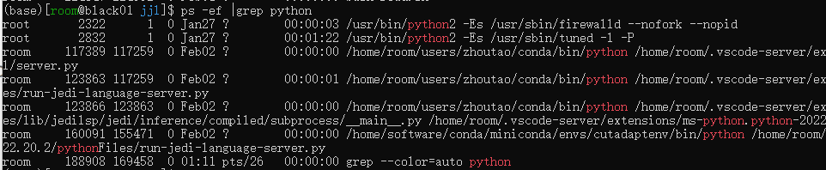
Monitoring system dynamics
du
#check the size of each folder in the current path
$du -h -d 1
df
# give a summery for the current disk usage
grep
#grep running python script in the system
$ps -ef |grep python
Notes:
Most softwares in linux are open source. According to build-in software “shell”, we can write codes and realize automatic operation

Slide 21
Transfer your files between hosts
scp - security copy
#transfer files from source to target
$scp file_source file_target
copy “libidn.so.11” from host:10.32.5.141 to local
#”-i” is needed when using identity file
copy folder “test” from local to host:10.32.1.106
Notes:
Most softwares in linux are open source. According to build-in software “shell”, we can write codes and realize automatic operation

Slide 22
Run software/script
Hangup
./shell.sh or sh ./xx.sh or python xxx.py
Kill or suspend
Ctrl+C :shut down the hangup program
Ctrl+Z : suspends the currently running foreground process
fg 1
# Brings background job #1 to the foreground (active terminal control)
bg 1
#Continues suspended job #1 in the background
nohup: immune to hangups
nohup./shell.sh > 1.log 2>1 &
jobs :show your submit nohup programs
kill : shut down the nohup program
ps –ef |grep xxx: Shows all system processes (ps -ef) and filters (| grep) for lines containing "xxx".
Find processes with "xxx" in their name or details.

Slide 23

Repeating your commands using loops
The real power of the shell is the ability to repeat commands on multiple targets. This is useful for example for creating multiple folders, moving files into each folder, running pipeline on multiple samples etc.
For example, we can use a for loop to print “hello” 10 times to screen by typing
$for num in {1..10}; do echo "hello"; done
It would be extremely useful when running a pipeline on multiple samples;
for i in sample*; do du -h {i}; done
Notes:
Most softwares in linux are open source. According to build-in software “shell”, we can write codes and realize automatic operation /ˈæstərɪsk/

Slide 24
Write your first hello world script
touch hello.sh
chmod +x hello.sh
vim hello.sh
Press i to enter insert mode
#Type this content:
#!/bin/bash
echo "Hello from VIM!“ # echo is used to print text
Press ESC to return to command mode
Type :wq to save and quit
sh ./hello world

Slide 25
Install software
apt install ( for Ubuntu) for administer
conda install
git clone
wget: download
docker pull

Slide 26
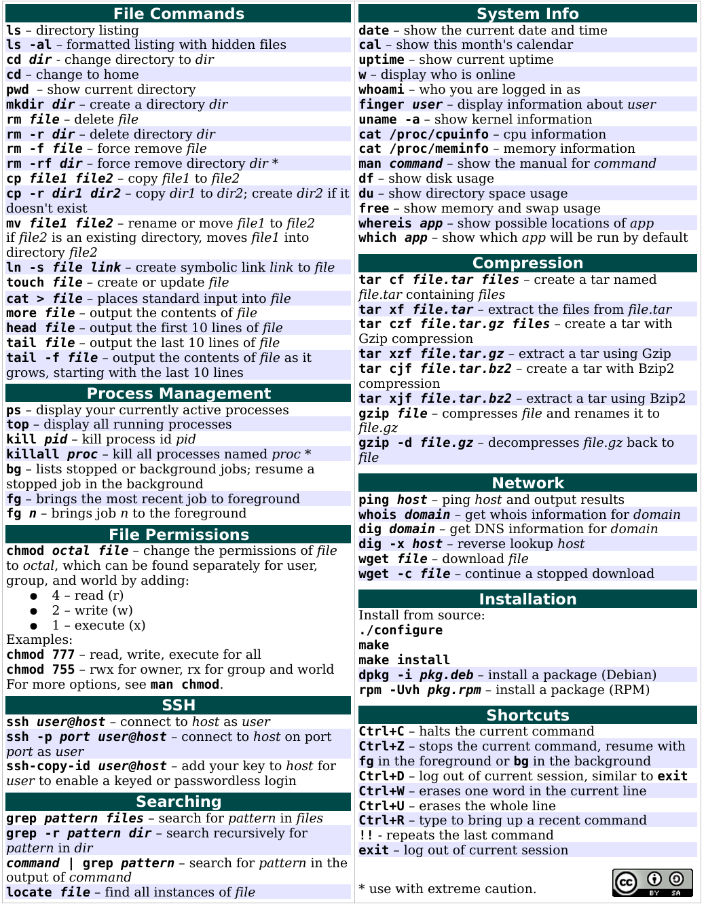
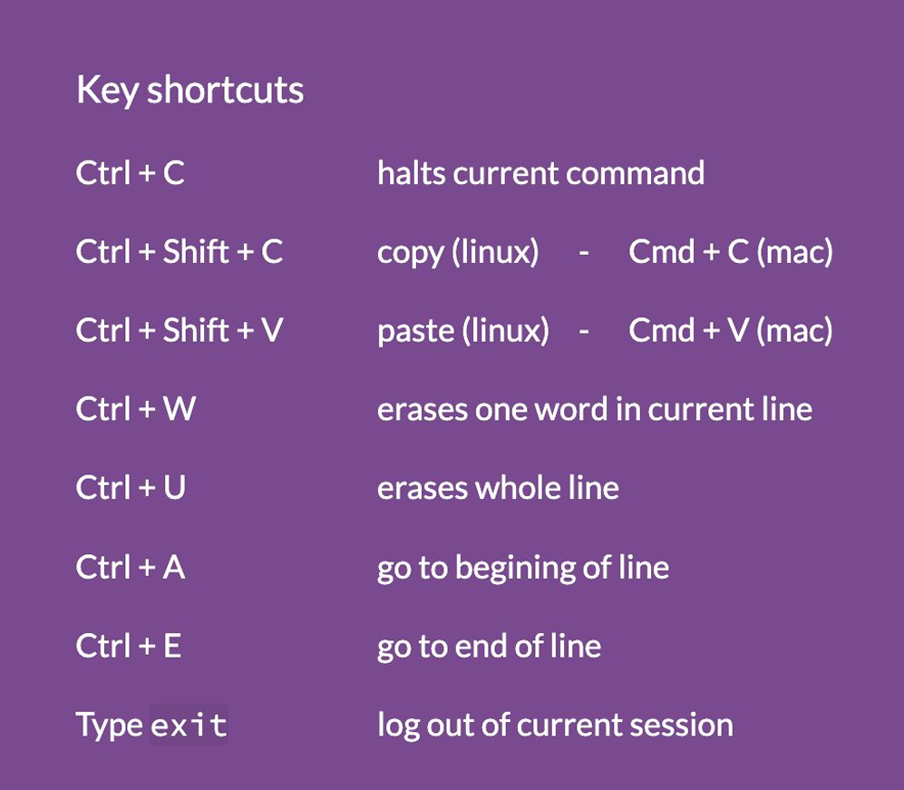
Learn by yourself !
Notes:
Most softwares in linux are open source. According to build-in software “shell”, we can write codes and realize automatic operation

Slide 27
Thanks!
"Unix was not designed to stop its users from doing stupid things, as that would also stop them from doing clever things." - Doug Gwyn

