Slide 1


The basic use of Linux based on Ubuntu
Zhang Jinghang

Slide 2
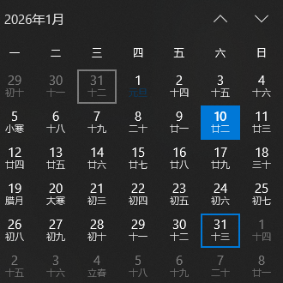
The account will be open until 8:00 PM (UTC+8), Jan. 31th ,2026

Slide 3
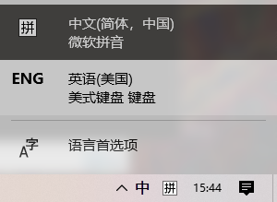

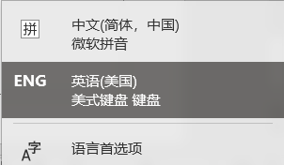

WARNING!!!
We must select IME in ENGLISH version for typing command and editing.
IME (Input Method Editor) 输入法

Slide 4

Why we need login server and learn linux?
Open source
High productivity and stability for mass-data computing
Efficiency and Speed
Automatic operation
High compatibility for most bioinformatic software

Slide 5
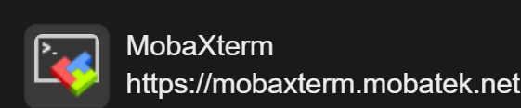


Some softwares used in SSH login
Mobaxterm
Download: MobaXterm free Xserver and tabbed SSH client for Windows
Visual Studio Code
Download: https://code.visualstudio.com/
Windows powershell
Download: https://github.com/PowerShell/PowerShell/releases/tag/v7.3.2

Slide 6
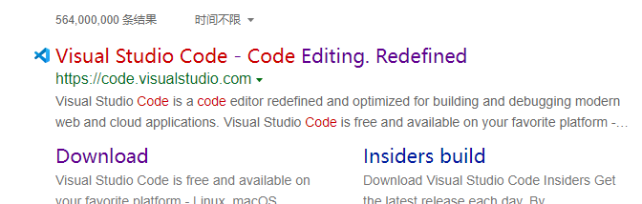
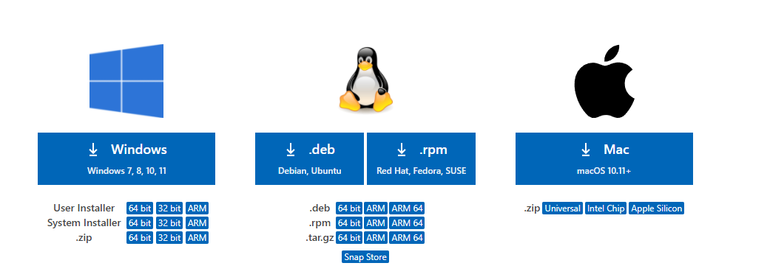
Enter to remote workstation
Choose the edition & Install

Slide 7
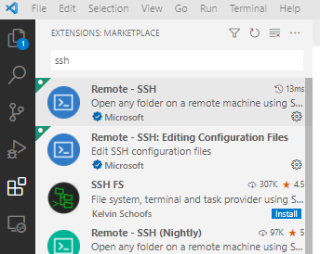
2 STEP SEARCH
3 STEP Download
1 STEP Click
4 STEP Click

Slide 8
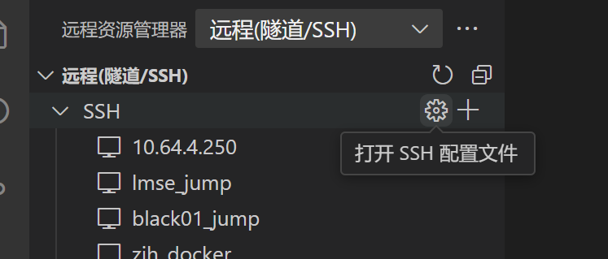
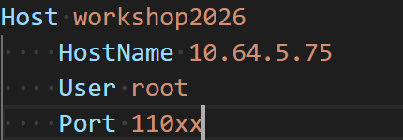
1 STEP Click

Slide 9
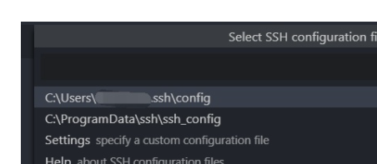
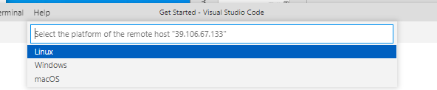
Choose one pathway to save
Click the button
Choose Linux platform
Password: workshop2026

Slide 10
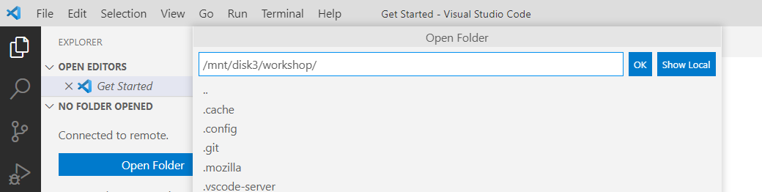
2
1

Slide 11
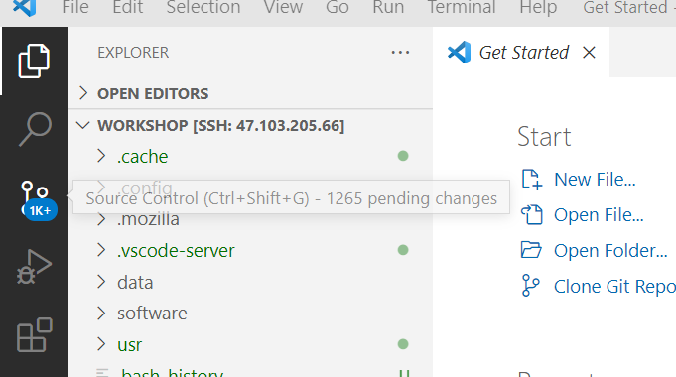
success to show the directory
which is convenient for you to edit and download/upload data

Slide 12
Server Using Regulation

Slide 13
Server Using Regulation
1. Check system usage before running your commands!
2. For beginners, do not install any software or perform updates on your own!
3. Monitor your disk volume after each step!
4. Pay attention to your configuration file settings!
5. Run commands under your directory!
6. Feel free to ask administrators when you are not ensuring about your commands!

Slide 14
LMSE服务器使用守则
1. 运行你的程序前，请先检查系统占用，保证系统不负载；
2. 对于初学者而言，涉及到系统配置，软件安装等步骤时，请先联系服务器管理员；
3. 及时删除中间文件以保证磁盘空间（尤其是比对生成的.bam,.sam文件）；
4. 运行某些软件会用到配置文件，注意检查配置文件中的各种设置；
5. 请在自己的路径下运行指令；
6. 当你对某项指令不太明确时，请及时上网查阅相关信息（AI助手）或询问服务器管理员

