Slide 1


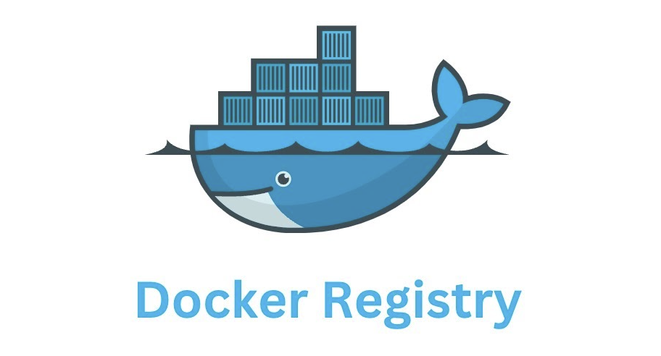
Practical Guide to Docker & Conda for Scientific Research
Application in Bioinformatics & Python Pipelines
Zhang Jinghang
Notes:
Hello everyone, and welcome to this presentation. Today, we'll explore how to practically apply Docker and Conda in scientific research, with a specific focus on their use in bioinformatics and Python pipelines.

Slide 2

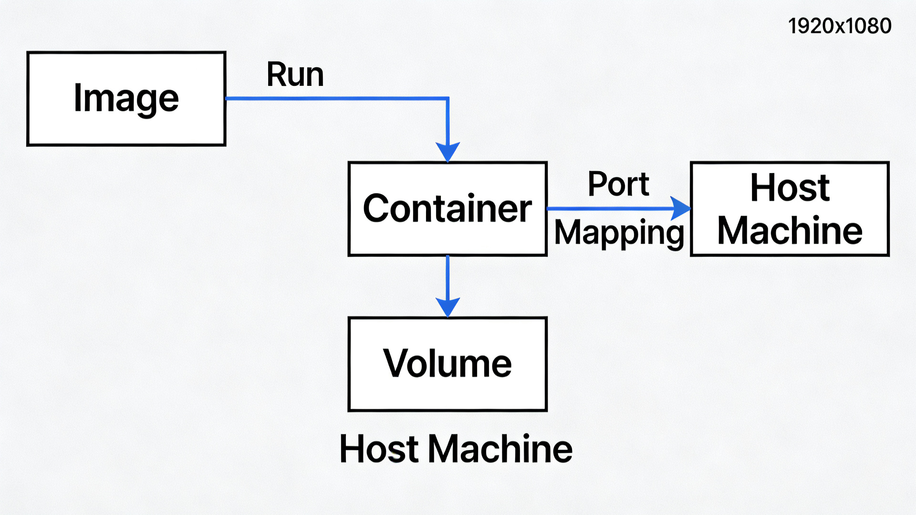



Docker Core Concepts
Image
The blueprint of your application, containing all code and dependencies.
Container
A runnable instance of an image, isolated and lightweight.
Volume
A persistent storage layer to share and save data outside the container lifecycle.
Port Mapping
Docker Working Principle Diagram
A way to expose containerized services to the host machine and network.
Notes:
Let's start with the four core concepts of Docker. An 'Image' is your application's blueprint. A 'Container' is a running instance of that image. 'Volumes' provide persistent storage, and 'Port Mapping' allows you to access services from outside the container.

Slide 3



Managing Docker Images
Pull
Download images from a registry like Docker Hub. Example: `docker pull ubuntu:22.04`
docker pull ubuntu:22.04 docker or pull docker.xuanyuan.me/library/nginx:latest
List
Check all locally available images with `docker images`.
docker images
Remove
Delete unused images to free up space. Example: `docker rmi <IMAGE_ID>`
docker rmi IMAGE_ID
Notes:
Managing Docker images involves three key operations: pulling them from a registry, listing what you have locally, and removing images you no longer need to conserve disk space.

Slide 4





Container Lifecycle Management
Run
List
Start a new container from an image. Example: `docker run -it ubuntu:22.04 /bin/bash`
Display running containers with `docker ps` or all containers with `docker ps -a`.
docker run -it ubuntu:22.04 /bin/bash
docker ps / docker ps -a
Stop/Start
Remove
Pause or resume a container's execution with `docker stop <CONTAINER_ID>` or `docker start <CONTAINER_ID>`.
Delete a stopped container to clean up resources with `docker rm <CONTAINER_ID>`.
docker stop / start CONTAINER_ID
docker rm CONTAINER_ID
CONTAINER_ID can be retrieved via `docker ps -a` or replaced with the container name.
Notes:
Docker container lifecycle management involves a few key commands: `run` to start, `ps` to list, `stop` and `start` to control, and `rm` to delete when finished.

Slide 5
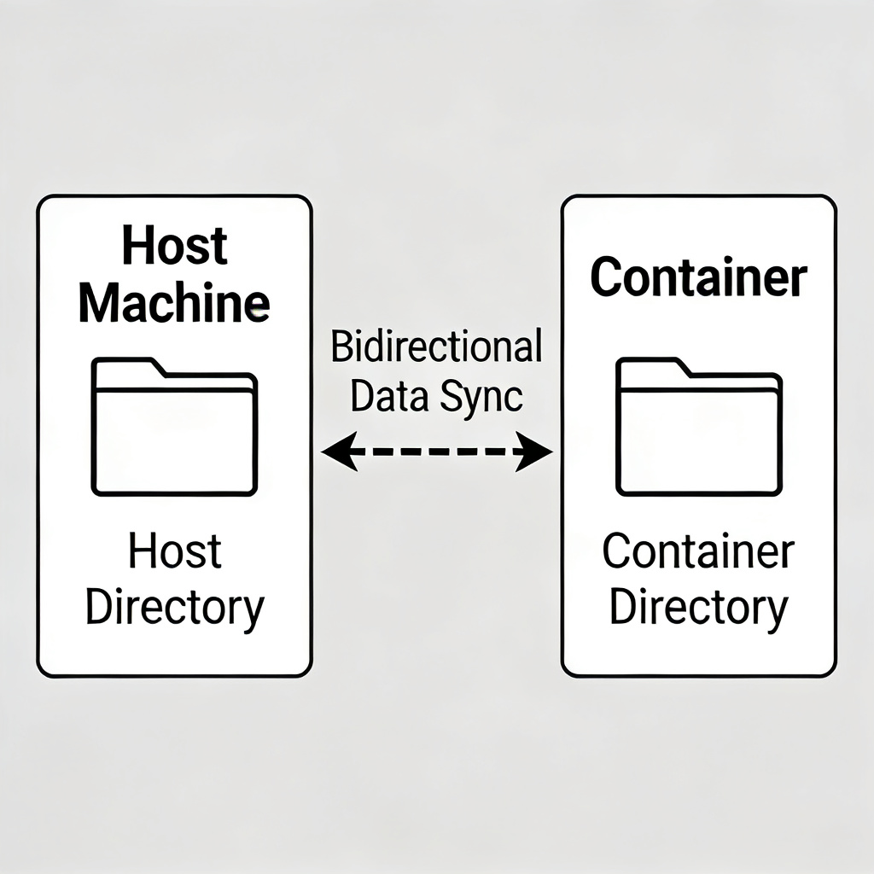

Volume Mounting (-v): Data Persistence for Bioinformatics
Core Command
docker run -v /host/path:/container/path image
Real-time synchronization between host and container directories
Function Explanation
Mount a directory from your host machine into the container. This is crucial for bioinformatics to persistently store large datasets (e.g., FASTQ, BAM files) and analysis results, ensuring they are not lost when the container exits.
Enables real-time data sharing and persistence between the host and the container.
Modifications made inside the container are immediately synced back to the host machine.
The file has the same owner as the Docker user, or it might be owned by root.
docker cp <host/location> <container_name>:/File/location # From container2host
docker cp <container_name>:/File/location <host/location> # From host2container
Notes:
Volume mounting (-v) is essential for data persistence in bioinformatics. It links a folder on your local machine to the container, allowing you to easily access and save your valuable sequencing data and analysis results.

Slide 6
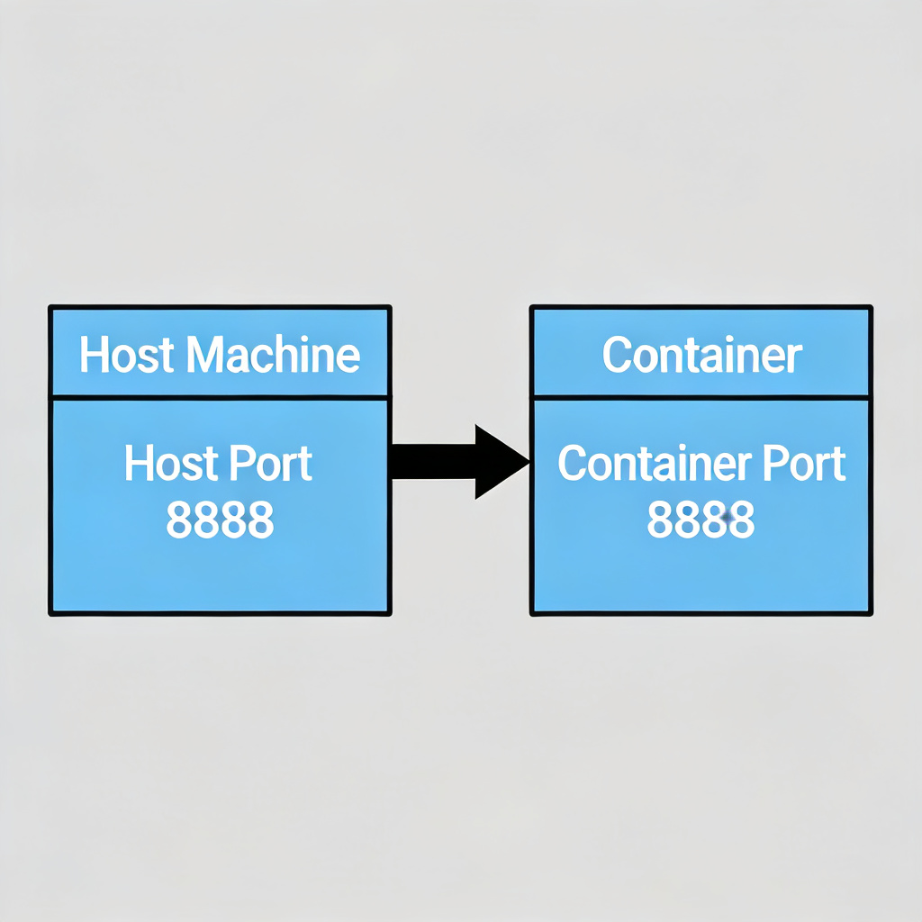
Port Mapping (-p): Accessing Services
Command Format
docker run -p host_port:container_port image
How It Works
Function Description
Map a port from inside the container to a port on your host machine. This is essential for accessing web-based tools (e.g., Jupyter Notebook, RStudio) running within the container from your local browser.
External traffic accesses container services via the host port
Notes:
另一个常用功能是端口映射。当我们在容器内部运行一个Web服务，比如Jupyter Notebook时，默认情况下外部是无法访问的。通过`-p`参数，我们可以将容器的端口映射到宿主机，这样就可以在宿主机的浏览器中直接访问容器内的服务了。

Slide 7
Common use
Create/Run a docker container
$docker run -dit \
--name my_docker \
-p 2222:22 \ # Map port 2222 on the host to port 22 inside the container (SSH default port)
-v /home/user/data:/data \ # Mount the host directory /home/user/data into /data in the container
ubuntu:22.04 \
bash -c "apt update && apt install -y openssh-server && mkdir /var/run/sshd && /usr/sbin/sshd -D"
Docker start/stop
docker start/stop <container_name_or_id>
Execute a command inside a running container
docker exec -it <container_name_or_id> /bin/bash
docker exec -it my_docker bash

Slide 8




Conda Fundamentals
What is Conda?
A powerful, cross-platform package and environment management system, ideal for handling complex dependencies in bioinformatics.
Key Concepts
Environment:An isolated space to manage specific project dependencies.
Package:A pre-built software component that can be installed.
Channel:A repository where Conda looks for packages. conda install -c <channel_name> <package_name> conda install bioconda::bioconductor-deseq2
Notes:
Now, let's turn to Conda. Conda is a powerful package and environment manager, perfect for bioinformatics where dependencies can be complex. Its key concepts are environments (isolated spaces), packages (software components), and channels (repositories).

Slide 9




Why Use Conda?
Simplified Package Management
Cross-Platform Compatibility
Simplifies installation, management, and updating of software packages and their dependencies across languages.
Works seamlessly on Windows, macOS, and Linux, ensuring consistent installations and avoiding compatibility issues.
Extensive Package Ecosystem
Environment Management
Access a vast collection of pre-built packages for data science, ML, and scientific computing, saving time.
Create isolated environments for projects to manage dependencies, ensure reproducibility, and avoid conflicts.

Slide 10
Conda vs Docker: Key Differences
Dimension | Conda | Docker
Isolation Level | Lightweight isolation, shares OS kernel. | Strong isolation, independent filesystem and network.
Dependency Scope | Manages Python packages and some C libraries. | Manages all dependencies, including OS libraries and tools.
Portability | Dependent on host OS and Conda installation. | Highly portable, runs on any Docker-supported OS.
Resource Footprint | Lightweight. | Heavier, due to container layers.
Primary Use Case | Development and local environment management. | Deployment and ensuring consistency across environments.

Slide 11


Why Use Conda with Docker?
Fine-grained Dependency Management
Environment Isolation
Access to Conda-Forge
Conda excels at resolving complex Python package dependencies, ensuring exact versions are installed, even within a container.
Run multiple Conda environments inside one Docker container, enabling side-by-side applications without conflicts.
Gain access to a vast repository of pre-built packages not easily available via other managers in Docker.
Combine the broad isolation of containers with the precise package management of Conda.

Slide 12

Docker + Conda Workflow for Bioinformatics
1. Pull a Conda Base Image: Start with a minimal Conda image.
docker pull continuumio/miniconda3
or install by yourselt(common)
wget https://repo.anaconda.com/miniconda/Miniconda3-latest-Linux-x86_64.sh
bash Miniconda3-latest-Linux-x86_64.sh
2. Create a Dockerfile: Define your environment, install bioinformatics packages (e.g., Biopython, samtools) using Conda.
Notes:
A typical workflow combines Docker and Conda. First, pull a base Conda image. Then, create a Dockerfile to define your specific environment and install the necessary bioinformatics packages using Conda commands.

Slide 13





Key Takeaways for Bioinformatics
Core Idea
Best Practices
Images are the environment, Containers are the execution.
Ensure consistency between host and container paths.
Two Essential Flags
Use non-root users for security.
-vfor data persistence,-pfor service access.
Activate Conda environments correctly.
Ultimate Goal
Achieve computational reproducibility and portability in your research.
Notes:
To summarize, remember that Docker images define the environment and containers are where the execution happens. The flags `-v` and `-p` are essential for data and access. The ultimate goal is reproducible and portable research. Always follow best practices like consistent paths and non-root users.

Slide 14


Conda Environment Management
Create Environment
Activate Environment
`conda create --name myenv python=3.9` - Create a new, isolated environment with a specific Python version.
`conda activate myenv` - Switch to the specified environment to use its packages.
conda create --name myenv python=3.9
conda activate myenv
List Environments
Remove Environment
`conda env list` - View all available Conda environments on your system.
`conda env remove --name myenv --all` - Permanently delete an environment and all its packages.
conda env list
conda env remove --name myenv --all
Notes:
Managing Conda environments is straightforward with these commands: `create` a new environment, `activate` it to work within it, `env list` to see what's available, and `env remove` to delete one when it's no longer needed.

Slide 15

Conda Package Management
Search
Install
`conda search pandas` - Find available packages and their versions.
`conda install pandas=1.5.0` - Install a specific package (and its dependencies) into the current environment.
conda search pandas
conda install pandas=1.5.0
Update
Remove
`conda update pandas` - Upgrade a package to the latest compatible version.
`conda remove pandas` - Uninstall a package from the current environment.
conda update pandas
conda remove pandas
Notes:
Finally, Conda's package management commands allow you to `search` for packages, `install` them into your environment, `update` them to newer versions, and `remove` them when they're no longer required.

Slide 16
Learn more

