Slide 1


DADA2 Strategy
Presenter: Li Xinru
Date: January 13, 2026
Callahan, B., McMurdie, P., Rosen, M. et al. DADA2: High-resolution sample inference from Illumina amplicon data. Nat Methods 13, 581–583 (2016)
Notes:
大家下午好！我是李心如。今天我要给大家介绍DADA2——一个能帮助我们更好地分析DNA测序数据的工具。
Good afternoon, everyone! My name is Li Xinru. Today, I’m going to talk about DADA2— a tool that helps us analyze DNA sequencing data better.

Slide 2

CONTENTS
What are DADA2
What are the differences if compared to OTUs
O1
O2
The Working Principle of DADA2
O3
DADA2 WorkflowTutorialin R
Notes:
我们会涵盖DADA2是什么、它与传统方法（OTU）的区别、核心工作原理（这是我们的重点）以及如何在R语言中使用它。让我们开始吧！
We’ll cover what DADA2 is, how it’s different from the old method (OTUs), its core working principles, and how to use it in R. Let’s start!

Slide 3
PART-01
What are DADA2
What are the differences if compared to OTUs

Slide 4
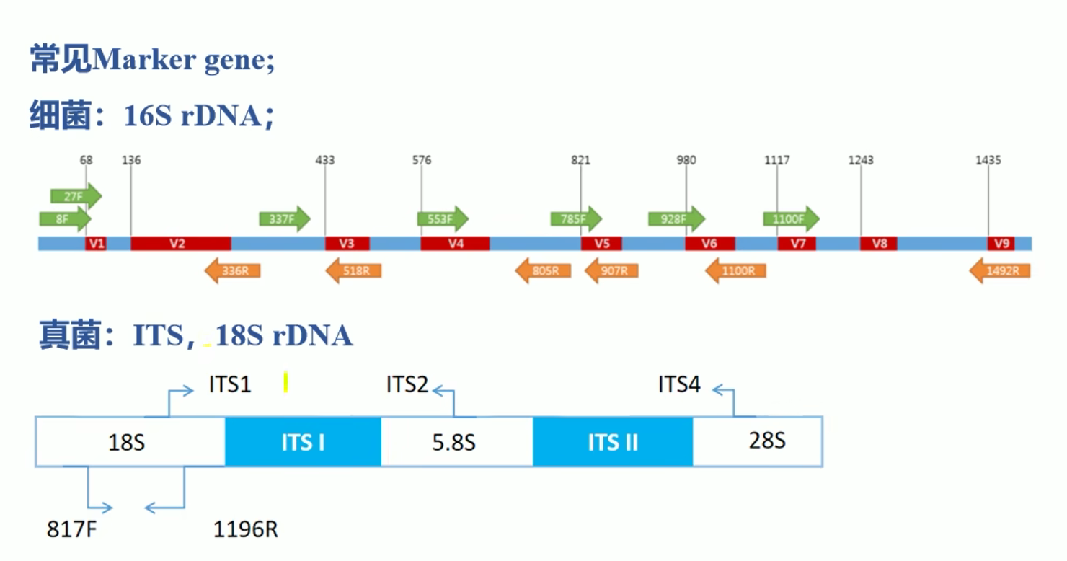
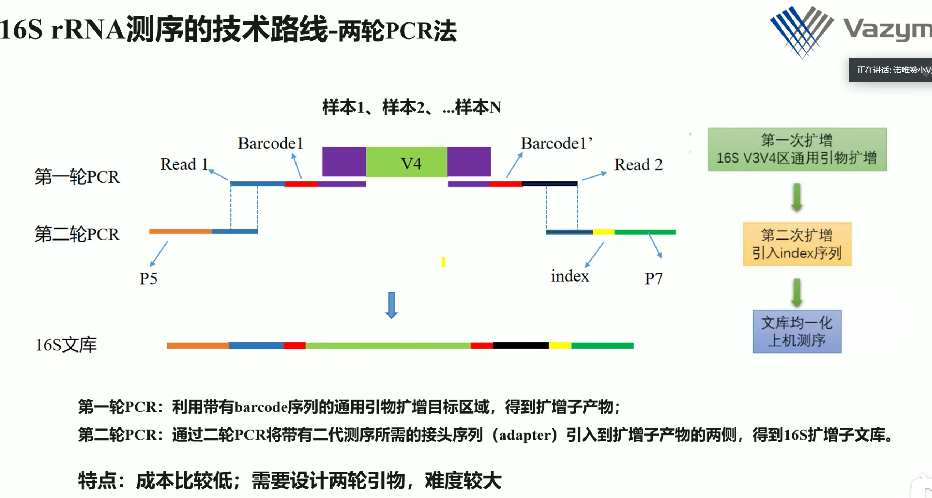
PART 01
The meaning of DADA2
First-round PCR: Using universal primers with barcode sequences to amplify the target region, obtaining amplicon products;
Second-round PCR: Through the second PCR, adapter sequences required for next-generation sequencing are introduced to both sides of the amplicon products, resulting in an amplicon library ready for sequencing.
Notes:
DADA2是一款用于分析扩增子测序数据的工具，我们首先了解什么是扩增子测序？扩增子测序是一种研究DNA中特定片段的方法，特定片段具有保守片段和可变片段相互构成，常用检测细菌的是16S rDNA，真菌的ITS片段，这些片段通过两轮PCR完成带条形码序列和接头序列连接进入测序，
DADA2 is a tool for analyzing amplicon sequencing data. First, let’s understand: What is amplicon sequencing?
Amplicon sequencing is a method to study specific fragments of DNA. These specific fragments consist of conserved regions and variable regions. For bacteria detection, we commonly use 16S rDNA; for fungi, we use ITS fragments. To sequence these fragments, we go through two rounds of PCR，two PCR: Using universal primers with barcode sequences and adapter sequences are introduced to both sides of the amplicon products, resulting in an amplicon library ready for sequencing.

Slide 5
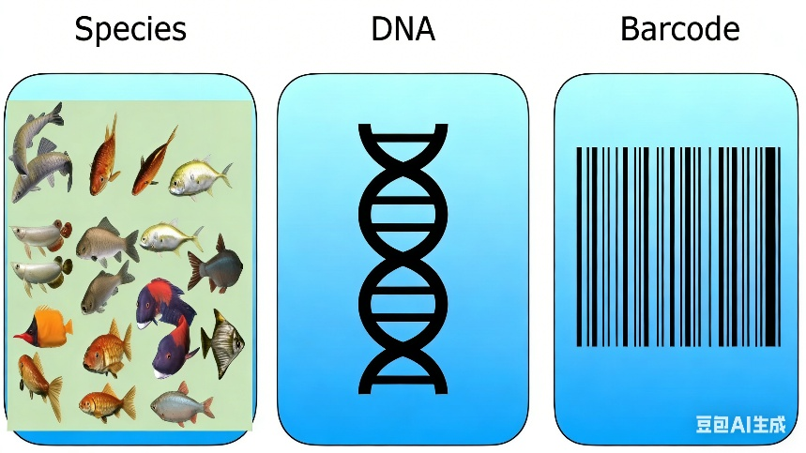


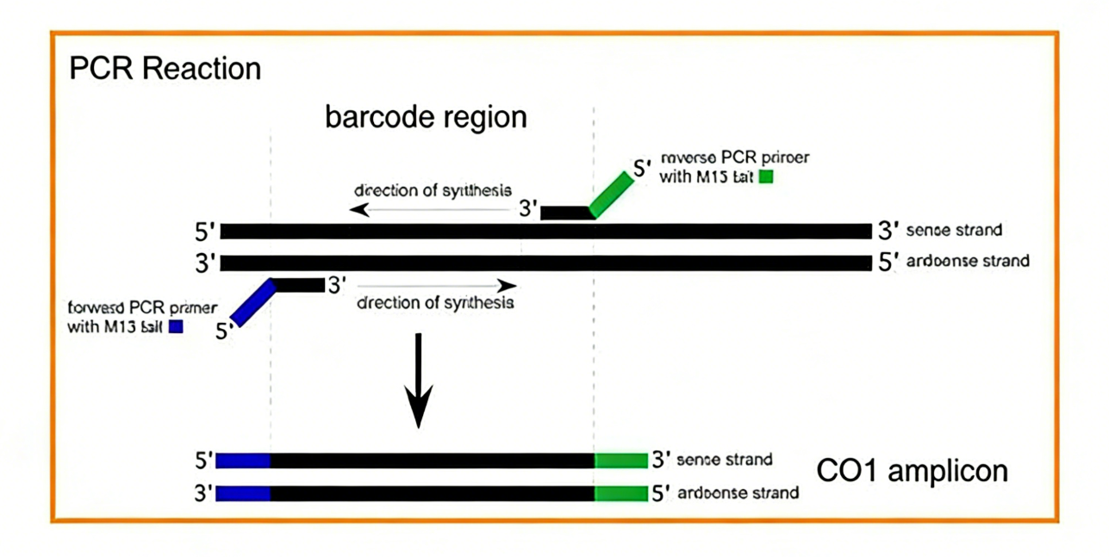
PART 01
The meaning of DADA2
How to identify erroneous sequences that occur during sequencing?
Notes:
我们实验室中针对鱼类辨认物种采用扩增coi序列。而在进行DNA测序过程，很容易出现误差。比如，真实DNA中的“A”碱基，可能会被测序仪误读为“C”那我们是如何辨别错误序列呢？
In our laboratory, we amplify the COI sequence to identify fish species.
However, sequencing errors are very common during DNA sequencing. For example, a real "A" base in DNA might be misread as "C" by the sequencing machine. So how do we identify these erroneous sequences?

Slide 6
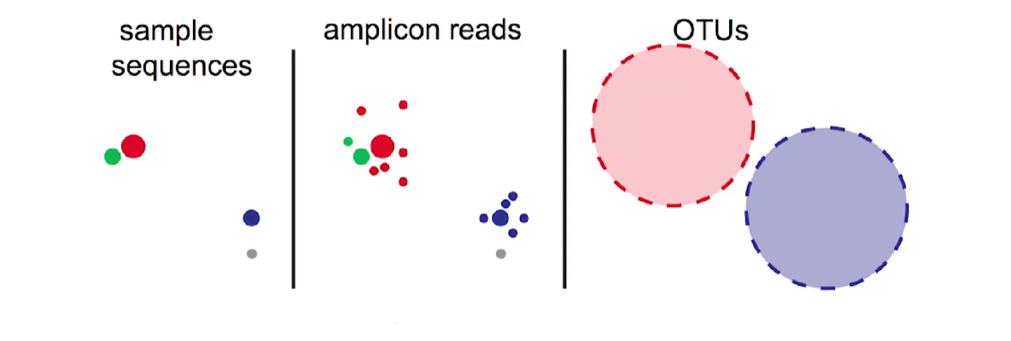
PART 01
The meaning of DADA2
OTU: OTUs are artificially created groups formed by clustering amplicon sequences based on a sequence similarity threshold (usually 97%). Their representative sequences are typically selected or generated from sequences within the cluster using clustering algorithms (such as UPARSE).
ASV: ASV is an accurate biological sequence inferred from amplicon sequencing data through an error correction model. It does not undergo any artificial similarity clustering and directly represents the biological variations that may exist in the sample with single-nucleotide resolution.
Notes:
而DADA2的作用，就是找出这些误差并修正它们，最终给我们提供准确的序列，这种准确序列被称为ASV。OUT基因通过将97％相似的序列富集起来的序列称为OUT，ASV相反，它是从扩增子测序数据中，通过错误校正模型从扩增子测序数据中推断出的精确生物序列，就能以单核苷酸分辨率，直接反映样本中可能存在的生物遗传差异。
hat’s where DADA2 comes in! DADA2 finds these errors, corrects them, and finally provides us with accurate sequences called ASVs。OTUs: They are formed by clustering amplicon sequences based on a sequence similarity threshold (usually 97%).ASVs (Amplicon Sequence Variants) are the opposite. They are precise biological sequences inferred from amplicon sequencing data through an error correction model. They do not undergo any artificial similarity clustering. Instead, they have single-nucleotide resolution, which means they can directly reflect the biological genetic variations that may exist in the sample.
下列图中是序列读数，颜色不同代表不同的序列，我们能够看出OUT中以97％聚集起来后形成粉色和蓝色两个框，实际上是将绿色和灰色的序列并入进去，而实际上他们的序列并不相同，OUT方法忽略这些微小差异，而ASV可以鉴别出这些差异序列。
Look at the figure below: Different colors represent different sequences. We can see that with the OTU method, sequences are clustered at 97% similarity into two boxes (pink and blue). In fact, the green and gray sequences are incorporated into these boxes, but their actual sequences are different. The OTU method ignores these small differences, while ASVs can identify these different sequences accurately.

Slide 7
PART 01
The difference between OTU and ASV
Problems with Traditional OTU Selection
Low resolution
97% similarity typically used -> usually not enough to differentiate species within a single genus
Highly dependent on the data that you input
Must re-run clustering as you get more data
Lead to large amount of false-positives
Results in over-inflation of OTUs
Notes:
1. **分辨率低**：97%的相似度标准远远不够，有时候同一个属里的不同物种，可能会被分到同一个OTU中，导致我们错过重要的差异。
2. **依赖输入数据**：如果后续新增了样本，就必须重新对所有序列进行分组，非常耗时。
3. **假阳性多**：有些罕见的序列（我们叫它“单例序列”）其实是测序误差导致的，但OTU会把它们当成真实序列，这就使得OTU的数量被高估了。

Slide 8
PART 01
The difference between OTU and ASV
Benefits to DADA2
Compatible with all amplicon types
18S, ITS, 16S, RpoB,etc
Works on lllumina, lon Torrent, and 454-pyrosequencing
Minor modifications needed for ion torrent and 454
Provides single-nucleotide resolution of amplicons
Aids in identification of chimeras
Lower false-positive rate
Notes:
- 适用于所有扩增子类型（16S、ITS、18S等）；
- 兼容不同的测序平台（Illumina、Ion Torrent、454），仅需对Ion Torrent和454做少量调整；
- 具备单核苷酸分辨率（能捕捉到DNA中微小的变化）；
- 能识别并去除“嵌合体”（PCR过程中错误产生的异常序列）；
- 假阳性率低得多，结果更准确。

Slide 9
PART-02
The Working Principle of DADA2

Slide 10
PART 02
The principle of DADA
Center and other sequence
序列1：10000
序列3：500
序列2：500
序列4：100
序列5：1200
序列7：15000
序列6：200
序列8：1000
Notes:
先理解两个概念，一个叫中心序列，一个加其他序列，首先dada会将序列相似的序列聚集在一起成为一组，然后数量最多叫做中心序列，其他都叫做其他序列。
First, understand two concepts: one is called the central sequence, and the other is called other sequences. DADA first clusters similar sequences together into a group, then the most numerous one is called the central sequence, and the rest are called other sequences.

Slide 11
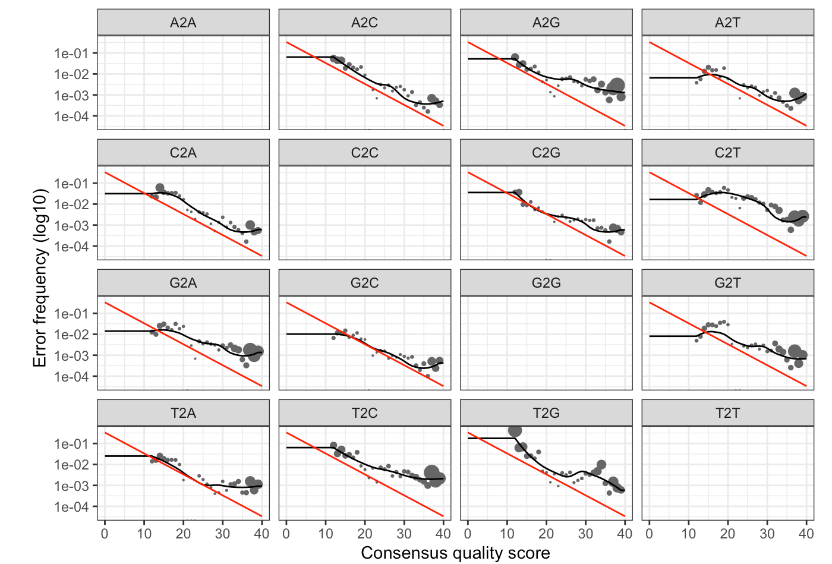
PART 02
The principle of DADA
1. Create an Error Model
Collecting Evidence
The algorithm first performs initial sequence grouping and then systematically counts all base differences (mismatches) between sequences within each group and their central sequence.
  What it records: The original base (e.g., A), the called base (e.g., C), and the quality score (Q score) at that position.
Fitting the Model
Based on the statistics from the previous step, the algorithm independently fits a "error rate vs. quality score" relationship curve for each possible type of base substitution (16 types in total, 4x4).
Applying the Model
When the probability of a specific error (e.g., A→C at Q=35) needs to be assessed, the algorithm simply queries the corresponding "A→C error curve" and reads the predicted value for Q=35.
序列1：10000
序列2：500
Notes:
步骤 1：构建误差模型测序过程会产生误差（比如把碱基 A 错读成 C），但这些误差并非毫无规律可循 —— 它们遵循一定的规则。DADA2 首先会学习这些规则，构建一本 “误差规则手册”。这一步分为三个子步骤：
Sequencing makes mistakes (like mixing up the letter A with C). But these mistakes aren’t random— they follow rules. DADA2 first learns these rules to make an “error rule book.” This step has 3 sub-steps:
子步骤 1：收集证据
DADA2 首先会将非常相似的序列归为一组。对于每组序列，它会找出 “中心序列”（出现频率最高的序列），然后将组内其他序列与中心序列进行对比。它会记录三样信息：原始碱基（比如中心序列中的 A）。错误碱基（比如其他序列中对应的 C—— 这就是一个误差）。错误碱基的质量分数（Q 值）。
DADA2 starts by grouping very similar sequences. For each group, it looks at the “center sequence” (the most common one) and compares other sequences in the group to it. It records three things:The original letter (e.g., A in the center sequence).The wrong letter (e.g., C in the other sequence— that’s a mistake).The quality score (Q score).
子步骤 2：拟合模型
碱基之间的误差共有 16 种可能（4 种碱基 ×4 种可能的变化：A→A、A→C、A→G、A→T、C→A 等），DADA2 会为每种误差绘制一条 “曲线”，这条曲线展示的是：“当 Q 值为 X 时，发生这种误差的概率是多少？”
Fit the Model：There are 16 possible mistakes (4 letters × 4 possible changes: A→A, A→C, A→G, A→T, C→A, etc.). DADA2 makes a “curve” for each mistake. Each curve shows: “When the Q score is X, what’s the chance of this mistake happening?”
子步骤 3：应用模型
之后，当 DADA2 发现一个可能的误差（比如 Q35 时出现 A→C 的变化），它会查阅 A→C 对应的误差曲线，曲线会给出这种误差发生的概率。如果概率极低，那么这个碱基差异很可能是真实的生物变异，而非测序误差。
Apply the Model：Later, when DADA2 sees a possible mistake (e.g., A→C with Q35), it checks the A→C curve. The curve tells it the probability of that mistake.

Slide 12
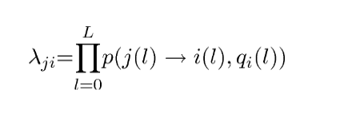
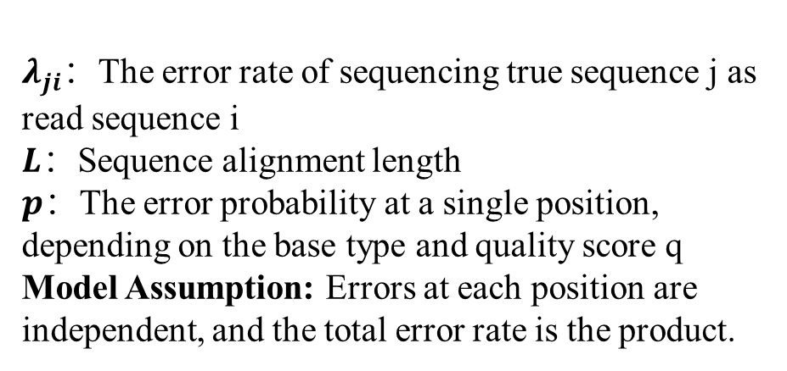
PART 02
The principle of DADA
2. Align Sequences
Center(j)：ATTAATCC
$λ_{ji}$：The error rate of sequencing true sequence j as read sequence i
$L$：Sequence alignment length
$p$：The error probability at a single position, depending on the base type and quality score q
Model Assumption: Errors at each position are independent, and the total error rate is the product.
Other(i)：ATTGATCT
The global alignment algorithm aligns i and j.
p(A→G, 30)=0.01
p(A→C, 35)=0.004
P1$×P2=λ_{ji}$
Notes:
步骤 2：序列比对计算序列错误率
DADA2 会将每个序列与所在组的中心序列进行对比，这个过程叫做 “全局比对”。经过比对，DADA2 发现两个个差异，第 4 个碱基和第8个碱基发生改变，且该会通过误差模型查询概率，最后相乘得到错误率。
DADA2 compares each sequence to the central sequence of its group. This process is called "global alignment." After alignment, DADA2 finds a difference: there are changes in the 4th and 8th bases. It then looks up the probabilities of these changes using the error model and multiplies them to get the error rate.

Slide 13

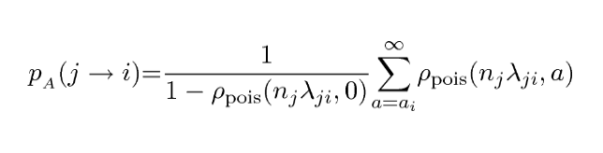

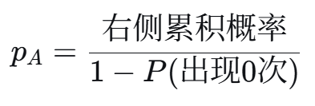
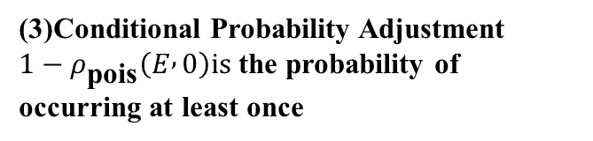
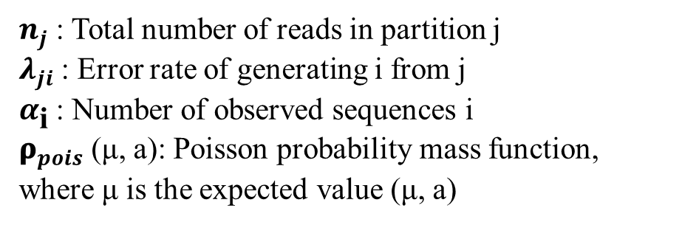
PART 02
The principle of DADA
(1)Calculate the expected probability
3. Calculate the Abundance p-value
(2)the right tail cumulative probability
(3)Conditional Probability Adjustment
$1−ρ_{\text{pois}}\left(E , 0\right)is$ the probability of
occurring at least once
$n_{j}$: Total number of reads in partition j
$λ_{ji}$: Error rate of generating i from j
$α_{\text{i}}$: Number of observed sequences i
${\text{ρ}}_{pois}$(μ, a): Poisson probability mass function, where μ is the expected value (μ, a)
Notes:
现在我们需要一个阙值来判断序列是否是错误序列，计算序列的P值与P=0.05进行比较。首先理解公式的各代表符号的意思，先计算期望值，由中心序列数量乘错误率，带入泊松公式计算，最后在条件概率下进行矫正得到序列p值
Calculate the Abundance p-value：We need a threshold to tell if a sequence is an error sequence. We calculate the sequence’s p-value and compare it with P = 0.05. First, let’s understand what each symbol in the formula means.
First, calculate the expected value: multiply the number of central sequences by the error rate. Then use the Poisson formula to compute the result. Finally, correct it under conditional probability to get the sequence’s p-value.

Slide 14
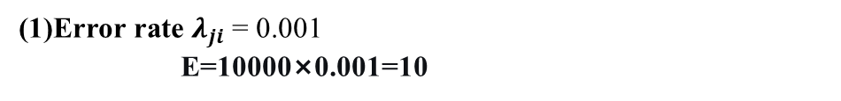
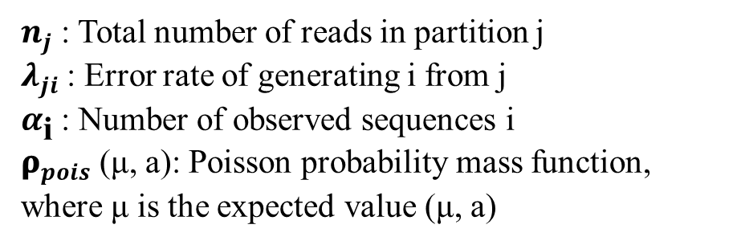
(1)Error rate $λ_{ji}$= 0.001
E=10000×0.001=10
PART 02
The principle of DADA
Center(j)：ATTAATCC
3. The abundance p-value
$n_{j}$= 10,000
Other(i)：ATTGATCT
$α_{\text{i}}$= 100
(2) Calculate the p-value: Under a Poisson distribution (μ=10), the probability of observing 100 i's (p ≈ 0.004)
$n_{j}$: Total number of reads in partition j
$λ_{ji}$: Error rate of generating i from j
$α_{\text{i}}$: Number of observed sequences i
${\text{ρ}}_{pois}$(μ, a): Poisson probability mass function, where μ is the expected value (μ, a)
(3) Conclusion: p-value = 0.004 < 0.05, i represents true biological variation
H0: Sequencing is caused by intrinsic variation (p less than 0.05)
HA: Sequencing is caused by sequencing errors (p greater than 0.05)
Notes:
以下面的例子说明，我们先理解公式两个假设，H0：该序列是真实的（由生物变异导致）。当 p 值小于 0.05（即出错概率低于 5%）时，我们接受这个假设。HA：该序列是测序误差导致的。当 p 值大于 0.05 时，我们接受这个假设。
计算出序列错误率为0.01，带入计算期望值是10，通过泊松分布计算出p 值，表示在期望值是10时，观测到500个序列的发生的概率，由于 p 值 = 0.004＜0.05，所以这个差异序列并非测序误差，而是真实的 ASV！
Let’s use an example to explain. There are two hypotheses:H0: The sequence is real (caused by biological variation). We accept this if the p-value is less than 0.05 (meaning the chance of it being an error is less than 5%).HA: The sequence is caused by a sequencing error. We accept this if the p-value is greater than 0.05.
Suppose the sequence’s error rate is 0.01. The expected value is 10 (calculated from central sequence count × error rate). Using the Poisson distribution, we find the p-value: it represents the probability of observing 500 such sequences when the expected value is 10. Since the p-value = 0.004 < 0.05, this different sequence is not a sequencing error—it’s a real ASV!

Slide 15
PART 02
The principle of DADA
4. The divisive partitioning
Remove duplicates (to get 6 unique entries)
Sequence2：500（One base difference）
Sequence1：1000(the largest number)
Sequence3：30（ two base difference ）
P=0.0001
P=0.03
(Initial State) Partition One
Sequence4：50（ Quite different ）
Sequence5：3（ One base difference ）
Sequence6：11（only one）
P=0.8
P=1
P=0.5
Notes:
接下来，DADA2 会拆分组群，去除重复序列，现在初始组群包含 6 个独特序列，首先序列 1：1000 次（出现次数最多 —— 中心序列）。再检查检查差异最大的序列，首先DADA2 会检查 p 值最低的序列（最可能是真实序列）。假设序列 2 的 p 值 = 0.0001＜0.05，它是真实序列！因此 DADA2 会拆分组群：新组群 1（序列 1）和新组群 2（序列 2）。
Next, DADA2 splits groups and removes duplicate sequences. Now the initial group has 6 unique sequences. Sequence 1 appears 1000 times (the most frequent—it’s the central sequence).
First, DADA2 checks the sequence with the lowest p-value (most likely real). Suppose Sequence 2 has a p-value = 0.0001 < 0.05—it’s real! So DADA2 splits the group into two new groups: Group 1 (Sequence 1) and Group 2 (Sequence 2).

Slide 16
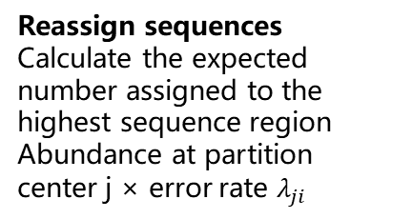
PART 02
The principle of DADA
4. The divisive partitioning
Sequence1：1000(the largest number)
Sequence2：500（One base difference）
Discover new central sequences
Reassign sequences
Calculate the expected number assigned to the highest sequence region
Abundance at partition center j × error rate $λ_{ji}$
P=1
P=0.8
P=0.7
P=0.6
Sequence3：30（ two base difference ）
Sequence4：50（ Quite different ）
Sequence5：3（ One base difference ）
Sequence6：11（only one）
Every p > Threshold 0.05 → No new partitions are generated; the algorithm terminates!
Notes:
检查剩余序列接着，DADA2 会将剩下序列与序列1和 序列2进行对比，计算期望值哪个大进去哪个组，分类完之后计算剩下序列的p值， 对比所以p 值＞0.05都认为剩下序列是错误序列，无新组群时停止DADA2 会持续拆分组群，最终，我们得到 2 个 ASV：序列 1、序列 2
Then, DADA2 compares the remaining sequences with both Sequence 1 and Sequence 2. It puts each remaining sequence into the group where the expected value is larger. After grouping, it calculates the p-value for each remaining sequence. Any sequence with a p-value > 0.05 is considered an error sequence.DADA2 keeps splitting groups until no new groups are formed. In the end, we get 2 ASVs: Sequence 1 and Sequence 2.
Part 4: DADA2 Workflow in R (Simple Steps)
Now, let’s talk about how to use DADA2 in R. You don’t need to remember all code— just the steps:

Slide 17
PART-03
DADA2WorkflowTutorialin R

Slide 18
PART 03
DADA2 Workflow
Trim and Filter Reads
修剪和过滤读数
Error Rate Estimation
错误率估算
Sample Inference
样本推断
Merge paired reads
合并配对读数
Assign Taxonomy
分配分类
Track reads through the pipeline
跟踪通过管道的读取
Remove chimeras
去除嵌合体
Construct sequence table
构建序列表

Slide 19
PART 03
DADA2WorkflowTutorialin R
1. Before Starting
(1)Barcodes and/or adapters should be removed Cutadapt
Cutadapt ：http://cutadapt.readthedocs.io/en/stable/index.html
Trimmomatic：http://www.usadellab.org/cms/?page=trimmomatic
(2)Samples should be demultiplexed into individual FASTQ filesidemp
Idemp：https://github.com/yhwu/idemp
FASTX-Toolkit ：http://hannonlab.cshl.edu/fastx_toolkit/
If using paired-end data, forward and reverse reads must be in the same order 20bq
Notes:
移除条形码 / 接头序列（可以使用 Cutadapt 等工具）；将样本拆分成单独的 FASTQ 文件（可以使用 Idemp 等工具）；如果是双端测序数据，要确保正向和反向读数的顺序一致。
Before StartingRemove barcodes/adapters (using tools like Cutadapt).Split samples into separate files (using tools like Idemp).Make sure forward and reverse reads are in the same order.

Slide 20


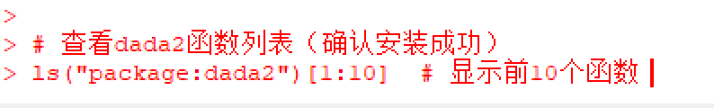
PART 03
DADA2WorkflowTutorialin R
2. Installation of DADA2
DADA2 Download :https://benjjneb.github.io/dada2/
R Download :https://posit.co/download/rstudio-desktop/
# 1. 安装BiocManager（用于安装Bioconductor包）
if (!require("BiocManager", quietly = TRUE))
install.packages("BiocManager")
# 2. 通过BiocManager安装dada2
BiocManager::install("dada2")
# 3. 加载dada2包测试是否安装成功
library(dada2)
Notes:
首先，安装 R 和 RStudio（都是免费软件）； 然后运行简单的代码安装 DADA2
Install DADA2.First, install R and RStudio (free software).Then run simple code to install DADA2.

Slide 21
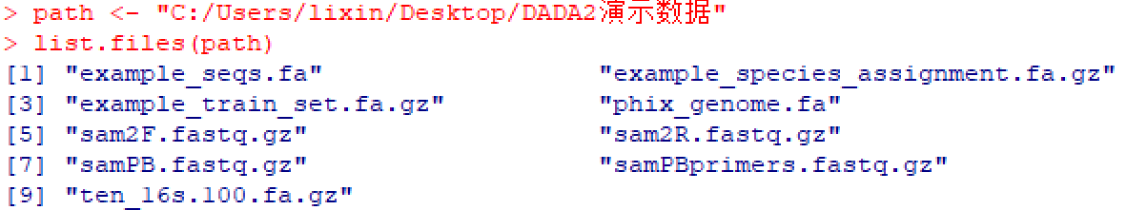
PART 03
DADA2WorkflowTutorialin R
Specify the path containing the data file
Notes:
准备数据告诉 R 你的数据文件存在哪里（也就是文件路径）；红色的地方你需要指定文件路径
First, prepare your data: Tell R where your data files are stored (that’s the "file path"). The red part in the code is where you need to specify your own file path clearly.

Slide 22
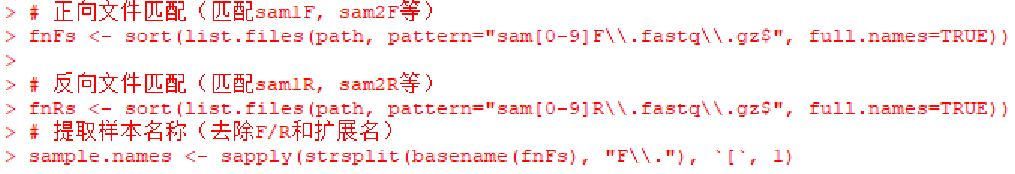
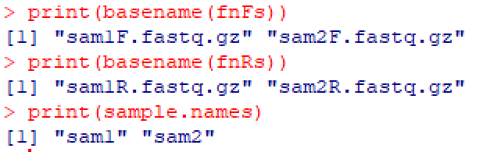
PART 03
DADA2WorkflowTutorialin R
Sort the files and extract the sample names
Notes:
对我们测序按照正反数据进行分类，生成新的数据文件夹
We sort our sequencing data into forward and reverse groups, then create a new folder to store this organized data.

Slide 23
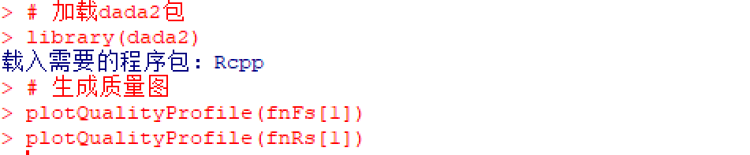
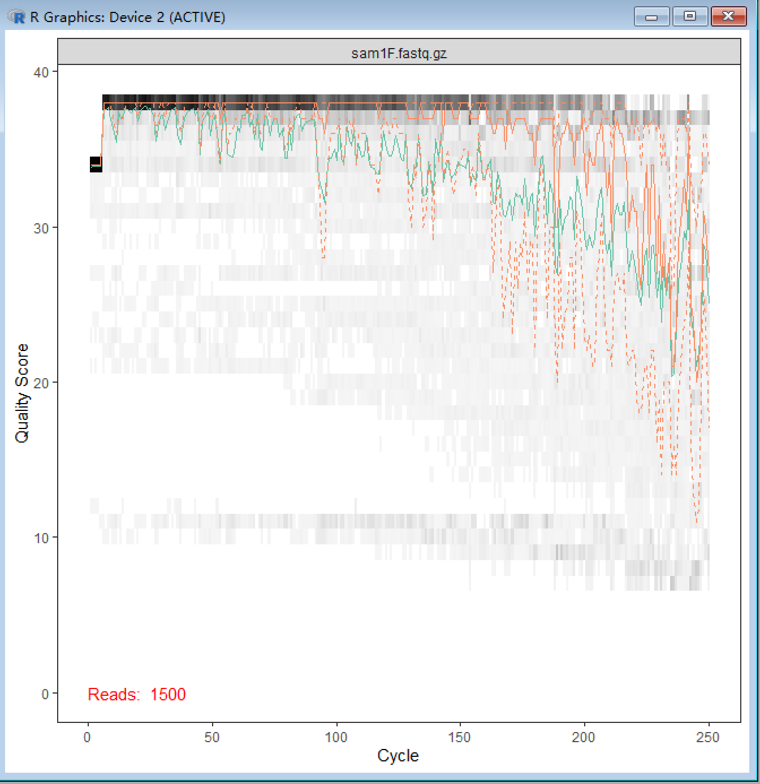
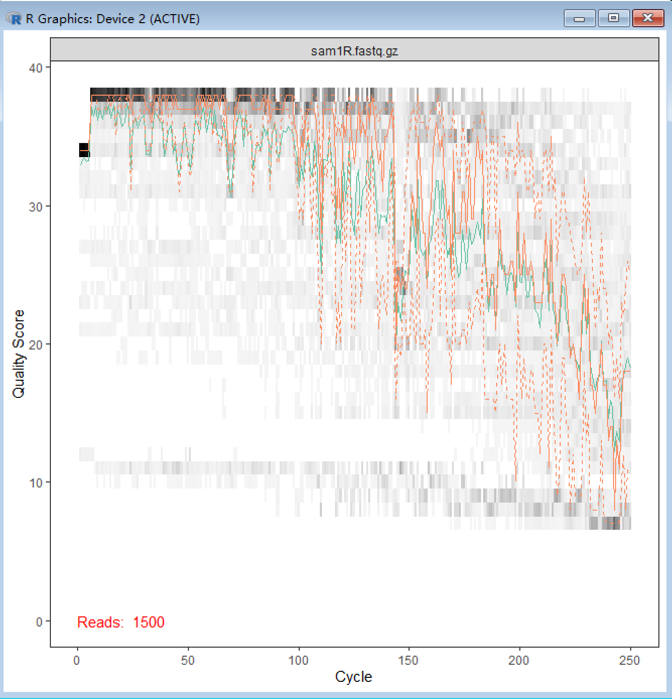
PART 03
DADA2WorkflowTutorialin R
Check reading quality profile
Notes:
检查测序读数质量（R 会生成质量图，我们能直观看到序列哪些部分质量好、哪些部分质量差），我们需要看绿色部分的线条，代表整体的质量，我们需要对 Q小于30的碱基进行修剪。看下图可知，左图需要在150，右图需要在120处进行修剪。
Next, check the quality of the sequencing reads. R will generate a quality plot — you can easily see which parts of the sequences are good or bad. Look at the green line in the plot; it shows the overall quality. We need to trim bases with a Q score lower than 30. From the plots below: trim the left plot at position 150 and the right plot at position 100.

Slide 24
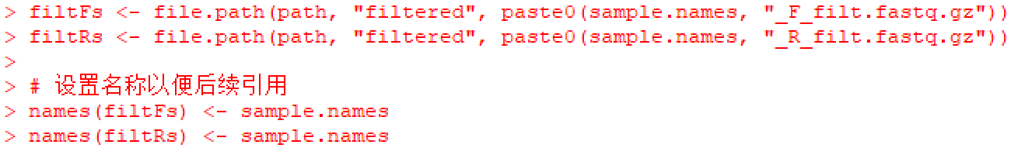
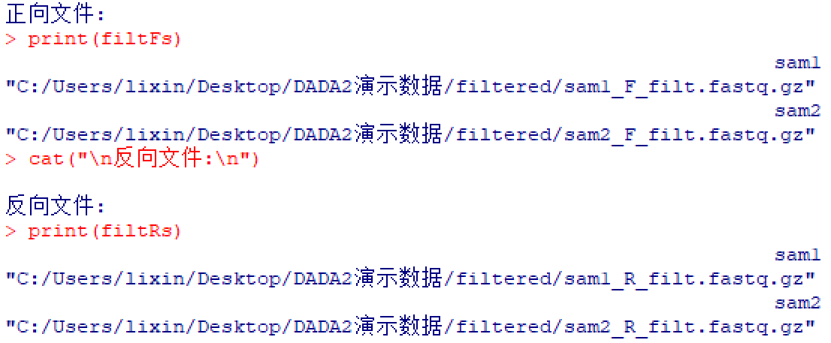
PART 03
DADA2WorkflowTutorialin R
Set the filter file path and rename the file
Notes:
再通过程序设置一个存储过滤文件的文件夹
Then use the program to create a folder for storing the filtered files.

Slide 25
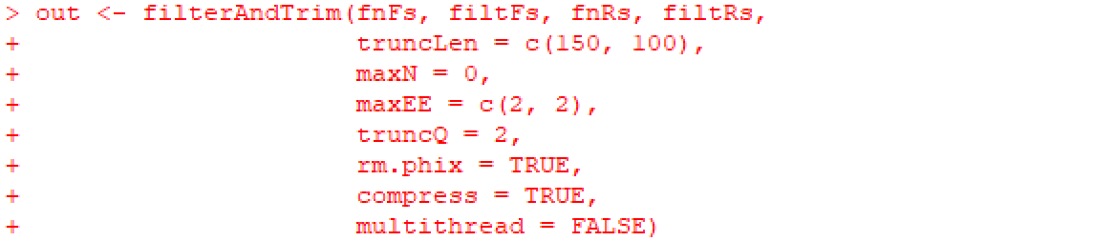
PART 03
DADA2WorkflowTutorialin R
Plot the quality scores and determine the trimming threshold
truncLen = c(FWD, REV)
Truncates read at specified base
Things to consider:
How long is your amplicon/how much overlap do you need?-DADA2 needs 20 ntby default
For V4, you have almost complete overlap-can trim reads aggressively.
For longer amplicons, there is a trade off between trimming low quality readsand assuring reads will merge
Notes:
接下来是重点内容，对于过滤和修剪的参数设置，接下来进行修剪的过程，这个地方代表需要修剪的长度，按照前面我们看过读数质量图确定在150.100之间，在修剪时我们要考虑片段长度，如果长度比较短，为了防止后续不能正常合并片段，故修剪的长度要小一些，同时DADA2默认20db合并片段。
Now comes the key part: setting parameters for trimming and filtering. Let’s start with trimming. The "truncLen" value is the length we keep for the sequences. From the quality plots earlier, we set it between 150 and 100. When choosing this length, think about the fragment size. If the fragments are short, don’t trim too much — otherwise, they can’t merge later. Remember, DADA2 needs at least 20 base pairs (bp) to merge fragments by default.

Slide 26
PART 03
DADA2WorkflowTutorialin R
Plot the quality scores and determine the trimming threshold
maxN = the maximum number of ambiguous bases allowed.
All reads with more than this number of Ns will be discarded
At this time, DADA2's denoising algorithm cannot tolerate ambiguous base calls.
Until that changes, do not change this setting
Notes:
这个值的意思是DADA最大容忍碱基模糊程度，但是实际上不能容忍，保持0
The "maxN" parameter means the maximum number of unclear bases DADA2 can tolerate. But actually, DADA2 can’t handle unclear bases at all, so keep this value at 0.

Slide 27
PART 03
DADA2WorkflowTutorialin R
Plot the quality scores and determine the trimming threshold
maxEE= c(FWD, REV) EE=sum(10^(-Q/10))
The maximum number of estimated errors allowed for an individual read. Reads with more EE's than this number will be discarded
Things to consider:
How much sequencing depth/how good are your quality scores?
Most 16S rRNA amplicon studies use c(2,2) or c(3,3).
For highly variable regions such as ITS, it can be appropriately relaxed (e.g., c(4,4)).
If the sequencing depth is high and the quality is good, it can be tightened to c(1,1).
Notes:
EE代表的是单个片段允许最大错误记数，一般是2，2，如果片段变异比较大可以选取4，4
"EE" stands for the maximum number of allowed errors per read. Usually, we set it to (2, 2). If your DNA fragments have more variations, you can set it to (4, 4) instead.

Slide 28
PART 03
DADA2WorkflowTutorialin R
Plot the quality scores and determine the trimming threshold
truncQ= truncates reads at the first instance of a Q score less than or equal to thevalue specified
A Q score of 2 is ver ybad (63% chance of a base call being incorrectl)
This setting is very permissive and will allow most reads to pass (but will likely getrid of some very bad ones(10-15)
The default value is 2.Don't set this too high -DADA2 is meant to correct for errors so you don't need to discard every poor quality base!
Other quality filtering parameters will likely get rid of most bad reads
Notes:
Q值是代表在质量小于进行截断，2认为很差，错误率是2％，但是dada2的主要目的是纠正错误，建议默认2，如果要求更高的精确度，可以设置10-15之间
The "truncQ" parameter means we truncate the read when the Q score is lower than this value. A Q score of 2 is very bad — it has a 2% error rate. But DADA2’s main job is to correct errors, so it’s better to keep the default value (2). If you need higher accuracy, you can set it between 10 and 15.

Slide 29
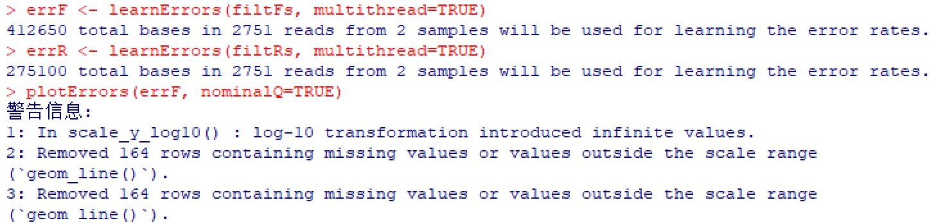
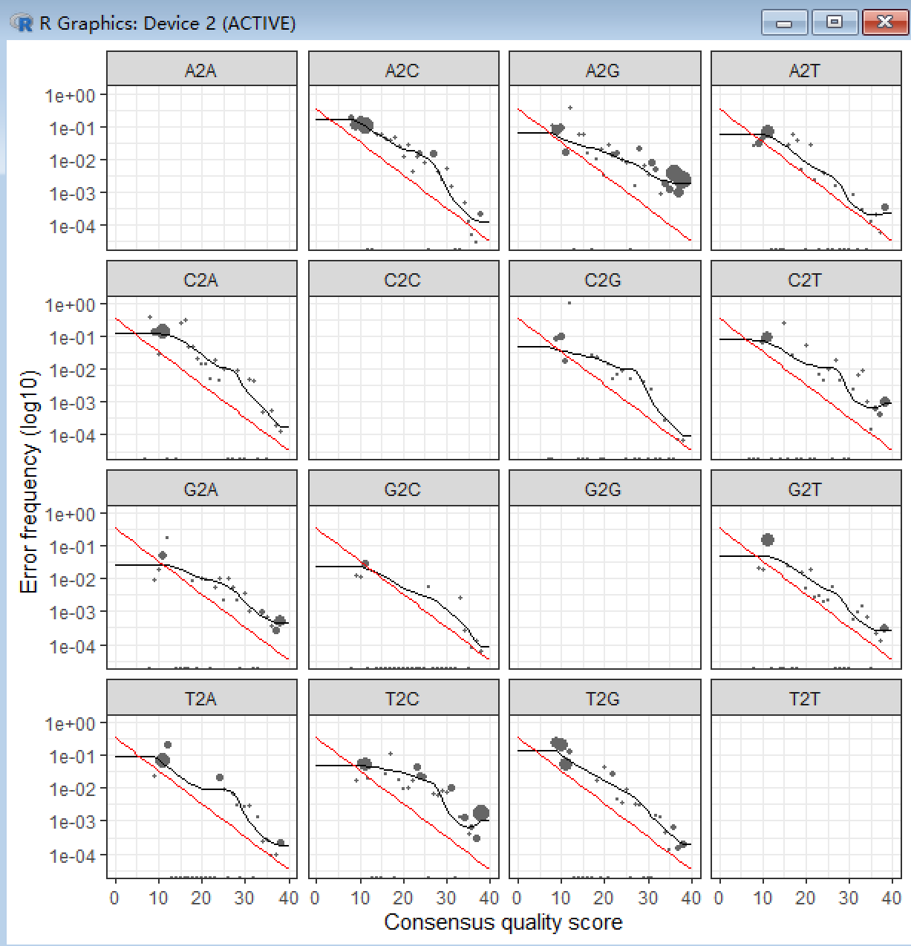
PART 03
DADA2WorkflowTutorialin R
Build an error rate model
Plots frequency of each possiblebase transition as a function ofquality score.
Black line -observed error rates
Red line - expected error rateunder the nominal definition of the Q-value.
In general, frequency of errors decrease as quality score increases.
These look as expected so we can proceed with data analysis.
Notes:
接下来构建错误率模型，红线代表模拟的错误模型，黑色代表实际上的实际情况，如果互相拟合，代表效果较好可以继续下一步实验，如果情况较差，前面设置过滤的过程需要进行纠正。
Next, we build an error rate model. The red line in the plot is the predicted error model, and the black line is the actual error situation. If the two lines match well, the model works — you can move to the next step. If they don’t match, you need to go back and adjust the filtering parameters.

Slide 30
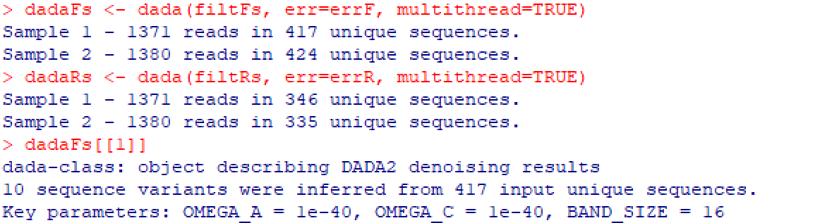
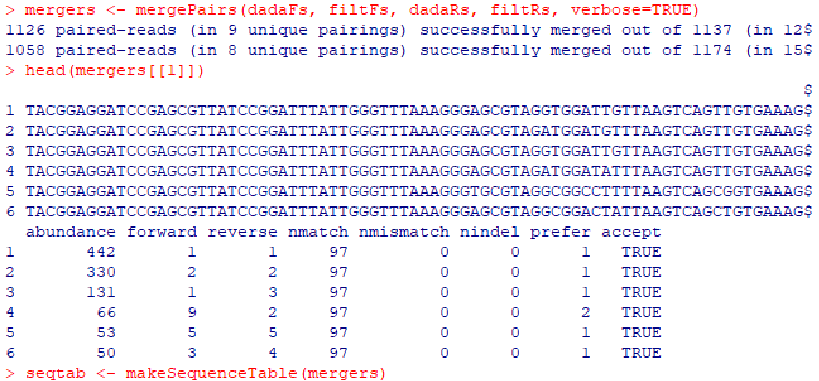
PART 03
DADA2WorkflowTutorialin R
Sample Inference and merge (Sample Denoising)
Notes:
接下来就是样本推断，合并，构造序列表、去除嵌合体、轨道读取管道，进行分配分类表，最后得到asv。
After that, we do sample inference (find real sequences), merge the forward and reverse reads, build a sequence table, remove chimeras (bad sequences), track reads through the process, assign taxonomy (figure out which organisms the sequences belong to), and finally get the ASVs!

Slide 31
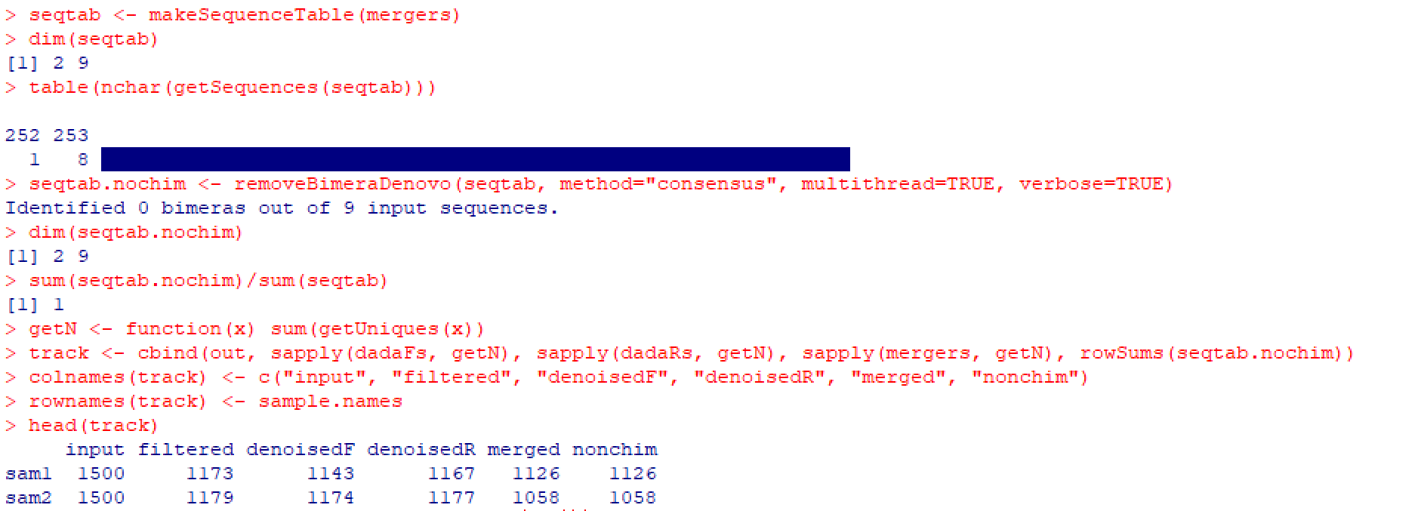
PART 03
DADA2WorkflowTutorialin R
Construct sequence tables, remove chimeras, and read sequences in the pipeline
Notes:
接下来就是样本推断，合并，构造序列表、去除嵌合体、轨道读取管道，进行分配分类表，最后得到asv。
After that, we do sample inference (find real sequences), merge the forward and reverse reads, build a sequence table, remove chimeras (bad sequences), track reads through the process, assign taxonomy (figure out which organisms the sequences belong to), and finally get the ASVs!

Slide 32
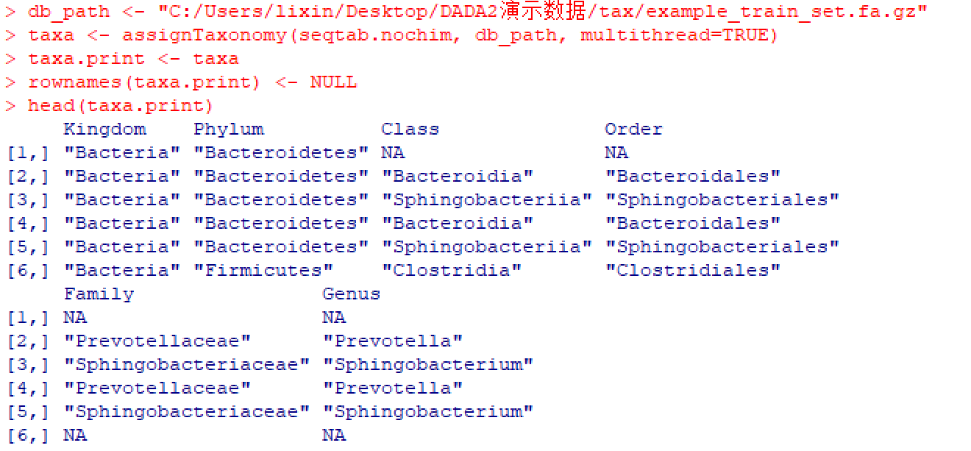
PART 03
DADA2WorkflowTutorialin R
Allocation taxonomy (completed ASV table)
Mito Fish
Notes:
接下来就是样本推断，合并，构造序列表、去除嵌合体、轨道读取管道，进行分配分类表，最后得到asv。
After that, we do sample inference (find real sequences), merge the forward and reverse reads, build a sequence table, remove chimeras (bad sequences), track reads through the process, assign taxonomy (figure out which organisms the sequences belong to), and finally get the ASVs!

Slide 33
Thank you everyone

