Slide 1
Population Demography
Fastsimcoal2 & SMC++
Jiantao Hu 2026.1.13

Slide 2
What is Demography?
The study of :
Population Size (Effective population size N_{e})
Structure (Genetic clusters)
Distribution
Dynamics (Divergence, Migration, Bottleneck)

Slide 3
Ways to simulate Demography
Site Frequency Spectrum (SFS) based > coalescent
Linkage Disequilibrium (LD) based > sequentially Markovian coalescent, SMC

Slide 4
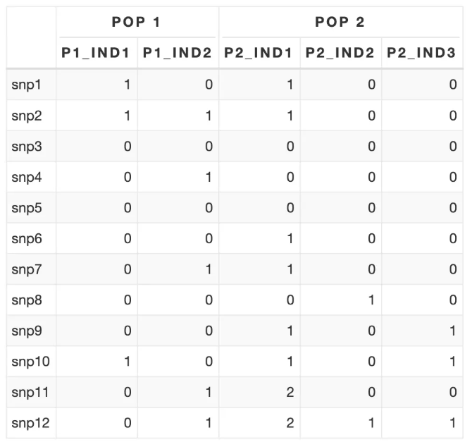
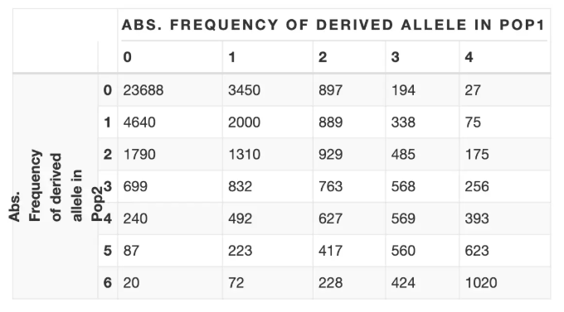
How to calculate SFS among two population

Slide 5
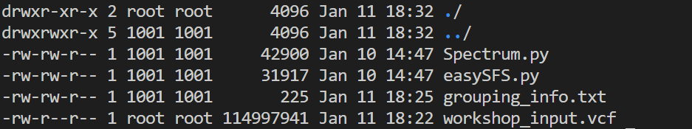
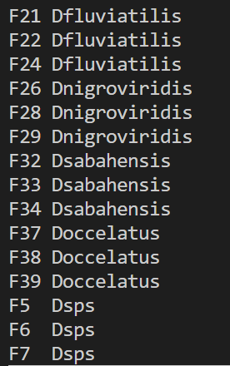
Calculate SFS using easySFS.py
MUST Under same folder !!!
cd /mnt/HJT_FSC/FSC/SFS_CAL/input_require

Slide 6
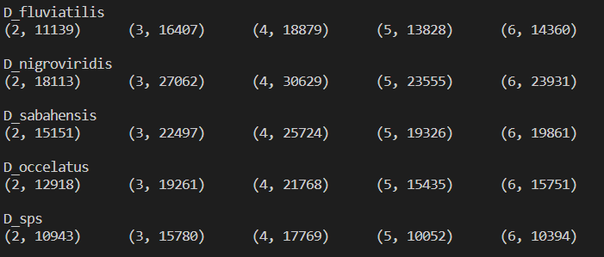
Two Steps run: Step1 preview
python easySFS.py -i file.vcf -p grouping_info.txt -a --preview
This step is to get results for # of segregating sites for multiple values of projecting down for each population [(n,m)]. Use the n with highest m.

Slide 7
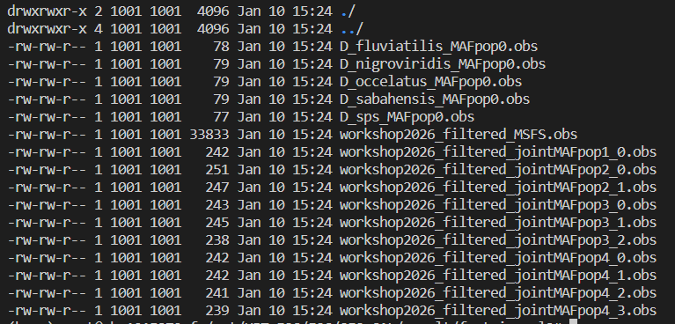
Two Steps run: Step2 calculate
python easySFS.py -i file.vcf -p grouping_info.txt -a --proj 4,4,4,4,4 -o outputfolder
cd ./outputfolder/fastsimcoal2/ & ll
input for fastsimcoal2

Slide 8
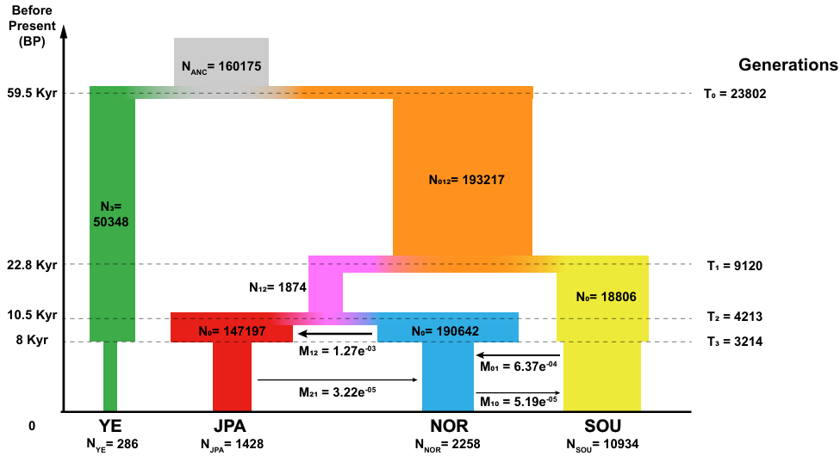
Running fastsimcoal2(fsc)

Slide 9
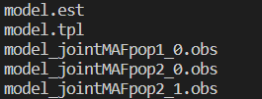
To simulate population dynamic history using SFS with Fastsimcoal, three input files are required, and the prefixes of these three files must be the same:
.tpl template file (parameter file): used to specify historical events migration、 Sample size, mutation rate, recombination rate, etc. Note that the mutation rate and recombination rate here are all [per generation]
. est parameter evaluation file (priority file): Here, apply priority to parameters, specify relationships between parameters, and so on.
. obs SFS observation file: can be generated using easySFS

Slide 10
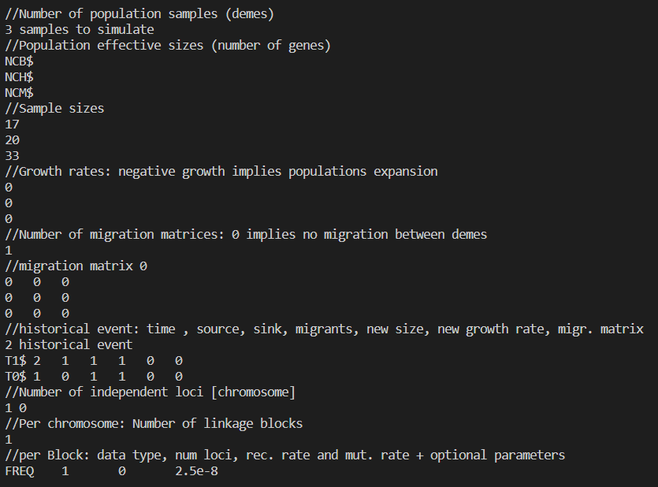
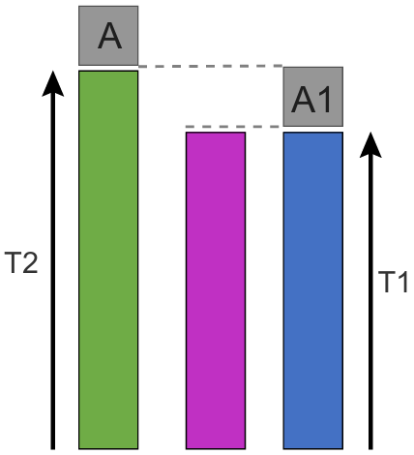

Slide 11
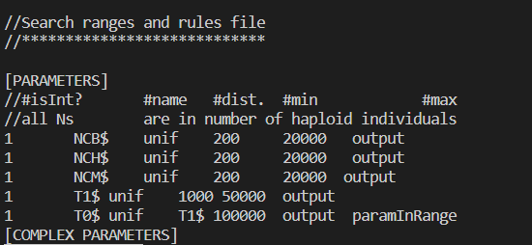

Slide 12
Running fastsimcoal2(fsc)
python run_fsc.py --fsc /home/software/fsc/fsc28_linux64 --dir /your/path/ --pre model
#compare the MaxEstLhood & MaxObsLhood…
less /your/path/model/model.bestlhoods

Slide 13
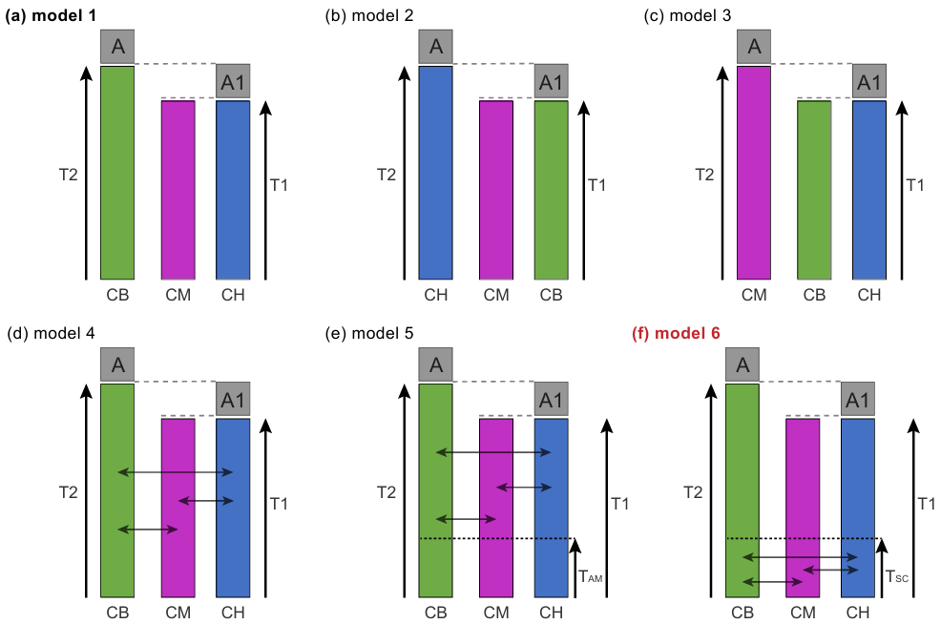
Setting more models
AIC = 2k - 2ln(L)
E.g.: AIC = 2*7 - 2*(2.303)(-879.24)
AIC = 2*12 - 2*(2.303)(-877.14)
AIC = 2*13 - 2*(2.303)(-620.44)
Notes:
Simple practice1: FSC

Slide 14
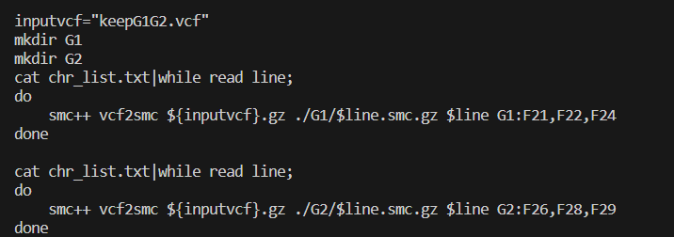
SMC methods: SMC++/SMCPP
bgzip keepG1G2.vcf -c > keepG1G2.vcf.gz
conda activate smcpp

Slide 15
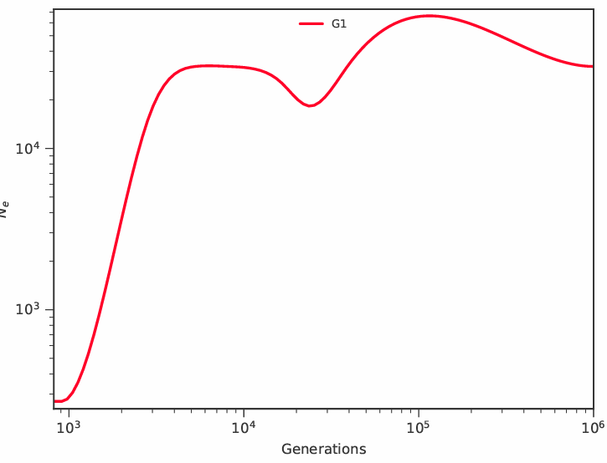

Slide 16
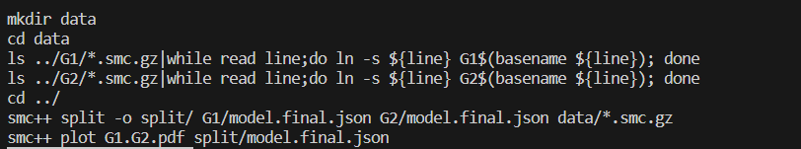
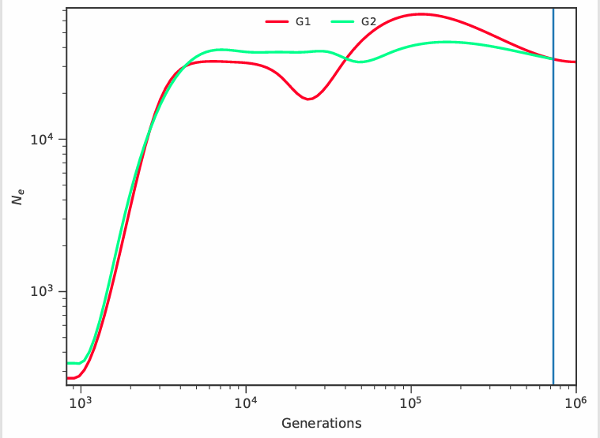
Notes:
Simple practice2: SMCPP

