Slide 1

Hybridisation
(Gene flow across species)
杂交
2026.01.14
FAM YI QING 范扆溱

Slide 2
01
General Introduction
D-suite
(D-statistic)
OVERVIEW
02
SNaQ
(Phylogenetic network inference)
03

Slide 3
01
General Introduction

Slide 4
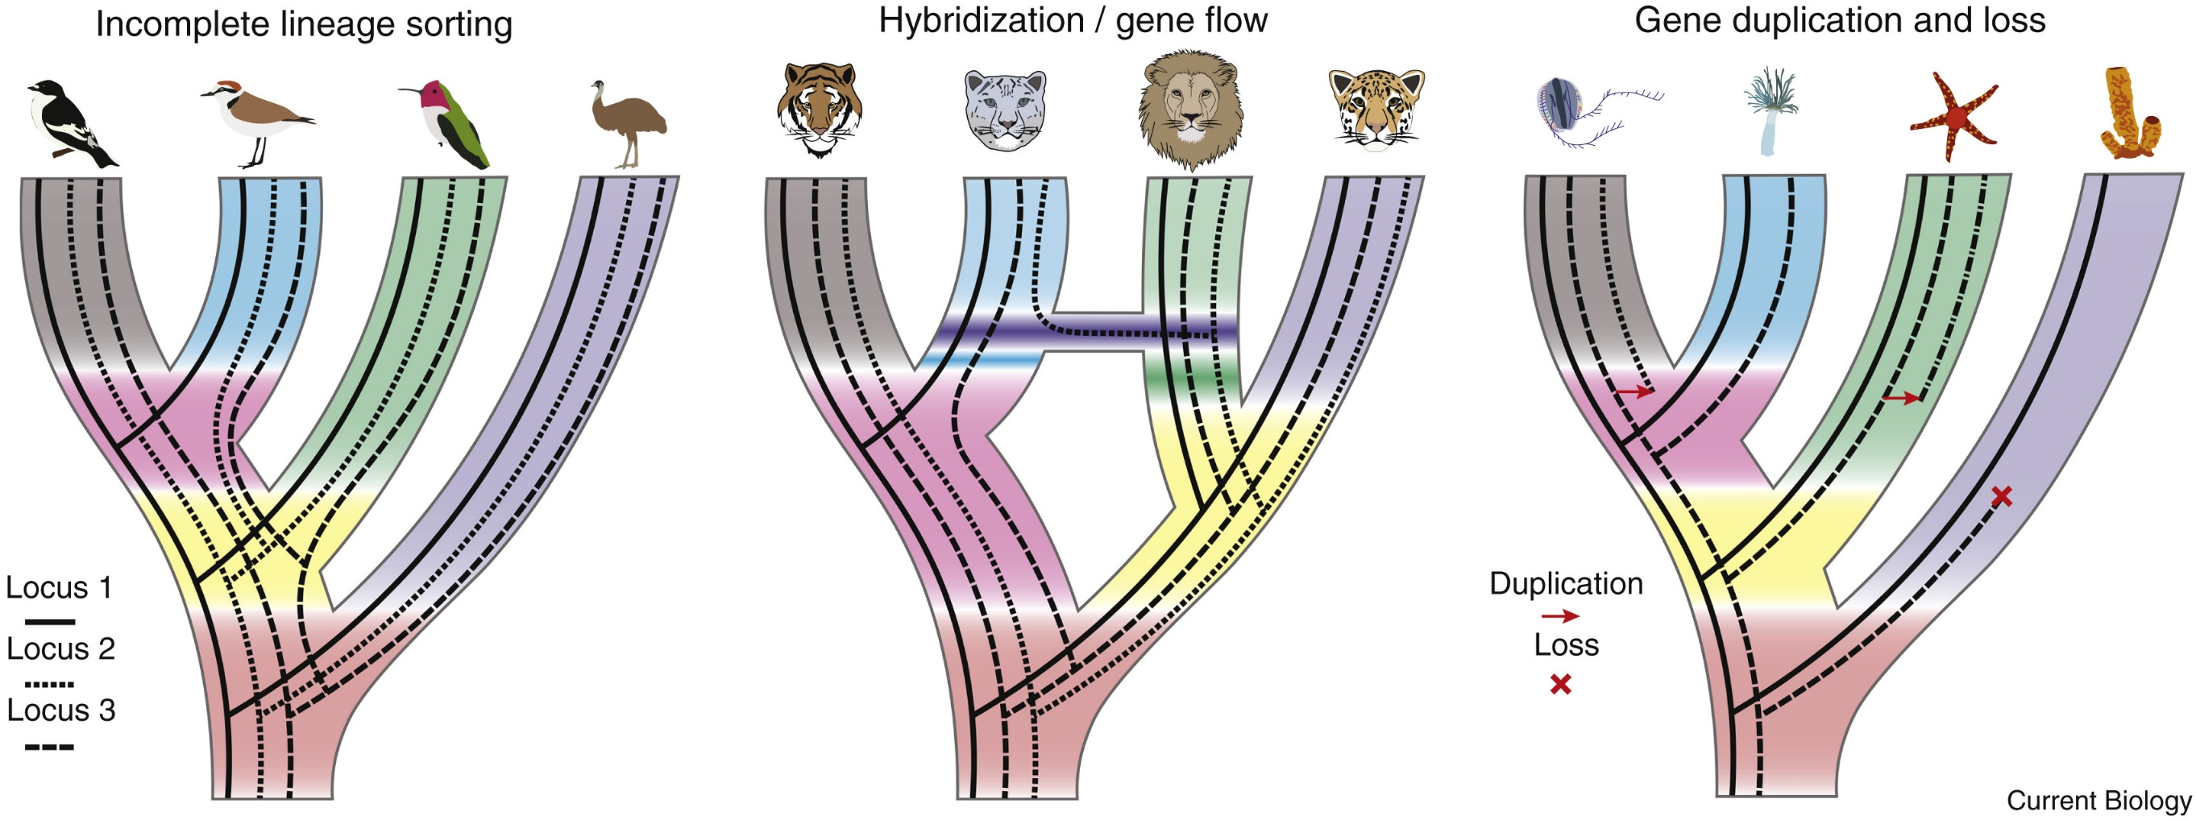
General Introduction
Notes:
在系统发育研究中，一个主要挑战是基因树常常与物种树不完全一致。这种不一致可能由多种进化过程引起。不完全谱系排序（incomplete lineage sorting, ILS）发生在祖先多态性跨越连续的物种分化事件并在后代中随机固定，从而导致基因树与物种树发生冲突。现代鸟类早期的快速辐射便是这一过程的经典实例。除 ILS 之外，物种分化后发生的杂交或基因流同样会造成基因树不一致，这是由于物种间基因组片段的交换所致。例如，对现代猫科动物的基因组研究发现，它们经历过历史性的基因渗透事件，并在其基因组中留下了可检测的遗传痕迹。
In phylogenomic studies, one of the major challenges is that gene trees often do not fully agree with the species tree. Such incongruence can arise from multiple evolutionary processes. Incomplete lineage sorting (ILS) occurs when ancestral polymorphisms persist across successive speciation events and are randomly fixed in descendant lineages, resulting in conflicts between gene trees and the species tree. A classic example of this process is found in the rapid early radiation of modern birds.
In addition to ILS, hybridization or gene flow occurring after speciation can also generate gene-tree discordance through the exchange of genomic fragments between species. For example, genomic studies of modern felines have revealed signatures of historical introgression, leaving detectable footprints in their genomes.

Slide 5
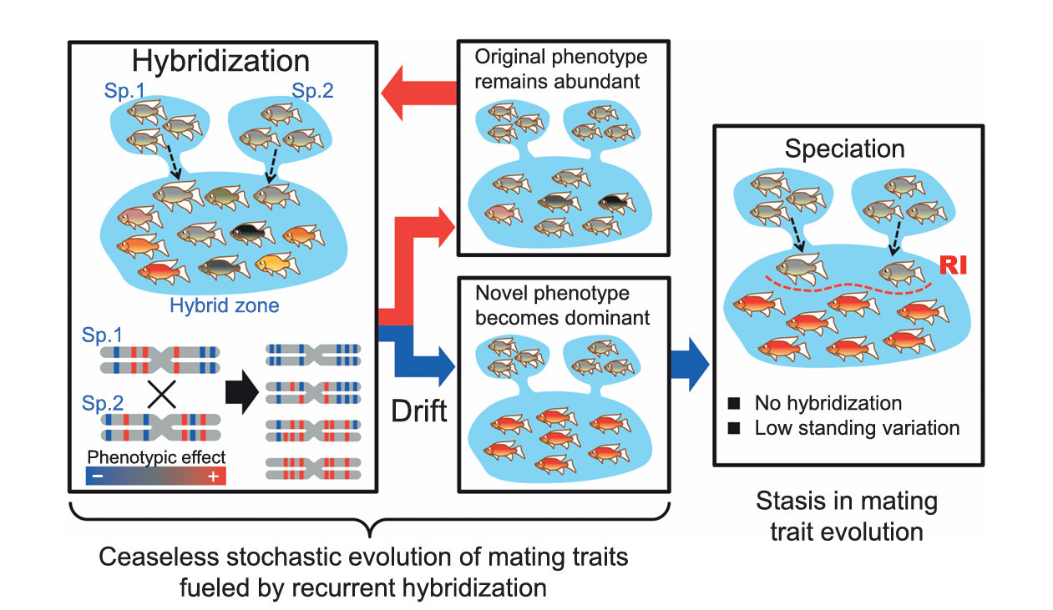
General Introduction

Slide 6

General Introduction
D-suite
SNaQ
  Phylogenetic network inference method
  Infers: Network topology + Hybridization edges + Inheritance probabilities (γ)
  Allows multiple hybridization events
  Best suited for reconstructing reticulate evolutionary histories
  Statistical test for introgression detection
  Based on ABBA–BABA (D statistic) and f-statistics
  Dsuite detects whether and where introgression signals exist
  SNaQ models how hybridization is embedded in the phylogenetic history

Slide 7
02
D-suite
(D-statistic)

Slide 8
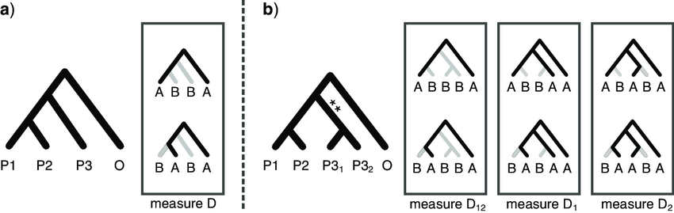
D-suite
D-suite calculates the D and f4-ratio statistics using biallelic SNPs
  Null hypothesis = no gene flow; ABBA and BABA = expected equal frequencies
  Significant deviation from equal ABBA and BABA frequencies = introgression between P3 and either P1 or P2.
  Interpretation of D values:
  D ≈ 0: no evidence of introgression
  D > 0 (ABBA > BABA) - excess allele sharing between P2 and P3
  D < 0 (BABA > ABBA) - excess allele sharing between P1 and P3

Slide 9
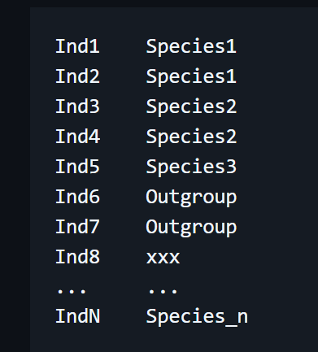
D-suite
D-suite calculates the D and f4-ratio statistics using biallelic SNPs
  Required files:
  1. VCF file – (filtered SNP .vcf)
  2. Population/species map SETS.txt
JAN 6th

Slide 10
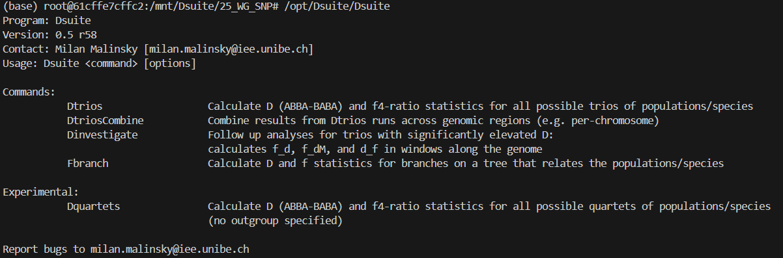
D-suite
Usage

Slide 11
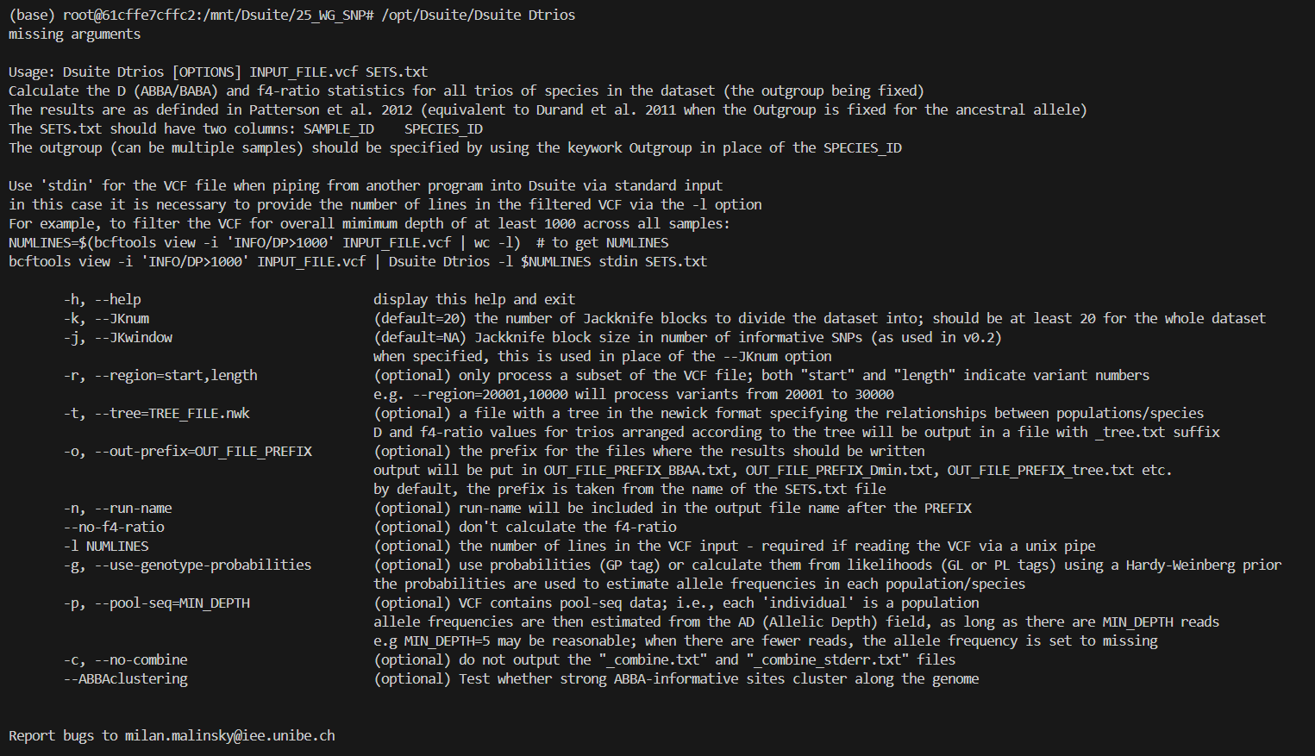
D-suite
Usage

Slide 12
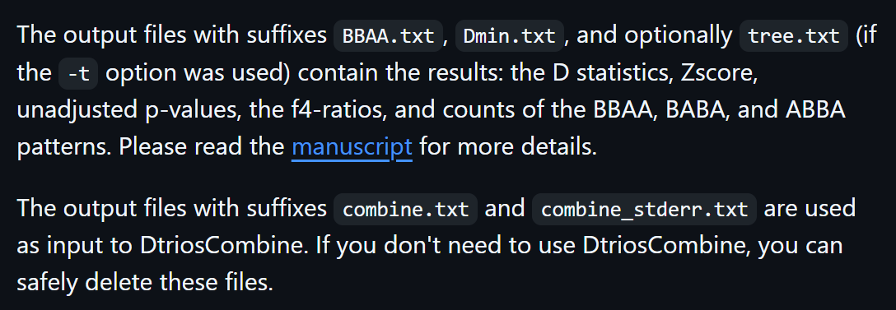
D-suite
Output files

Slide 13
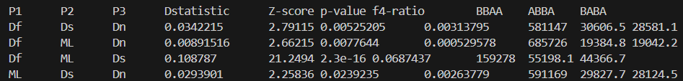
D-suite
Interpret the result
D-statistic - Measures the directional asymmetry of allele sharing between populations
Z-score - Tests whether the observed D value deviates significantly from zero
p-value - small (<0.05) = significant
f4-ratio - estimates the proportion of ancestry in population P3 derived from the P2 lineage

Slide 14
03
SNaQ
(Phylogenetic network inference)

Slide 15
SNaQ
PhyloNetworks - a Julia package for handling phylogenetic trees and networks
It serves as a core package that other packages depend on
SNaQ - inference of phylogenies from genetic data
Phylogenetic networks can represent evolutionary relationships, such as populations and species
File required
All_genes.tre (Species mapping version)
Species tree (Astral tree)

Slide 16
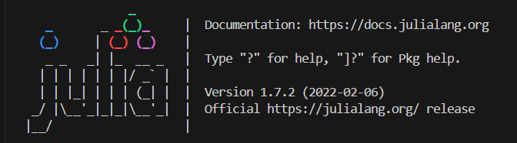
SNaQ
Activate julia
julia
Activate package
$ using PhyloNetworks, SNaQ, DataFrames, CSV, RCall, PhyloPlots

Slide 17
SNaQ
Read all_gene.tre (concatenate gene tree)
$ raxmltrees=joinpath("genetree_species_name.tre")
$ genetrees = readmultinewick(raxmltrees)
Generate Table CF
$ q,t = countquartetsintrees(genetrees)
$ nt = tablequartetCF(q,t)
$ df = DataFrame(nt, copycols=false)
$ show(df, allcols=true)
$ CSV.write("tableCF.csv", df)
> Quit Julia - Ctrl+d

Slide 18
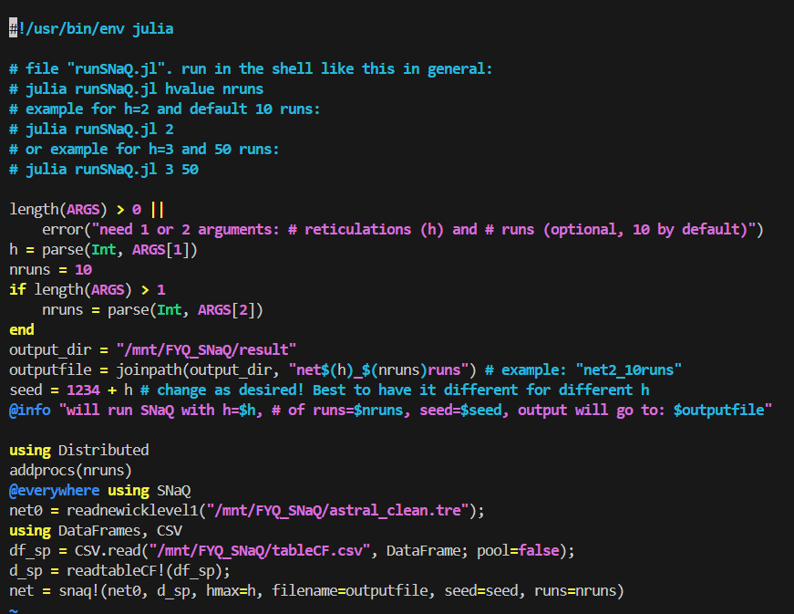
SNaQ
Run SNaQ with script
vim runSNaQ.jl
:wq
nohup ./runSNaQ.jl 1 10 > snaq.log 2>&1 &

Slide 19

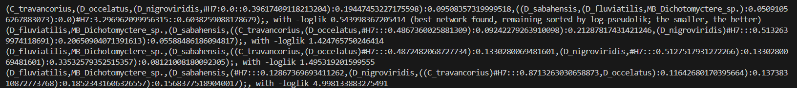
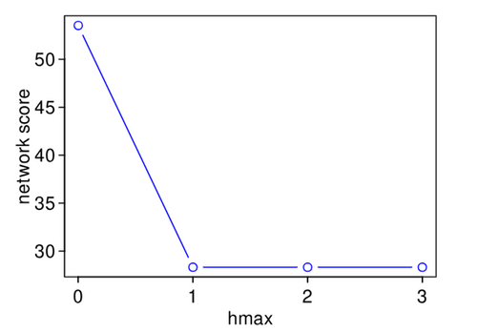
SNaQ
Output files
File that we concerned
Can run with different hmax, and compare the score

Slide 20
SNaQ
Output the best tree
$ julia
$ using PhyloNetworks, SNaQ, DataFrames, CSV, RCall, PhyloPlots
$ net = readnewick("net1_10runs.networks")
$ writenewick(net, round=true, digits=2)
$ writenewick(net, "bestnet_h1.tre") # writes to file: creates or overwrites file
Reroot the best tree
$ net1 = readnewick("bestnet_h1.tre")
$ rootatnode!(net1, "Outgroup")
$ net1_reroot = rootatnode!(net1,"Outgroup")
$ writenewick(net1_reroot)
$ writenewick(net1_reroot, "net1_reroot.tre")

Slide 21
SNaQ
Visualise the final tree
$ imagefilename = "net1_10.svg"
$ R"svg"(imagefilename, width=6, height=3)
$ R"par"(mar=[0,0,0,0])
$ plot(net1_reroot, showgamma=true, showedgenumber=true);
$ R"dev.off()"; # wrap up and save image file

Slide 22
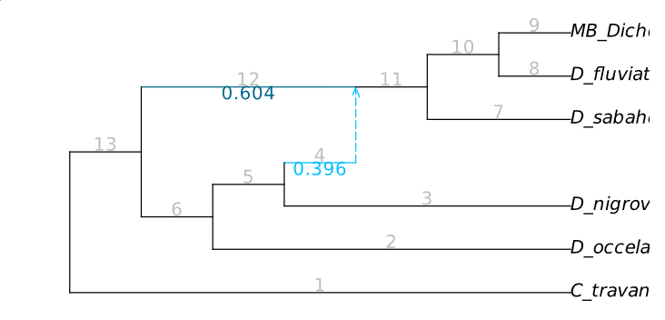
SNaQ
Result

Slide 23

Thank You
2025.01.14
FAM YI QING 范扆溱

