Slide 1


Biogeography
(BioGEOBEARS + RASP)
Jiantao Hu
LMSE
2026

Slide 2
1
Introduction
2
Tutorial 1. Getting started with RASP
3
Tutorial 2. Selecting the biogeographic model
Contents
4
Tutorial 3. Test phylogenetic signal
Tutorial 4. Trait evolution
5
6
Tutorial 5. Compare trees derived
    from different genes
7
Tutorial 6. Modify trees and states

Slide 3
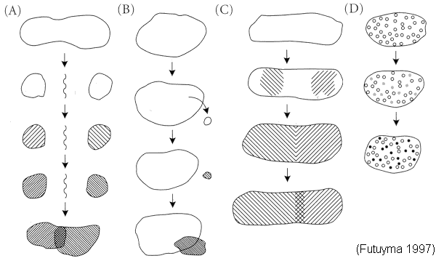
Allopatric 异域种化
Founder Effect 奠基者效应
Parapatric 邻域种化
Sympatric 同域种化

Slide 4
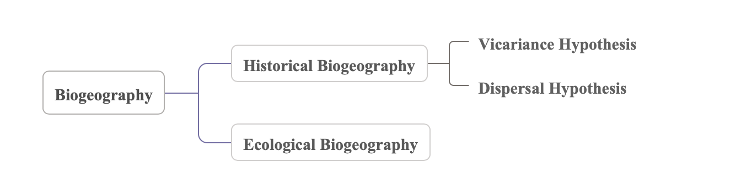
Ancestral Distribution
important part
models：
扩散-灭绝分支进化模型（Disperasl-Extinction Cladogenesis, DEC）(Ree, 2005, 2008)
基于统计的扩散-灭绝分支进化模型（Statistical Dispersal-Extinction Cladogenesis, S-DEC）(Yan Yu et el., 2015)
扩散-隔离分析模型（Dispersal-Vicariance Aanlyses, DIVA）(Ronquist, 1997)
基于统计学的扩散-隔离分析模型（Statistical Dispersal-Vicariciance Analyses, S-DIVA）（Yan Yu, 2010）
BayArea模型 (Landis, 2013)
......
software | model
Lagrange | DEC
RASP | S-DIVA, DEC, S-DEC, BayArea
BioGeoBEARS（R） | DIVE, DIVAj, DEC, DECj, BayArea, BayAreaj

Slide 5
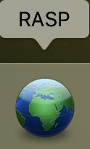
How to download
download from sourceforge: https://sourceforge.net/projects/rasp2/files/
or github: https://github.com/sculab/RASP
Windows
System Requirement: If you are using Windows 2000, 2003 or XP, please make sure that Microsoft® .NET 2 Framework is installed on your computer.
Mac OS
System Requirement: This version of RASP is developed for use on Mac OS X versions 10.6 and above on computers with Intel processors only. RASP for Mac uses the Wineskin program in order for RASP to run.
Linux
For Linux users, one could use Wine and Winetricks to run RASP for Win (recommended). Using following command to install Winesticks and .NET framework: wget http://kegel.com/wine/winetricks
sh winetricks dotnet20

Slide 6
1
Introduction
2
Tutorial 1. Getting started with RASP
3
Tutorial 2. Selecting the biogeographic model
Contents
4
Tutorial 3. Test phylogenetic signal
Tutorial 4. Trait evolution
5
6
Tutorial 5. Compare trees derived
    from different genes
7
Tutorial 6. Modify trees and states

Slide 7
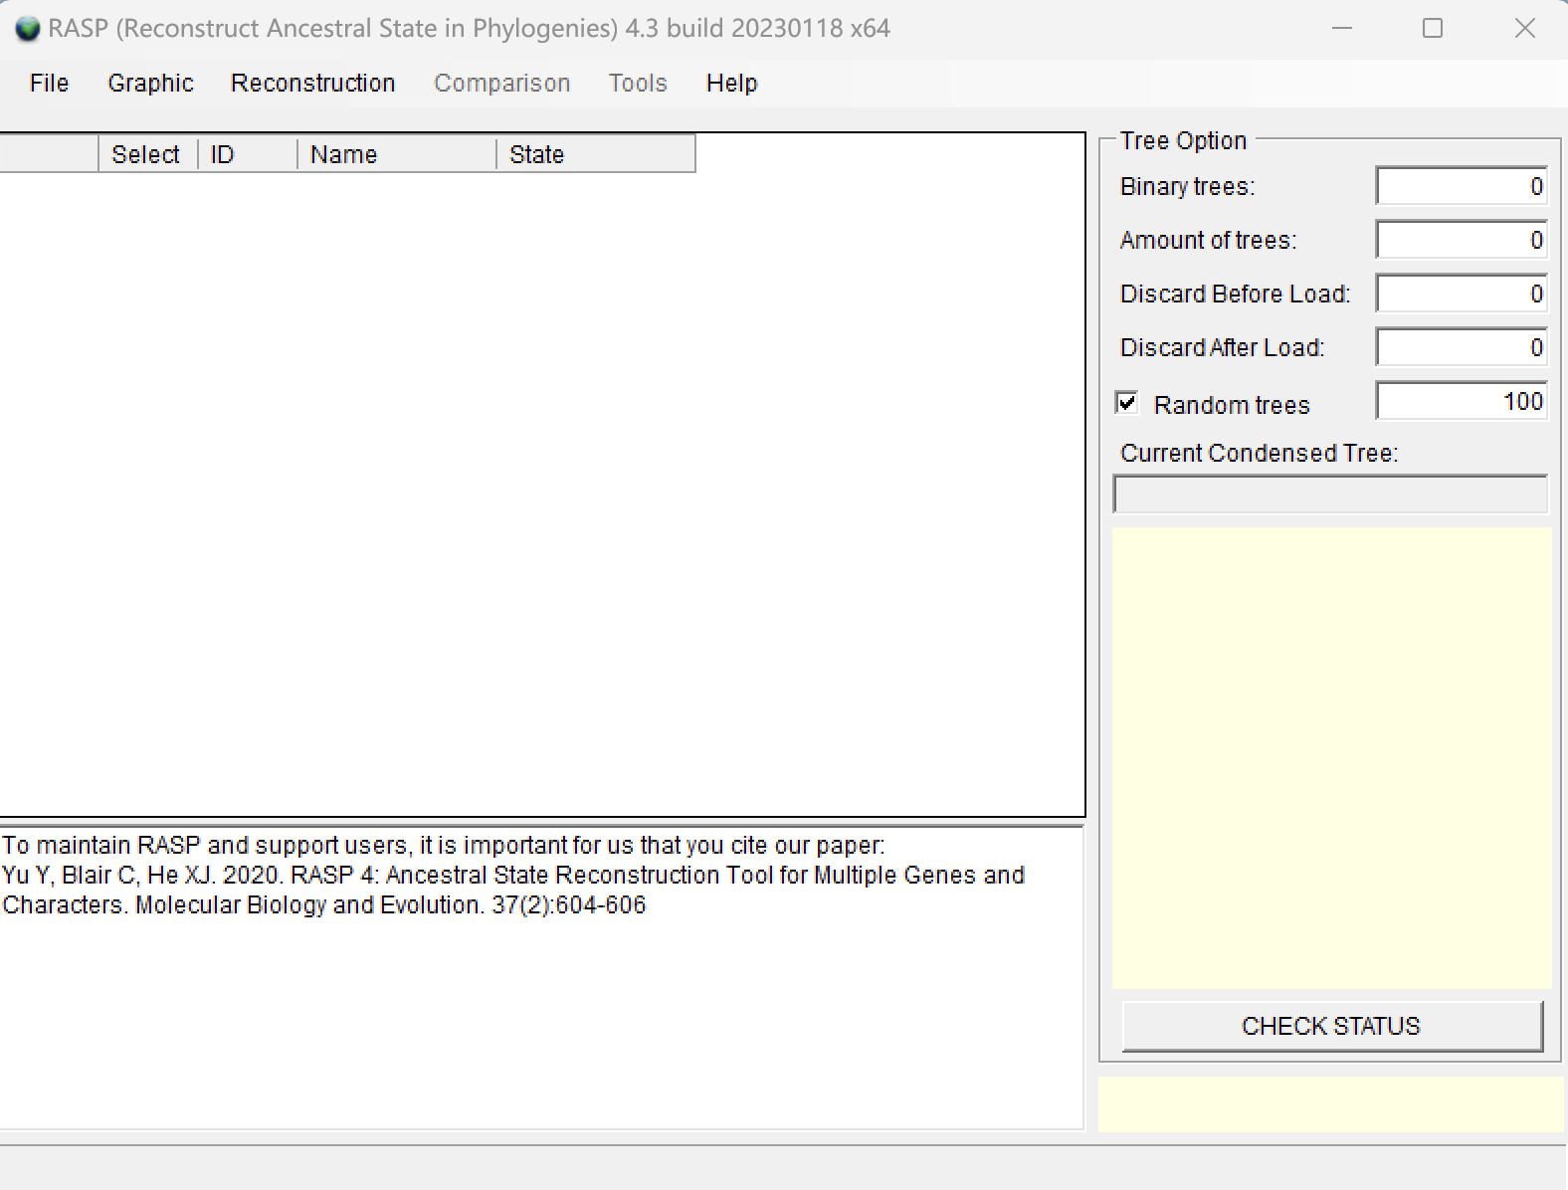
Binary trees: The total number of binary trees in your trees data set. (from bootstrap file of raxml/trees from BEAST runs)
Amount of trees: The total number of trees in your trees data set.
Discard trees: The number of trees that will be discarded from the beginning of the trees data set; equivalent to a burnin.
Random tree: Select random trees form trees dataset to run the Statistical Method. Trees will be selected from between Discard Trees and Amount of trees. You can save the randomly selected trees to a new file with [File>Export Trees ->Random
Trees] after analysis has been done.
Current Condensed tree: Show the condensed tree in text. You could view your
condensed tree in graphic form [Graphic > Tree View]
CHECK STATUS: Check the current status of RASP
Prepare file and information：
Trees data set
Condensed tree
States (Distributions) file (not required).
examples/Psychotria/Trees_States

Slide 8
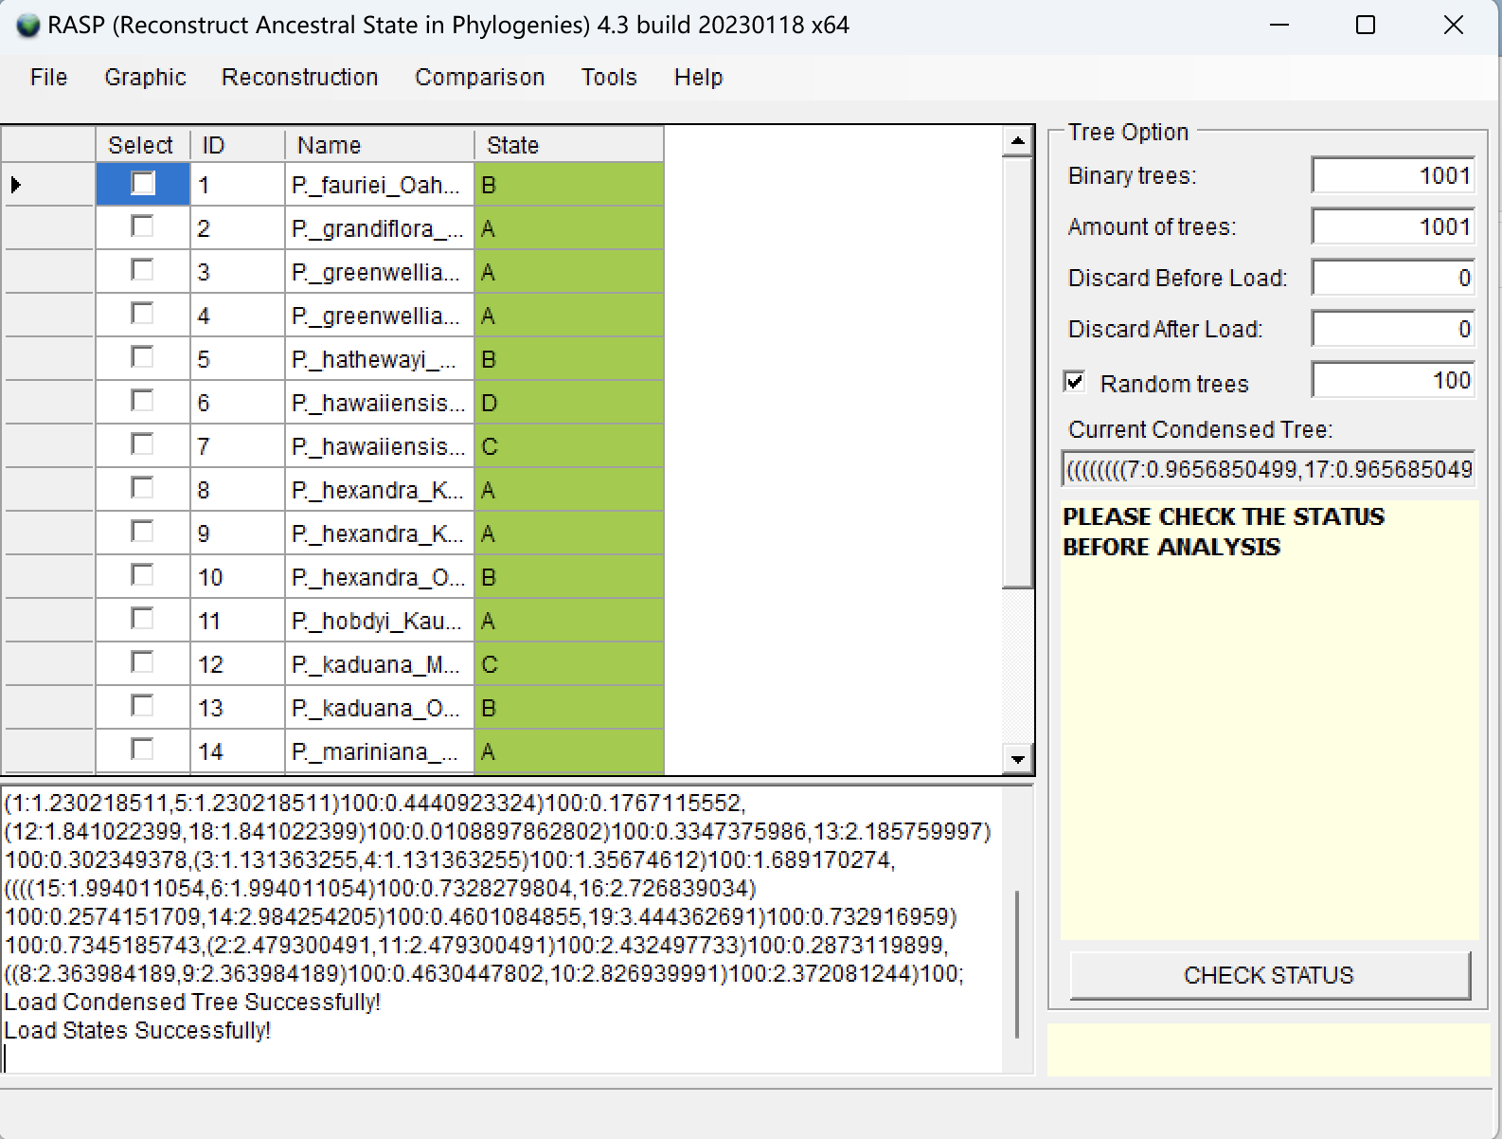
Loading the tree files
Open [File > Load Trees> Load Trees (more format)] and navigate to dataset.trees and select it.
Open [File> Load Consensus Tree> Load name-specified Tree] and navigate to name.tree and select it.
Editing the distribution state with build in editor (or load from .csv)
Now you will see a window like this:
Notes:
NOTE: Users can open and edit the distribution.csv file with Excel. The columns in distribution.csv are the ID, species names and distribution (state). The species names need to be exactly the same as those in the RASP window, but the order of species names does not.
NOTE: The A, B, C and D in the distribution.csv file indicate different distribution areas. If a species is distributed in both A and C, the distribution should be AC. RASP requires users to use continuous letters to represent distribution areas. For instance, if you have four areas, they should be A, B, C and D, but not A, C, D, E.

Slide 9
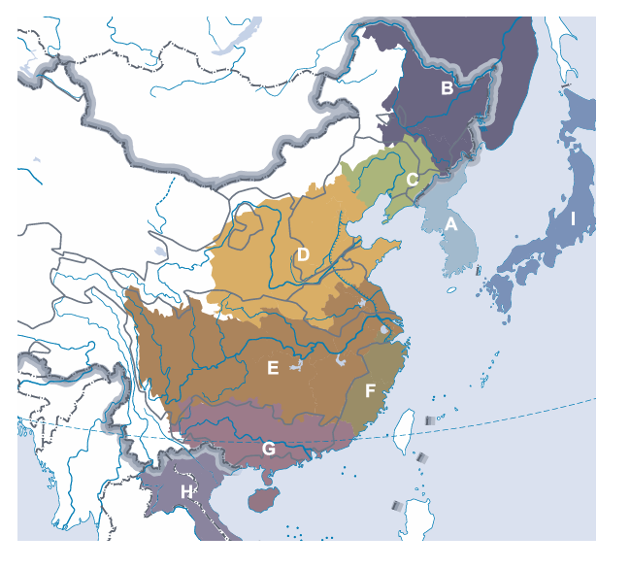
distribution state
Geographically isolated either in present or past

Slide 10
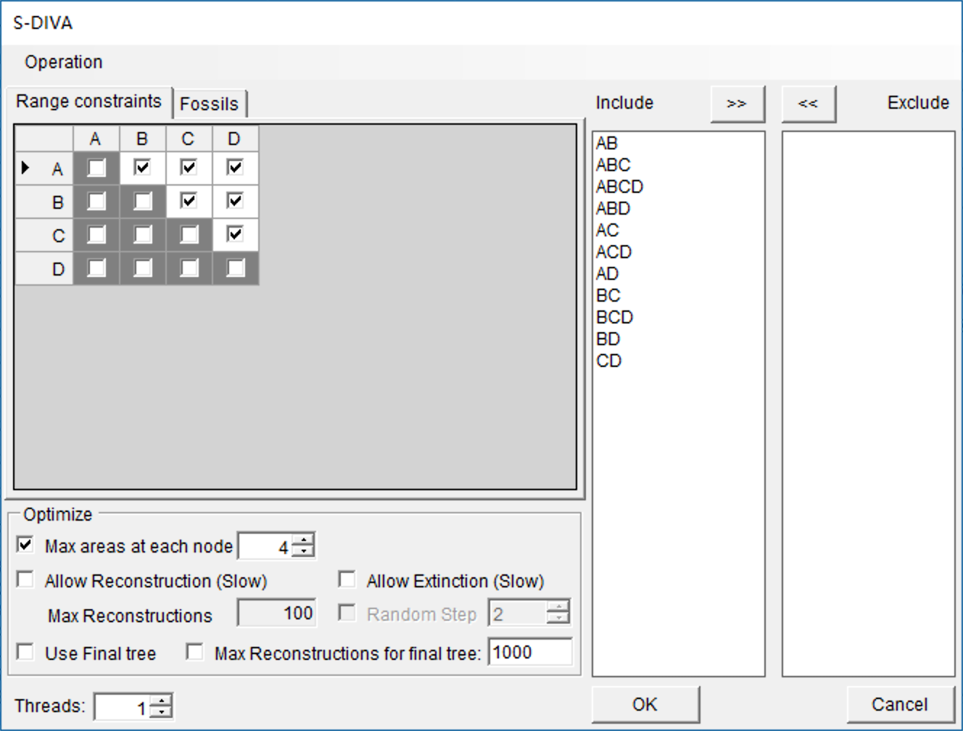
Running a classical S-DIVA model
Open [Reconstruction> On Trees> Statistical Dispersal-Vicariance Analysis (S-DIVA)]
Max areas at each node: It defines the number of unit areas allowed in ancestral distributions.
The list of “Include” will be updated when you change the value of "Max areas at each node ".
Threads: increase the speed of analyses that are more computationally intensive.
Notes:
The value of "Max areas at each node" can be set as the maximum number of unit areas of current species or even the total number of your areas. However, these settings may also lead to a wide distribution at the root node. Users can restrict this value to obtain a more meaningful result.

Slide 11
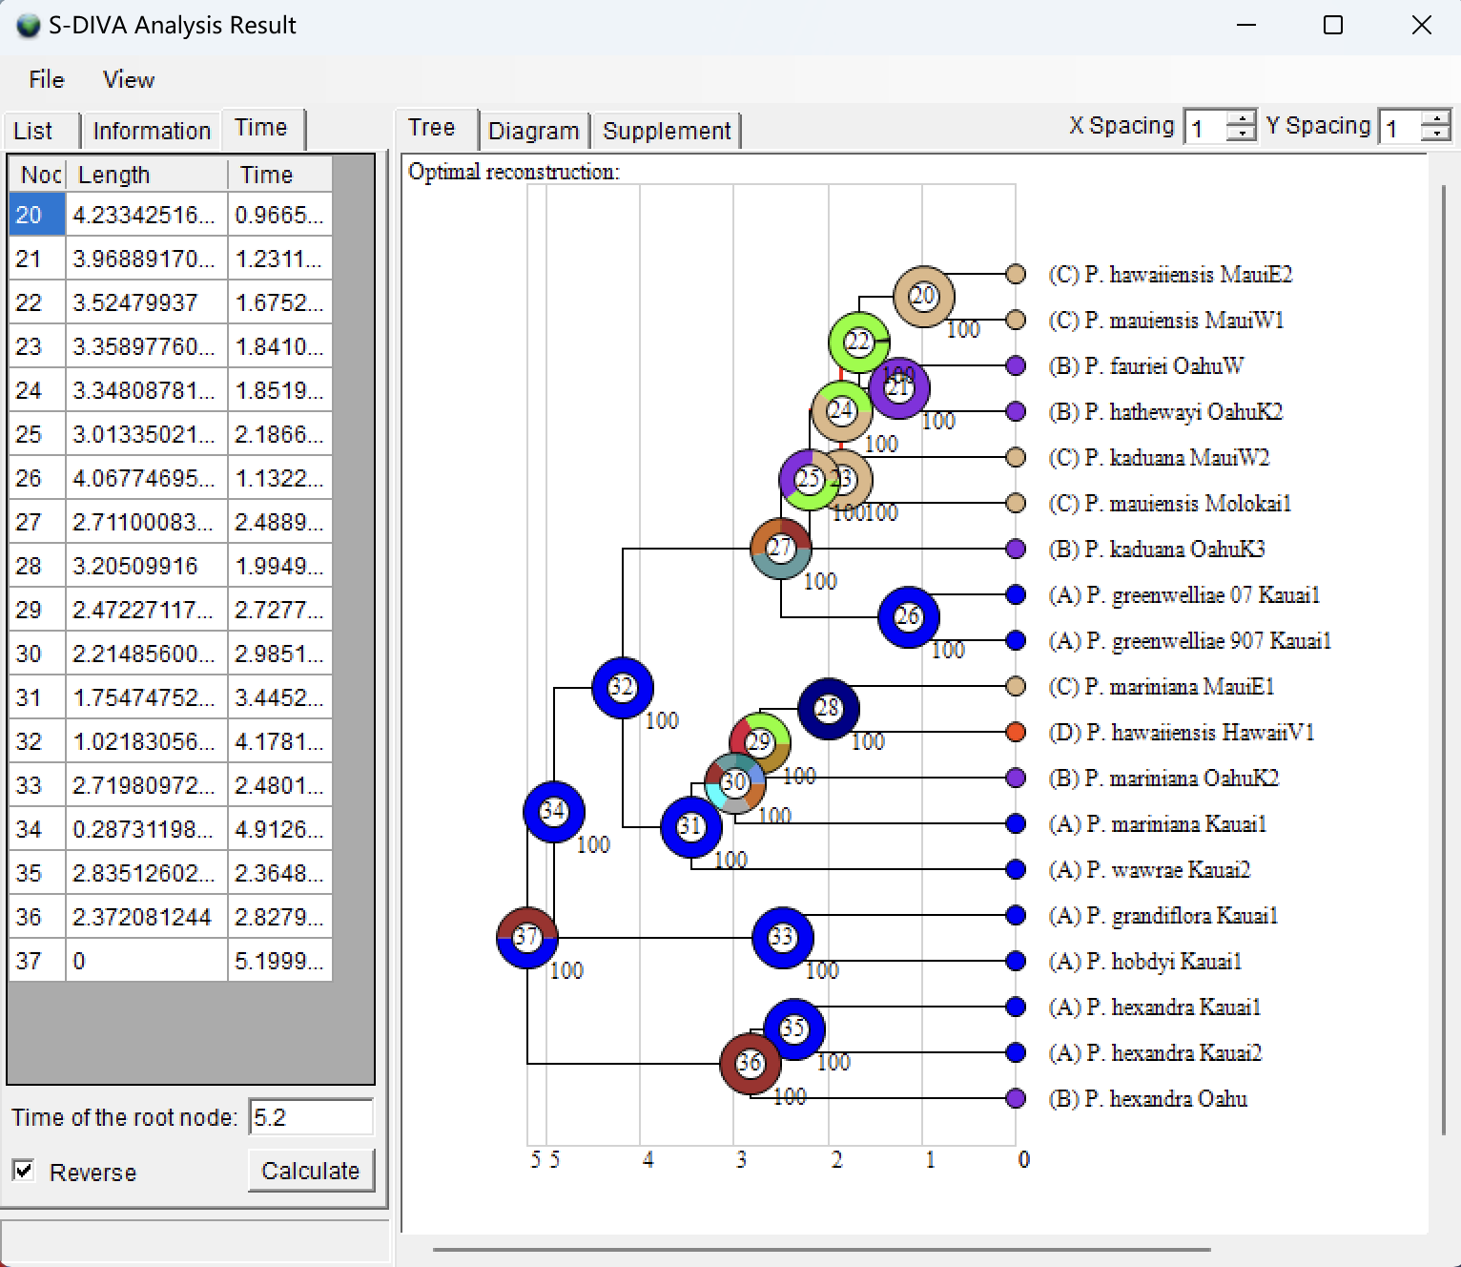
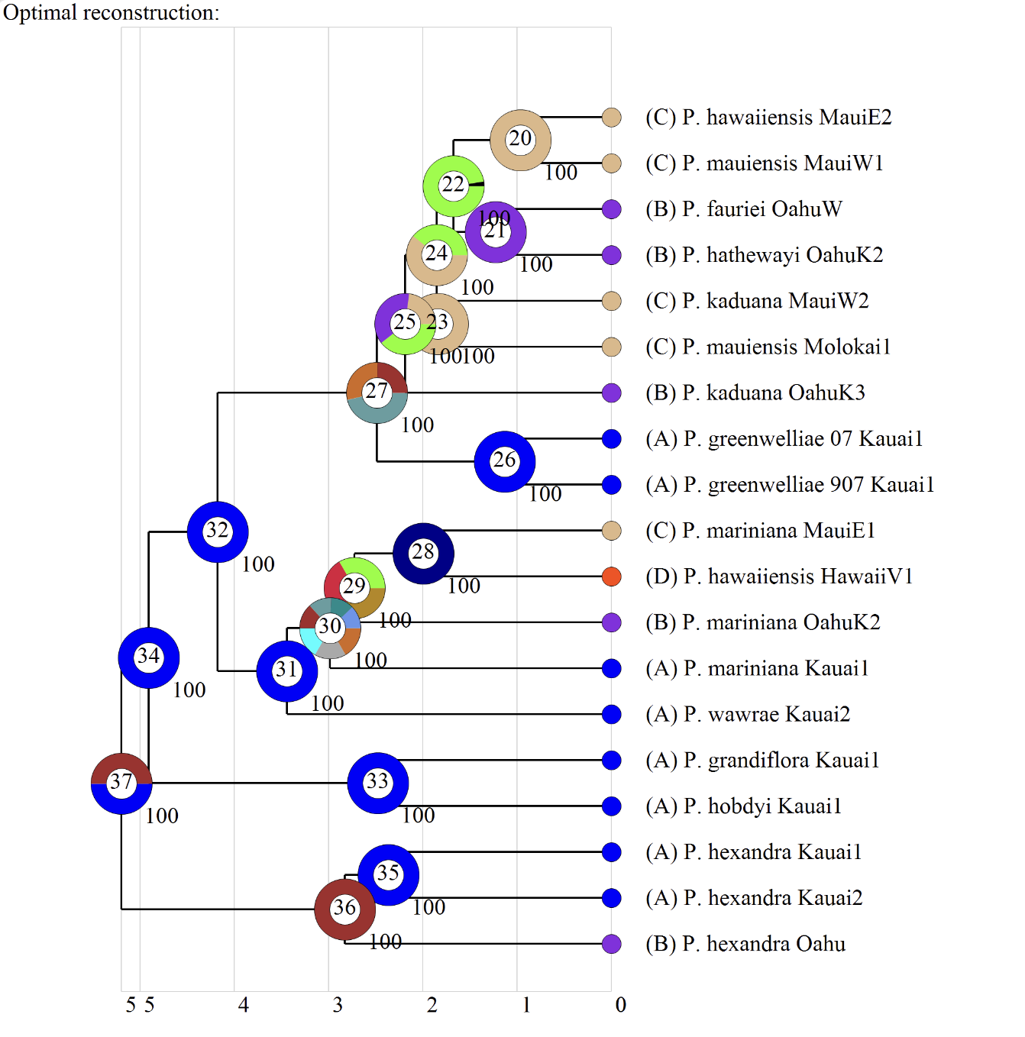
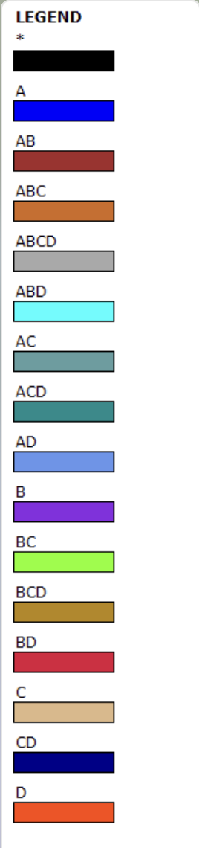
Visualizing the result
Open [Graphic->Tree View]
and you will see a window like this
Open [File> Save Result] to save the result.
Open [File> Export Graphic> Export Tree]
and [File> Export Graphic> Export Legend] to save the tree and legend, respectively.

Slide 12
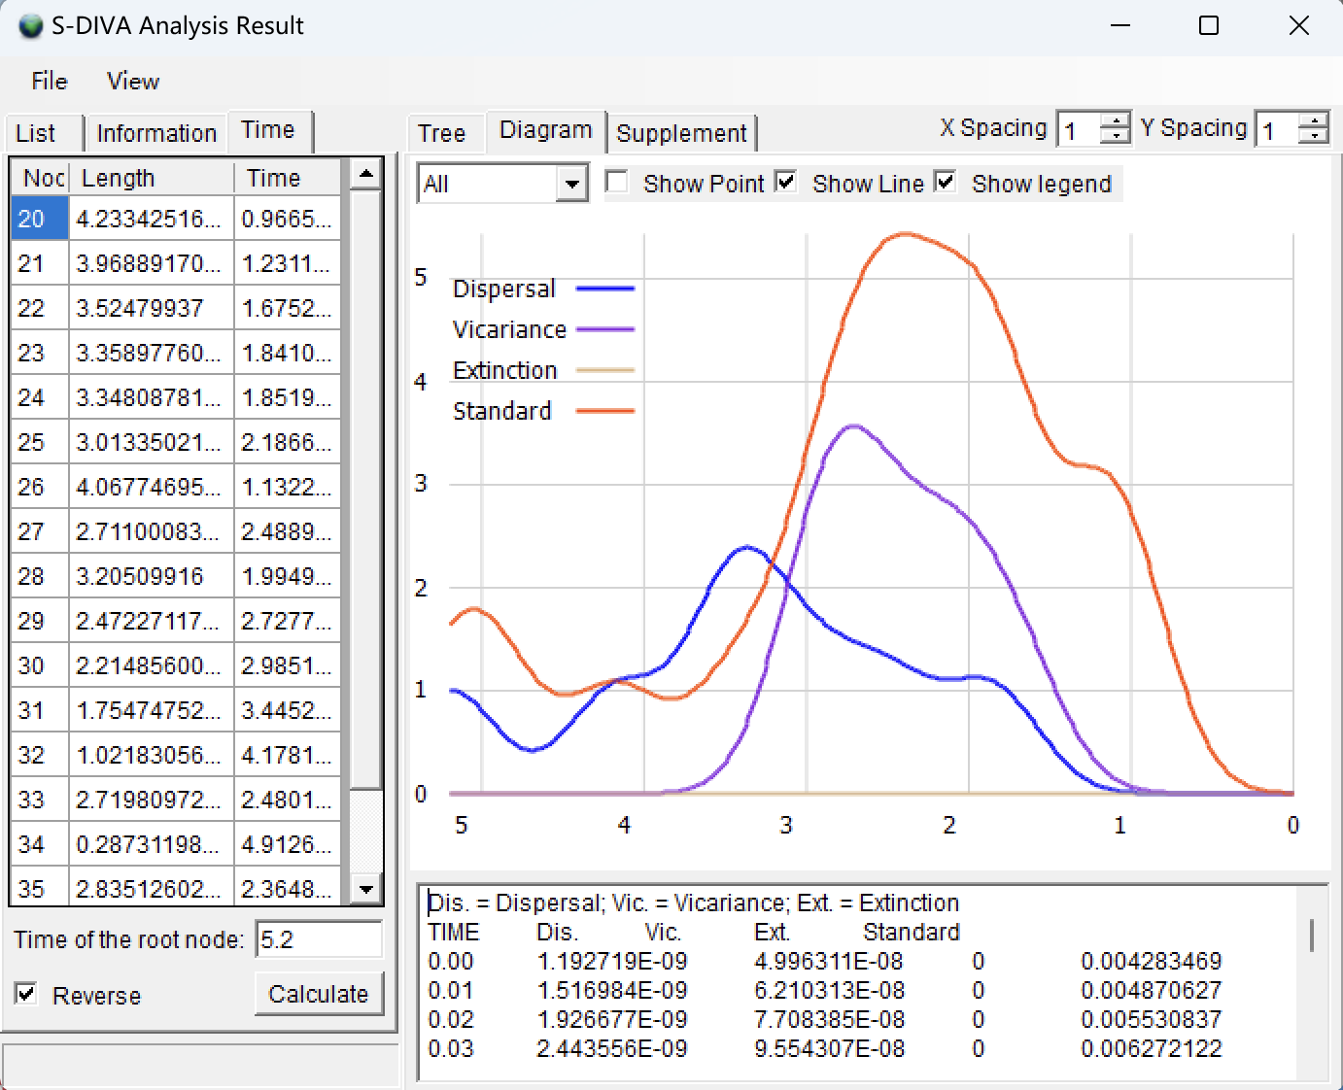
If you are using a dated tree, you could go to the “Time” tab and click “Calculate”.
In the image below, the X-axis represents time and the Y-axis is the density of different events on the tree.
Open [File> Export Graphic> Export Diagram] to save the graphic.

Slide 13
1
Introduction
2
Tutorial 1. Getting started with RASP
3
Tutorial 2. Selecting the biogeographic model
Contents
4
Tutorial 3. Test phylogenetic signal
Tutorial 4. Trait evolution
5
6
Tutorial 5. Compare trees derived
    from different genes
7
Tutorial 6. Modify trees and states

Slide 14
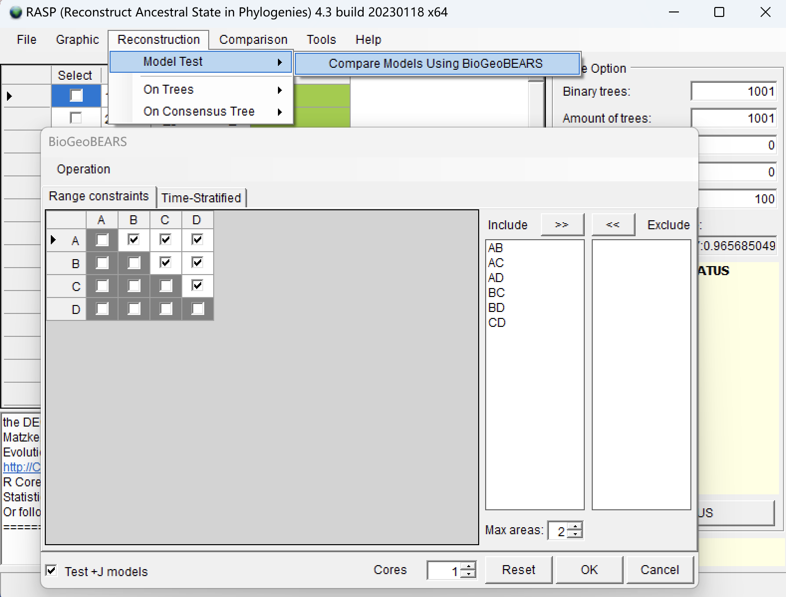
you will see a window like this:
Loading the data files
Selecting the biogeographic model
In RASP, we use the R package ‘BioGeoBEARS’ (Matzke 2014) to select the historical biogeography model.
Open [Reconstruction> Model Test> Compare Six Models Using BioGeoBEARS],
Keep everything as default and click “OK”.

Slide 15
BioGeoBEARS adds an additional cladogenic event: founder-event speciation (the new species jumps to a range outside of the ancestral range)(+J), and also allows the relative weighting of the different sorts of events to be made into free parameters, allowing optimization and standard model choice procedures to pick the best model. The relative probability of different descendent range sizes is also parameterized and thus can also be specified or estimated.

Slide 16
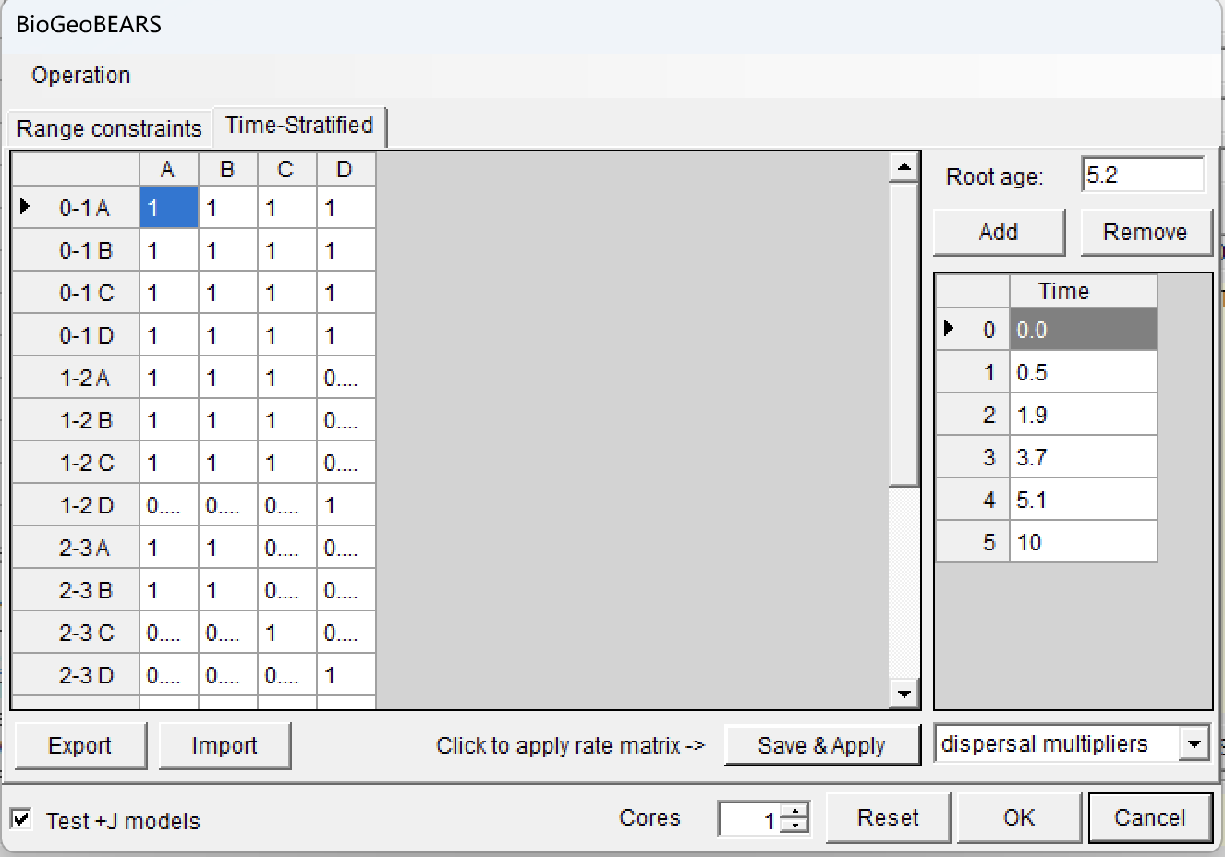
Variation in dispersal can be specified by time periods in which particular constraints can be enforced.
Load a time‐stratification file under the Time-Stratified tab.
Click [Import] button in Time-Stratified tab, navigate to examples/Psychotria/States/timeperiods.txt and select it.

Slide 17
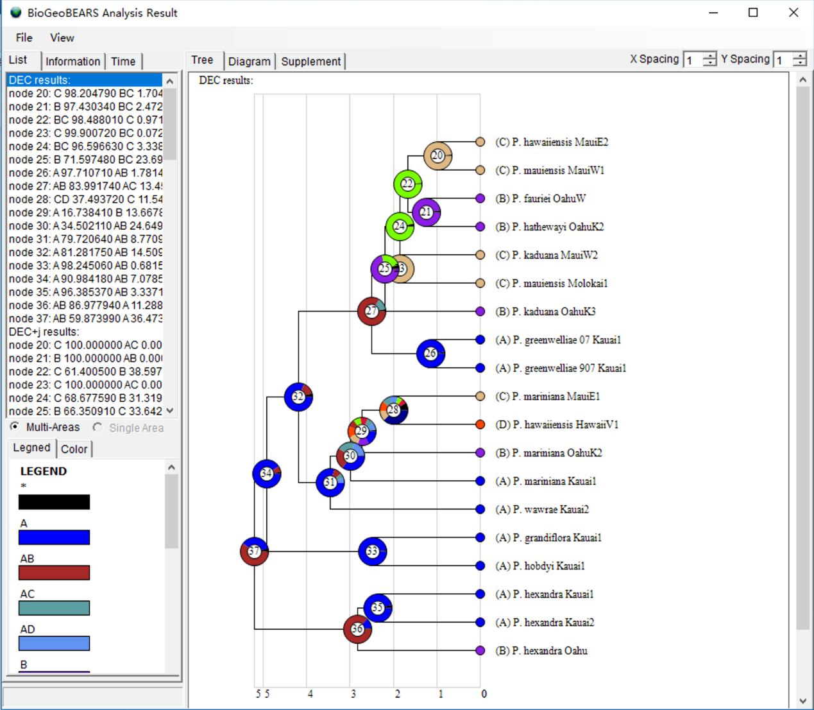
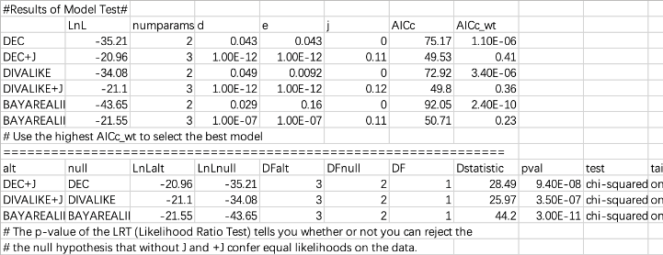
Open [Graphic> Tree View] and you will see:
To select the best fit model, click the Supplement tab to see the details of the model test.
Results can be saved using [File> Save Info> Supplement Information] in this window and then opened in Excel. See Results/model_test.xls.
The list to the left shows the inferred biogeographic history on the consensus tree with different models.
Notes:
In the above result, we can see that DEC+J has the highest AICc_wt value of 0.41. We will use this model in the subsequent analysis.

Slide 18
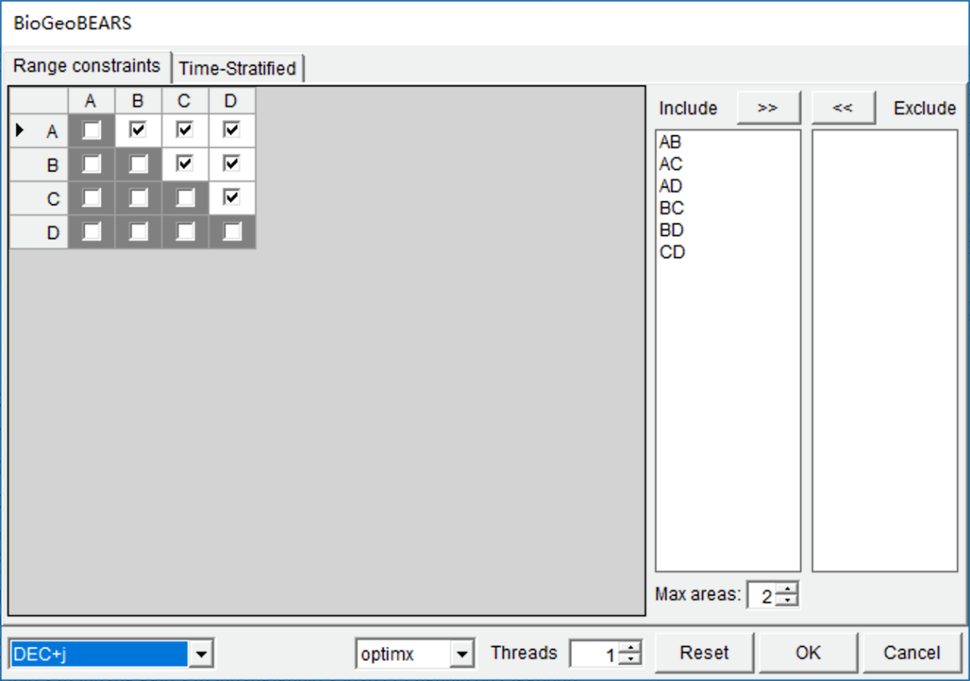
Apply the model on trees dataset
Usually, the trees dataset contains hundreds or thousands of trees.
NOTE: Users can define a seed for the random method in [Tools> Seed For Random Trees]
Open [Reconstruction> On Trees> Statistical DIVALIKE/DEC/BAYAREALIKE in BioGeoBEARS (S-BGB)], you will see:
Select “DEC+J” model in the selection box at the left bottom.
Open [Graphic->Tree View] to see the results.
Notes:
We can randomly subsample trees to decrease the calculation time. You can change the default values (select 100 trees from the trees file) in the upper right of main window.
NOTE: Users can set a larger value for “Threads” to speed up the analysis if you have a multicore CPU.

