Slide 1
Gene flow within population Treemix Intro & Practice

Slide 2
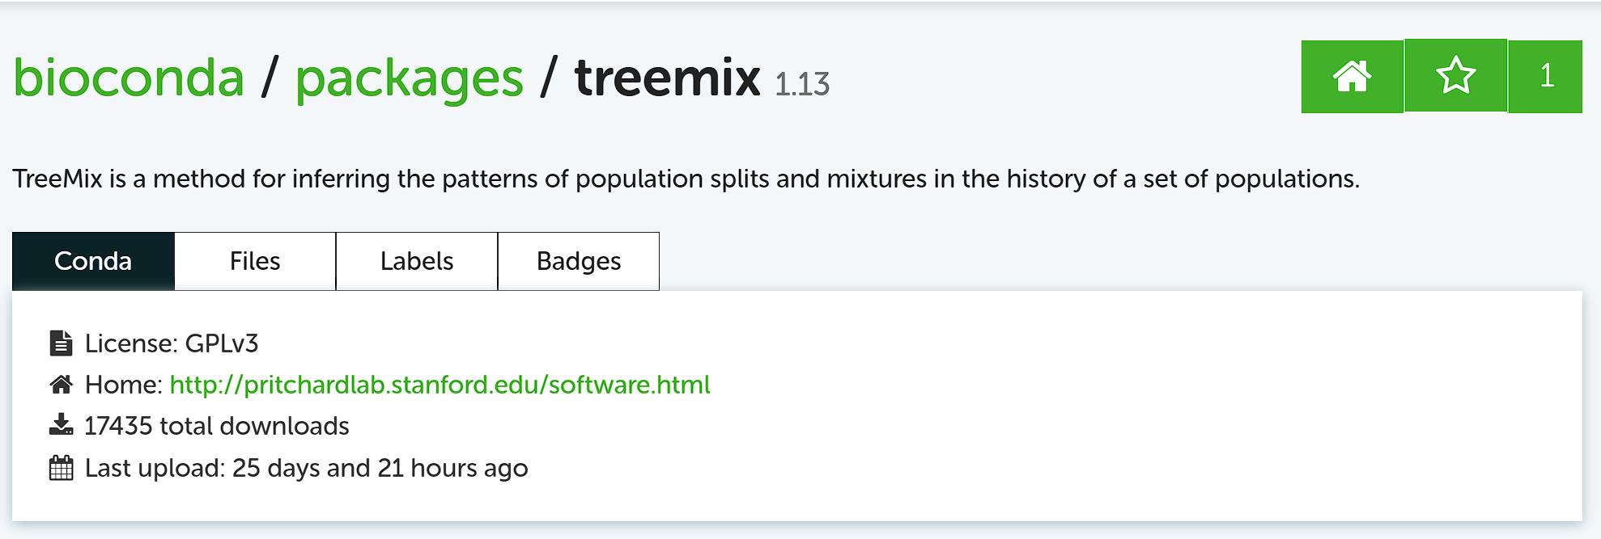

Slide 3
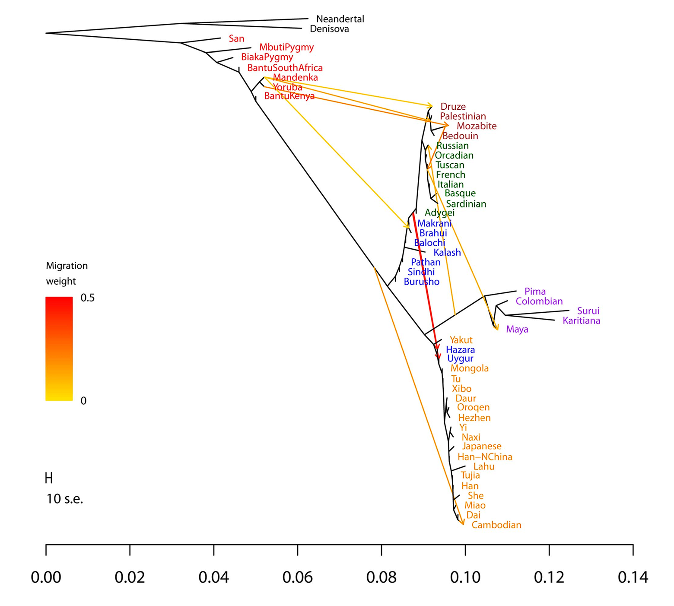
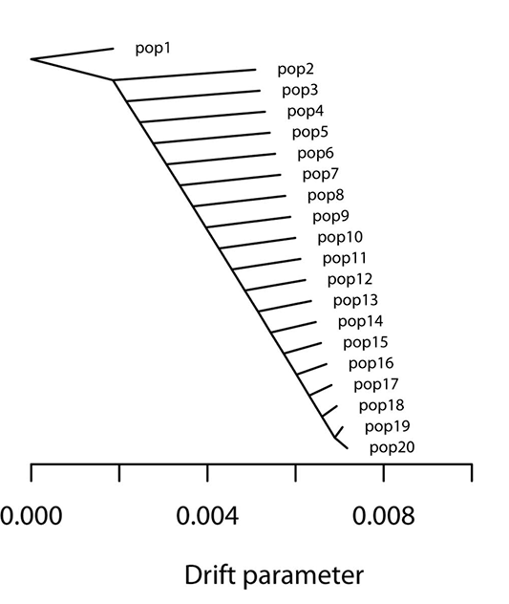
How Treemix works:
SNP data
allele frequency
Real value
ML tree
If R.V < Est.V
Gene flow exist
ML Tree topology
Estimate value

Slide 4
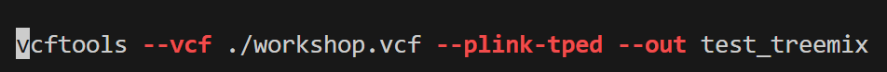
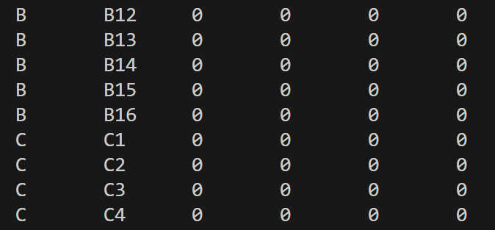
Let's practice!
Step 1: cd /mnt/HJT_TREEMIX/
Vcf data to tped/tfam
Family ID
Idv. ID
Father Info.
Mother Info.
Sex Info.
Phenotype Info.

Slide 5
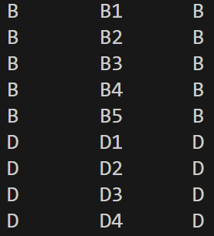
Step 2: Edit pop.cov

Slide 6
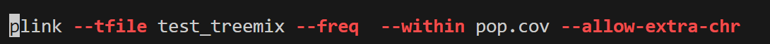
Step 3: Calculate allele frequency
Important for non-human sample
gzip

Slide 7
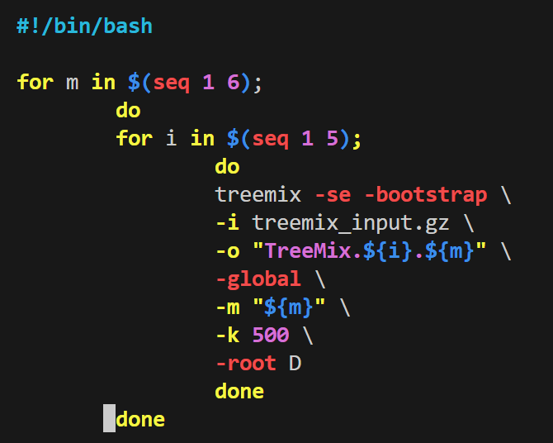
Step 4: generate input file for Treemix
Step 5: run Treemix

Slide 8
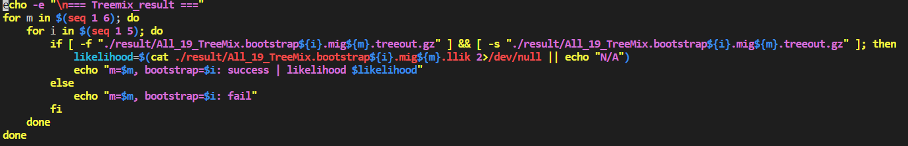
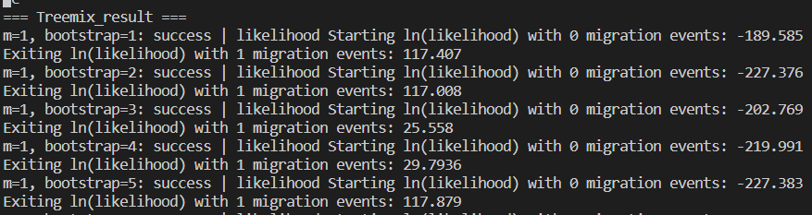
Step 6: check result

Slide 9
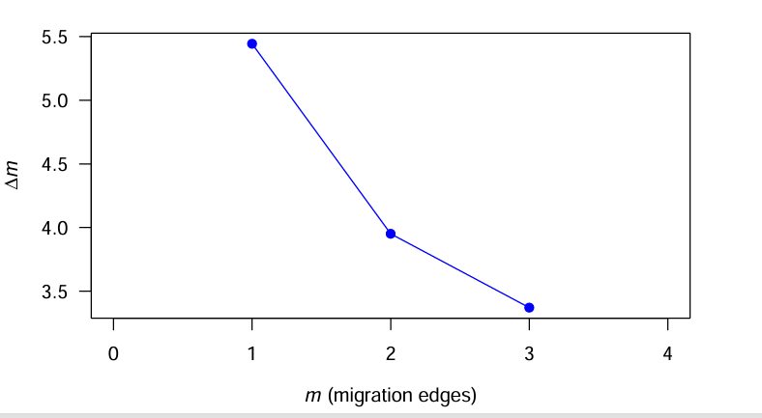
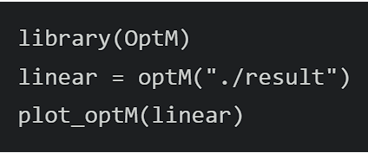
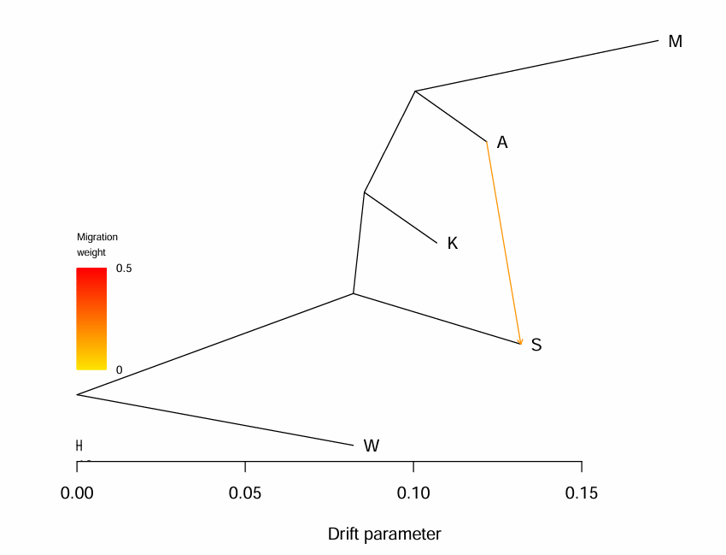
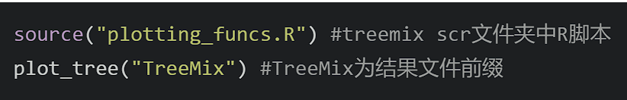
Step 7: find the best m & visualize

