Slide 1
Chapter 16 – The Fishes, Part II
Osteichthyes

Slide 2
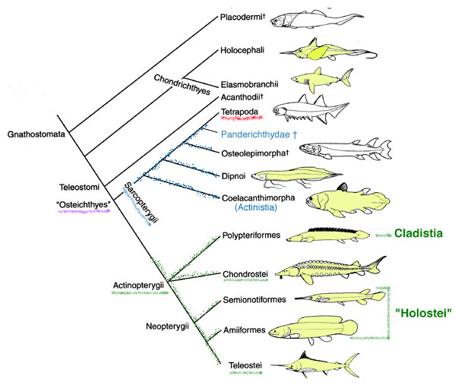
Gnathostome Phylogeny

Slide 3
Osteichthyes: Bony Fishes
Lineage of fishes with bony endoskeletons contains 96% of living fishes and all living tetrapods
3 features unite bony fishes and tetrapod descendants
  Endochondral bone replaces cartilage during development
  Lung or swim bladder is present
    Evolved as an extension of gut
  Have several cranial and dental characters unique to clade

Slide 4
Diversity
  Common ancestor of fishes is also an ancestor of land vertebrates
  Approximately 24,600 living species; mostly bony fishes
    Include more species than all other vertebrates combined
  Adapted to live in medium 800 times denser than air
  Can adjust to the salt and water balance of their environment

Slide 5
Diversity
Gills are efficient at extracting oxygen from water that has 1/20 the oxygen of air
Lateral line system detects water currents and vibrations, a sense of “distant touch”
The aquatic environment has shaped and constrained evolution – myriad adaptations

Slide 6
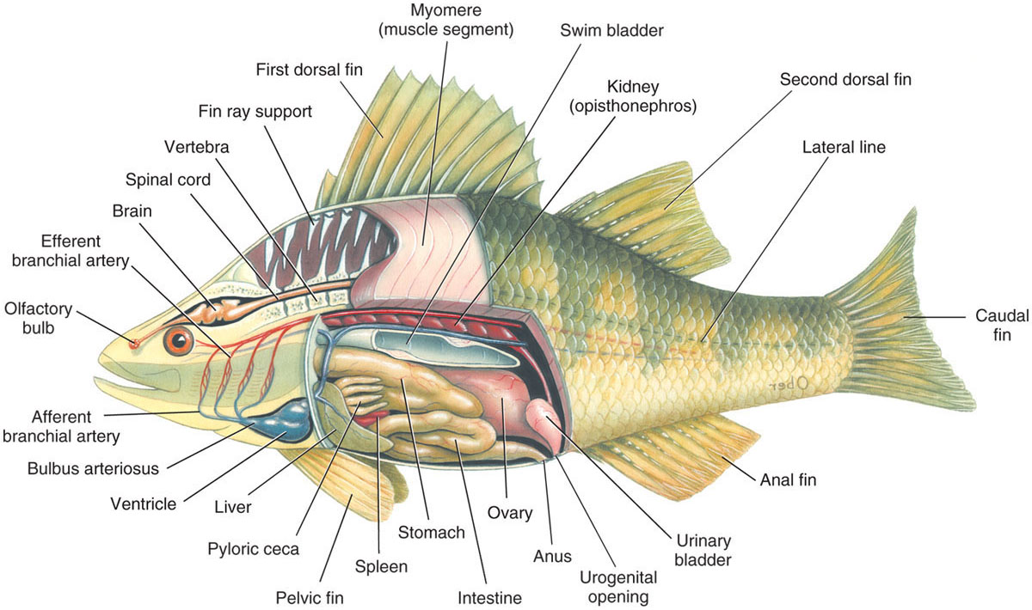

Slide 7
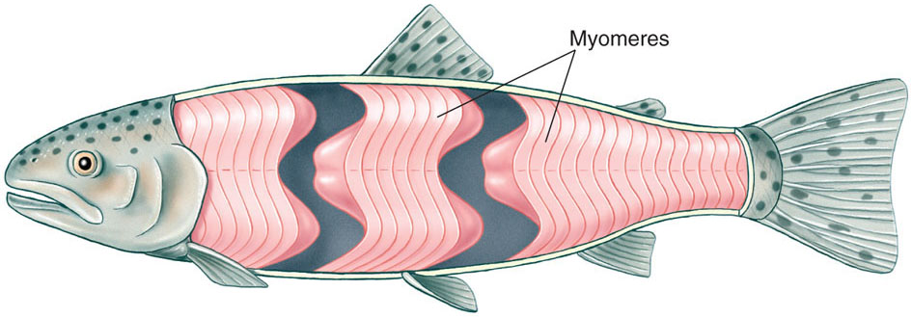
Locomotion in Water
Speed
  Most fishes swim maximally at ten body lengths / second
    Larger fish therefore swims faster
  Short bursts of speed are possible for a few seconds
Mechanism
  Trunk and tail musculature propels a fish
  Muscles are arranged in zigzag bands called myomeres
    Have the shape of a W on the side of fish
    Internally the bands are folded and nested
    Each myomere pulls on several vertebrae

Slide 8
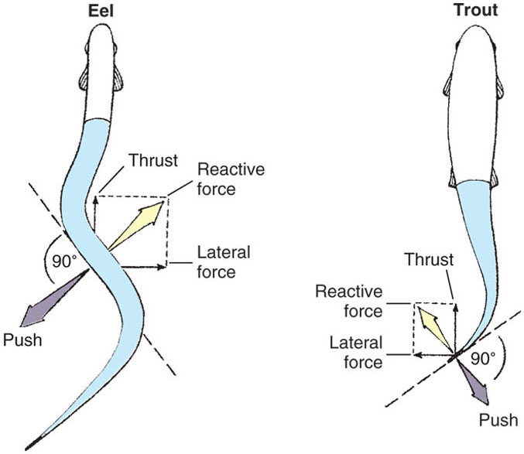

Slide 9
张艺卓_types of locomotion in fishes

Slide 10


Slide 11
Neutral Buoyancy and the Swim Bladder
Fish are slightly heavier than water
To keep from sinking, a shark must continually move forward
  Fins keep it “angled up”
Shark liver has a special fatty hydrocarbon, or squaline, that acts to keep the shark a little buoyant
Swim bladder, as a gas-filled space, is the most efficient flotation device

Slide 12
孙萧涵_How does fish keep their neutral buoyancy?

Slide 13
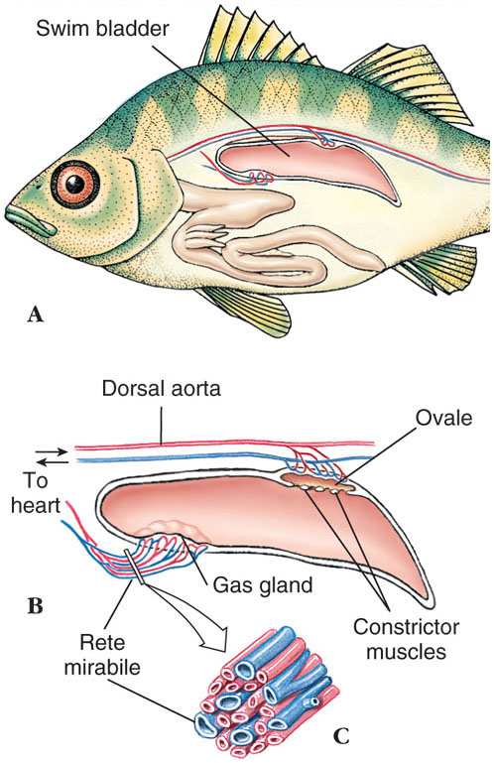
Swim bladder arose from paired lungs of primitive bony fishes
  Absent in tunas, some abyssal fishes, and most bottom dwellers
  Fish controls depth by adjusting volume of gas in swim bladder
  Due to pressure, as a fish descends, the bladder is compressed making the total density of the fish greater
  As a fish ascends, the bladder expands making the fish lighter and it will rise ever faster

Slide 14
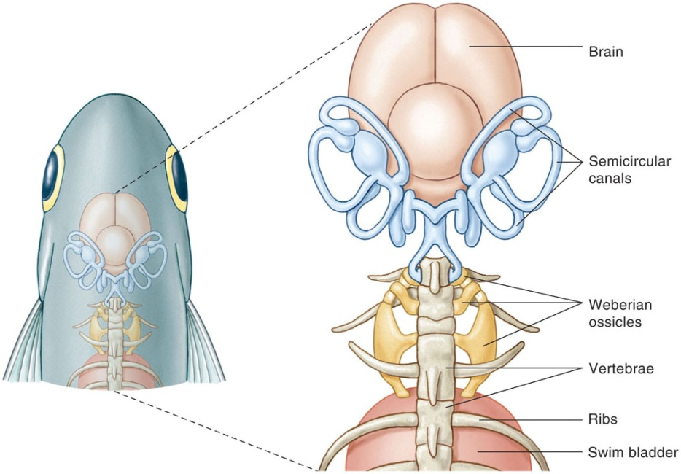
Hearing and Weberian Ossicles
Fish, like other vertebrates, detect sounds as vibrations in the inner ear.
A teleost group, ostariophysans
  Possess Weberian ossicles
    Allow them to hear faint sounds over a much broader range than other teleosts

Slide 15
陈坤仪_Weberian occicles

Slide 16
Types of fish respiration

Slide 17
Respiration
Fish gills are filaments with thin membranes folded into plate-like lamellae
Gills are inside the pharyngeal cavity and covered with a movable flap, the operculum
Operculum protects delicate gill filaments and streamlines body
Pumping action by operculum helps move water through gills

Slide 18
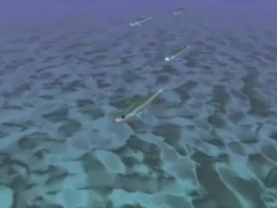
Buccal pumping

Slide 19
Buccal pumping
  Carp, eel, tilapia
Some active fishes use ram ventilation
  Tuna, lemmon shark
  Forward movement is sufficient to force water across gills
  Such fishes are asphyxiated in a restrictive aquarium even if the water is saturated with oxygen

Slide 20
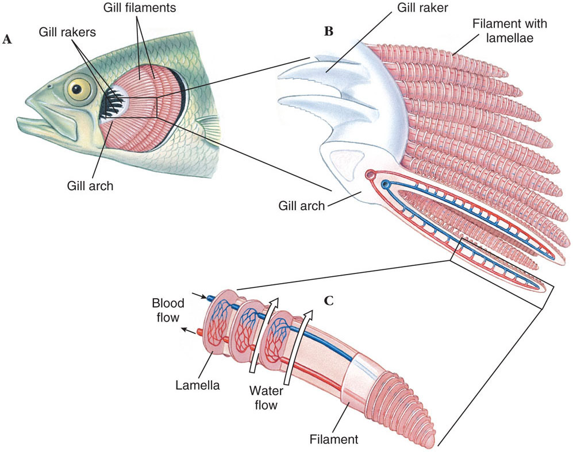

Slide 21
杨霖青_Countercurrent exchange

Slide 22
Water flow is opposite to the blood flow
  Countercurrent exchange maximizes exchange of gases
Some bony fishes remove 85% of the oxygen from water passing over gills

Slide 23
Fishes Out of Water
  Lungs of lungfishes allow them to respire in air
  Eels can wriggle over land during rainy weather
    Use skin as major respiratory surface
  A bowfin uses gills at cooler temperatures and lung-like swim bladder at higher temperatures
  Electric eel has degenerate gills and gulps air through vascular mouth cavity
  Indian climbing perch spends most of its time on land, breathing air in special chambers

Slide 25
Feeding Behavior
Fish devote most of their time searching for food to eat and eating
With the evolution of jaws
  Fish left a passive filter-feeding life and entered a predator-prey battle
Most fish are carnivores
  Feed on zooplankton, insect larvae, and other aquatic animals
Most fish do not chew food
  Would block water flow across the gills

Slide 26
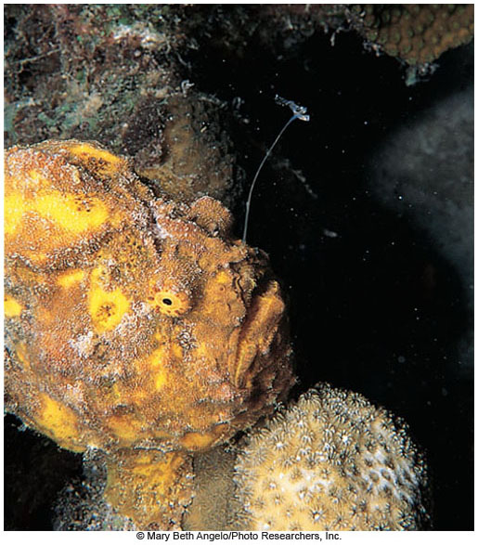

Slide 28
Many plankton feeders swim in large schools and using gill rakers to strain food
Omnivores feed on both plants and animals
Scavengers feed on organic debris
Detritovores consume fine particulate organic matter
Parasitic fishes suck body fluids of other fishes

Slide 29
李欣欣_Carnivorous/herbivorous/… and examples in fishes

Slide 30
Intestine tends to be shorter in carnivores and long and coiled in herbivores
Stomach primarily stores food
Intestine digests and absorbs nutrients
Teleost fishes have pyloric ceca
  Apparently for fat absorption

Slide 31
Fish reproductive migration

Slide 32
Reproduction
some fish undergo reproductive migrations
  eels are catadromous
    live in streams, go to sea to spawn
  Salmon, sturgeons are anadromous
    live in the sea, go upstream to spawn
  amphidromous fish
    rhinogobius

Slide 33
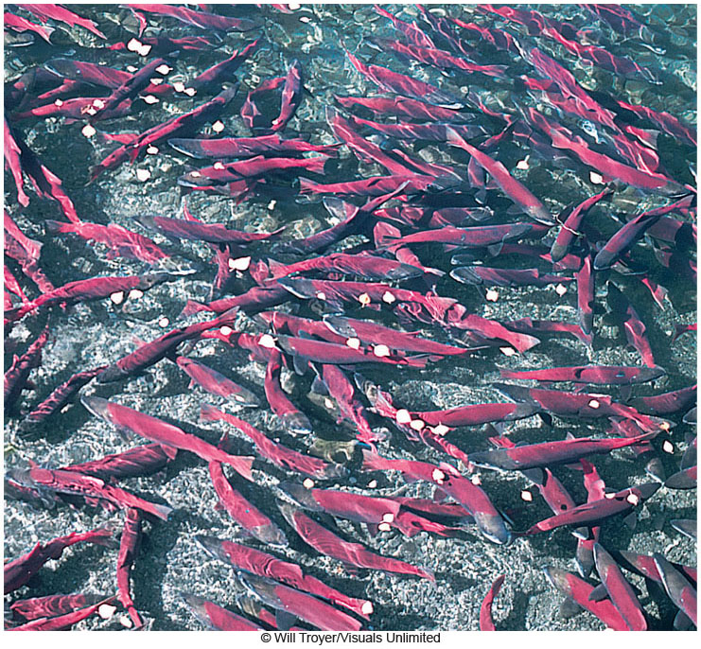
Homing Salmon
Salmon are anadromous
  Grow up in sea but return to freshwater to spawn
6 species of Pacific salmon and 1 Atlantic salmon migrates
Atlantic salmon makes repeated spawning runs
Pacific species spawn once and die

Slide 34
Fish reproduction

Slide 35
Quick Comments on Reproduction
Most fishes are dioecious with external fertilization and external development, but there is great variation…
Some sharks are viviparous with some kind of placental attachment to nourish young
Most oviparous pelagic fish lay huge numbers of eggs
  Female cod may release 4–6 million eggs
Some are territorial and guard eggs; others release into water column and leave (no parental care)
Some carry broods in their mouth
Many variations in morphology and behavior!

Slide 36
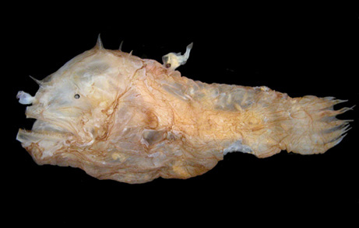
Reproductive variations
male (6 mm)
Female deep sea anglerfish

Slide 37
Osmoregulation
Chondrichthyes has high concentration of urea (up to 2.5%) and trimethylamine N-oxide (TMAO),
allowing them to be in osmotic balance with the seawater.

Slide 38
叶玉林_Osmoregulation in fishes

Slide 39
Osmoregulation
marine bony fish are hypoosmotic (less salty)
  to gain water, they absorb water through the stomach
  to dump salts, they secrete salts through the gills
freshwater bony fish are hyperosmotic (more salty)
  to dump water, they produce dilute urine
  to gain salts, they absorb salt from food and across gills

Slide 40
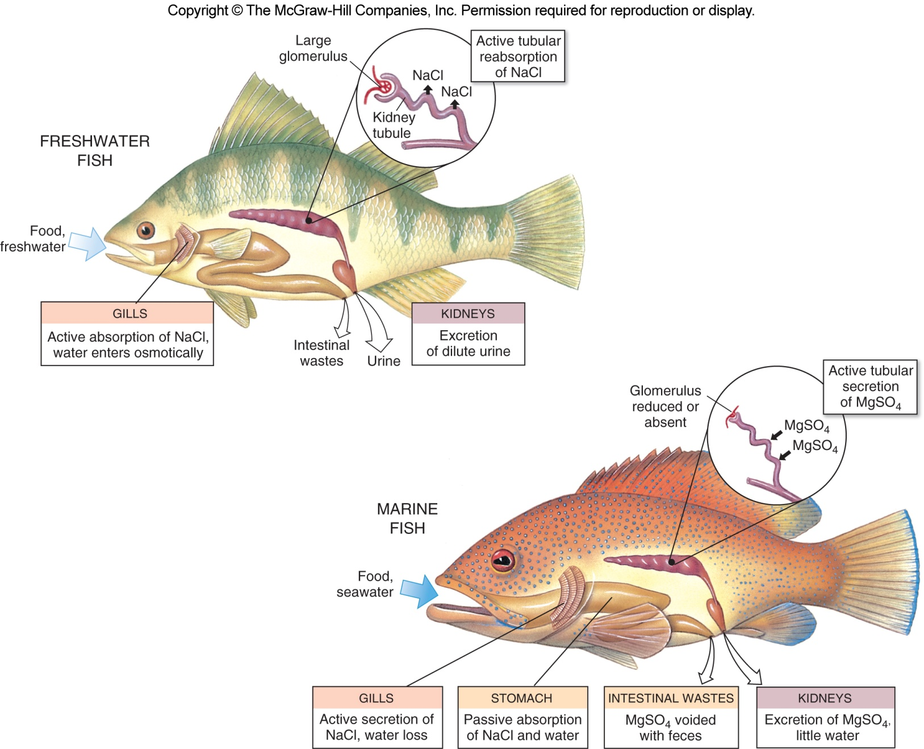

Slide 41
Osteichthyes: Bony Fishes
  2 major lineages
    Ray-finned fishes, class Actinopterygii, radiated to form modern bony fishes
    Lobe-finned fishes, class Sarcopterygii, include lungfishes and the coelacanth

Slide 42
Gnathostome Phylogeny

Slide 43
Gnathostome Phylogeny
Lobe-finned fishes.
Lungfishes + coelacanths = extant groups of Sarcopterygii, the group from which tetrapods diverged.

Slide 44
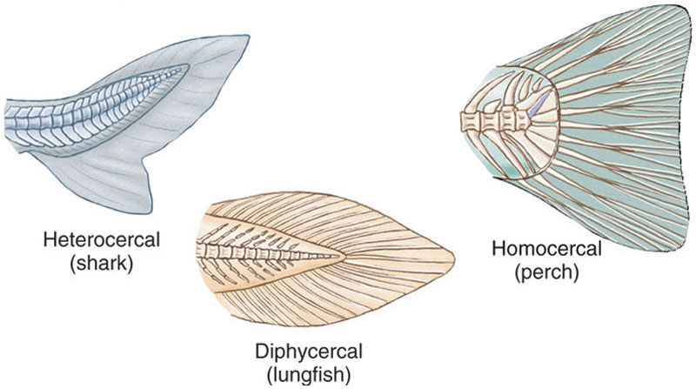
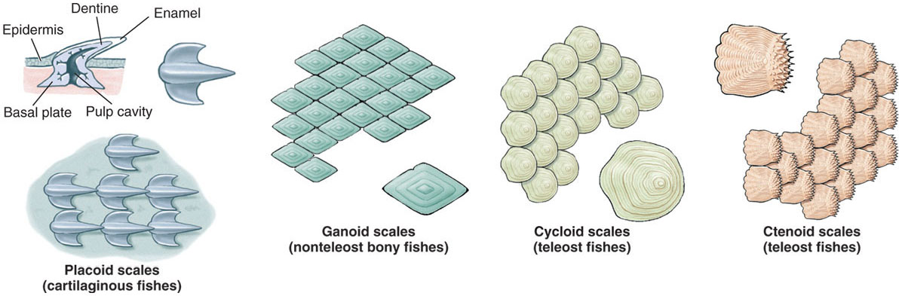
Class Sarcopterygii: Lobe-finned Fishes
Diversity
Ancestor of tetrapods
Today, clade is represented by 8 fish species
  6 species of lungfishes and 2 species of coelacanths
paired lobed fins

Slide 45
“Sarcopterygii”
the other main group of “bony fish”
low diversity; only eight living species
  two coelacanth species, six lungfish species
    coelacanths both deep marine, lungfish freshwater
characteristics of sarcopterygians
  have a central appendage in their fins that contains many bones and muscles
    fins are flexible and potentially useful for supporting the body
  possess a diphycercal tail

Slide 46
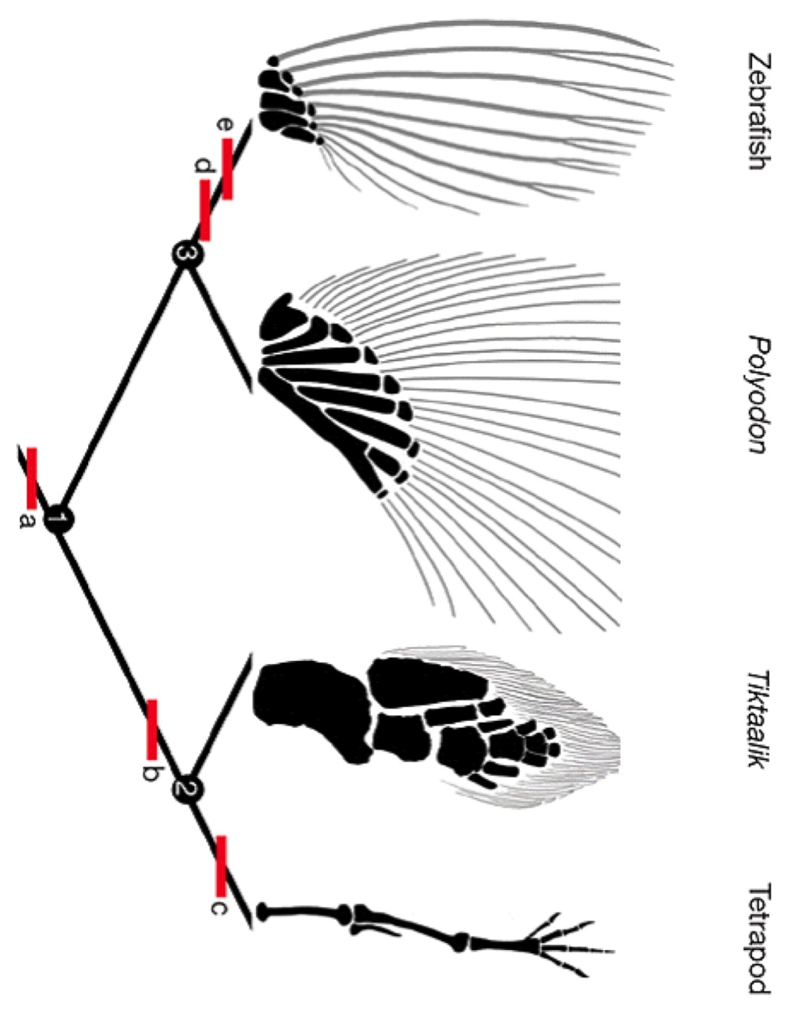
Actinopterygii
Sarcopterygii
Davis et al. 2007

Slide 47
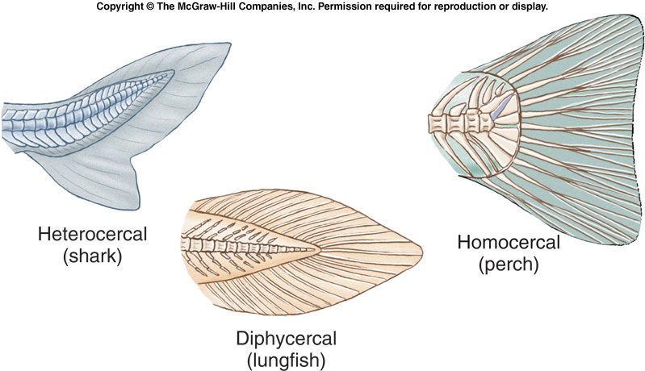
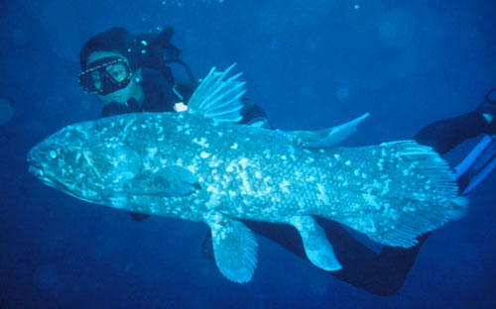
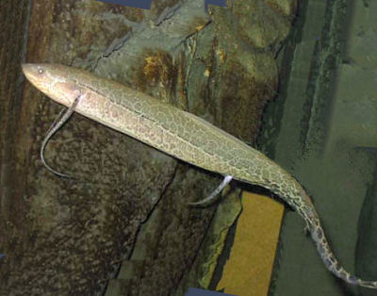
Fins and
Sarcopterygii
African leopard lungfish
coelacanth
(and primate)
lungfish: animal-world.com, coelacanth: itsnature.org
Notes:
http://www.youtube.com/watch?v=706FDbri2M4
http://www.youtube.com/watch?feature=player_detailpage&v=R6xj7LypeGY#t=26s

Slide 48
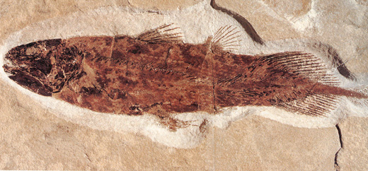
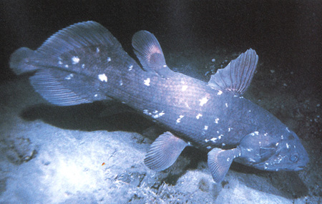
Actinistia: Coelacanths
Long thought to be extinct, rediscovered in 1938.
Distinguishing character = ossified swim bladder.
Other key character...
Long, muscular, “lobed” fins that move similarly to the limbs of tetrapods (ancestral character shared with lungfish).

Slide 49
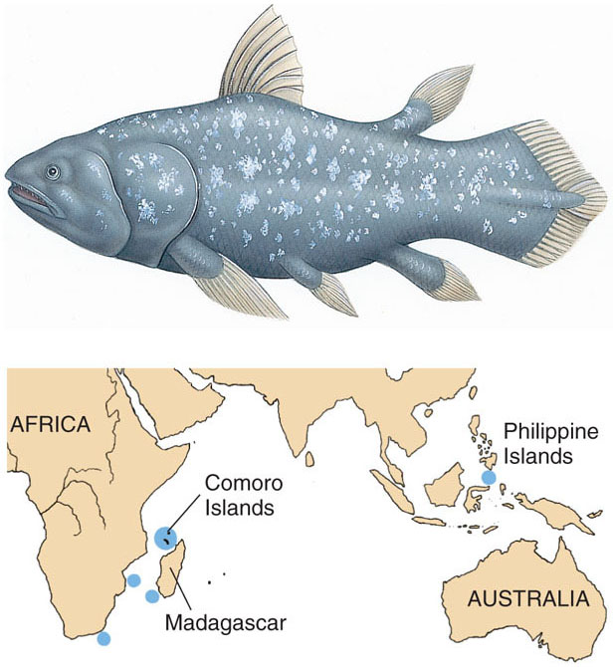

Slide 50
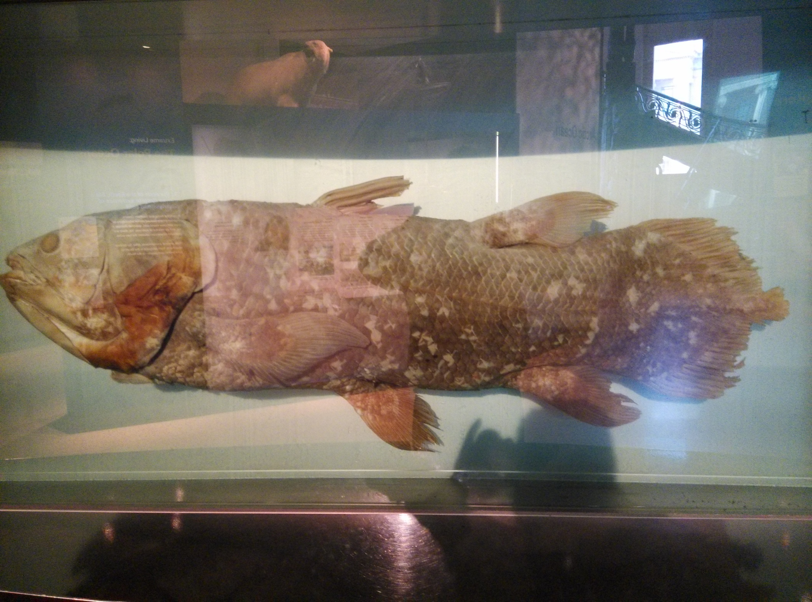

Slide 51
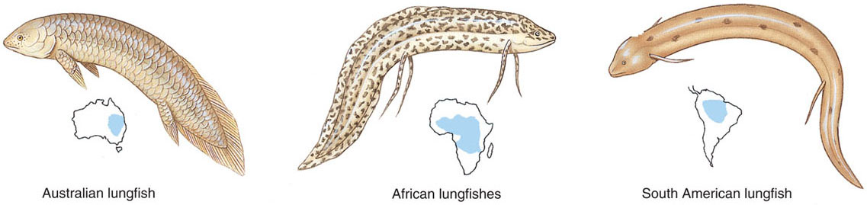
Class Sarcopterygii: Lobe-finned Fishes
Lungfish
  Australia lungfishes, unlike close relatives, rely on gill respiration and cannot survive long out of water
  South American and African lungfish can live out of water for long periods of time
    Share most recent common ancestry with tetrapods

Slide 52
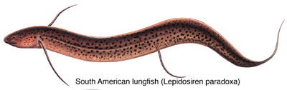
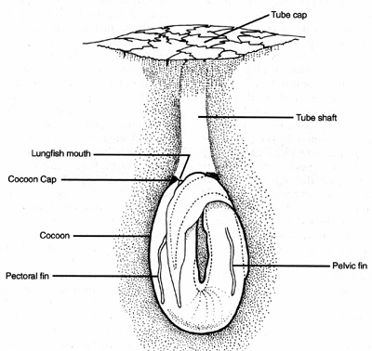
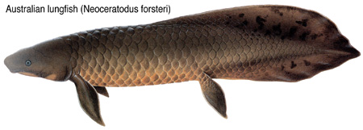
Dipnoi: Lungfish
Synapomorphies:
External nare forms an internal nostril.
South American and African lungfish aestivate deep within substrate during the dry season
Can survive out of water for a long time
Tetrapods are hypothesized to be the sister group to lungfish.
Other characters:

Slide 53


Slide 54
Actinopterygii: some primitive groups

Slide 55
Actinopterygii Diversity
possess lepidotrichia (fin rays)
  bony or horny spines that support the fins

Slide 56
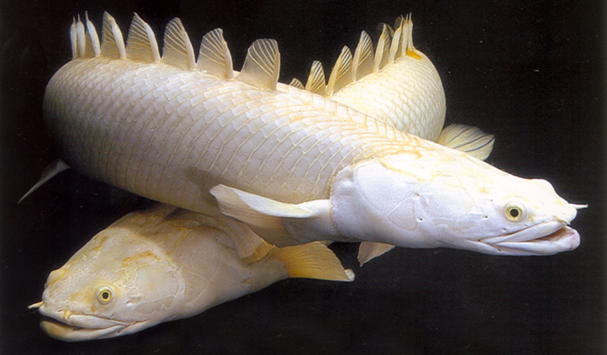
Polypteriformes: bichirs
Synapomorphy for this group:
dorsal finlets with spines.
Other characters:
lobed pectoral fins.
ganoid scales.

Slide 57
Actinopterygii: some primitive groups
Chondrostei

Slide 58
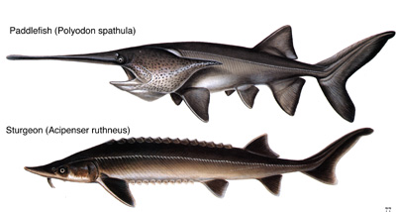
Chondrostei: sturgeons and paddlefish
Synapomorphy:
Endochondral bone absent (cartilagenous).
Other characters:
Heterocercal tail.
Bony scutes on sturgeon.
Gas bladder can be used for breathing.

Slide 59
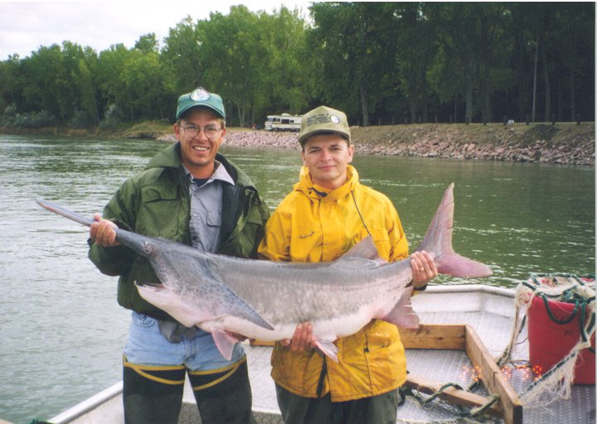
There are only two species of paddlefish (Polyodontidae) and one can be found in Wisconsin waters (largest population is in lower Chippewa River). The other is in China, probably extinct.
Tagging a 67 lb individual below Gavins Point Dam, NE.

Slide 60
Actinopterygii: some primitive groups
Semionotiformes

Slide 61
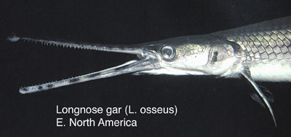
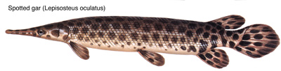
Semionotiformes: gars
Synapomorphy:
Elongated jaws.
Other characters:
ganoid scales.
morphology specialized for ambush
gas bladder still has respiratory function

Slide 62
Gnathostome Phylogeny
Amiiformes

Slide 63
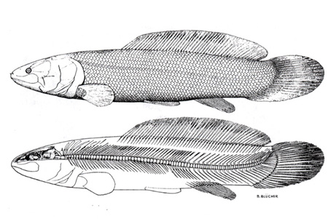
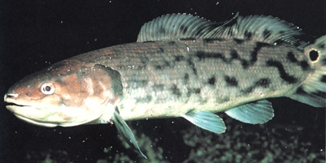
Amiiformes: bowfin
Synapomorphy(?):
Gular plate
Other characters:
cycloid scales
gas bladder can be used for breathing
amiiform swimmers (undulate dorsal fin to propel themselves)

Slide 64
Gnathostome Phylogeny
Teleostei

Slide 65
Class Actinopterygii: Ray-finned Fishes
Teleosts
  Constitute 96% of all living fishes and half of all vertebrates
  Range from 10 millimeters to 17 meters long, and up to 900 kilograms in weight
  Survive from 5,200 meters altitude in Tibet to 8,000 meters below the ocean surface
  Some can live in hot springs at 44º C while others survive under Antarctic ice at - 2º C
  Some live in salt concentrations three times seawater
  Others found swamps devoid of oxygen

Slide 66
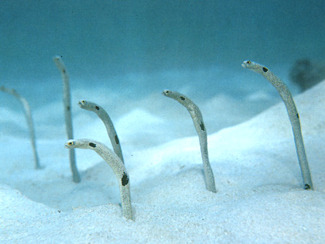
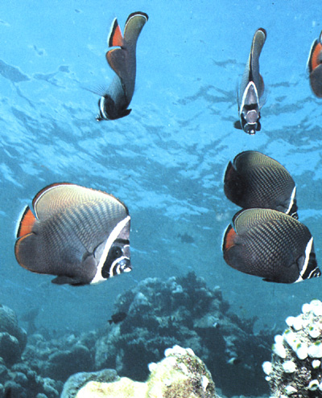
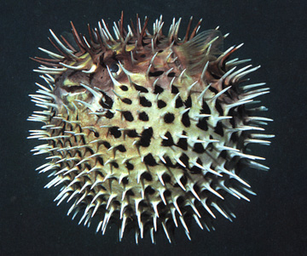
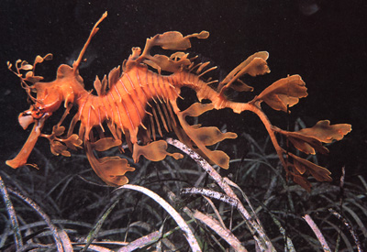
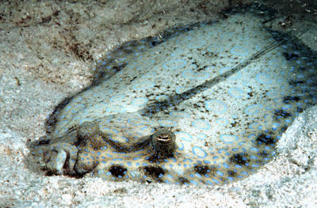
Teleostii: everything else
Synapomorphies:
Homocercal tail.
Premaxilla mobile (enables diverse feeding behaviors).
EXTREMELY DIVERSE GROUP! (>23,000 sp.)

