Slide 1
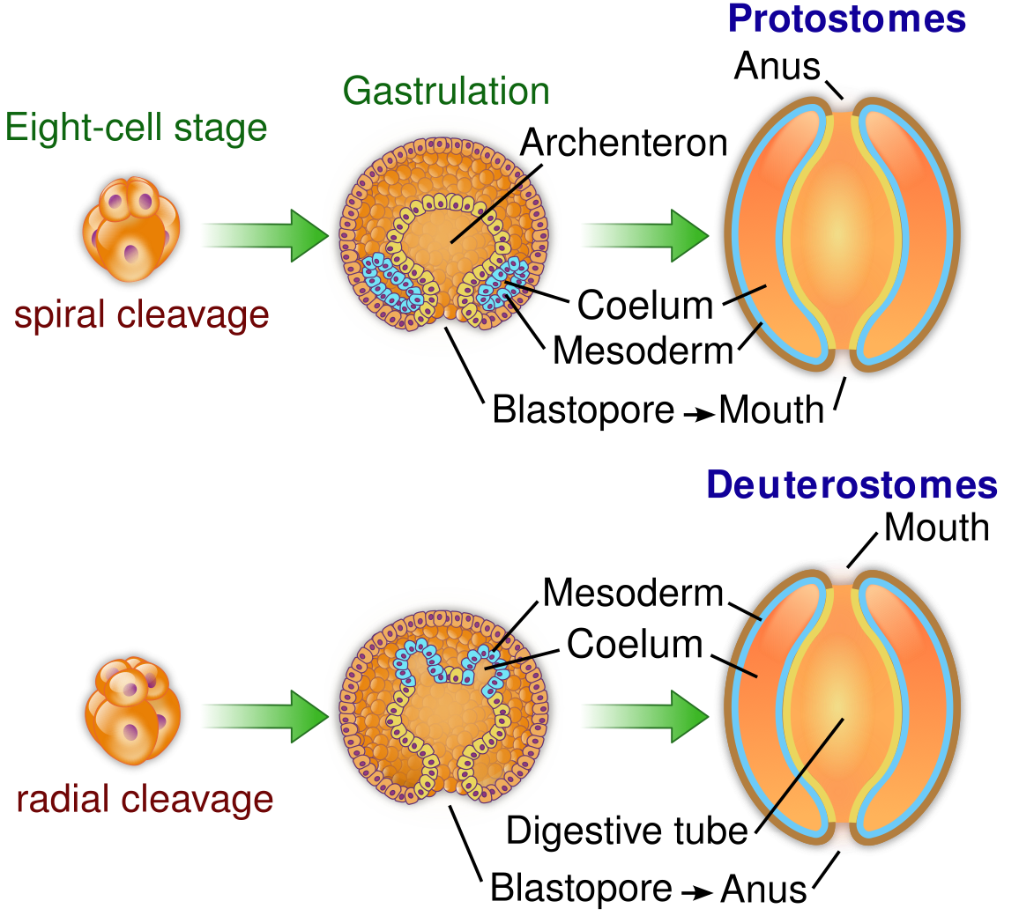

Slide 2
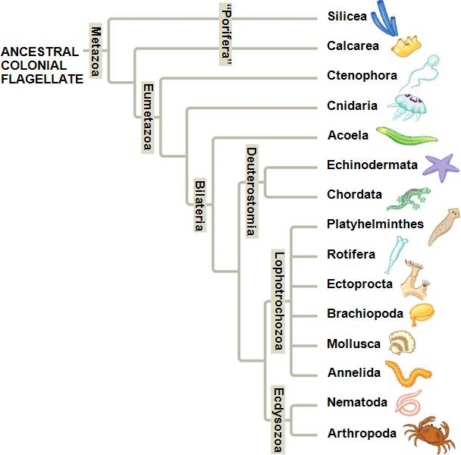
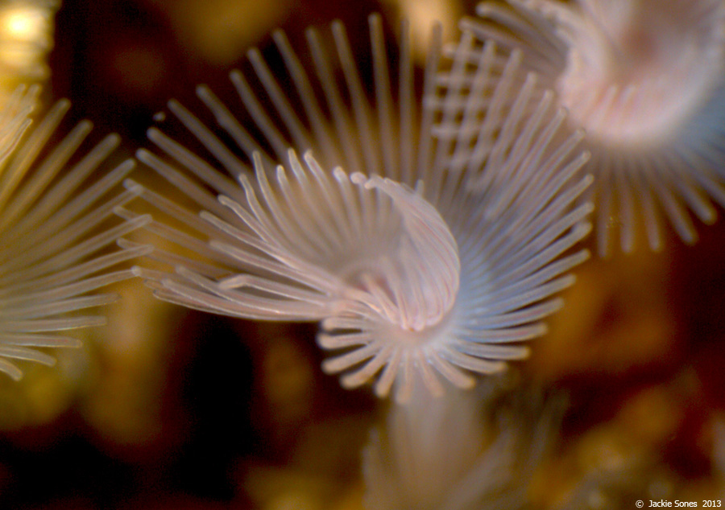
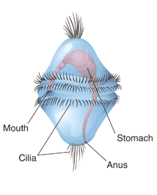
Protostomes, Lophotrochozoa, Part 1
lophophore
trochophore larva

Slide 3
Some Evolutionary Experiments
Three phyla:
Phoronida (帚虫动物门)
Ectoprocta (外肛动物门)/Bryozoa(苔藓动物)
Brachiopoda (腕足动物门)
possess a crown of cilated tentacle called a lophophore, Lophophore is used in food catching and respiration

Slide 4
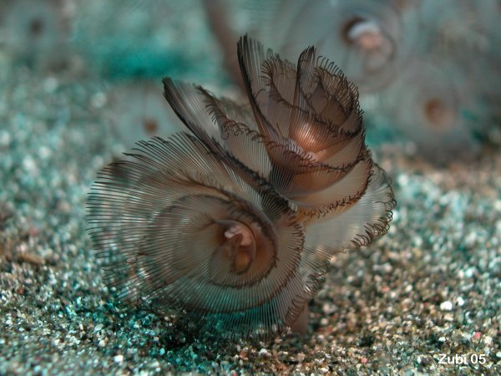
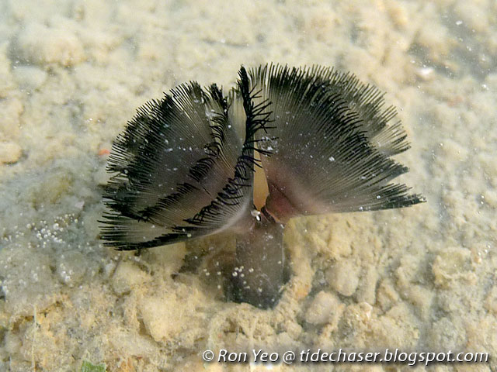
Phoronida
The Phoronida is one of the smallest and least familiar phyla; there are about twelve or so living species in two genera, Phoronis and Phoronopsis.
The mouth is surrounded by the ciliated feeding structure known as a lophophore

Slide 5
Phylum Ectoprocta
Ectoprocts
Approximately 4000 living species
Inhabit both freshwater and marine habitats
Most are colony builders
  Contains aquatic animals that often encrust firm surfaces such as shells, rock, large brown algae, mangrove roots, and ship bottoms
Some colonies form limy encrustations on seaweed, shells, and rocks: others form fuzzy or shrubby growths or erect branching colonies
Freshwater colonies may form finely branching stolons on the underside of plants or rocks

Slide 6
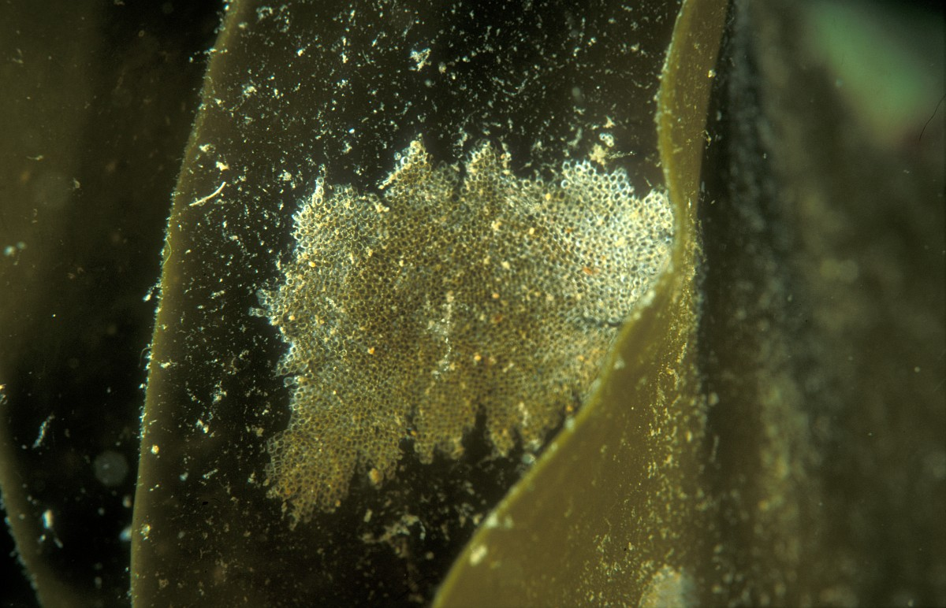
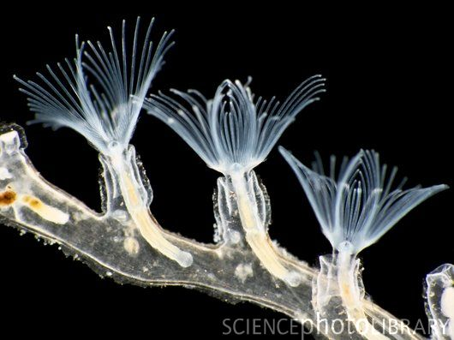
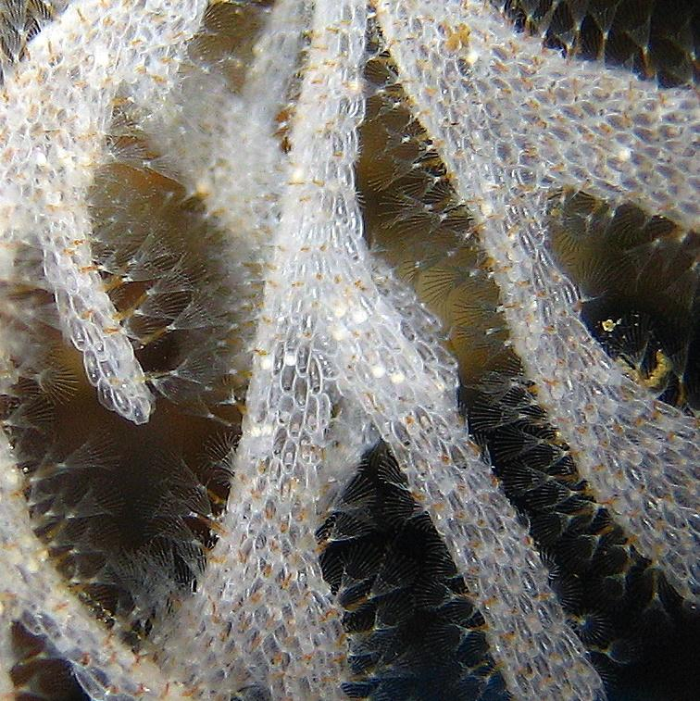
Ectoprocta (Bryozoa)

Slide 7
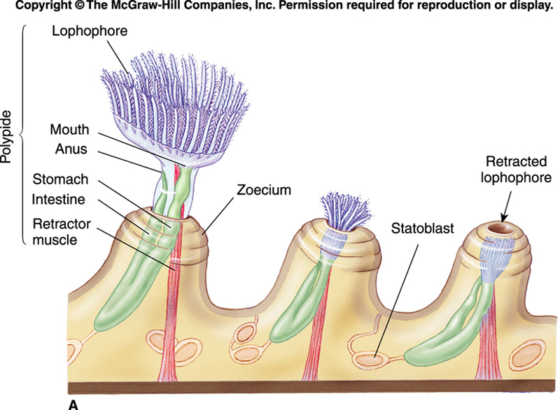
Figure 9_10

Slide 8
Phylum Brachiopoda, not confuse with Branchiopoda
Characteristics
Also called lamp shells
Ancient group
Approximately 300 living species
Fossil record indicates 30,000 species lived during Paleozoic and Mesozoic seas
Attached, bottom-dwelling, marine forms that inhabit mostly shallow water
Externally resemble bivalved mollusks
Have dorsal and ventral valves
Attach to substrate directly or by fleshy stalk, the pedicel

Slide 9
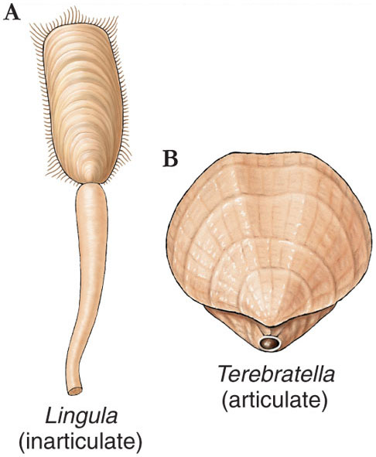

Slide 10
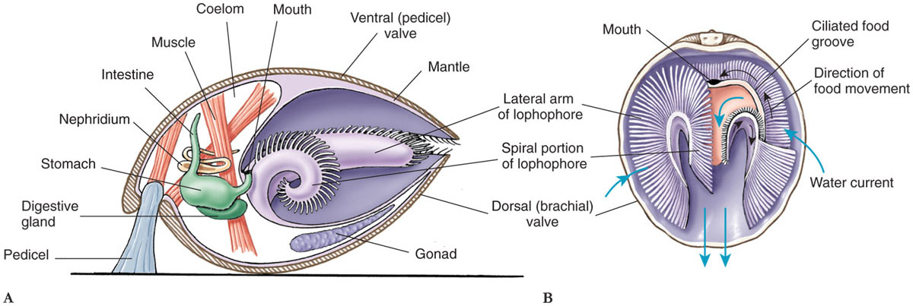

Slide 11
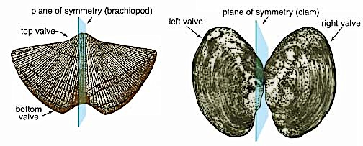
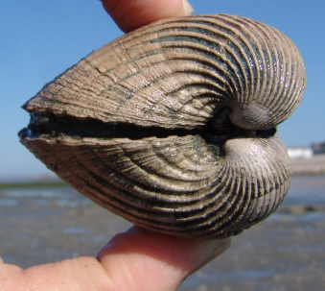
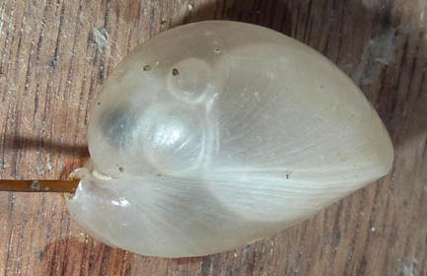
Bivalves versus brachiopods … how do I distinguish them?
http://www.faculty.biol.ttu.edu/rice/evolution/brach_biv.gif

Slide 12
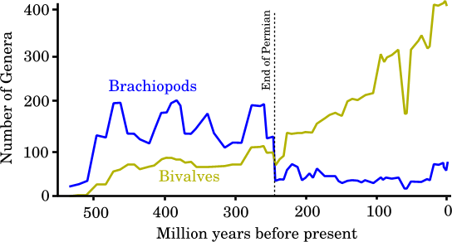

Slide 13
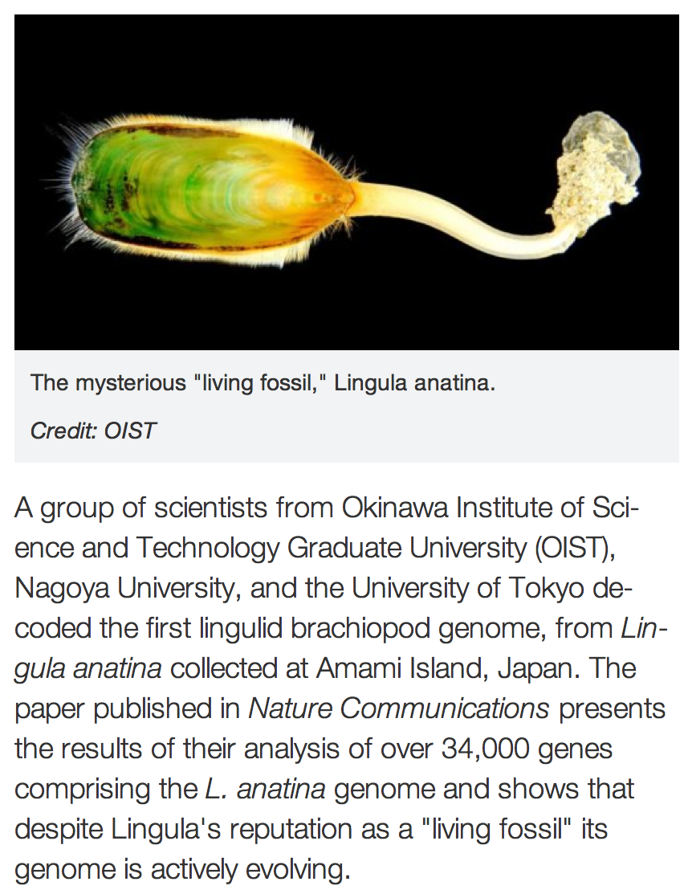
Brachiopods are one of the first known examples of animal biomineralisation -- a process whereby living organisms stiffen or harden tissues with minerals.
The earliest discovered brachiopod fossils date to the early Cambrian period, approximately 520 million years ago.

Slide 14
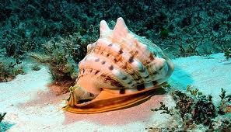
Mollusca
thehindu.com
www.en.wikipedia.org

Slide 15
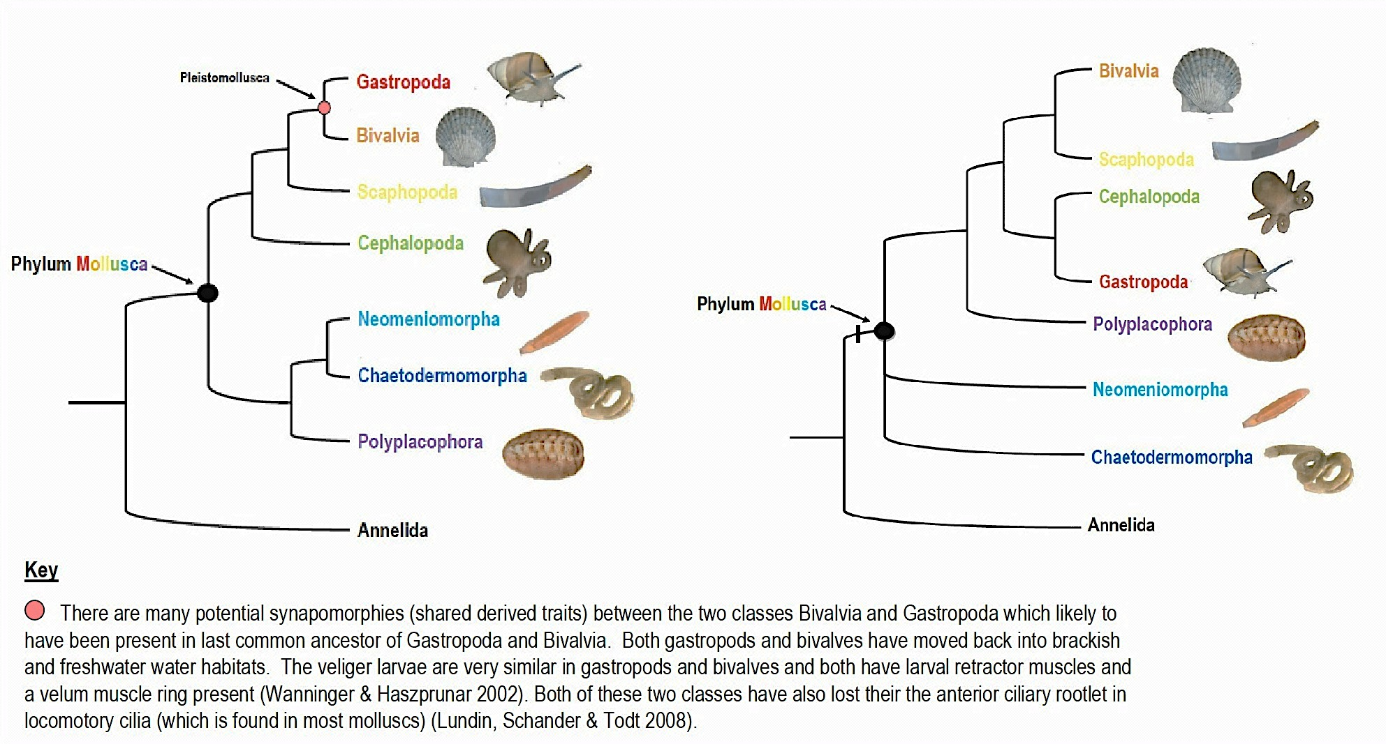
Current classification recognizes several molluscan lineages, relationships among which are in flux.
M. Strike & K. Jones, salinella.bio.uottawa.ca
www.gbri.org.au
Notes:
Blank slide for drafting a title slide.

Slide 16
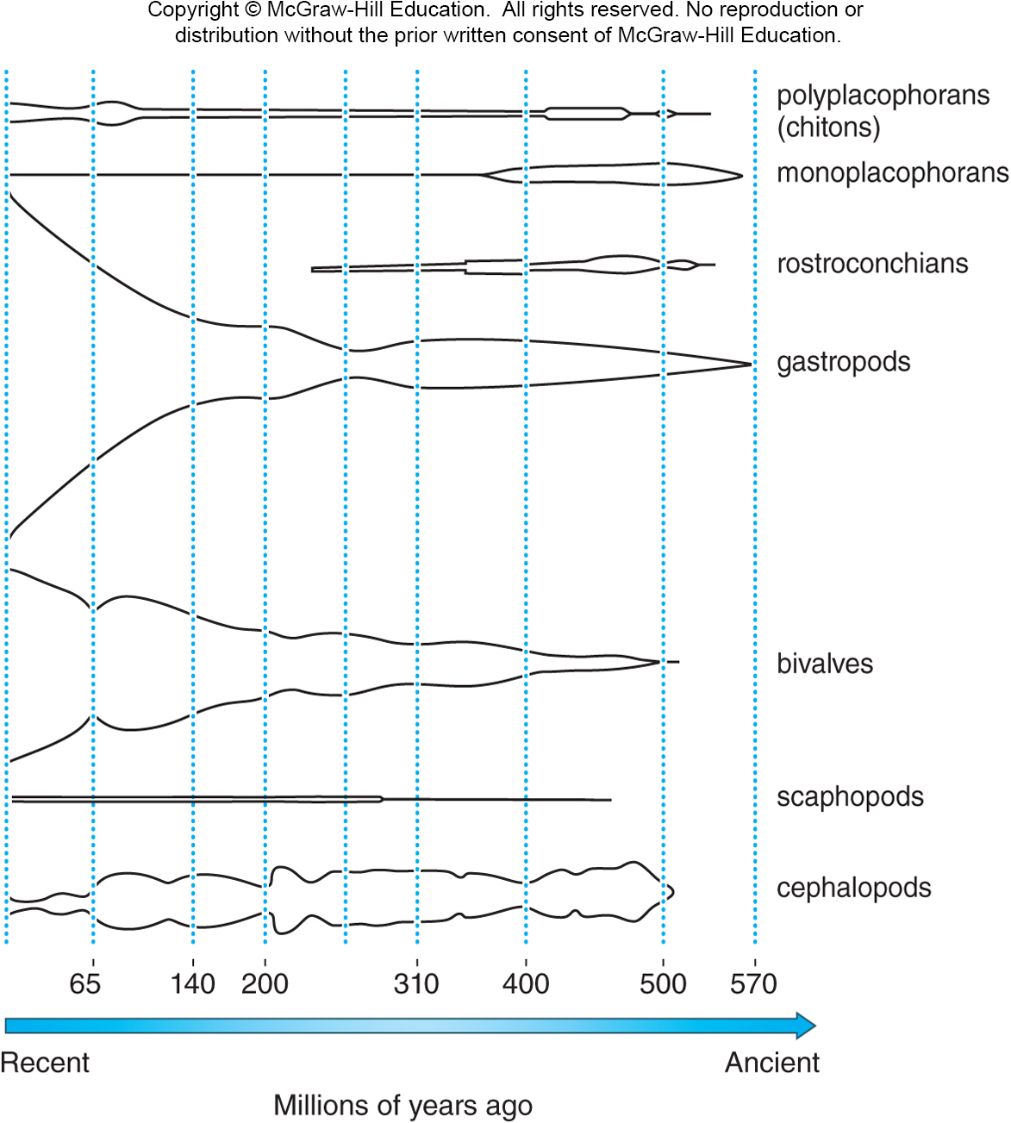
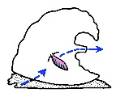
The molluscs are the second largest invertebrate phylum.
~200,000 species
extinct diversity >> extant diversity
~80% of species are gastropods
Yochelcionella, an early mollusc?
Helcionellid fossil
Author: Pilcha, Public Domain
Precambrian origin
Notes:
Blank slide for drafting a title slide.

Slide 17
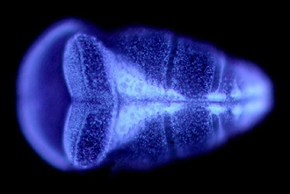
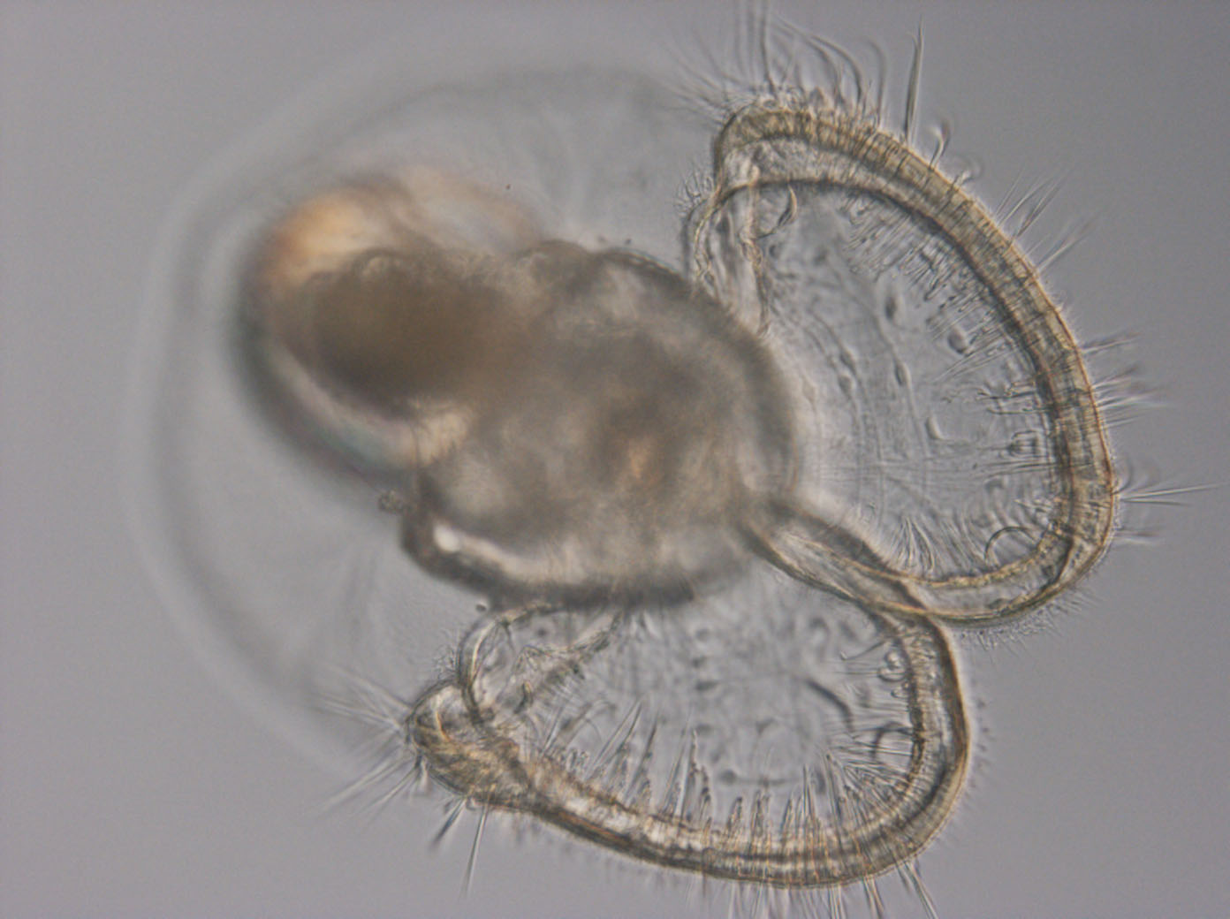
Molluscs are lophotrochozoans with trochophore larvae and many have a second [veliger] larval stage.
Trochophore
ciliated lobes
Veliger: shell and velum
www.invert-embryo.blogspot.com
www.bio.miami.edu.dana/160/160S11_15print.html
Notes:
Blank slide for drafting a title slide.

Slide 18
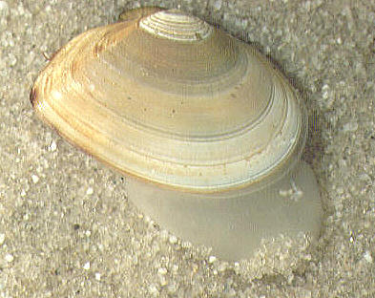
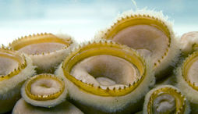
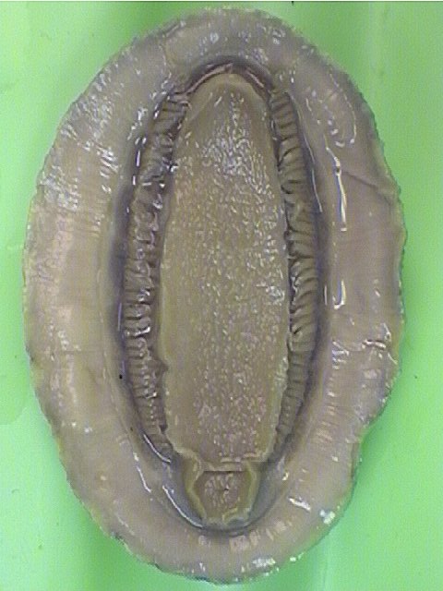
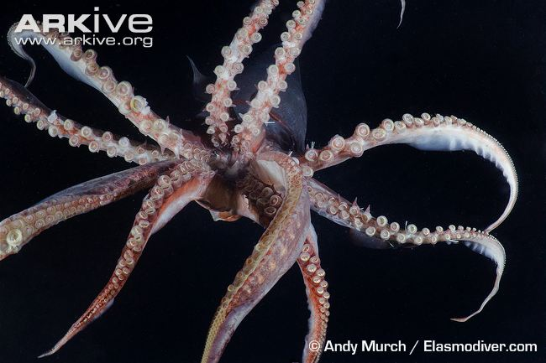
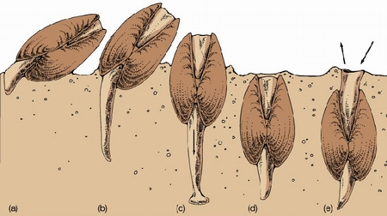
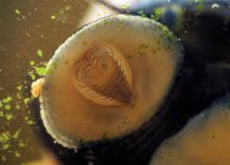
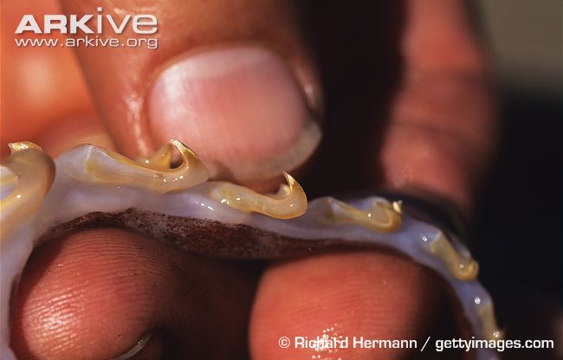
Disparity of the body plan is based on modifications of three body parts: foot, mantle, & radula.
www.research.amnh.org
Notes:
Blank slide for drafting a title slide.

Slide 19
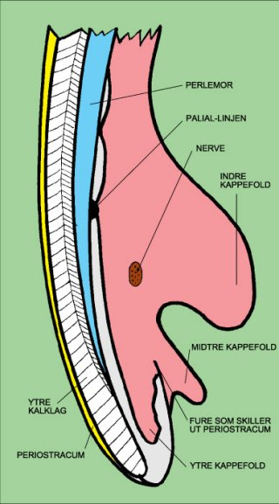
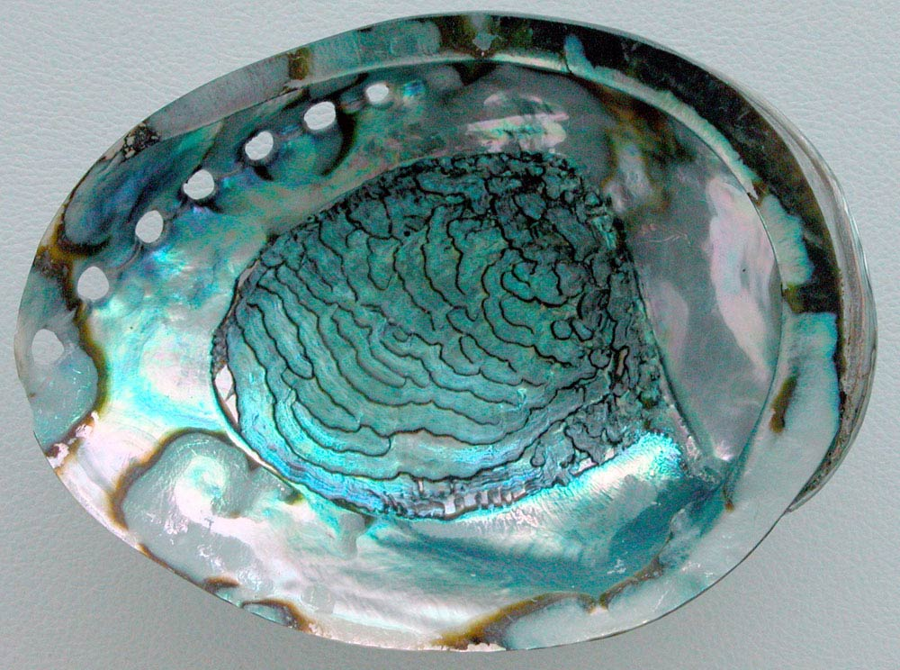
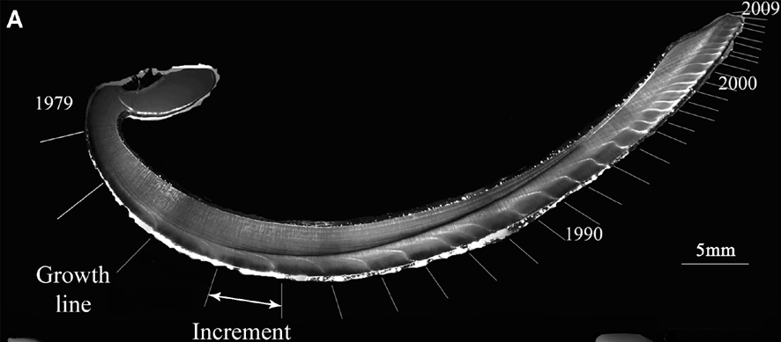
The mantle is derived from epithelium and secretes a calcium carbonate shell.
mother-of-pearl
periostracum
nacre
mantle
prismatic layer
Growth rings for aging
McNeill 1983
© J. Thebault
Notes:
Blank slide for drafting a title slide.

Slide 20
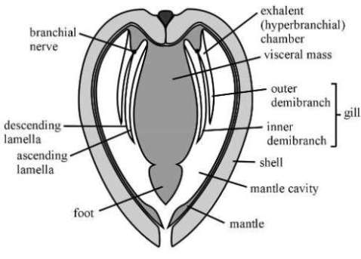
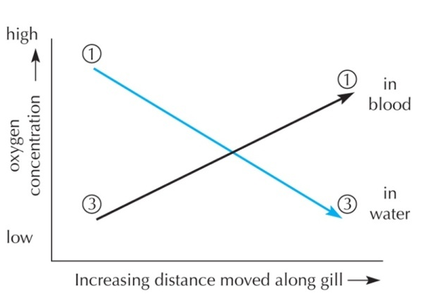
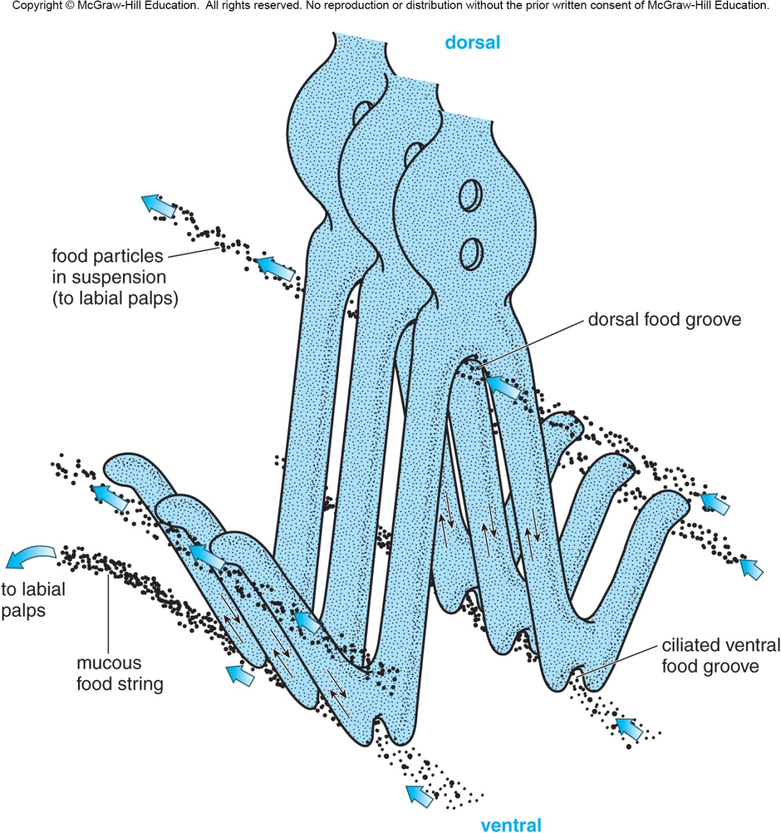
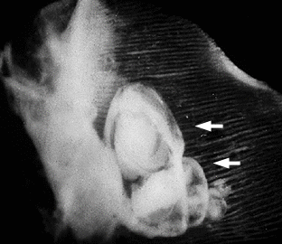
The mantle cavity is larger than the coelom and holds the gills [ctenidia].
Countercurrent flow of water and blood
Lamellibranch pattern
Brood pouch: marsupium
el.erdc.usace.army.mil
Notes:
Blank slide for drafting a title slide.

Slide 21
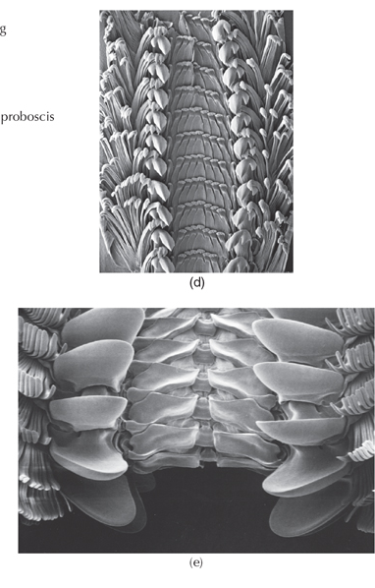
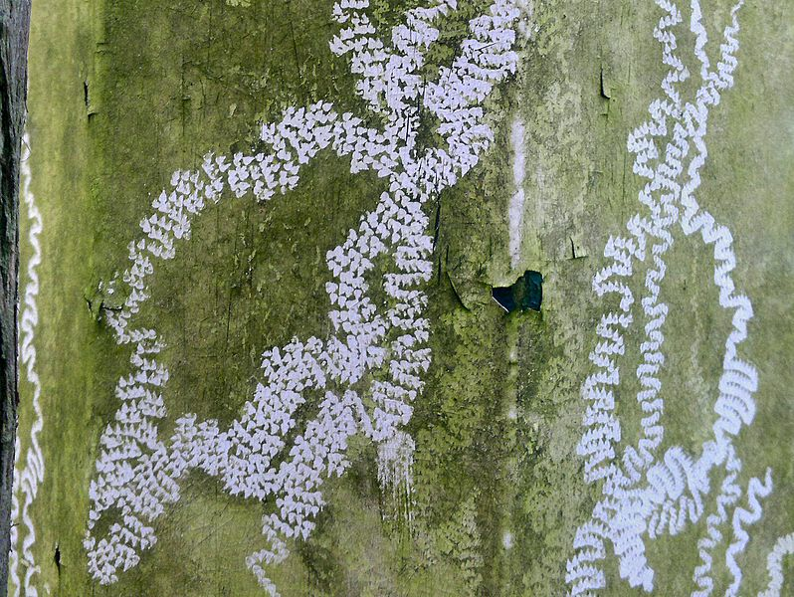
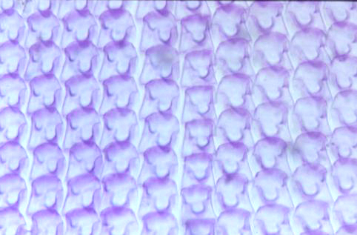
A radula [chitin and protein feeding structure] is unique to molluscs.
Teeth are replaced posteriorly
C. Chap. Wikimedia Commons
Cerion uva Linn Curacas WA Evans Dahlia in CB 13.2.32 AFP R4692/20 600228. AF
Notes:
Blank slide for drafting a title slide.

Slide 22
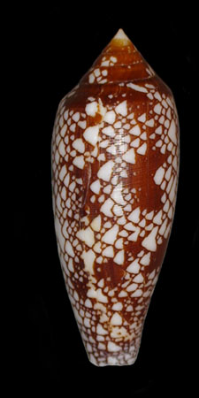
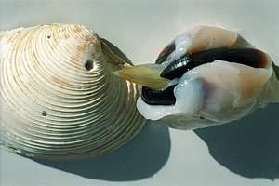
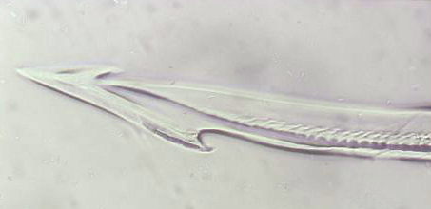
… and modified in various lineages.
Gastropoda: Injects poison with harpoon-like dart
Cephalopoda: Holds prey
Bivalvia: Absent
Conus
Conus aulicus Mahé Seychelles, xi.36 (x) Winckworth
GLJ 9.2.37 AFF R4692/18 600231. AF Piele Collection
http://www.seafriends.org.nz/indepth/octopus.htm
Notes:
Blank slide for drafting a title slide.

Slide 23
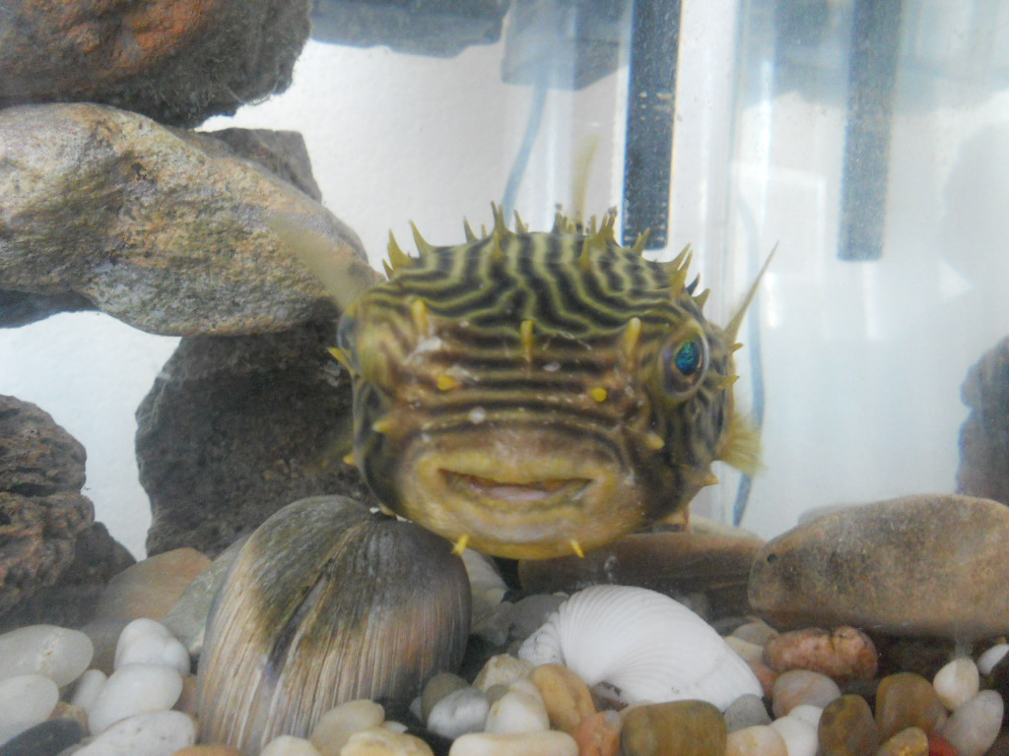

Slide 24
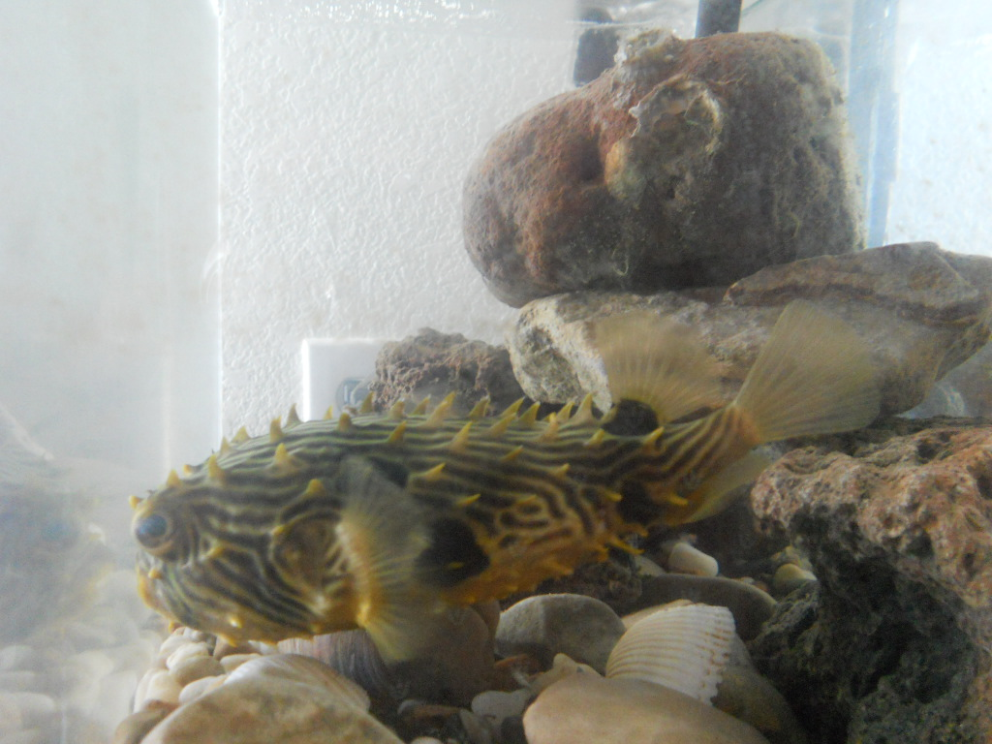

Slide 25
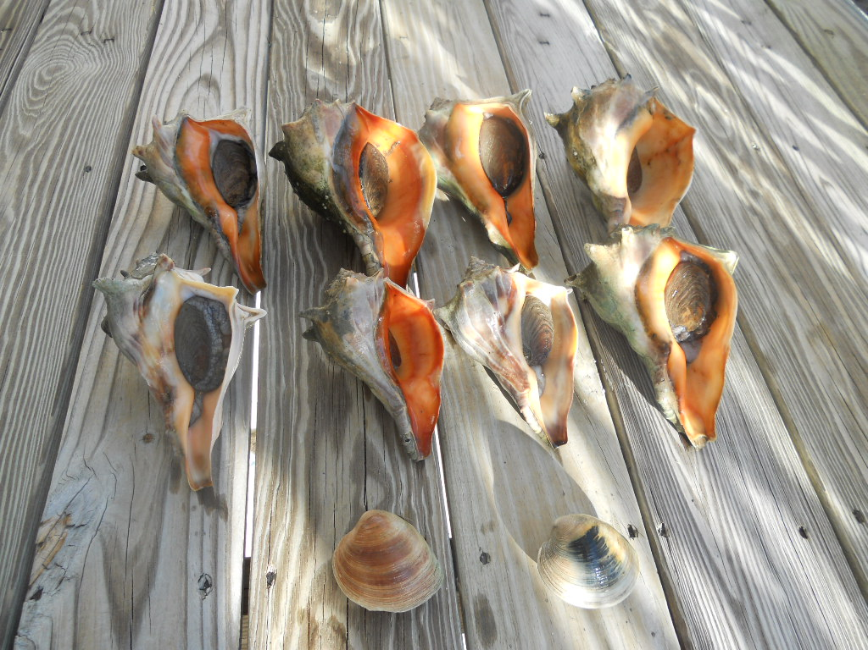
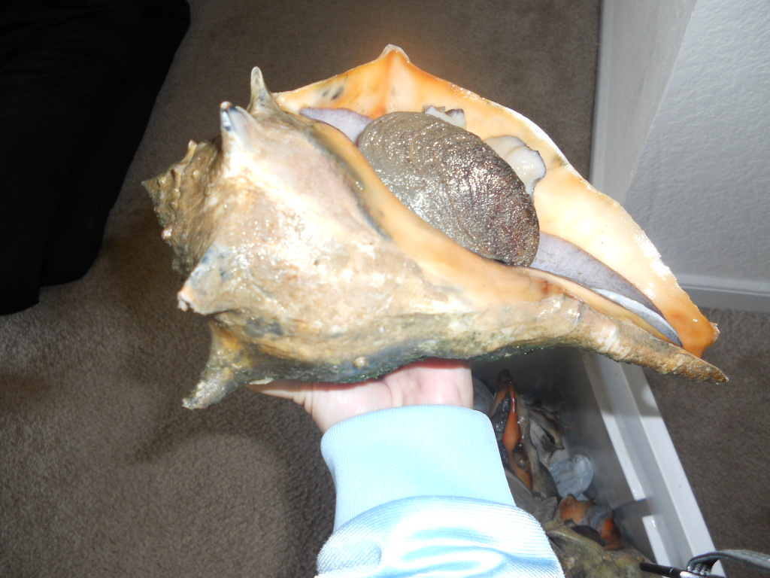

Slide 26
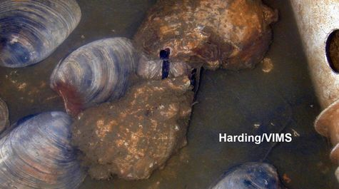

Slide 27
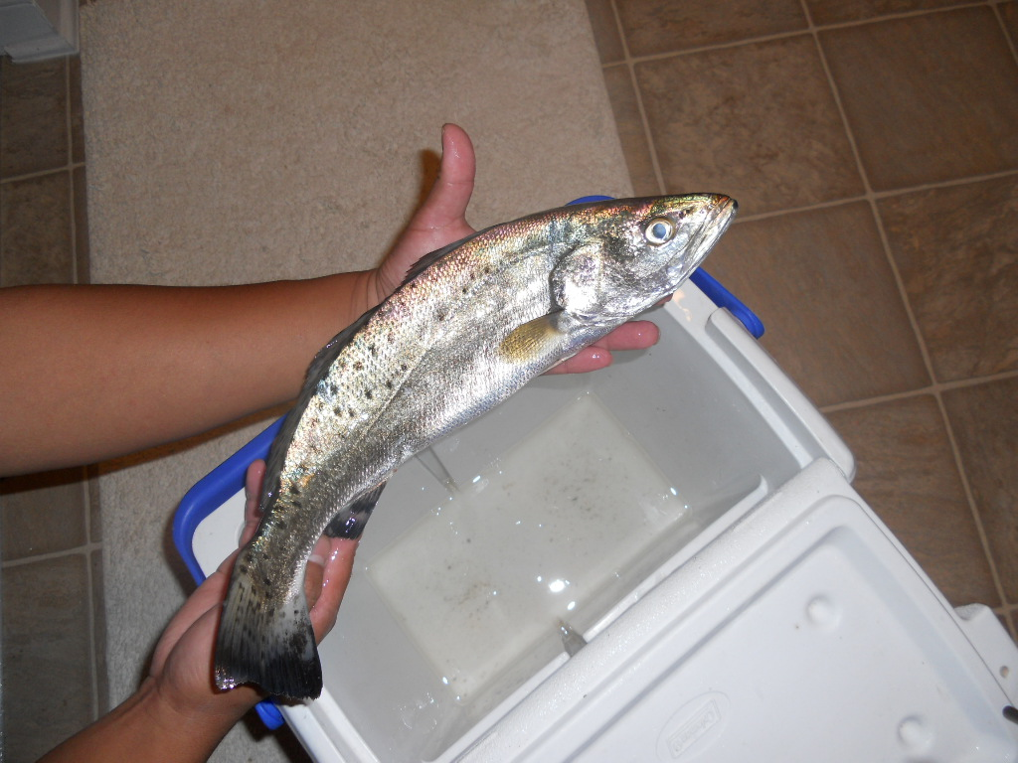
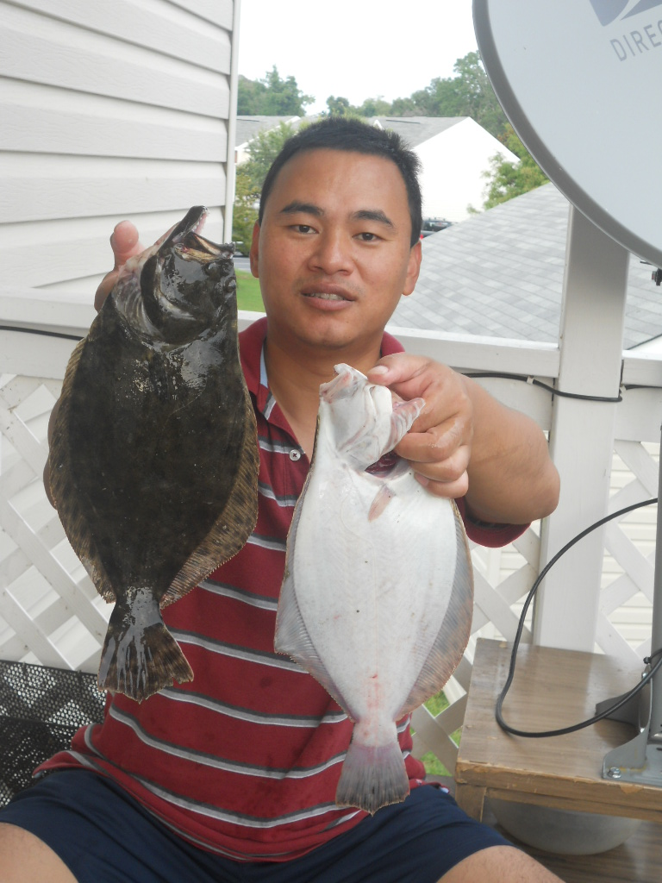

Slide 28




Slide 29



They have a head-foot and a visceral mass body regions.
www.research.amnh.org
Notes:
Blank slide for drafting a title slide.

Slide 30

The visceral mass supports digestive, circulatory, reproductive, and respiratory organ systems.
An open circulatory system bathes organs in blood.
2 fluid-filled cavities:
coelom
(reduced to heart, metanephridia, gonads)
hemocoel
(open circulatory & hydraulic systems)
Notes:
Blank slide for drafting a title slide.

Slide 31

The visceral mass supports digestive, circulatory, reproductive, and respiratory organ systems.
An open circulatory system bathes organs in blood.
Circulation in a bivalve & the heart.
Notes:
Blank slide for drafting a title slide.

Slide 32

Molluscs are triploblast, protostome, shizo-coelomates.
2 fluid-filled cavities:
coelom
(reduced to heart, metanephridia, gonads)
hemocoel
(open circulatory & hydraulic systems)
www.eplantscience.com
Notes:
Blank slide for drafting a title slide.

