Slide 1
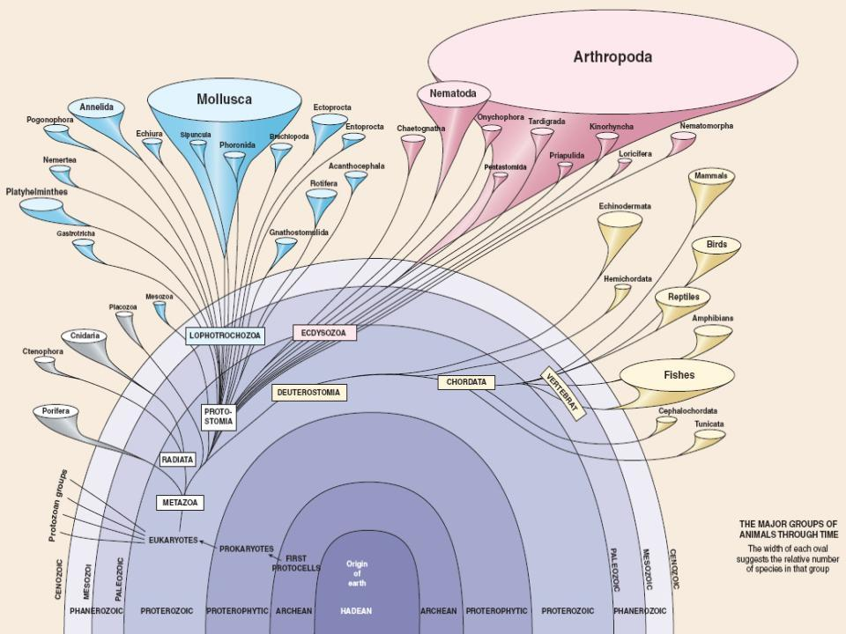
Ecdysozoa
Lophotrochozoa

Slide 2
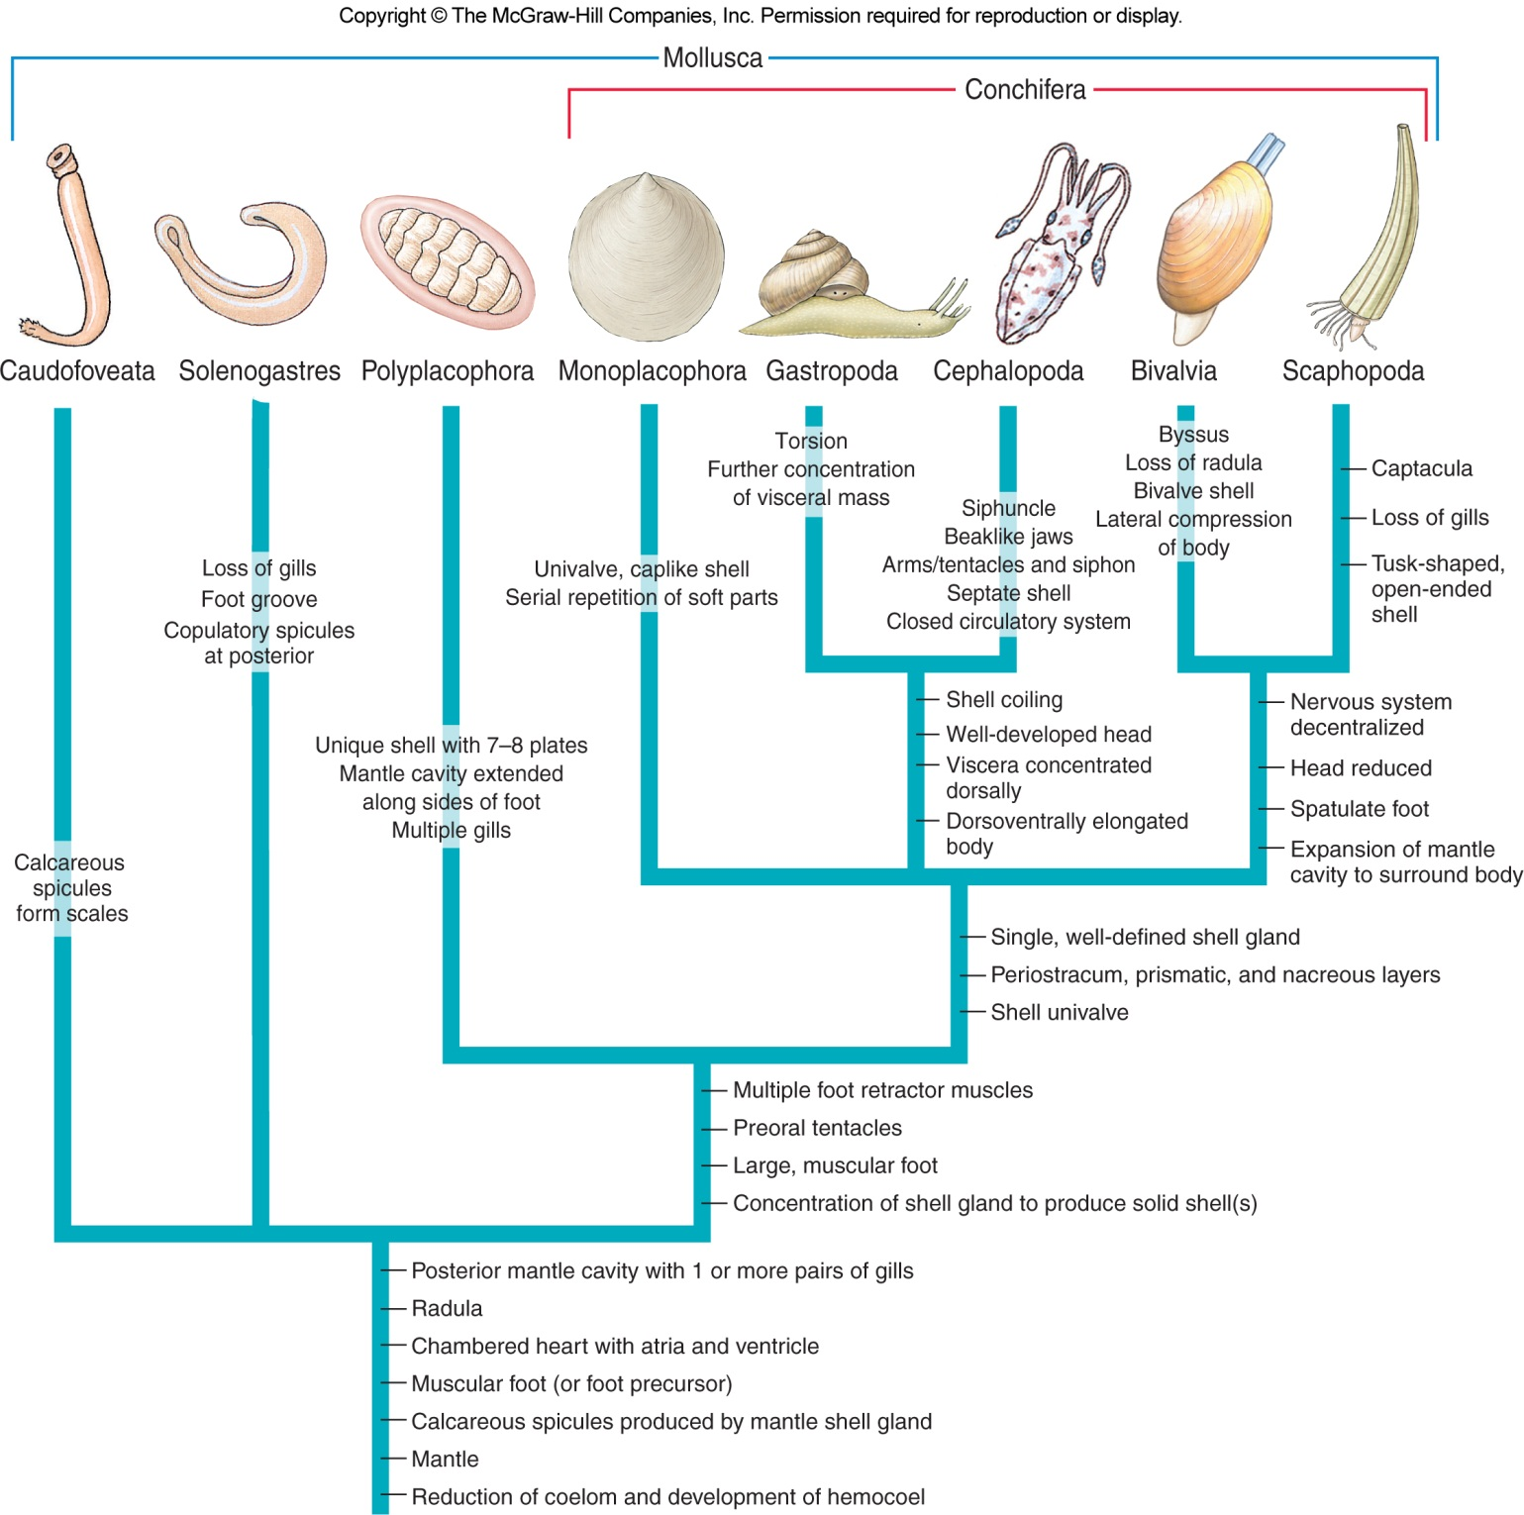

Slide 3
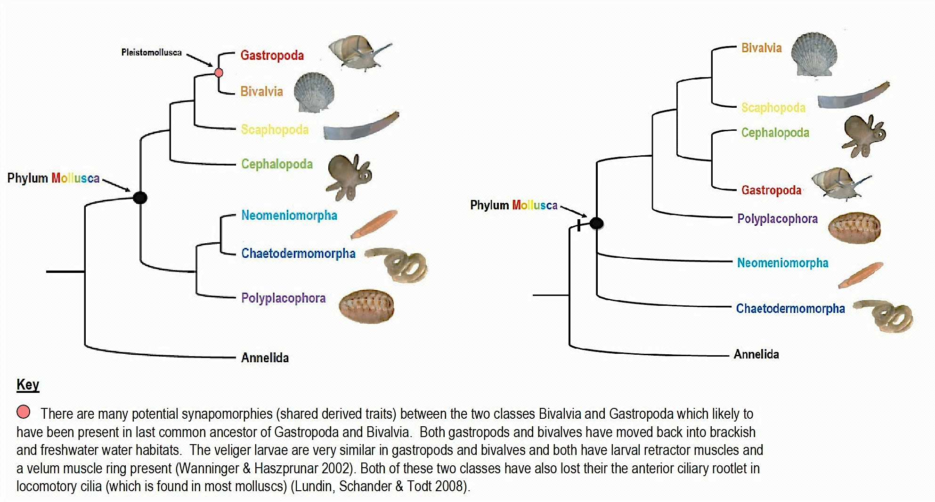
Current classification recognizes several molluscan lineages, relationships among which are in flux.
M. Strike & K. Jones, salinella.bio.uottawa.ca
www.gbri.org.au
Notes:
Blank slide for drafting a title slide.

Slide 4
Learning Objectives
Describe common features shared by all molluscs.
Characterize each of these four classes of molluscs (describe distinguishing features)
Polyplacophora
Gastropoda
Bivalvia
Cephalopoda

Slide 5
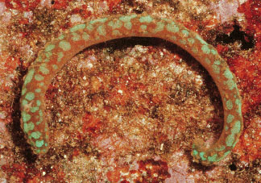
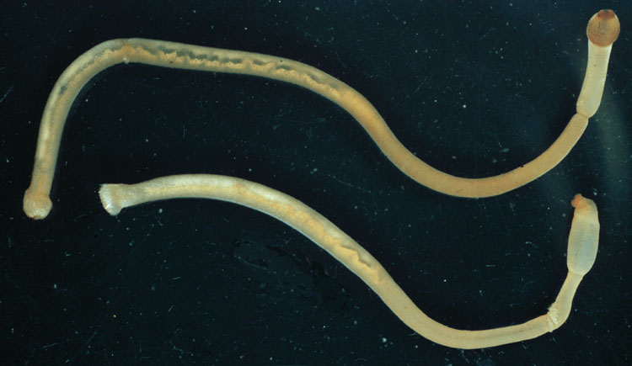
Three Odd Molluscan Groups
Aplacophora
marine “worms” with calcareous scales or spicules
Aplacophora
(Neomeniomorpha = Solenogastres)
Aplacophora
(Chaetodermomorpha = Caudofoveata)

Slide 6
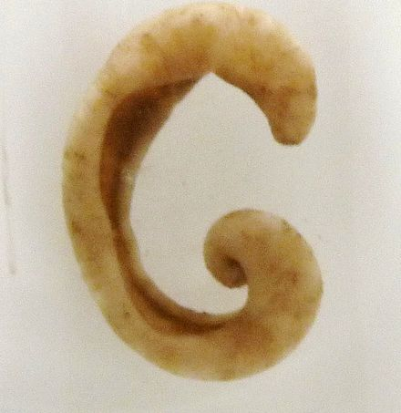
Neomeniomorpha = Solenogastres
the Aplacophora have no shell
Solenogasters feed on cnidaria and ctenophores
some molecular datasets plot Solenogastres as an outgroup to Mollusca

Slide 7
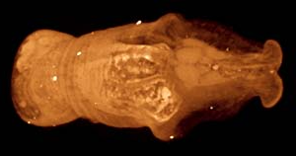
Chaetodermomorpha = Caudofoveata
Caudofoveata are small (1-30 mm), mainly deep sea molluscs
burrow through soft sediment
feed on foramanifera

Slide 8
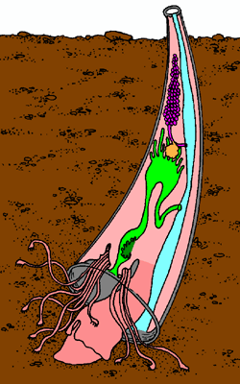
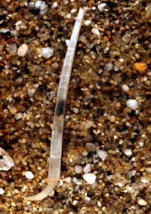
Three Odd Molluscan Groups
Scaphopoda = “tusk shells”
all marine; live buried in sediment
use clubbed tentacles (captacula) to gather food
typically microorganisms (e.g., diatoms)
mantle cavity
captacula
foot

Slide 9
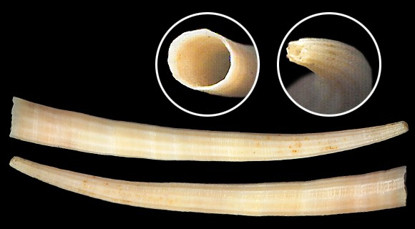
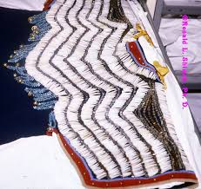
Tusk shells [Scaphopoda] are univalves and lack ctenidia, a heart, and a circulatory system.
www.idscaro.net
Notes:
Blank slide for drafting a title slide.

Slide 10
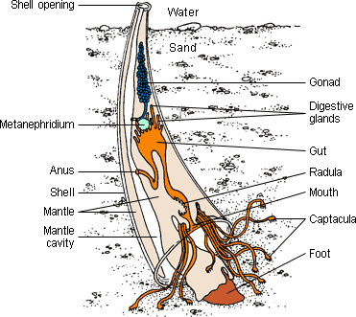
O’Connor et al., 2010
www.ucmp.berkeley.edu
live in soft substrates offshore (usually not intertidally)
Molecular data suggest that the scaphopods are a sister group to the cephalopods
eggs hatch into a free-living trochophore larva, which develops into a veliger larva

Slide 11
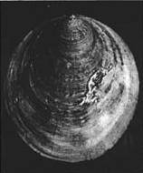
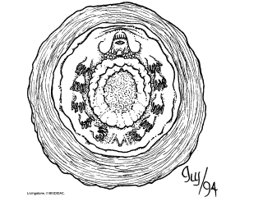
Three Odd Molluscan Groups
Monoplacophora - marine, limpet-like
known only as fossils until 1952
possess multiple pairs of gills, gonads, kidneys
hints of segmentation?
foot
gills
Laevipilina antarctica

Slide 12
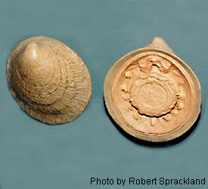
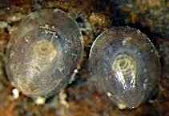
Monoplacophora was known only from fossils until 1952.
single, unhinged shell
M. Strike & K. Jones, salinella.bio.uottawa.ca
Although the shell is limpet-like in shape, they are not gastropods
The extant members live only in the deep ocean at depths below 180 metres
three to six pair of "gills”, as many as six "kidneys”
In 2006 a molecular study suggested that extant Monoplacophora and Polyplacophora form a well-supported clade
Notes:
Blank slide for drafting a title slide.

Slide 13
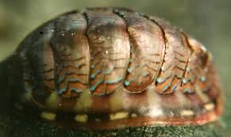
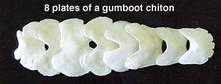
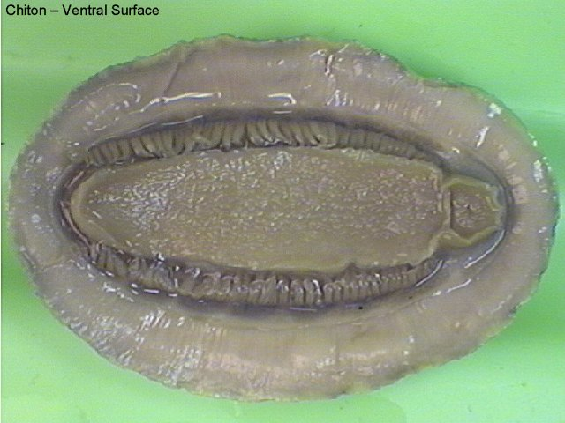
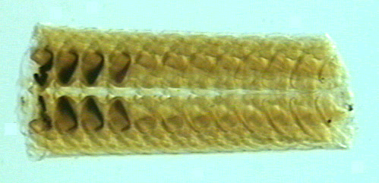
Chitons [Polyplacophora] have 7-8 plates embedded in a tough mantle.
www.palaeocast.com
www.research.amnh.org
Iron oxides on radula teeth reduce wear.
The large foot secures their position in the intertidal zone.
www.faculty.clintoncc.suny.edu
Notes:
Blank slide for drafting a title slide.

Slide 14
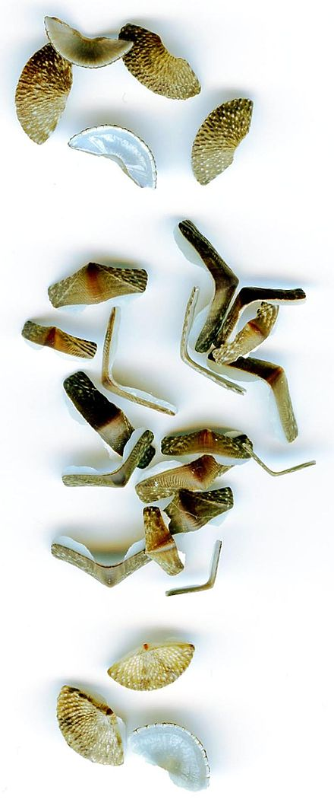
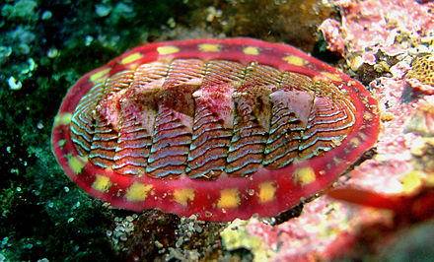
Permit flexibility when move, and also provide protection
The shell plates are surrounded by a structure known as a girdle

Slide 15
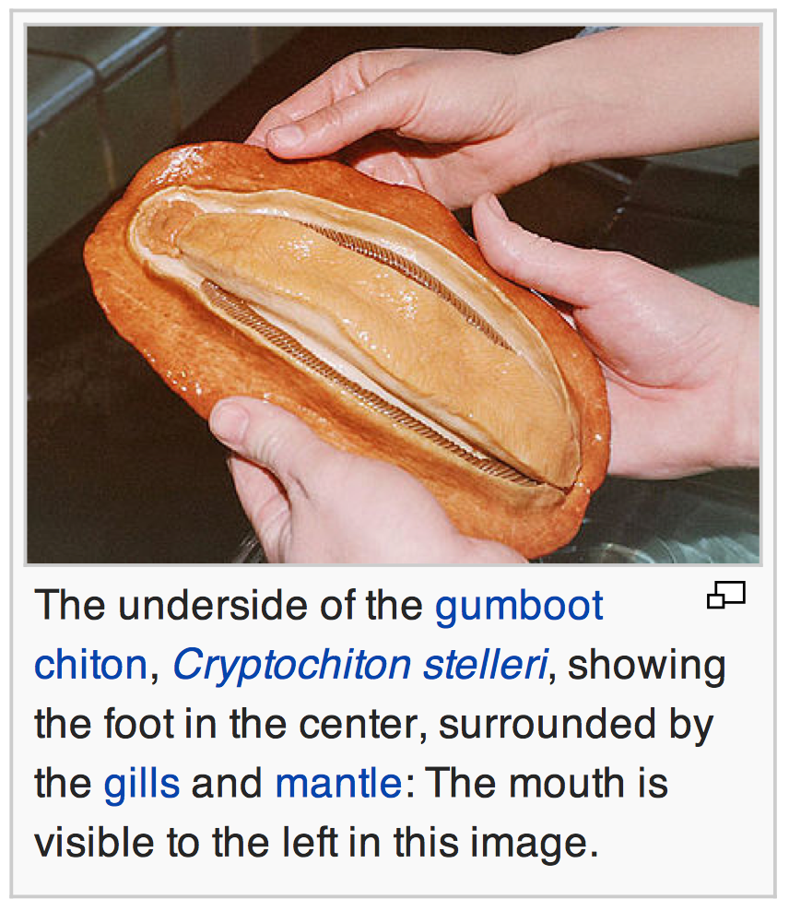
Radula teeth are coated with magnetite, a hard ferric/ferrous oxide mineral. The radula is used to scrape microscopic algae off the substratum.
several species of chiton are known to exhibit homing behaviours
live in intertidal zone or subtidally, as deep as 6,000 m (20,000 ft).

Slide 16
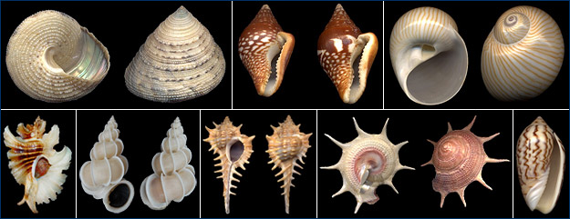
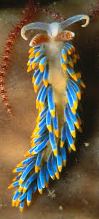
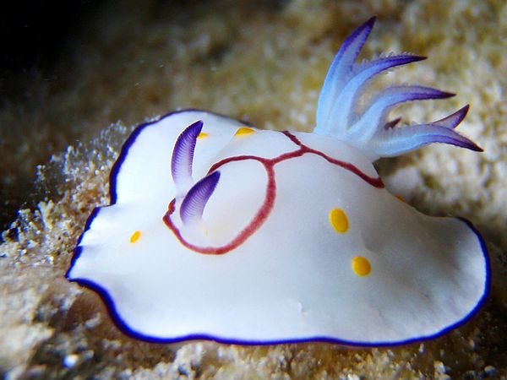
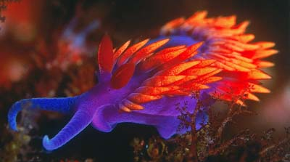
Gastropods are the most diverse group of molluscs.
www.ucmp.berkeley.edu
ocean.nationalgeographic.com
cerata
Notes:
Blank slide for drafting a title slide.

Slide 17
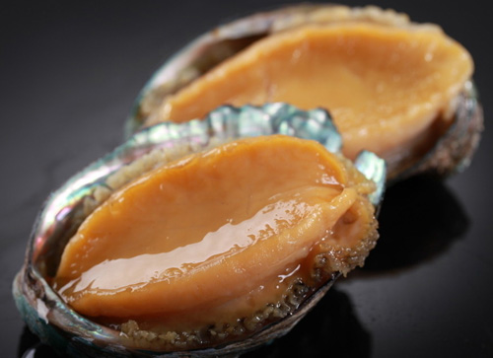
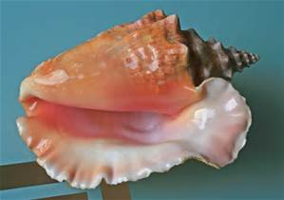
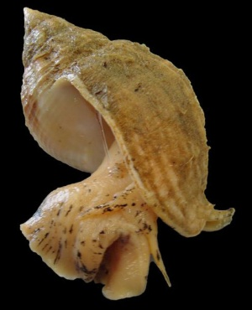
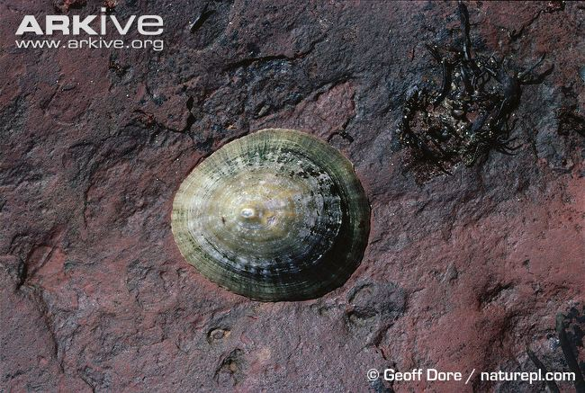
abalone
conches
whelks
limpets
abalone, conches, whelks, limpets

Slide 18
Classes of Molluscs
Class Gastropoda
Most diverse class
Over 70,000 living and more than 15,000 fossil species
Snails, limpets, slugs, whelks, conches, periwinkles, sea slugs, sea hares, etc.
From marine forms to air-breathing terrestrial snails and slugs
Typically sluggish, sedentary animals
Shells are chief defense
Some produce distasteful or toxic secretions

Slide 19
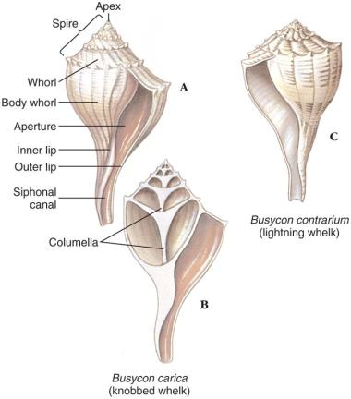
Classes of Molluscs
Gastropod Shells
One-piece univalve, coiled or uncoiled
Apex is smallest and oldest whorl
Whorls become larger and spiral around central axis
Many snails have an operculum covering shell aperture
Giant marine gastropods have shell up to 60 cm long
Some fossil forms are 2 meters long
Terrestrial gastropods are restricted by soil mineral content, temperature, dryness, and acidity

Slide 20
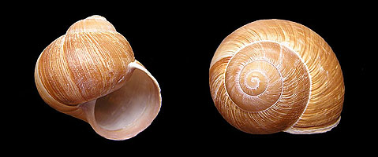
Gastropods display coiling and torsion. The shell coils clockwise and leans left with respect to the body.
apex
whorl
suture
molluscs.at
aperture with operculum
columella
Organs on the right side of the body tend to be reduced/lost.
Notes:
Blank slide for drafting a title slide.

Slide 21
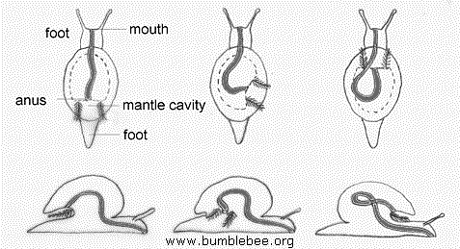
Classes of Molluscs
Form and Function
Torsion
Developmental process that changes the relative position of the shell, digestive tract and anus, nerves that lie on both sides of the digestive tract, and the mantle cavity containing the gills
Digestive tract moves both laterally and dorsally so that anus lies above head within mantle cavity
After torsion, anus and mantle cavity open above mouth and head
This arrangement resulting from torsion creates fouling
Wastes being washed back over the gills

Slide 22
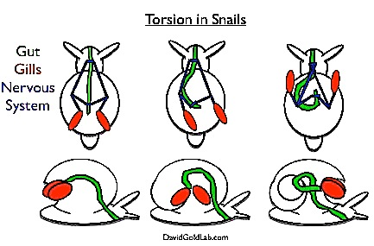
Torsion turns the visceral mass 90–180° counter-clockwise. The body is asymmetrical: anus over the head, figure-8 nerve cord.
But why go through this trouble?
Notes:
While scientists don’t entirely understand why torsion occurs, it is related to the growth of the external shell and the muscles that attach to it. In other species of molluscs, such as cephalopods (octopi, squid, cuttlefish), nudibranchs (sea hares), and pulmonate slugs, torsion never occurs. Instead, the shell grows inside of the animal, creating a cone-shaped internal shell. The cuttlefish bone, which is often sold in pet stores as a calcium supplement for birds, is an example of this internal shell.
Molluscs share a basic body plan, although it has been highly modified in different groups.
Snails, for example, develop their shells through a bizarre developmental process called torsion. During torsion, multiple parts of the body are rotated 180 degrees. By the end, the anus and gills are sitting above the head of the animal, the nervous system has turned into a figure 8, and the right and left hand sides of the animals have become asymetrical:

Slide 23
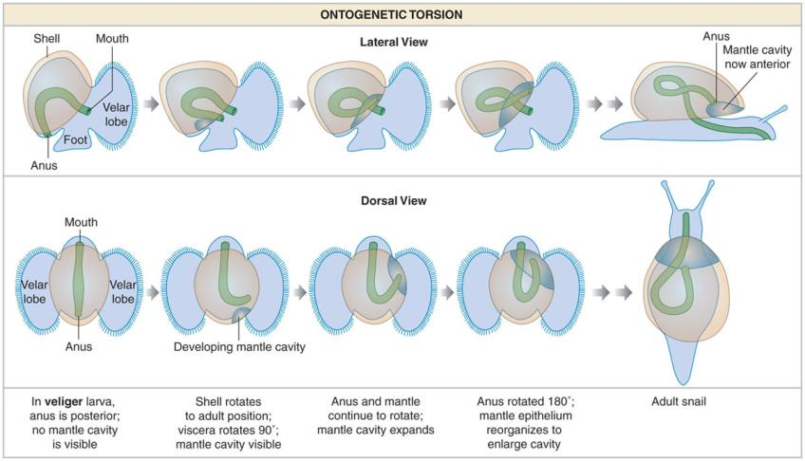

Slide 24
Classes of Molluscs
Coiling
Coiling or spiral winding of the shell and visceral mass not the same as torsion
Occurs at same larval stage as torsion but had a separate, earlier evolutionary origin
All living gastropods descended from coiled, torted ancestors
Planospiral shell has all whorls in a single plane
Primitive state
Conispiral shape provides more compactness
Each whorl is to the side of the previous one

Slide 25
Classes of Molluscs
Feeding Habits
Adaptation of the radula provides much variation in gastropod feeding habits
Herbivorous, carnivores, carnivores

Slide 26
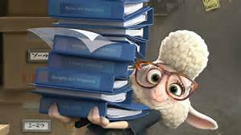
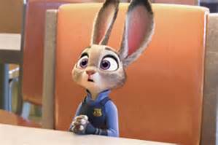
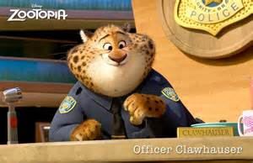
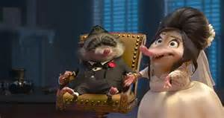
Carnivores
Herbivorous
Herbivorous
Carnivores
Scavenge

Slide 27
Classes of Molluscs
Feeding Habits
Adaptation of the radula provides much variation in gastropod feeding habits
Many are herbivorous and graze, browse or feed on plankton
Some scavenge decaying flesh
Others carnivores that tear prey using radula
Oyster borer alternates rasping with chemical softening of the shell to bore a hole

Slide 28
Classes of Molluscs
Sense organs include eyes, statocysts, tactile organs, and chemoreceptors
Eyes vary from simple cups holding photoreceptors to a complex eye with a lens and cornea.
Monoecious and dioecious species
Many terrestrial species inject a dart to heighten arousal before copulation
Primitive gastropods discharge ova and sperm into water and fertilization is external
Eggs emitted singly or in clusters, and may be transparent or in tough egg capsules
Some species, including most freshwater snails, are ovoviviparous

Slide 29
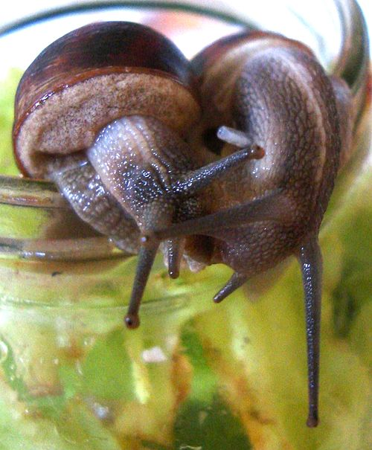
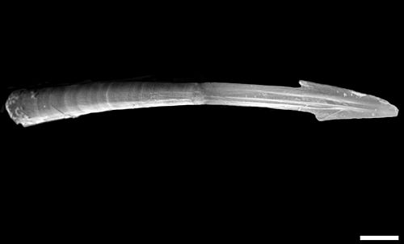
Love dart
Love darts are made in sexually mature animals only, and are used as part of the sequence of events during courtship before mating
Recent research shows that mucus on the dart introduces a hormone-like substance that allows far more of its sperm to survive

Slide 30
Habitat
Representatives live in
gardens, woodland, deserts, and on mountains;
in small ditches, great rivers and lakes;
in estuaries, mudflats, the rocky intertidal, the sandy subtidal,
in the abyssal depths of the oceans including the hydrothermal vents, and numerous other ecological niches, including parasitic ones.

Slide 31
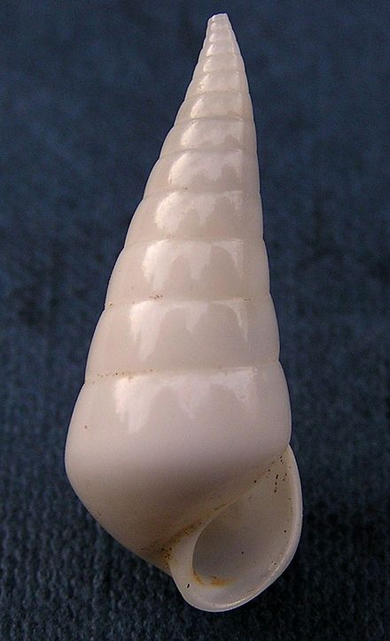
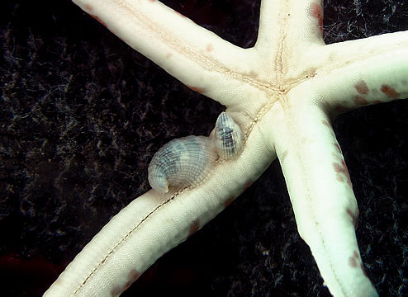
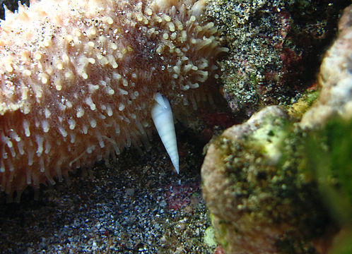
Eulimidae is a family of very small parasitic sea snails, marine gastropod
live on (or in some cases in) the bodies of echinoderms such as sea cucumbers, sea urchins, sea stars
proboscis which they extend into their host's body cavity in order to feed

Slide 32
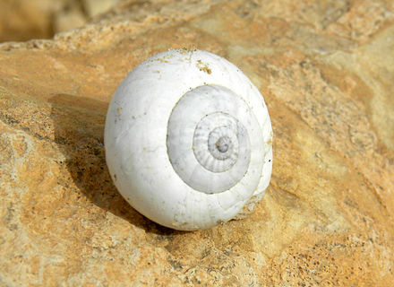
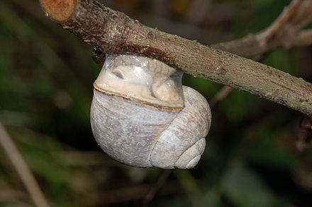
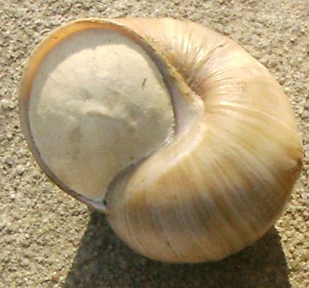
Sphincterochila boissieri
is a species of air-breathing land snail, lives in deserts in Israel and Egypt.
adaptations include a thick shell with a relatively reduced aperture
a thick epiphragm, produces a new epiphragm after every period of activity
shell surface reflects the visible portion of the solar spectrum
dig themselves into the soil to depths from 1 to 5 cm while they aestivate during summer
Dormant snails are known to have survived in museum collections for up to 6 years

Slide 33
The class Gastropoda contains a vast total of named species, second only to the insects in overall number
with 60,000 to 80,000[3][4] living snail and slug species.
In the older classification of the gastropods, there were four subclasses:
Opisthobranchia (gills to the right and behind the heart).
Gymnomorpha (no shell)
Prosobranchia (gills in front of the heart).
Pulmonata (with a lung instead of gills)

Slide 34
the name "snail” commonly means only those species with an external shell large enough that the soft parts can withdraw completely into it.
Those gastropods without a shell, and those with only a very reduced or internal shell, are usually known as slugs
those with a shell into which they cannot withdraw are termed limpets.

Slide 35
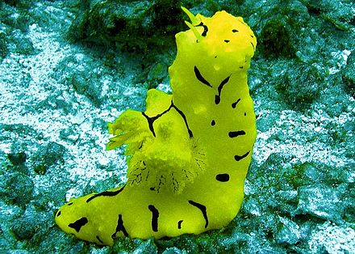
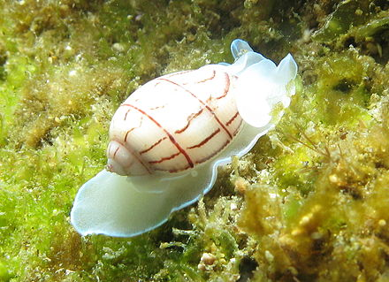
The Opisthobranchia included species in the order Cephalaspidea (bubble shells and headshield slugs), the sacoglossans, anaspidean sea hares, pelagic sea angels, sea butterflies, and many families of the Nudibranchia.
Opisthobranch means "gills behind" (and to the right) of the heart. Opisthobranchs are characterized by two pairs of tentacles and a single gill behind and to the right of the heart.

Slide 36
Prosobranchia was a large taxonomic subclass of sea snails, land snails and freshwater snails
It has however been proven to be polyphyletic
Prosobranch means gills in front (of the heart)
The prosobranch gastropods include the majority of marine snails, among them conches, cones, cowries, limpets, murexes, periwinkles, volutes and whelks, as well as numerous freshwater groups, and some land snails with an operculum

Slide 37
The Pulmonata are an informal group of snails and slugs characterized by the ability to breathe air, having a pallial lung instead of a gill, or gills.
The group includes many land and freshwater families, and several marine families.
lacks gills, instead being converted into a vascularised lung. Most species have a shell, but no operculum

Slide 38
Chinton
石鳖
石蟥
Onchidiidae

Slide 39
According to Goldfrank's Toxicologic Emergencies, only about 15 human deaths can be confidently attributed to cone snail envenomation.
Conus geographus, is also known colloquially as the "cigarette snail", a gallows humor exaggeration implying that, when stung by this creature, the victim will have only enough time to smoke a cigarette before dying.

Slide 40
The appeal of the cone snail's venom for creating pharmaceutical drugs is the precision and speed with which the various components act; many of the compounds target a particular class of receptor, to the exclusion of any other. This means that, in isolation, they can reliably and quickly produce a particular effect on the body's systems without side effects; for example, almost instantly reducing heart rate or turning off the signaling of a single class of nerve, such as pain receptors.
Ziconotide, a pain reliever 1,000 times as powerful as morphine, was initially isolated from the venom of the magician cone snail, Conus magus. It was approved by the U.S. Food and Drug Administration in December 2004 under the name "Prialt".

