Slide 1
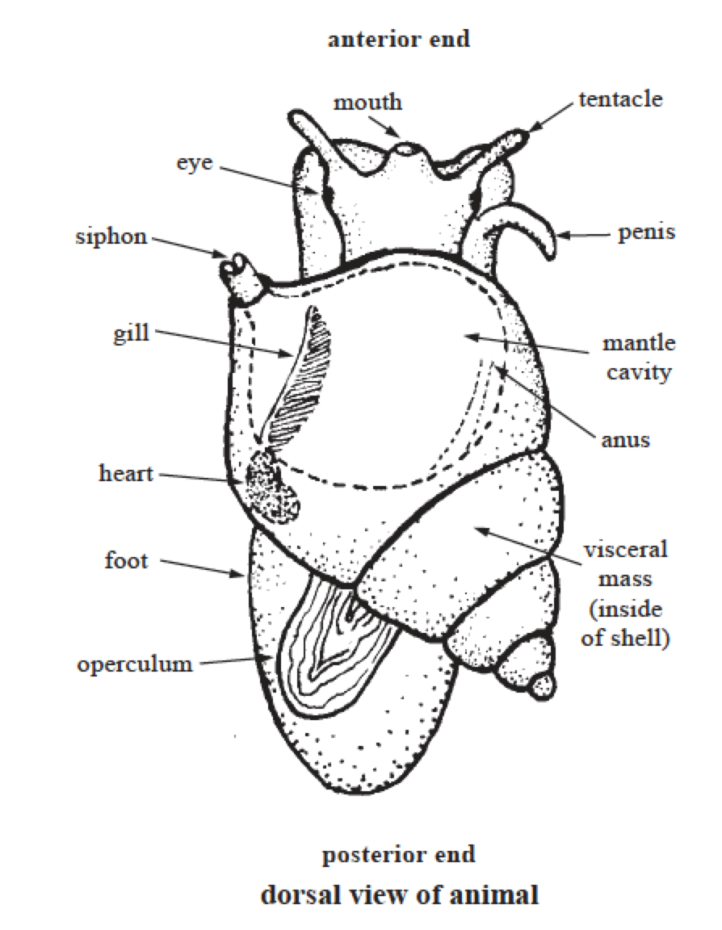
Adaptive value of torsion?
Torsion moves the mantle cavity and associated organs such as anus, nephridiopores and gonopores to a more anterior position
Easy to retract
Undisturbed water to mantle cavity …
Many of the evolutionary pathways in post-trosional gastropods seem to involve modification to prevent fouling of the anterior region of the mantle cavity (which includes the ctenidia) and head

Slide 2
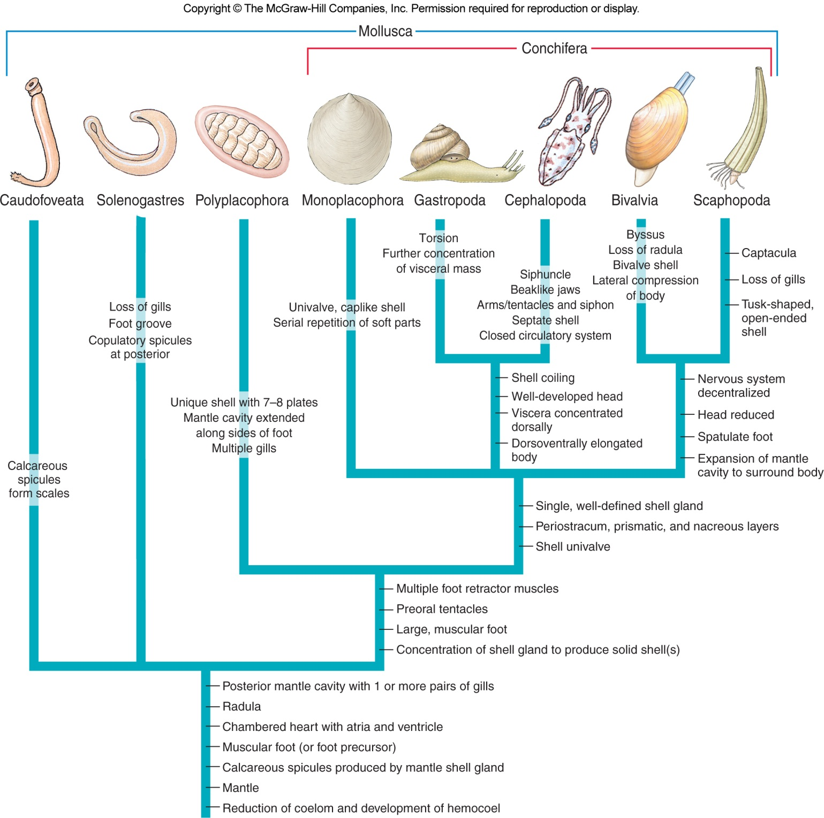

Slide 3
Classes of Molluscs
Class Cephalopoda
Squids, octopuses, nautiluses, and cuttlefish
All marine predators
Foot is in the head region
Modified for expelling water from mantle cavity
Range from 2 cm to the giant squid
Largest invertebrate
Cephalopod fossil record goes back to the Cambrian
Earliest shells were straight

Slide 4
These exclusively marine animals are characterized by:
bilateral body symmetry
a prominent head
a set of arms or tentacles modified from the primitive molluscan foot.
inkfish, referring to their common ability to squirt ink.

Slide 5
Classes of Molluscs
Cephalopods
Mostly marine
Octopuses mostly intertidal
Squids are deep-sea animals
Nautilus
Remaining survivor of nautiloids
Series of gas chambers in shell helps maintain neutral buoyancy
Octopi and squids apparently evolved from early straight-shelled ancestors
Ammonoids
Extinct but had elaborate shells

Slide 6
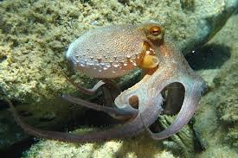
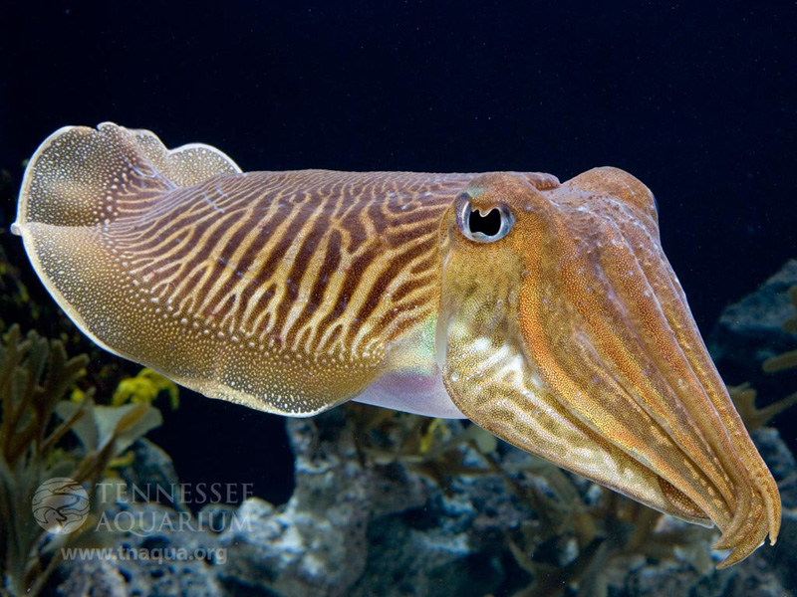
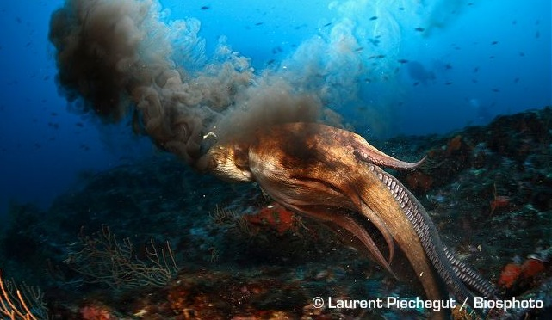
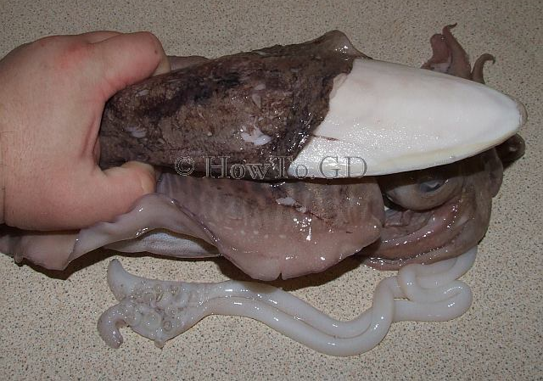
Cephalopoda
www.practicalfishkeeping.co.uk
Tnaqua.org
With a reduced shell, you need other defenses.
Howto.gd
Notes:
Blank slide for drafting a title slide.

Slide 7
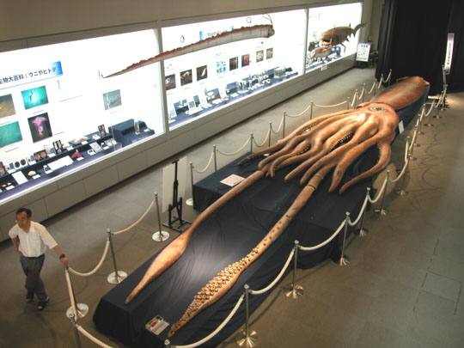
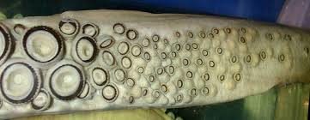
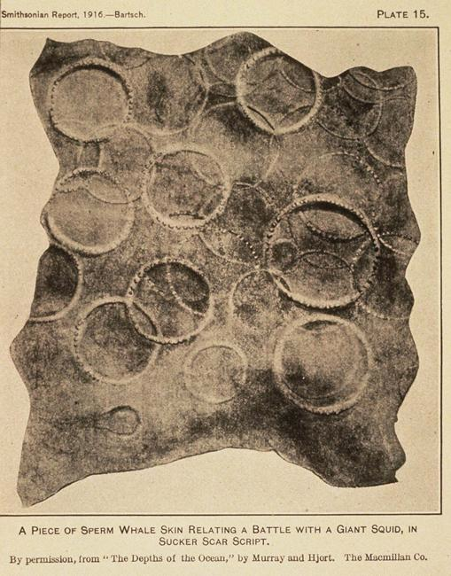
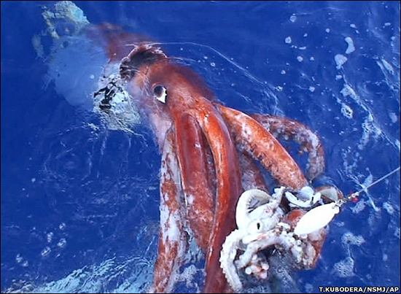
Notes:
Blank slide for drafting a title slide.

Slide 8
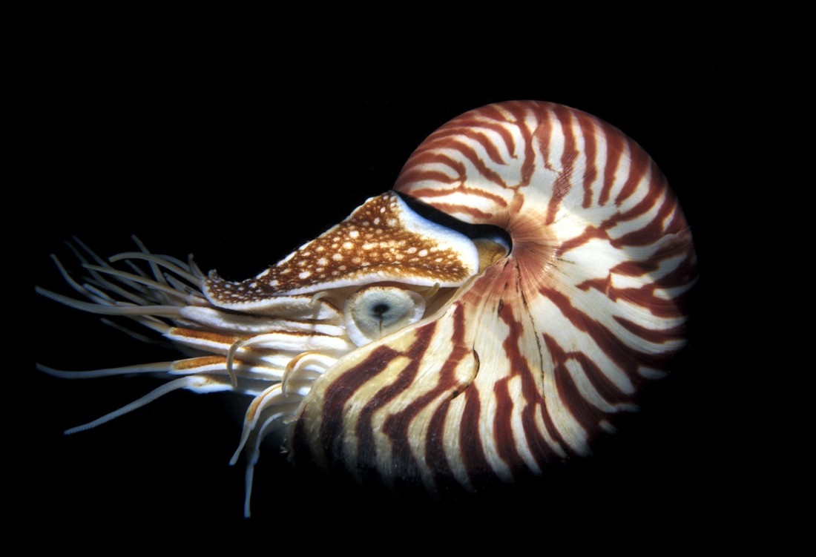
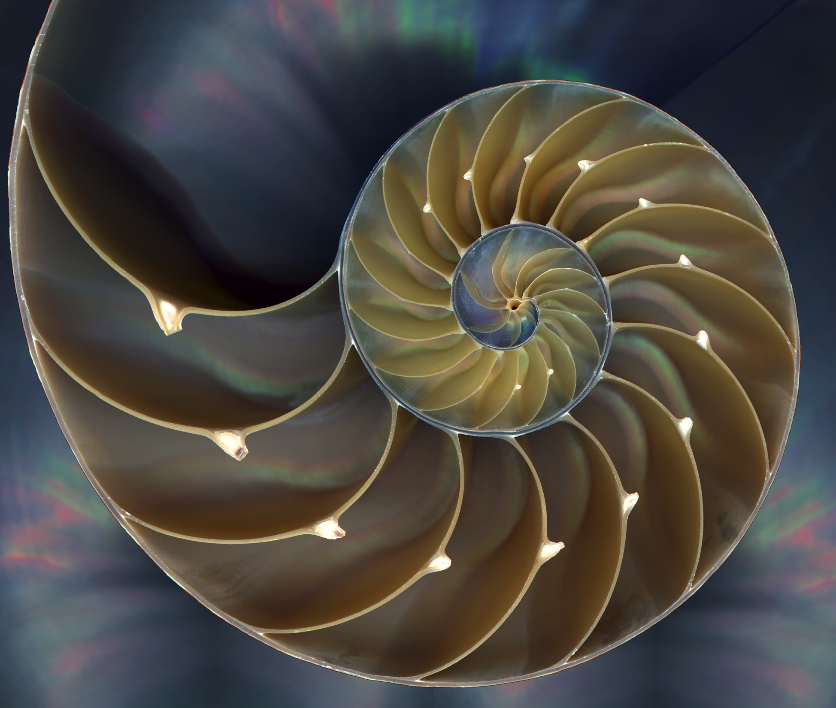
A nautilus is the only shelled cephalopod. Does it produce ink?
siphuncle
Notes:
Blank slide for drafting a title slide.

Slide 9
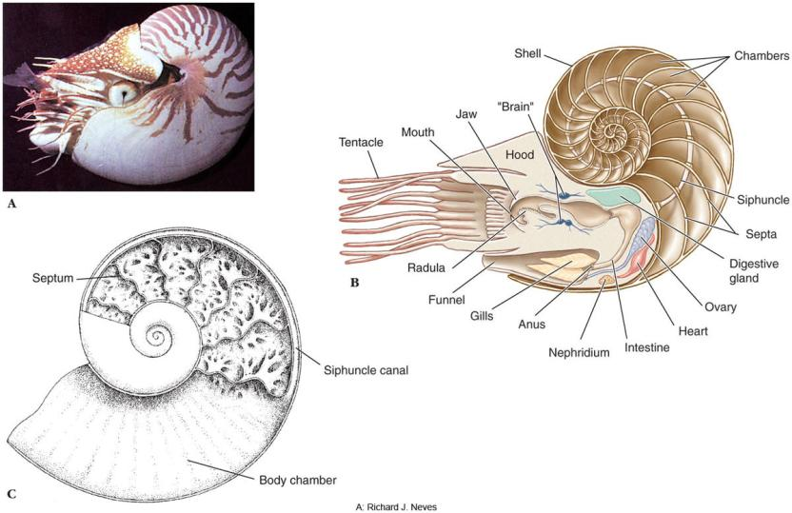

Slide 10
extant subclasses: Coleoidea, which includes octopuses, squid, and cuttlefish; and Nautiloidea, represented by Nautilus and Allonautilus.
In the Coleoidea, the molluscan shell has been internalized or is absent, whereas in the Nautiloidea, the external shell remains.
There are over 800 extant species of cephalopod
Cephalopods are found in all the oceans of Earth. None of them can tolerate freshwater

Slide 11
Classes of Mollusks
Class Cephalopoda
-Active marine predators
-Foot has evolved into a series of arms equipped with suction cups
-Squids have 10; octopuses, 8; and nautiluses, 80 to 90
-Have highly developed nervous systems
-Exhibit complex patterns of behavior and a high level of intelligence

Slide 12
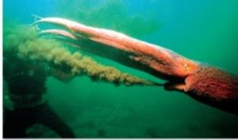
Classes of Mollusks
Class Cephalopoda
-Many have an ink sac and are capable of expelling ink to confuse predators
-Octopuses and squids can change color using pouches of pigment called chromatophores

Slide 13
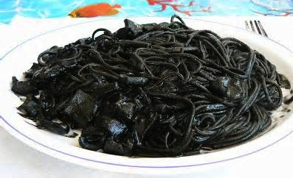
Ink
confuse predators
a muscular bag which originated as an extension of the hind gut
its contents – almost pure melanin
upon expulsion, with mucus
Pseudomorph

Slide 14
Classes of Molluscs
Form and Function
Shell
Nautiloid and ammonoid shells had gas chambers allowing them to swim
Cuttlefish shell is enclosed in mantle
Squid shell is a thin strip called the pen, enclosed in mantle
Octopus has completely lost the shell

Slide 15
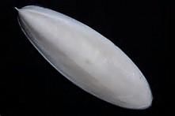
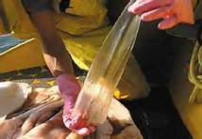
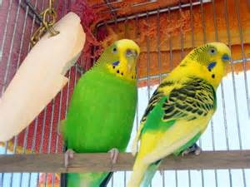
Cuttlebone
The gladius, pen (chitinous)

Slide 16
Classes of Molluscs
Locomotion
Cephalopods swim by forcefully expelling water through a ventral funnel or siphon
Control direction and force of the water, thus determining its speed
Lateral fins of squids and cuttlefishes are stabilizers
Nautilus swims mainly at night
Octopuses mainly crawl on the bottom but can swim backward by spurting jets of water
Some with webbing between their arms swim with a medusa-like action
Active life of cephalopods is reflected in their respiratory, circulatory and nervous systems.

Slide 17
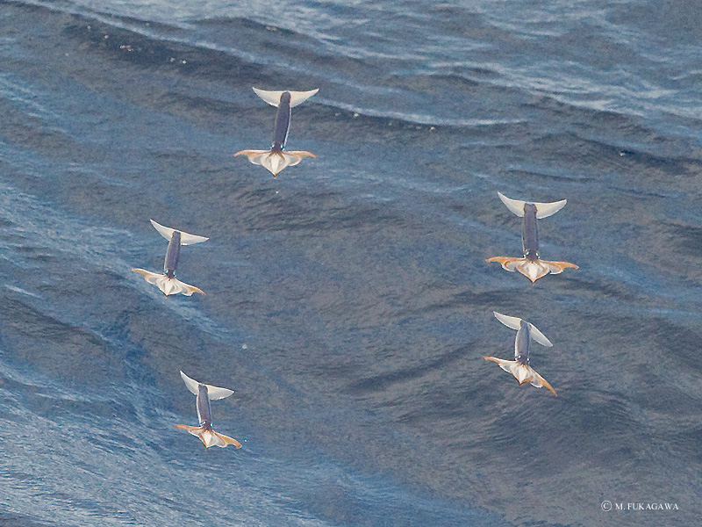
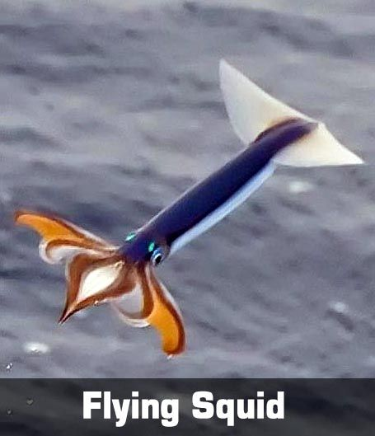

Slide 18
Circulatory system
Cephalopods are the only mollusks with a closed circulatory system.
Coleoids have two gill hearts (also known as branchial hearts) that move blood through the capillaries of the gills.
A single systemic heart then pumps the oxygenated blood through the rest of the body.

Slide 19
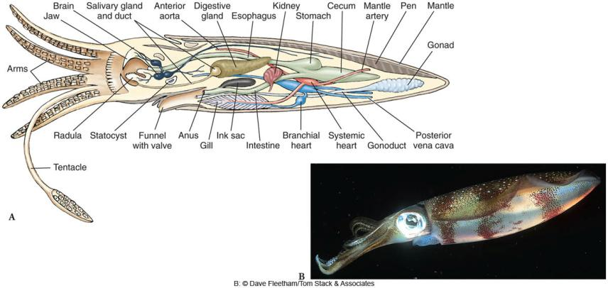

Slide 20
Classes of Molluscs
Nervous and Sensory Systems
Cephalopod brain is the largest of any invertebrate
Squids have giant nerve fibers
Sense organs are well-developed
Eyes are complex, complete with cornea, lens, and retina
Can learn by reward and punishment, and by observation of others
Cephalopods lack a sense of hearing but have tactile and chemoreceptor cells in their arms

Slide 21
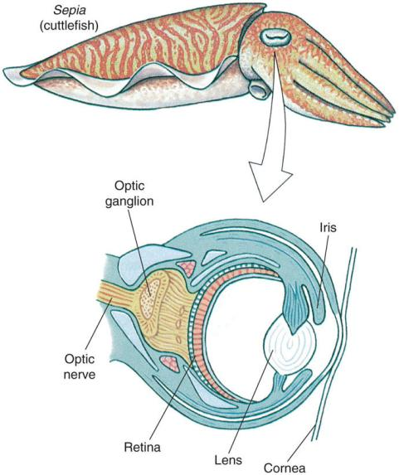

Slide 22
Classes of Molluscs
Communication
Use chemical and visual signals to communicate
Chromatophores are cells in the skin that contain pigment granules
Contractions of the muscle fibers attached to the cell boundary causes the cell to expand and change the color pattern
Color patterns can be changed rapidly
Deep-water cephalopods have elaborate luminescent organs
Ink sac empties into rectum;
Contains ink gland that secretes sepia when animal alarmed

Slide 23
As well as providing camouflage with their background
some cephalopods bioluminesce, shining light downwards to disguise their shadows from any predators that may lurk below
Cephalopods can change their colors and patterns in milliseconds, whether for signalling (both within the species and for warning) or active camouflage, as their chromatophores are expanded or contracted

Slide 24
Chromatophore

Slide 25
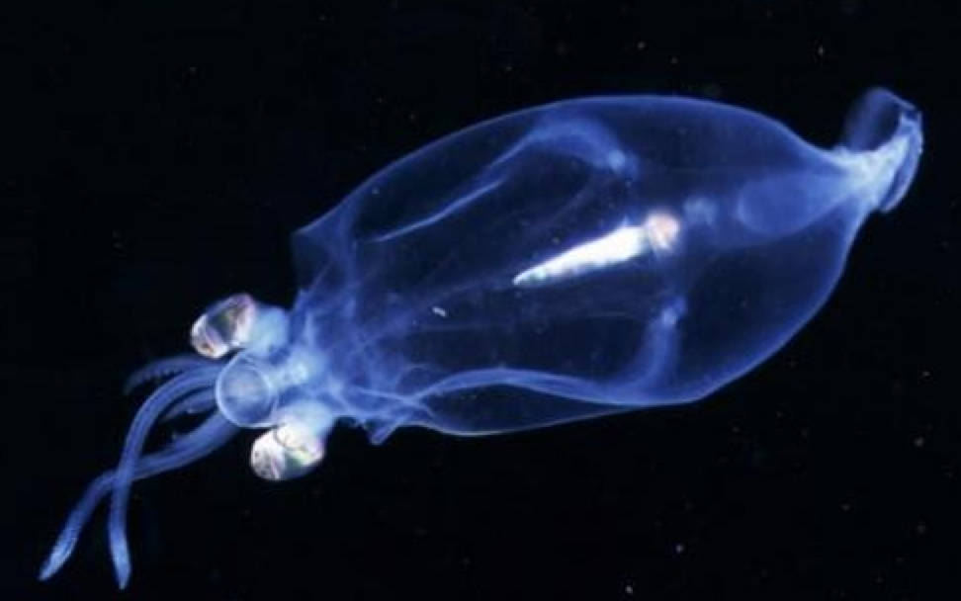
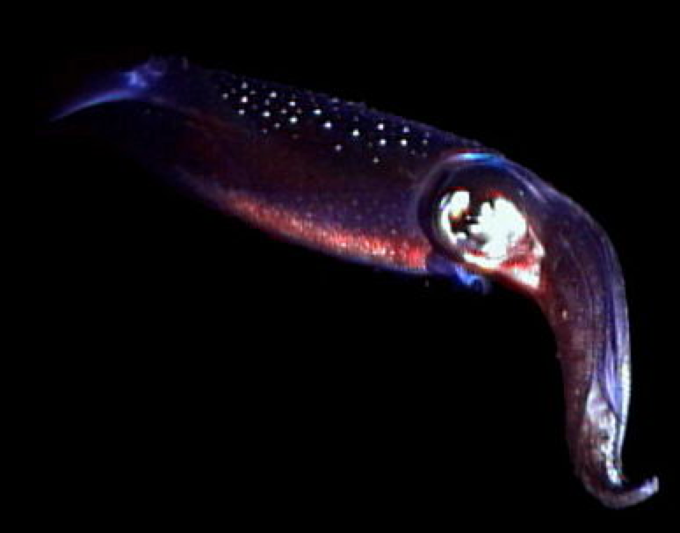

Slide 26
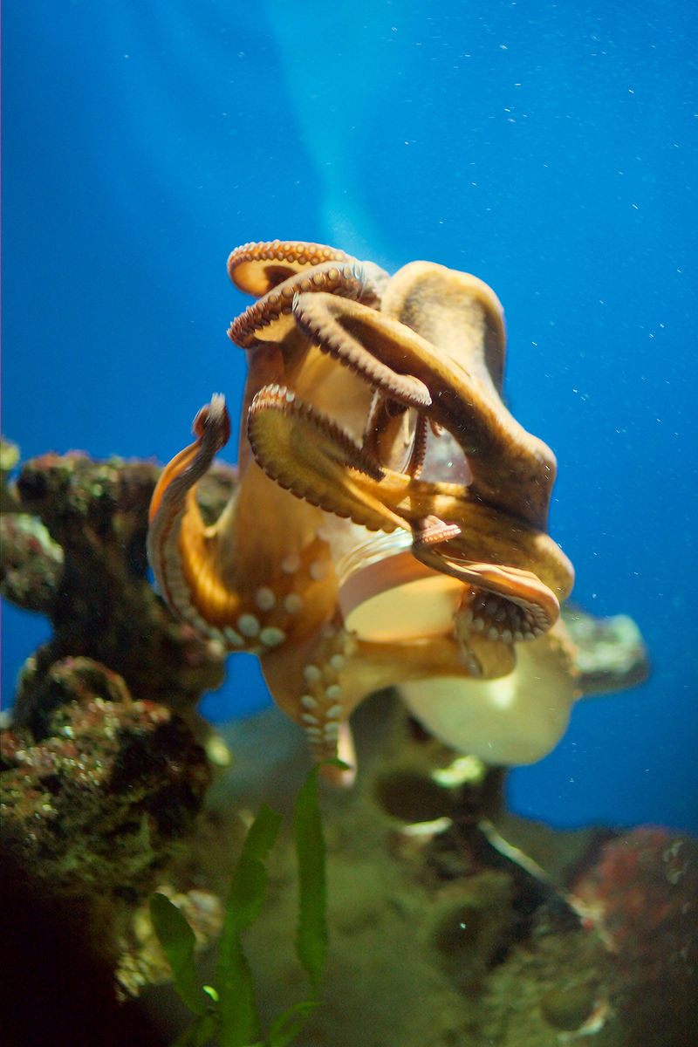
Cephalopods are widely regarded as the most intelligent of the invertebrates, and have well developed senses and large brains. The nervous system of cephalopods is the most complex of the invertebrates
Cephalopods have also been known to climb out of their aquaria, maneuver a distance of the lab floor, enter another aquarium to feed on the crabs, and return to their own aquarium

Slide 27
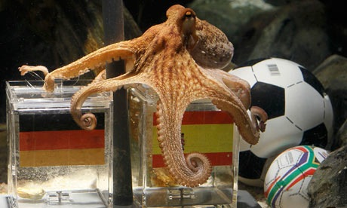
Paul the Octopus

Slide 28
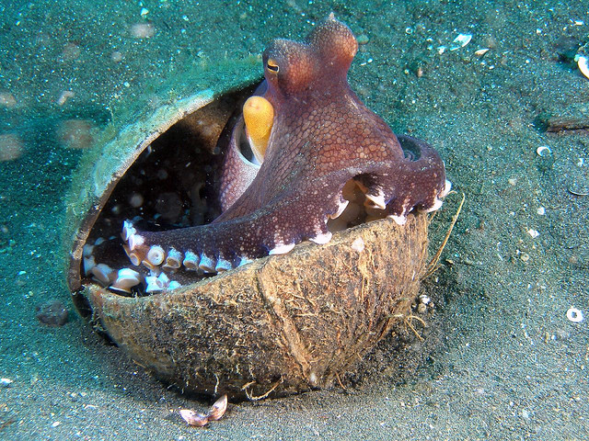

Slide 29
Classes of Molluscs
Reproduction
Sexes are separate
Fertilized eggs leave oviduct and are attached to stones, etc.
Hatch into juveniles with no free-swimming larval stage

Slide 30
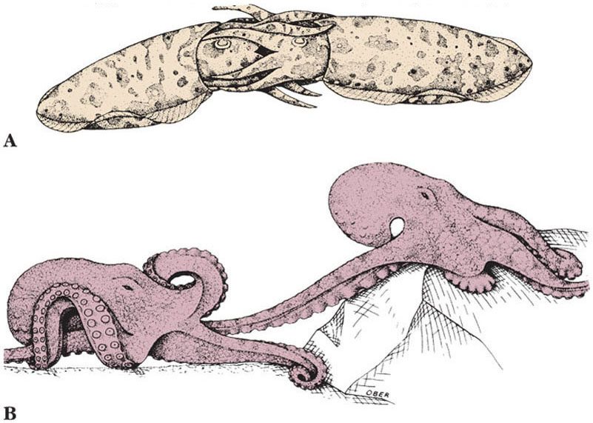

Slide 32
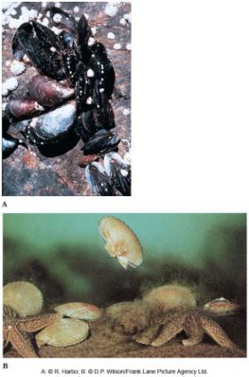
Classes of Molluscs
Class Bivalvia
Mussels, clams, scallops, oysters, and shipworms
Range in size from 1–2 mm in length to the giant South Pacific clams
Most are sedentary filter feeders
Bivalves lack a head, radula, or other aspects of cephalization
Most are marine

Slide 33
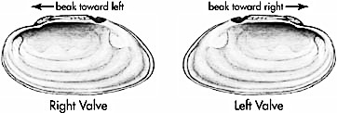
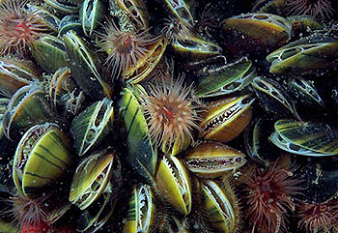
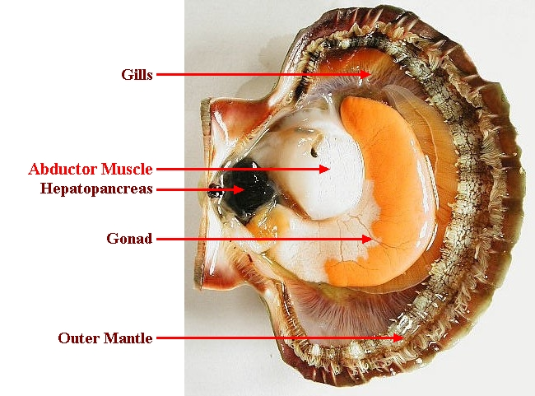
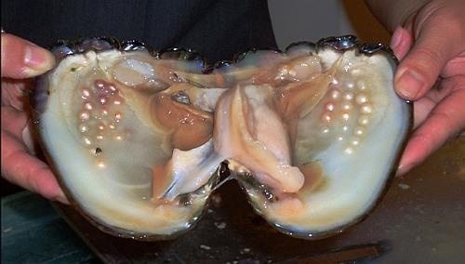
Bivalves include scallops, mussels, clams, oysters, and are aptly named for having 2 valves.
Orientation is a Left and Right valve.
Great filter feeders
www.ct.gov
www.molluscs.at
They are a girl’s best friend.
www.snipview.com

Slide 34
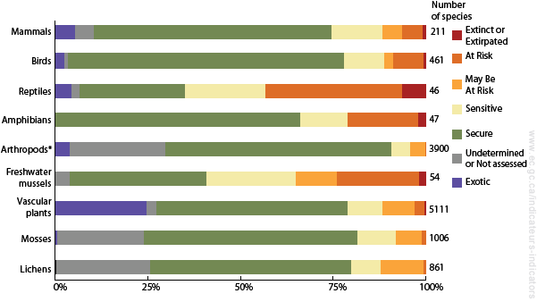
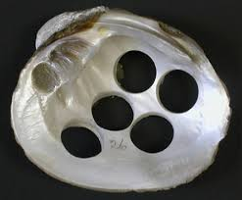
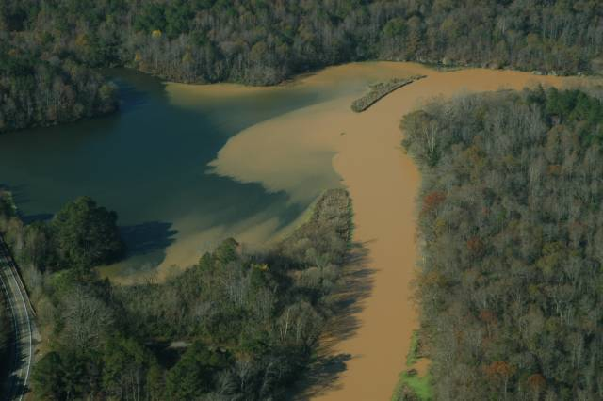
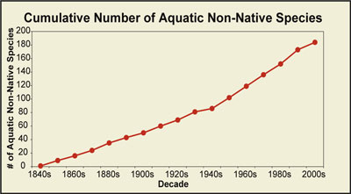
Freshwater bivalves are at high risk of extinction due to habitat loss/degradation, invasive species, pollutants.
*
www.carnegiemnh.org
www.research.amnh.org
www.ec.gc.ca
www.blackwarrior.org
Notes:
Blank slide for drafting a title slide.

Slide 35
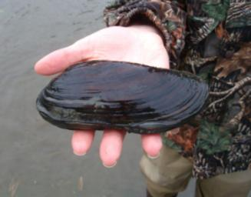
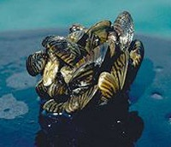
Classes of Molluscs
Native freshwater clams in the U.S. are the most jeopardized animal group
Of more than 300 species once present, 12 are extinct, 42 are threatened or endangered and 88 more are of concern
Sensitive to water quality changes, including pollution and sedimentation
Zebra mussels are a serious exotic invader into the Great Lakes Region

Slide 36
Classes of Molluscs
Form and Function
2 shells or valves are held together by a hinge ligament
Valves are drawn together by strong adductor muscles
Umbo is the oldest part of the shell with growth occurring outward in rings
Pearls are produced when an irritant is lodged between the shell and mantle
Layers of nacre are secreted around the foreign material

Slide 37
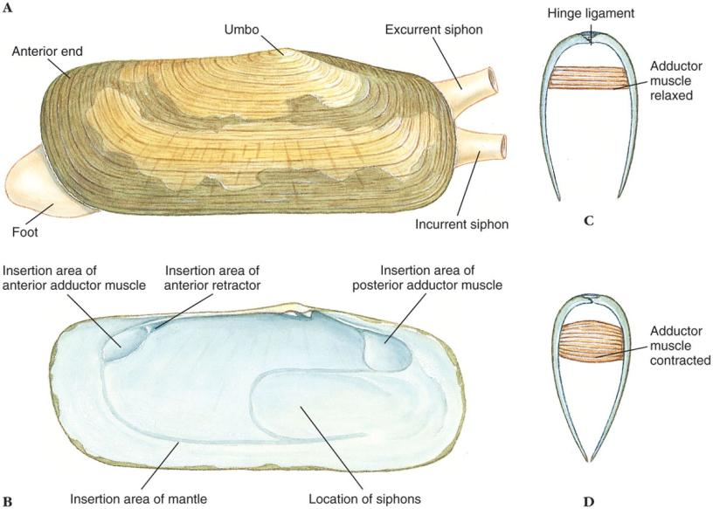

Slide 38
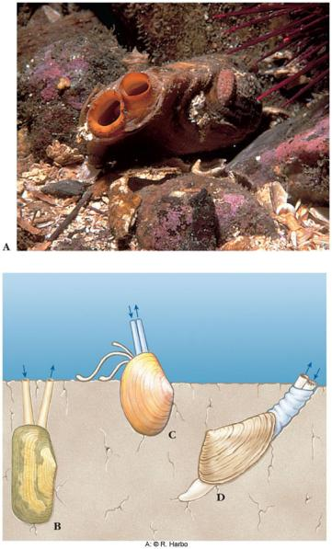
Classes of Molluscs
Body and Mantle
Visceral mass is suspended from the dorsal midline
Foot is attached anteroventrally
Ctenidia hang down on each side, each covered by a fold of the mantle
Posterior edges of the mantle folds form excurrent and incurrent openings
In burrowing clams, mantle forms long siphons to reach the water above

Slide 39
Classes of Molluscs
Locomotion
Foot is extended out from between the valves
Blood is pumped into the foot
Foot swells and anchors the bivalve in the mud
Shortening of the foot pulls the clam forward
Scallops clap valves to create a jet propulsion

Slide 41
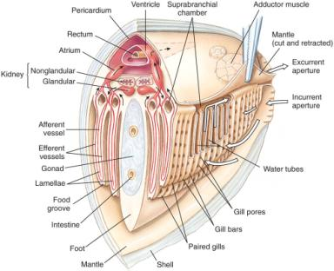
Classes of Molluscs
Gills
Both mantle and gills perform gaseous exchange
Water enters incurrent siphon
Passes into water tubes through pores
Exits through the excurrent siphon

Slide 42
Classes of Molluscs
Feeding
Suspended organic matter enters incurrent siphon
Gland cells on gills and labial palps secrete mucus to entangle particles
Food in mucous masses slides to food grooves at lower edge of gills
Cilia and grooves on the labial palps direct the mucous mass into mouth
Some bivalves feed on deposits in sand
Shipworms excavate particles of wood
Septibranchs draw in crustaceans by creating a sudden inflow of water

Slide 43
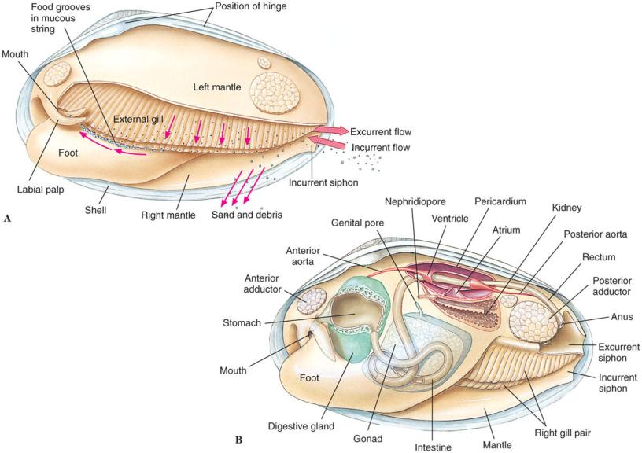

Slide 44
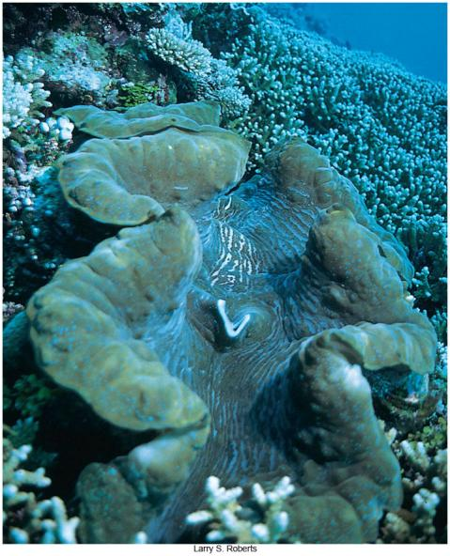

Slide 45
Classes of Molluscs
Reproduction and Development
Sexes usually separate
Gametes discharged in suprabranchial chamber are carried out in excurrent flow
Fertilization usually external
Freshwater clams have internal fertilization
Sperm enter the incurrent siphon to fertilize eggs in water tubes of the gills
Larvae develop into a bivalved glochidia stage
Attaches to gills of passing fish where they live briefly as parasites
Eventually sink to begin independent life on the streambed
“Hitchhiking” having helped distribute the species

Slide 46
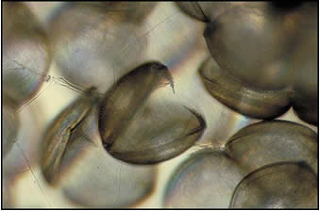
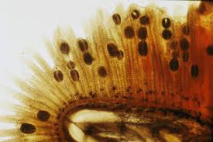
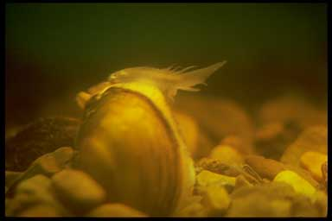
The glochidium is a specialized parasitic veliger larva found in freshwater bivalves.
www.research.amnh.org
That fish lure is part of the mantle!
movie of lure in action:
http://www.youtube.com/watch?v=UQLWuTg9FcY
Notes:
Blank slide for drafting a title slide.

Slide 47
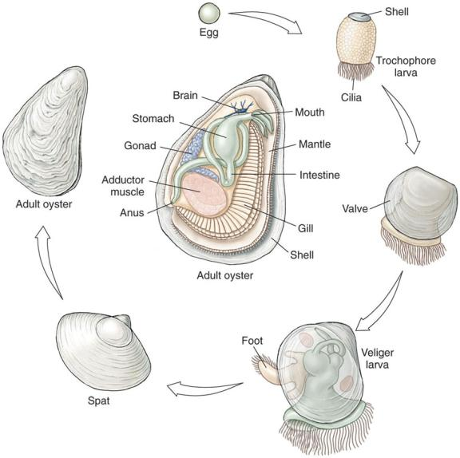

Slide 48
Nervous system
The sedentary habits of the bivalves have meant that in general the nervous system is less complex than in most other molluscs
The animals have no brain
the nervous system consists of a nerve network and a series of paired ganglia.

Slide 49
Learning Objectives
Describe common features shared by all molluscs.
Characterize each of these four classes of molluscs (describe distinguishing features)
Polyplacophora
Gastropoda
Bivalvia
Cephalopoda

Slide 50
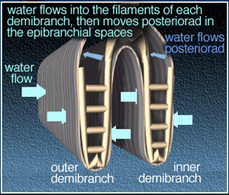
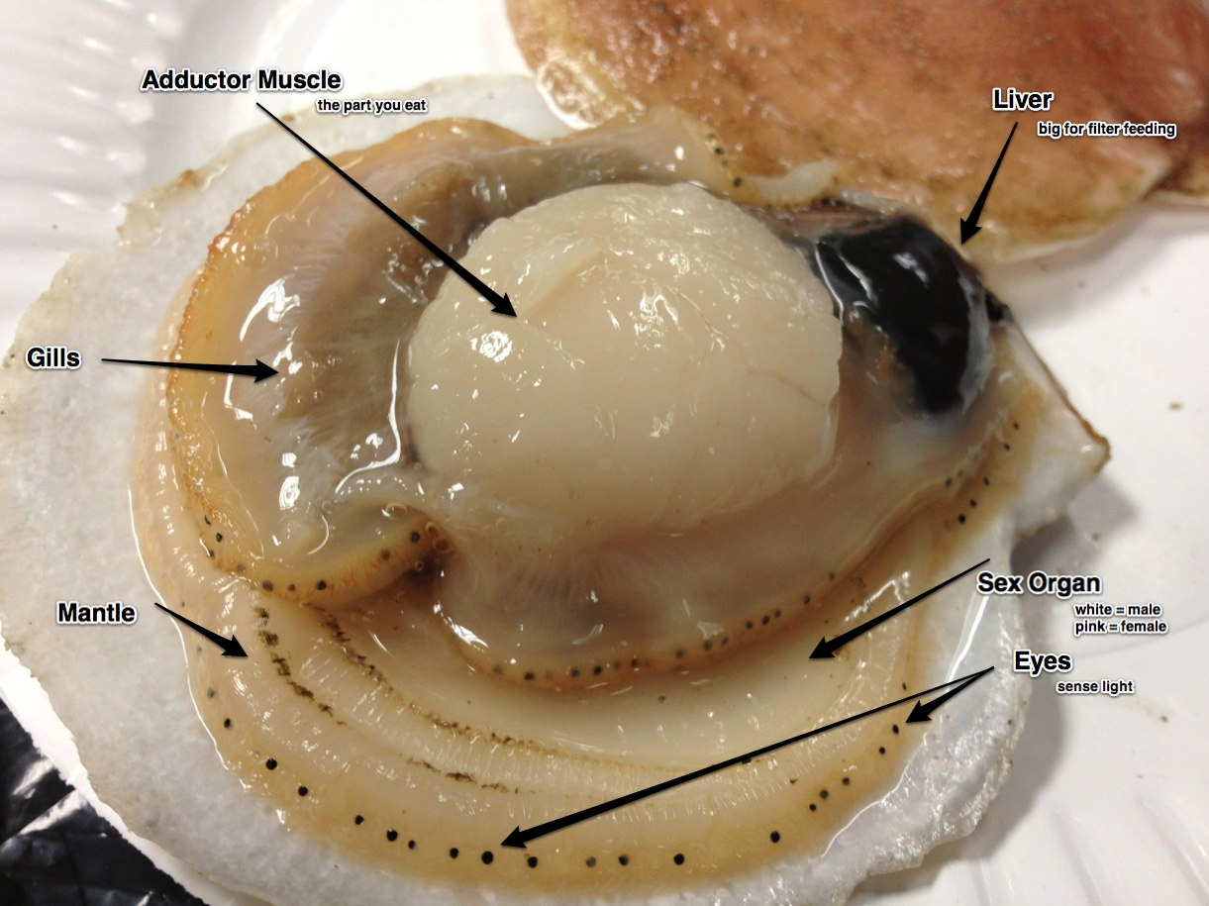
http://www.justjulieb.com/the-notable-nudibranch/
www.biobull.org
www.mesa.edu.au
www.asnailsodyssey.com

